Slide 1
Onboarding in the Virginia
Public Health Laboratory
10/31/2023
Fay Kutner Kessler, M.S.

Slide 2
Orientation 2022 - 2023
 | Jan 2022 – Dec 2022 | Jan 2023 – Oct 2023
# new staff onboarded | ~60 | ~65
# of NEO sessions | 22* excluding mini-NEO sessions hosted by LSIT | 10* excluding mini-NEO sessions hosted by LSIT
~ # of hours providing live training | ~304 (includes 12 hours/NEO plus 4 hours/Lab Safety Skills) | ~248 (includes 12 hours/NEO plus 4 hours/Lab Safety Skills)
# of staff offboarded | ~74 | ~25

Slide 3
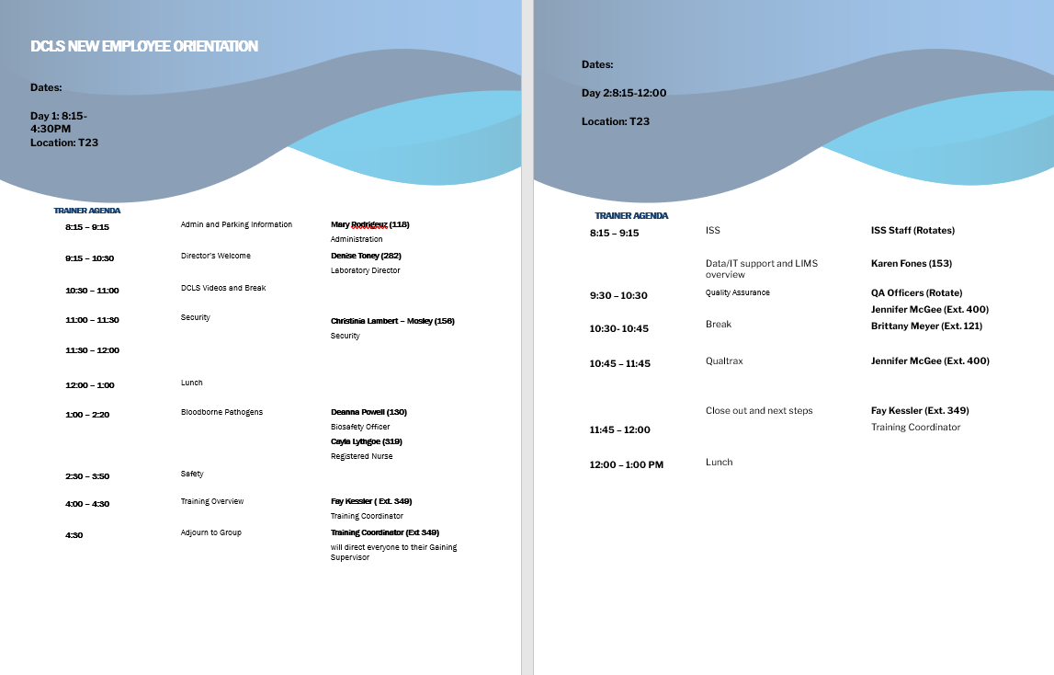

Previous NEO Agenda
12 hours of training over 1.5 days (9 presenters)

Slide 4
Onboarding Statistics
Great employee onboarding can improve employee retention by 82%
Per the Society for Human Resource Management (SHRM)
  Costs a company 6-9 months of a staff member’s salary to replace them. For an employee making $40,000/year that equals $20,000 - $30,000 in recruiting and training costs
44% of new staff decide in the first week that they have made the wrong decision
Only 12% of staff say their organization does a good job of onboarding
Great employee onboarding can improve employee retention by 82%

Slide 5
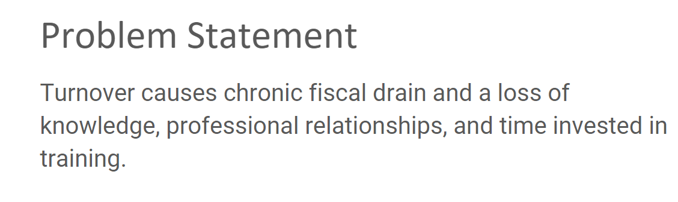
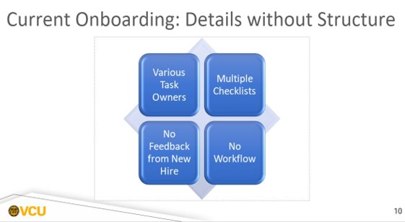
2018 VCU Capstone Project
Notes:
Hiring a new employee is an expensive and time-consuming process. According to the Society for Human Resource Management (SHRM), it typically costs $4,425 to hire a new employee — not to mention the 36 days the average team spends trying to fill a position.
Yet nearly 1 in 5 employees (16%) of employees quit in their first week — and 17% leave after the first month.
To learn why so many companies are struggling with onboarding, BambooHR surveyed employees who quit. In this in-depth guide, we’ll cover actionable tips for improving new hire paperwork, assigning onboarding tasks, facilitating personal connections, and more.

Slide 6
Orientation vs Onboarding
Terms are not interchangeable
Per SHRM –
  Orientation is necessary for completing paperwork and other routine tasks while onboarding is a comprehensive process involving management and other employees and can last up to 12 months
The end goal of onboarding is to empower a new employee in their role and as part of your organization

Slide 7
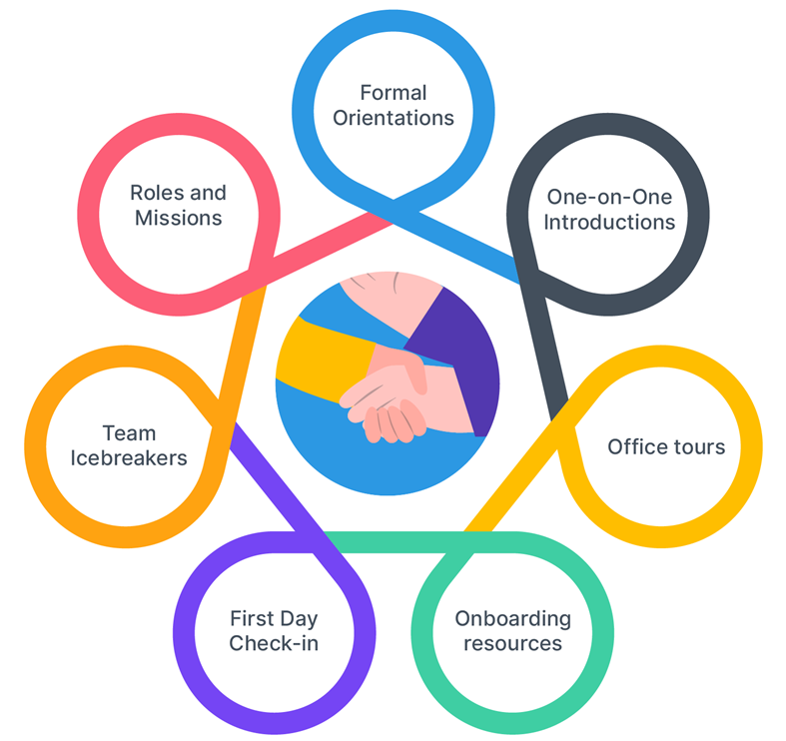
Approach to Onboarding

Slide 8
Feedback – Managers & Staff
Lack of retention on key areas
  Compliance
    Safety, QA, Security, IT/ISS, Parking, etc.
  Culture
    Who we are, vision/mission, team and group dynamics
  Connection
    Engagement, professional identity, belonging, values
  Clarification
    How to, who to, where to, etc. - what leads to success beyond first week, how to fulfill their role
Firehose Approach
  Difficult to identify and retain critical information
Notes:
Goal = Optimize each process to increase retention

Slide 9
Opportunities for DCLS
Reduce amount of information related to compliance delivered at orientation (what needs to be delivered on day 1)
  Goal - increase retention by providing just in time instructions and more in-depth learning throughout the next 90 days via hands on events
Reduce amount of time being spent by each group trainer at the twice monthly NEO
  Goal - provide a dedicated time for deeper comprehension, offered longer (if needed) but less frequently (i.e., Safety, QA, Qualtrax, LIMS, etc.)

Slide 10
Opportunities for DCLS
Reduce confusion and information overload
  Goal - Increase the specificity of training provided to each staff member based on their role and responsibility
Reduce new staff “buyer’s remorse” around joining a new organization
  Goal - increase staff retention by providing multiple positive interactions that increase connection, culture and clarity to foster belonging and reconfirm decision to join DCLS

Slide 11
Capstone Recommendation
S
T
Square one
A
Training
R
Admin
T
Review
Transition

Slide 12
Square One
All communications and paperwork, processes etc. related to
  Preboarding
  Onboarding
  Orientation (Cs the Day)
= Connection (Employee Engagement)
= Compliance (Employee Empowerment)

Slide 13
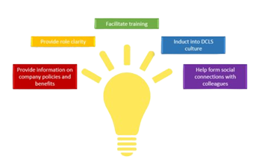
"Cs the Day"
Proposed new model for a one-day onboarding session which focuses on the 4 essential C’s:
  Compliance
  Culture
  Connection
  Clarification

Slide 14
Training
Takes place over the first 90 days as part of the START program
Delivered just in time, closer to the actual event or time of need
30, 60, 90-day touchpoints
Dedicated sessions for in-depth learning with trainers who previously all presented in 1.5 days
= Culture (Employee Engagement)
= Compliance (Employee Empowerment)

Slide 15
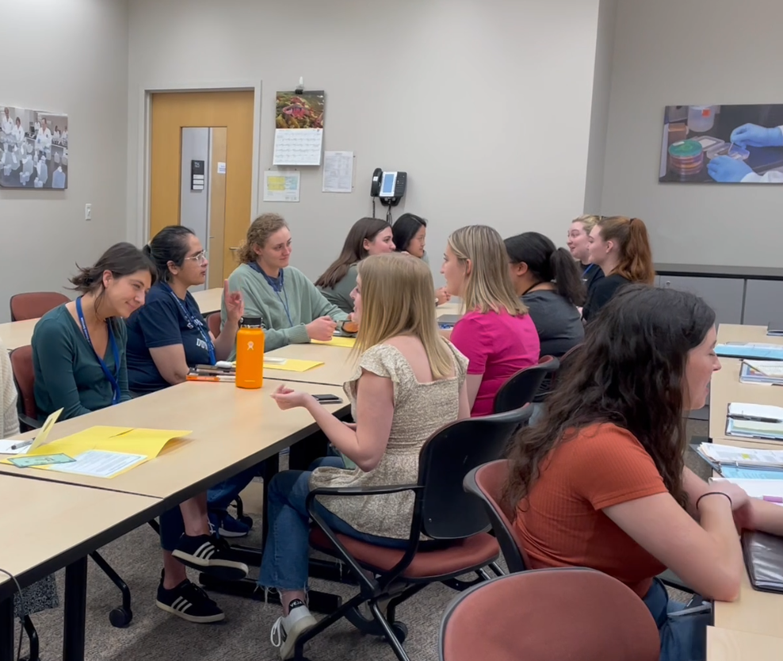
Employee Engagement

Slide 16
Administration
Systems access (email, LIMS, etc)
Personnel files and paperwork
Roles and responsibilities, role clarity
  Qualtrax
  Packaging and Shipping
  Visual Color Discrimination
  Evidence Handling
  BSL2 vs BSL3
= Compliance (Employee Empowerment)

Slide 17
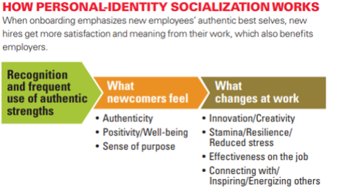
Review
Buddy program
Building Tour
Coffee chats
Engage with team
Engage with committees
Manager check ins
Surveys (“pulse checks” )
= Connection (Employee Engagement)

Slide 18
Transition of Duties
Completion of competencies
Recognize non-conformances
Identify safety issues
Engage with DCLS in new, more meaningful ways
= Clarification (Employee Empowerment)

Slide 19
START Timeline
Preboarding
Cs the Day (1 day Orientation twice a month)
Self paced learning due within 14 - 30 days through SPOT, Qualtrax, SAP Litmos, COVLC
30-60-90 days with
  Regular check ins with Manager, Buddy and LSIT
  Pre-scheduled deep learning time for essential Subject Matter Experts (SMEs). What would you want staff to know if you had time to tell them?
    Lab Safety Skills
    Case studies for Quality Assurance, Ethics, HIPAA
    Hands on LIMS “how to”
    Procurement best practices

Slide 20
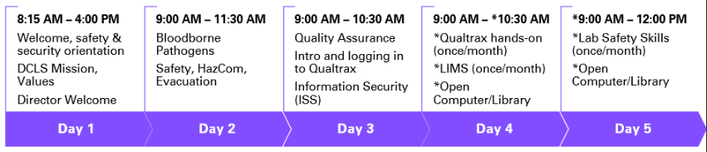
START Timeline - Pilot
Compliance – Days 1-5
Culture – Days 1-5
Connection – Days 1-5
Clarification – Day 1-5

Slide 21

Contact Information
Fay Kutner Kessler, M.S.
Sr. Laboratory Training Coordinator
Virginia Division of Consolidated Laboratory Services
fay.kessler@dgs.virginia.gov
804-648-4480 x349

Slide 22

Thank You
Sr. Leadership –
  Dr. Denise Toney and Dr. Marilyn Bibbs Freeman
Leadership Team
  Managers
LSIT Team
Crystal Barrett

