Slide 1
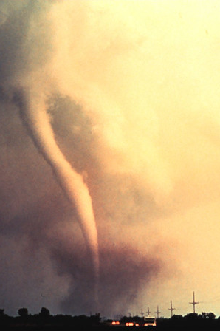
Continuity of Operations Plan (COOP) Tabletop Exercise
[Laboratory Name]
[Date]
NOAA public-domain image taken from Wikimedia Commons

Slide 2
Welcome
Introductions
Exercise Structure
  Each module will begin with a situation briefing or update and offer a list of questions for discussion
  Participants should feel free to openly ask questions of other players and to express their thoughts or opinions
  A note-taker will capture the responses
  Immediately following the exercise, there will be a debrief/hotwash
Please remember to mute your cell phones

Slide 3
Exercise Guidelines
This is an open, low‐stress, no‐fault environment for discussion and problem solving
Varying viewpoints are expected and encouraged
Assume the scenario is plausible
Respond based on your knowledge of current plans and capabilities (i.e., you may use only existing assets)
Decisions are not precedent setting and may not reflect your organization’s final position on a given issue
This is an opportunity to discuss and present multiple options and possible solutions

Slide 4
Objectives
In response to a disruptive incident, assess the laboratory’s ability to
  Activate the COOP
  Notify key personnel
  Identify and implement essential lab activities,
  Identify alternative labs and process for relocation
  Reconstitute normal operations.
Evaluate the adequacy of the laboratory COOP, identify gaps, and suggest improvements

Slide 5
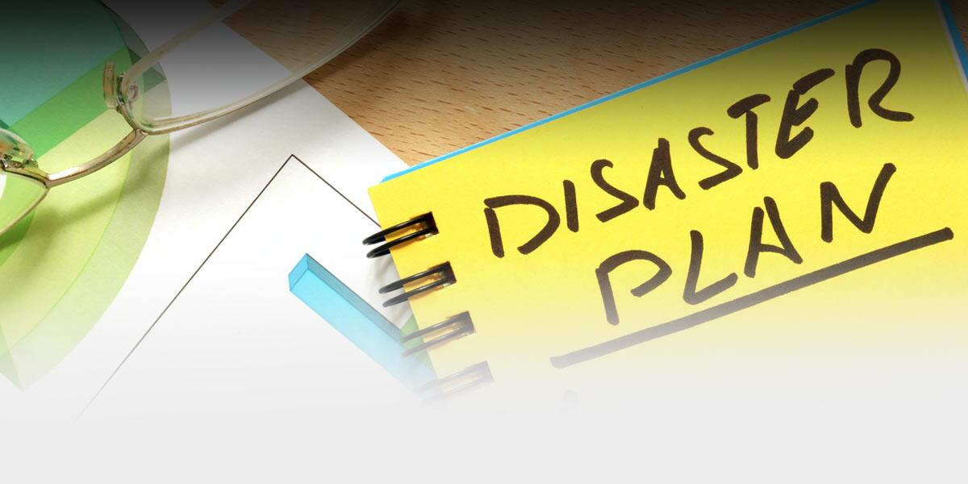
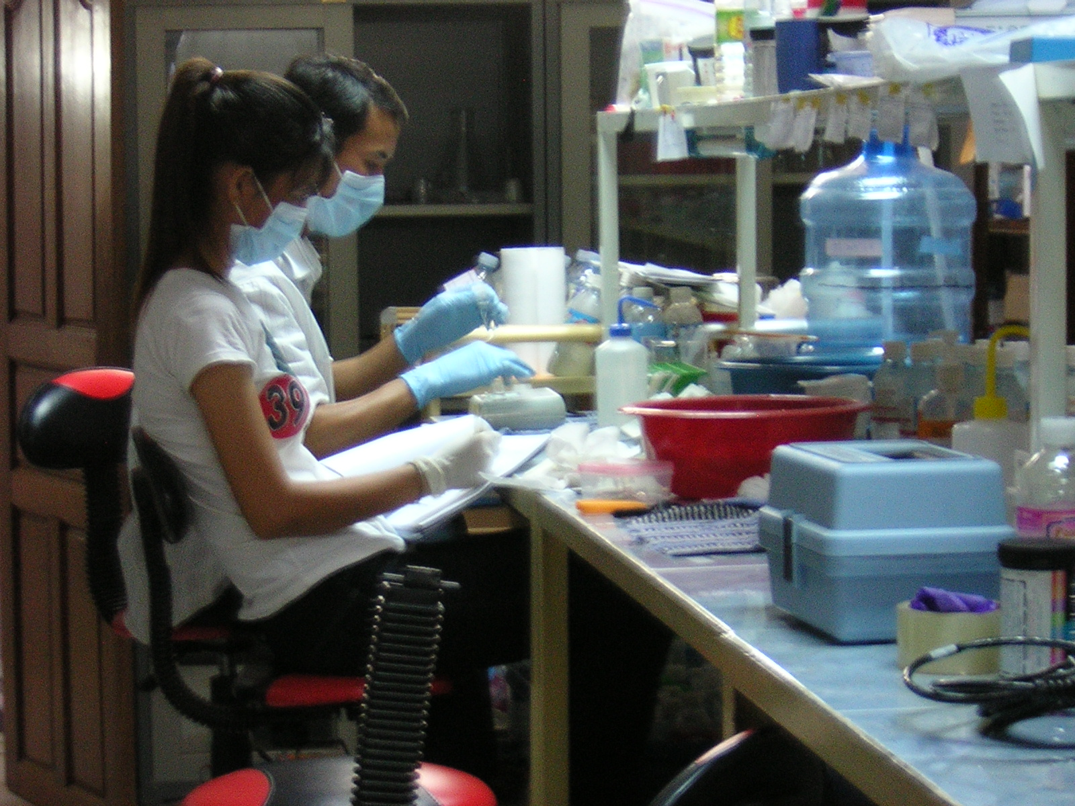
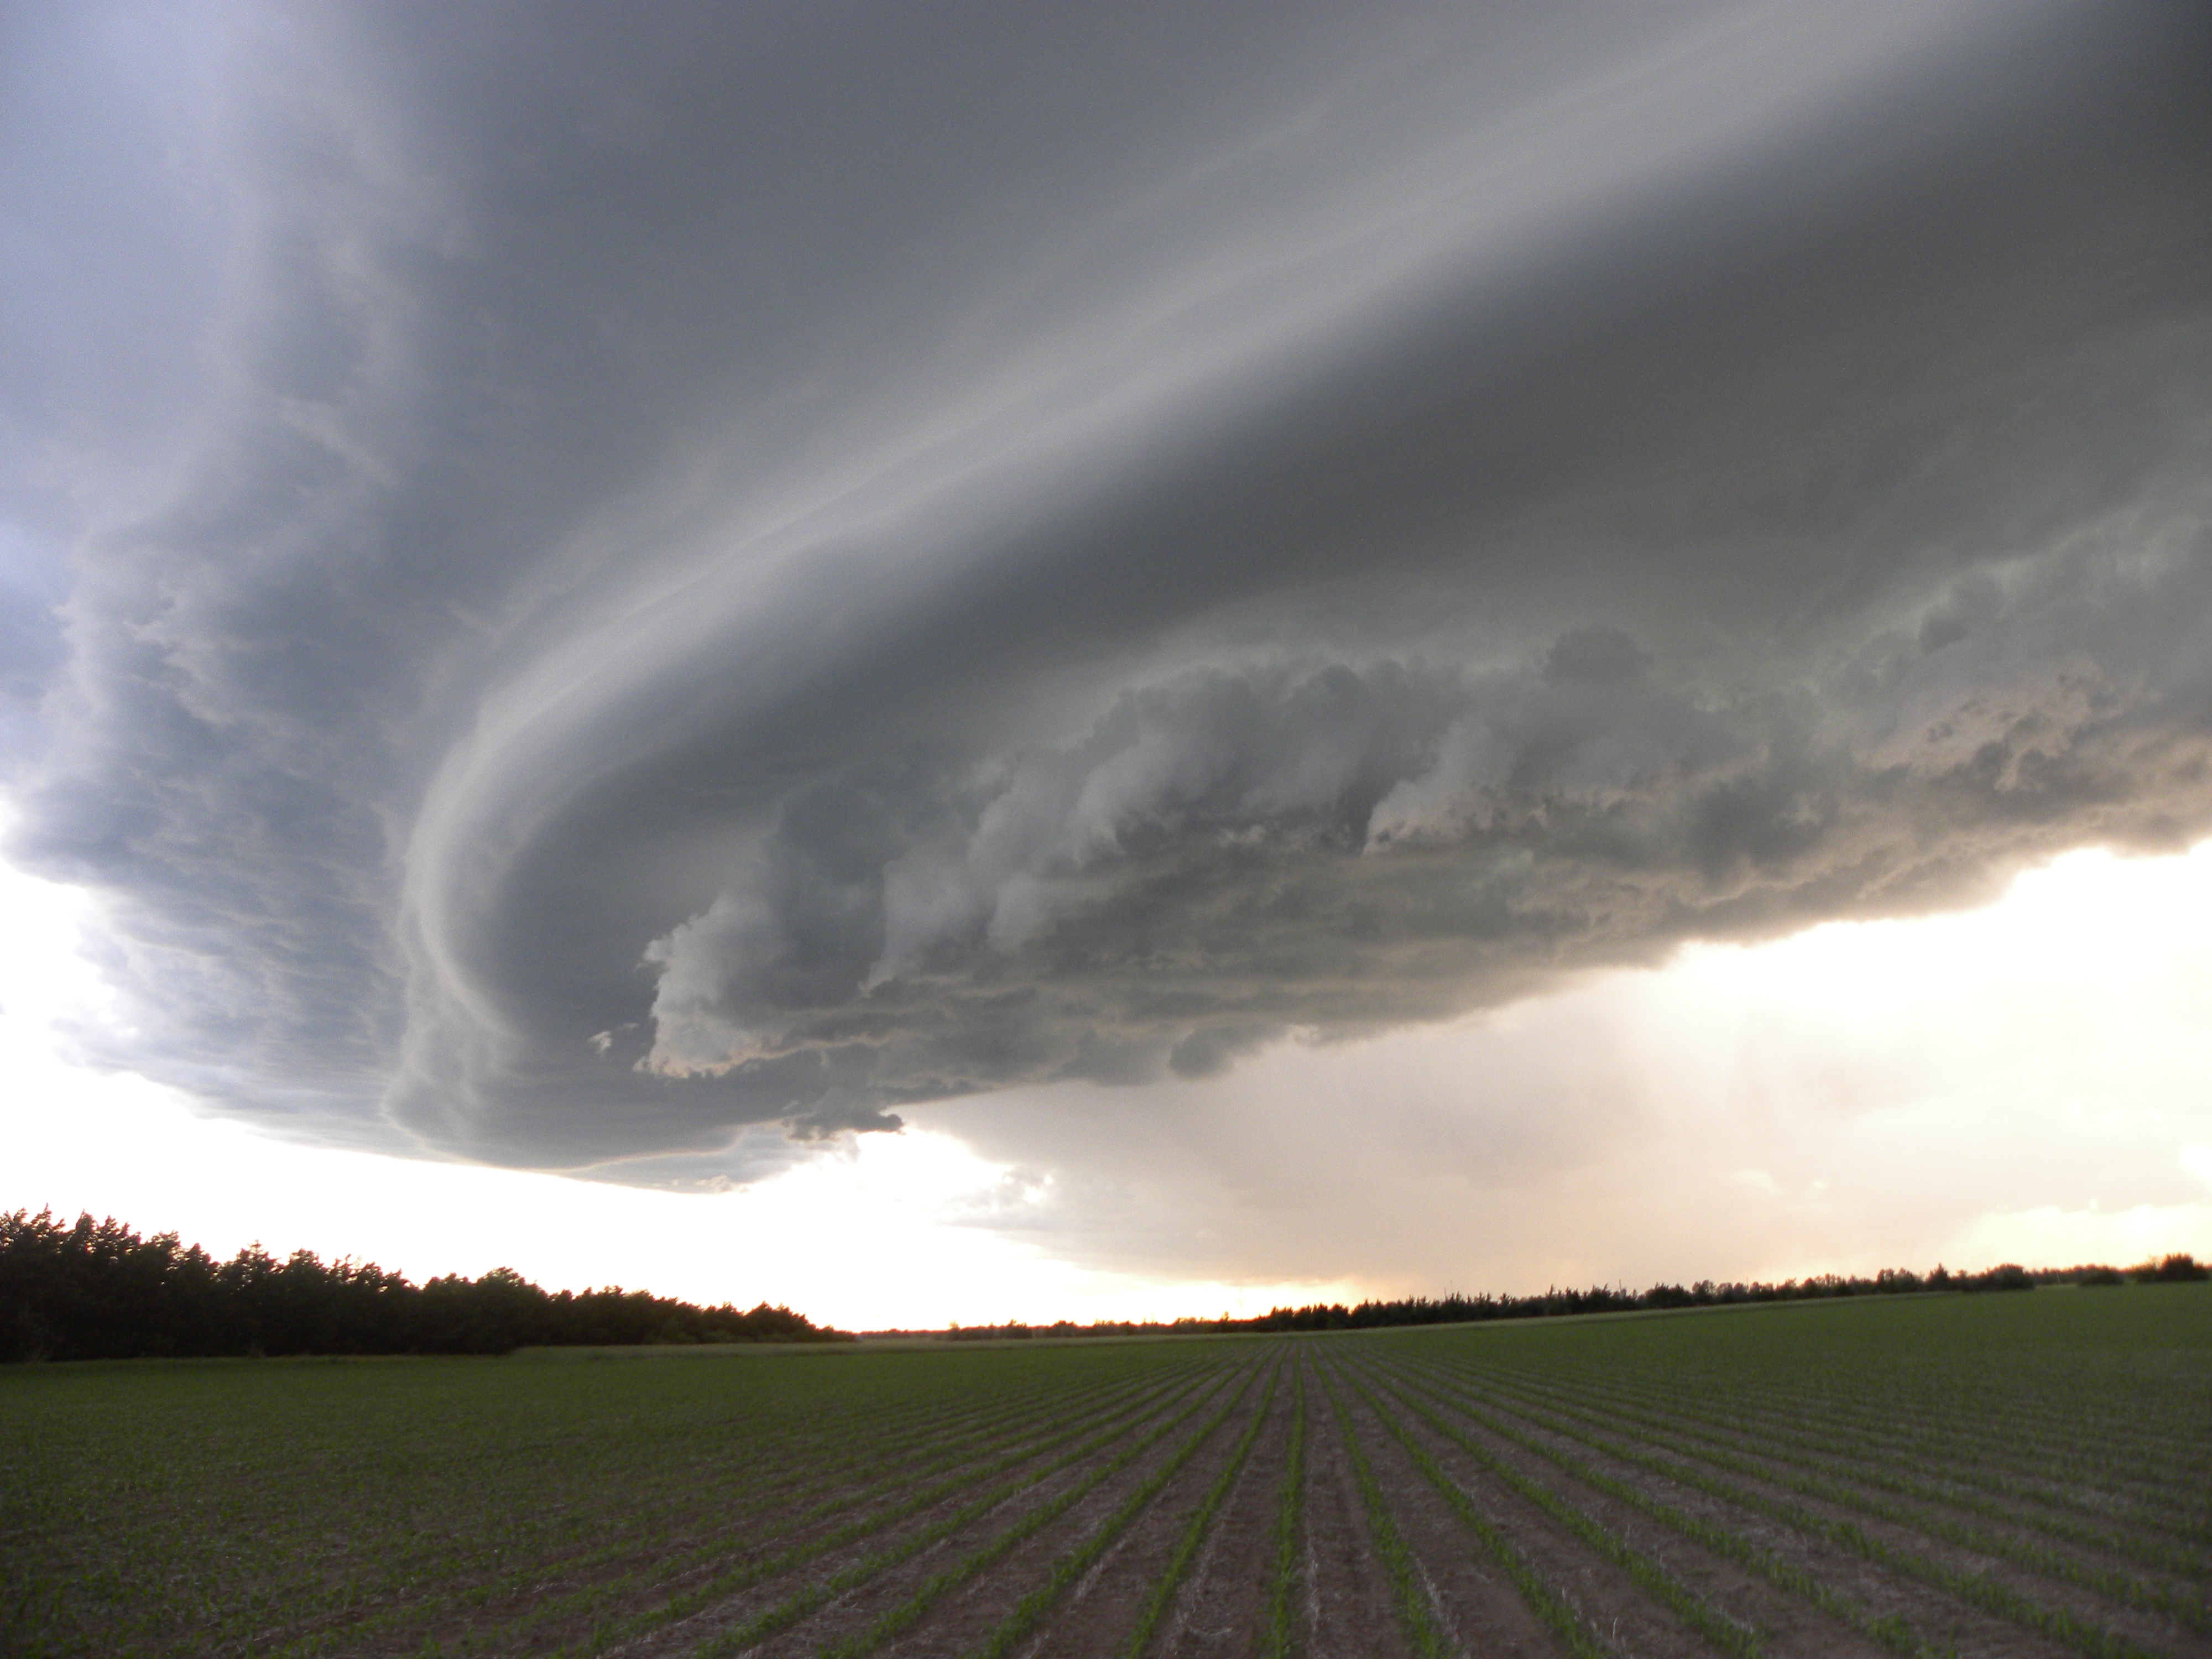
Situation Report #1: Tornado Watch
At noon on [date], the National Weather Service (NWS) issues a Tornado Watch for your area.
A large line of powerful thunderstorms is approaching. Conditions are favorable for tornadoes.
Top image: Department of Homeland Security, public domain
Middle image: Scott Gottreu, www.treutech.com, free to use with attribution
Bottom image: NOAA Photo Library, free to use

Slide 6
Discussion
What actions need to be taken?
What decisions need to be made? Who makes these decisions?
How will the thunderstorms likely impact lab operations?
Notes:
Additional prompts:
What site security precautions do you take, if any? Who is responsible for this?
Do you activate the COOP?
Do you activate ICS?
How much certainty do you need before you do something?

Slide 7
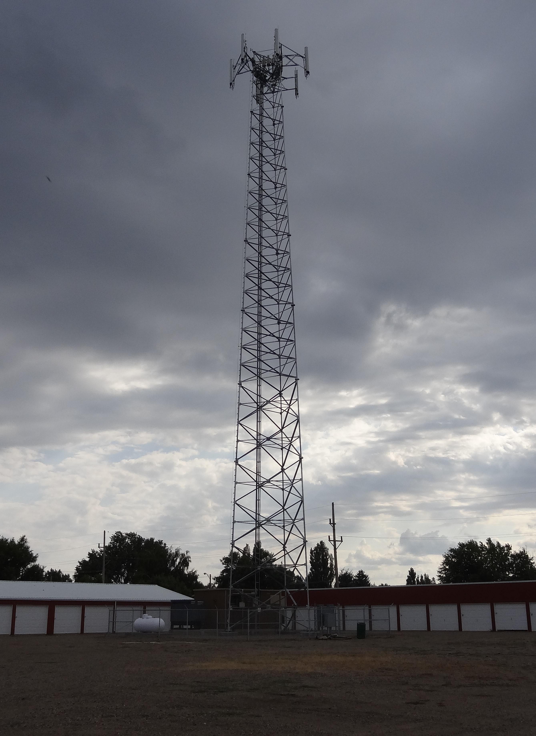
Situation Report #1: Tornado Watch, Continued
Verizon reports widespread outages in the region.
It does not know the cause of this “network outage,” but the thunderstorms are likely a contributor.
In addition to work cell phones being down, personal cell phones are down for about half the staff of your laboratory.
Photo (cropped) by David Schott; free to use with attribution

Slide 8
Discussion
What actions need to be taken?
Does this new information change any of your previous decisions?
What decisions need to be made? Who makes these decisions?
Notes:
Additional prompts:
How does this affect your network communications?
Are work cell phones wi-fi enabled?

Slide 9
Discussion: Notification
How do you notify employees? What back-up communications systems do you have?
What other agencies do you notify?
Is contact information up-to-date?
When was the last time you conducted a call-down drill?
What will you do if cell phones do not work? How will you get in touch with people? What back-up communications systems do you have?

Slide 10
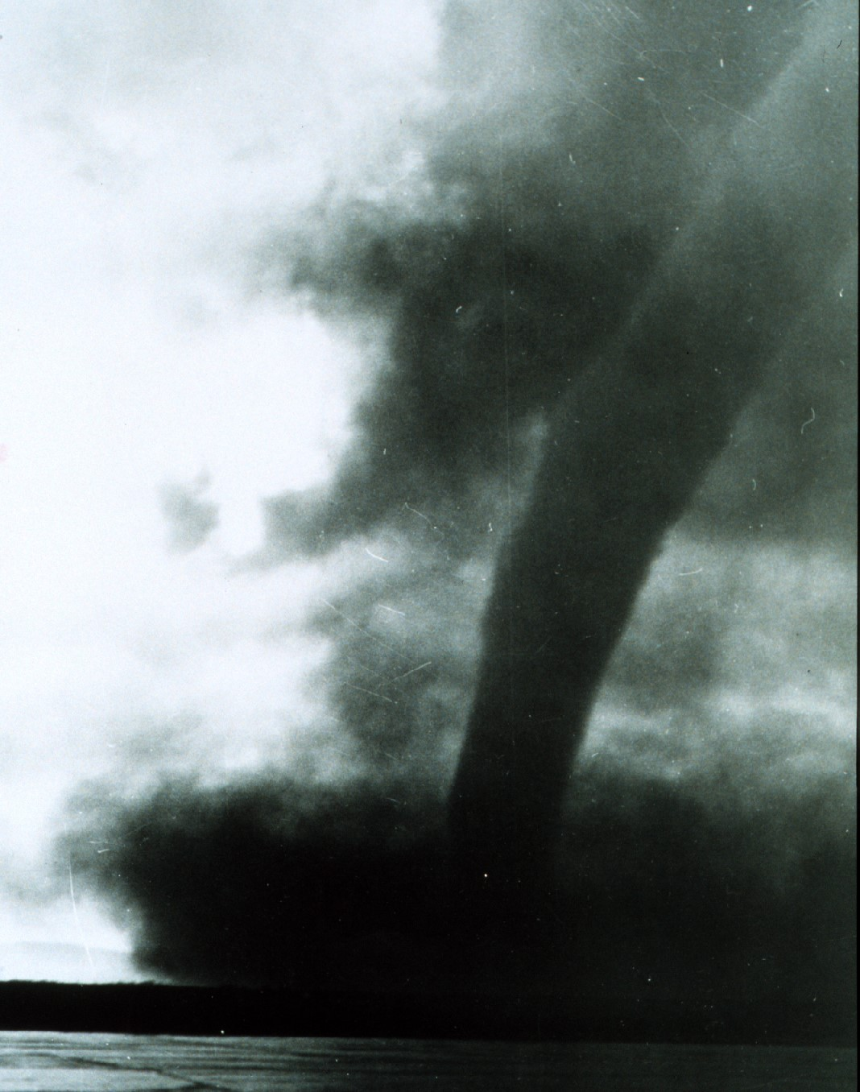
Situation Report #2: Tornado Warning
At 12:45 PM, a large tornado, initially thought to be an EF3, hits [8 miles south of your lab.]
NWS reports that the system responsible for this tornado is headed directly for [a community 4 miles northwest of your lab] and issues a tornado warning for the area.
The power in your lab has been flickering on and off.
(Cropped) photo by Derek Stratman; NOAA public domain
NOAA public domain photo

Slide 11
Discussion
What actions need to be taken?
Does this new information change any of your previous decisions?
What decisions need to be made? Who makes these decisions?

Slide 12
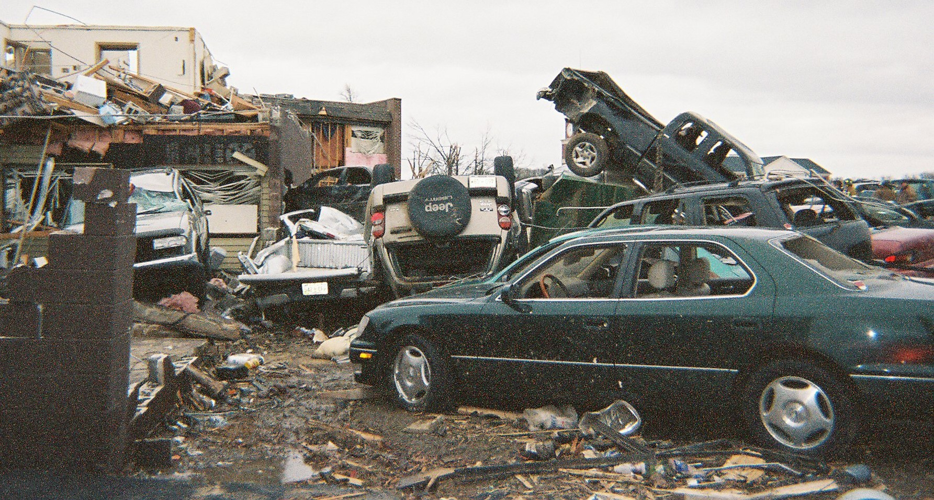
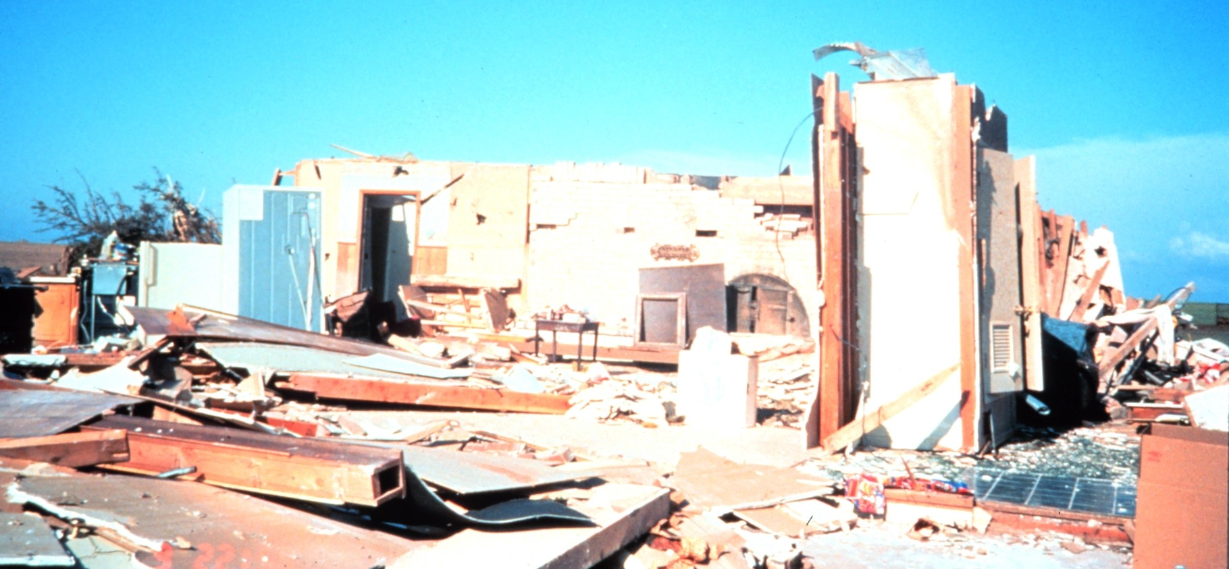
Situation Report #3: It Hits
Ten minutes later, you hear loud rumbling noises and glass breaking as the building shakes and the power goes out.
Reports indicate that a large tornado touched down in your community. The tornado damages nearly all buildings, shrubbery, and trees within its path, generating massive amounts of debris.
The lab sustains major structural damage, and local servers and network functions are not available.
Utility companies report that nearly all customers in the region are without power, including the lab. Utility crews are fighting to restore at least temporary power to critical facilities, but they estimate it will take at least 3 days to restore power.
(Cropped) NOAA public domain photo
(Cropped) NOAA public domain photo

Slide 13
Discussion
What actions need to be taken?
Does this new information change any of your previous decisions?
What decisions need to be made? Who makes these decisions?
How will you evaluate and communicate the status of the lab?
How will the building damage likely impact lab operations?
Notes:
Additional prompts:
What agreements are in place? Who coordinates these requests?
Are there legal barriers?
Has relocation to an alternate facility been tested?
How do you secure select agents?

Slide 14
Discussion: Alternative Facilities/Relocation
Which lab activities/testing are essential and therefore must continue? Which activities are nonessential and may be suspended or deferred?
Can any lab activities be outsourced?
What arrangements are in place for transferring testing responsibilities to other facilities?
Do laboratory staff, equipment, and essential activities need to be relocated to another facility?
Notes:
Additional prompts:
How will the specimens/samples be transported to the other laboratories?
Do you anticipate needing to move equipment? What is the process for moving equipment?
What is in your go-kits? How quickly could all of the material and equipment required for relocation be assembled?
Are certifications or outside entities required to get equipment up and running? What is the timeframe for this?
How does the debris and damage to roads impact the transport of samples?

Slide 15
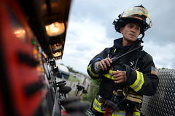
Situation Report #4:
Lab Sustains Damage
By [Day 3], structural engineers conclude that damage to the laboratory is worse than initially thought and declare the buidling unstable.
Personnel are instructed not to occupy the facility until initial repairs can take place, which could take up to a month.
Image shared by the US Air Force via Flickr; U.S. government work.

Slide 16
Discussion
What actions need to be taken?
Does this new information change any of your previous decisions?
What decisions need to be made? Who makes these decisions?
Notes:
Additional prompts:
What are the staffing, payroll, etc. implications of this scenario?

Slide 17
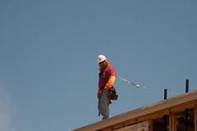
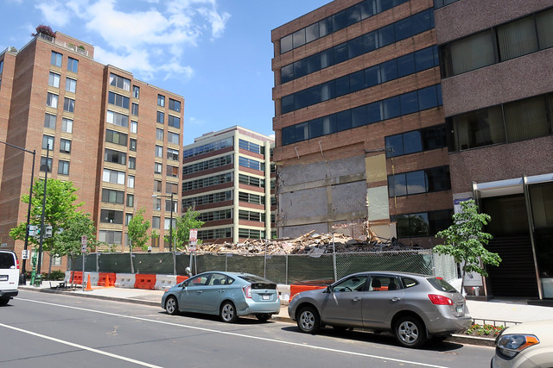
Situation Report #4:
Restoration
It is now [date], one month since the tornado.
Power has been restored. Debris and rubble have been cleared.
Your lab building has been repaired and deemed safe to enter.
Top image shared by National Institute for Occupational Safety and Health via Flickr; U.S. government work.
Bottom image shared by Daniel Lobo via Flickr Creative Commons; no known copyright restrictions.

Slide 18
Discussion: Reconstitution
When does reconstitution begin?
What is involved with reconstitution?
What are the effects of the building damage and electrical outage that may impact lab operations?

Slide 19
Lunch Break

Slide 20
Hot Wash
Based on this exercise, what are the greatest strengths of your COOP?
Where are the gaps in your COOP?
  Knowledge gaps
  Gaps due to infrastructure
What initial steps can you take to reduce these gaps?

