Slide 1
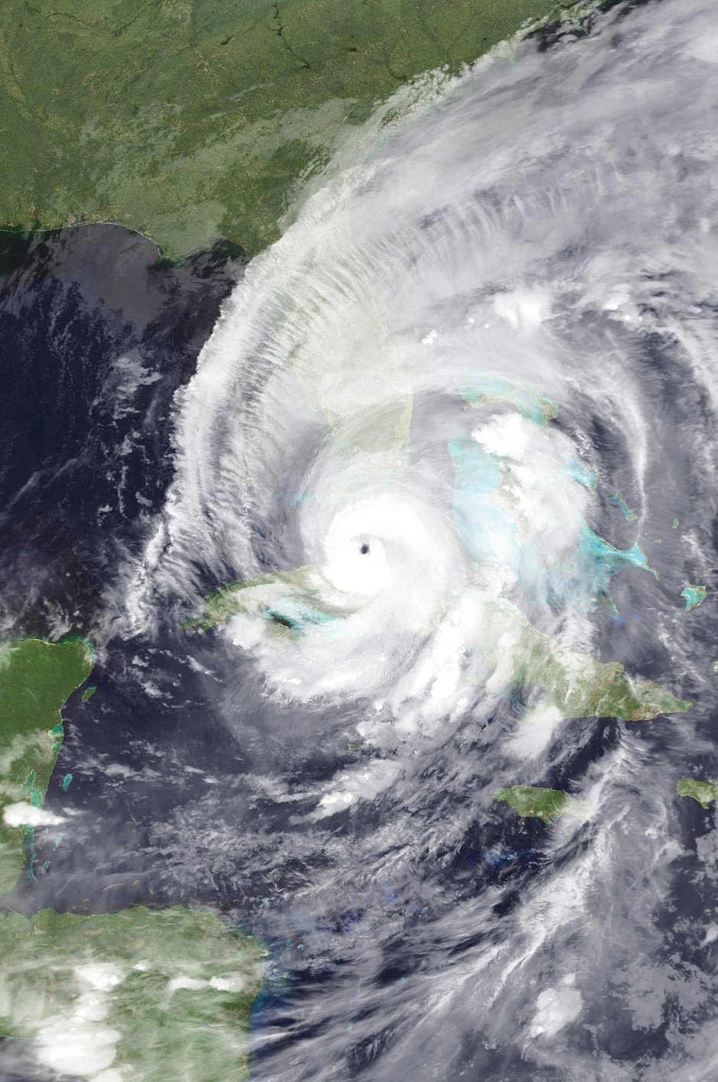
Continuity of Operations Plan (COOP) Tabletop Exercise
[Laboratory Name]
[Date]
NASA public domain photo

Slide 2
Welcome
Introductions
Exercise Structure
  Each module will begin with a situation briefing or update and offer a list of questions for discussion
  Participants should feel free to openly ask questions of other players and to express their thoughts or opinions
  A note-taker will capture the responses
  Immediately following the exercise, there will be a debrief/hotwash
Please remember to mute your cell phones

Slide 3
Exercise Guidelines
This is an open, low‐stress, no‐fault environment for discussion and problem solving
Varying viewpoints are expected and encouraged
Assume the scenario is plausible
Respond based on your knowledge of current plans and capabilities (i.e., you may use only existing assets)
Decisions are not precedent setting and may not reflect your organization’s final position on a given issue
This is an opportunity to discuss and present multiple options and possible solutions

Slide 4
Objectives
In response to a disruptive incident, assess the laboratory’s ability to
  Activate the COOP
  Notify key personnel
  Identify and implement essential lab activities
  Identify alternative labs and process for relocation
  Reconstitute normal operations
Evaluate the adequacy of the laboratory COOP, identify gaps, and suggest improvements

Slide 5

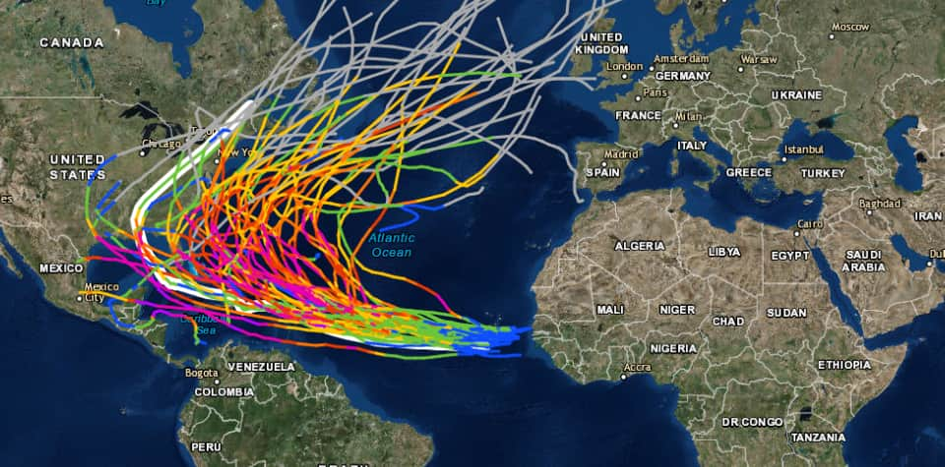
Situation Report #1: Before the Storm
On [date], a tropical storm develops in the Atlantic.
By [Day 3], the storm is a Category 3 hurricane; by [Day 4], it is a Category 4 hurricane with a trajectory several hundred miles south of your lab.
The National Hurricane Center issues a hurricane watch for the southern part of your state.
The governor declares a state of emergency and activates the National Guard to assist in preparations.
Top image: Department of Homeland Security, public domain
Bottom image: NOAA public domain map of historical hurricane tracks

Slide 6
Discussion
Given its current path, how will the hurricane likely impact lab operations?
What laboratory functions are likely to be affected?
What decisions need to be made? Who makes these decisions?
What can be done to prepare for the hurricane?
Notes:
Additional prompts:
What site security precautions do you take, if any? Who is responsible for this?
Do you activate the COOP?
Do you activate ICS?
How much certainty do you need before you do something?

Slide 7
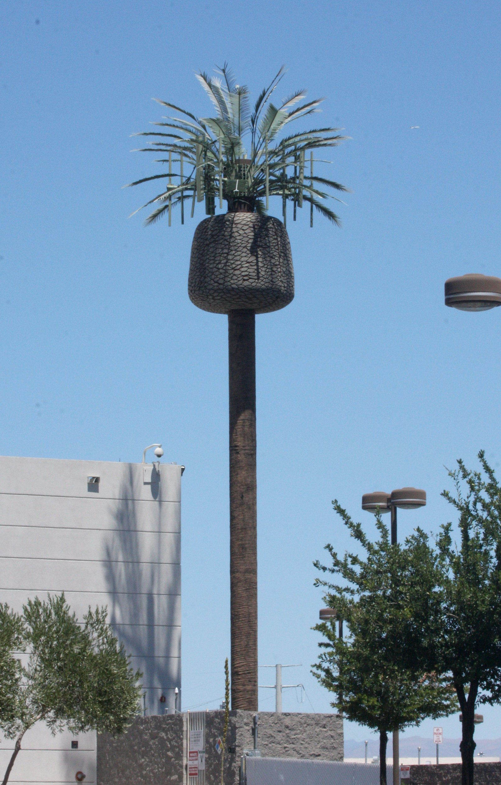
Situation Report #1: Before the Storm, Continued
Verizon reports widespread outages in the region.
It does not know the cause of this “network outage.” The storm has not yet made landfall in the states.
In addition to work cell phones being down, personal cell phones are down for about half the staff of your lab.
Photo by J. N. Stuart. Permissible to use with attribution.

Slide 8
Discussion
Does this new information change any of your previous decisions?
What will you do if cell phones do not work? How will you get in touch with people? What back-up communications systems do you have?
Notes:
Additional prompts:
How does this effect your network communications?
Are work cell phones wi-fi enabled?

Slide 9
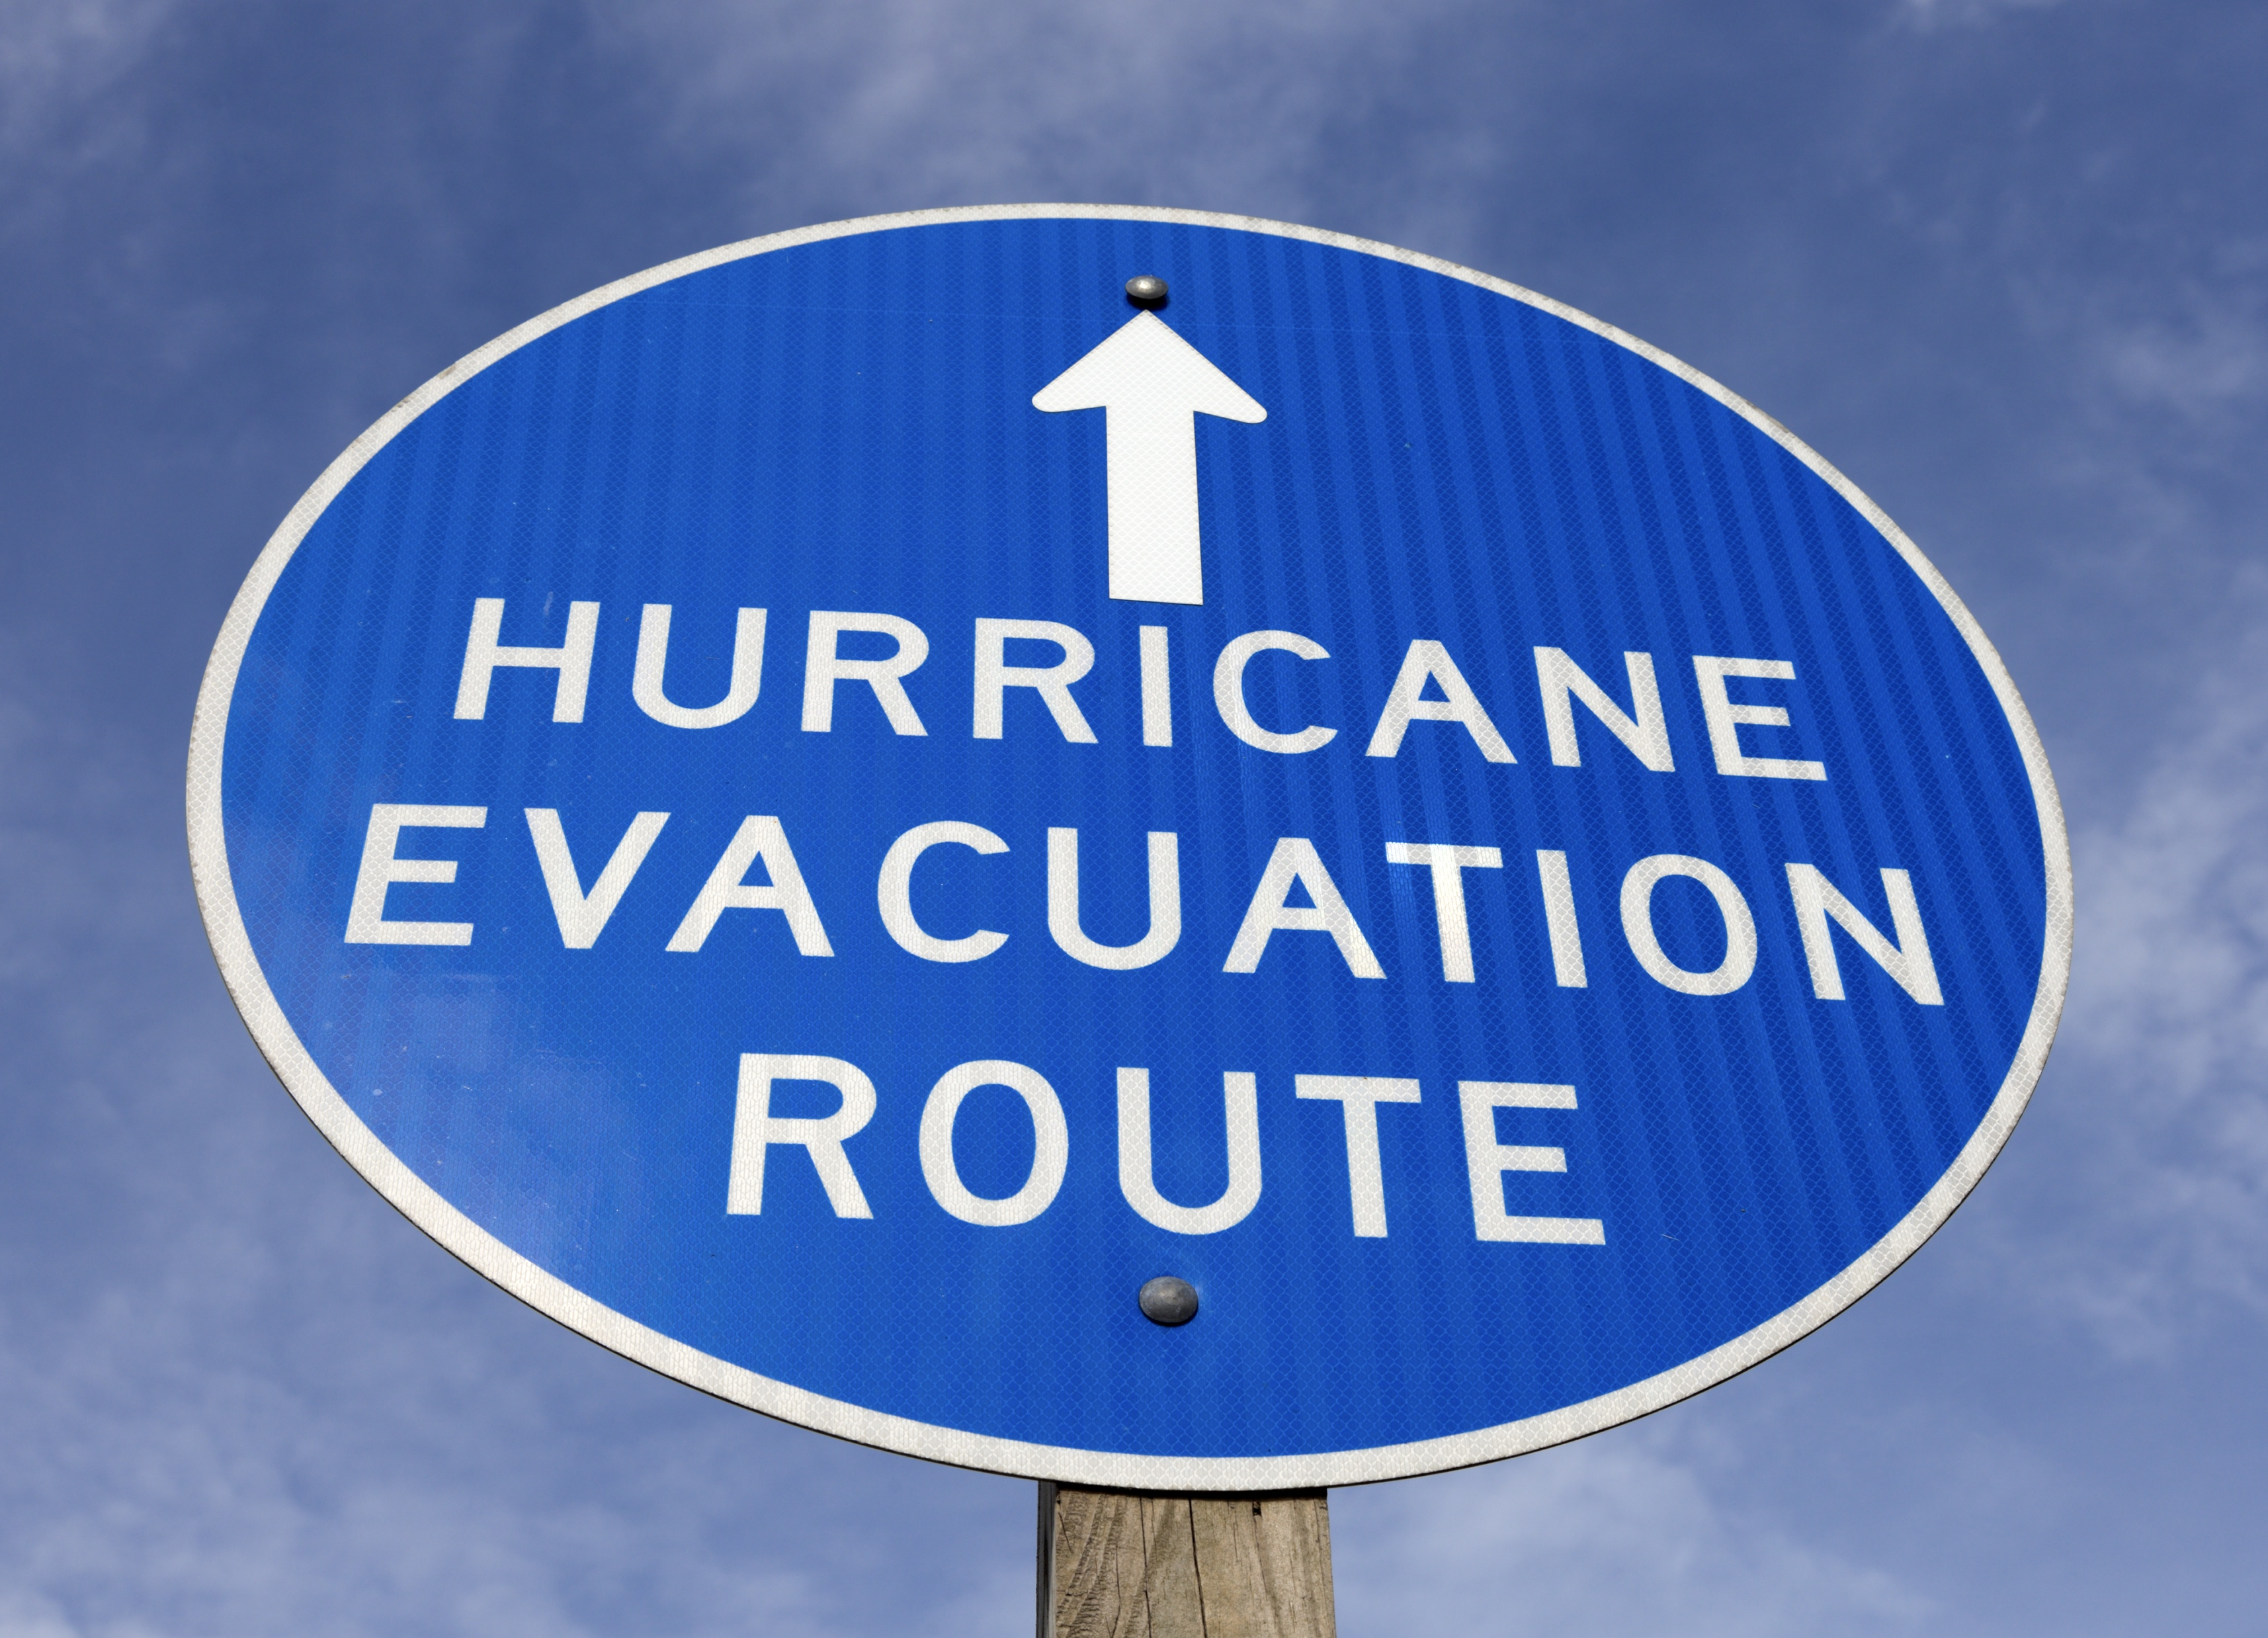

Situation Report #2: The Storm Changes Path
On [Day 5], the storm changes path and is tracking towards your part of the state.
The National Hurricane Center upgrades the hurricane watch to a warning and updates it to include your community, among others.
The governor issues evacuation orders for persons living within 10 miles of the coast, in mobile or sub-standard homes, or in low-lying or flood prone areas.
CDC public domain photo
Photo by Melissa Venable. Permissible to use with attribution.

Slide 10
Discussion
Given its new path, how will the hurricane likely impact lab operations?
Does this new information change any of your previous decisions?
What decisions need to be made? Who makes these decisions?
Notes:
Additional prompts:
How do the evacuation orders impact your staff?
What site security precautions do you take? Who is responsible for this?
When do you start notifying staff?

Slide 11
Discussion: Notification
How do you notify staff? What back-up communications systems do you have?
Is contact information up to date?
When was the last time you conducted a call-down drill?
What other agencies do you notify?
What external partners or services do you notify?

Slide 12
Discussion: Identification of Essential Activities
Which lab activities/testing are essential and therefore must continue? How do you prioritize?
Given the evacuation orders, do you have the staffing to continue essential tasks? What if some staff are not available?
Which labs are responsible for essential activities and which labs are their back-up? Which labs are available to support?
Which activities are nonessential and may be suspended or deferred?
Notes:
Additional prompts:
Which activities/testing have the highest priority? Medium priority? Lowest priority?
How do you secure the select agents?

Slide 13
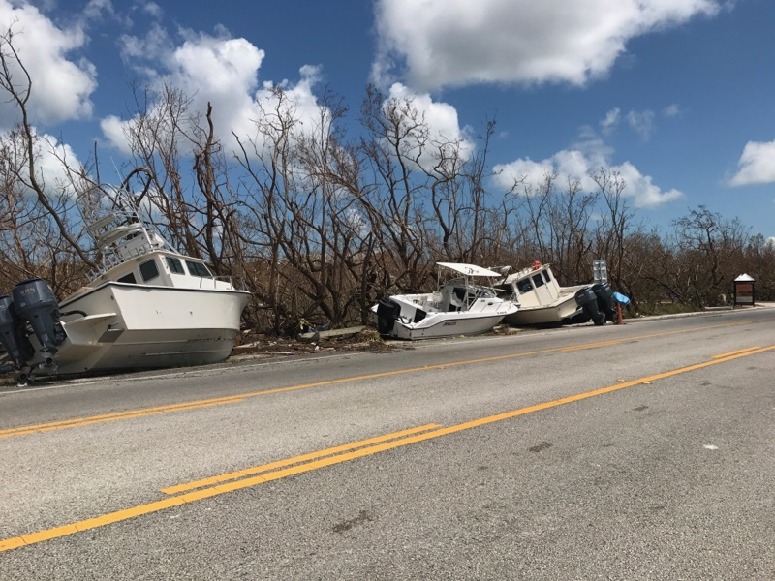
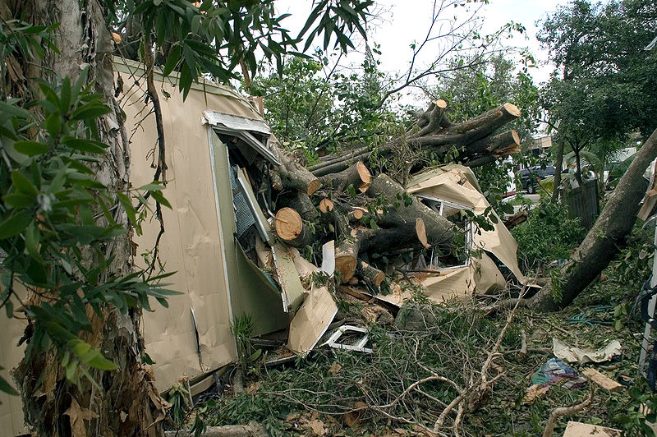
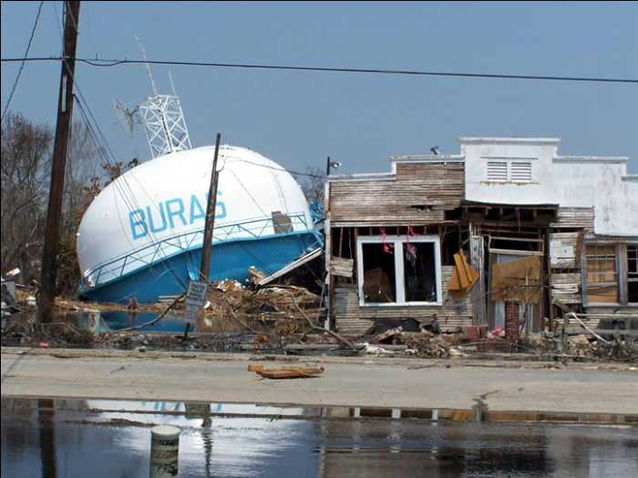
Situation Report #3: Landfall
On [Day 6], the now Category 5 hurricane makes landfall near you. Your city is hit hard by sustained 160 mph winds and over 20 inches of rain within 24 hours. Your lab sustains severe flooding. Debris and flooding impact all major roadways.
Utility companies report that nearly half a million customers in the region are without power, including your lab, and utility crews are fighting to restore at least temporary power to critical facilities.
The lab’s local servers and network functions are not available. The state is working with federal officials and private companies on restoring communications, transportation, and other critical infrastructure.
U.S. Fish and Wildlife Service, public domain photo
FEMA public domain photo
EPA public domain photo

Slide 14
Discussion
What decisions need to be made? Who makes these decisions?
How will you evaluate and communicate the status of the lab?
What systems and information sharing networks does the lab use? If these are not available, how will you access essential records?
What arrangements are in place for transferring testing responsibilities to other facilities?
Can any lab activities be outsourced or relocated to another facility?
Notes:
Additional prompts:
What agreements are in place? Who coordinates these requests?
Are there legal barriers?
Has relocation to an alternate facility been tested?

Slide 15
Discussion: Relocation/Alternative Facilities
If operations must be moved to another lab, what information would the other lab need from this lab? What information will your lab eventually need from the other lab?
How will the specimens and samples be transported to the other laboratories? Will they receive them directly?
Will you need to move equipment? What is the process for doing so?
What is in your go-kits? How quickly could all of the material and equipment required for relocation be assembled?
Notes:
Additional prompts:
Are certifications or outside entities required to get equipment up and running? What is the timeframe for this?
Do you have limited staff because of evacuation? What are the staffing, payroll, etc. implications of this scenario?
How does the debris and flooding on roads impact the transport of samples?

Slide 16
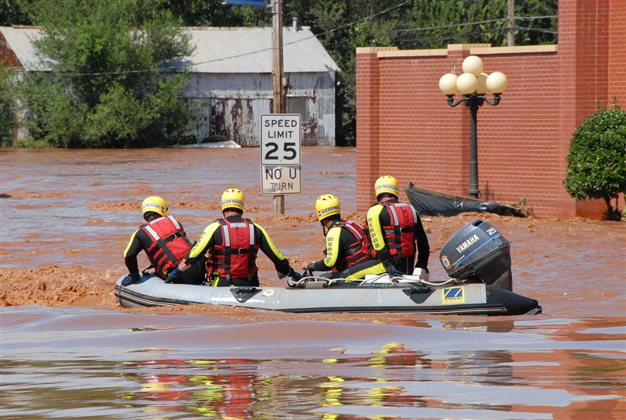
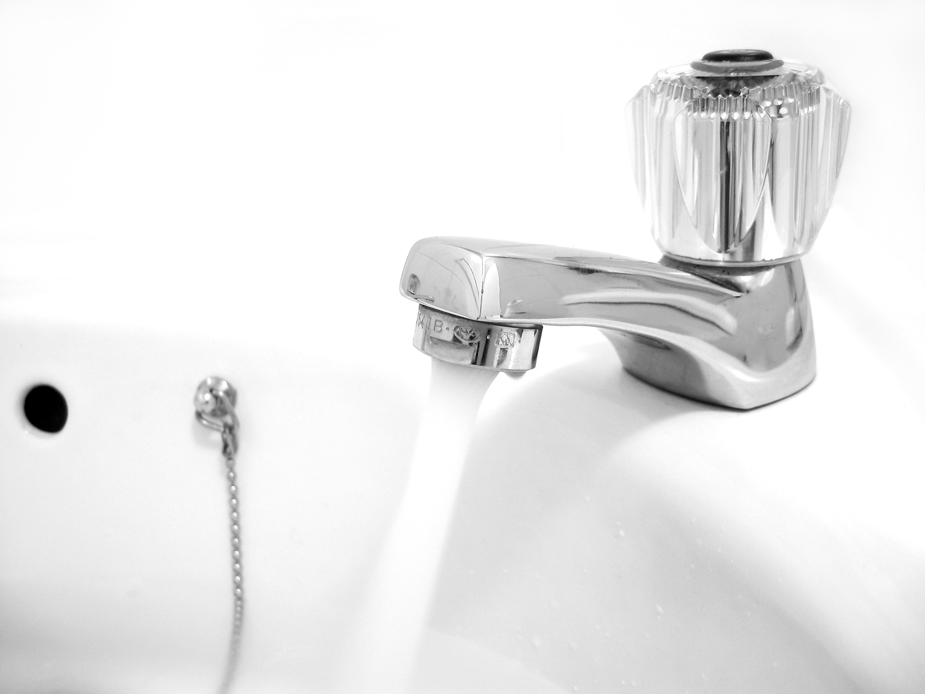
Situation Report #4: Breach to Water Supply
It has been 12 hours since the hurricane moved through the area, but heavy rain and high winds continue.
On [Day 8], state officials report the local water system has been breached by toxic chemicals and sewage from treatment plants.
Residents are warned not to use system water for drinking, washing hands, or bathing, but some neighborhoods are still flooded and unreachable and may not receive the warning.
NOAA public domain photo
Photo by Matthew Bowden; permissible to use with attribution

Slide 17
Discussion
What key actions should be taken? Who is responsible for these?
What decisions need to be made? Who makes these decisions?
How does the water supply breach impact your response to the hurricane?
How will you handle the surge in the demand for water testing?
What are the long-term effects of the hurricane and water breach that may impact lab operations?

Slide 18
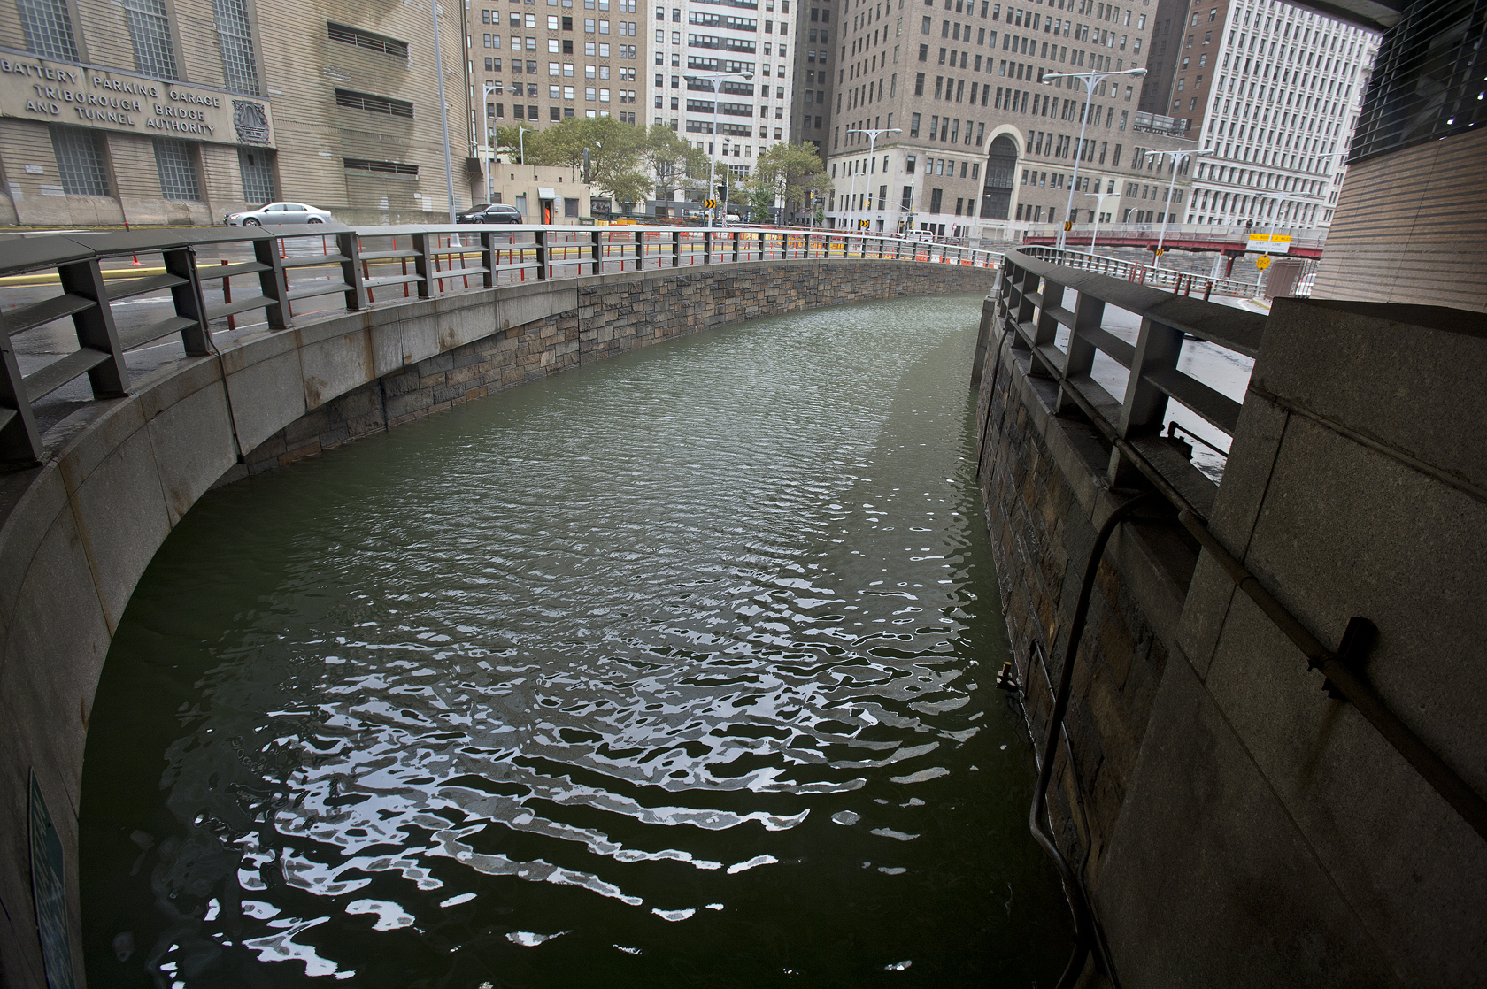
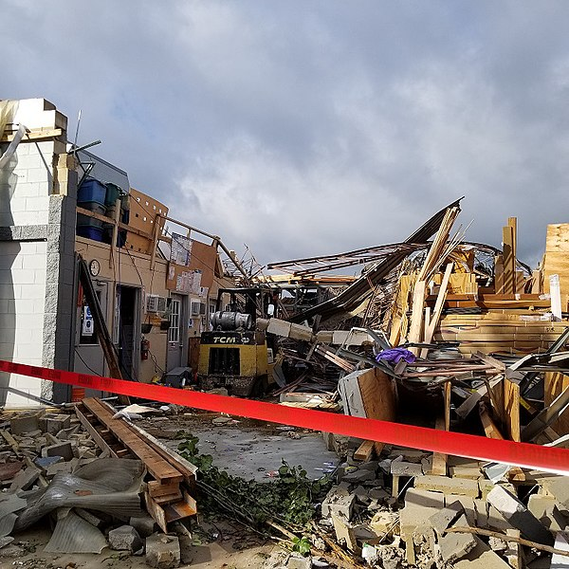
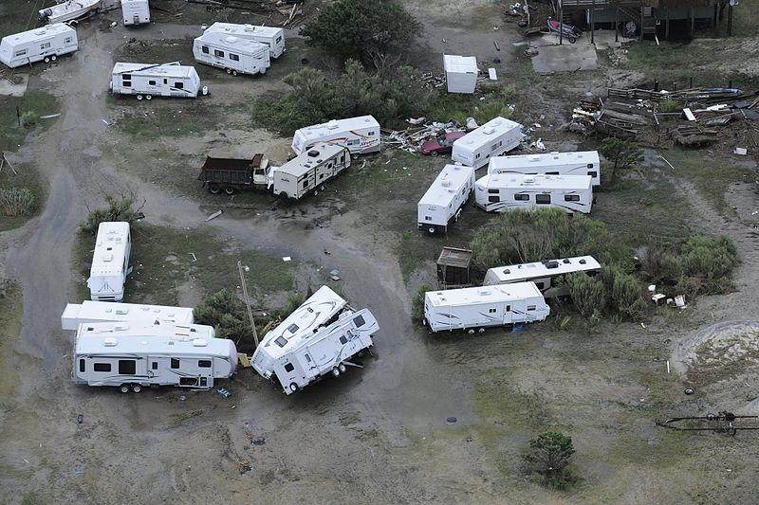
Situation Report #5: After the Hurricane
It is now [Day 13], and one week since the hurricane hit.
Power has been restored, but many streets remain covered in debris and the trees and surrounding structures have suffered extensive damage.
Mitigation of the water supply breach continues.
Photo by Patrick Cashin of Metropolitan Transportation Authority; permissible to use with attribution
National Weather Service, public domain
U.S. Coast Guard, public domain

Slide 19
Discussion: Reconstitution
When does reconstitution begin?
What is involved with reconstitution?

Slide 20
Lunch Break

Slide 21
Hot Wash
Based on this exercise, what are the greatest strengths of your COOP?
Where are the gaps in your COOP?
  Knowledge gaps
  Gaps due to infrastructure
What initial steps can you take to reduce these gaps?

