Slide 1
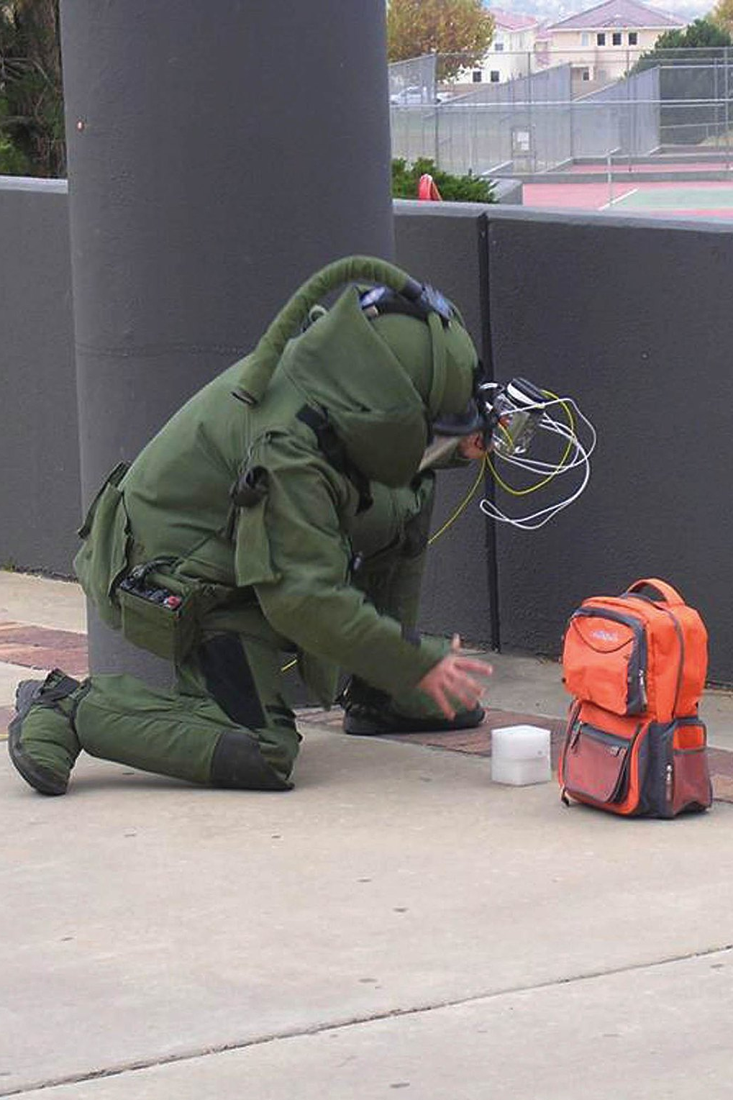
Continuity of Operations Plan (COOP) Tabletop Exercise
[Laboratory Name]
[Date]
Image shared by the U.S. Department of Energy via Flickr; U.S. government work.

Slide 2
Welcome
Introductions
Exercise Structure
  Each module will begin with a situation briefing or update and offer a list of questions for discussion
  Participants should feel free to openly ask questions of other players and to express their thoughts or opinions
  A note-taker will capture the responses
  Immediately following the exercise, there will be a debrief/hotwash
Please remember to mute your cell phones

Slide 3
Exercise Guidelines
This is an open, low‐stress, no‐fault environment for discussion and problem solving
Varying viewpoints are expected and encouraged
Assume the scenario is plausible
Respond based on your knowledge of current plans and capabilities (i.e., you may use only existing assets)
Decisions are not precedent-setting and may not reflect your organization’s final position on a given issue
This is an opportunity to discuss and present multiple options and possible solutions

Slide 4
Objectives
In response to a disruptive incident, assess the laboratory’s ability to
  Activate the COOP
  Notify key personnel
  Identify and implement essential lab activities
  Identify alternative labs and process for relocation
  Reconstitute normal operations.
Evaluate the adequacy of the laboratory COOP, identify gaps, and suggest improvements

Slide 5
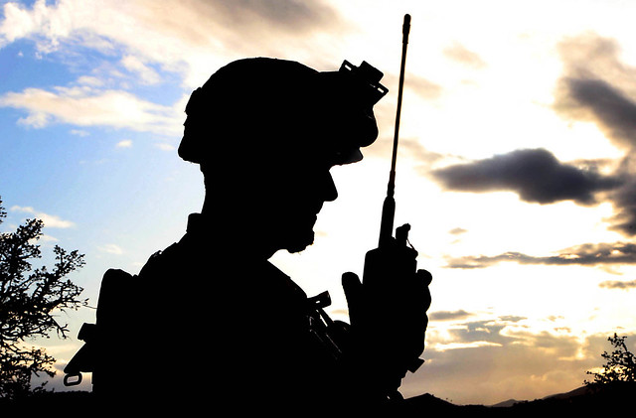
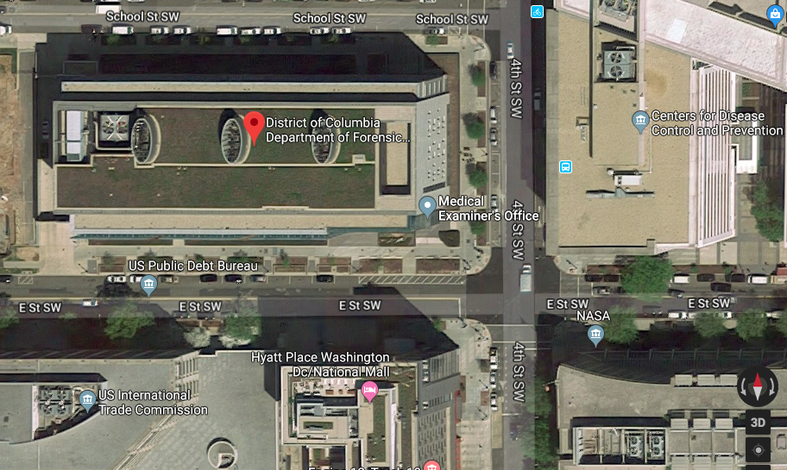
Situation Report #1: Bomb Threat
It is [date], around 8 PM.
The FBI shares intel about a highly credible bomb threat to one or more buildings in your area.
Specific targets are not currently known.
Replace with map of your area
Top image shared by the US Marine Corps via Flickr; U.S. government work.

Slide 6
Discussion
How would you learn more about the bomb threats?
What actions need to be taken?
What decisions need to be made? Who makes these decisions?
How will the bomb threats likely impact lab operations?
Notes:
Additional prompts:
What site security precautions do you take, if any? Who is responsible for this?
Do you activate the COOP?
Do you activate ICS?
How does your lab prepare for surge/transfer of specimens?
How much certainty do you need before you do something?
Do people still come to work?

Slide 7
Situation Report #1: Bomb Threat, Continued
Insert map of your area here
By 8 AM on [Day 2], the FBI and local law enforcement have narrowed the search radius to a few city blocks.
In an effort to prevent detonation of the bombs by cell phone, the Department of Homeland Security authorizes jamming all cell signals in the area.
It is not known when cellular service will return.
Notes:
Facilitator notes:
Adjust discussion if participants said they wouldn’t send anyone to work if there were threats in response to first sit rep slide.

Slide 8
Discussion
What actions need to be taken?
Does this new information change any of your previous decisions?
What new decisions need to be made? Who makes these decisions?
How will the cell phone jamming affect lab operations?

Slide 9
Discussion: Notification
How do you notify employees? What back-up communications systems do you have?
Is contact information up to date?
When was the last time you conducted a call-down drill?
What other agencies do you notify?
What external partners or services do you notify?
Notes:
Additional prompts
How do you notify shippers/suppliers?

Slide 10
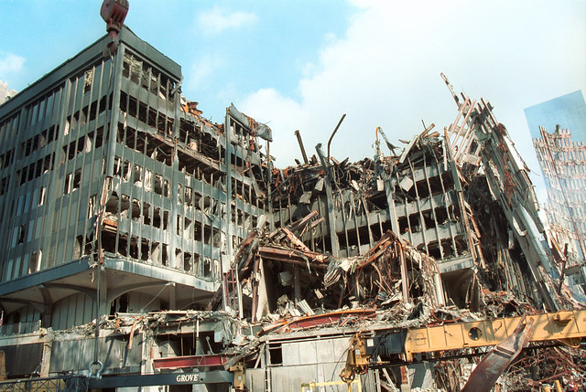
Situation Report #2:
Detonation
It is now 10 AM [on Day 2]. The bomb squad has spent the morning searching buildings in the identified area.
A bomb explodes before the squad can search an office building adjacent to your lab building.
It levels the office building and damages nearby buildings, including half of your lab building.
Image shared by the US Customs and Border Protection via Flickr; U.S. government work.
Notes:
Facilitator notes:
If it is decided that cell phone jammer is no longer in place, cell phone networks are likely overwhelmed and only a small portion of calls go through.

Slide 11
Discussion
What actions need to be taken?
Does this new information change any of your previous decisions?
What decisions need to be made? Who makes these decisions?
How will you evaluate and communicate the status of the lab?
How will the building damage likely impact lab operations?
Notes:
Facilitator notes:
If participants ask, “How damaged is the building?” You don’t know the degree of damage yet—but clearly something bad happened and you need to get out.
This slide is temporary disruption—2 days.
Additional prompts:
If employees are there—how quickly can you evacuate? Are go kits ready? Where do you evacuate to?
What site security precautions do you take? Who is responsible for this? Are there emergency shut offs that need to be implemented?

Slide 12
Discussion: Alternative Facilities/Relocation
What arrangements are in place for transferring testing responsibilities to other facilities?
Can any lab activities be outsourced?
Do laboratory staff, equipment, and essential activities need to be relocated to another facility?
Notes:
Facilitator notes:
Firefighters, etc. generally allow access only if leaving the material/sample/activity would create a new safety hazard.
Additional prompts:
What if you cannot get back into the laboratory? What would happen with samples, etc.?

Slide 13
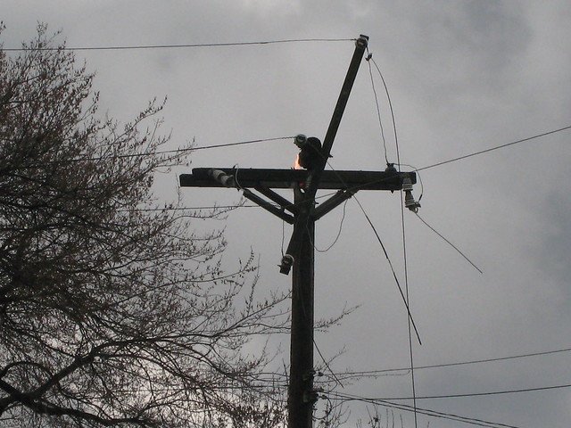
Situation Report #2:
Detonation, Continued
Due to blast damage, all buildings in the area—including your lab—are without power.
Utility crews are fighting to restore at least temporary power to critical facilities, but immediate priority remains emergency response to the explosion. Crews estimate it will take 2 days to restore power.
Your lab’s backup generator was damaged also by the blast. Your lab’s local servers and network functions are not available.
Image shared by Ed Kohler via Flickr Creative Commons; no known copyright restrictions.
Notes:
Facilitator notes:
First responders have notified you that you cannot occupy the building until it is deemed safe by structural engineers.

Slide 14
Discussion
What actions need to be taken?
Does this new information change any of your previous decisions?
What decisions need to be made? Who makes these decisions?
What systems and information sharing networks does the lab use? If these are not available, how will you access essential records?

Slide 15
Discussion: Identification of Essential Activities
Which lab activities and testing are essential and therefore must continue? How do you prioritize?
Given building access restrictions, do you have the staffing to continue essential tasks? What if some staff are not available?
Which labs are responsible for essential activities and which labs are their back-up? Which labs are available to support?
Which activities are nonessential and may be suspended or deferred?
Notes:
Additional prompts:
Which activities/testing have the highest priority? Medium priority? Lowest priority?
How do you secure the select agents?

Slide 16

Situation Report #3:
Lab Sustains Damage
On [Day 3], structural engineers conclude that damage to your lab building is worse than initially thought. They declare it unstable.
Personnel may not occupy the facility until initial repairs can take place, which could take one month.
Image shared by the US Air Force via Flickr; U.S. government work.
Notes:
Facilitator notes:
Include info that suspect has been apprehended and threat no longer exists.

Slide 17
Discussion: Relocation/Alternative Facilities
If operations must be moved to another lab, what information would that lab need from yours? What information will your lab eventually need from the other lab?
How will specimens and samples be transported to the other laboratories?
Will you need to move equipment? What is the process for doing so?
What is in your go-kits? How quickly could all the material and equipment required for relocation be assembled?
Notes:
Additional prompts:
What agreements are in place? Who coordinates these requests?
Are there legal barriers?
Has relocation to an alternate facility been tested?
Are certifications or outside entities required to get equipment up and running? What is the timeframe for this?
What are the staffing, payroll, etc. implications of this scenario?

Slide 18
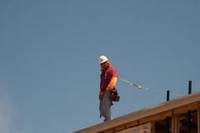
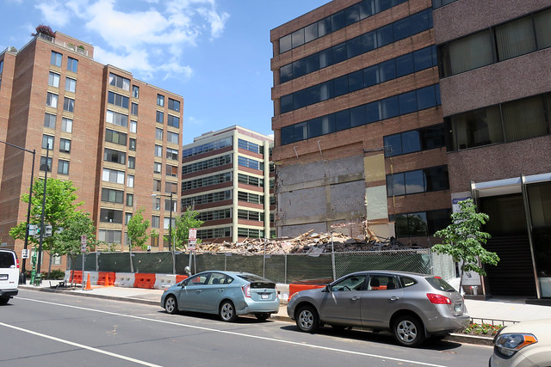
Situation Report #4:
Restoration
It is now [date], one month since the explosion.
Power has been restored. Debris and rubble have been cleared.
Your lab building has been repaired and deemed safe to enter.
Top image shared by National Institute for Occupational Safety and Health via Flickr; U.S. government work.
Bottom image shared by Daniel Lobo via Flickr Creative Commons; no known copyright restrictions.

Slide 19
Discussion: Reconstitution
When does reconstitution begin?
What is involved with reconstitution?
What are the long-term effects of the building damage and electrical outage that may impact lab operations?

Slide 20
Lunch Break

Slide 21
Hot Wash
Based on this exercise, what are the greatest strengths of your COOP?
Where are the gaps in your COOP?
  Knowledge gaps
  Gaps due to infrastructure
What initial steps can you take to reduce these gaps?

