Slide 1
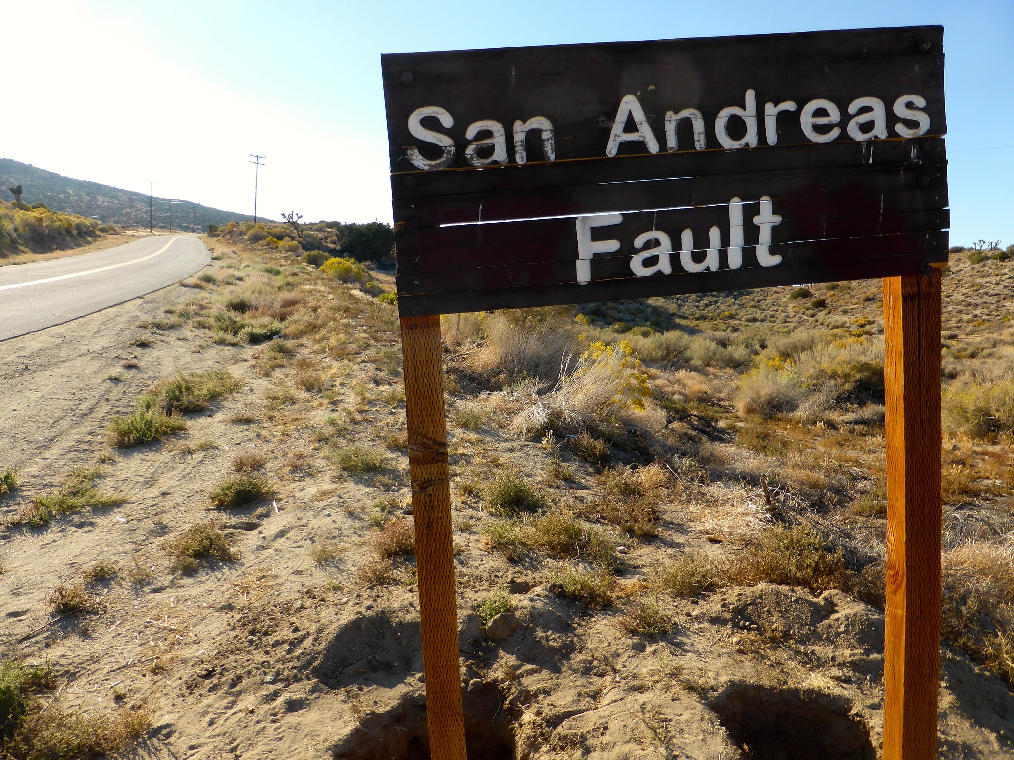
Continuity of Operations Plan (COOP) Tabletop Exercise
[Laboratory Name]
[Date]
Image shared by Michael R. Perry via Flickr Creative Commons; no known copyright restrictions.

Slide 2
Welcome
Introductions
Exercise Structure
  Each module will begin with a situation briefing or update and offer a list of questions for discussion
  Participants should feel free to openly ask questions of other players, express thoughts and/or opinions
  A note-taker will capture the responses
  Immediately following the exercise, there will be a debrief/hotwash
Please remember to mute your cell phones

Slide 3
Exercise Guidelines
This is an open, low‐stress, no‐fault environment for discussion and problem solving
Varying viewpoints are expected and encouraged
Assume the scenario is plausible
Respond based on your knowledge of current plans and capabilities (i.e., you may use only existing assets)
Decisions are not precedent-setting and may not reflect your organization’s final position on a given issue
This is an opportunity to discuss and present multiple options and possible solutions
Notes:
Facilitator notes:
This scenario is primarily based on the 2014 South Napa Earthquake (magnitude 6.0, intensity XIII) and the 1994 Northridge Earthquake (magnitude 6.7) but also influenced by USGS Shakeout Scenario, about a 7.8 earthquake striking southern California.

Slide 4
Objectives
In response to a disruptive incident, assess the laboratory’s ability to
  Activate the COOP
  Notify key personnel
  Identify and implement essential lab activities
  Identify alternative labs and process for relocation
  Reconstitute normal operations
Evaluate the adequacy of the laboratory COOP, identify gaps, and suggest improvements

Slide 5
Situation Report #1:
The Fault Awakens
At 10 AM on [date], a magnitude 6.0 earthquake begins 170 miles from your lab and travels northwest along a fault at two miles per second.
It compromises 10 miles of a principal freeway in your area. Other roads have been damaged or blocked by minor landslides. Pipelines snap, and some electrical transmissions fail.
In your county, building code improvements have mitigated the worst of the damage, but some older structures have collapsed or shifted off their foundations, breaking gas and water lines in the process.

Slide 6
Discussion
What preparations and mitigations are in place before an earthquake?
How will you evaluate and communicate the status of the lab?
What actions need to be taken?
What decisions need to be made? Who makes these decisions?
Notes:
Additional prompts:
What site security precautions do you take, if any? Who is responsible for this?
Do you activate the COOP?
Do you activate ICS?
How do you prepare for surge/transfer of specimens?
How much certainty do you need before you do something?
Do people still come to work?
Do you have mitigation procedures in place for non-structural damage (is your equipment secured, do you have heavy or breakable things on high shelves, etc.)?

Slide 7
Situation Report #1:
The Fault Awakens, Continued
In your county, road damage is fairly minor, but traffic is heavier due to closure and rerouting of some major thoroughfares. Closer to the quake center, road and building damage is more severe.
Your lab building has not suffered significant structural damage and everyone in the building is unharmed. However, many unsecured objects have broken.
Additionally, like many others in your county, you are without power and water. Utility crews are working around the clock, but they estimate it will take 2 days to restore power, and 3 to 4 days to restore water.
Notes:
Facilitator notes:
For a magnitude 6.0, intensity XIII 2014 Napa Earthquake, power had been "mostly restored" a day later. Same event estimated 3-4 days to restore water (but for about 600 people).
Also, it is very common for water mains/pipes to break because they are underground and "Pipes of concrete and iron are brittle and break in many places in an earthquake.”

Slide 8
Discussion
What actions need to be taken?
Does this new information change any of your previous decisions?
What decisions need to be made? Who makes these decisions?
How will the utility outages and transportation disruptions likely impact lab operations?
Notes:
Additional prompts:
What laboratory functions are likely to be affected?
How do you notify shippers/suppliers? How do they notify you?
Discuss generators, backup water supply. What can/will you continue to do in-house?

Slide 9
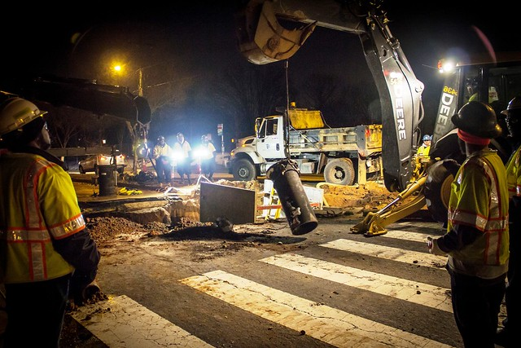
Situation Report #2:
From Bad to Worse
On [Day 2], many small fires start throughout the region due to ruptured gas lines.
Broken water mains, overtasking of firefighters, and high winds are hindering response.
Evacuation orders have not been made for your lab community, but some areas where employees live have been ordered to evacuate.
Image shared by Arlington Department of Environmental Services via Flickr Creative Commons; no known copyright restrictions.

Slide 10
Discussion
How will the encroaching fire likely impact lab operations?
What actions need to be taken?
Does this new information change any of your previous decisions?
What decisions need to be made? Who makes these decisions?
Notes:
Additional prompts:
What site security precautions do you take? Who is responsible for this?
When do you start notifying employees?

Slide 11
Discussion: Identification of Essential Activities
Which lab activities and testing are essential and therefore must continue? How do you prioritize?
Given the evacuation orders, do you have the staffing to continue essential tasks? What if some staff are not available?
Which labs are responsible for essential activities and which labs are their back-up? Which labs are available to support?
Which activities are nonessential and may be suspended or deferred?
Notes:
Additional prompts:
Which activities/testing have the highest priority? Medium priority? Lowest priority?
How do you secure the select agents?

Slide 12
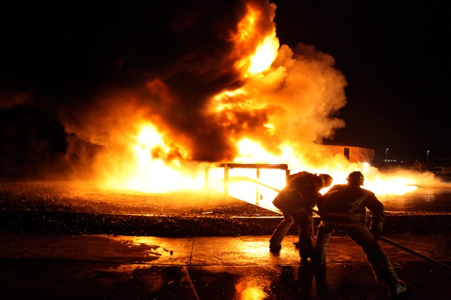
Situation Report #3:
The Fire Spreads
By the evening of [Day 3], power and water are restored to the lab, but fires to the northeast have become uncontained.
Evacuation orders have now been called for the lab community and several other nearby cities in your county.
Image by Harry Garvin and shared by Los Angeles Fire Department via Flickr Creative Commons; no known copyright restrictions.

Slide 13
Discussion
What decisions need to be made? Who makes them?
What systems and information sharing networks does the lab use? If these are not available, how will you access essential records?
What arrangements are in place for transferring testing responsibilities to other facilities?
Can any lab activities be outsourced or relocated to another facility?
Notes:
Additional prompts:
How do you prepare when it is unknown how long the evacuation orders will last?
What agreements are in place? Who coordinates these requests?
Are there legal barriers?
Has relocation to an alternate facility been tested?
What are the staffing, payroll, etc. implications of this scenario?

Slide 14
Discussion: Notification
How do you notify employees? What back-up communications systems do you have?
Is contact information up to date?
When was the last time you conducted a call-down drill?
What other agencies do you notify?

Slide 15
Discussion: Relocation/Alternative Facilities
If operations have to be moved to another lab, what information would that lab need from yours? What information will your lab eventually need from the other lab?
How will the specimens/samples be transported to the other laboratories? Will they receive them directly?
Will you need to move equipment? What is the process for doing so?
What is in your go-kits? How quickly could all of the material and equipment required for relocation be assembled?
Notes:
Additional prompts:
Are certifications or outside entities required to get equipment up and running? What is the timeframe for this?

Slide 16
Situation Report #4: Testing Surge
One week after evacuation orders were issued, the fires have been contained.
Residents can return to their homes and businesses are reopening.
The lab was not damaged by the fires.
Two weeks after the earthquake, state government officials report that there has been an increase in patients presenting with flu-like symptoms in local hospitals and doctors’ offices.
Notes:
Facilitator notes:
There is an increased risk of Valley Fever after earthquakes/strong winds and fires (because of the winds). Incubation period for Valley Fever is 1-3 weeks.

Slide 17
Discussion
What actions need to be taken?
What decisions need to be made? Who makes these decisions?
How will you handle the surge in the demand for testing?
What are the long-term effects of the evacuation on lab operations?

Slide 18
Discussion: Reconstitution
When does reconstitution begin?
What is involved with reconstitution?

Slide 19
Lunch Break

Slide 20
Hot Wash
Based on this exercise, what are the greatest strengths of your COOP?
Where are the gaps in your COOP?
  Knowledge gaps
  Gaps due to infrastructure
What initial steps can you take to reduce these gaps?

