Slide 1
Other Agents of Bioterrorism
Coxiella burnetii

Slide 2
Other Agents of Bioterrorism
Following guidance from your LRN reference laboratory:
  Do
    Advise clinical staff on appropriate specimen selection, collection (and storage)
    Establish a chain of custody, if necessary
    Assist in packaging and preparing for transport of specimens
  Don’t
    Attempt to recover from or detect these agents in clinical specimens
    Accept or process environmental samples
Notes:
The response of the Sentinel Lab is straightforward—assist in specimen selection, collection, packaging and shipping.
Guidelines for these agents are found on the ASM website and for those not listed there, on the CDC emergency response web site. As with the agents you might actually recover from clinical specimens, guidance on these agents focuses on what are appropriate specimens to collect, suitable collection devices, how to hold collected specimens if necessary and any special requirements on shipping, such as maintaining a given temperature during the trip.
If the specimens are considered part of a criminal investigation, as indicated by local or federal law enforcement, you might need to establish a chain of custody document.
You will likely be responsible for packaging and shipping of these materials for transfer to a reference laboratory. This is a process that you should already have in place.
Above all, do not do processing, aside from preparing them for transport of these specimens. Do not accept or process environmental samples, including food, but refer these to your LRN reference laboratory.

Slide 3
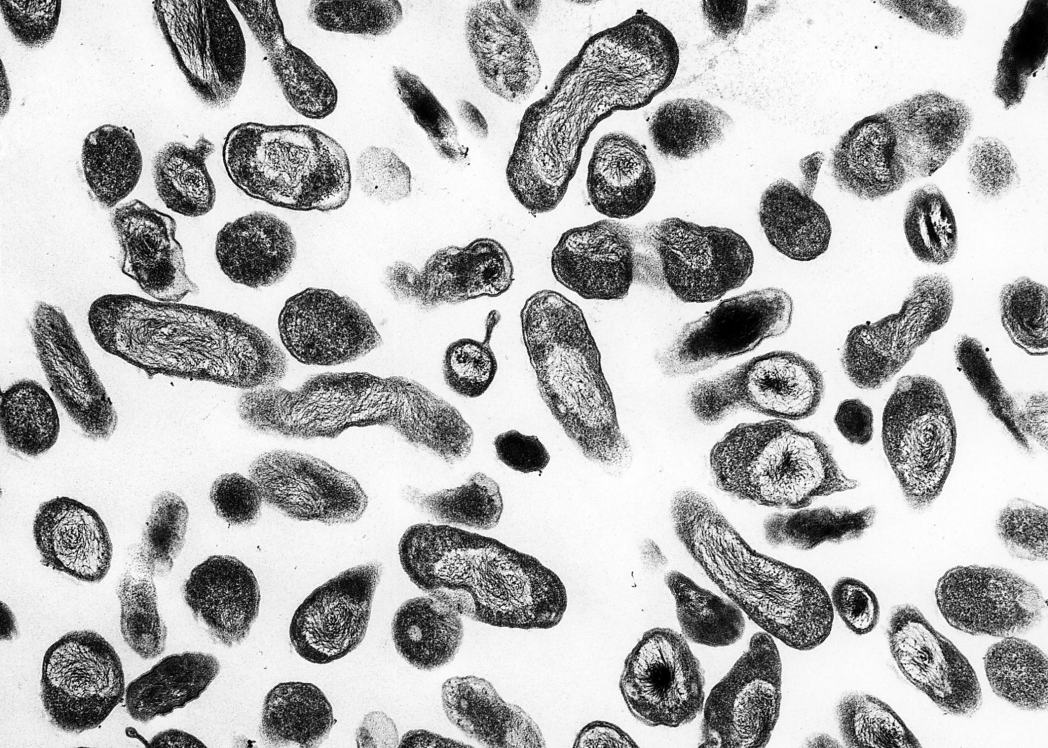
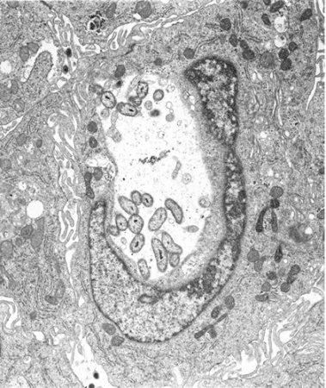
Other Agents of Bioterrorism
Coxiella burnetii
  Rickettsia-like, pleomorphic, coccobacillus
  Causes “Q fever”
  Can grow in common cell lines used in viral tissue culture
Notes:
Of the “other” agents, there is only one bacterium that is considered a having potential for aerosol BT release—Coxiella burnettii. Although other bacteria, such as Salmonella spp., have been used in the past as BT agents, these would be detected by Sentinel laboratories using routine methods and are of sufficient public health concern that a cluster of isolates would be brought to the attention of public health officials. C. burnetii is not likely to be detected by most culture activity in Sentinel laboratories. This is a rickettsia-like organism and is an obligate intracellular parasite. It is a zoonotic disease, but can cause an acute, flu-like disease—Q-fever—in humans, thus its potential as a BT agent. Only laboratories performing cell culture for viruses could recover this organism, but these labs should not try to culture Coxiella.

Slide 4
Other Agents of Bioterrorism
Coxiella burnetii cont.
  Whole blood for serum (acute and convalescent)
  Whole blood (EDTA, citrate) for PCR or culture
  Tissues, body fluids, cell culture
  Send to LRN reference lab for testing by PCR
  Note: This organism is highly infectious!
  BSL-3 laboratory required
Notes:
Instead, as advised by your LRN reference laboratory, these specimens should be collected if there is a suspicion of exposure—acute and convalescent phase sera; whole blood, either EDTA or citrate anticoagulant for PCR or culture; tissue, body fluids, or positive cell culture should be sent to the LRN reference laboratory.

Slide 5
Other Agents of Bioterrorism: Toxins
Ricin, Staphylococcal enterotoxin B (SEB), and Clostridium botulinum

Slide 6

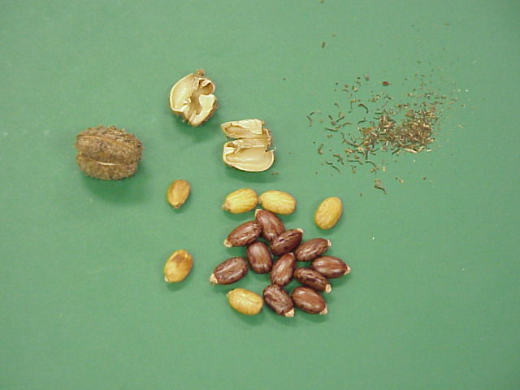
Other Agents of Bioterrorism: Toxins
Ricin
  Collect as per instructions for persons exposed to Chemical Agents
Notes:
Ricin is probably the most notorious terror agent since it has been used to assassinate a political enemy of the old Soviet Union. It is easy to obtain being a protein extract of the castor beans. Aerosol exposure causes weakness, fever, cough, and pulmonary edema within 18-24 hours and severe respiratory distress and death within 36-72 hours. Ricin, however, would have efficacy as a disabling agent. Its use as a food and water contaminant easily could incapacitate many and overwhelm local healthcare resources. Thus, its use as a food and water contaminant is a major concern because of ricin's ease of availability. Treatment is supportive, and no antidote or vaccine is available
For specimen collection it can be considered a chemical agent, and CDC indicates that you should collect specimens from exposed persons following the chemical agent guideline that we’ll talk about shortly.

Slide 7
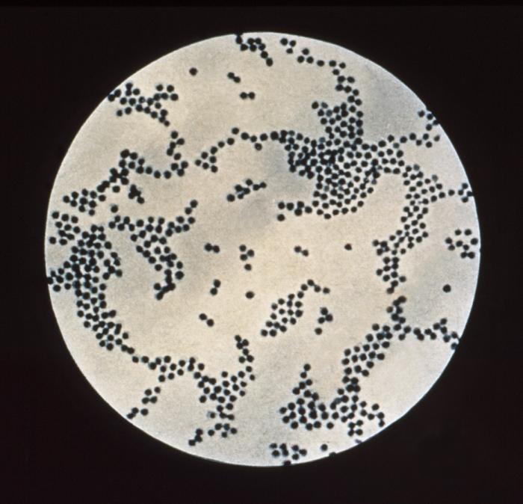
Other Agents of Bioterrorism: Toxins
Staphylococcal enterotoxin B (SEB)
The LRN Reference Laboratories no longer have specific testing available. Contact them for guidance.
  Clinical Specimens
    • Contact your LRN Reference level laboratory for specific guidance prior to specimen collection
  Culture isolate
    • Fresh subculture on agar slant or transport swab
    • Transport at 2 to 8ºC
    • Store at room temperature
Notes:
Staphylococcal enterotoxin B is one of 8 toxins produced by various staphylococci that when ingested act directly on the gastrointestinal tract. When inhaled as an aerosol, as in a terror event, the symptoms can be systemic—multi-organ system failure, shock, and even death, when inhaled in high doses. When inhaled headache, fever, myalgia, nonproductive cough, chills, shortness of breath, and retro-sternal pain can be caused by SEB at low doses via inhalation. Fever may last 2-5 days, and cough may persist for up to 4 weeks.
Death is an unusual outcome, even when inhaled, but lower doses cause 50% high morbidity for up to two weeks that would be a significant outcome in a terror release. Higher exposure to SEB may lead to septic shock and death.
The toxin is difficult to detect in clinical specimens because is does not remain in the system for long. Usually by the time clinical signs and symptoms have begun, toxin can no longer be detected in blood. If other persons are suspected of exposure, but do not show symptoms, collecting serum might yield detectable toxin.

Slide 8
Other Agents of Bioterrorism: Toxins
Staphylococcal enterotoxin B (SEB) cont.
  Food
    • Sentinel laboratories should forward these specimens directly to an LRN Reference or FERN laboratory
    Store and ship @ 2-8°C
  Environmental (non-food)
    • Sentinel facilities should not attempt to collect these samples
    • Contact your designated LRN Reference level laboratory for guidance

Slide 9
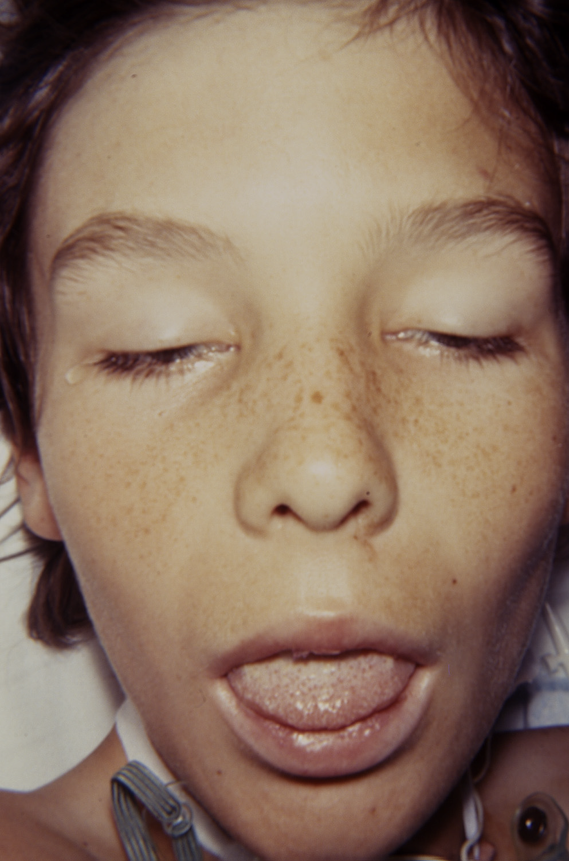
Other Agents of Bioterrorism: Toxins
Clostridium botulinum: Botulism
  The suspicion of botulism is a public health emergency: notify both local public health officials and the state public health laboratory for approval to submit samples for testing. Submit specimens without delay.
  DO NOT attempt to culture, identify the organism, or perform toxin analysis.
Notes:
The most potent toxin is botulinum toxin from Clostridium botulinum. Any suspicion of exposure to this toxin must be acted upon quickly whether or not a terror event is suspected. Release of this toxin in a terror event might be as an aerosol or through direct contamination of food. Symptoms, which may begin 18 to 36 hours after eating a contaminated food, but they can occur as early as 6 hours or as late as 10 days, are similar regardless of route of exposure and intensity is dose-related. A characteristic descending flaccid paralysis is the hallmark feature with progressive drooping eyelids, general facial paralysis, difficulty swallowing and eventually breathing. Mental status is usually normal. The classic symptoms of botulism include double vision, blurred vision, drooping eyelids, slurred speech, difficulty swallowing, dry mouth, and muscle weakness.
Aerosolized botulinum toxin is inhalational botulism. This mode of transmission has been shown effective in primates, has been attempted by bioterrorists, and has been the intended use of biowarfare programs in more than one country.
Since it is the toxin that is either the naturally occurring or terror threat, there is no utility to isolate C. botulinum from a specimen, even if your laboratory has the capability. Detection of the agent and characterization of the toxin will be done at selected Reference and National Reference Laboratories.

Slide 10
Other Agents of Bioterrorism: Toxins
Clostridium botulinum toxin cont.
  Botulism toxins are extremely poisonous.
  Exposure to the toxin represents the primary laboratory hazard.
  All materials suspected of containing toxin must be handled using standard precautions and BSL-2 containment criteria.

Slide 11
Other Agents of Bioterrorism: Toxins
Clostridium botulinum toxin cont.
Collect all specimens prior to treatment with antitoxin.
Note: Treatment should not wait for laboratory confirmation.
  Feces, enema fluid
  Gastric aspirate or vomitus
  Serum
  Tissue or GI contents collected post mortem
  Hold all specimens at 4°C and transport to LRN reference laboratory as soon as possible
Notes:
Here are specimens that would be appropriate to collect from someone possibly exposed to this toxin. This toxin is moderately stable, but specimens should be held a 4°C and sent to the reference laboratory quickly.

Slide 12
Other Agents of Bioterrorism: Toxins
Clostridium botulinum toxin cont.
Specimens – not to be processed by Sentinel Laboratories
    Surface swabs
    Food
    Soil or water
Notes:
As with any of these “other” agents, do not accept or process these types of samples. Refer them directly to the LRN reference laboratory performing the assay.

Slide 13
Other Agents of Bioterrorism
Viruses

Slide 14
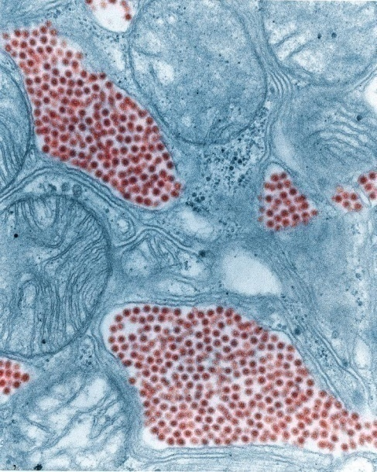
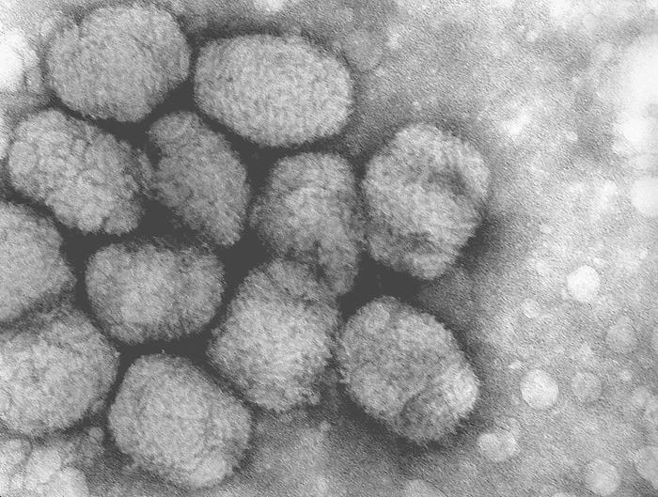
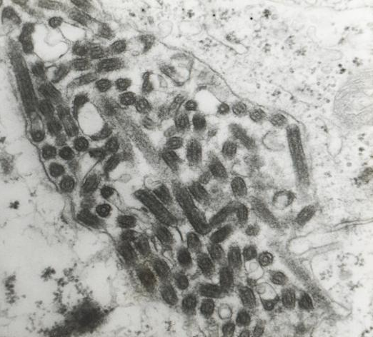
Other Agents of Bioterrorism: Viruses
Variola Virus
    Smallpox
Viral Hemorrhagic Fevers (VHF)
    Ebola
    Yellow Fever
RNA Viruses: Alphavirus
    Chikungunya
    Western Equine Encephalitis (WEE)
    Eastern Equine Encephalitis (EEE)
    Venezuelan Equine Encephalitis (EEE)
Avian influenza (Influenza A H5N1)
Notes:
This is the group—smallpox, the alphavirus, or agents of the equine encephalitis virus, the agents of viral hemorrhagic fever. Exposure of laboratory personnel to these agents is minimized where standard blood borne pathogens precautions are in effect. However, laboratories doing tissue culture must be on alert for cultures showing cytopathic effects, the effect is transmissible, but the causative agent is not identifiable.

Slide 15
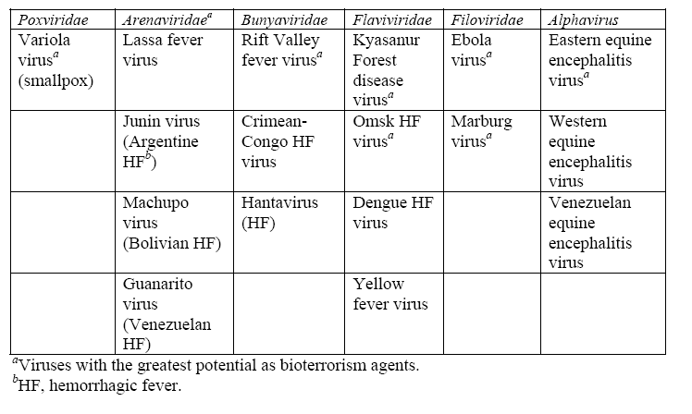
Other Agents of Bioterrorism: Viruses

Slide 16
Other Agents of Bioterrorism: Viruses
Variola Virus: Smallpox
  The physician caring for the patient should use charts on the following slides to determine risk
  Based on that assessment, laboratory testing should be ordered
  Do not culture
    Vesicular material
    Scab
    Lesion biopsy
    Whole blood for serum
Notes:
The challenge for the clinical laboratory would be the need to rule out other viruses causing similar disease—the herpes virus. Action taken by the sentinel lab should be made in close consultation with the clinical staff using the risk assessment guidelines developed by CDC. Consultation should also be made with the Reference Lab and CDC if there is a high index of suspicion.

Slide 17
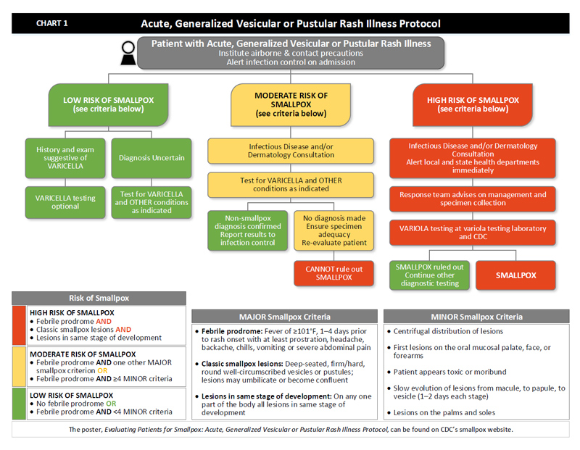

Slide 18
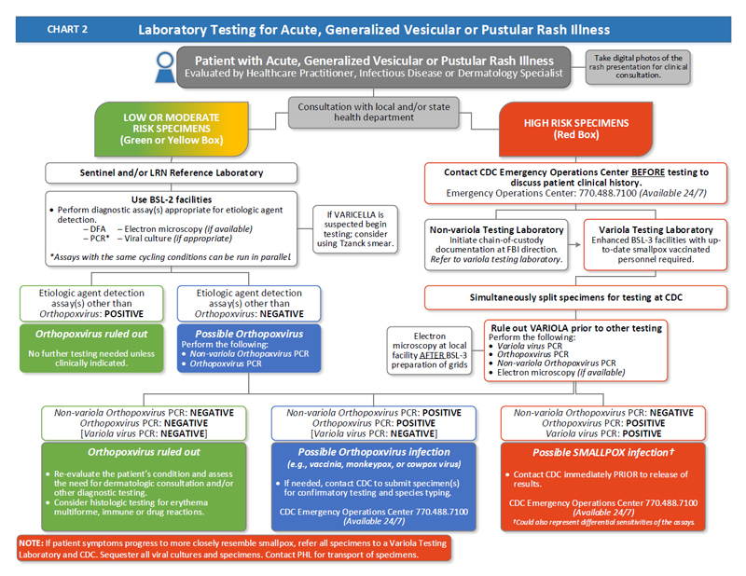

Slide 19
Other Agents of Bioterrorism: Viruses
Viral Hemorrhagic Fevers (VHF)
  Ebola
  Yellow Fever
Do not culture
Whole blood for serum – acute and convalescent (≤ 14 days)
Tissue for Immunohistochemistry (IHC) – formalin-fixed or in paraffin block: lung, spleen, kidney
PCR – buffy coat, clotted blood, fresh tissue

Slide 20
Other Agents of Bioterrorism: Viruses
RNA Viruses: Alphavirus
  Chikungunya
  Western Equine Encephalitis (WEE)
  Eastern Equine Encephalitis (EEE)
  Venezuelan Equine Encephalitis (EEE)
Do not culture
  Whole blood for serum (acute and convalescent)
  Whole blood (EDTA, citrate) for PCR or culture
  CSF
  Tissue, body fluids, cell culture material

Slide 21
Other Agents of Bioterrorism: Viruses
Novel Influenza Viruses
  Respiratory (throat, nasopharyngeal, BAL, tracheal)
  Whole blood for serum (acute and convalescent)
  Cell culture material
  Rapid Tests – discouraged due to poor specificity and sensitivity for some viruses. Perform in a BSC.
Note: Avian influenza (Influenza A H5N1) – do not culture unless using enhanced BSL-3 laboratory conditions.

Slide 22
Other Agents of Bioterrorism
Chemicals

Slide 23
Other Agents of Bioterrorism: Chemicals
Collect Specimens
  Advise clinical staff in prompt collection and transport of specimens from those exposed or possibly exposed
  Follow the Chemical Terrorism Event Specimen Collection Guidelines
Specimens Collected from People Potentially Exposed to Chemical Terrorism Agents (8/2016)
  Shipping Instructions for Blood Specimens https://emergency.cdc.gov/labissues/pdf/chemspecimenshipping-blood1.pdf
  Shipping Instructions for Urine Specimens https://emergency.cdc.gov/labissues/pdf/chemspecimenshipping-urine1.pdf

Slide 24
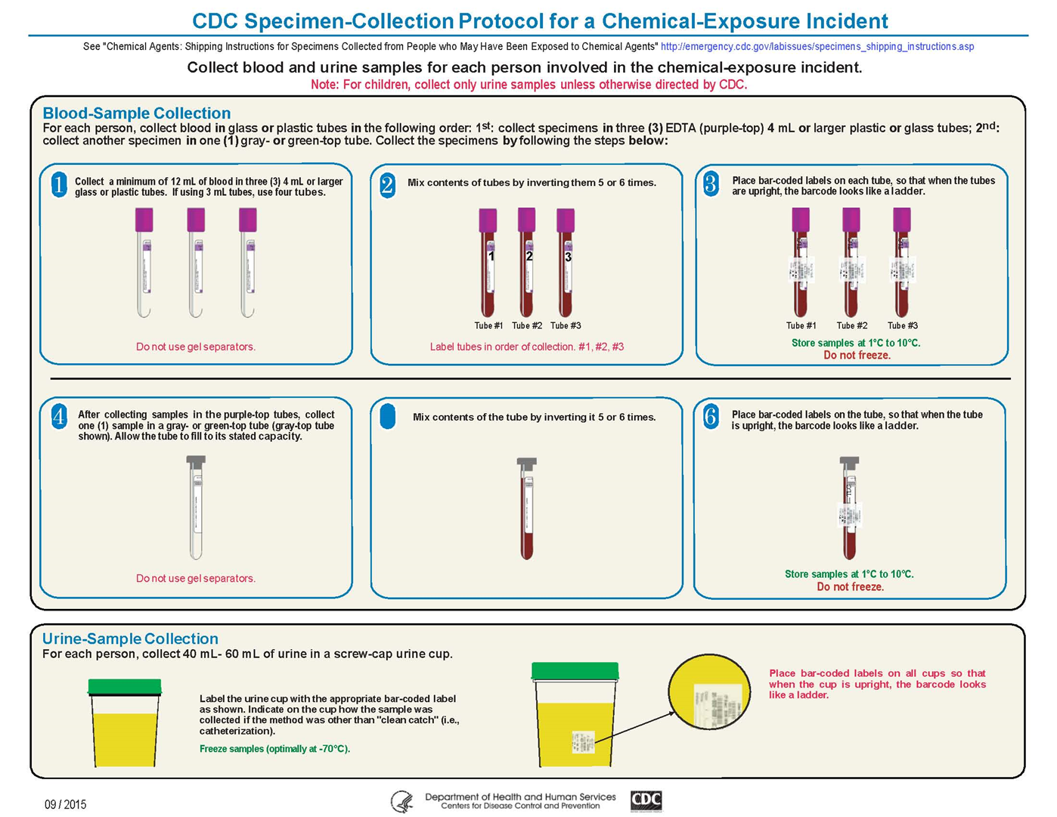
Other Agents—Chemicals

Slide 25
CONTACT YOUR LRN
reference laboratory

