Slide 1
Agents of Bioterrorism
Burkholderia pseudomallei: Melioidosis

Slide 2
Sentinel Laboratory Procedures for Burkholderia pseudomallei
Gram stain morphology
  Straight or slightly curved, Gram negative bacilli
  No particular arrangement – some smooth strains show bundling
  May demonstrate bipolar morphology in direct specimens
Notes:
straight, or slightly curved gram-negative bacilli; may demonstrate bipolar morphology in direct specimens.

Slide 3
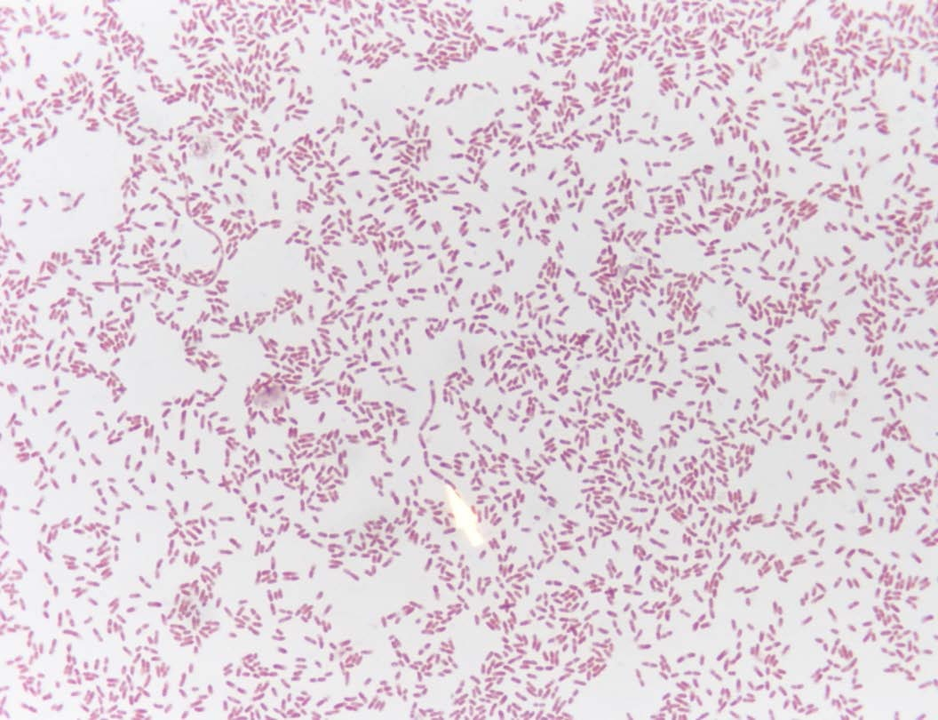
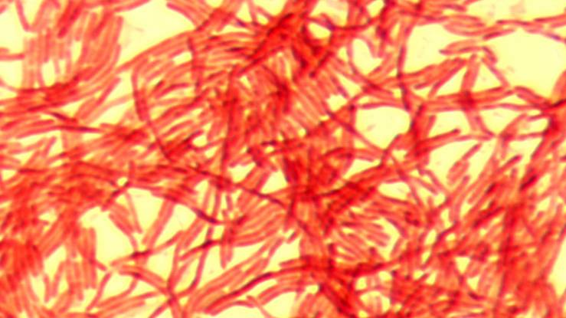
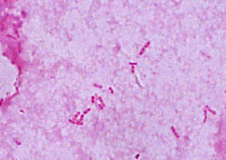
Sentinel Laboratory Procedures for Burkholderia pseudomallei
Gram stain B. pseudomallei
Notes:
B. pseudomallei is a gram-negative rod 1-3 μm in length and < 2 μm in width. Bipolar staining, resembling a safety pin, is common and arises from intracellular depots of β-hydroxybutyric acid. Smooth form appears as long parallel bundles that resemble filaments. Rough form appears more irregularly arranged. Cells from young culture often show bipolar staining. As cultures age, cells become rounder with stain at the periphery and may be mistaken for endospores.

Slide 4
Sentinel Laboratory Procedures for Burkholderia pseudomallei
Culture Characteristics
  Grows on BAP, CHOC, and MAC/EMB @ 35°C
  Mature colonies at 48 to 72 hrs
  Colonies become rough and wrinkled with time
  Growth at 42°C
Notes:
NOTE: Pseudomonas cepacia (PC) agar is recommended for the isolation of B. cepacia from respiratory secretions of patients with cystic fibrosis. This agar helps by inhibiting the growth of Pseudomonas aeruginosa and other respiratory pathogens.
B. mallei grows slower on PC agar with small colorless or white colonies at 48 to 72 h.
B. pseudomallei grows large white colonies at 24 h, media changes from dull yellow to bright pink.

Slide 5
Sentinel Laboratory Procedures for Burkholderia pseudomallei
Culture on BAP at 35°C
  Mature growth at 48 hrs
  Grey glistening colonies, some strains appear slightly tan
  non-hemolytic

Slide 6
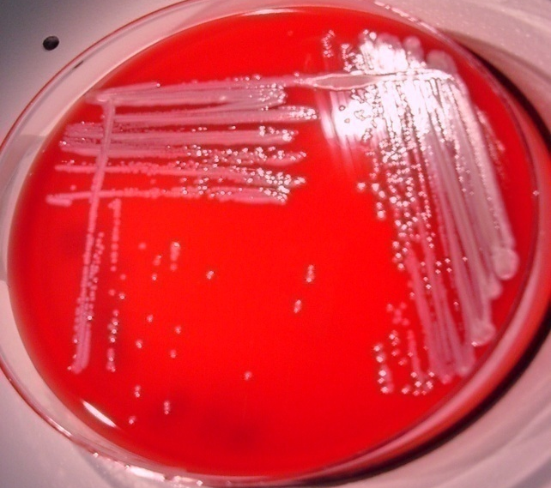
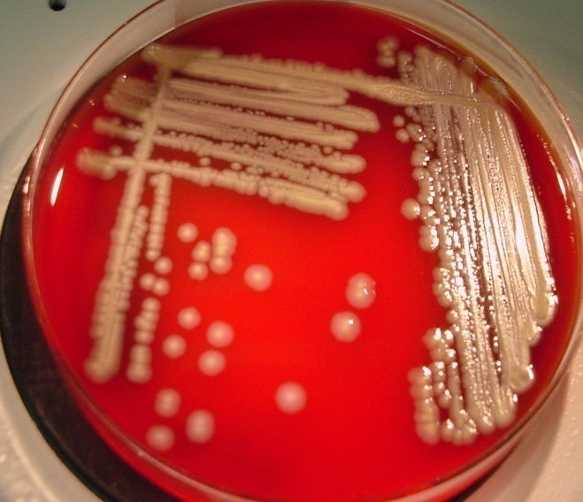
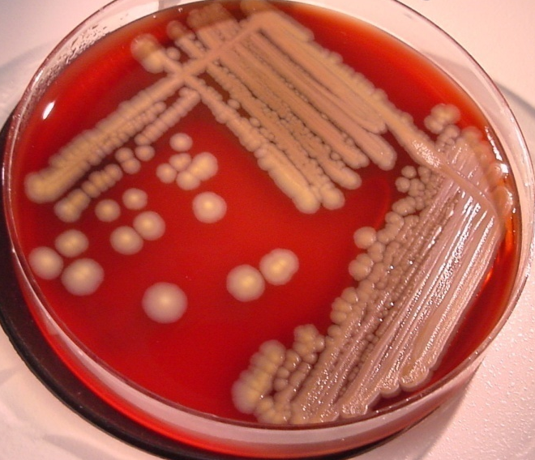
Sentinel Laboratory Procedures for Burkholderia pseudomallei
24 hrs
48 hrs
72 hrs
Notes:
B. pseudomallei produces small smooth whitish colonies within 24 h at 37°C. After 48-72 h some may be mucoid and dry and wrinkled. Some colonies take on a metallic sheen. They produce a characteristic earthy odor on plated media after 48 h of incubation. However, Do NOT sniff plates. They may show a diffuse lysis of red blood cells extending out from heavy growth with no action by individual colonies. Thus they are considered non-hemolytic. A metallic sheen may be produced on growth on BAP, Choc after 48 hrs.

Slide 7
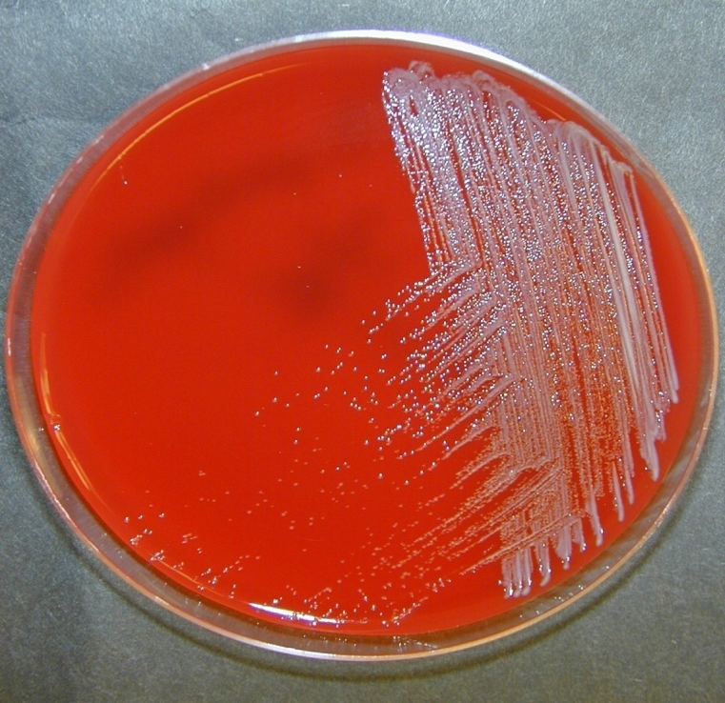
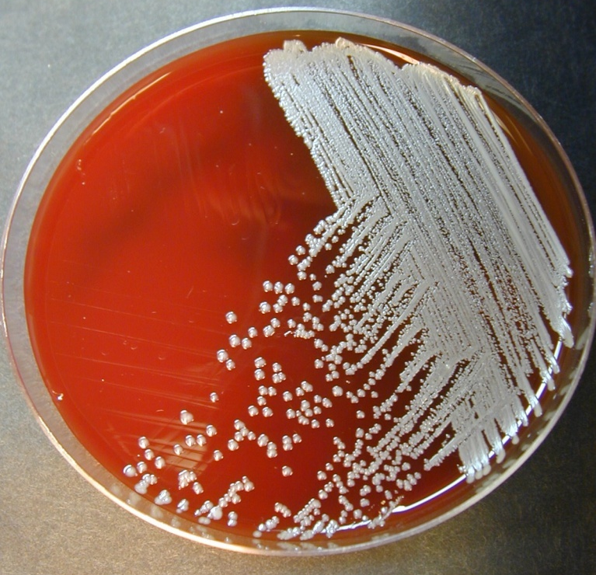
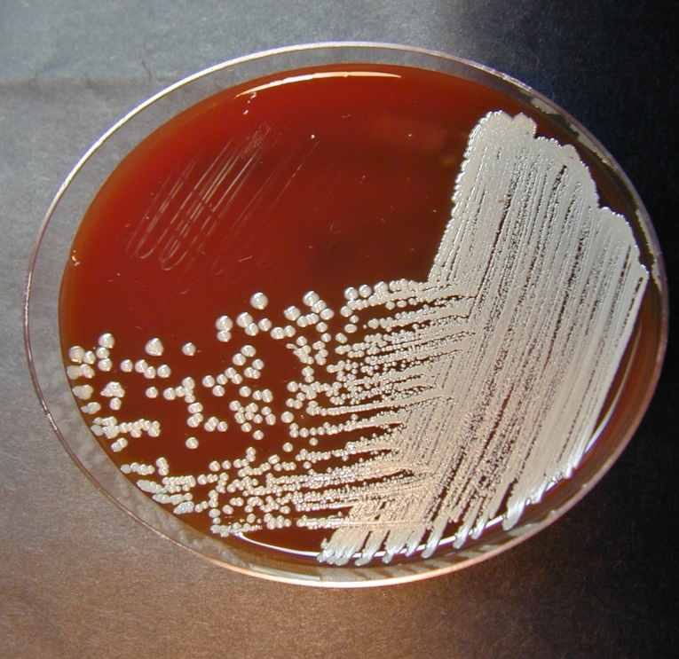
Sentinel Laboratory Procedures for Burkholderia pseudomallei
24h
48h
72h

Slide 8
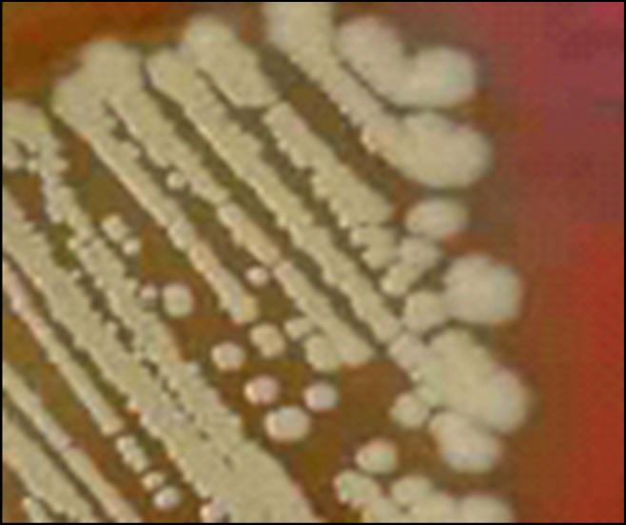
Sentinel Laboratory Procedures for Burkholderia pseudomallei
B. pseudomallei on BAP after 72 hrs @35°C
72 hrs

Slide 9
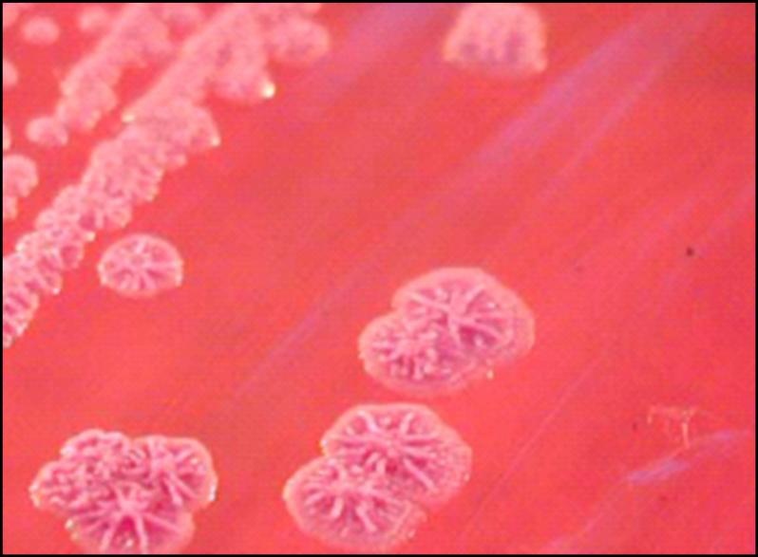
Sentinel Laboratory Procedures for Burkholderia pseudomallei
B. pseudomallei on BAP after >72 hrs @35°C
Notes:
Ageing colonies on BAP take on the markedly wrinkled surface, similar to that seen with Pseudomonas stutzeri.

Slide 10
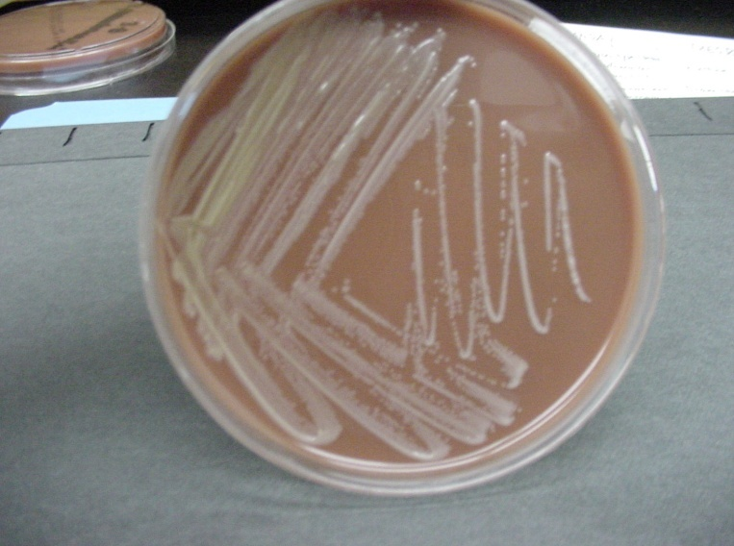
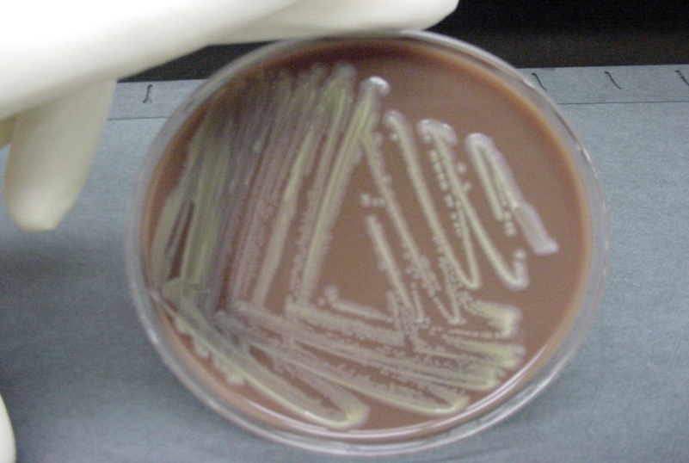
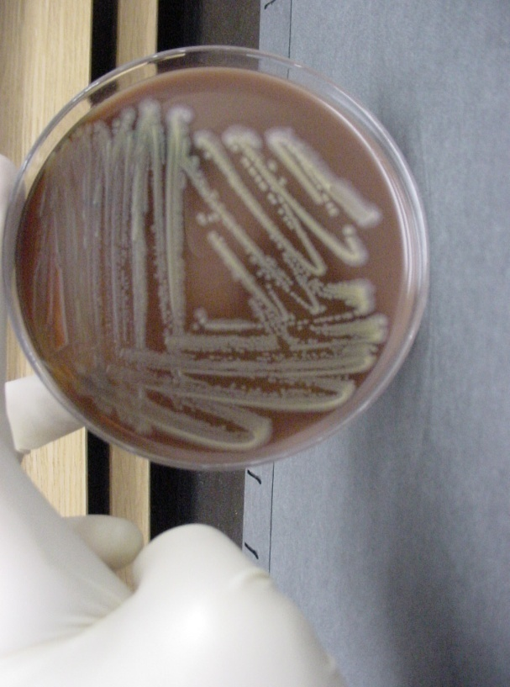
Sentinel Laboratory Procedures for Burkholderia pseudomallei
Culture on CHOC at 35°C
  -Burkholderia pseudomallei – mature growth at 24 hrs
24 hrs
48 hrs
72 hrs

Slide 11
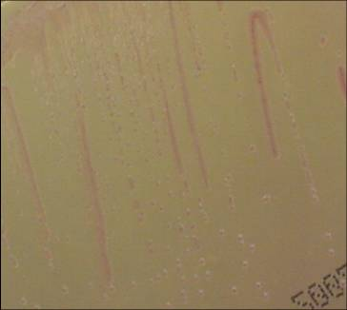
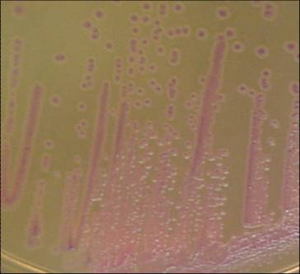
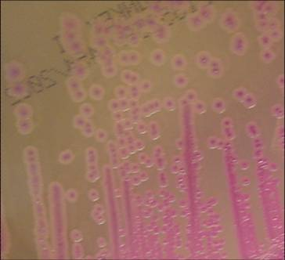
Sentinel Laboratory Procedures for Burkholderia pseudomallei
Culture on MAC at 35°C
  -Slow growth, producing colorless colonies with slight pink centers at 72 hrs
24 h
48 h
72 h
Notes:
B. mallei either do not grow on MAC or will only grow a few colonies visible after 48-72 h. The streaks seen here are just from the inoculating loop-there is little to no growth visible.
B. pseudomallei grow easily on MAC, developing small, clear or slightly pink colonies by 48 hrs.

Slide 12
Sentinel Laboratory Procedures for Burkholderia pseudomallei
  Screening Tests
    Oxidase
    Indole
    Colistin resistance
    Susceptibility – Not for treatment – only for ID
      Amoxicillin-clavulanate (most strains are susceptible but resistance cannot rule out the identification)
      Penicillin
    Catalase (perform if not growing well on MAC - not on flow chart)
Notes:
Catalase – is positive for both species. It is not on the flowchart for B. pseudomallei because it usually grows well on MAC.

Slide 13
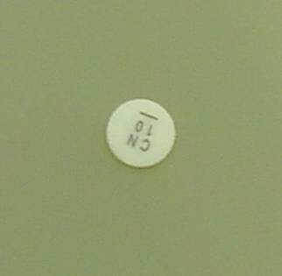
Sentinel Laboratory Procedures for Burkholderia pseudomallei
  Resistance to colistin using disc diffusion
Notes:
Although Sentinel laboratories should not perform susceptibility tests on these organisms, a disk diffusion assay to screen for resistance to colistin can be useful. Care must be used in performing this assay since the process of preparing the inoculum will likely generate an aerosol. If possible, perform the set up in a biological safety cabinet.

Slide 14
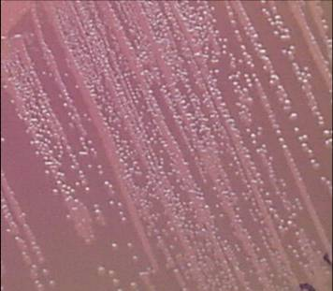
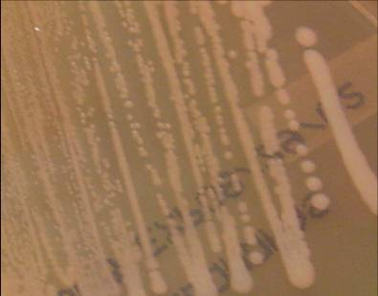
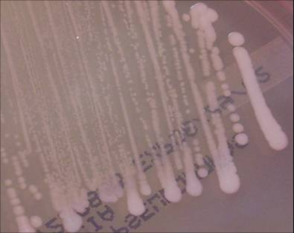
Sentinel Laboratory Procedures for Burkholderia pseudomallei
Burkholderia pseudomallei resistance to polymyxin B using PC agar @ 35°C
-can also use B. cepacia agar
24 h
48 h
72 h
Notes:
Pseudomonas cepacia (PC) agar is recommended for the isolation of B. cepacia from respiratory secretions of patients with cystic fibrosis. This agar helps by inhibiting the growth of Pseudomonas aeruginosa and other respiratory pathogens.
B. mallei grows slower on PC agar with small colorless or white colonies at 48 to 72 h.
B. pseudomallei grows large white colonies at 24 h, media changes from dull yellow to bright pink.

Slide 15
Sentinel Laboratory Procedures for Burkholderia pseudomallei
  Screening Tests Results:
    Oxidase - positive
    Spot Indole - negative
    Colistin resistance – no zone or growth B. cepacia select agars
    Growth at 42°C
    Susceptibility – Most are susceptible to Amoxicillin-clavulanate acid but resistance cannot rule out the identification; resistant to penicillin
Notes:
Catalase - positive

Slide 16
Additional screening to increase identification specificity, if available:
  >99% are amoxicillin-clavulanate susceptible
  Motility positive
  Grows at 42°C
  Glucose oxidizer
  Arginine-positive, lysine and ornithine negative
The above biochemical reactions can be evaluated from the API 20E, if the laboratory has no system specific for glucose non-fermenting organisms. If any identification system is not incubated for 48 h or a heavy inoculum used, the arginine can be negative, leading to misidentifications. http://www.asm.org/images/PSAB/Burkholderia50713.pdf
Notes:
CHANGE ?

Slide 17
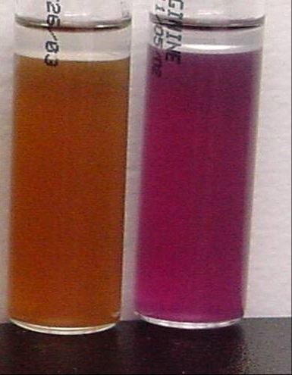
Sentinel Laboratory Procedures for Burkholderia Pseudomallei
Optional screening tests: arginine dihydrolase
B. pseudomallei is positive
Decarboxylase base: B. pseudomallei
Decarboxylase base w/ arginine : B. pseudomallei
1 2
Notes:
This test will distinguish between Burkholderia spp. (+) and Pseudomonas stutzeri.
Organisms growing in the base will turn the broth yellow due to acid produced by metabolism of the available glucose. Those organisms capable of decarboxylating the arginine present will produce alkaline amine byproducts that will eventually shift the pH to alkaline causing the indicator color change to purple. Actually the decarboxylation of the arginine begins with a hydroxylation of the amino acid producing ornithine, which is then decarboxylated to putrescine. Both strains of Burkholderia are arginine positive.

Slide 18
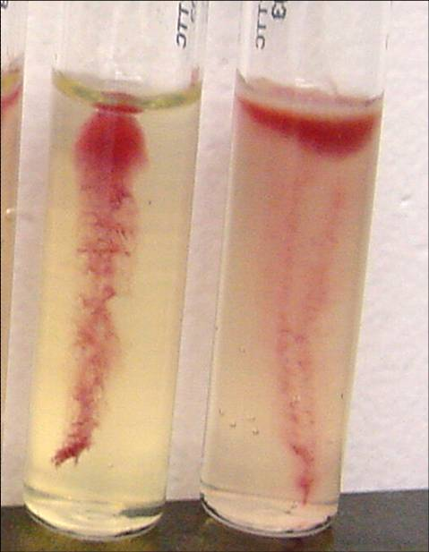
Sentinel Laboratory Procedures for Burkholderia pseudomallei
Optional screening tests : Motility
NEGATIVE
POSITIVE
Burkholderia
pseudomallei

Slide 19
Burkholderia Comparison Chart
 | B. pseudomallei | B. mallei
Gram stain | Small, straight or slightly curved Gram negative bacilli | Small, straight or slightly curved Gram negative coccobacillus
BAP Colony morphology | Smooth, creamy and white after 24 hours incubation; metallic sheen at 48 hrs; may become dry and wrinkled after 48 hrs. | Smooth, gray, translucent only after 48 hours incubation
Oxidase | Positive | Variable
Indole | Negative | Negative
Growth at 42ºC in 48 hrs | Growth | No Growth
Motility | Positive | Negative
Musty/earthy odor | Yes | No
Catalase | Positive | Positive

Slide 20
Sentinel Laboratory Procedures for Burkholderia spp.
Similar organisms:
Burkholderia cepacia
Burkholderia gladioli
Burkholderia thailandensis
Pseudomonas mendocina
Pseudomonas stutzeri
Ralstonia picketii
Stenotrophomonas maltophilia
Acinetobacter spp.

Slide 21
Major characteristics of Burkholderia pseudomallei:
Gram stain morphology: Gram negative bacilli, straight or slightly curved, may demonstrate bipolar morphology at 24 h and peripheral staining, like endospores, when cultures are older
Colony morphology: Poor growth at 24 hrs; good growth of smooth, creamy colonies at 48 hrs on BAP; may develop metallic sheen at 48 hrs and wrinkled colonies in time; non-hemolytic; may have non-violet pigment. No pigment on Mueller-Hinton agar. Often demonstrates strong characteristic musty, earthy odor; growth on MAC/EMB in 48 hrs.
Reactions: Oxidase positive; indole negative
Burkholderia pseudomallei
Identification Flowchart
Yes
No
Rule out other agents such as Burkholderia mallei, Brucella and Francisella
Growth on MAC/EMB?
Yes
SAFETY: As soon as Burkholderia is suspected, perform ALL further work in a Class II Biological Safety Cabinet using BSL-3 practices. If Burkholderia cannot be ruled out with tests below, do not attempt further ID using commercial automated or kit identification systems.
Oxidase positive and indole negative?
No
Not Burkholderia
Yes
Polymyxin B or colistin; no zone or growth on B cepacia selective agars
No
Not Burkholderia
Yes
No hemolysis on BAP; no violet pigment
No
Consider Chromobacterium violaceum or indole-negative Vibrio spp.
Yes
B. pseudomallei NOT ruled out, especially if colonies have musty odor.
Contact your LRN reference laboratory to refer isolate.
Place Reference Lab Contact Information Here
Report: Possible Burkholderia pseudomallei submitted to LRN reference laboratory for confirmatory testing.
Additional screening tests: B. pseudomallei is arginine positive, unlike other Burkholderia (test can be in kit identification systems). B. pseudomallei is separated from B. cepacia by a susceptible amoxicillin-clavulanate test. Although rare in B. pseudomallei, resistance cannot rule out the identification.

Slide 22
Sentinel Laboratory Procedures for Burkholderia pseudomallei
IF YOU SEE:
  Gram negative bacilli that may demonstrate bipolar staining
  Characteristic slow to moderate growth on BAP and MAC
  Oxidase positive, indole negative
  Resistant to polymyxin B or colistin or growing on Selective agar
  And you cannot rule out Burkholderia pseudomallei using the protocol flow chart…….

Slide 23
CONTACT YOUR LRN
reference laboratory

