Slide 1
Agents of Bioterrorism
Burkholderia species Introduction
Burkholderia mallei: Glanders

Slide 2
Burkholderia spp. Safety Alert
These are dangerous, highly virulent organisms and should not be manipulated on an open bench. Laboratory-acquired infections can occur.

Slide 3
Working Safely with Burkholderia spp. in the Laboratory
Remember—laboratory infections have been reported
  Laboratory-Acquired Human Glanders --- Maryland, May 2000 MMWR Vol. 49 (24):532 06/23/2000
  Laboratory Exposure to Burkholderia pseudomallei---Los Angeles, California, 2003 MMWR Vol. 53 (42):988 10/29/2004
Initial processing of diagnostic specimens where B. mallei or B. pseudomallei are suspected—use BSC (Class II) and follow BSL-2 practices
All manipulations of cultures including test procedures require the use of biological safety level BSL-3 or BSL-2 with BSL-3 precautions.
Notes:
Here is the important safety information for working with these organisms. Laboratory-acquired infections have been reported. Because the two primary routes of transmission for these organisms is inhalation and mucous membrane contact it is recommended that the initial processing of the specimens be done in a class II biological safety cabinet using BSL-2 practices and hopefully your sentinel and clinical labs are doing this.

Slide 4
Why Burkholderia?
Both have been “weaponized”
B. mallei and B. pseudomallei highly infectious as aerosol
No vaccine
Classified as Tier 1 biological threat agents
  Are moderately easy to disseminate
  Mortality rate for untreated glanders (B. mallei) is high.
  B. pseudomallei has a low infectious dose.
  Due to rarity of both diseases in the US experience in diagnosis and treatment is limited. Require special diagnostic capacity and enhanced disease surveillance
Notes:
So why do we talk about Burkholderia? Currently, there are three species of Burkholderia that are considered human pathogens: B. mallei, B. pseudomallei and the B. cepacia complex. B. mallei and B. pseudomallei are also considered possible bioterror agents because:
Both of these organisms have been weaponized. And actually, Glanders, B. mallei, has been used as a biological terror agent. Back in World War I and II and even in Afghanistan it was thought the Soviets had used it to disable the horses and other animals and therefore slow down the troops.
B. mallei can be easily produced in large quantity and transmitted via the aerosol route. In addition, the mortality rate for untreated cases of glanders is high, and given the rarity of this disease in the United States, experience in the diagnosis and treatment is limited.
B. pseudomallei is not endemic in the United States, B. pseudomallei has a low infectious dose, B. pseudomallei possesses robust environmental stability, and timely diagnosis may be complicated because of the rareness of disease in the United States. B. pseudomallei
is not extensively endemic in the United States.
There is no human vaccine for these diseases.
These organisms have been classified as Tier 1 terror agents by CDC/APHIS because these biological agents and toxins present the greatest risk of deliberate misuse with significant potential for mass casualties or devastating effect to the economy, critical infrastructure, or public confidence, and pose a severe threat to public health and safety.
They are relatively easy to disseminate. Second, these two organisms really would be very bad if they are released as biological terror agents because the progression to severe disease is very slow and there is nothing characteristic diagnostically that would make you recognize them such as a widening mediastinum which makes you think of anthrax. Third, they look like many other diseases so it would be a challenge for a hospital to make diagnostic assessment and they require specialized testing capability in order to identify them. Finally, treatment requires patients to be in the hospital for IV antibiotics.
To sum it up, either one of these organisms would be very effective as a biological terror agent.

Slide 5
Disease Caused by Burkholderia
General symptoms - fever, malaise, muscle aches, chest pain, weight loss, night sweats, headache
Nothing distinctive or characteristic – patient history, especially travel history, is very important
Bacteria considered in differential diagnoses: Mycobacterium tuberculosis, Yersinia spp., Brucella spp.
Notes:
Disease caused by both of these organisms appears to be very broad with general flu-like symptoms such as fever, malaise, and muscle aches. But it tends to go on a little bit longer and might bring the patient into the emergency room. There is nothing that stands out so the patient history is critical to helping diagnose the disease. If you look at MMWR cases in the USA for the last ten years almost always it has b been imported due to travel. So it is very important that if a physician or one of your sentinel labs suspects one of these organisms that you get a patient history.
Other bacteria that you need to rule out due to the similarity of the symptoms and diseases are Mycobacteria tuberculosis, Yersinia spp. especially Y. entercolitica and Y. pseudotuberculosis, and Brucella spp.
.

Slide 6
Burkholderia mallei
Zoonotic agent—causes glanders in equids, humans and other mammals
  Glanders - infection through abrasions of skin, penetrating wounds, mucous membrane contact, inhalation, ingestion
  incubation 1-14 days
    Cutaneous - lesions with localized lymphadenopathy
    Systemic - pneumonia with or without bacteremia, bacteremia may result in lesions in liver or spleen
Enzootic in North Africa, Middle East, Turkey, Central and South America, Asia
Risk factors where enzootic—horse caretakers, veterinarians, slaughterhouse workers
Risk factor in this country--laboratorian
Notes:
Burkholderia mallei causes Glanders primarily in equids—horses, donkeys, mules—but also in other mammals such as camels, goats, dogs, and cats. Human infection is rare and is associated with close contact with infected animals.
It is a rare disease even among animals but is still enzootic in parts of North Africa, the Middle East, Turkey, Central and South America, and Asia. It has not been seen naturally in the United States since the 1940’s following years of monitoring herds and screening with mallein (B. mallei antigen) and destroying infected animals and animals showing exposure by reacting with the antigen.
Where these organisms are found, people who take care of these animals or anyone who comes in contact with diseased animals such as veterinarians and slaughter house workers, is at a higher risk.
In the United States the most important risk factor is being a laboratory scientist working with cultures of B. mallei.

Slide 7
Burkholderia pseudomallei
Soil and ground water saprophyte--etiologic agent of melioidosis
  Melioidosis (B. pseudomallei) – a glanders-like disease, infection through abrasions of skin, penetrating wounds, mucous membrane contact, inhalation, ingestion
  Incubation 2-5 days, months, years (can reoccur years later)
Endemic in Southeast Asia and northern Australia, Central America
Risk factors where endemic—diabetes, alcoholism, renal impairment, penetrating wounds
Risk factor in this country--laboratorian
Notes:
B. pseudomallei, like most Burkholderia species, is an environmental saprophyte that can be found in soil and ground water. It could cause disease in animals but that’s not really the concern. The concern is that it is found in ground water and it is believed that infection follows contact with contaminated ground water through puncture wounds, cuts or abrasions of the skin, and from contact with mucous membranes.
It is endemic in tropical and subtropical regions of Southeast Asia, northern Australia, and Central America. It causes a lot of disease in these areas. It is a big problem.
Risk factors where it is endemic are people who are immunocompromised due to underlying diseases such as diabetes, alcoholism, renal impairment. Also, anyone who has any kind of penetrating wounds and abrasions and comes in contact with contaminated soil or water.
Again, as will the B. mallei, the most important risk factor for someone in this country is being a laboratorian.

Slide 8

Sentinel Laboratory Procedures for Burkholderia spp.
In a Sentinel Laboratory, you could encounter these organisms in:
  Bone marrow or whole blood
  Sputum or bronchoscopically obtained specimans
  Tissue Specimens (biopsies, abscess aspirates ) and wound swab
  Urine
Notes:
.

Slide 9
Sentinel Laboratory Procedures for Burkholderia spp.
    Gram stain
    Culture characteristics
    Hemolysis
    Oxidase
    Catalase
    Indole
    Polymyxin B or Colistin resistance
    Motility
    Growth at 42°C
    Susceptibility - Amoxicillin-clavulanate , Penicillin

Slide 10
Burkholderia mallei
GLANDERS

Slide 11
Sentinel Laboratory Procedures for Burkholderia mallei
Gram stain morphology
Small, straight or slightly curved Gram-negative coccobacilli
Cells are arranged in pairs, parallel bundles, or Chinese-letter form

Slide 12
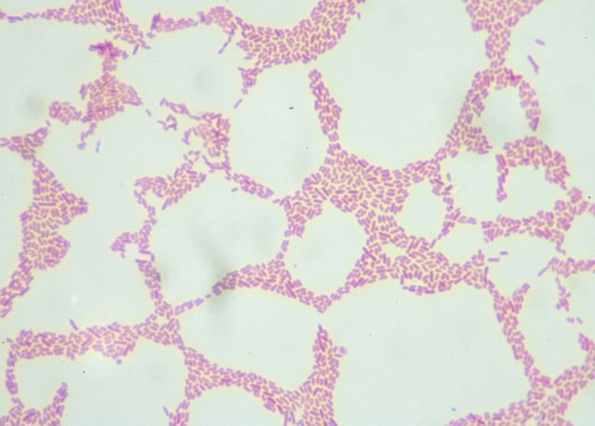
Sentinel Laboratory Procedures for Burkholderia mallei
Gram stain B. mallei
Notes:
B. mallei is a gram negative coccobacilli or occasional long bacillus, 1-3 μm in length and 0.3-0.5 μm in width. Faintly staining with straight or slightly curved ends and irregularly parallel or wavy sides. Cells can be arranged in pairs end-to-end, in parallel bundles, or in Chinese letter form.

Slide 13
Sentinel Laboratory Procedures for Burkholderia mallei
Culture Characteristics
  Grows on BAP and CHOC, but not generally on MAC/EMB, @ 35°C
  Mature (small) colonies at 72 hrs
  Smooth, gray, translucent colonies, non-hemolytic
  B. mallei will not grow at 42°C on BAP by 48 hrs., compare with growth at 35°C
Notes:
NOTE: Pseudomonas cepacia (PC) agar is recommended for the isolation of B. cepacia from respiratory secretions of patients with cystic fibrosis. This agar helps by inhibiting the growth of Pseudomonas aeruginosa and other respiratory pathogens.
B. mallei grows slower on PC agar with small colorless or white colonies at 48 to 72 h.
B. pseudomallei grows large white colonies at 24 h, media changes from dull yellow to bright pink.
smooth, gray, translucent colonies in 2 days, without pigment or distinctive odor

Slide 14
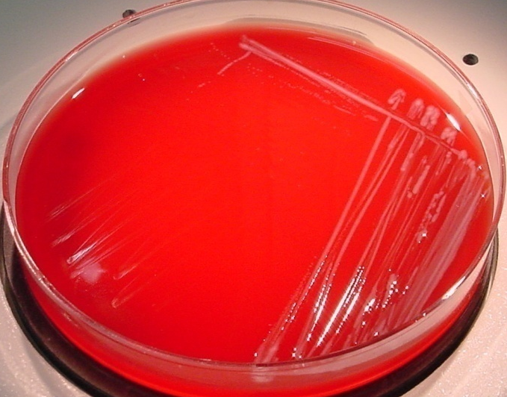
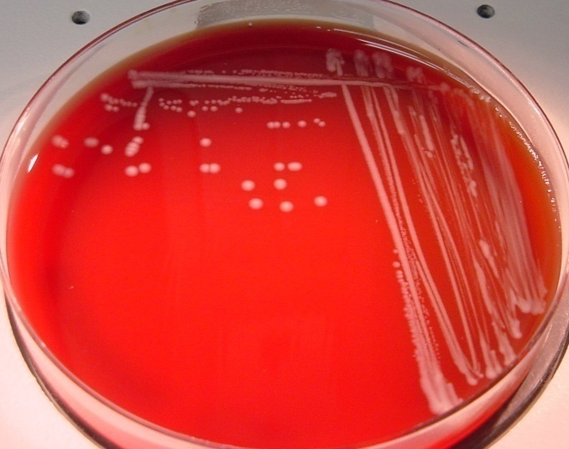
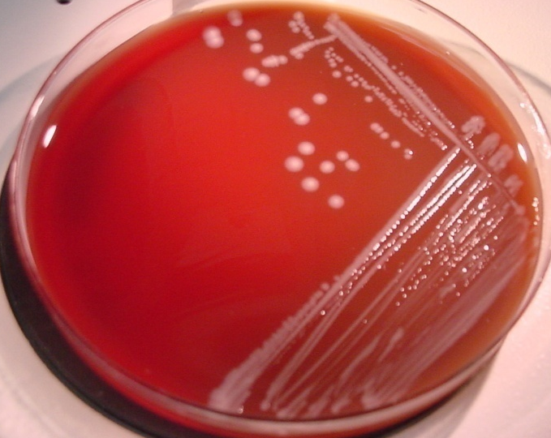
Sentinel Laboratory Procedures for Burkholderia mallei
24 hrs
48 hrs
72 hrs
Notes:
Burkholderia mallei – very small, gray translucent colonies

Slide 15
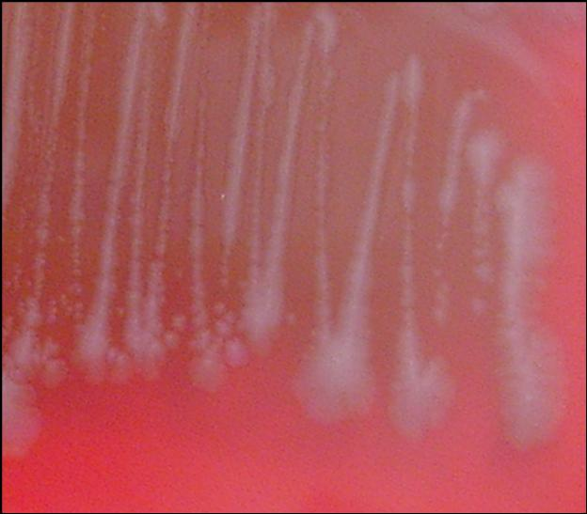
Sentinel Laboratory Procedures for Burkholderia mallei
B. mallei on BAP after 72 hrs @35°C
72 hrs

Slide 16
Sentinel Laboratory Procedures for Burkholderia mallei
Culture on CHOC at 35°C
  Burkholderia mallei – slow growth, mature colonies by 48 to 72 hrs

Slide 17
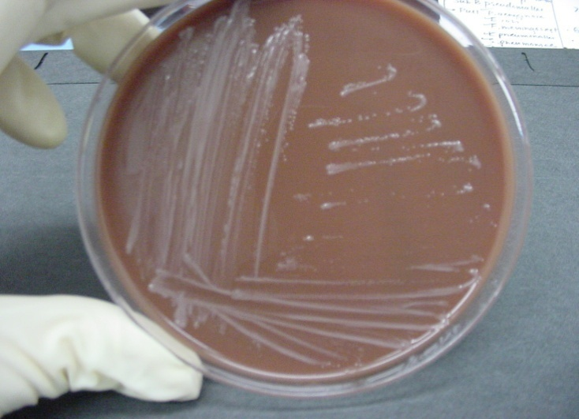
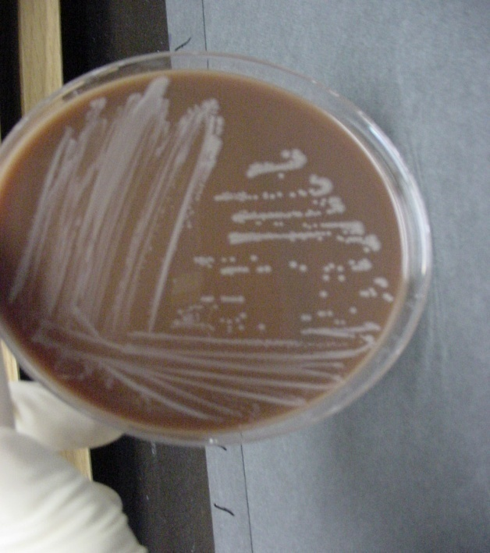
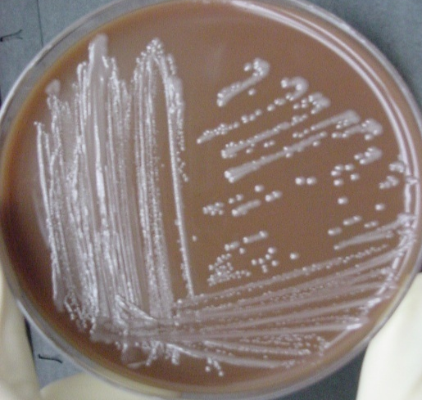
Sentinel Laboratory Procedures for Burkholderia mallei
Burkholderia mallei
on chocolate agar @ 35°C
24 hrs
48 hrs
72 hrs
Notes:
Both organisms grow well on CHOC agar.

Slide 18
Sentinel Laboratory Procedures for Burkholderia mallei
Culture on MAC at 35°C
  -Burkholderia mallei – no growth, or very
  small @ 72 hrs

Slide 19
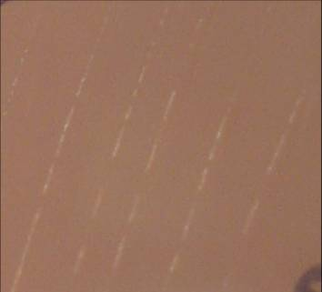

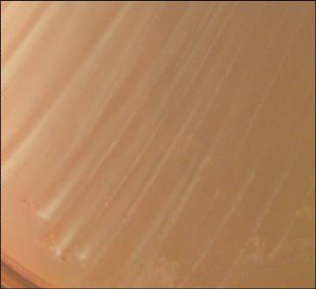
Sentinel Laboratory Procedures for Burkholderia mallei
Burkholderia mallei
on MacConkey agar @ 35°C
24 hrs
48 hrs
72 hrs
Notes:
B. mallei either do not grow on MAC or will only grow a few colonies visible after 48-72 h. The streaks seen here are just from the inoculating loop-there is little to no growth visible.
B. pseudomallei grow easily on MAC, developing small, clear or slightly pink colonies by 48 hrs.

Slide 20
Sentinel Laboratory Procedures for Burkholderia mallei
  Screening Tests
    Oxidase
    Catalase
    Spot indole
    Colistin resistance
    Motility – using medium with TTC
    Susceptibility - Amoxicillin-clavulanate, Penicillin

Slide 21
Sentinel Laboratory Procedures for Burkholderia mallei
Resistance to colistin
    Using KB disk diffusion assay
    Zone / no zone on BAP, Chocolate, or Mueller-Hinton
    Growth / no growth on: PC agar, BC agar (without gentamicin),Thayer-Martin agar
Notes:
Although Sentinel laboratories should not perform susceptibility tests on these organisms, a disk diffusion assay to screen for resistance to colistin can be useful. Care must be used in performing this assay since the process of preparing the inoculum will likely generate an aerosol. If possible, perform the set up in a biological safety cabinet.

Slide 22
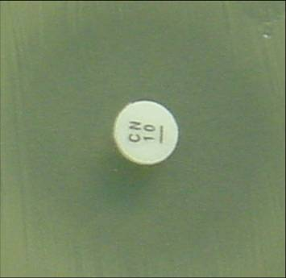
Sentinel Laboratory Procedures for Burkholderia mallei
Resistance to colistin using disc diffusion
Notes:
Although Sentinel laboratories should not perform susceptibility tests on these organisms, a disk diffusion assay to screen for resistance to colistin can be useful. Care must be used in performing this assay since the process of preparing the inoculum will likely generate an aerosol. If possible, perform the set up in a biological safety cabinet.

Slide 23

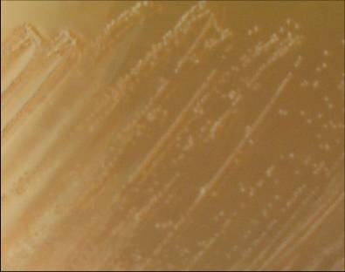
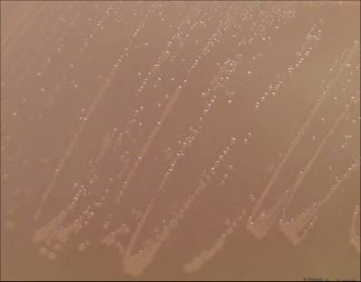
Sentinel Laboratory Procedures for Burkholderia mallei
Burkholderia mallei resistance to polymyxin B using PC agar @ 35°C
(also can use B. cepacia agar )
24 hrs
48 hrs
72 hrs
Notes:
Pseudomonas cepacia (PC) agar is recommended for the isolation of B. cepacia from respiratory secretions of patients with cystic fibrosis. This agar helps by inhibiting the growth of Pseudomonas aeruginosa and other respiratory pathogens.
B. mallei grows slower on PC agar with small colorless or white colonies at 48 to 72 h.
B. pseudomallei grows large white colonies at 24 h, media changes from dull yellow to bright pink.
The PC agar contains crystal violet, bile salts, ticarcillin, and polymyxin B, which inhibit the growth of Pseudomonas aeruginosa and other respiratory pathogens. ¹¹ Prior experience with this agar has demonstrated good growth with both B. mallei and B. pseudomallei strains. However, other organisms have demonstrated growth similar to B. cepacia and a small percentage of B. cepacia strains are inhibited. ^{8,11}

Slide 24
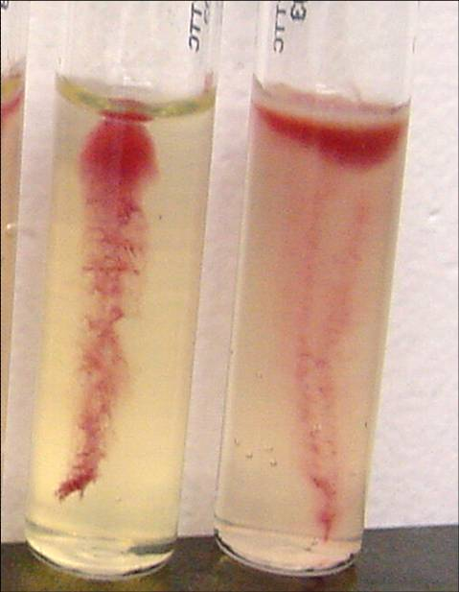
Sentinel Laboratory Procedures for Burkholderia mallei
  Motility
NEGATIVE
Burkholderia
mallei
POSITIVE

Slide 25
Sentinel Laboratory Procedures for Burkholderia mallei
  Screening Tests results:
    Oxidase - variable ( mostly negative )
    Catalase - positive
    Spot indole - negative
    Colistin resistance - no zone
    Motility - negative (using medium with TTC)
    No growth at 42°C
    Amoxicillin-clavulanate susceptible, Penicillin resistant

Slide 26
Sentinel Laboratory Procedures for Burkholderia mallei
Optional screening tests: arginine dihydrolase
  B. mallei is positive
  This test will distinguish between Burkholderia spp. (+) and Pseudomonas stutzeri
Notes:
This test will distinguish between Burkholderia spp. (+) and Pseudomonas stutzeri.

Slide 27
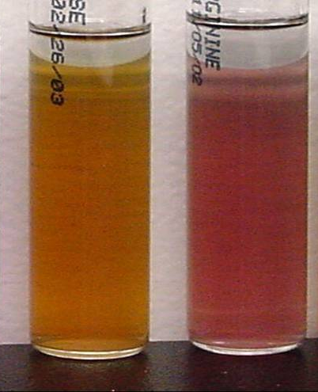
Sentinel Laboratory Procedures for Burkholderia mallei
B. mallei is positive
1 2
Decarboxylase base: B. mallei
Decarboxylase base w/ arginine: B. mallei - positive
Notes:
Organisms growing in the base will turn the broth yellow due to acid produced by metabolism of the available glucose. Those organisms capable of decarboxylating the arginine present will produce alkaline amine byproducts that will eventually shift the pH to alkaline causing the indicator color change to purple. Actually the decarboxylation of the arginine begins with a hydroxylation of the amino acid producing ornithine, which is then decarboxylated to putrescine. Both strains of Burkholderia are arginine positive.

Slide 28
Major characteristics of Burkholderia mallei:
Gram stain morphology: Gram negative coccobacilli or small bacilli
Colony morphology: Poor growth at 24 hr; better growth of gray, translucent colonies without pigment or hemolysis at 48 hours on BAP;
poor or no growth on MAC/EMB in 48 hrs; no distinctive odor
Reactions: Oxidase-variable; indole negative; catalase positive
Yes
Burkholderia mallei
Identification Flowchart
Indole negative, catalase positive, non-hemolytic, no pigment, poor growth or
no growth on MAC/EMB
No
Not B. mallei or B. pseudomallei
Yes
Polymixin B or colistin: no zone,
Amoxicillin-clavulanate susceptible
Penicillin resistant
No
Not B. mallei or B. pseudomallei; may be Brucella
Yes
No
Not B. mallei;
May be B. pseudomallei
SAFETY: As soon as Burkholderia is suspected, perform ALL further work in a Class II Biological Safety Cabinet using BSL-3 practices. If Burkholderia cannot be ruled out with tests below, do not attempt further ID using commercial automated or kit identification systems.
No growth at 42°C, no odor
Yes
non-motile?
No
Not B. mallei
Yes
B. mallei NOT ruled out.
Contact your LRN reference laboratory to refer isolate.
Place Reference Lab Contact Information Here
Report: Possible Burkholderia mallei submitted to LRN reference laboratory for confirmatory testing.
Additional screening test: B. mallei is Arginine positive, unlike many other Burkholderia spp. (test can be observed in kit identification systems.)

Slide 29
Sentinel Laboratory Procedures for Burkholderia mallei
IF YOU SEE:
  Gram negative coccobacilli
  Characteristic very slow growth on BAP, CHOC and little if any growth MAC
  No pigment , hemolysis , odor or growth at 42°C
  Oxidase variable
  Catalase positive
  Motility negative
  Amoxicillin-clavulanate acid susceptible, Penicillin resistant
  And you cannot rule out Burkholderia mallei using the protocol flow chart…….

Slide 30
CONTACT YOUR LRN
reference laboratory

