Slide 1
Agents of Bioterrorism
Brucella species: Brucellosis

Slide 2
Brucella spp. Biosafety Alert
Brucellosis has been the most commonly reported laboratory-associated bacterial infection, aerosols are highly infectious. Infective dose = 10 -100 organisms
Laboratory workers can also acquire the disease from direct exposure to cultures of the organism
Cases have occurred in clinical laboratory settings by “sniffing” cultures, direct skin contact with cultures, and aerosol generating procedures.
Notes:
Refer to page 1 ASM info sheets. Infectious dose of 10-100 organisms from BMBL by aerosol and subcutaneous routes in laboratory animals.

Slide 3
CLINICAL SIGNIFICANCE AND BIOTERRORISM
B. melitensis; (goats, sheep, camels) most severe and more acute
B. abortus; (cattle) more chronic
B. suis; (pigs) severe, associated with osteomyelitis
B. canis; (dogs) very rare in humans
B. melitensis and B. suis: BT agents of concern
  most easily aerosolized
  studied as biological weapons agents
  causes high morbidity
Notes:
Cases in humans of B. pinnipediae and B. cetaceae, normally found in marine species, have rarely been reported. A new species, Brucella inopinata that caused a breast implant infection, has been described recently. B. suis in feral pigs hunted in the southern U.S. have caused human infections in recent years.

Slide 4
BRUCELLOSIS: TRANSMISSION
Ingestion-Unpasteurized dairy products
  The most common mode of transmission
Direct skin contact
  Occupational hazard for farmers, butchers, veterinarians, hunters, and laboratory personnel
Aerosols
  Highly infectious; easily aerosolized
Notes:
Direct skin contact w/ meat and tissues from animals

Slide 5
Sentinel Laboratory Procedures for Brucella spp.
In a Sentinel Laboratory, you could encounter this
organism in:
    Bone Marrow or whole blood
    Joint or abdominal fluid
    Spleen, liver abscesses
    Rarely sputum
    Serum used for antibody titers

Slide 6
Sentinel Laboratory Procedures for Brucella spp.
Serum—not for culture!
If brucellosis is suspected, the diagnoses is often made by serology. Collect acute and convalescent serum samples 14 to 28 days apart:
Collect at least 1 ml without anticoagulant for serologic diagnosis
Store at 4°C until testing is performed.
Acute specimen is collected as soon as possible after onset of disease
Convalescent-phase should be collected >14 days after the acute specimen.
Notes:
Tests include the titrated Rose Bengal test, microagglutination test, microtiter-adapted Coombs test, and immunocapture-agglutination test, all of which are more sensitive than EIA tests, which vary in their sensitivity and specificity

Slide 7
Sentinel Laboratory Procedures for Brucella spp.
    Gram stain morphology
    Culture characteristics
    Oxidase
    Catalase
    Urease
    Satellite phenomenon

Slide 8
Sentinel Laboratory Procedures for Brucella spp.
Gram stain morphology
  Very small, faintly staining, Gram negative coccobacilli; may be slow to decolorize
  Larger than F. tularensis--discrete organisms evident

Slide 9
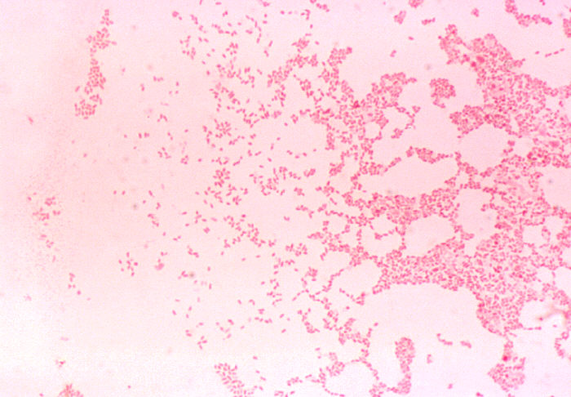
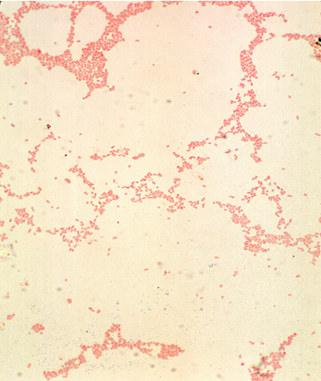
Sentinel Laboratory Procedures for Brucella spp.
Notes:
Here is a Gram stain of culture material. You can see the small Gram-negative coccobacilli. These cells are much easier to see than those of Francisella tularensis.

Slide 10
Sentinel Laboratory Procedures for Brucella spp.
Culture characteristics
  Grows slowly on BAP and CHOC, not on MAC/EMB (except, in some cases, after 7 days incubation)
  Grows in routine blood culture systems, but may require extended incubation
  Some strains benefit from an incubation atmosphere enriched with CO₂
Notes:
Brucella grows on both BAP and CHOC but not on MAC. Colonies are pinpoint at 24 h and are easily visible as white, non-hemolytic colonies at 48 h.

Slide 11
Sentinel Laboratory Procedures for Brucella spp.
Colony on BAP at 35°C
  Small (0.5-1.0mm), convex, glistening
  non-hemolytic and non-pigmented
  Visible growth may take 48 - 72 hrs

Slide 12
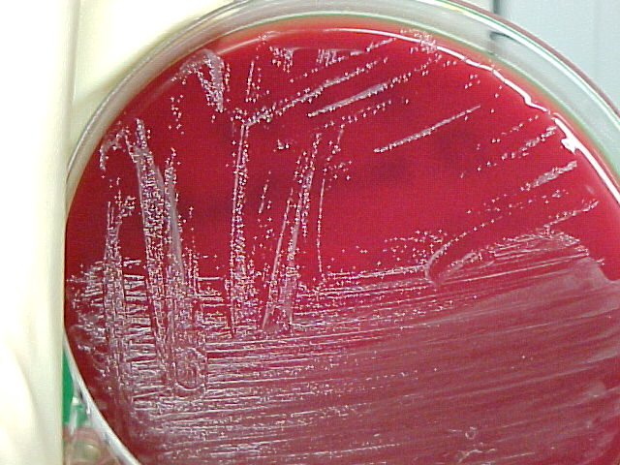
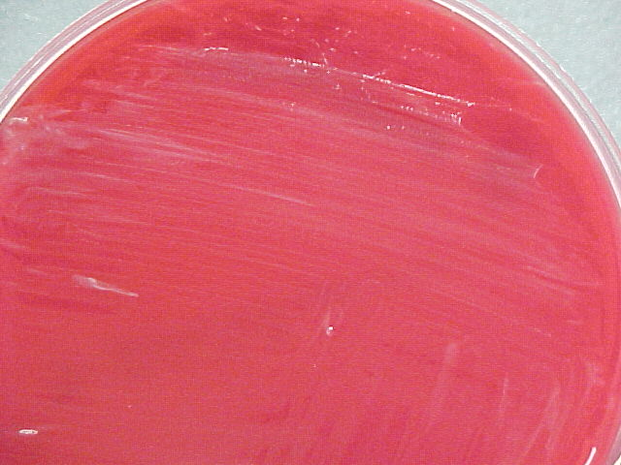
Sentinel Laboratory Procedures for Brucella spp.
Growth on sheep blood agar @35C
_{After 24 – 48 hrs}
_{After 72 hrs}
Notes:
You can see the characteristic growth at 24 to 48 hours—there is definite growth, but individual colonies are still very small. They are convex, grey glistening, and have no pigment.

Slide 13
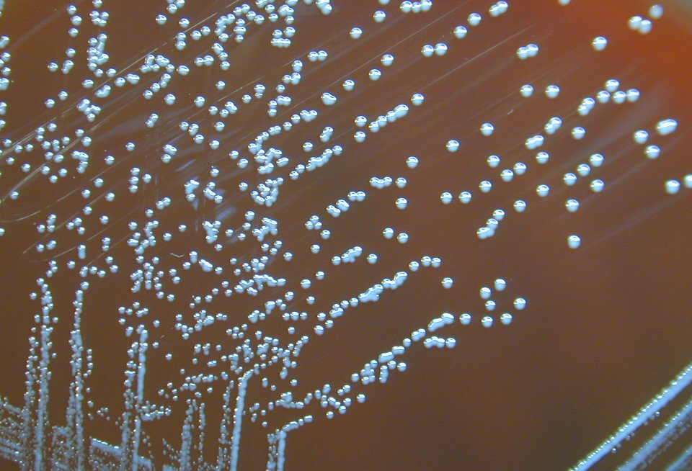
Sentinel Laboratory Procedures for Brucella spp.
Growth on sheep blood agar after 96 hrs @35C
Notes:
Distinct colonies at 4 days (remember this is a QC strain).

Slide 14
Sentinel Laboratory Procedures for Brucella spp.
Screening Tests
  Oxidase
  Catalase
  Urease
  Satellite phenomenon*
  *Can do test for X & V on TSA.
Notes:
Haemophilus can be confused with Brucella; however Haemophilus do not grow on BAP. When in doubt, differentiate between these two genera by performing a satellite test. Inoculate a blood agar plate, followed by cross-streaking or spotting with Staphylococcus aureus ATCC 25923. After 24-48 h of incubation in 5% CO2, Haemophilus demonstrate satellite growth around the S. aureus, while Brucella growth is present on the BAP but is not limited to the area around the Staphylococcus.
Is the organism only growing on BAP without the need to satellite around the S. aureus at 24-48 hours?

Slide 15
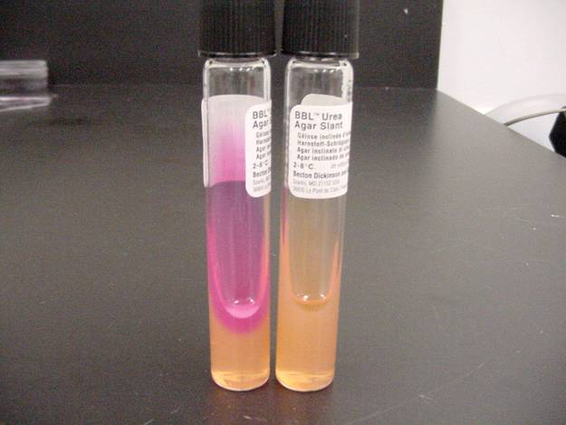
Sentinel Laboratory Procedures for Brucella spp.
  Urease hydrolysis – positive
  Different strains of Brucella and their
  reaction to urea
    B. suis, B. canis ~15 min
    B. abortus and melitensis ~24hr

Slide 16
Sentinel Laboratory Procedures for Brucella spp.
Screening Tests Results
  Oxidase - positive
  Catalase - positive
  Urease - positive
  Satellite phenomenon – growth on BAP without need to satellite around S. aureus
Notes:
Brucella will grow on the BAP while Haemophilus will grown only around the S. aureus

Slide 17
Sentinel Laboratory Procedures for Brucella spp.
Organisms presenting identification challenges:
Achromobacter grp B
Acidovorax spp.
Agrobacterium spp.
Methylobacterium spp.
Psychrobacter phenylpyruvicus
Psychrobacter immobilis
Oligella urealytica
Bordetella bronchiseptica
Haemophilus spp.
Paracoccus yeei
Notes:
Organisms that resemble Brucella and can present an identification challenge for the laboratorian.
Other organisms that can be confused with Brucella species because they are urease positive include. Oligella ureolytica (usually found only in the urine), Psychrobacter phenylpyruvicus, Psychrobacter immobilis, and Bordetella bronchiseptica (motile) (19). The Gram stain of Brucella is unique in that the organisms are small, stain poorly and not clustered (See Table 1). Colonies are odorless, non-pigmented, non-hemolytic, and non-mucoid on BAP, which further differentiates them from other genera.
CHANGE!!!!

Slide 18
 | Brucella spp. | Psychrobacter immobilis | Paracoccus yeei | Psychrobacter phenylpyruvicus | Methylobacterium spp. | Oligella ureolyticaa | Bordetella bronchiseptica, B. hinzii, Cupriavidus pauculus | Haemophilus spp.
Gram stain morphology | tiny ccb, stains faintly | ccb, bacilli | cocci in packets | ccb, bacilli, retains crystal violet | Vacuolated bacilli | tiny ccb | bacilli | Tiny ccb
Catalase | + | + | + | + | + | + | + | v
Oxidase | + | + | + | + | + | + | + | v
Urea | + | v | + | + | v | + | + | v
Motility | - | - | - | - | - | +,delayed | + | -
BAP distinctions | - | Prefers 20°C, Odor of roses | Mucoid | - | Pink, mucoid | - | - | No growth
MAC-48 h | - | - | - | - | - | - | + | -
Notes:
Looking at the chart you can cross off all but one of the Psychrobacters and then need to rely on the gram stain characteristics and the satellite. Haemophilus will generally present and cause the greatest confusion but can be quickly eliminated with the satellite testing

Slide 19
Major characteristics of Brucella species:
Gram stain morphology: Small (0.4 x 0.8µm), Gram negative coccobacillus
THINK BRUCELLA
Growth: Subculture positive aerobic blood culture to BAP, CHOC. Incubate in 5-10% CO₂ at 35°C, Spot BAP with S. aureus ATCC 25923 for satellite test. Note poorly growing colonies after 24 hour incubation on BAP and CHOC.
Incubate plates for at least two additional days if no growth in 24 hours.
Organism does not grow on MAC/EMB.
Brucella
Identification
Flowchart
Yes
Is the organism growing on BAP without the need to satellite around the S. aureus at 24-48 hours?
No
Consider Haemophilus
SAFETY: As soon as Brucella is suspected, perform ALL further work in a Class II Biological Safety Cabinet using BSL-3 practices. If Brucella cannot be ruled out with tests below, do not attempt further ID using commercial automated or kit identification systems.
Yes
Oxidase positive and catalase positive?
No
Think Francisella (see procedure)
Yes
Urea positive?
No
Reincubate and see written procedure
Yes
Brucella NOT ruled out.
Contact your LRN reference laboratory to refer the isolate.
Place Reference Lab Contact Information Here
Report: Possible Brucella submitted to LRN reference laboratory for confirmatory testing.
Antimicrobial therapy: Rifampin or Streptomycin plus Doxycycline

Slide 20
Sentinel Laboratory Procedures for Brucella spp.
IF YOU SEE:
  Very small, faintly staining, Gram negative coccobacilli from blood, bone marrow, or lymphoid tissue
  Slow growth on BAP, CHOC needing 2-3 days for colonies to appear
  Oxidase (+), urease (+), catalase (+)
  Satellite phenomenon- growth on BAP without need to satellite around S. aureus
  And you cannot rule out Brucella spp. using the protocol flow chart…….

Slide 21
CONTACT YOUR LRN
reference laboratory

