Slide 1
Agents of Bioterrorism
Yersinia pestis: Plague

Slide 2
Yersinia pestis Biosafety Alert
Dangerous, highly virulent organism
Should not be manipulated on an open bench
Laboratory-acquired infections can occur

Slide 3
Geographic distribution
From 2007-2011, a total of 23 human cases of plague from the U.S. were reported to the CDC.
Zoonotic disease transmitted by animals and their infected fleas. Most cases occur in the late winter to summer months and are associated with flea contact.

Slide 4
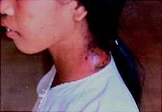
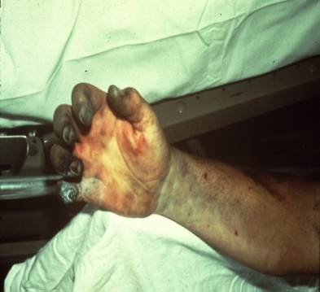
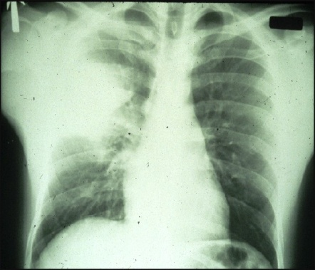
Clinical Presentations of Plague
Three clinical forms of disease:
  Bubonic
    Results from bite of an infective flea
    Lymph nodes become inflamed (bubo)
    Most common clinical presentation
  Septicemic
    Results form bites or direct contact with infective material through cracks in the skin
    Similar to bubonic without swollen lymph nodes
    Blood-borne organisms
  Pneumonic
    Deadliest, least common
    Results from aerosol transmission
    Secondary pneumonic plague can occur from advanced infection of an initial bubonic form
Notes:
The organism can also occasionally be passed from human to human by close contact as in primary pneumonic plague http://www.asm.org/images/PSAB/YERSINIA_PESTIS_50713.pdf

Slide 5
Bioterrorism
Primary pneumonic plague is most likely the form that would be seen if Y. pestis were used in a bioterrorism event. This is due to the high likelihood of aerosol delivery; the communicability of this form of the disease would make control of this particular agent even more problematic.

Slide 6
Sentinel Laboratory Procedures for Y. pestis
In a Sentinel Laboratory, you could encounter this
organism in:
  Lower respiratory tract
  Blood
  Aspirate, tissue or biopsy specimen
  Swabs of tissue (not recommended)
Notes:
Note changes in protocol for specimen collection

Slide 7
Sentinel Laboratory Procedures for Y. pestis
    Gram stain morphology
    Culture characteristics
    Oxidase
    Catalase
    Urease
    Indole
Notes:
- Note that culture characteristic in broth is not recommended because it is hard to interpret, not specific, and broth culture of Y. pestis in a glass tube does present an unnecessary potential safety hazard. The Wayson (or Giemsa) stain is of limited value except when staining direct specimen materials where bipolar staining or organisms is most likely to be seen. This characteristics is not sensitive and not specific. Use extreme caution when performing the catalase test to avoid exposure to the aerosol produced.

Slide 8
Sentinel Laboratory Procedures for Y. pestis
Gram stain morphology:
  Large Gram negative bacilli
  Resembles other Enterobacteriaceae

Slide 9
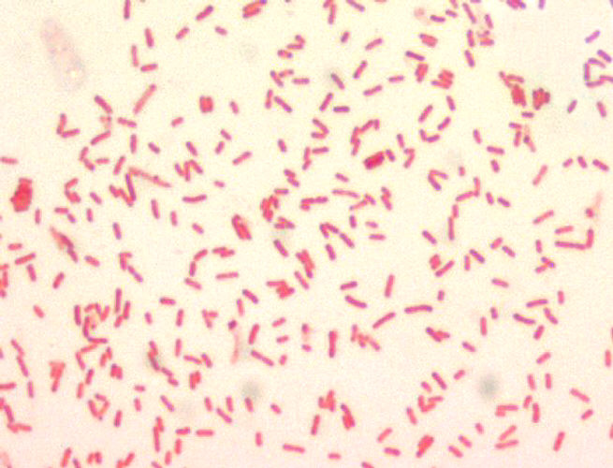
Sentinel Laboratory Procedures for Y. pestis
Notes:
Gram stain from culture of Y. pestis
Gram stained specimens containing Y. pestis often reveal Gram negative bacilli, 1–2 μm x 0.5 μm, that are seen mostly in single cells or pairs and/or short chains in liquid media (Figure 1).

Slide 10
Sentinel Laboratory Procedures for Y. pestis
Giemsa or Wayson Stain Morphology*
  Dark blue rod-shaped organisms
  From direct specimen material may show bipolar - “safety-pin” morphology**
  “Safety-pin” feature is neither specific nor sensitive
*Giemsa & Wayson stains aren’t normally performed in the microbiology lab.
** In patients with overwhelming sepsis, bipolar staining may be seen on a Gram stain of the direct specimen.
Notes:
, Wright or Giemsa stains performed on peripheral blood or tissue by hematology or histopathology may reveal the bipolar staining characteristics of Y. pestis, whereas the Gram stain may not. (Note that in patients with overwhelming sepsis, bipolar staining bacilli may be detected in peripheral blood smears). It is useful to note these characteristics in the event that hematology or histopathology asks for a microbiology consult.

Slide 11
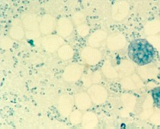
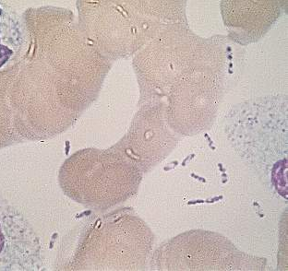
Sentinel Laboratory Procedures for Y. pestis
Wayson Stain Wright-Giemsa Stain
Notes:
A Wright-Geimsa stain of Y. pestis from a smear of blood. Bi-polar staining is best observed in organisms found in specimen material.

Slide 12
Sentinel Laboratory Procedures for Y. pestis
Culture characteristics
  Grows on routine culture media: BAP, CHOC, and MAC/EMB
  Resembles other Enterobacteriaceae, EXCEPT grows more slowly
  Slow growing at 35-37ºC and at 25- 28ºC (optimal but optional)
  Non-lactose fermenter on MAC/EMB
  Grows in routine blood culture systems

Slide 13
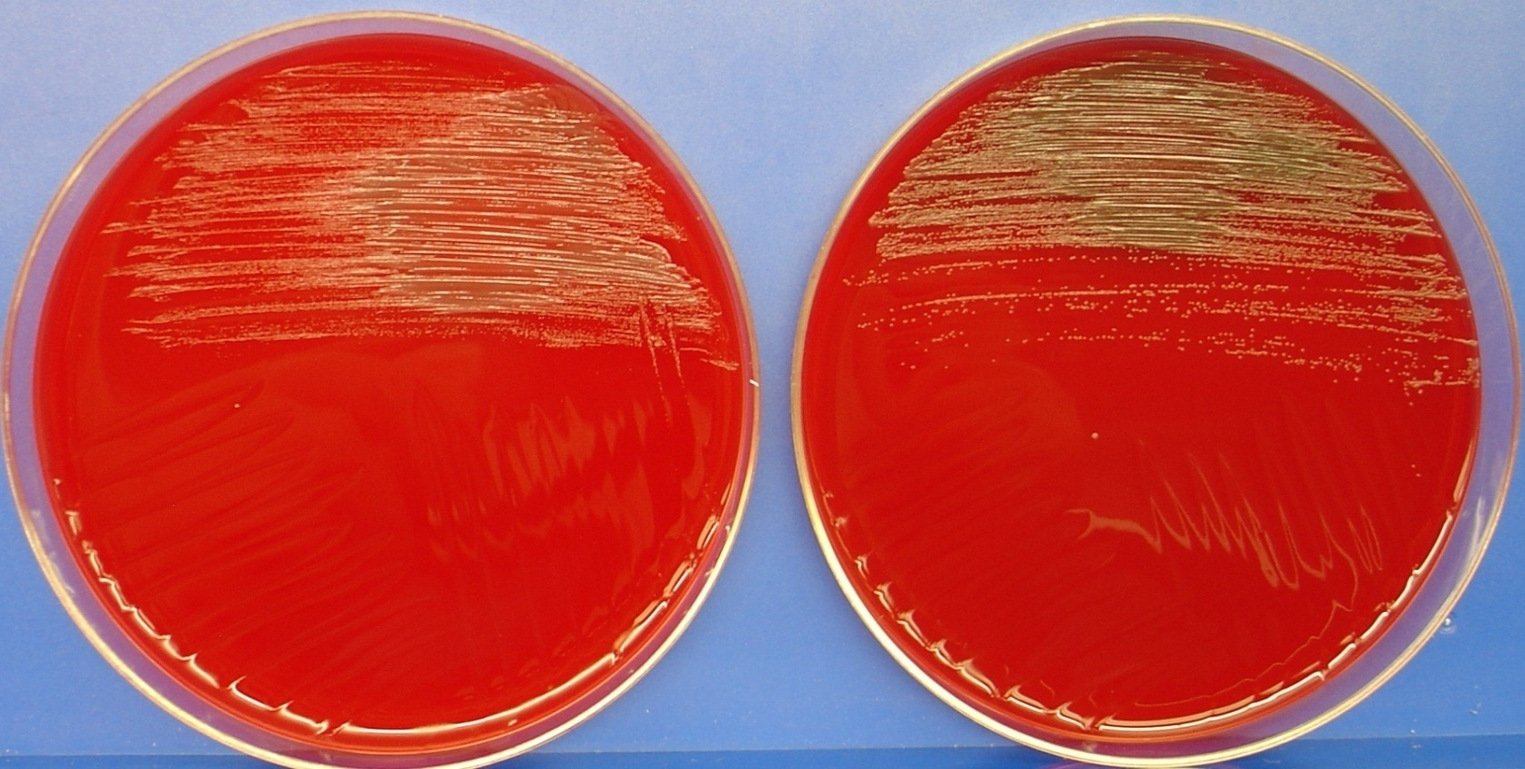
Sentinel Laboratory Procedures for Y. pestis
Growth on BAP after
24 hrs
@ 25C
@ 35C
Notes:
Grey-white translucent pinpoint colonies after 24hrs.

Slide 14
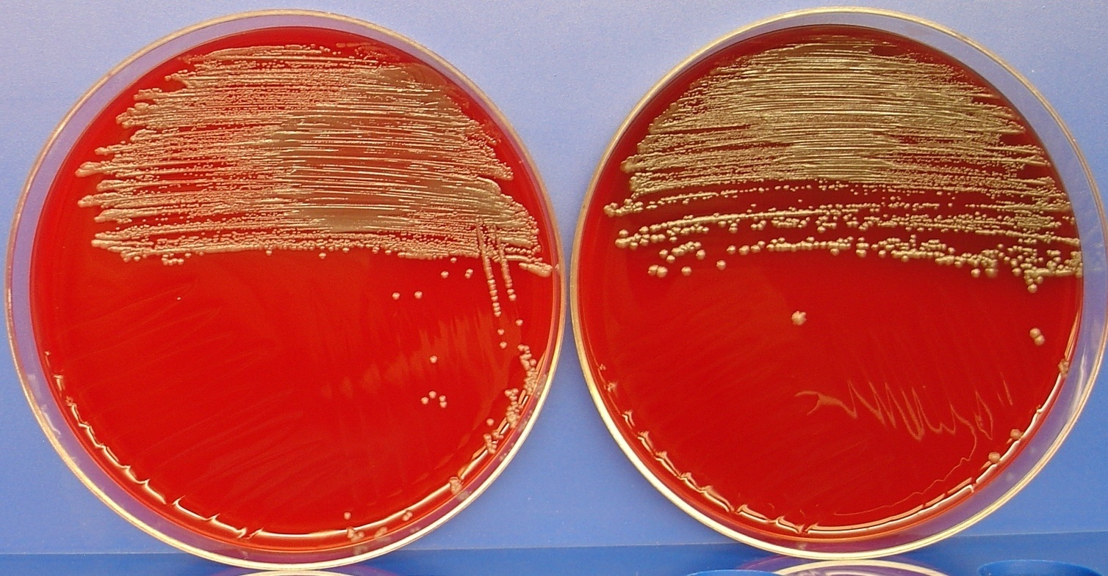
Sentinel Laboratory Procedures for Y. pestis
Growth on BAP after
48 hrs
@ 25C
@ 35C
Notes:
Colonies are approx 1-2 mm in diameter gray –white to slightly yellow and opaque

Slide 15
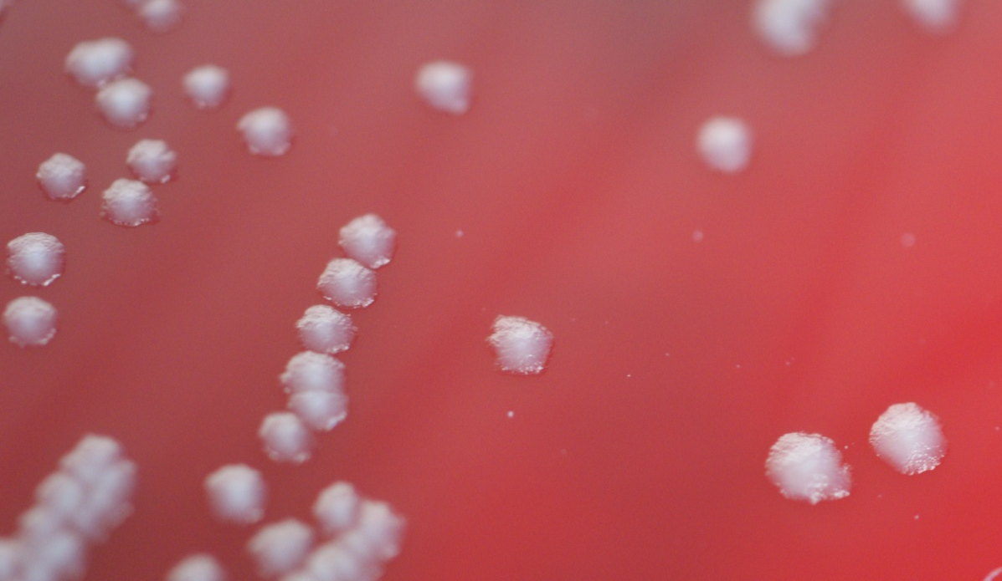
Sentinel Laboratory Procedures for Y. pestis
Fried Egg Appearance
Notes:
After 48–72 h of incubation colonies have a raised, irregular "fried egg" appearance, which becomes more prominent as the culture ages. There is little or no hemolysis .

Slide 16
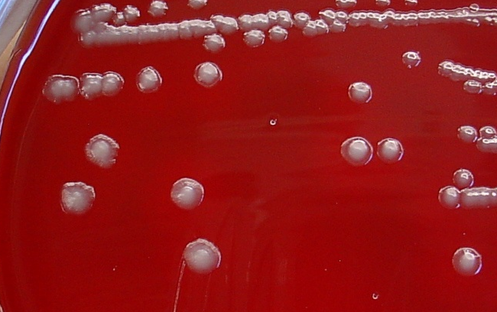
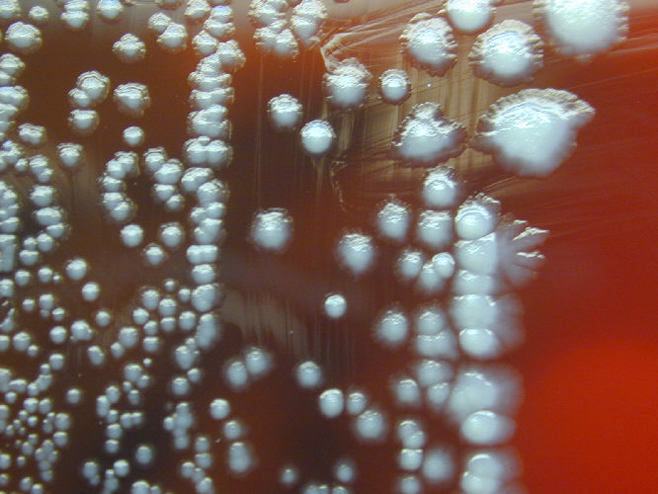
Sentinel Laboratory Procedures for Y. pestis
Notes:
Older colonies of wild-type strains often show a “skirt” or take on a raised irregular “fried-egg” appearance. Very little or no hemolysis will been seen on BAP

Slide 17
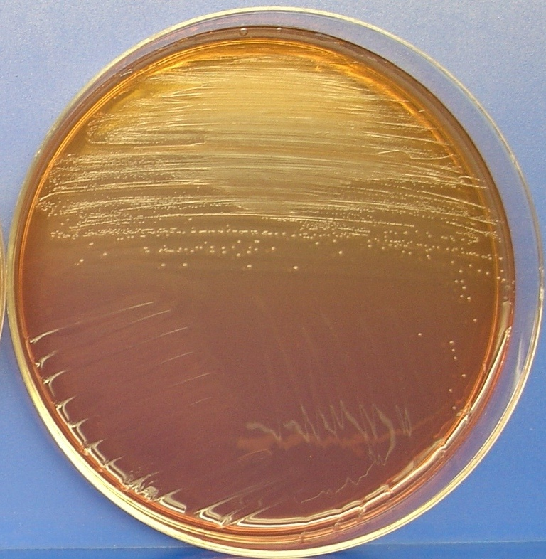
Sentinel Laboratory Procedures for Y. pestis
Growth on MAC after
24 hrs @35C
Notes:
Y. pestis will grow as small, non-lactose fermenting colonies on MAC or EMB agar. Colonies may not be visible at 24 hrs .

Slide 18
Sentinel Laboratory Procedures for Y. pestis
Screening Tests:
  Oxidase
  Catalase
  Urease
  Spot indole

Slide 19
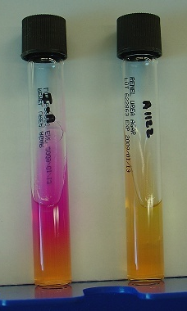
Sentinel Laboratory Procedures for Y. pestis
  Urease detection with Christensen’s urea agar or broth maybe used
Positive Negative
Y. pestis

Slide 20

Sentinel Laboratory Procedures for Y. pestis
  Spot indole
Positive Negative

Slide 21
Sentinel Laboratory Procedures for Y. pestis
Screening Tests Results:
  Oxidase - negative
  Catalase - positive
  Urease - negative
  Spot indole - negative

Slide 22
Table 1: Differentiation of other important Yersinia species
Yersinia species | Oxidase | Catalase | Urea* | Indole
Y. pseudotuberculosis | negative | positive | positive | negative
Y. enterocolitica | negative | positive | positive | variable
Y. frederiksenii | negative | positive | positive | positive
Y. kristensenii | negative | positive | positive | variable
Y. Ruckeri (Infections in fish) | negative | positive | negative | negative
Y. pestis | negative | positive | negative | negative
* Y. pseudotuberculosis and Y. enterocolitica give stronger reactions in urea agar or broth when incubated at 25-28ºC, but incubation at this temperature is not necessary to demonstrate urease production
Notes:
Always take note on the growth rate, colony morphology , gram stain , they can help determine what species you may have and when ever you are in doubt send to us! I couldn’t find any reference to a human infection from Y. ruckeri. Note change for urease in March 2016.

Slide 23
Similar Organisms Ruled out by Sentinel Procedures
Organism | Gram Stain | Growth on BAP | Growth on MacConkey | Oxidase | Catalase | Urease
Yersinia pestis | Gram negative | Slow | Non-Lactose Fermenter | Negative | Positive | Negative
Yersinia pseudotuberculosis | Gram negative | Slow | Non-Lactose Fermenter | Negative | Positive | Positive
Yersinia enterocolitica | Gram negative | Slow | Non-Lactose Fermenter | Negative | Positive | Positive
Escherichia coli | Gram negative | Good | Lactose Fermenter | Negative | Positive | Negative
Klebsiella pneumoniae | Gram negative | Very good, 2-4 mm colonies 24 hrs | Lactose Fermenter | Negative | Positive | Positive
Staphylococcus epidermidis | Gram positive | Good | No growth | Negative | Positive | Positive
Enterobacter cloacae | Gram negative | Good | Lactose Fermenter | Negative | Positive | Variable
Pasteurella multocida | Gram negative | Good | Variable | Positive | Positive | Negative

Slide 24
Major characteristics of Yersinia pestis:
Gram stain morphology: Gram negative bacilli, 0.5 x 1-2 mm
Colony morphology: Slow growing, pinpoint colonies after 24h; colonies are 1-2 mm, gray-white to slightly yellow and opaque on BAP after 48 h; non-lactose fermenter on MAC/EMB;
Specimen is blood, sputum, or lymph node aspirate
Perform all work in a biosafety cabinet using BSL-2 practices.
Yes
Yersinia pestis
Identification
Flowchart
Oxidase: Negative
Catalase: Positive
Indole: Negative
Urease: Negative
Not Yersinia pestis. Continue identification per routine laboratory procedures.
May be other Yersinia spp.
No
SAFETY: As soon as Yersinia is suspected, perform ALL further work in a Class II Biological Safety Cabinet using BSL-3 practices. If Yersinia cannot be ruled out with tests below, do not attempt further ID using commercial automated or kit identification systems.
YES
Y. pestis is NOT ruled out.
Contact your LRN reference laboratory to refer the isolate.
Place Reference Lab Contact Information Here
Report: Possible Y. pestis submitted to LRN reference laboratory for confirmatory testing.
WARNING: Some of the automated identification systems do not identify Y. pestis adequately.
Y. pestis has been falsely identified as Y. pseudotuberculosis, Shigella, H₂S negative Salmonella, Acinetobacter and Pseudomonas spp..

Slide 25
Sentinel Laboratory Procedures for Y. pestis
IF YOU SEE:
  Gram negative bacilli from blood, lymph node, or respiratory specimens
  Colonies resemble enterics, but grow much more slowly
  Non-lactose fermenter on MAC/EMB
  Catalase (+), oxidase (-), urease (-), indole (-)
  And you cannot rule out Y. pestis using the protocol flow chart……
Notes:
Add motility

Slide 26
CONTACT YOUR LRN
reference laboratory

