Slide 1
Agents of Bioterrorism
Francisella tularensis: Tularemia

Slide 2
Francisella tularensis Biosafety Alert
This is a dangerous, highly virulent organism and it should not be manipulated on an open bench. It has a very low infectious does (10-50 organisms).
Laboratory-acquired infections can occur.

Slide 3
Geographic distribution
F. tularensis is a zoonotic pathogen that is widespread throughout the Northern Hemisphere and is responsible for recent tularemia outbreaks in several countries including Norway and Turkey .
Within the United States, tularemia has been reported in every state (with the exception of Hawaii) and approximately 120 cases are reported a year
F. tularensis is a zoonotic pathogen with an extremely wide host range that includes mammals, birds and amphibians. The primary hosts for F. tularensis are believed to be small rodents (hares, voles, muskrats).
Notes:
Most patients have a recent history of animal contact (bite, scratch) or arthropod bite.

Slide 4
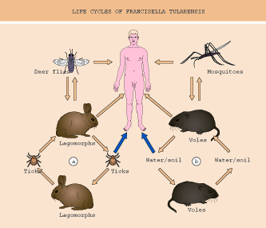
Disease Transmission
Bite of an infected arthropod
  Ticks, deer fly, horse fly and mosquitoes
Contact with infected animal or carcasses
Ingestion of contaminated food or water
Inhalation of infectious aerosols
  No evidence for person to person transmission via the respiratory route

Slide 5
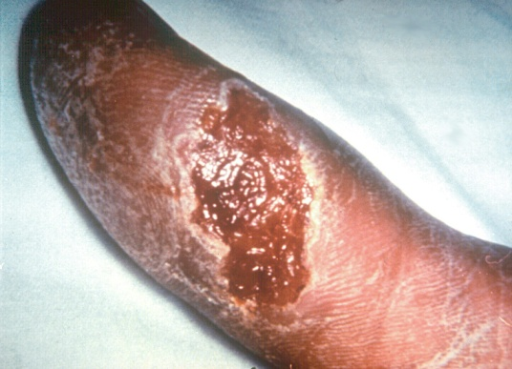
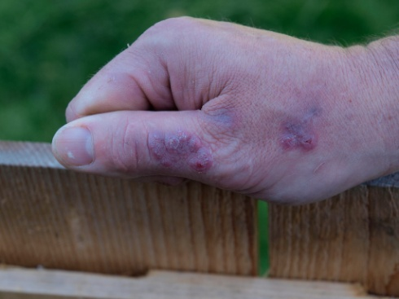
Clinical Presentation
Ulceroglandular | Most common form (45 to 80% of cases) Results from a bite of infected arthropod or handling infected materials Ulcer at site of exposure with inflamed lymph nodes
Glandular | Results from a bite of infected arthropod or handling infected materials Regional lymphadenopathy Ulcer is undetectable 10 to 25% of cases
Oculoglandular | Results from touching the eye with contaminated fingers Conjunctivitis with regional lymphadenopathy

Slide 6
Clinical Presentation
Oropharyngeal | Results from ingestion of contaminated food or water Acute septicemia with no localizing signs Regional neck lymphadenitis Can present as pharyngitis
Typhoidal | Acute septicemia with no localizing signs Route of infection is unknown
Pneumonic | Results from inhaling infectious aerosols Most severe and lethal form May present as unresponsive community acquired pneumonia

Slide 7
Bioterrorism
The most likely exposure in a bioterrorism attack is from an aerosol and the pneumonic form would likely be the primary clinical presentation. F. tularensis was actively pursued as a biological warfare agent by both the United States and the former Soviet Union.
The bacterium’s low infective dose (<10 organisms) and ability to infect via aerosol not only make it a potential bioterrorism agent but also a significant occupational hazard in the clinical microbiology laboratory.

Slide 8
Sentinel Laboratory Procedures for F. tularensis
In a Sentinel Laboratory, you could encounter this organism in:
Tissue - Biopsy or scraping of an ulcer or conjunctival swab
Aspirate - lymph node or lesion
Blood
Bone Marrow
Respiratory secretions
Serum may be collected for antibody titer testing

Slide 9
Sentinel Laboratory Procedures for F. tularensis
    Gram stain
    Culture characteristics
    Oxidase
    Catalase
    beta-lactamase
    Satellite phenomenon
Notes:
Use extreme caution when performing the catalase test to avoid exposure to the aerosol produced.

Slide 10
Sentinel Laboratory Procedures for F. tularensis
Gram Stain Morphology
  Very small Gram negative coccobacillus
  May stain weakly
  Often difficult to see individual cells
Notes:
Smaller than H. influenzae and bipolar staining isn’t a distinct feature 0.2-0.5 micrometers by 0.7 to 1.0 micrometers

Slide 11
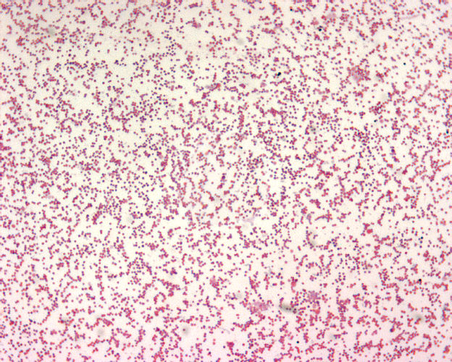
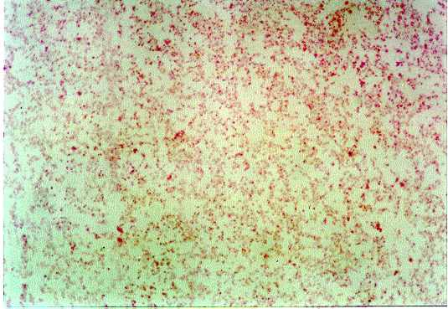
Sentinel Laboratory Procedures for F. tularensis
Notes:
Smaller than H. influenzae and bipolar staining isn’t a distinct feature 0.2-0.5 micrometers by 0.7 to 1.0 micrometers

Slide 12
Sentinel Laboratory Procedures for F. tularensis
Culture characteristics
  Slow growing, nutritionally fastidious
  Grows on BAP initially, poorly or not at all on subculture
  Grows on CHOC but not BAP in 24h or it grows better on CHOC than on BAP in 48 hours
  Cysteine-enriched media such as CHOC, TM, BCYE, thioglycollate broth support subculture
  Will NOT grow on MAC or EMB plates

Slide 13
Sentinel Laboratory Procedures for F. tularensis
Colonies on BAP @ 35° C
  After 18 to 24 hrs: pin-point, translucent colonies usually too small to be seen individually
  After 48 hrs: <1 mm, gray-white, opaque, no hemolysis

Slide 14
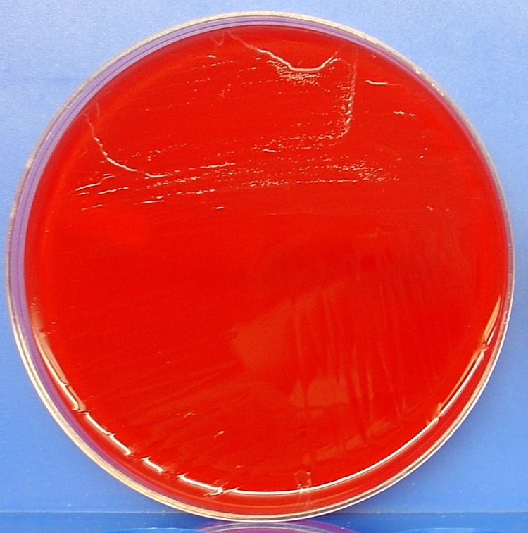
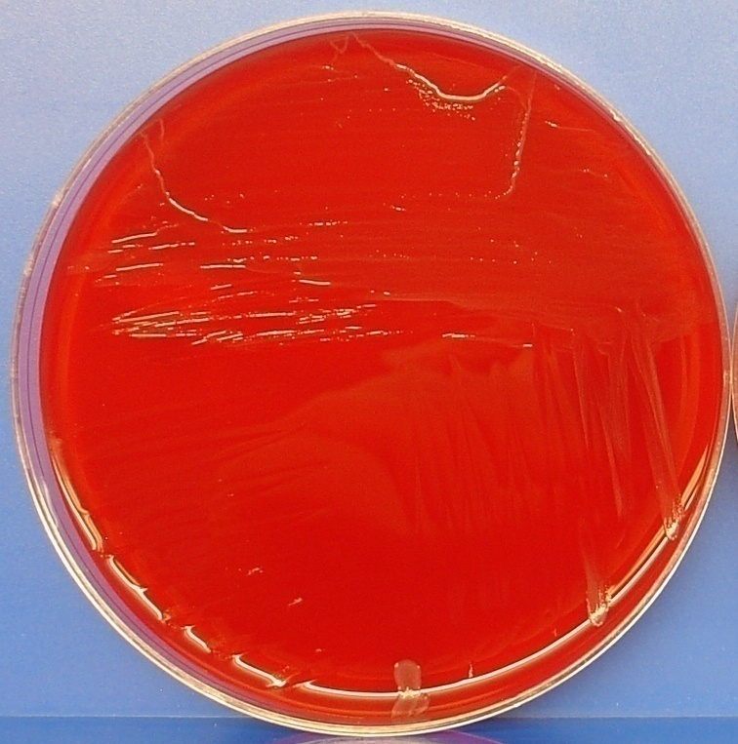
Sentinel Laboratory Procedures for F. tularensis
Growth on sheep blood agar @ 35C
_{24 hours}
_{48 hours}
Notes:
Here is the kind of growth you might see on sheep blood agar after 24 to 48 hours. Growth on BAP becomes progressively weaker with subsequent subculture.

Slide 15
Sentinel Laboratory Procedures for F. tularensis
Colonies on CHOC @ 35°C
  After 24 hrs: very small pinpoint, gray-white, opaque
  After 48 hrs: 1-2 mm, grey-white or bluish-grey, opaque, flat with an entire edge, smooth, shiny
  Mature growth at 72 hrs

Slide 16
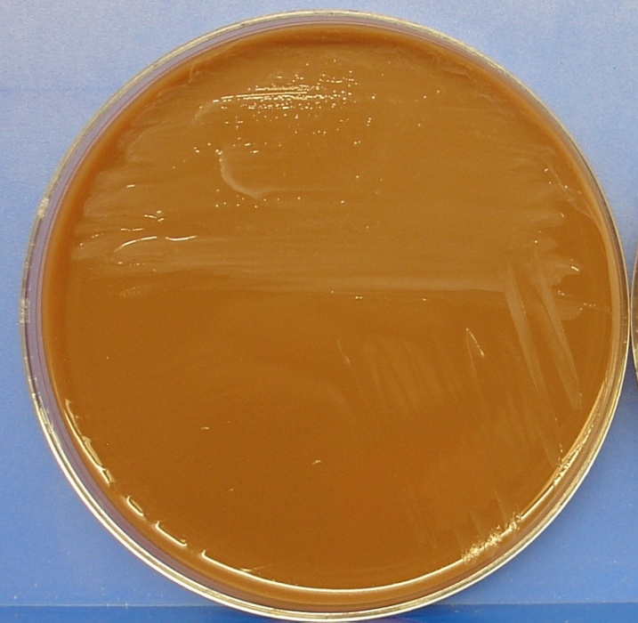
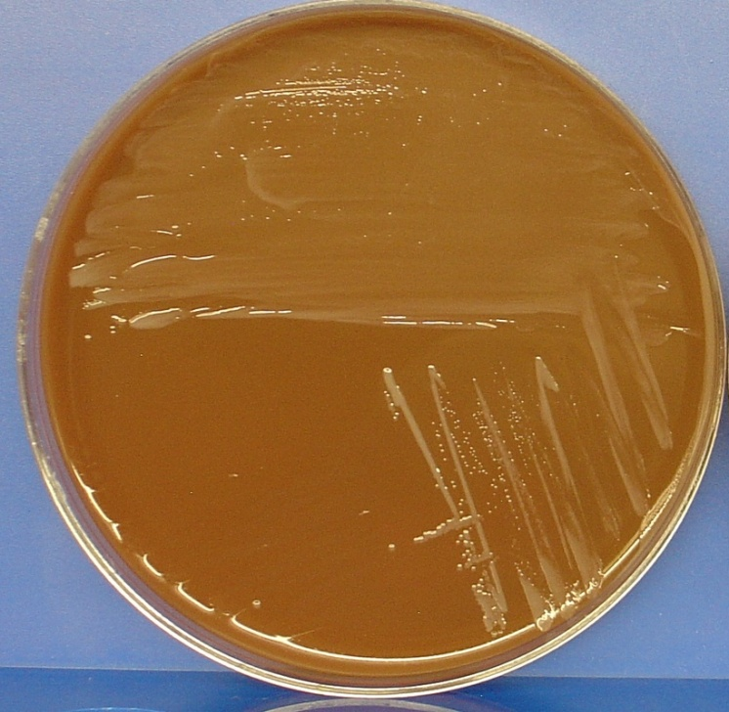
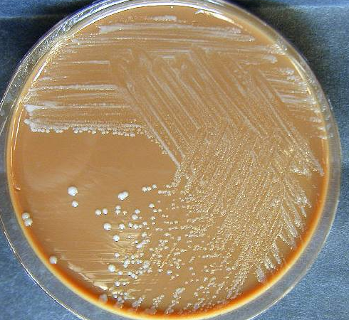
Sentinel Laboratory Procedures for F. tularensis
_{Growth on chocolate agar @ 35C}
_{After 24 hrs}
_{After 48 hrs}
_{After72 hrs}
Notes:
After 48hrs or more 1-2mm white to grey to bluish grey, opaque flat with an entire edge , smooth and shiny surface

Slide 17
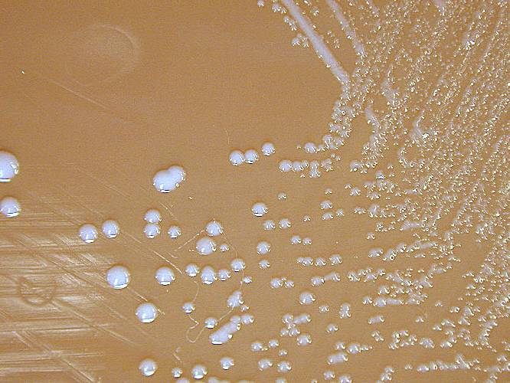
Sentinel Laboratory Procedures for F. tularensis
Growth on chocolate agar after 72 hours @ 35C
Notes:
A close-up of colonies after 72 hours.

Slide 18
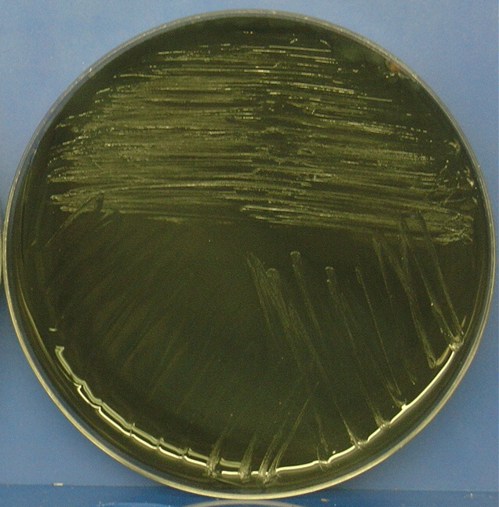
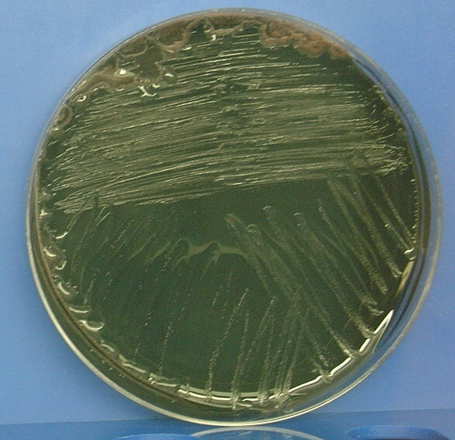
Sentinel Laboratory Procedures for F. tularensis
_{Growth on BCYE @ 35C}
_{After 24 hrs}
_{After 48 hrs}
Notes:
Won’t grow on MAC or EMB plates BCYE- buffered charcoal yeast extract

Slide 19
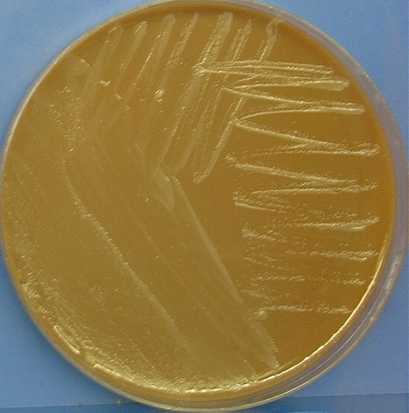
Sentinel Laboratory Procedures for F. tularensis
    _{Growth on}
    _{TM after 48 hrs}
    _{@ 35C}
Notes:
Remember plates should be taped shut and all subsequent work to be performed in the BSC with Biosafety level III practices , further identification should not be attempted with commercial automated or kit identifications

Slide 20
Sentinel Laboratory Procedures for F. tularensis
Screening Tests:
  Oxidase
  Catalase
  beta-lactamase
  Satellite phenomenon*
  *Note: F. tularensis does not need hemin or NAD (X or V) but may not grow on the tryptic soy agar plates or it may make a very fine film since the medium does not contain cysteine. Look very carefully at the plates.

Slide 21

Sentinel Laboratory Procedures for F. tularensis
Oxidase Test
Positive Negative F. tularensis

Slide 22

Sentinel Laboratory Procedures for F. tularensis
beta-lactamase Test
Positive
Negative

Slide 23
Sentinel Laboratory Procedures for F. tularensis
Screening Tests Results:
  Oxidase – negative
  Catalase – negative (or weakly positive)
  beta-lactamase - positive
  Satellite phenomenon - negative

Slide 24
Sentinel Laboratory Procedures for F. tularensis
  Less frequent:
  Dysgonomonas spp. (DF-3)
  Bordetella, Grp. IV (inert, urea pos)
  Psychrobacter phenylpyruvicus
  Oligella ureolytica
  Haemophilus spp.
  Acinetobacter spp. (oxidase negative, MAC +)
  Aggregatibacter spp.
  H. influenzae (satellite or XV positive)
  Brucella spp. (gram stain, catalase positive)
  Pasteurella spp. (nonsticky,
  MAC/EMB +)

Slide 25
Similar Gram-Negative Bacteria Ruled out by Sentinel Procedures
Organism | Gram Stain | Growth on BAP | Growth on cystine containing agar | Oxidase | Catalase | β−Lactamase
Francisella tularensis | Gram negative | Little to no growth | Slow | Negative | Weak Positive or Negative | Positive
Francisella philomiragia | Gram negative | Slow | Slow | Positive | Positive | Positive
Brucella abortus | Gram negative | Slow | Slow | Positive | Positive | Positive
Haemophilus influenzae | Gram negative | No growth | Slow | Positive | Positive | Positive
Actinobacillus actinomycetemcomitans | Gram negative | Slow | Slow | Positive | Positive | Negative
Pasteurella multocida | Gram negative | Good | Good | Positive | Positive | Negative

Slide 26
a Reactions extracted from ASM Sentinel Protocols for Brucella spp. and F. tularemia; NA, not applicable;
v, variable; ccb, coocbacilli. O. ureolytica is primarily a uropathogen.
b Only grows on CHOC (requires X & V); or on BAP associated with staphylococcus colony (satellite test).
Presumptive ID Chart for Francisella tularensis ª
 | Brucella spp. | Francisella tularensis | Psychrobacter phenylpyruvicus | Oligella ureolyticaa | Haemophilus spp. ^{b}
Gram stain morphology | tiny ccb, stains faintly | Tiny ccb, stains faint | ccb, bacilli, retains crystal violet | tiny ccb | Tiny ccb
Catalase | + | - , or weakly + | + | + | v
Oxidase | + | - | + | + | v
Motility | - | - | - | +, delayed | -
BAP distinctions | - | + (scant growth) | - | - | No growth ^{b}
Beta-lactamase | - | + | - | - | -
a Reactions extracted from ASM Sentinel Protocols for Brucella spp. and F. tularensis; NA, not applicable;
v, variable; ccb, coccobacilli. O. ureolytica is primarily a uropathogen.
b Only grows on CHOC (requires X & V); or on BAP associated with staphylococcus colony (satellite test).

Slide 27
Major characteristics of Francisella tularensis
Gram stain morphology: Pleomorphic, minute (0.2 to 0.5 by 0.7 to 1.0 µm) faintly staining, Gram negative coccobacillus
Colony morphology: No growth on MAC/EMB, scant to no growth on BAP after > 48 h.
Produces 1-2 mm gray to grayish-white colonies on CHOC after > 48 h
Yes
Francisella tularensis
Identification Flowchart
Does the organism grow on CHOC but not BAP in 24h? Or does it grow better on CHOC than on BAP in 48 hours?
No
Not Francisella
Yes
Do colonies fail to exhibit enhanced growth (satellite) around S. aureus, indicating no requirement for X and V factors?
No
Consider Haemophilus
Yes
Oxidase negative and catalase weakly positive or negative?
No
Not Francisella
SAFETY: As soon as Francisella is suspected, perform ALL further work in a Class II Biological Safety Cabinet using BSL-3 practices. If Francisella cannot be ruled out with tests below, do not attempt further ID using commercial automated or kit identification systems.
Yes
Not Francisella; continue identification per routine laboratory procedures
β lactamase positive?
No growth on MAC?
No
F. tularensis is NOT ruled out.
Contact your LRN reference laboratory to refer the isolate.
Place Reference Lab Contact Information Here
Report: Possible F. tularensis submitted to LRN reference laboratory for confirmatory testing.
WARNING: Automated identification systems may key out as non-F. tularensis
(e.g. Haemophilus influenzae and Aggregatibacter)
Notes:
Telll them ON ASM website - Note: Biochemical test procedures and quality control instructions can be found at the end of the General Recommendation and Biochemical Testing Procedures document.
End of presentation add this for protocols and procedures .

Slide 28
Sentinel Laboratory Procedures for F. tularensis
IF YOU SEE:
  Tiny, Gram negative coccobacilli from blood, lymph node aspirate, skin ulcer, or respiratory specimens
  Grows on CHOC (slowly) but not BAP in 24h or it grows better on CHOC than on BAP in 48 hours
  No growth on MAC/EMB
  Oxidase (-), satellite (-)
  Catalase (-) or wk (+), beta-lactamase (+)
  And cannot rule out F. tularensis using the protocol flow chart……

Slide 29
CONTACT YOUR LRN
reference laboratory

