Slide 1
Agents of Bioterrorism
Bacillus anthracis: Anthrax

Slide 2
Anthrax and Bioterrorism
The use of B. anthracis as a bioterrorism agent to inflict disease and death has occurred for centuries.
Used by many countries, primarily for military purposes in the conduct of biowarfare.
Inhalational anthrax results from the inhalation of B. anthracis spores and can occur following an intentional aerosol release, as was evident in the 2001 anthrax event.
Incubation period ranges from 1 to 6 days.
Aerosolization of anthrax spores is the most likely method to be used in a bioterrorism event.
Notes:
Though the minimum infectious inhaled dose has not been specifically determined, the U. S. Department of Defense (DoD) estimates that the 50% lethal dose for humans is between 8,000 and 10,000 spores.

Slide 3
Bacillus anthracis
Naturally occurring in the environment.
Zoonotic disease that occurs most frequently in herbivorous animals (e.g., cattle, sheep, and goats), which acquire endospores from contaminated soil.
Human disease is less common and results from contact with infected animals or with commercial products derived from them, such as wool and hides.
Five naturally occurring cases of anthrax have been reported since 2006: gastrointestinal, cutaneous, and inhalational.
Notes:
Cases have also been reported in livestock in South Dakota, Nebraska, Arkansas, Mississippi, Louisiana, and California. Endemic in southern Europe, parts of Africa, Austrialia, Asia and Noth and South America Its persists in arid deserts of the Middle East, Asia, Africa, Australia and South America with the majority of cases reported from Iran, Turkey, Pakistan, and Sudan.

Slide 4
Infection can occur in one of four forms:
Cutanous - via broken skin
Gastrointestinal - via ingestion
Inhalation anthrax – via breathing in anthrax spores. Commonly know as “woolsorter disease” due to its prevalence in the textile mills by workers handling wool and other contaminated animal products.

Slide 5
Infection can occur in one of four forms:
Injection anthrax - Recently, another type of anthrax infection has been identified in heroin-injecting drug users in northern Europe. This type of infection has never been reported in the United States. Symptoms may be similar to those of cutaneous anthrax, but there may be infection deep under the skin or in the muscle where the drug was injected. Injection anthrax can spread throughout the body faster and be harder to recognize and treat.

Slide 6
Sentinel Laboratory Procedures for B. anthracis
In a Sentinel Laboratory, you could encounter
this organism in:
Cutaneous - Vesicles (early), Eschars (late), (unroof vesicle and aspirate fluid)
Inhalational - Sputum, Blood culture or CSF culture (inhalational, septicemic)
Gastrointestinal - Stool and Blood culture
Postmortem Tissue - Tissue pieces
Environmental or non-clinical specimens are not to be processed by Sentinel Labs

Slide 7
Sentinel Laboratory Procedures for B. anthracis
    Gram stain
    Culture characteristics
    Hemolysis
    Catalase
    Motility
Notes:
catalase testing should always be done with caution to avoid exposure to the aerosol created.

Slide 8
Sentinel Laboratory Procedures for B. anthracis
Gram stain morphology – in clinical specimen smears
Large Gram positive bacilli in short chains, 2 - 4 cells
  Spores are NOT usually present

Slide 9
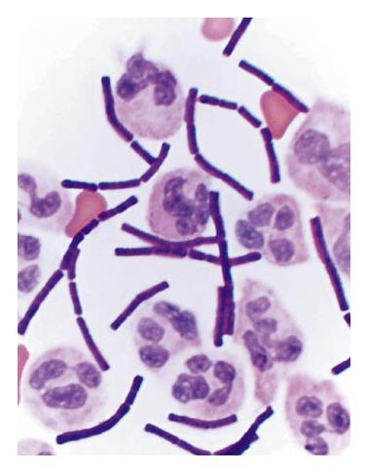
Sentinel Laboratory Procedures for B. anthracis
Gram Stain of Spinal Fluid
Bush, et al. 2001. N Engl J Med 345(22):1607-1610
Notes:
Here is the Gram stain of the spinal fluid from the first victim of the October, 2001, anthrax spore release.

Slide 10
Sentinel Laboratory Procedures for B. anthracis
Gram stain morphology – from culture
  Large Gram positive bacilli
  Nonencapsulated, often in long chains
  Cells are more readily decolorized with age
  Central to subterminal oval spores, with no swelling of cell
  Presence of spores increases with age of culture

Slide 11
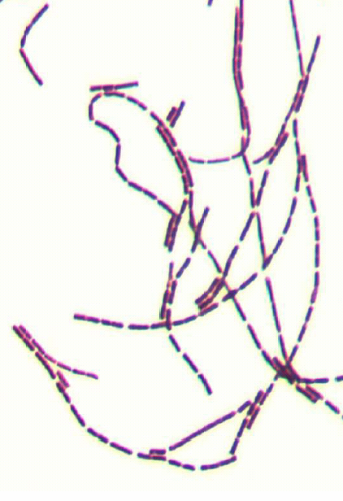

Sentinel Laboratory Procedures for B. anthracis
Notes:
Gram stain of cells taken from a colony—long chains, but spores are not evident.

Slide 12
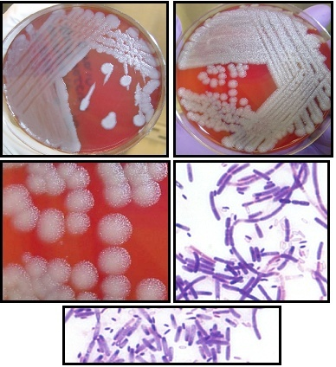
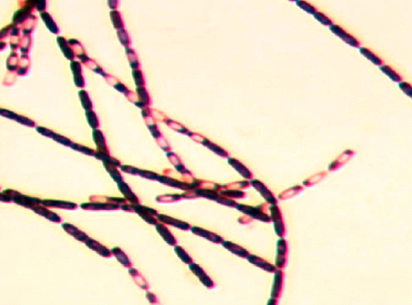
Sentinel Laboratory Procedures for B. anthracis
Notes:
Here are B. anthracis cells showing characteristic broad, blunt-ended bacilli. These cells do have typical spores: oval, central to subterminal, do not cause swelling of the vegetative cell.

Slide 13
Sentinel Laboratory Procedures for B. anthracis
Culture characteristics
  Organism will grow on most routine culture media – BAP, CHOC, but NOT MAC or EMB
  Will grow in routine blood culture systems
  Growth on plate media may be evident as early as 8 hours

Slide 14
Sentinel Laboratory Procedures for B. anthracis
  Colony on BAP @ 35°C, 18-24 hr
    Flat or slightly raised, white to grey
    Undulate edge may show curling resembling a Medusa head
    Surface has “ground glass” appearance
    Tenacious or sticky consistency
    B. anthracis is non-hemolytic

Slide 15
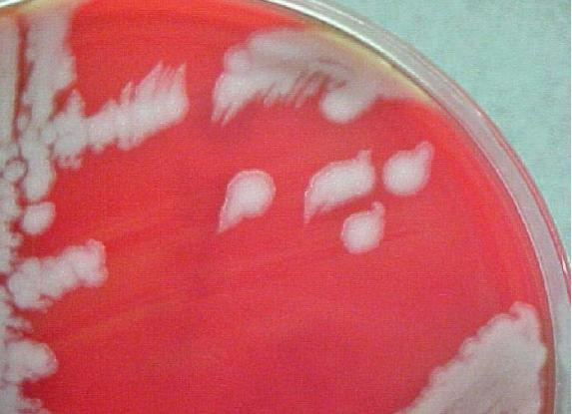
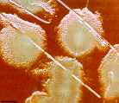
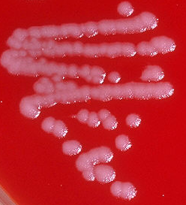
Sentinel Laboratory Procedures for B. anthracis
B. anthracis on sheep blood agar @35C for 18 hrs
Notes:
Edge shape is strain, incubation, and medium dependent. Shape may vary from smooth or entire to “medusa head”, to a single project not unlike a comma.

Slide 16
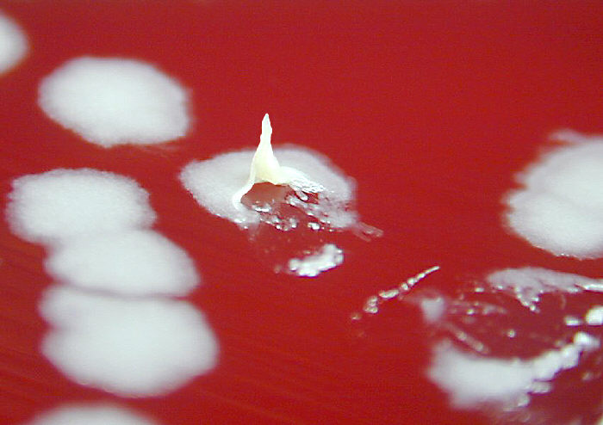
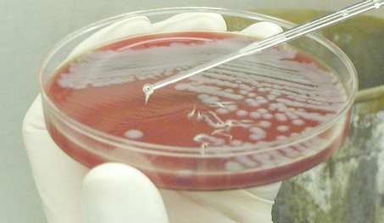
Sentinel Laboratory Procedures for B. anthracis
Notes:
Consistency like petroleum jelly

Slide 17
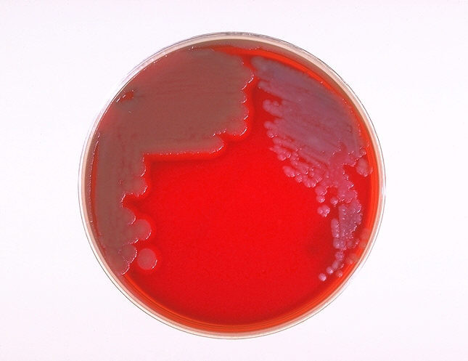
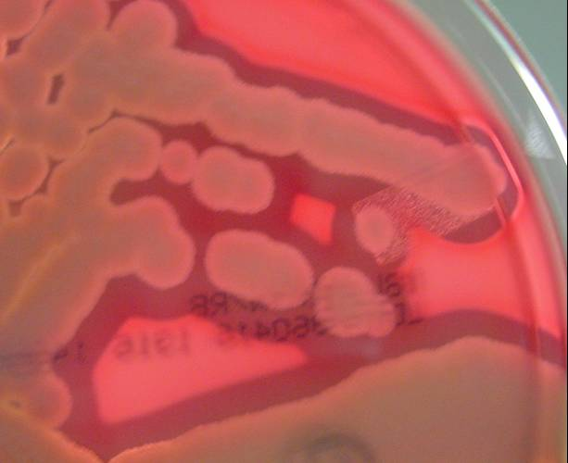
Sentinel Laboratory Procedures for B. anthracis
Growth on sheep blood agar after 18 hrs @35C
B. anthracis
B. cereus
Notes:
This is a culture of wild-type B. anthracis with the “Medusa head” colony morphology. Bacillus Anthracis is gamma hemolytic (no hemolysis.) As you can see the distinct difference from Bacillus cereus which is alpha to beta hemolytic

Slide 18
Screening Tests: Motility
  Motility can be detected by microscopic wet preparation (using TSB)—not recommended due to safety concerns and difficulty interpreting.
  Motility test medium is more reliable but results take longer
Notes:
Where do you obtain the bacteria to inoculate the motility medium? If it is from a BAP or chocolate, please send us those plates or slants when you are dealing with a suspicious organism. Motility slants are not the optimum for growth or optimum for PCR.

Slide 19
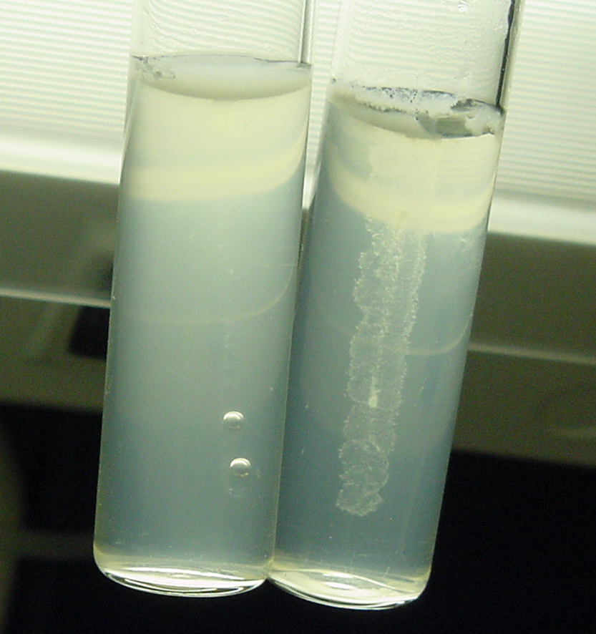
Sentinel Laboratory Procedures for B. anthracis
_{Positive}
_{(B. cereus))}
_{Negative}
_{(B. anthracis)}
Notes:
Using a 24 hour culture of motility medium, you can see the motile organism on the left, the non-motile B. anthracis on the right. TTC indicator (tetrazolium chloride) is not recommended for suspect B. anthracis because it will inhibit growth. Also, always use positive and negative (motile and non-motile) controls.

Slide 20
Screening Tests: Catalase
  Catalase - Positive
  Catalase test is very dangerous—do not perform as a slide test on the open bench
  Recommend doing tube test or doing it in a BSC or doing the slide test in a covered petri dish

Slide 21
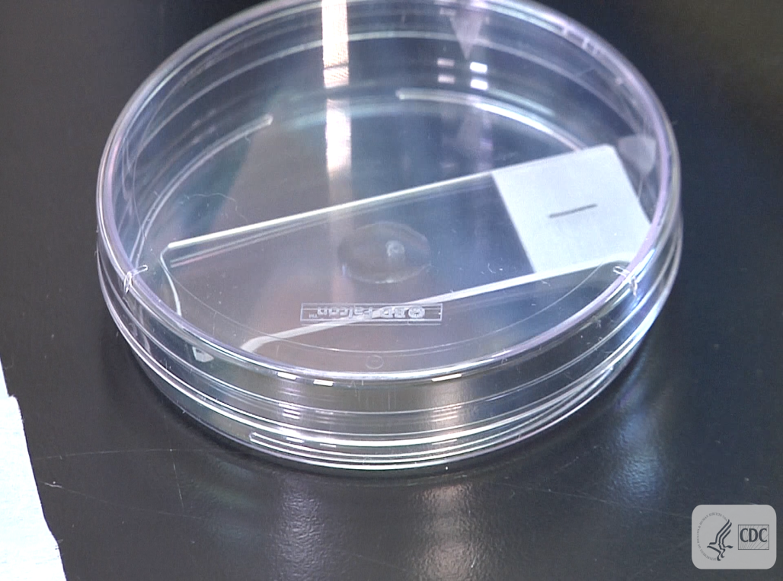
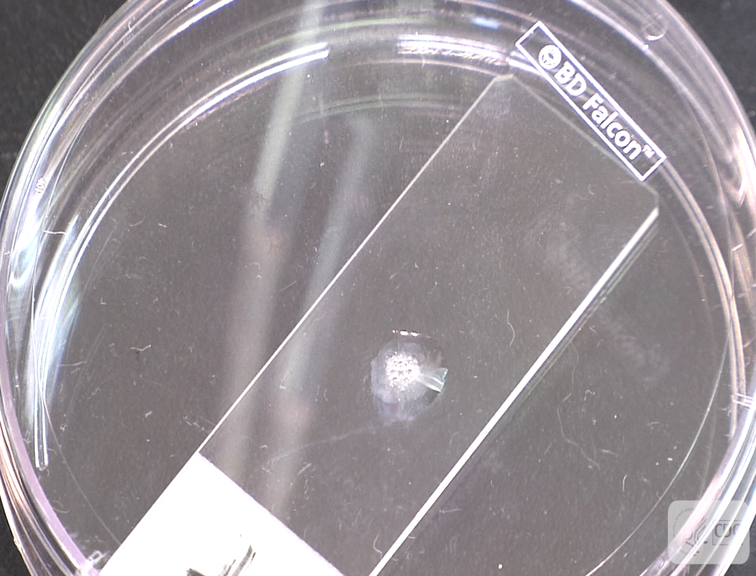
Catalase Test
Negative
Positive
Notes:
Look for bubbles

Slide 22
Screening Tests: Catalase tube test
  Use a small test tube with cap
  Add 1 – 2 drops of hydrogen peroxide to tube
  Transfer colony material from plate to wall of tube just above the level of peroxide
  Cap tube
  Tilt the tube until the peroxide washes over to material on the wall and observe for evidence of bubbling
Notes:
Careful only to not take up any of the esp from blood plates media agar. In doing so you can create a false positive

Slide 23
Catalase tube test for B. anthracis

Slide 24
Sentinel Laboratory Procedures for B. anthracis
B. cereus Group Characteristics
  Ground glass colony/ non-swelling, subterminal spores--B. anthracis, B. cereus, B cereus var. mycoides, and B. thuringiensis
  Non-motile—B. anthracis and B cereus var mycoides (and B. megaterium)
  Non-hemolytic--presumptive B. anthracis
Notes:
Because B. anthracis shares common characteristics with the other members of the “B. cereus group” organisms that might be readily encountered in the environment, careful determination of motility and hemolysis are key to making an accurate rule-out or refereral.

Slide 25
Select Agent Regulations
Wild-type Bacillus anthracis is a Tier 1 Overlap Select Agent requiring registration with CDC and/or USDA for possession, use, storage and transfer
Bacillus cereus biovar anthracis added to the HHS List of Select Agents and Toxins in 2017
Tier 1 agent
Not an Overlap select agent
Bacillus cereus biovar anthracis was first described as an agent of anthrax-like disease in gorillas and chimpanzees in Cameroon and Côte d’Ivoire (Klee). The organism has since been recovered from an elephant and goats in other countries of Africa (Antonation). It carries the 2 virulence plasmids found in Bacillus anthracis.
Notes:
Bacillus anthracis is designated in the United States as a Select Agent. Possession, use, storage and transfer of select agents require registration with Centers for Disease Control and Prevention and/or the United States Department of Agriculture. Bacillus cereus biovar anthracis was first described as an agent of anthrax-like disease in gorillas and chimpanzees in Cameroon and Côte d’Ivoire (Klee). The organism has since been recovered from an elephant and goats in other countries of Africa (Antonation).

Slide 26
B. cereus biovar anthracis
Current recommendations:
Suspect Bacillus spp. isolates that are large Gram-positive bacilli and weakly or non-hemolytic (at 24 hours or less) should be tested for motility and catalase production. Semi-solid medium is recommended for motility for consistent results.
Isolates that are positive for catalase and motility should be investigated further by contacting the patient’s attending physician to determine if the patient has an anthrax-like illness or if the patient has an infection caused by this organism. Travel history is important. If the isolate is deemed significant, the local LRN reference laboratory (e.g. state or local public health laboratory) should be contacted and the isolate forwarded for further testing.
If the sentinel laboratory is unable or unwilling to contact the patient’s physician, notify the local LRN reference laboratory and provide the physician’s contact information and laboratory testing results.

Slide 27
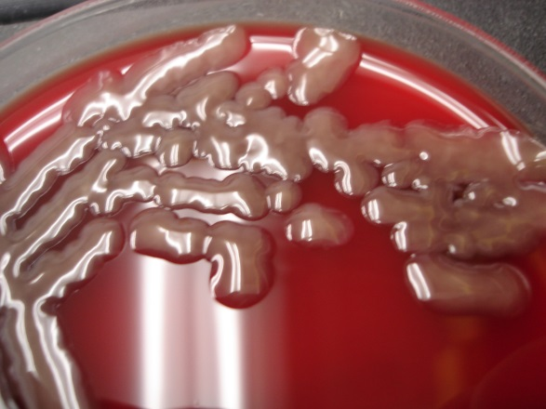
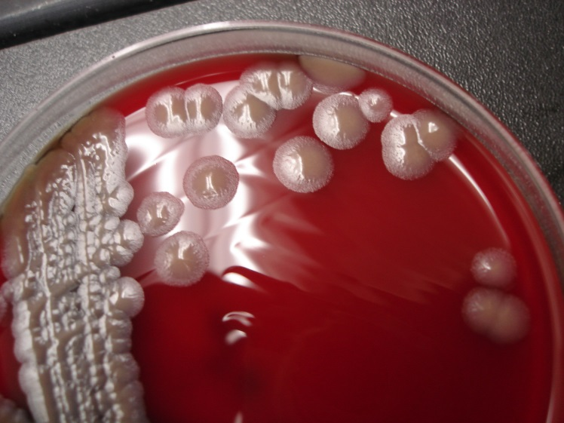
B. cereus biovar anthracis
BAP 5% CO₂
Cameroon (CA) strain Côte d'Ivoire (CI) strain
Photos courtesy of Alex Hoffmaster., PhD., CDC
Notes:
Current ASM/APHL/CDC recommendations:
Sentinel laboratories should continue using the existing ASM Sentinel Level Clinical Laboratory Guidelines.
1) Suspect Bacillus spp. isolates that are large Gram-positive bacilli and weakly or non-hemolytic (at 24 hours or less) should be tested for motility and catalase production. Semi-solid medium is recommended for motility for consistent results.
2) Isolates that are positive for catalase and motility should be investigated further by contacting the patient’s attending physician to determine if the patient has an anthrax-like illness or if the patient has an infection caused by this organism. If the isolate is deemed significant, the local LRN reference laboratory (e.g. state or local public health laboratory) should be contacted and the isolate forwarded for further testing.
3) If the sentinel laboratory is unable or unwilling to contact the patient’s physician, notify the local LRN reference laboratory and provide the physician’s contact information and laboratory testing results.

Slide 28
Major characteristics of Bacillus anthracis:
Gram stain morphology: Large, Gram positive bacilli. Spores may be found in cultures grown in 5% CO₂ but not usually in clinical samples
Colony morphology: Ground glass appearance, non-pigmented, gamma hemolytic on BAP,
No growth on MAC (or EMB)
Yes
Bacillus anthracis
Identification Flowchart
Bacillus anthracis is ruled out. Continue with routine identification.
Yes
Gamma hemolytic (no hemolysis)?
No
Yes
No
Bacillus anthracis is ruled out. Continue with routine identification.
Catalase positive?
Yes
SAFETY: As soon as B. anthracis or B. cereus biovar anthracis is suspected, perform ALL further work in a Class II BSC using BSL-3 practices. If B. anthracis and B. cereus biovar anthracis cannot be ruled out with tests below, do not attempt further ID using commercial automated or kit identification systems.
Bacillus anthracis / B. cereus biovar anthracis NOT ruled out.
Contact your LRN reference laboratory to refer isolate.
Place Reference Lab Contact Information Here
Report: Possible Bacillus anthracis or B. cereus biovar anthracis submitted to LRN reference laboratory for confirmatory testing.

Slide 29
Sentinel Laboratory Procedures for B. anthracis
IF YOU SEE:
  Rapidly growing, flat, “ground-glass” colonies on BAP
  Large Gram positive bacilli
  non-hemolytic
  non-motile
  Catalase positive
  And cannot rule out B. anthracis using the protocol flow chart…….

Slide 30
CONTACT YOUR LRN
reference laboratory

