Slide 1
Agents of Bioterrorism
An Overview for Sentinel Laboratories

Slide 2
Outline
The Laboratory Response Network
Review of the Sentinel Laboratory Protocols
Laboratory Preparedness
Notes:
Three broad topics are presented:
An overview of the LRN and where the Sentinel Laboratory fits into the program—roles and responsibilities
An overview of the agents of bioterrorism with special regard for the Sentinel Laboratory Protocols
A brief discussion of how to proceed developing a laboratory preparedness plan—not just for bioterrorism, but all hazards and possible public health emergencies.
As you design your course, you can pick and chose and re-organize this presentation to meet your needs. For example, each section could be delivered separately, or combined with other topics depending on the focus of your program.

Slide 3
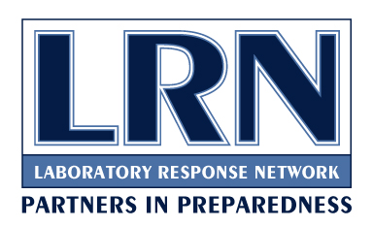
The Laboratory Response Network (LRN)

Slide 4



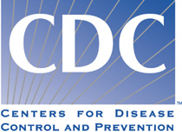
The Laboratory Response Network
Created as part of the government bioterrorism response program
Interconnected system of laboratories
Provide standardized testing in response to a terrorism event
Notes:
Concern over the ability of the laboratory “system” to respond to the threat of bioterrorism, in light of the well-documented need to rebuild the long-neglected public health infrastructure, led to the establishment of the national Bioterrorism Preparedness Initiative. Through this initiative, in February 1999, the Centers for Disease Control and Prevention (CDC) in partnership with the Association of Public Health Laboratories (APHL), the Federal Bureau of Investigation (FBI), the Department of Defense (DoD), and the state public health laboratories, established a collaborative and voluntary system of laboratories, the Laboratory Response Network (LRN) for bioterrorism.
All laboratorians should be familiar with the Laboratory Response Network, whether or not you consider yourself a “member”. The concept was developed to ensure the emergency response that would be mounted following a bioterror agent release--including local, state and federal emergency responders, mobilization of the nation pharmaceutical stockpile, epidemiology teams from CDC—all of this mobilization of resources would be based on the test results confirmed by laboratories using standardized reagents and protocols and by laboratorians trained by or thorough the CDC. Clinical laboratories that would likely be the sentinels in such an event need only be capable of ruling out an isolate as a bioterror agent or sending the isolate to a Level B/C laboratory (State Public Health Laboratory) for confirmation.

Slide 5
The Laboratory Response Network
Laboratory network includes:
    Clinical
    State and local public health
    Veterinary
    Selected federal
    Food testing and environmental
    Military
    International

Slide 6
Notes:
This map shows the 153 LRN labs as of March 2014

Slide 7
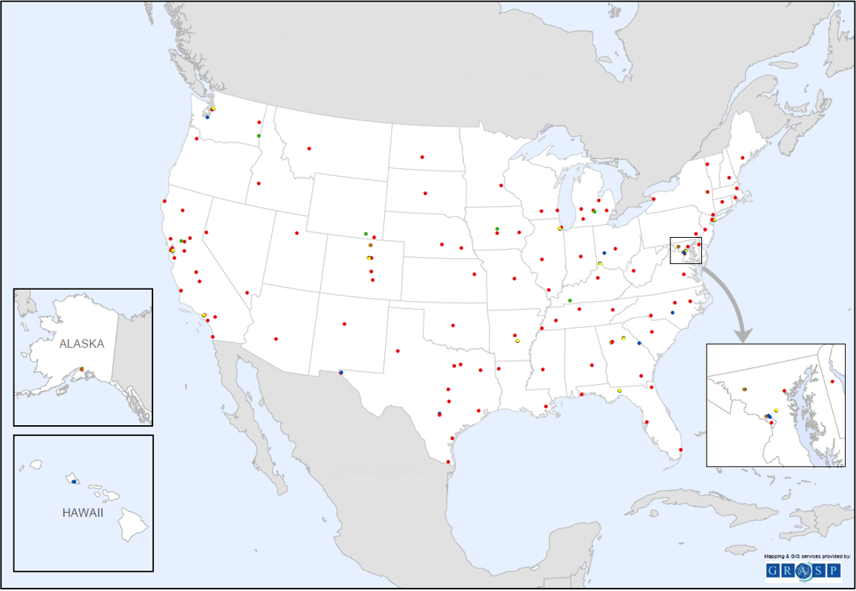
Notes:
This is from the updated April 2019 website. It is missing the legend and international partner. You need to decide if you want to use this map.

Slide 8
The Laboratory Response Network
National Laboratories
(definitive characterization)
Reference Laboratories
(confirmatory testing)
Sentinel Laboratories
(recognize, rule out, refer)
Notes:
Current structure—three levels: the Sentinel Laboratories, Reference Laboratories, and the National Laboratories.
National laboratories, including those operated by CDC, U.S. Army Medical Research Institute for Infectious Diseases (USAMRIID), and the Naval Medical Research Center (NMRC), are responsible for specialized strain characterizations, bioforensics, select agent activity, and handling highly infectious biological agents.
Reference laboratories are responsible for investigation and/or referral of specimens. they are made up of more than 150 state and local public health, military, international, veterinary, agriculture, food, and water testing laboratories. in addition to laboratories located in the United States, facilities located in Australia, Canada, the United Kingdom, Mexico and South Korea serve as reference laboratories abroad.
Sentinel laboratories play a key role in the early detection of biological agents. sentinel laboratories provide routine diagnostic services, rule-out, and referral steps in the identification process.

Slide 9
Sentinel Laboratory Definition
A Sentinel Clinical Laboratory is formally defined as a laboratory that is “certified to perform high complexity testing under the Clinical Laboratory Improvement Amendments of 1988 (CLIA) by the Centers for Medicare & Medicaid Services (CMS) for the applicable Microbiology specialty, or the laboratory is a Department of Defense (DoD) Laboratory certified under the DoD Clinical Laboratory Improvement Program (CLIP), or the laboratory is a veterinary medical diagnostic laboratory that is fully accredited by the American Association of Veterinary Laboratory Diagnosticians (AAVLD). Laboratory in-house testing includes Gram stains and at least one of the following: lower respiratory tract, wound or blood cultures.
Note: If the laboratory does not fully meet the definition above, all clinical laboratories should still act in accordance to the full list of items in the Responsibilities of the Sentinel Clinical Laboratory section below, as it applies to their facility.”
Notes:
Responsibilities of the Sentinel Clinical Laboratory
Clinical core/central laboratories are responsible for providing their satellite facilities with written directions and training as needed for appropriate sample collection and handling. Core/central laboratories should also provide satellite facilities with procedures for the recognition of the agents of bioterrorism and assure training at a level commensurate with the complexity of services offered at that facility.
The laboratory maintains the capability to perform the testing outlined in the ASM Sentinel Level Clinical Microbiology Laboratory Protocols and Guidelines for Suspected Agents of Bioterrorism and Emerging Infectious Diseases² and must demonstrate annual competency by participation in proficiency testing or exercises, such as the APHL, CDC and College of American Pathologists (CAP) Laboratory Preparedness Exercise (LPX), State-developed proficiency/challenge sets, or other equivalent assessment.
The laboratory is familiar with reportable disease guidelines in its jurisdiction, and has policies and procedures in place to refer clinical and diagnostic samples or isolates suspected to contain agents of public health significance to the appropriate local or state public health laboratory.
The laboratory ensures a sufficient number of personnel have met the applicable federal regulations for packaging and shipping of Category A and B infectious substances.¹
The laboratory has policies and procedures for the collection and referral of suspect biothreat agents or other emerging threat samples and/or isolates to the appropriate LRN reference laboratory consistent with the American Society for Microbiology (ASM) Sentinel Level Clinical Microbiology Laboratory Protocols and Guidelines for Suspected Agents of Bioterrorism and Emerging Infectious Diseases.²
The laboratory complies with the practices as outlined in the current edition of the Biosafety in Microbiological and Biomedical Laboratories (BMBL) guidelines³ and those detailed in the Guidelines for Safe Work Practices in Human and Animal Medical Diagnostic Laboratories.⁴
The laboratory has a biosafety and biosecurity risk assessment policy and ensures that such risk assessments are routinely performed as part of their quality management program.
Based on the laboratory’s risk assessment, the laboratory has and utilizes a Class II or higher currently certified Biological Safety Cabinet (BSC) when there is a risk of aerosol production or when working with a biological threat agent or an emerging threat organism is suspected.
The laboratory complies with applicable Occupational Safety and Health Administration (OSHA) regulations for bloodborne pathogens⁵ and has a respiratory protection program.
The laboratory complies with the applicable rules and regulations of the Federal Select Agent Program.⁶
The laboratory has policies and procedures for secure storage of any remaining suspect biothreat or other emerging threat agent material retained within its facilities until it is transferred or destroyed.
The laboratory has policies and procedures for final decontamination/destruction of any remaining suspect biothreat or other emerging threat agent material within the required time-frame (e.g., primary samples or subcultures retained within its facilities).

Slide 10
LRN Reference Laboratories
  Formally registered with the LRN
  Connected through a secure website for information, results sharing and ordering reagents
  Receive isolates from Sentinel Laboratories for confirmation
Notes:
The next level are the LRN Reference Laboratories.

Slide 11
LRN Reference Laboratories
  Receive proficiency test samples from the LRN
  Perform rapid molecular tests to detect biological agents
  May process environmental samples
  Refer isolates to the LRN National Reference Laboratory
Notes:
The next level are the LRN Reference Laboratories.

Slide 12
LRN National Laboratories
  CDC, USAMRIID
  Have highest biosafety level
  Work with highly dangerous/infectious agents (smallpox, Ebola)
  Further characterize biological agent isolates
Notes:
Finally, the LRN National Reference Labortories.

Slide 13
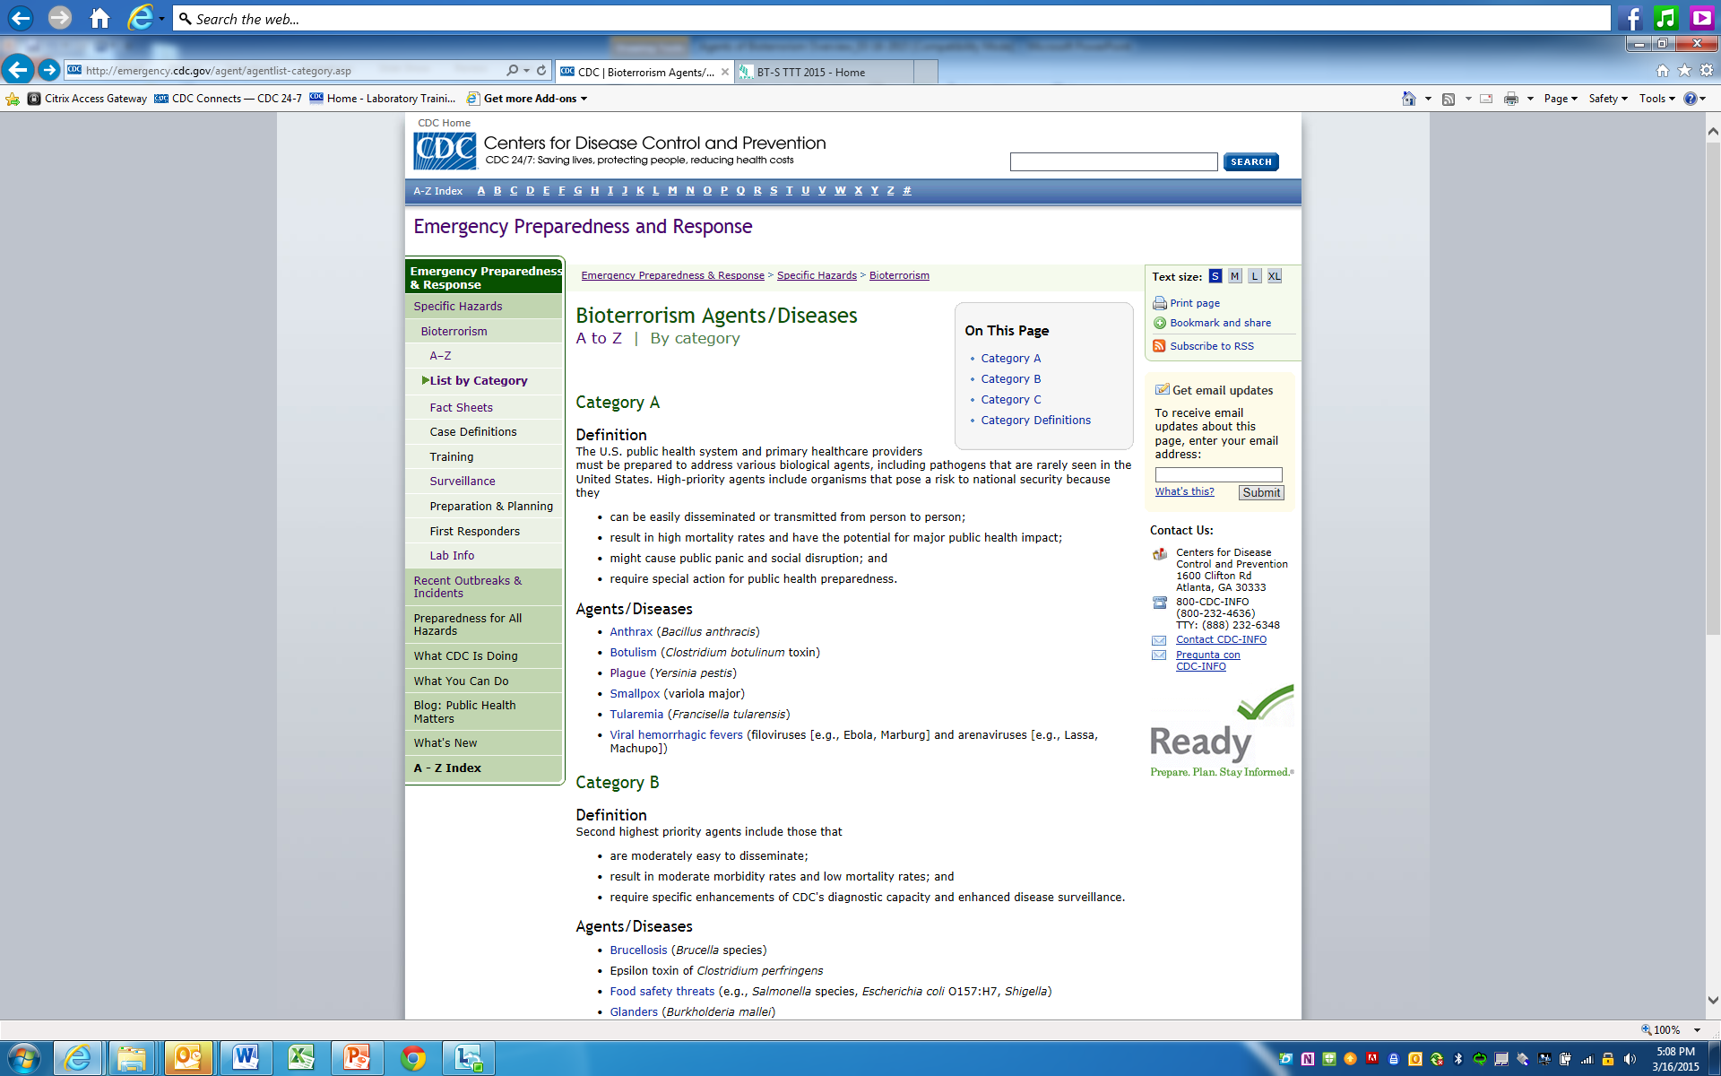
LRN Agent Categories
Notes:
Don’t confuse with P&S categories A and B. they are separate from the Select Agent List and Tier 1 – different agencies.

Slide 14
LRN Structure for Testing and Specimen Flow
National Laboratory (CDC)
Contact CDC
Emergency Operations
Center for BRRAT Lab
Consultation
Agent Specific Laboratory
SENTINEL
LABORATORY
LRN
REFERENCE
LABORATORY
Notes:
When a Sentinel Laboratory cultures a suspect organism that it cannot rule-out as a BT agent, the isolate then moves through the LRN as seen above.
BRRAT – Biological Rapid Response and Advanced Technology Laboratory

Slide 15
Important Links
  LRN: https://emergency.cdc.gov/lrn/
  Biological Structure: https://emergency.cdc.gov/lrn/biological.asp
  Laboratory Information: https://emergency.cdc.gov/labissues/index.asp
  Bioterrorism Agents: https://emergency.cdc.gov/bioterrorism/index.asp
Notes:
Finally, the LRN National Reference Labortories.

Slide 16
The Laboratory Response Network -- Chemical
Level 2
Level 3
activities plus:
  Cyanide
  Nerve Agents
  Toxic metals
Level 3
Competency in collecting, storing, and shipping clinical specimens
Comprehensive chemical terror response plan
CDC
Level 1
Level 2
activities plus:
  Nerve Agents
  Mustard Agents
  Other toxic industrial chemicals
Notes:
Although we are focusing on bioterrorism and the LRN-B arm of the government response program, we need to recognize that National Center for Environmental Health at CDC has established the LRN-C to respond to a possible chemical release. Sentinel Laboratories need to be able to collect, package and ship specimens to LRN Reference or National Reference Laboratories as directed.
In the event of a possible release of chemical agent (and that could be an industrial accident), clinical samples—blood and urine—would be collected from victims and sent to NCEH in Atlanta. Using the GC mass spectrophotometer that can screen 150 metabolites or adducts, the particular agent can be identified. CDC will then contact those state laboratories that can detect the analyte and the will serve as high-through-put surge laboratories and will receive samples from other victims, possible victims, and worried well. This meets the requirement of detecting possible terror agents accurately and rapidly.
Although this structure covers the state public health laboratories, LRN Sentinel Laboratories would resemble the Level 3 laboratories by having chemical terror response as part of their overall terrorism response plan, and would be ready to collect, package, and ship specimens as appropriate.

Slide 17
Sentinel Laboratory Protocols
Protocols are maintained by American Society for Microbiology on web site (www.asm.org)
  https://asm.org/Articles/Policy/Laboratory-Response-Network-(LRN)-Sentinel-Level-C
Integrate protocols into laboratory SOP and review annually along with other laboratory documents

Slide 18
Sentinel Laboratory Protocols
Do not process nonclinical (environmental or animal) specimens in hospital or commercial reference laboratories; restrict processing to human clinical specimens only.
Nonclinical specimens should be directed to your designated LRN reference laboratory.

Slide 19
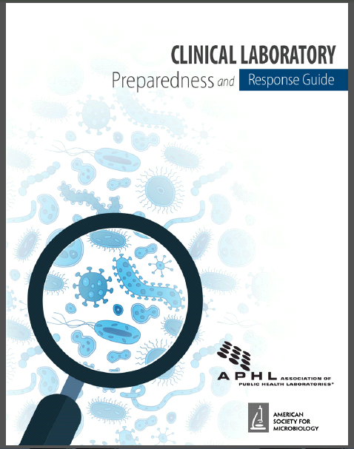
Clinical Laboratory Preparedness and Response Guide
Notes:
Tell them about this new reference guide. All of the changes except for B. cereus bv anthracis are in it. Give them a link to your website where they can download it with your contact information.

