Slide 1

Legacy Conditions Revisited: Newborn Screening for Congenital Hypothyroidism
Thursday, August 1, 2024
This webinar is supported by Cooperative Agreement # 5NU60OE000103 funded by the Centers for Disease Control and Prevention. Its contents are solely the responsibility of the authors and do not necessarily represent the official views of CDC or the Department of Health and Human Services.

Slide 2
Objectives
Describe the landscape of testing for congenital hypothyroidism in newborn screening programs
Discuss the challenges and complexities of screening for congenital hypothyroidism.

Slide 3
Moderators
Adrienne Manning, BS, Division Director, Newborn Screening, Connecticut Department of Public Health, Katherine A. Kelley Public Health Laboratory
Inderneel Sahai, MD, FACMG, Chief Medical Officer, New England Newborn Screening Program

Slide 4
Speaker
Ernest M. Post, MD, pediatric endocrinologist, Cooper Medical School of Rowan University

Slide 5
Newborn Screening for
Congenital Hypothyroidism
APHL 8/1/2024
Ernest M. Post, MD
poste@Rowan.edu
Pediatric Endocrinologist
Cooper Medical School of Rowan University
NJ Newborn Screening Advisory Review Committee
CLSI Newborn Screening Expert Panel
Notes:
PK

Slide 6
Disclaimers and Guidelines
These are my own views.
I have no financial conflicts of interest
  CLSI NBS Expert Panel & DDC - volunteer
Some content could be proprietary
Medical jargon – please stop me
Notes:
- me
- school background
- lcme update- msche
- bldg
- curriculun; what's unique about school
- admissions update
- rowan and cmsru mutual benefits
- development; moving forward
- opportunities
- CMSRU alumni

Slide 7
Agenda
Resources
Overview of CH
  Etiology
  Signs/Symptoms
  Specialists
  Treatment Options
  Outcome(s)
Laboratory Assays
    Biochemical
    Molecular(Genetic)
Special Considerations
  NICU
  OOH Births
Equity Considerations
  Ancestral Group
  Geography
  Access to care
Resources
Rose SR et al. CH Screening and Management. Pediatrics. 2023 Jan 1;151(1):e2022060419. doi: 10.1542/peds.2022-060419. PMID: 36827523. (20 pages)
CLSI. Newborn Screening for Congenital Hypothyroidism. 1st ed. CLSI Guideline NBS10. Clinical Laboratory and Standards Institute; 2024. (104 pages)
Notes:
Comment on urgency sequence CAH > CH > XALD

Slide 8
TLAs (Three Letter Acronyms)
ACMG American College of Medical Genetics
DBS Dried blood spot
LMIC Low and Middle Income Countries
NBS Newborn Screening (newborn bloodspot screening)
OOH Out of hospital
PPV Positive predictive value
T3 tri-iodo-thyronine
T4 tetra-iodo-thyronine, thyroxine
TSH thyroid stimulating hormone
Notes:
Two names for many entities; ACTH other name; NBS incorrect name

Slide 9
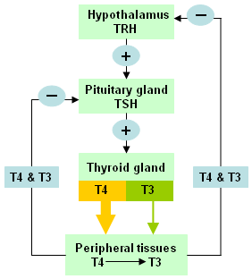
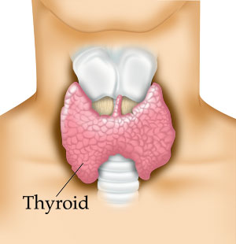
Thyroid Anatomy/Physiology
Notes:
NOT to scale; Left side only; Describe negative feedback, effect of T4/T3 on TSH

Slide 10
Congenital Hypothyroidism (CH)
Irreversible physical and cognitive impairment if not treated early (before ~2 wks)
NBS started in 1970s
  All of US and 1/3 of world
DBS tested for TSH (or total T4)
Birth prevalence 1:2,000 to 1:4,000
1,873 cases/yr in US from 4M births

Slide 11
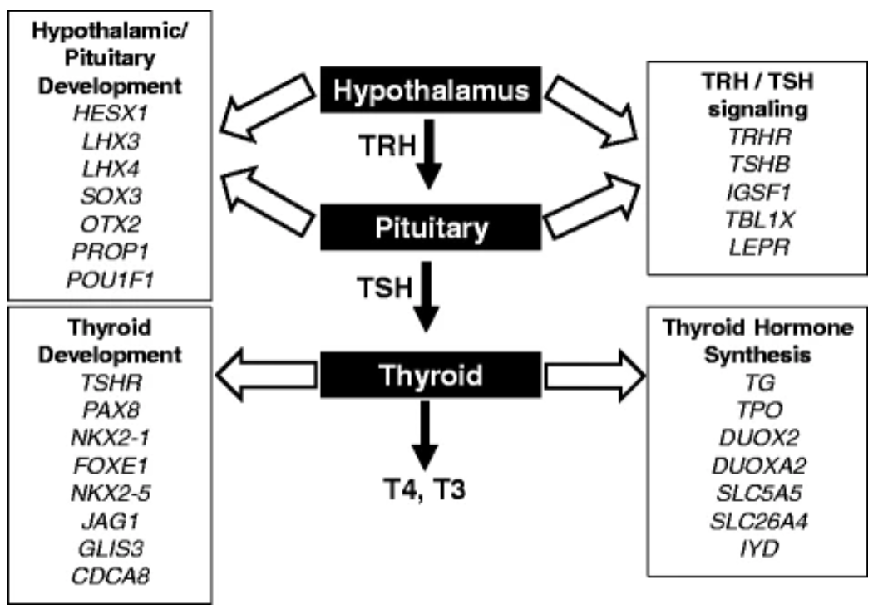
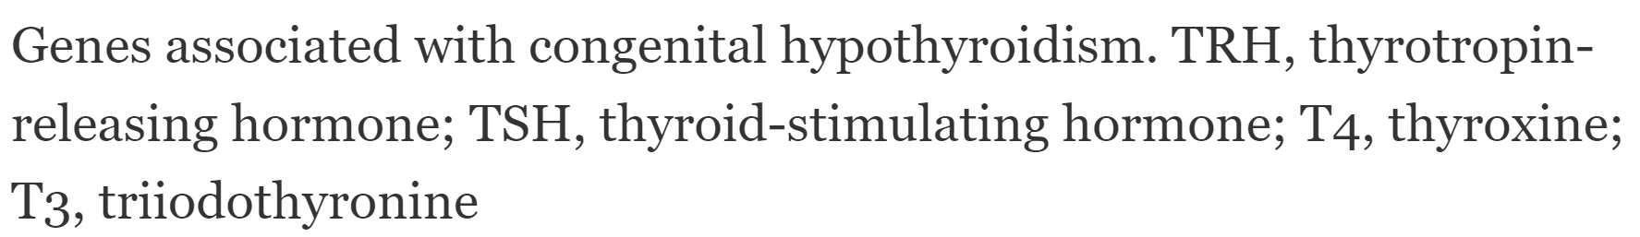
Causes of CH
Brain abnormalities
Anencephaly
Septo-optic dysplasia
Pituitary stalk
Pituitary gland
Thyroid gland
Iodine deficiency
TSH insensitivity
dysgenesis/agenesis
dyshormonogenesis (7)
maternal autoimmunity
Peripheral resistance
Membrane transporter
Thyroid receptor
Transient CH
resolves at 2-3 years
Cherella, C.E., Wassner, A.J. Congenital hypothyroidism: insights into pathogenesis and treatment. Int J Pediatr Endocrinol 2017, 11 (2017).
https://doi.org/10.1186/s13633-017-0051-0
Most cases sporadic. Identifiable genetic causes explain only 10-15% of CH.
Notes:
Central vs Primary CH

Slide 12
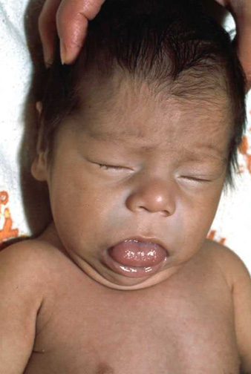
Symptoms of CH
NONE
Open posterior fontanel
Wide open cranial sutures
Constipation
Hypotonia (low muscle tone)
Hoarse cry
Feeding or sucking difficulty
Skin mottling
Macroglossia (big tongue)
Hyperbilirubinemia (jaundice)
Rough, dry skin
Umbilical hernia
Hypothermia, cold and pallor
Edematous (face)
Goiter
BW > 3.5 kg

Slide 13
CH Outcomes
Untreated
Irreversible cognitive impairment (untreated early)
Irreversible short stature (untreated while growing)
Constipation, dry skin/hair, cold intolerance
Weight gain failure to thrive
Treated
Under “14 days” - NORMAL
May be slightly below siblings
Treated late or inadequate dose – some impairment
Rovet J. Children with congenital hypothyroidism and their siblings : Do they really differ? Pediatrics. 2005;115;52-57
Karin A, Selva K, Harper A, Downs A, Blasco P, LaFranchi S. Neurodevelopmental outcomes in congenital hypothyroidism: Comparison of initial T4 dose and time to reach target T4 and TSH
Notes:
In utero effects

Slide 14
NBS for CH
Dried blood spot (point of care – LMIC only)
First tier TSH-most commonly used in US and worldwide
First tier T4 (several US states)
able to detect central CH (TSH NOT elevated)
false positives from TBG defic and premees
requires second tier TSH
Sensitivity and Specificity determined by cut-off
sensitivity - % of CH cases detected
specificity - % of non-CH having normal result
PPV – percent of those who test + that have CH

Slide 15
CH NBS Follow-up
TSH high (defined by each state, w or w/o low T4)
Immediate referral to Ped Endo
serum Free T4, TSH
consider imaging: sonogram, thyroid scan
start treatment ASAP
TSH borderline
Repeat dried blood spot OR serum tests
Referral to Ped Endo depending on results
Genetic testing optional if diagnosed with CH
Notes:
This is a simplification of the next slide. First tier T4 NOT shown.

Slide 16
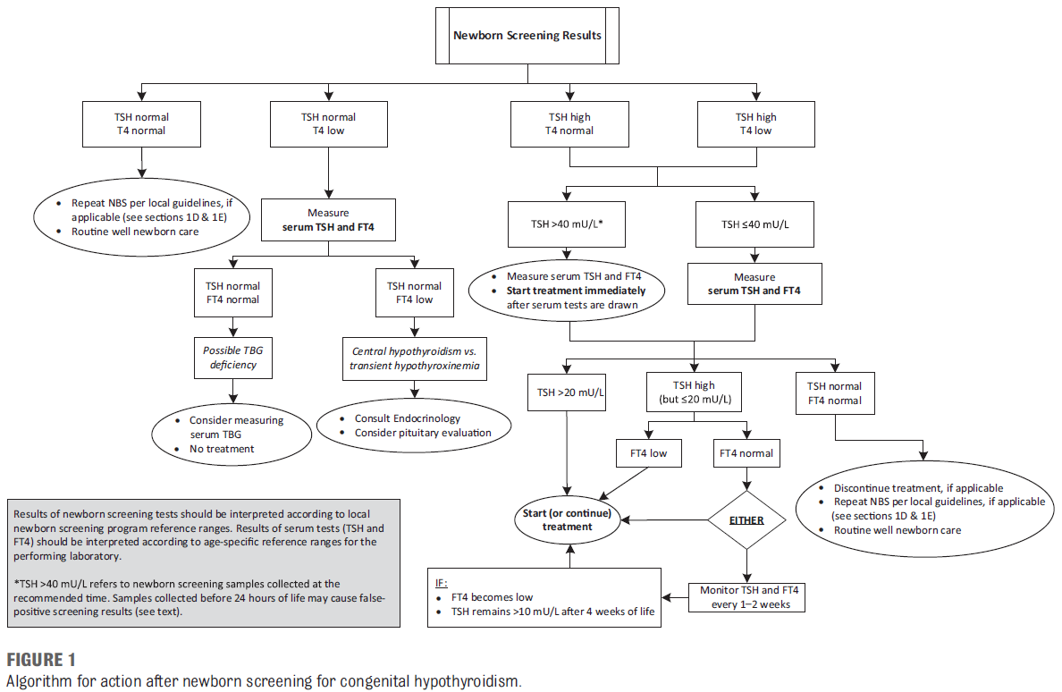
Rose SR, Wassner AJ, Wintergerst KA, Yayah-Jones NH, Hopkin RJ, Chuang J, Smith JR, Abell K, LaFranchi SH; SECTION ON ENDOCRINOLOGY EXECUTIVE COMMITTEE; COUNCIL ON GENETICS EXECUTIVE COMMITTEE. Congenital Hypothyroidism: Screening and Management. Pediatrics. 2023 Jan 1;151(1):e2022060419. doi: 10.1542/peds.2022-060419. PMID: 36827523.

Slide 17
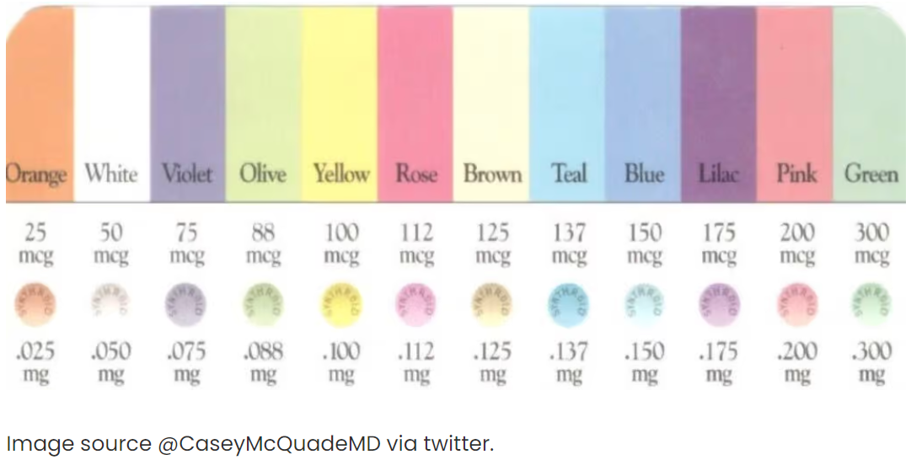
CH Treatment
Levothyroxine (<$0.50 per day, generic)
start 10-15 mcg/kg/day
titrate based on lab results
adult 2 mcg/kg/day
T3 or Desiccated thyroid – short acting

Slide 18
CH Clinical Follow-up
Monitor
free T4 (upper half of normal for age)
TSH (normal for age)
growth and development
Every
1-2 months for 6 months
2-3 months for second 6 months
3-4 months from 1-3 yrs
6-12 months until growth complete
annually thereafter
Rose SR, Wassner AJ, Wintergerst KA, Yayah-Jones NH, Hopkin RJ, Chuang J, Smith JR, Abell K, LaFranchi SH; SECTION ON ENDOCRINOLOGY EXECUTIVE COMMITTEE; COUNCIL ON GENETICS EXECUTIVE COMMITTEE. Congenital Hypothyroidism: Screening and Management. Pediatrics. 2023 Jan 1;151(1):e2022060419. doi: 10.1542/peds.2022-060419. PMID: 36827523.

Slide 19
Special Considerations – all disorders
NICU
Many false positives
CH – delayed maturation >> low T4
Vital Signs being monitored often
Repeat screens routine in most states
Routine (all babies) second screens
Done is handful of states
Not clear if additional cases detected due to cutoffs
Out of Hospital (OOH) Births
Requirement same as in hospital (in NJ)
Some declined because of fee ($150 in NJ)

Slide 20
Equity – all disorders
State mandates do not discriminate
Race and ethnicity irrelevant; each baby counts
OOH births may be more frequent among poor
Midwife may charge additional fee for NBS
Medical care should be accessible to all babies in US
US citizens
Medicaid eligibility varies by state
Needs to cover services, tests and meds
2/3 of world births do not get screened!
4 of 47 European countries
LMICs usually have no NBS.

Slide 21
CLSI NBS Guidelines
NBS01 – DBS Specimen Collection
NBS02 - Follow-up and Education
NBS03 - Preterm, Low Birth Weight, and Sick Newborns
NBS04 - Tandem Mass Spectrometry
NBS05 – Cystic Fibrosis
NBS06 – Severe Combined Immunodeficiency
NBS07 - Pompe Disease
NBS08 - Hemoglobinopathies
NBS09 - X-Linked Adrenoleukodystrophy,
NBS10 – Congenital Hypothyroidism
NBS11 – Congenital Adrenal Hyperplasia (soon)
NBS12 – Galactosemia (2025)
NBS13 – Spinal Muscular Atrophy (2025)

Slide 22
Resources
Rose SR et al. CH Screening and Management. Pediatrics. 2023 Jan 1;151(1):e2022060419. doi: 10.1542/peds.2022-060419. PMID: 36827523.
CLSI. Newborn Screening for Congenital Hypothyroidism. 1st ed. CLSI Guideline NBS10. Clinical Laboratory and Standards Institute; 2024.
ACMG ACT(ion) Sheets: https://www.ncbi.nlm.nih.gov/books/NBK55827/
Loeber et al, Neonatal Screening in Europe Revisited: An ISNS Perspective on the Current State and Developments Since 2010, Int J Neonatal Screen. 2021 Mar; 7(1): 15, doi: 10.3390/ijns7010015.

Slide 23
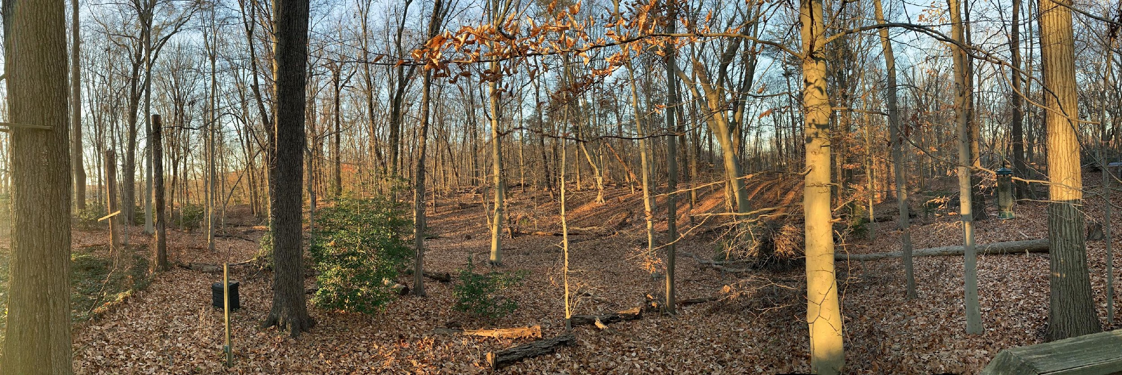
Questions?

Slide 24
Thank you.

Slide 25

Q&A

Slide 26
Post-webinar evaluation: Three questions
https://www.surveymonkey.com/r/R3R37FZ
Your feedback is appreciated!
Let us know what you would like to see in future NBS webinars and trainings.

Slide 27
Stay Tuned for Part Two!
Legacy Conditions Revisited: Newborn Screening for Congenital Hypothyroidism
A Deeper Dive into Screening Algorithms
Featuring speakers from state NBS programs
To be announced on the APHL NewSTEPs ColLABorate listserv

Slide 28
Thank you!

