Slide 1
Lab Math
Primer Preparation and Dilution
Carlos A. Saavedra-Matiz, MD
Newborn Screening Program
Wadsworth Center
New York State Department of Health
February 25, 2020
APHL-CDC

Slide 2
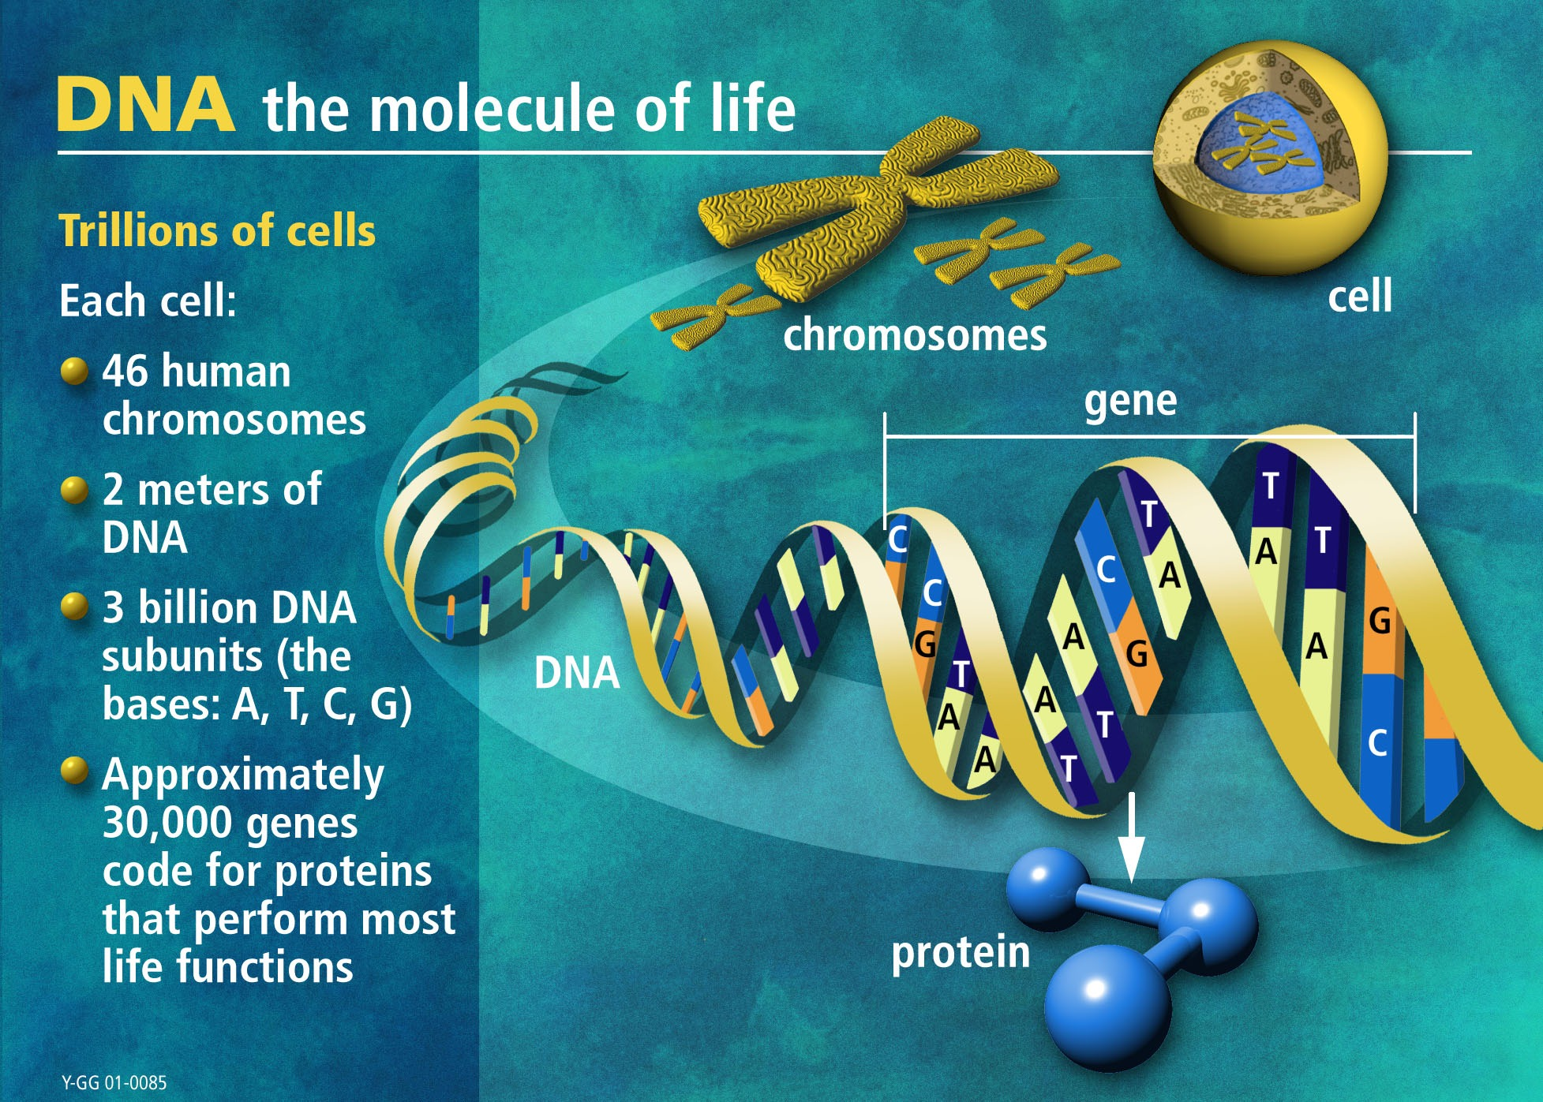

Slide 3
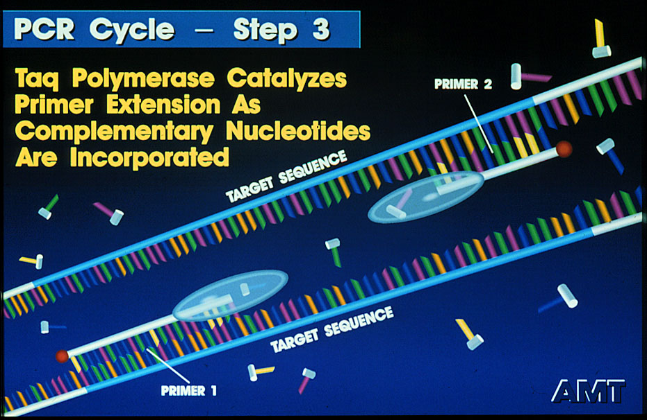

Slide 4
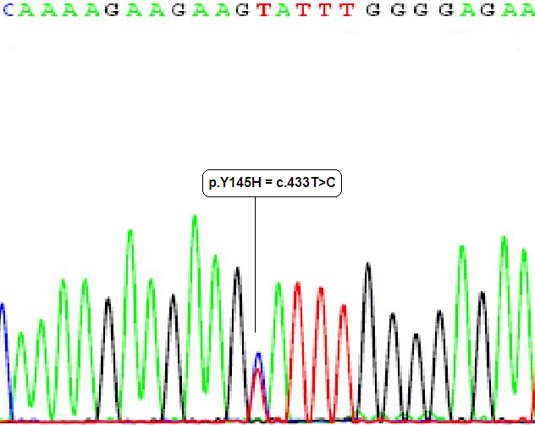
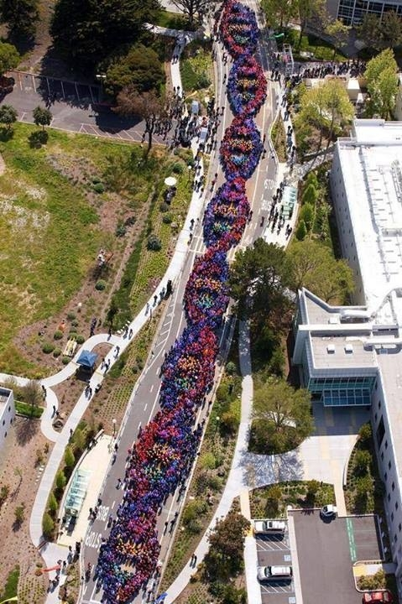

Slide 5
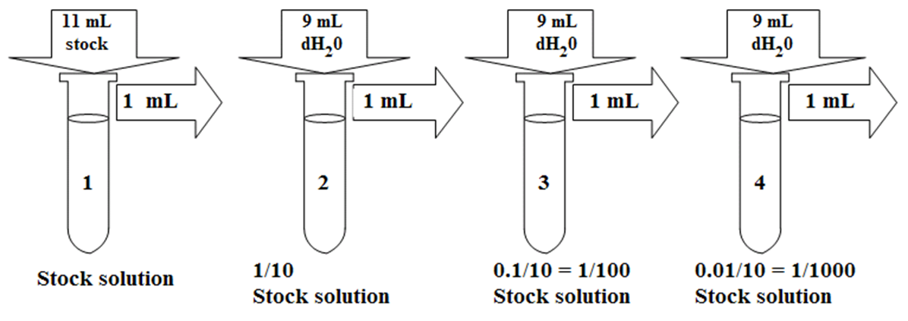
Concentration of a Solution:
1M solution of NaOH (²³Na¹⁶O¹H) = 40 g NaOH dissolved in 1 liter of H₂O = 1N
1mM (miliM) = 1:1000 dilution of 1M or 10⁻³
1μM (microM) = 1:1000 dilution of 1mM or 1:1,000,000 of 1M or 10⁻⁶
1nM (nanoM) = 1:1000 dilution of 1 μM or 1:1,000,000,000 of 1M or 10⁻⁹
1pM (picoM) = 1:1000 dilution of 1 nM or 1:1,000,000,000,000 of 1M or 10⁻¹²

Slide 6
Demonstration: 100 μM = 100 μMoles/L = 0.1 nMoles/μL
100 μM = 100 μMoles/L
= 100 μMoles / 1,000 mL or 100 μMoles / 10³ mL
= 100,000 nMoles / 1,000 mL or 100 x 10³ nMoles / 10³ mL
= 100 nMoles / mL
= 100 nMoles / 1,000 μL or 100 nMoles / 10³ μL
= 0.1 nMoles/μL = 100 μM

Slide 7
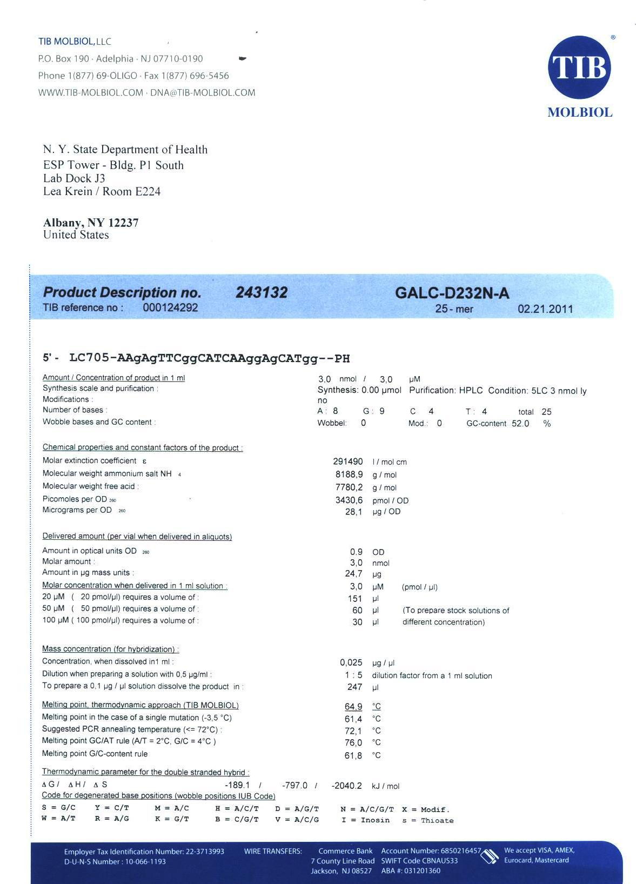

Slide 8
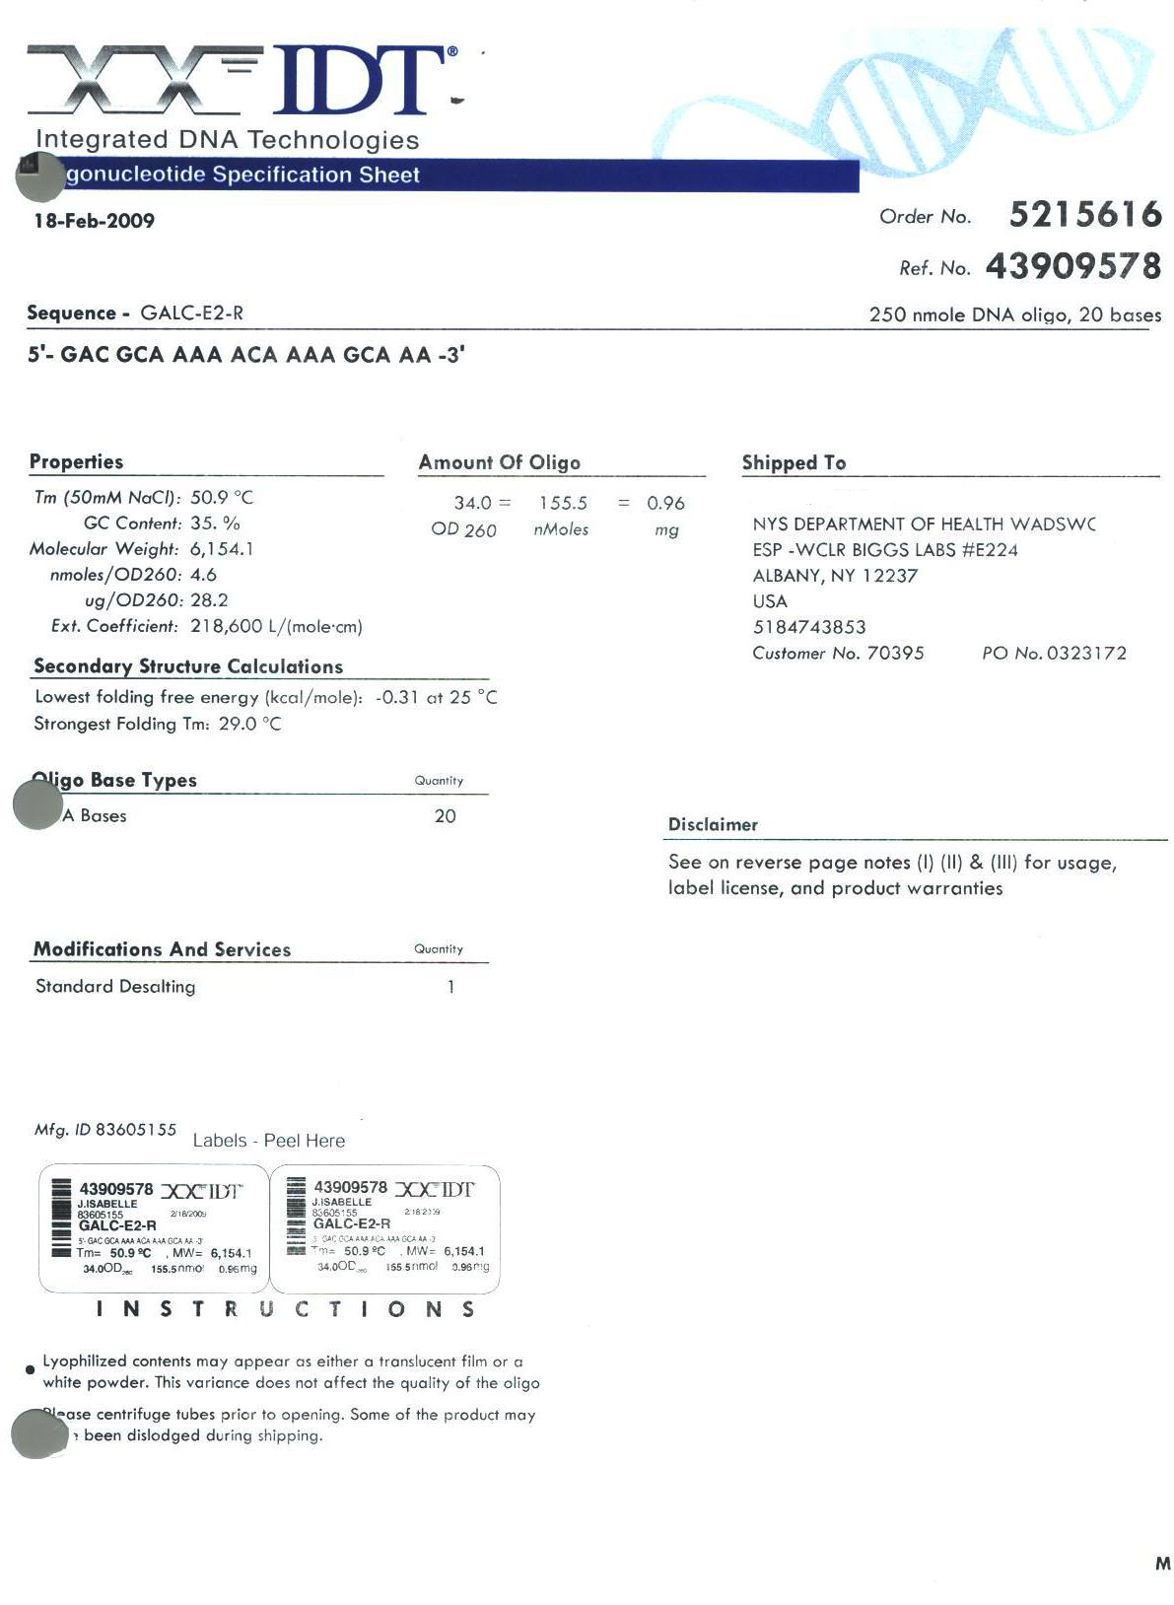

Slide 9
Concept: 0.1 nMoles/μL = 100 μM
Primer reported Amount: 155.5 nMoles
If you want a Stock Solution of 100 uM, resuspend oligo in 1555 μL of ddH₂O or TE buffer:
      155.5 nMoles / 1555 μL = 0.1 nMoles/μL = 100 μM
If you want a Working Solution of 10 uM make a 1:10 dilution from the stock:
- Add 1.0 μL from Stock (100 μM) to 9.0 μL of ddH₂O or TE buffer (1:10).
- 5.0 μL 45.0 μL
      100 μM x 1 μL / 10 uL = 10 μM
Concentration in your final PCR mix: C₁V₁ = C₂V₂
  10 μM x V₁ = 0.3 μM x 20 μL V₁ = 0.3 μM x 20 μL = 0.6 μL
10 μM
http://www.idtdna.com/Calc/resuspension/

Slide 10
Primer reported Amount: 155.5 nMoles = 0.96 mg = 960 μg
If you want a Stock Solution of 1 μg/μL, resuspend oligo in 960 μL of ddH₂O or TE buffer:
      960 μg / 960 μL = 1.0 μg/μL = 1000 ng/μL
If you want a Working Solution of 100 ng/μL make a 1:10 dilution from the stock:
- Add 1.0 μL from Stock (1 μg/μL) to 9.0 μL of ddH₂O or TE buffer (1:10).
      1000 ng x 1 μL / 10 μL = 100 ng/μL
Concentration in your final PCR mix: C₁V₁ = C₂V₂
  100 ng/μL x V₁ = 3 ng/μL x 20 μL V₁ = 3 ng/μL x 20 μL = 0.6 μL
100 ng/μL
http://www.idtdna.com/Calc/resuspension/

Slide 11
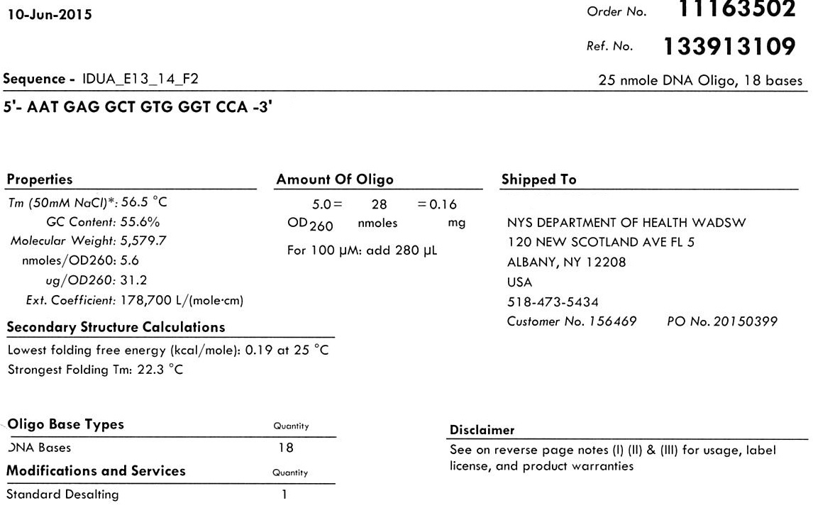
Same on 03-Aug-2018

Slide 12
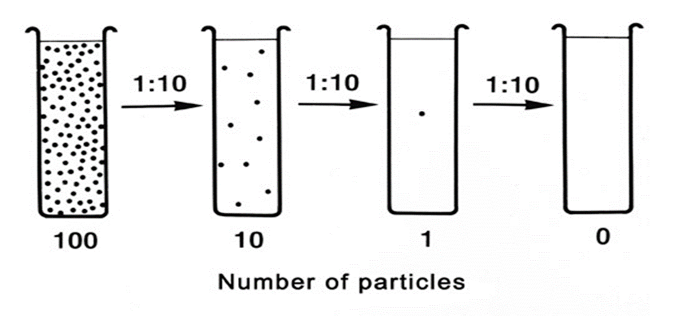
Prepare Stock Solution and Working solution for primers forward and reverse to amplify exon 5 of the ABCD1 gene.
You have received:
ABCD1-E5-F1: 183.5 nMoles
ABCD1-E5-R1: 354.8 nMoles
Once your primer solutions are prepared do the calculations needed to run a PCR reaction using a 0.25 uM concentration for each primer in a 20 uL total volume PCR.

Slide 13
