Slide 1
Instructions for Using APHL’s Member Portal

Slide 2
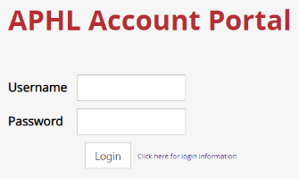
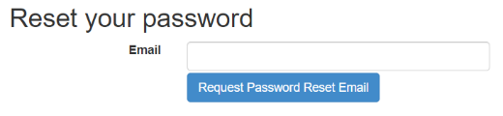
Log in to take control of your account
You will need to use your email address/username and password to gain access to our Member Portal.
If you ever forget your password, click the “Click here for login information” link to have your password reset.

Slide 3
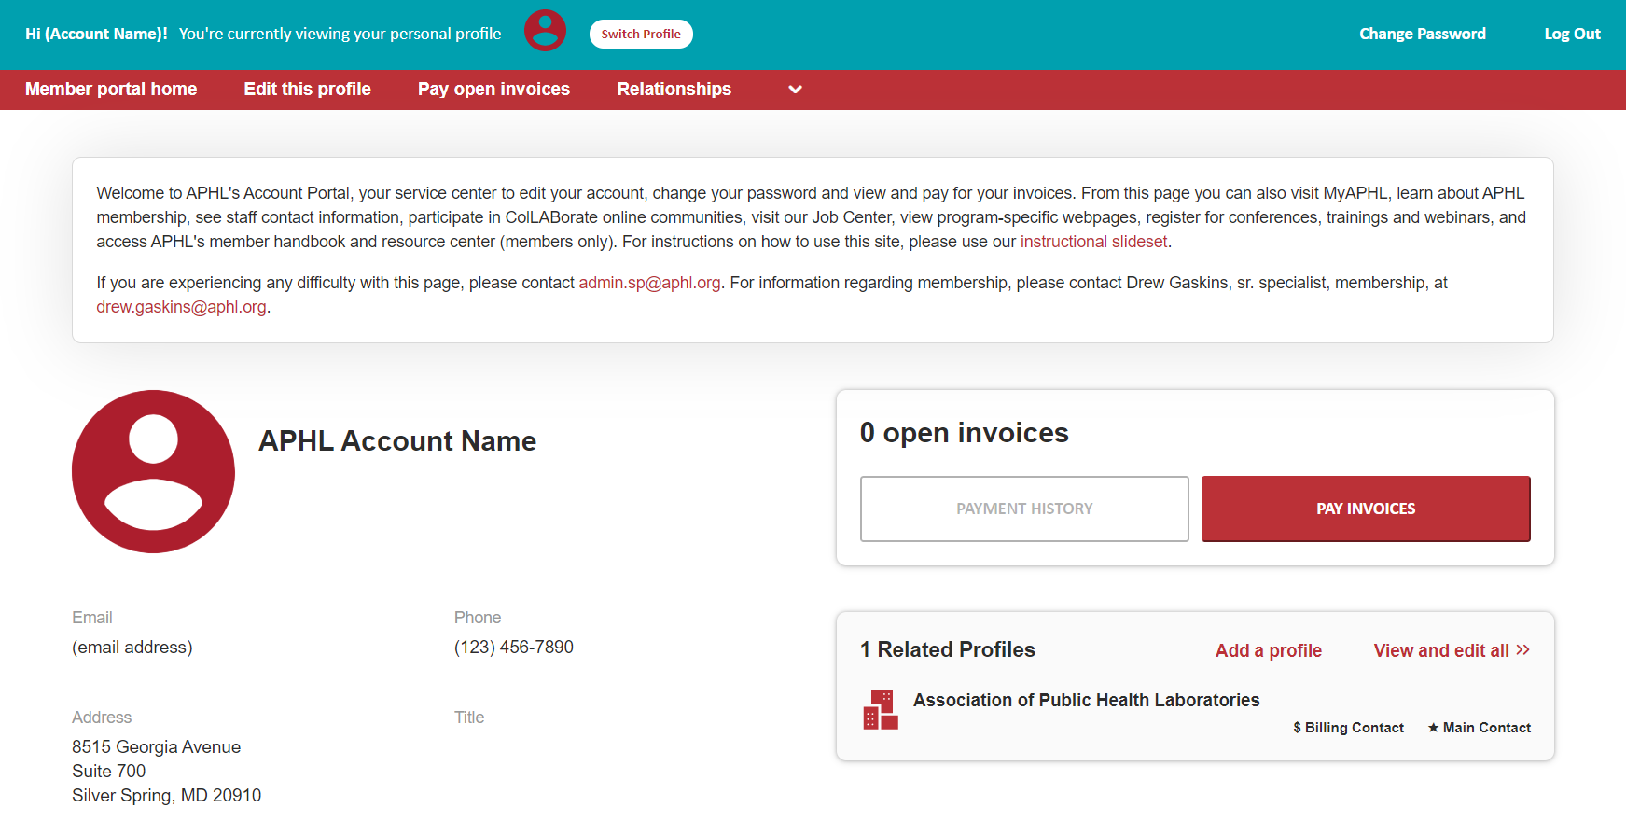
What Can I Do Here?
Update your or your organization’s profile info
Pay your bills
Change your password
Contact APHL staff
Participate in ColLABorate online communities
Visit our Job Center
View APHL program webpages
Register for conferences, trainings and webinars
Access the Member Handbook (Members Only)
Access the Member Resource Center (Members Only)
Access the PHLSD (Member Labs Only)

Slide 4
Table of Contents
Slide 5:
Slides 6-7:
Slide 8:
Slides 9-11:
Slides 12-14:
Profile Update overview
Edit your personal profile information
Create a new profile and relate it to a current profile.
As an editor, update your org’s profile and related profiles
Access your open invoices, use online bill pay and view your transaction history

Slide 5
Profile Update: Change Your Account Info
Profile Update allows you to update much of the information on your profile. If you are a Member Representative or have editing rights for an organization’s profile, you can update that profile’s information as well, including adding Member-Associates for your organization.
If you are unsure of how many Member Representative or Member-Associate positions that your organization has available, please contact membership@aphl.org.
You can edit the following information:
Update name, address, phone number, email address, position title, website and other basic contact information for your account and organizational profiles that you have editing rights for.
Create or remove Member Representatives, Member-Associates, Billing Contacts and/or employee accounts for organizational profiles that you have editing rights for.
Update relationships you have to other profiles (including adding new profiles you are related to)
Update social media accounts

Slide 6
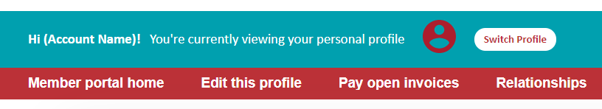
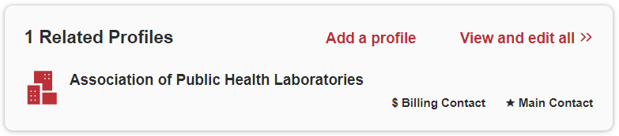
Profile Update
Use the Edit This Profile button to update your account information.
Use the Add A Profile button to create an organizational profile and relate it to your personal profile.
To be added as a related profile to an existing organizational profile, contact membership@aphl.org.
All changes require APHL review prior to approval.

Slide 7
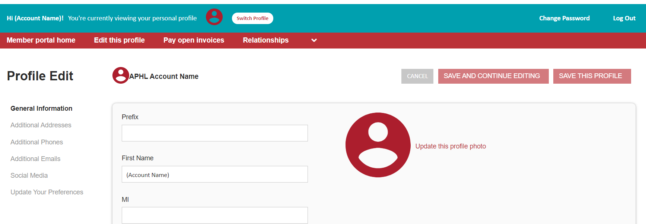
Profile Update
Edit This Profile
The Profile Edit page shows you all of your information on file. Add as much as you can!
Make sure to click the Save This Profile button at the top of the page when you’re finished.
These fields show you what information we have now. Please fill in any blanks so that we can know you as well as possible. Fields with Required must be filled in order to save.
Choose different sections when updating information, then save your changes

Slide 8
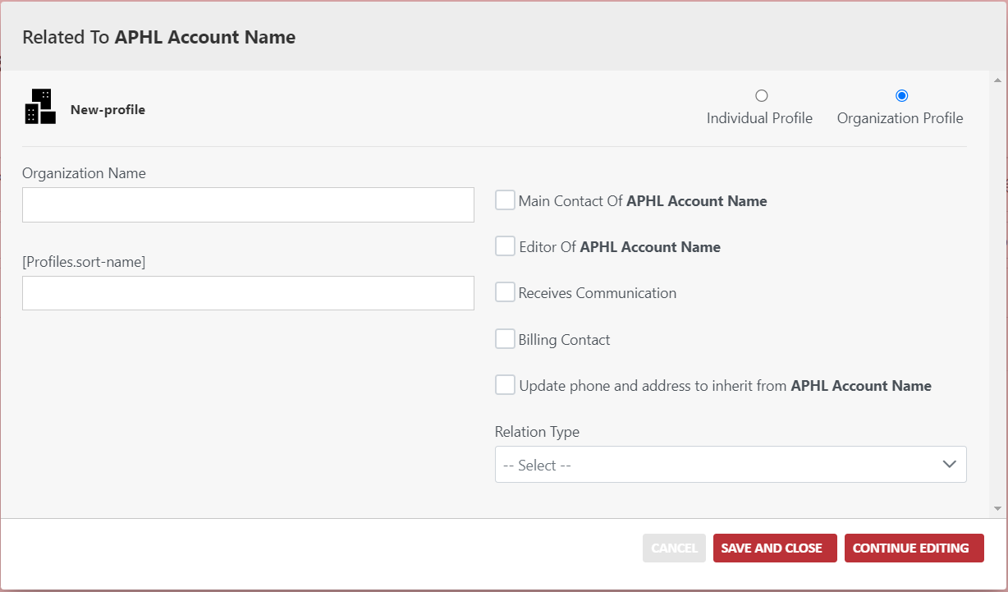
Profile Update
1. Choose the appropriate profile type for the profile being created.
Create a Related Profile
Clicking on Add a Profile will take you to the New Profile form, which allows you to create a new profile and relate it to your current profile – use this option when your organization or individual does not already exist in the system.
Be sure to choose the appropriate profile type and relationship type for the profile you’re creating.
Add any additional information for the new related profile by clicking on the Continue Editing button and be sure to click Save when you are finished.
2. Add information for your new profile in these fields.
3. Choose the appropriate “relation type” for the profile you’re creating.
5. Once you’ve finished, save your new profile.
4. Add general profile information (and any other info you’d like) by clicking the Continue Editing button.

Slide 9
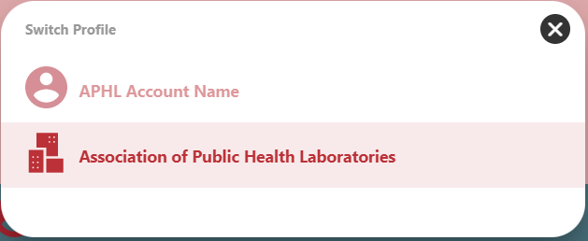
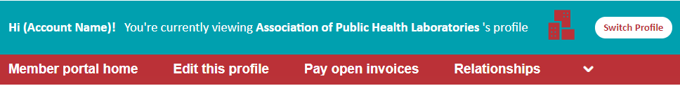
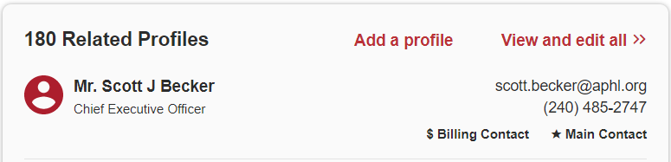
Profile Update
Update Information For Your Organization’s Related Profiles (Member Representative(s), appointed Member-Associates, employees, etc.)
If you are a designated editor of an organization’s profile, you will see a Switch Profile button at the top of the page (circled in red). Click this button to switch from your personal profile to the organization’s profile, which will allow you to edit the profiles related to your organization.
From the organization’s profile, you can add a new related profile or view and edit all currently related profiles by clicking the appropriate button (circled in red).

Slide 10
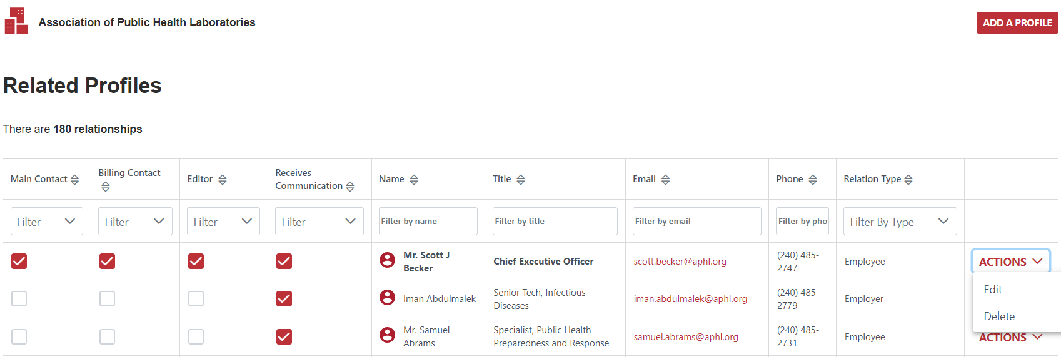

Profile Update
Update Information For Your Organization’s Related Profiles
On the organization’s related profiles page, if you are a designated editor of an organization’s profile, you will see that box checked (circled in red). In the example below, Scott Becker is the only account with editing rights for APHL’s organizational profile. This means that Scott can edit profiles related to APHL’s profile. Once Scott has made his changes, they are submitted for APHL review prior to approval.
If you have editing rights, click here to create/add related profiles, like Member Representative(s) or Member-Associate(s), to the organization’s profile.
Editors of an organization profile can create/add related profiles
Click here to edit information of the profiles related to your organization.

Slide 11
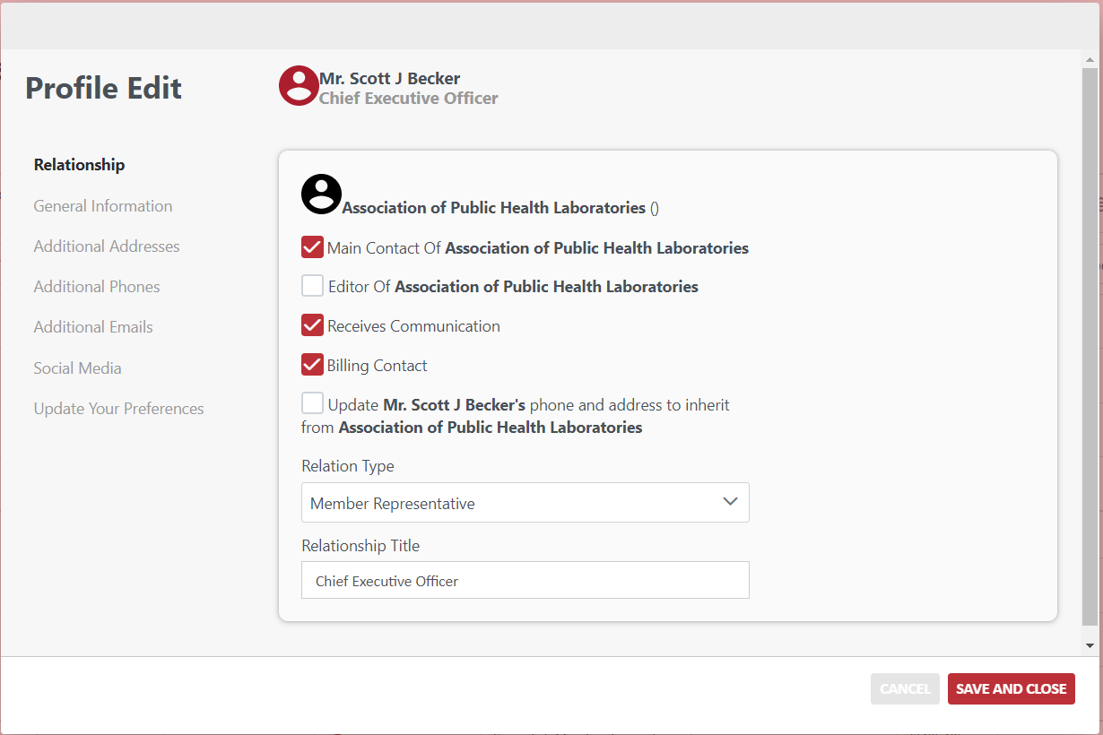
Profile Update
3. Uncheck these boxes if you intend to fully remove the relationship.
Edit Organization’s Currently Related Profiles
If you have editing rights for an organization’s profile, you can edit the list of current Member Representatives and/or Member-Associates.
If you are intending to remove/replace a current Member-Associate related to the organization’s profile, DO NOT change the existing related profile to a different person’s name. Instead, first remove the relation by changing the Relation Type on the existing profile to “Employee” or “Former Employee” and then use the instructions on slide 8 to create a new profile/relation for your laboratory’s new Member-Associate.
Remember, all changes are submitted for APHL review prior to approval and may be rejected if submitted incorrectly. Contact membership@aphl.org with any questions.
2. Use this dropdown menu to change relation types (e.g. Member Representative, Member-Associate, former employee, etc.) for a profile that already exists in the APHL database.

Slide 12
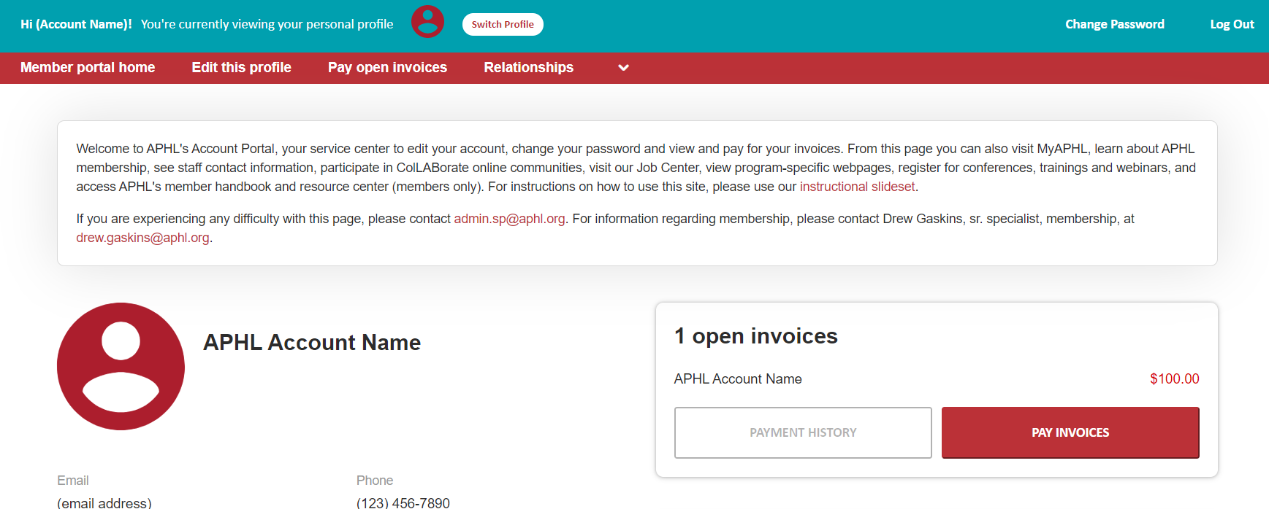
Profile Update
Access Your Open Invoices and Payment History
This area will give you access to your open invoices, online bill pay and your transaction history. If you intend to use our online bill pay system, be sure to check the box next to the appropriate line item prior to submitting payment information.
If you have any questions about this page, or cannot access this link, please contact membership@aphl.org.

Slide 13
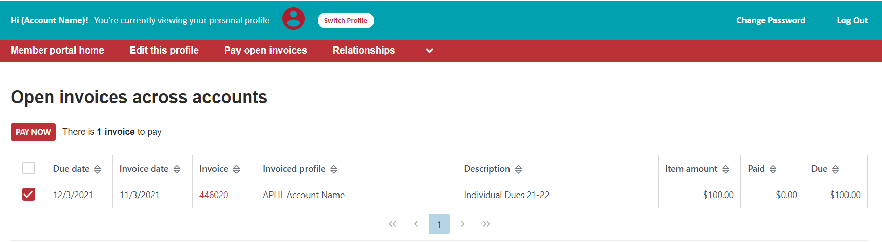
Online Bill Pay
Pay Your Bills
Below is an example of an open invoice. Be sure to check the box next to the appropriate line item prior to submitting payment. Once you have chosen the invoice(s) that you want to submit payment for, click on the Pay Now button.
Choose the invoice(s) that you’d like to pay by clicking the appropriate check box

Slide 14
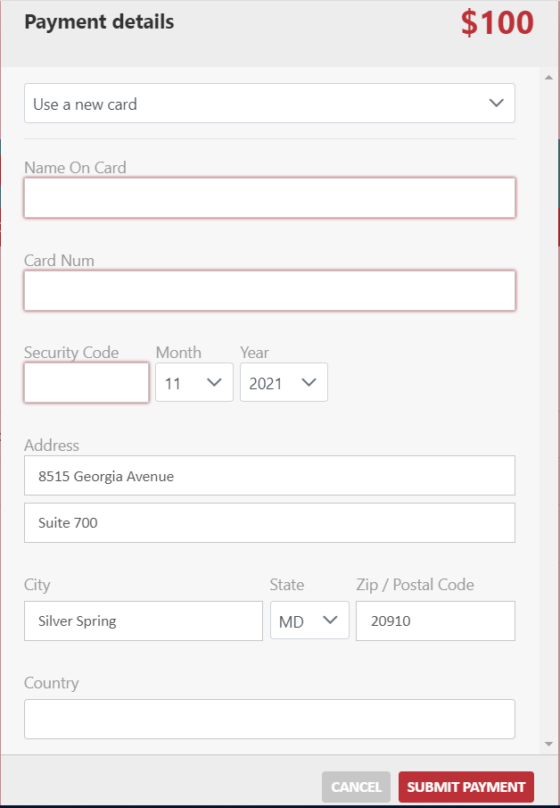
Online Bill Pay
Pay Your Bills
Once you’ve clicked on the Pay Now button, a payment details pop-up page will appear.
The total balance of the invoices you’ve selected will be noted on the top right of the pop-up page (circled in red).
Fields outlined in red are required information – your payment will not go through without completing these fields. Please provide as much information as possible.
APHL does not save credit card information for future use.
Please contact membership@aphl.org with any issues you experience.
Required fields are highlighted with red outlines.

