Slide 1
Everything You Wanted to Know About Public Health (But Were Afraid to Ask)
Michael D. Wichman, MS, PhD
Associate Director
Environmental Health Programs
State Hygienic Laboratory
The University of Iowa
Workforce and Membership Committees

Slide 2
Agenda
What is Public Health
Public Health Laboratories (PHL’s)
What do PHL’s do?
Who works in PHL’s? (and why)
Professional Organizations
About APHL

Slide 3
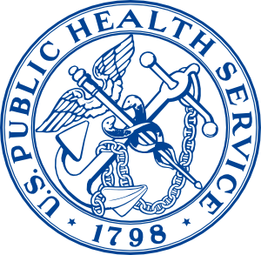
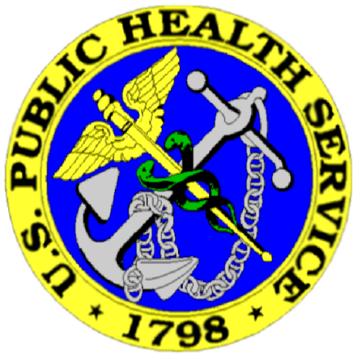
What is Public Health?
The science of protecting and improving
the health of communities through
  Education
  Promotion of healthy lifestyles
  Research for disease and injury prevention
Overall, public health is concerned with protecting the health of entire populations
  These populations can be as small as a local neighborhood, or as big as an entire country
Notes:
Public health professionals analyze the effect on health of genetics, personal choice, and the environment in order to develop programs that protect the health of your family and community.
Taken from http://www.whatispublichealth.org/ http://www.clker.com/ - free public domain

Slide 4
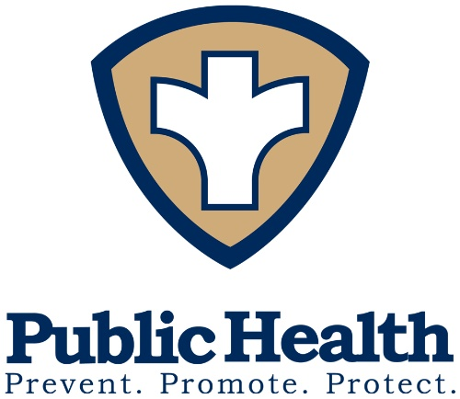
Public Health Practice
The science and art of
disease prevention,
prolonging life and
promoting health and well-being through organized community effort.
Notes:
When I was in your place, I had a poor understanding of the difference between the science I was learning through academia and what actually happens in a health department.
So I thought I’d start with a definition of public health practice. . . [read]
Public health is an interdisciplinary field and professionals in many disciplines such as medicine, veterinary medicine, laboratory medicine, dentistry, nursing and pharmacy routinely deal with public health issues. A degree in public health practice enables clinicians to apply public health principles to improve their practice. (http://www.whatispublichealth.org/what/index.html#Practice) clip art was found on 4 different websites in a google search

Slide 5

Public Health Concerns
America’s health is increasingly at risk
  Emerging infectious diseases
  Foodborne illnesses
  Environmental exposures
  Potential for chemical and biological terrorism
These risks are associated with a variety of factors
  Increased global travel
  Widespread access to imported foods
  Role of environmental factors in chronic disease
  Rise of domestic and international terrorism

Slide 6
Agenda
What is Public Health
Public Health Laboratories (PHL’s)
What do PHL’s do?
Who works in PHL’s? (and why)
Professional Organizations
About APHL

Slide 7
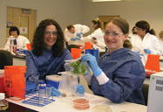
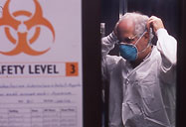
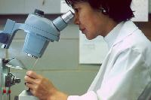

Public Health Laboratory Practice
In order to ensure the safety of our food and water, to screen for the presence of certain diseases within communities, and to respond to public health emergencies, such as bioterrorism, public health laboratory practice is essential.
Notes:
Public health laboratory professionals such as microbiologists and chemists test biological and environmental samples in order to diagnose, prevent, treat, and control infectious diseases or environmental threats in communities.
This is what public health labs do every day.
The key difference between academic laboratories, clinical laboratories and Public Health laboratories is the connection to the community.
Clip art from phgfoundation and APHL website

Slide 8
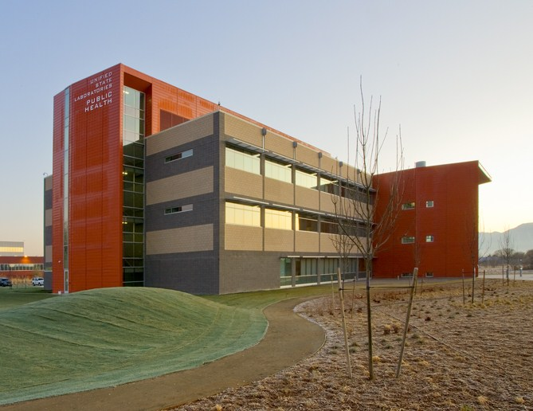
Public Health Laboratories
Notes:
Public health laboratories are state & local laboratories integrated into the broader public health system.
They perform complex testing to protect communities from disease and other health and environmental threats.
They serve as an early warning system for things like influenza outbreaks and food-borne illness.
Such testing requires highly trained staff, sophisticated instrumentation and specially-designed facilities.
56 state and territorial PHLs
>17 million specimens received annually
5,600 employees
$809 million annual budget
~200 local (city, county) PHLs
Several federal PHLs (CDC, EPA, USDA, DoD…)
Governmental PHLs are not regulators of private laboratories, although they may license or certify them in some States.
PHLs focus on protecting the public’s health while private labs focus more on client services and individual health.
Photo: new Utah public health laboratory, 2010

Slide 9
Changing Roles of PHLs
Surveillance and Reference
Activities
Primary
Diagnostic Tests
1900
2000
2100
Diphtheria testing
Syphilis testing
TB testing
Coliform testing
Advanced molecular testing
Antimicrobial resistance surveillance
Pharmaceutical surveillance
Regulatory food testing
Drinking water monitoring
Notes:
In the early 1900s, public health laboratories primarily performed testing for infectious agents, and were the only laboratories capable of performing these tests. These days, public health laboratories do not have a primary role in diagnostic testing, but are moving to surveillance testing and specialized referral tests. Examples of testing being performed in the 21st century include emerging non-regulated issues, pesticides, pharmaceuticals and personal care products (environmental testing) and clinical testing such as Influenza molecular subtyping or Salmonella DNA fingerprinting

Slide 10
Current Role of PHLs
The population/community as a whole is our patient
Timely response to emerging threats
Works collaboratively with public health programs to determine disease interventions
Detects, identifies, & monitors contaminants in people and the environment

Slide 11
Current Role of PHLs
Provides laboratory surveillance
Provides testing of public health significance
Consults and provide educational opportunities
Works collaboratively with partners in a public health laboratory system

Slide 12
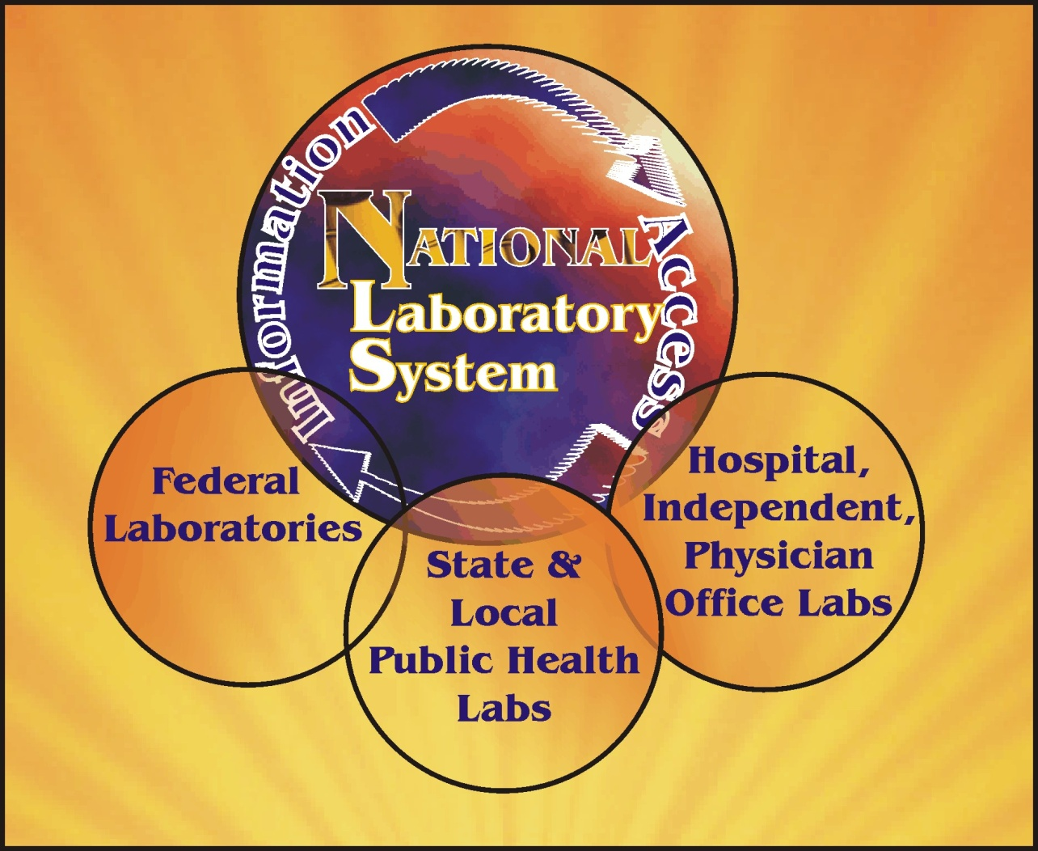
National Laboratory System
Notes:
National Laboratory System
Federal Laboratories – CDC, EPA, FDA, USDA
State Public Health Laboratories
Local Public Health Laboratories
Partnering with Independent, Hospital and Physician Office Laboratories
A nation-wide laboratory system which provides the communication, coordination and testing capacity required to effectively detect and report outbreaks and exposures is crucial to the future health and safety of our communities.
We are going to describe working in the federal, state and local public health laboratories.

Slide 13
State Public Health Laboratory System
Schools
State Public Health
Laboratory
Media
Nursing Homes
Environmental Laboratory
EMS
Policy Makers
Agricultural Laboratory
Hospitals
Local Public Health Laboratories
Clinical Laboratories
State Public Health
Private Laboratories
Providers
Mental Health
Law
Enforcement
Tribal Health
Academia
CHCs
Fire
Transit
Employers
Elected Officials
Corrections
Notes:
The National Laboratory System begins with a strong state and local public health laboratory system comprised of many partners.

Slide 14
Agenda
What is Public Health
Public Health Laboratories (PHL’s)
What do PHL’s do?
Who works in PHL’s? (and why)
Professional Organizations
About APHL

Slide 15
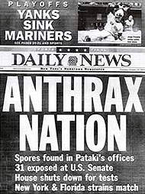
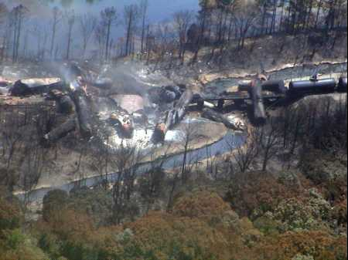

Notes:
Public health laboratories respond to virtually any health threat, whether it’s an infectious disease outbreak, industrial accidents, toxic chemical spill, natural disaster or a suspected terrorist event.
Pictured are a copy of a newspaper from the 2001 anthrax attacks, a train derailment leaking hazardous chemicals, and a ship spraying oil dispersants.
Nikki Lurie from HHS recently said “If you can’t detect it, you can’t respond to it”.

Slide 16
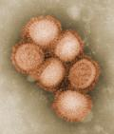
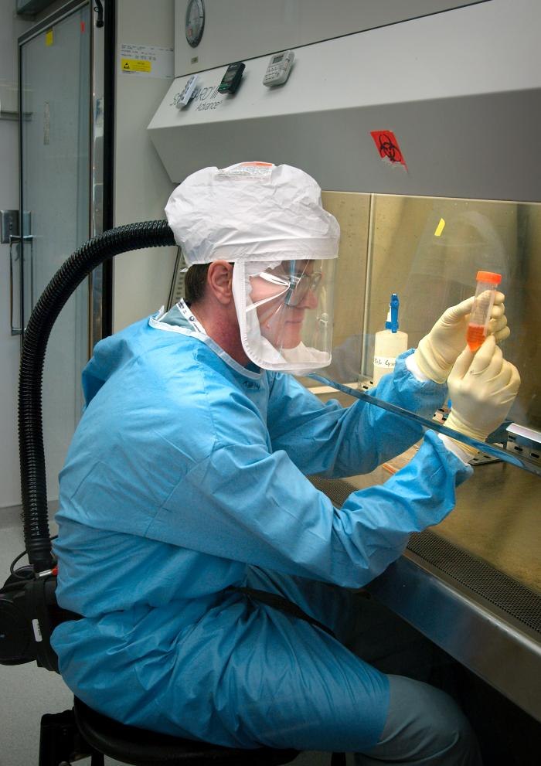
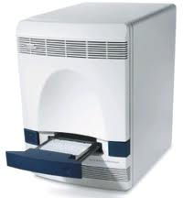
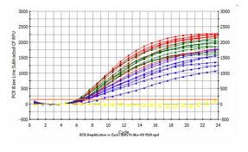
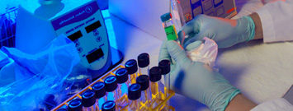
Responding to pandemic Influenza
Notes:
In April 2009, Mexico health officials reported the first cases of H1N1 influenza to the World Health Organization, and in the United States, public health officials announced that seven people in Texas and California have been diagnosed with H1N1. Shortly after, health officials across the globe were on alert for a flu virus feared to have pandemic potential. Behind the scenes, public health laboratories and their highly skilled workers were furiously working to stay one step ahead of the virus and provide the critical information health officials needed to control its spread and put precautionary measures in place.
The H1N1 outbreak is just one example of the vital role public health labs play in keeping people healthy, preventing disease and detecting new and emerging threats.
Need data on the number of tests performed during the peaks of the pandemic – CDC and State lab response with deploying kits and getting FDA approved testing to the field in record time, including new instrumentation and kits.

Slide 17
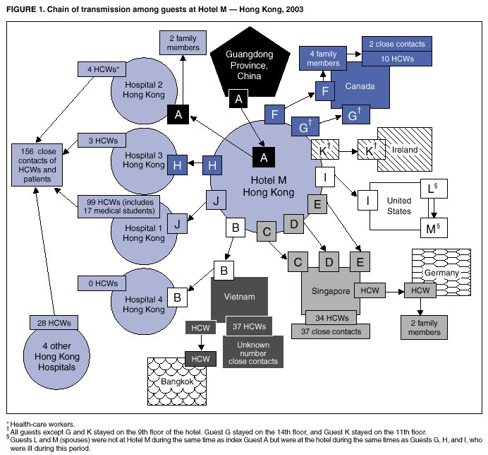
SARS ASSOCIATED VIRUS:
Investigating the global spread of a new infection
Notes:
This slide is used to demonstrate how quickly an emerging infectious disease can spread worldwide.

Slide 18
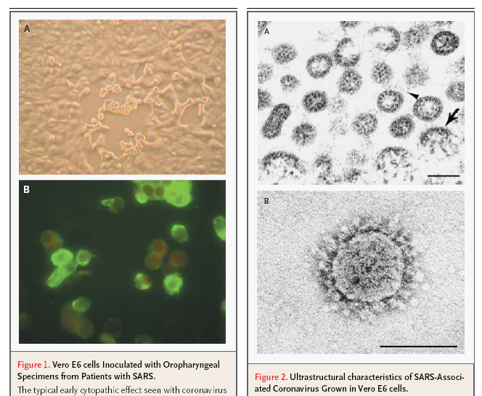
SARS ASSOCIATED VIRUS:
Investigating the global spread of a new infection
CPE in Vero E6 Cells
FA Convale-scent Sera
SARS Virus

Slide 19
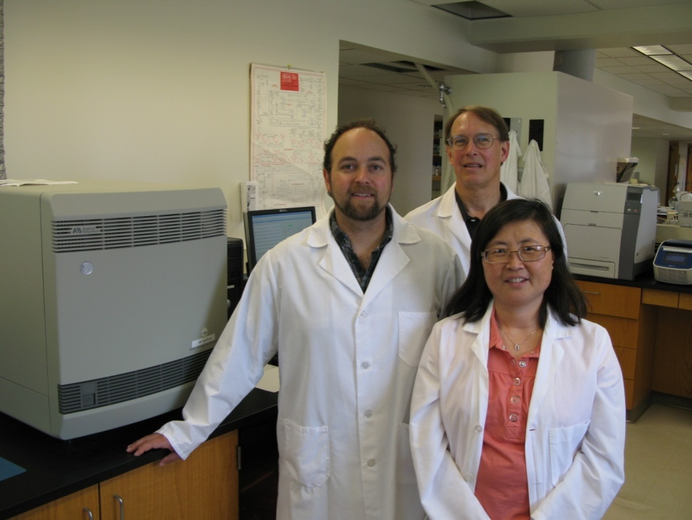
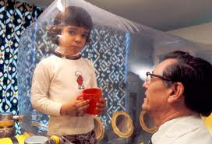
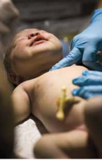
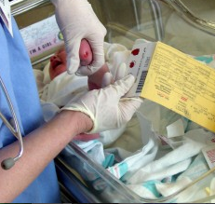
Newborn
Screening Programs
Notes:
Collectively, PHLs perform (or oversee) the screening of 97% of the babies born in the US each year,
testing for more than two dozen conditions that can result in death or disability if not treated soon after birth;
conditions like cystic fibrosis, hypothyroidism, sickle cell disorders and PKU.
Of the 4.5M US babies screened annually, over 5,000 screen positive for a genetic or inherited disorder.
PHL screening data enables these babies to receive immediate follow-up testing and early diagnosis and treatment.
PHLs also help to develop new tests and help authorities determine which new tests should be added to the screening panel.
I want to point out the top right photo, pictured is David Vetter in isolation, due to a condition commonly called Bubble Boy Disease.

Slide 20
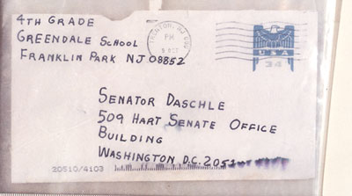
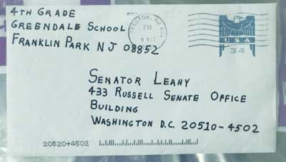
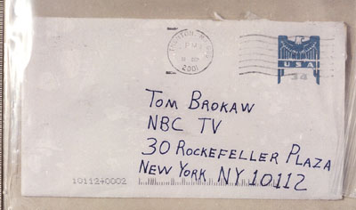
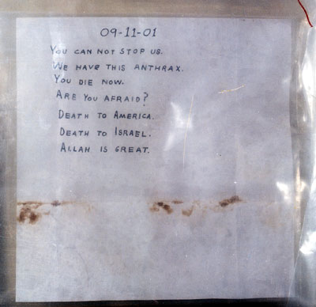
Bioterrorism Experience
Notes:
Public Health Labs serve as confirmatory laboratories for agents of bioterrorism
Some of these agents naturally occur
Tularemia
Plague
Anthrax
Botulism
Need to be able to quickly respond and confirm the presence of an agent so that public health interventions can take place
(These examples are from the anthrax threat letters from 2001. PHL’s performed a lot of testing for anthrax then, and somewhere in the US a PHL is probably testing a threat letter today!! )

Slide 21
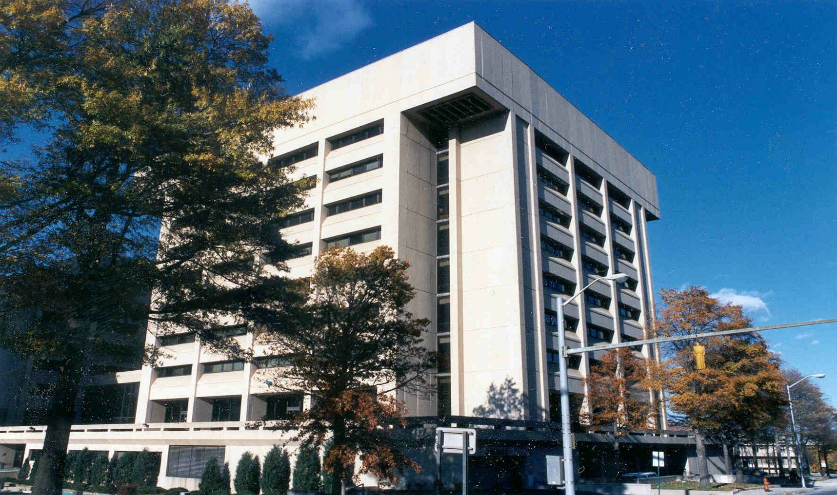

Environmental Laboratories
Notes:
Some public health laboratories are integrated with microbiology, newborn screening, environmental and agricultural testing all housed in one facility. Other states may have stand alone environmental or agricultural laboratory facilities

Slide 22
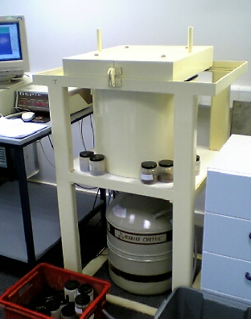
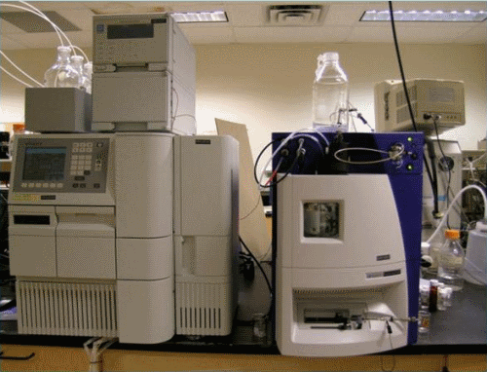
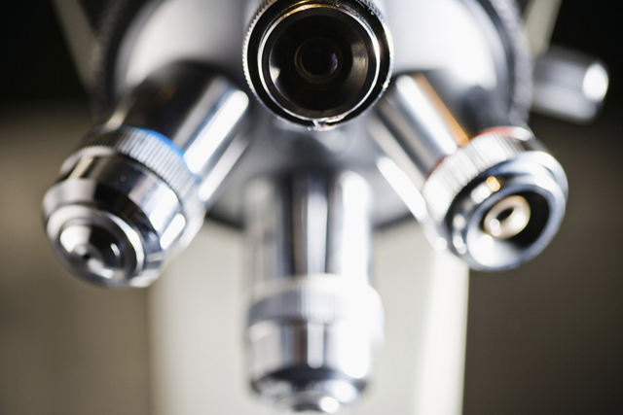
Detect, identify
& monitor…
Notes:
ELs [read]
Pictured are some of the equipment used to “detect, identify & monitor” environmental contaminants:
Does anyone know what they are?
I won’t bore you with technical terms, but I will tell you they are complex instruments and that yes they are expensive (both to purchase & maintain).
[a liquid chromatograph, a gamma spectrometer, and a trusty microscope]

Slide 23
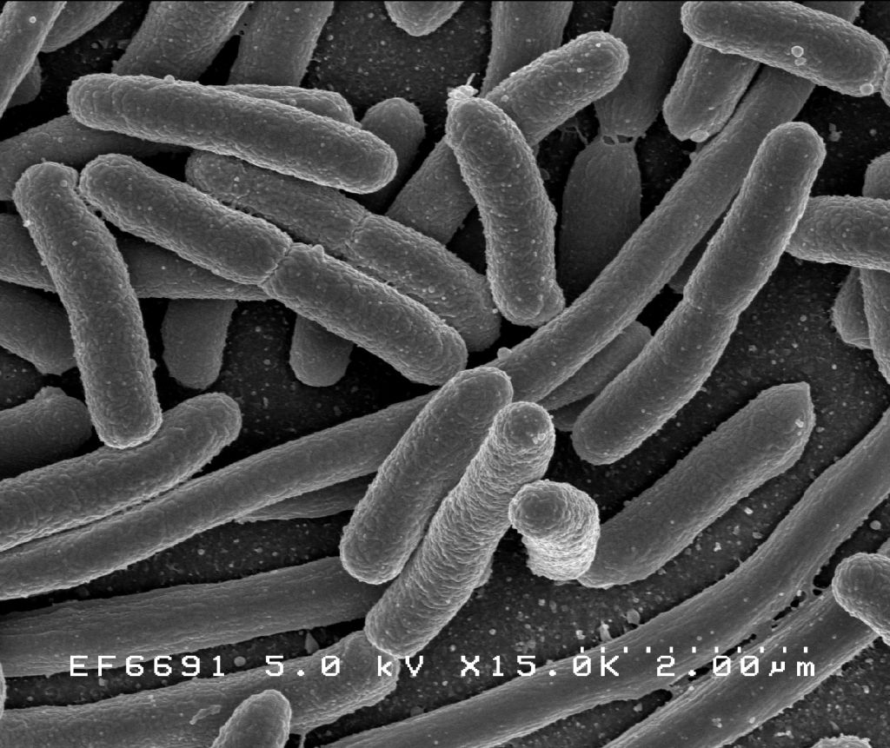
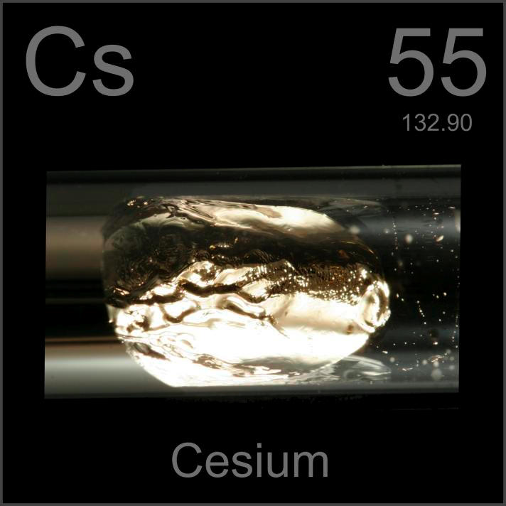
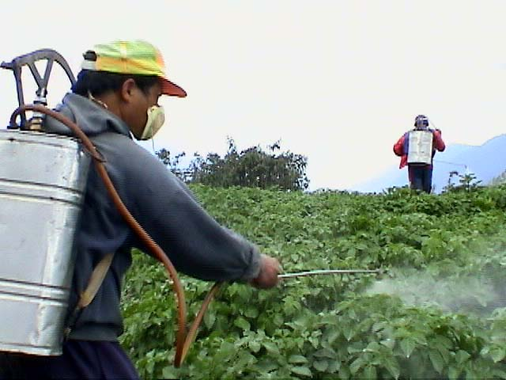
…contaminants…
Notes:
Here are some of the types of environmental contaminants ELs look for: E coli, Cesium (isotopes of which are radioactive) and pesticides.

Slide 24
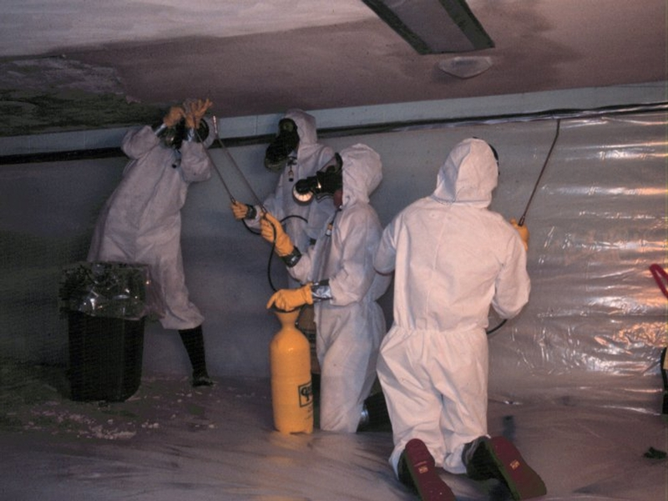
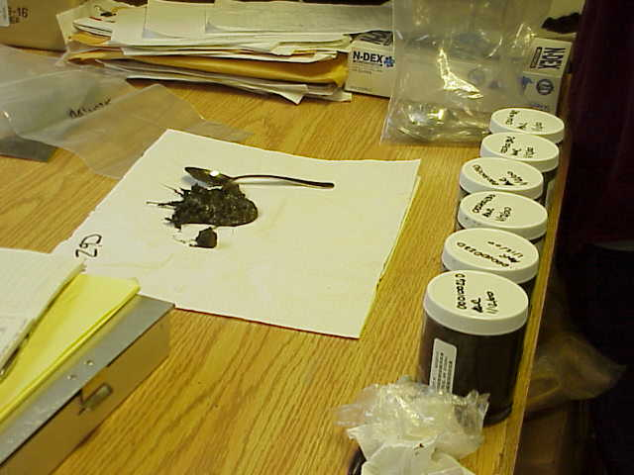
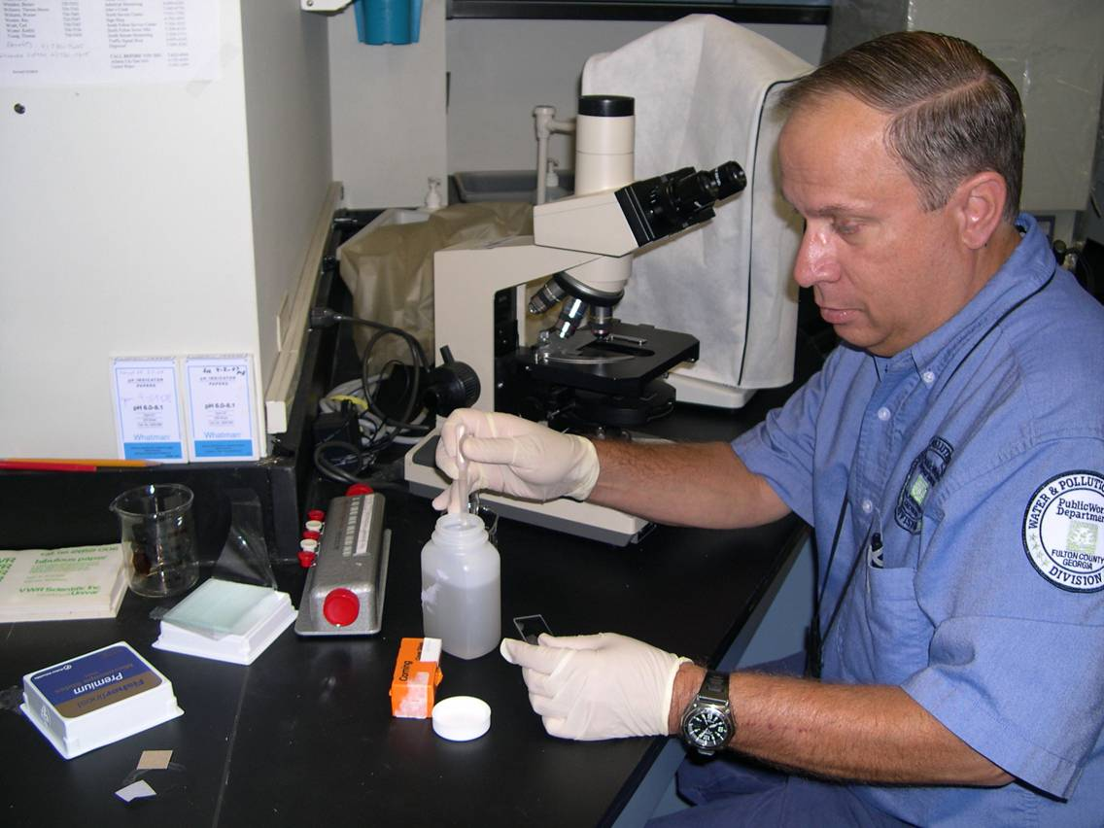
…in the environment
Notes:
In the environment. . .
They:
Analyze air, water, soil, and other environmental samples for potential threats to human health.
Ensure compliance with environmental laws & regulations.

Slide 25
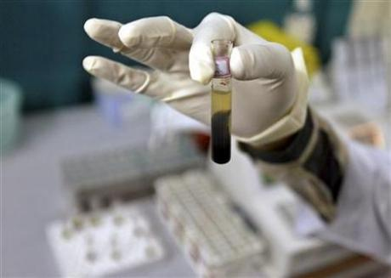
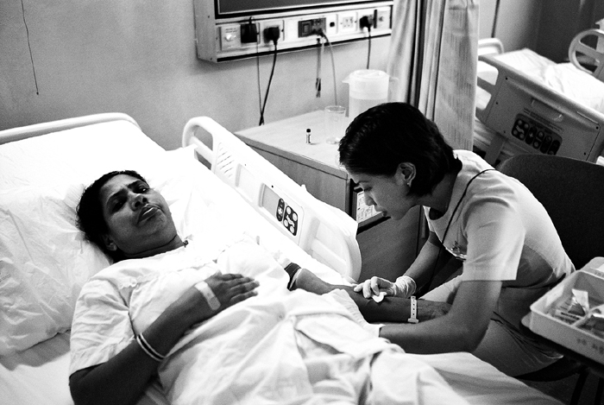
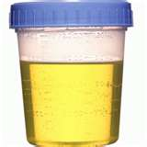
…and in people…
Notes:
Environmental labs look for these contaminants in people (this is what we call biomonitoring)

Slide 26
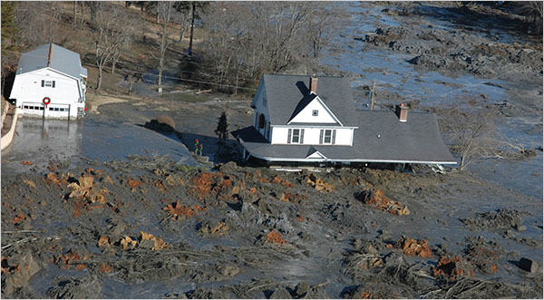
Notes:
The point is everything is a complex mixture.
Pictured here is the coal ash spill that happened in eastern Tennessee in 2008.
Measuring chemicals in air, water, soil, & food doesn’t tell us whether people are actually affected by it or how much.

Slide 27
Air levels
Biomonitoring
Water levels
Soil/dust levels
Food levels
Levels
of pollution
in people
Nutritional status
Lifestyle factors
Personal habits
Genetic factors
* Slide adapted from Tom Burke, Johns Hopkins
Notes:
1
1
Traditionally we have estimated exposure mathematically, which involves so many factors:
air levels
water levels
soil and dust levels
food levels
Also on here are personal factors such as nutritional status, personal habits and genetic factors.
An Improved Way:Instead of estimating, measure levels of chemicals in people.
The good thing about biomonitoring is that it presents an integrated picture of exposures from all sources: air, water, soil, food.
It also provides indication of how these exposures interact with other factors such as our genes, diet, habits etc.
*Decrease biomonitoring and add a little more on traditional environmental monitoring
- Include sulfur mustard slides

Slide 28

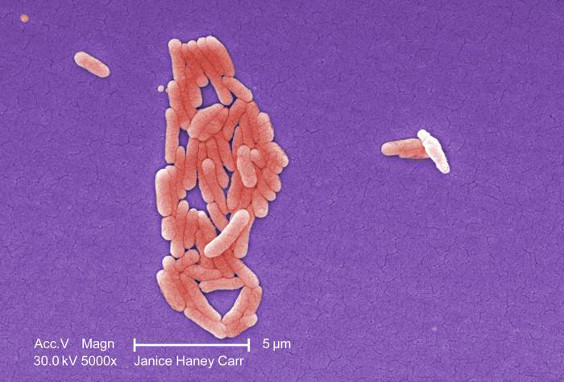
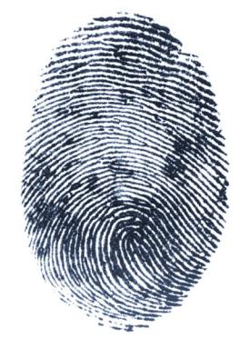
Food Safety
Are the new cases of food poisoning random
… or the beginning of an outbreak?
Notes:
The industrialization & globalization of the food supply have made large-scale food-borne disease outbreaks more common.
In the past few years alone, we’ve seen outbreaks associated with
E coli in spinach (2006),
E. coli O157:H7 in beef (2009-2010),
Salmonella Enteritidis in eggs,
salmonella in peanut butter in 2009, and
just this year listeria in cantaloupes.
PHLs work to help identify foodborne outbreaks—and their source—as quickly as possible so contaminated foods can be recalled & fewer people become sick.
Because random cases of food poisoning occur routinely, there is a lot of background noise that can complicate disease investigations.
PHLs determine which cases of food poisoning are related—and therefore part of an outbreak—and which are not.
PHLs are part of an international network that generate DNA “fingerprints” of food-borne bacteria cultured from people who got ill.
A central database enables related cases to be linked, even if the infected patients are in different parts of the country (or world).

Slide 29


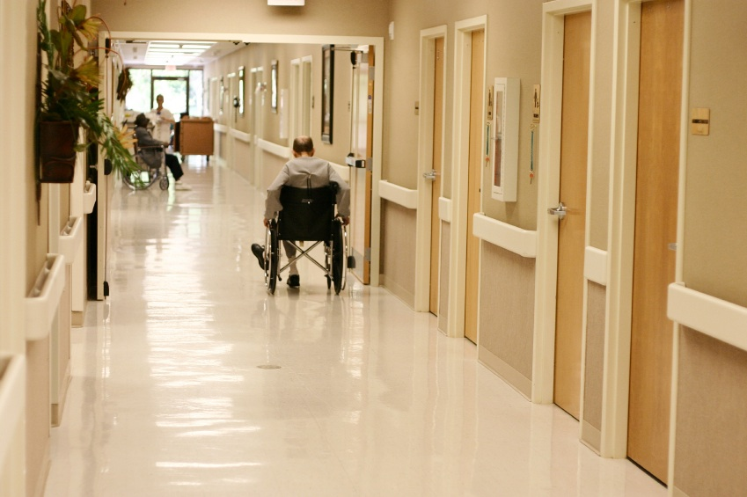
Notes:
MN’s ‘Team Diarrhea,’ interviewed each patient about what foods they had eaten, raising suspicions about either peanut butter or a chicken product.
Within 7 days, the DOH determined that many patients ate meals in one of three institutions: two long–term care facilities and an elementary school.
Looking at their menus & grocery receipts revealed a common food distributor, based in North Dakota.
Just one food item was ordered by all three institutions: King Nut creamy peanut butter.
Within three weeks of spotting the cluster, the Minnesota agricultural laboratory isolated Salmonella from a container of King Nut peanut butter.
Health officials immediately issued a product warning, and Peanut Corporation of America’s Blakely, GA plant was promptly shut down.
Overall, the outbreak sickened over 700 people nationwide, 100 people were hospitalized and 8 died.
It also prompted one of the most extensive food recalls in US history—affecting more than 3,000 products.
The swift work of the MN PHL hastened the end of the outbreak and undoubtedly saved many more people.

Slide 30
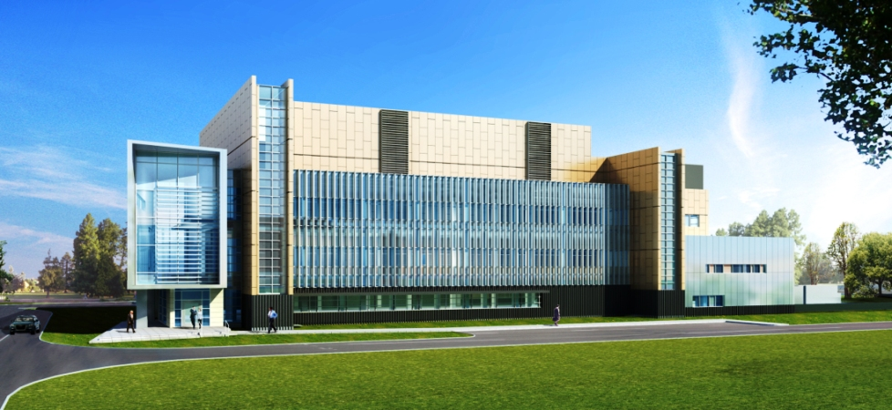
Agricultural Laboratories
New York State
Analytical testing in support of
Food safety and security programs
Consumer and agricultural interests
Notes:
A few slides ago, I mentioned food safety in conjunction with Public Health laboratories. Similar (and complimentary) testing is also done in State agricultural labs.

Slide 31
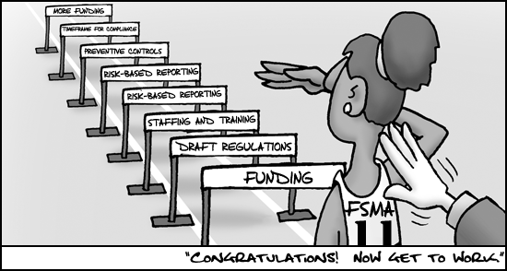
Food Safety and Modernization Act
Catch potential problems before they become actual problems
Set forth requirements for mandatory testing for specified reasons
Reduce the incidence of foodborne illness
Share information on a timely basis among public health and food regulatory agencies, food industry, heath care providers and the general public
Staffing will be needed!!!
Notes:
(read after fourth bullet)
“FSMA shifts our food safety focus from reaction and response to prevention – from catching food safety problems after the fact to systematically building in prudent preventive measures across the food system…”
Michael Taylor, FDA Deputy Commissioner for Foods, April 5,2012
(go to “staffing will be needed”)

Slide 32
Agenda
What is Public Health
Public Health Laboratories (PHL’s)
What do PHL’s do?
Who works in PHL’s? (and why)
Professional Organizations
About APHL

Slide 33
Who Works in Public Health Laboratories?
Bachelors Degrees
  Life Sciences (Biology, Chemistry, Microbiology)
  Clinical Laboratory Sciences or Medical Technology
Advanced Degrees
  Masters Degree in Applied Sciences, Public Health, Epidemiology
  PhD or DrPH
Notes:
Other opportunities for working in PHLs - CDC/APHL Fellowships

Slide 34

What’s In It For You?
National Statistics
  Jobs exist for Chemists, Agriculture or Food Scientists, Microbiologists and Medical Laboratory Scientists
  Laboratory Professional average age ~ 48 years old
  Professions will experience a 10-13% growth rate per year in next ten years
Demand is high
  Aging Workforce
  Demand for more testing
Notes:
Quick Facts: Agricultural and Food Scientists 2010 Median Pay $58,450 per year
$28.10 per hour Entry-Level Education See How to Become One Work Experience in a Related Occupation None On-the-job Training None Number of Jobs, 2010 33,500 Job Outlook, 2010-20 10% (About as fast as average) Employment Change, 2010-20 3,500
Quick Facts: Chemists and Materials Scientists 2010 Median Pay $69,790 per year
$33.55 per hour Entry-Level Education Bachelor’s degree Work Experience in a Related Occupation None On-the-job Training None Number of Jobs, 2010 90,900 Job Outlook, 2010-20 4% (Slower than average) Employment Change, 2010-20 4,000
Quick Facts: Microbiologists 2010 Median Pay $65,920 per year
$31.69 per hour Entry-Level Education Bachelor’s degree Work Experience in a Related Occupation None On-the-job Training None Number of Jobs, 2010 20,300 Job Outlook, 2010-20 13% (About as fast as average) Employment Change, 2010-20 2,700
Quick Facts: Medical and Clinical Laboratory Technologists and Technicians 2010 Median Pay $46,680 per year
$22.44 per hour Entry-Level Education See How to Become One Work Experience in a Related Occupation None On-the-job Training None Number of Jobs, 2010 330,600 Job Outlook, 2010-20 13% (About as fast as average) Employment Change, 2010-20 42,900
*Additional information from Bureau of Labor Statistics
70% of medical decisions based on laboratory results
Aging population needs more health care and more tests
- Demand for more testing imported foods
New tests frequently introduced to improve diagnosis and care
Threat of bioterrorism has increased demand for qualified laboratory professionals in infectious disease testing

Slide 35
Agenda
What is Public Health
Public Health Laboratories (PHL’s)
What do PHL’s do?
Who works in PHL’s? (and why)
Professional Organizations
About APHL

Slide 36
Enhance Your Personal & Professional Goals
Join a laboratory professional organization
  APHL (Public Health Laboratories)
  AACC (Clinical Chemistry)
  ACS (American Chemical Society)
  AOAC (Association of Official Analytical Chemists)
  ASCLS (Clinical Laboratory Science)
  ASCP (Medical Laboratory Scientists)
  ASM (Microbiology)
  CLMA (Laboratory Managers)
  IAFP (International Association for Food Protection)
Notes:
There are many laboratory professional organizations that you can belong to, depending on your interests. Many have student memberships for a reduced fee, yet you can gain many benefits.

Slide 37
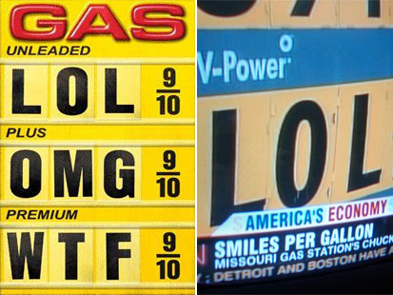
Professional membership costs are reasonable!
Notes:
Being a member of a professional organization is not expensive – especially if you can have a student membership.
For example: An individual membership with APHL is only $100 and a student membership is only $35!

Slide 38
Advantages to Professional Involvement
Networking Opportunities
Career Development
Professional Acknowledgement
Develop Leadership Skills
Show a sense of pride in your profession
Find a job!
Make a difference
Notes:
There are many advantages to being a professional. Tell a story about someone you know that was able to find a new position because of the contacts they had because of being an active member in their professional society. Professional organizations offer ways to find employment opportunities, contact subject matter experts to ask questions about lab practices, and having encouragement to advance your learning.

Slide 39
Agenda
What is Public Health
Public Health Laboratories (PHL’s)
What do PHL’s do?
Who works in PHL’s? (and why)
Professional Organizations
About APHL

Slide 40
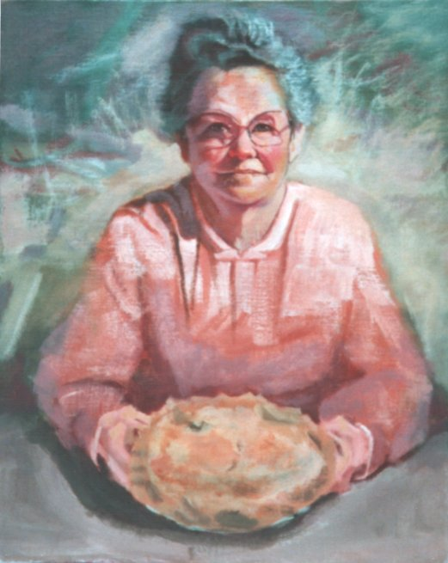
APHL’s Vision:
A healthier world through quality laboratory practice.
Notes:
APHL is the primary professional organization for scientists working in Public Health and the only organization that represents the nation’s public health and environmental health laboratories. The association was founded over 50 years ago with the vision of . . .[read slide]. Basically this is motherhood and apple pie. APHL works to strengthen labs in the US and across the world, advances laboratory systems and practices to promote continuous improvement in the quality of practice, and promotes policies that support healthy communities.

Slide 41
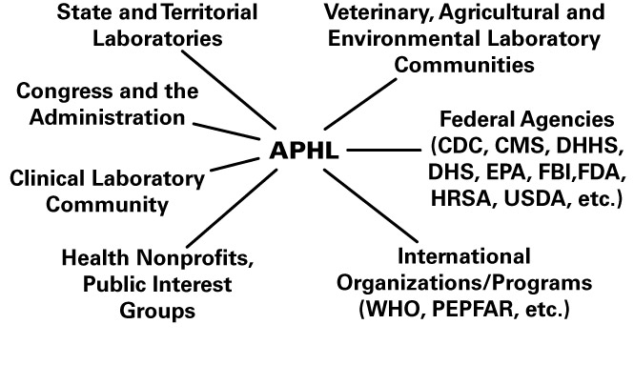
Partner Connections
Notes:
APHL’s most important role is as nexus for communication among diverse constituencies.
The association (refer to graphic):
Connects the 56 state and territorial labs as well as an increasing number of local ones
Links those labs with federal partners such as CDC, EPA, FDA, DHS, FBI, & HRSA
Serves as a nexus between public health and clinical lab communities, such as those in hospitals
Acts as a liaison between public health labs and the companies that supply them with testing materials, instrumentation, facilities and other commercial services.
Advocates for labs with Congress and the Administration. . .

Slide 42


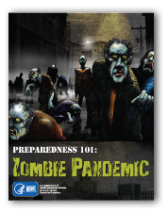
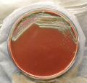
APHL & CDC
Notes:
APHL and CDC have been working together through a cooperative agreement for at least 23 years.
APHL co-founded the CDC Laboratory Response Network in 1999 with the CDC and FBI
Designed to ensure fast and effective action to protect the public from biological and chemical threats
Uses validated methods to assure rapid and certain identification of threat agents in clinical samples
APHL collaborated with developing a secure website

Slide 43

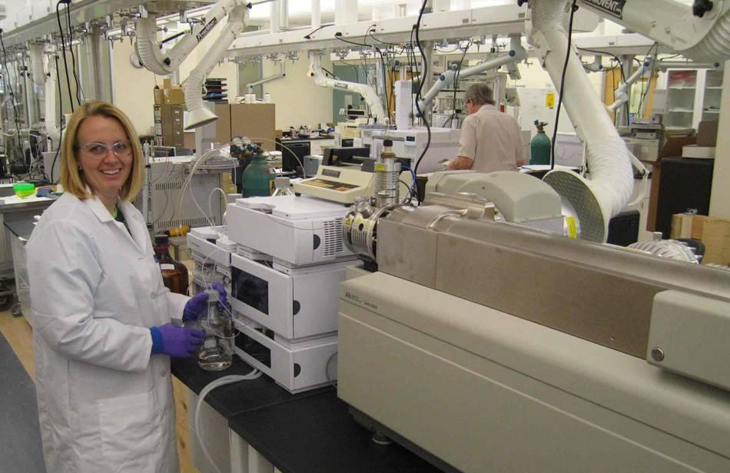


APHL & EPA
Notes:
EPA recognized that the partnership model developed on the clinical side of public health was missing on the environmental side and They recognized that the experience APHL developed with the LRN would serve them well in working with environmental labs, to establish a home base for environmental laboratories
Home Base means having APHL serve as the primary and central point of contact/ communication between state environmental laboratories and EPA’s many programs.

Slide 44

Contagion
http://www.youtube.com/watch?v=4sYSyuuLk5g

Slide 45
Questions?

Slide 46
Acknowledgements
APHL’s Membership & Recognition Committee
  Jack Bennett, Chair
  Cynthia Mangione
  Pam Mollenhauer
APHL’s Workforce Development Committee
  Shashi Mehta
  Susie Zanto
Megan Latshaw (APHL staff)

