Slide 2
WSLH AST Surveillance Projects and Detection of Emerging Resistance Patterns in the Public Health Laboratory
Tim Monson, M.S.
Dave Warshauer, Ph.D.
Wisconsin State Laboratory of Hygiene
Challenges in Antimicrobial Susceptibility Testing Conference- 2012
May 10,2012 Lake Delton, WI

Slide 3
Objectives
Discuss emerging antimicrobial resistance and the mechanisms responsible for the resistance
Become aware of AST surveillance activities and target organisms for WSLH and other Public Health Laboratories
Compare and contrast WI resistance data to available national resistance data
Discuss the future of AST testing and the partnering of clinical laboratories and PHL

Slide 4

http:\www.sodahead.com

Slide 5
Question
A “Superbug” is defined as:
The ’75 souped-up VW Beetle you cruised around in while in college
The star performer in a flea circus
Pandemic influenza
A strain of bacteria resistant to most available antibiotics for its treatment
All of the above

Slide 6
Emerging “Superbugs”
Staphylococcus aureus
Streptococcus pneumoniae
Enterococcus species
Acinetobacter baumannii
Klebsiella pneumoniae
Pseudomonas aeruginosa
NDM-1 and ESBL Enterobacteriaceae
MDR- and XDR-TB

Slide 7
Resistance Mechanisms
Alteration of antibiotic binding site(s)
  Penicillin binding protein (PBP)
Modification/ inactivation of antibiotic
  Production of enzymes
Changes in metabolic pathways
  Ability to utilize alternative synthetic precursors than those affected by antibiotics
Adaptations in bacterial cell surfaces
  Decrease in permeability
  Use of efflux/reflux pumps

Slide 8
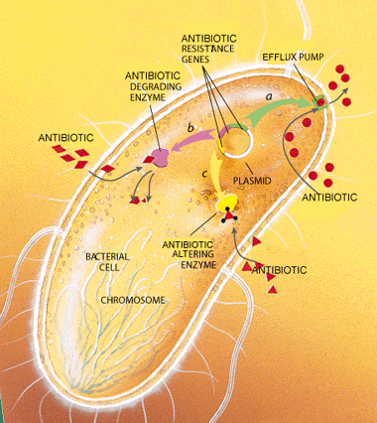
Resistance Mechanisms http://www.estacaobr.net/superbacteria-kpc-veja-quais-sao-os-sintomas.html

Slide 9
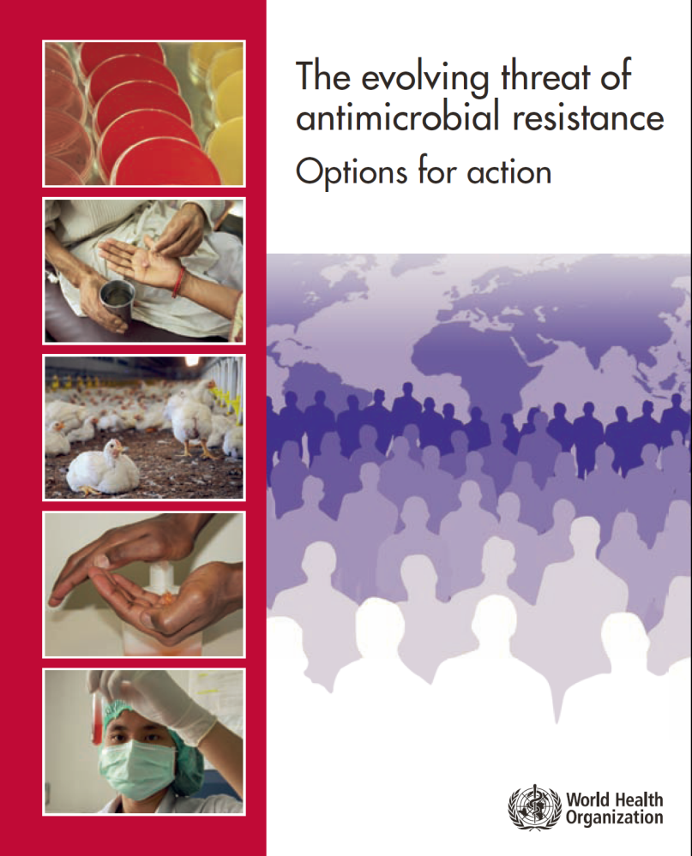
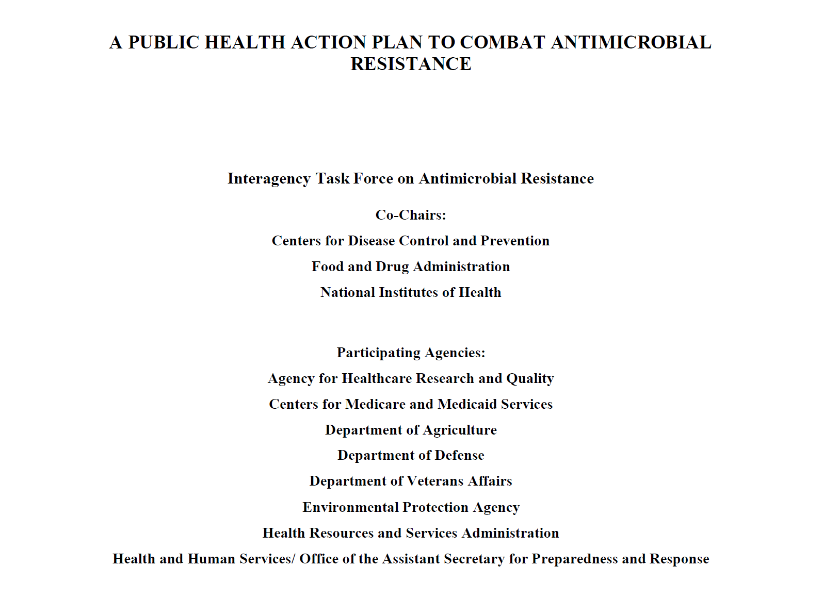
Responses to Emerging Resistance

Slide 10
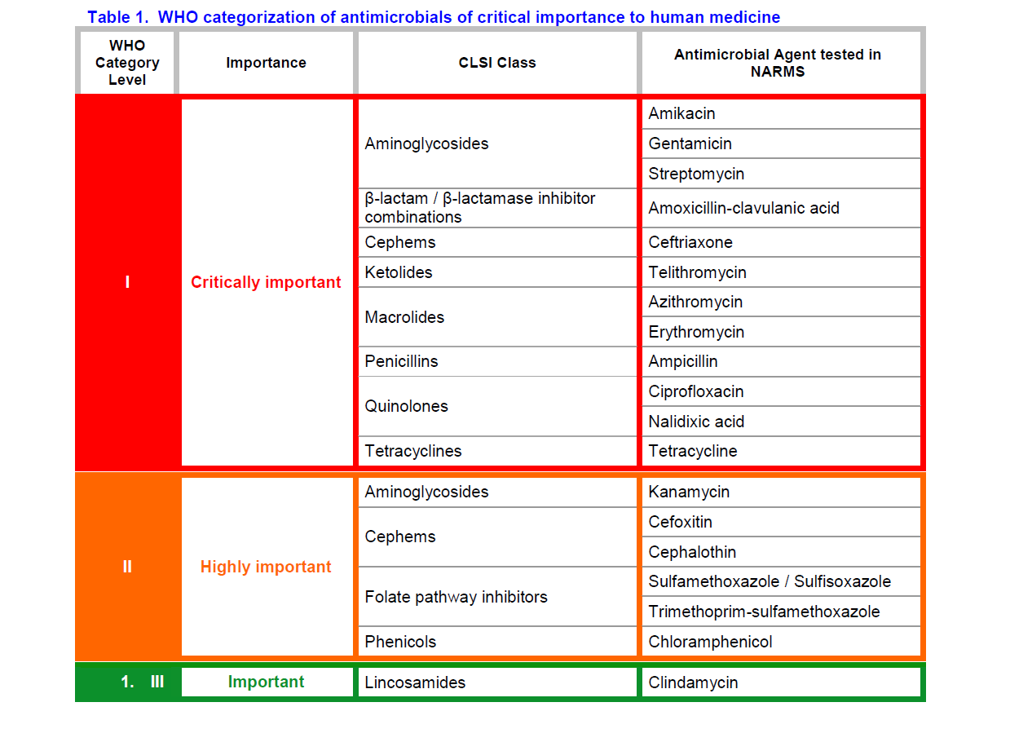
WHO- Critical Antibiotics
Evolving Threat of Antimicrobial Resistance- Options for Action, WHO, 2012

Slide 11
Emerging Resistance
WHO Strategies to combat emerging antimicrobial resistance:
  Antimicrobial resistance surveillance
  Rational antimicrobial use and regulation
  Regulated antimicrobial usage in animal husbandry
  Effective infection control and prevention
  Fostering innovations in antimicrobial development
  Political involvement and commitment

Slide 12
Burden of Antimicrobial Resistance
Estimated costs of $18,588 to $29,069 per patient, hospital stays extended between 6.4 to 12.7 days, and an attributable mortality of 6.5% in infections caused by resistant organisms (Clin. Infect. Dis. 2009; 49:1175-84)
$20 billion/ yr in excess healthcare costs and an additional 8 million days of hospitalization for those infected by resistant organisms (CDC)

Slide 13
Question
Which of the following organisms is/are reportable to WI public health officials?
VRE
VISA
VRSA
KPC-positive Enterobacteriaceae
Both B and C

Slide 14
Staphylococcus aureus
VRSA
  All isolates to date have possessed vanA
  Thought to have been obtained from VRE via plasmid- or transposon-mediated DNA transfer
  When VRSA is suspected, CDC requests retention of all VRSA, MRSA and VRE isolates from that patient
  WDPH and WSLH request submission of all VRSA to WSLH for confirmation (by E Test) and forwarding to CDC

Slide 15
VRSA- U.S. Historical Cases
Case | State | Year | Age | Source | Diagnosis | Underlying Conditions
1 | MI | 2002 | 40 | Plantar ulcers and Catheter tip | Plantar soft tissue infection | Diabetes, dialysis
2 | PA | 2002 | 70 | Plantar ulcer | Osteomyelitis | Obesity
3 | NY | 2004 | 63 | Urine from a nephrostomy tube | No infection | Multiple sclerosis, Diabetes, kidney stones
4 | MI | 2005 | 78 | Toe wound | Gangrene | Diabetes, vascular disease
5 | MI | 2005 | 58 | Surgical site wound after panniculectomy | Surgical site infection | Obesity
6 | MI | 2005 | 48 | Plantar ulcer | Osteomyelitis | MVA, chronic ulcers
7 | MI | 2006 | 43 | Triceps wound | Necrotizing fasciitis | Diabetes, dialysis, chronic ulcers
8 | MI | 2007 | 48 | Toe wound | Osteomyelitis | Diabetes, obesity, chronic ulcers
9 | MI | 2007 | 54 | Surgical site wound after foot amputation | Osteomyelitis | Diabetes, hepatic encephalopathy
10 | MI | 2009 | 53 | Plantar foot wound | Plantar soft tissue infection | Diabetes, obesity, lupus, rheumatoid arthritis
11 | DE | 2010 | 64 | Wound drainage | Prosthetic joint infection | Diabetes, end-stage renal disease, dialysis
12 | DE | 2010 | 83 | Vaginal swab | Vaginal discharge | Chronic recurrent C. difficile infection, chronic UTIs, vesicoenteric fistula
http://www.cdc.gov/HAI/settings/lab/vrsa_lab_search_containment.html

Slide 16
Staphylococcus aureus
VISA
  NOT detected by disk diffusion; non-automated MIC methods such as E Test, Agar Dilution and Broth Microdilution are best (CDC)
  Vanco Screen Agar Test adequate for MIC= 8mcg/ml; more data needed to assess ability to adequately detect isolates with MIC= 4 mcg/ml
  WDPH and WSLH request submission of all VISA to WSLH for confirmation (by E Test) and forwarding to CDC

Slide 17
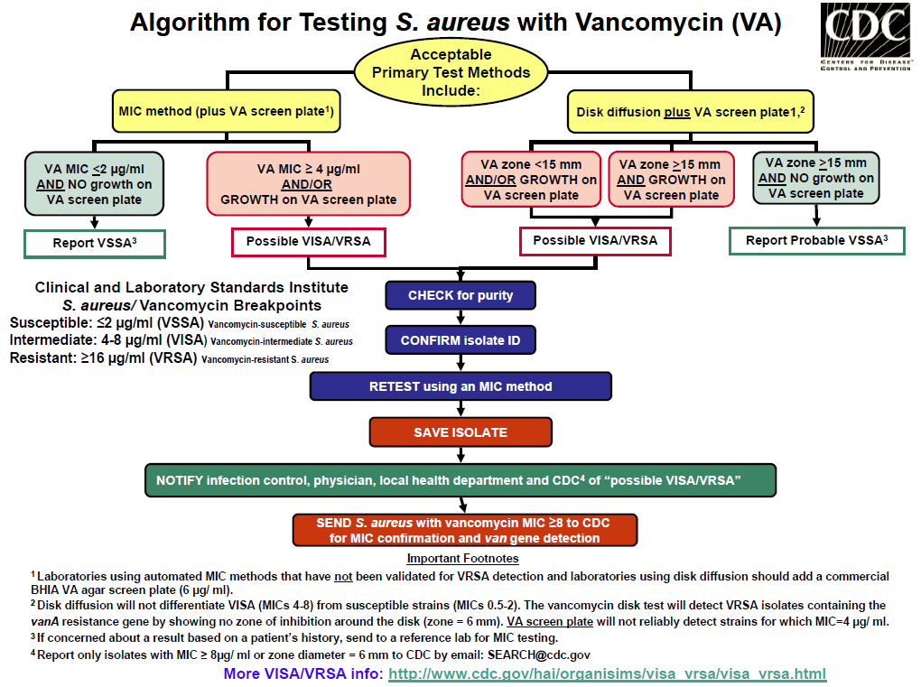
CDC VISA/VRSA Algorithm

Slide 18
Staphylococcus aureus
MRSA
  Responsible for >90,000 invasive infections each year in the U.S. (JAMA. 2007 Oct 17;298(15):1763-71)
  Almost 19,000 fatal infections in the U.S., 369,000 total hospitalizations and costs the healthcare system billions of dollars each year (“Superbug: The Fatal Menace of MRSA”, 2011, Maryn McKenna)
  Hospital-acquired (HA-MRSA) or Community-acquired (CA-MRSA)

Slide 19
Staphylococcus aureus
HA-MRSA
  USA100 most commonly seen among isolates PFGE-subtyped at WSLH
  USA500 a distant second most common PFT
CA-MRSA
  USA300 predominates among CA-MRSA isolates PFGE-subtyped at WSLH and Marshfield Clinic
  USA400 a distant second most common PFT

Slide 20
USA 300 MRSA Antibiogram
2010-2011 WSLH and Marshfield Clinic Data- WDPH HAI Program
Agent | Number (%) Susceptible | 95% Confidence Interval
Clindamycin | 140 (95%) of 147 | 90-98%
Erythromycin | 8 (5%) of 151 | 2-10%
Tetracycline | 146 (99%) of 147 | 92-100%
TMP/SMX | 150 (99%) of 151 | 96-100%
Rifampin | 151 (100%) of 151 | 97-100%
Vancomycin | 151 (100%) of 151 | 97-100%

Slide 21
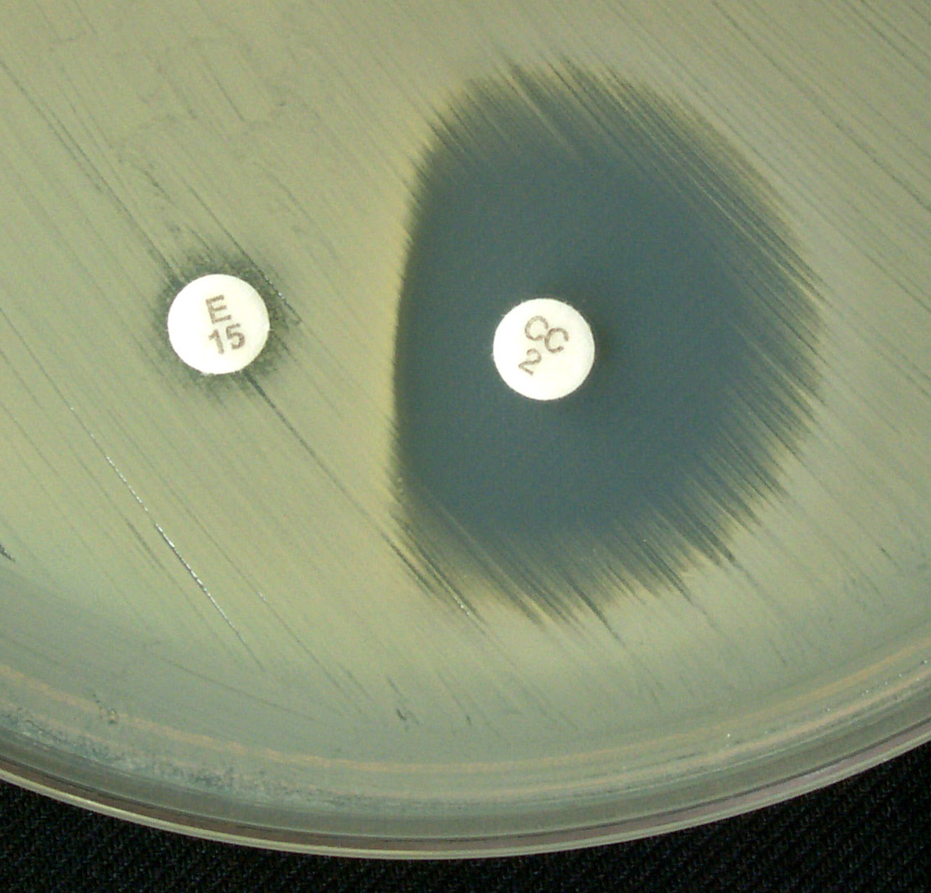
Staphylococcus aureus
WSLH MRSA Studies
  Cefoxitin screen superior to Oxacillin screen-ease of reading and higher sensitivity (JCM, 2009, p. 217–219 Vol. 47, No. 1)
  D Test (Clindamycin Disk Induction Test) used on isolates that test resistant to Erythomycin but susceptible to Clindamycin; detects inducible R
Mechanism | Determinant | Erythro | Clinda
Efflux Pump | msrA | R | S
Ribosome Altered | erm | R | S*
Ribosome Altered | erm | R | R (constitutive)

Slide 22
Does your laboratory perform AST on S. pneumoniae isolates?
A. YES
B. NO
C. NO, SEND TO REFERENCE LAB
D. DON’T HAVE A CLUE

Slide 23
DOES YOUR LABORATORY PERFORM…
A. DISK DIFFUSION ONLY
B. DISK DIFFUSION PLUS E-TEST
C. ETEST ONLY
D. AUTOMATED SYSTEM
E. AUTOMATED SYSTEM PLUS ETEST OR DISK DIFFUSION

Slide 24
Streptococcus pneumoniae
Suggested Antimicrobials to Test
Group A
  Penicillin
  Erythromycin
  Trimeth/sulfa
Group B
  Cefotaxime
  Ceftriaxone
  Clindamycin
  Levofloxacin
  Moxifloxacin
  Ofloxacin
  Meropenem
  Tetracycline
  Vancomycin
Group C
  Amoxacillin
  Amox/Clav
  Cefuroxime
  Chloramphenicol
  Linezolid
  Ertapenem
  Imipenem
  Rifampin
CLSI M100-S22, 2012

Slide 25
S. Pneumoniae Test Methods
Inoculum: Direct colony suspension
Incubation: 35C + 2; 20-24 hours
Disk Diffusion – CO₂
Broth Dilution – O₂
Media: Disk Diffusion – MHA with 5% sheep blood
Broth Dilution – CAMHB with lysed horse blood

Slide 26
S. Pneumoniae
Oxacillin Disk Test
1 ug Oxacillin disk
Interpretation
  >20 mm---Report “S” to penicillin, cefotaxime/ceftriaxone, other β-lactams
  <19 mm---Perform MICs for penicillin and cefotaxime/ceftriaxone
    Usually “R” or “I”, but some are “S” by MIC
Read the upper surface of the agar with reflected light
and cover removed. Zone margin is visible growth with
unaided eye.

Slide 27
DOES YOUR LABORATORY USED THE OXACILLIN SCREEN?
A. YES
NO
I DON’T KNOW

Slide 28
IF OXACILLIN ZONE SIZE IS <19MM, DOES YOUR LABORATORY FOLLOW UP WITH AN MIC METHOD?
A. YES
B. YES, REFER TO REFERENCE LAB
C. NO
D. YOU TELL ME

Slide 29
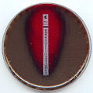
S. Pneumoniae Etest
Inoculum: Direct colony suspension
0.5 McFarland
Medium: MHA with 5% sheep blood
Incubation: 35C + 2; 20-24 hours
CO₂

Slide 30
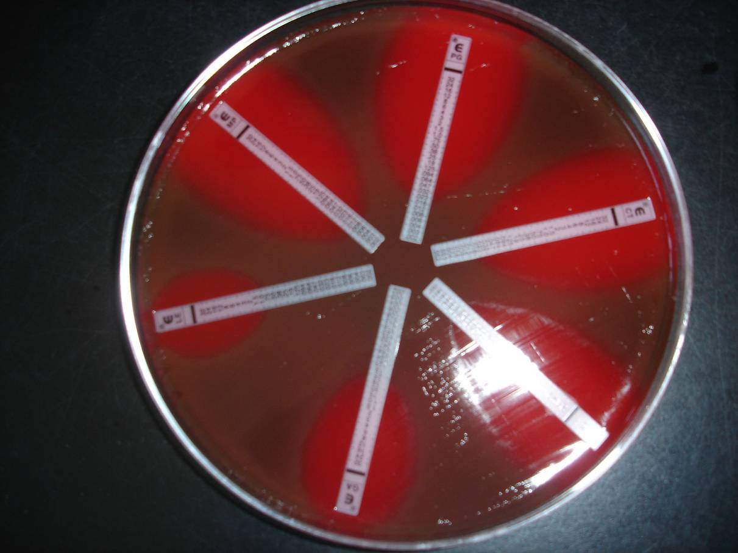
S. Pneumoniae Etest

Slide 31
S. pneumoniae Meningitis and Non-Meningitis Breakpoints
For CSF isolates, report only meningitis interpretations.
For all isolates other than those from CSF, report interpretations for both meningitis and nonmeningitis.

Slide 32
S. pneumoniae Meningitis and Non-Meningitis Breakpoints
For CSF isolates, report only meningitis interpretations.
For all isolates other than those from CSF, report interpretations for both meningitis and nonmeningitis.

Slide 33
DOES YOUR LABORATORY…
A. Report both mening and non- mening interpretations for blood isolates
B. Report only the non-mening interpretations
C. Report only the mening interpretations
D. You’ll have to ask my supervisor

Slide 34

Antimicrobials
NOT to Report for CSF isolates
Agents administered by oral route only
1st- and 2nd-generation cephalosporins
  Except cefuroxime parenteral
Cephamycins
Clinidamycin
Macrolides
Tetracyclines
Fluoroquinolones
CLSI M100-S20. pp. 35.

Slide 35
CDC Invasive Bacterial Surveillance Program
Streptococcus pneumoniae
Neisseria meningitidis
Haemophilus influenzae
Group A Strep
Group B Strep
MRSA

Slide 36
DOES YOUR LABORATORY SUBMIT ISOLATES TO WSLH?
A. YES
B. NO
C. DON’T KNOW

Slide 37
WARN
Wisconsin Antibiotic Resistance Network
  Education to improve antimicrobial prescribing in Wisconsin
    Clinicians
    The general public
    Parents of young children
  Laboratory Surveillance
    Labs submit invasive S. pneumoniae isolates to WSLH for AST

Slide 38
Demographics of Patients with Invasive Strep. pneumoniae Infections

Slide 39
Wisconsin Susceptibility Data 2010: β-lactams
Invasive S. pneumoniae (n=399)

Slide 40
Wisconsin Susceptibility Data 2010
Invasive S. pneumoniae (n=399)
Total
Non-Suscept
Susceptible
Intermediate
Resistant

Slide 41
Temporal Trends in Invasive S. pneumo. Resistance

Slide 42
Invasive S. pneumo. Pen Susceptibility by Region, 2010

Slide 46
Neisseria meningitidis- WSLH Resistance Surveillance
WSLH surveillance (E Test)
  Penicillin
  Azythromycin
  Rifampin
  Minocycline
  Ciprofloxacin
  Ceftriaxone

Slide 47
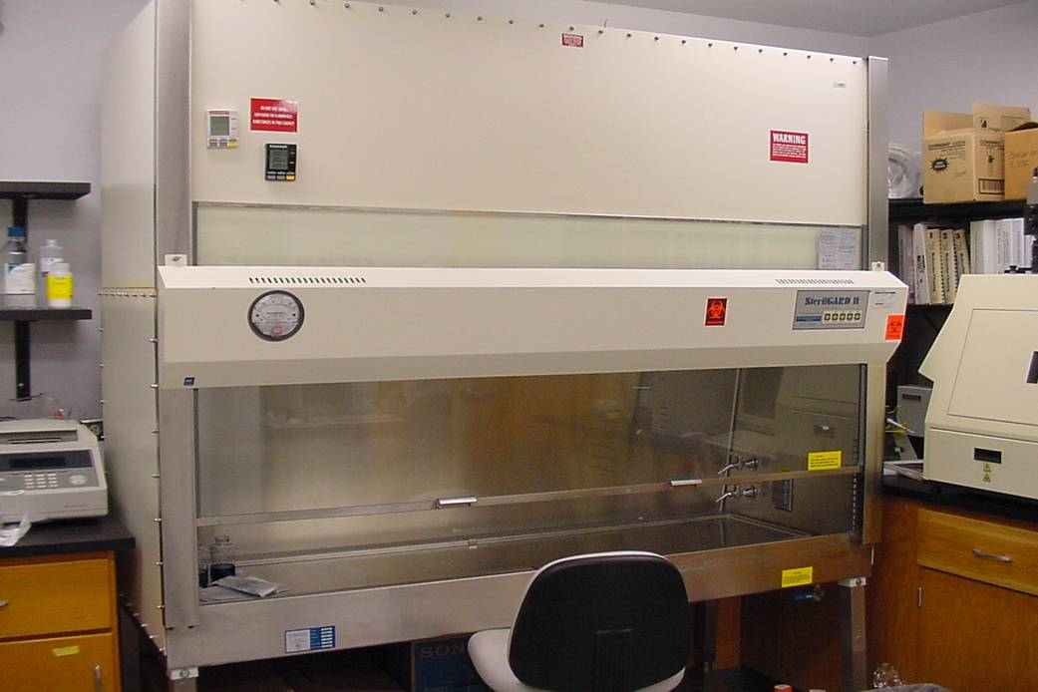
Routine AST by clinical laboratories is not necessary
WORK SAFELY!

Slide 48
Antibiotics with CLSI Interpretations
For N. meningitidis treatment:
  Penicillin--------MIC only
  Ampicillin-------MIC only
  Cefotaxime/Ceftriaxone----”S” only
  Meropenem-------------------”S” only
  Choramphenicol---DD or MIC

Slide 49
Antibiotics with CLSI Interpretations
For Prophylaxis of N. meningitidis contacts
  Rifampin----DD and MIC
  Ciproloxacin---DD and MIC
  Levolfloxacin---MIC only
  Minocycline—”S” only
  Azithromycin---”S” only
  Sulfisoxazole---MIC only
  SXT---Predictive for sulfonamides

Slide 50
N. meningitidis AST Methods
Broth microdilution
  CAMHB with 2-5% lysed horse blood
  Incubate 35C in 5% CO₂ 20-24 hr
Agar dilution
Disk diffusion
E-test

Slide 51
N. meningitidis AST Procedures
Direct colony suspension in saline of overnight growth from Choc agar
CAMHB with 2-5% lysed horse blood for broth dilution
MHA supplemented with 5% sheep blood for agar dilution, DD, and E-test
Incubate 35C in 5% CO₂ 20-24 hr

Slide 52
CDC ABC 2010 Data
Antibiotic | Interpretation | N(%) | MIC₅₀ µg/mL | MIC₉₀ µg/mL
Ceftriaxone | Susceptible | 80 (100) | ≤0.015 | ≤0.015
 | Non Susceptible | 0
Cefotaxime | Susceptible | 80 (100) | ≤0.015 | ≤0.015
 | Non Susceptible | 0
Meropenem | Susceptible | 80 (100) | ≤0.015 | ≤0.015
 | Non Susceptible | 0
Ciprofloxacin | Susceptible | 80 (100) | ≤0.008 | ≤0.008
 | Intermediate | 0
 | Resistant | 0
Penicillin | Susceptible | 66 (82.5) | 0.06 | 0.12
 | Intermediate | 13 (16.25)
 | Resistant | 1 (1.25)
Ampicillin | Susceptible | 68 (85) | 0.06 | 0.25
 | Intermediate | 11 (13.75)
 | Resistant | 1 (1.25)
Rifampin | Susceptible | 80 (100) | 0.06 | 0.25
 | Intermediate | 0
 | Resistant | 0
Azithromycin | Susceptible | 80 (10) | 0.25 | 0.5
 | Non Susceptible | 0
Minocycline | Susceptible | 80 (100) | 0.25 | 0.25
 | Non Susceptible | 0
Chloramphenicol | Susceptible | 79 (98.75) | 1 | 1
 | Intermediate | 1 (1.25)
 | Resistant | 0
Courtesy of
Amanda Cohn
CDC

Slide 53
Resistance to Ciprofloxacin
2007/2008---4 cases of N. meningitidis R to Cipro
  2 cases of meningitis in MN
  1 case of meningitis in N. Dakota
  1 pt from CA with pneumonia
    Blood isolate R to Cipro
WI has not seen any non-susceptible N. meningitidis isolates other than sporadic Penicillin intermediate/resistance to date

Slide 54
Question
“NARMS” stands for:
A. National Antimicrobial Resistance Monitoring and Surveillance Network
B. Nuclear ARMS race
C. Not Able to Read any More Slides
D. Not Answering, Really need More Sleep
E. All of the above

Slide 55
NARMS
National Antimicrobial Resistance Monitoring and Surveillance Network
Annual national surveillance for antimicrobial resistant enteric pathogens
Use Sensititre® broth microdilution method (Trek Diagnostics)
Target enteric bacterial pathogens implicated in foodborne diseases

Slide 56
NARMS
Standard Antimicrobial Test Panel:
Amikacin
Ampicillin
Amoxicillin-clavulanic acid
Cefoxitin
Ceftiofur
Ceftriaxone
Cephalothin
Chloramphenicol
Ciprofloxacin
Gentamicin
Kanamycin
Nalidixic acid
Streptomycin
Sulfisoxazole
Trimethoprim-Sulfamethoxazole
Tetracycline

Slide 57
NARMS
Resistance Phenotypes of Interest:
  Pan resistance to NARMS panel
  Elevated MIC for Ceftriaxone or Ceftiofur
  Elevated MIC for Ceftriaxone and/ or Ceftiofur with elevated MIC to Nalidixic Acid and/ or Ciprofloxacin
  Fluoroquinolone resistance
  Amikacin resistance
  Macrolide resistance (Shigella)

Slide 58
NARMS
Receive every 5th isolate of Salmonella, Shigella and E. coli O157:H7 from participants
Receive every 5th , 2nd or every Campylobacter isolate from FoodNet (enhanced foodborne disease surveillance) sites
Receive every S. Typhi, S. Paratyphi A-C, or Vibrio (cholerae and non-cholerae)

Slide 59
Question
Which of the following organisms has different reporting criteria depending upon site of infection?
A. Salmonella
B. Shigella
C. E. coli
D. Campylobacter
E. All of the above

Slide 60
Clinically Relevant Antibiotics-Salmonella
Intestinal infections
  Ciprofloxacin
  Ampicillin
  SXT
Extraintestinal infections
  Ciprofloxacin
  Ampicillin
  SXT
  Ceftriaxone (third generation cephalosporin)
  Chloramphenicol (if requested)

Slide 61
Salmonella Resistance
Resistance of interest (2002-2010 WI):
  49% S. Typhi resistant to Nalidixic Acid; No Ciprofloxacin resistance detected
  3% non-typhoidal Salmonella resistant to Nalidixic Acid; No Ciprofloxacin resistance detected
  12% non-typhoidal Salmonella resistant to Ampicillin
  8% non-typhoidal Salmonella resistant to Ceftriaxone

Slide 62
Salmonella Resistance- Amp
WI vs NARMS National Data

Slide 63
Salmonella Resistance- Cipro
WI vs NARMS National Data

Slide 64
Salmonella Resistance- SXT
WI vs NARMS National Data

Slide 65
Salmonella Resistance- Chlor
WI vs NARMS National Data

Slide 66
Shigella sp. Resistance
Routinely reportable antimicrobials
  Ampicillin
  Ciprofloxacin (fluoroquinolone)
  SXT
Treatment not normally recommended but may be employed to shorten duration if illness or decrease infectious shedding in daycares or schools
MDR strains of Shigella have been on the rise in the U.S. (Amp + SXT)

Slide 67
Shigella sp. Resistance
Resistance of interest (2002-2010- WI)
  60% of Shigella sp. resistant to Ampicillin
  30% of Shigella sp. resistant to SXT
  1% of Shigella sp. resistant to Ceftriaxone
  No Ciprofloxacin resistance detected
8% of WI Shigella sp. isolates (2002-2010) were Ampicillin and SXT resistant (MDR)

Slide 68
Shigella Resistance- Amp
WI vs NARMS National Data

Slide 69
Shigella Resistance- Cipro
WI vs NARMS National Data

Slide 70
Shigella Resistance- SXT
WI vs NARMS National Data

Slide 71
Campylobacter AST Testing
WSLH tests every 10th Campylobacter isolate received or recovered
E Test method
  Ciprofloxacin
  Erythromycin
  Tetracycline
MHSBA plates; 1.0 McFarland turb. std.
Microaerophilic growth for 24 hr at 42⁰C

Slide 72
Campylobacter AST- WI

Slide 73
Campy Resistance- Cipro
WI vs NARMS FoodNet Sites

Slide 74
Campy Resistance- Erythro
WI vs NARMS FoodNet Sites

Slide 75
Campy Resistance- Tetra
WI vs NARMS FoodNet Sites

Slide 76
Escherichia coli O157:H7
Resistance

Slide 77
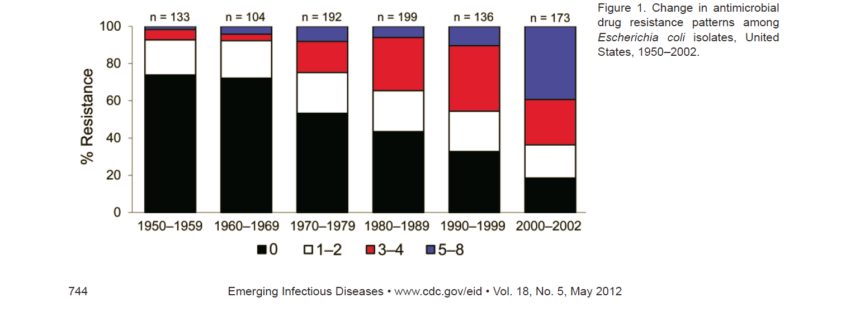
Escherichia coli

Slide 78
Does your laboratory perform genital cultures for Neisseria gonorrhoeae?
A. YES
B. YES, but rarely have a positive
C. Refer to a reference lab
D. NO
E. I don’t know…I can’t even spell “gonorrhoeae”

Slide 79
Antibiotic Resistance in GC
1970s and 80s
  Resistance to penicillin and tetracycline
1999
  Fluoroquinolone resistance
  Asia Hawaii western states rest of the US
  2007 FQs no longer recommended

Slide 80
Neisseria gonorrhoeae
Chromosomal and/or plasmid-mediated resistance
  Penicillins
  Tetracyclines
Chromosomal- mediated resistance
  Azithromycin (emerging)
  Fluoroquinolones (emerging)
  Spectinomycin

Slide 81
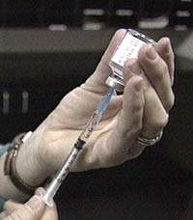

Current Recommended Therapy for GC Infections
Ceftriaxone (250mg IM) plus azithromycin or doxycycline

Slide 82
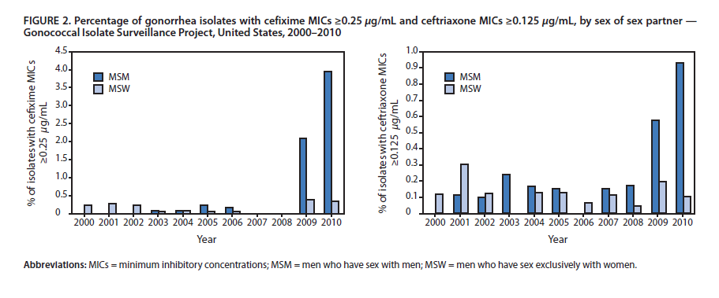
Emergence of Increased Cephalosporin MICs in GC

Slide 83
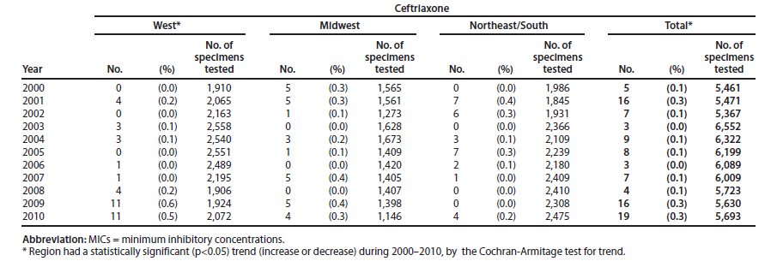
Ceftriaxone

Slide 84
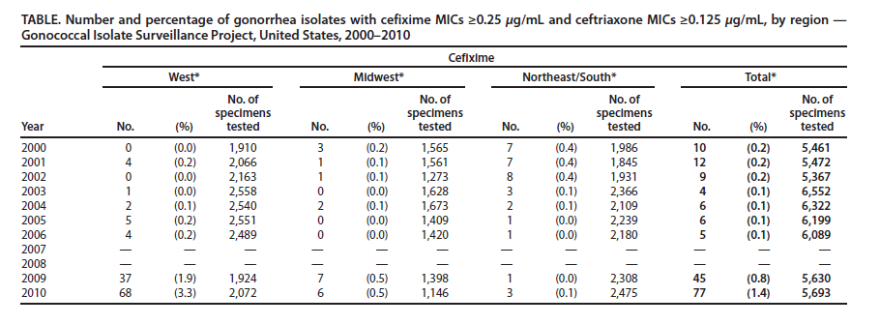
Cefixime

Slide 85
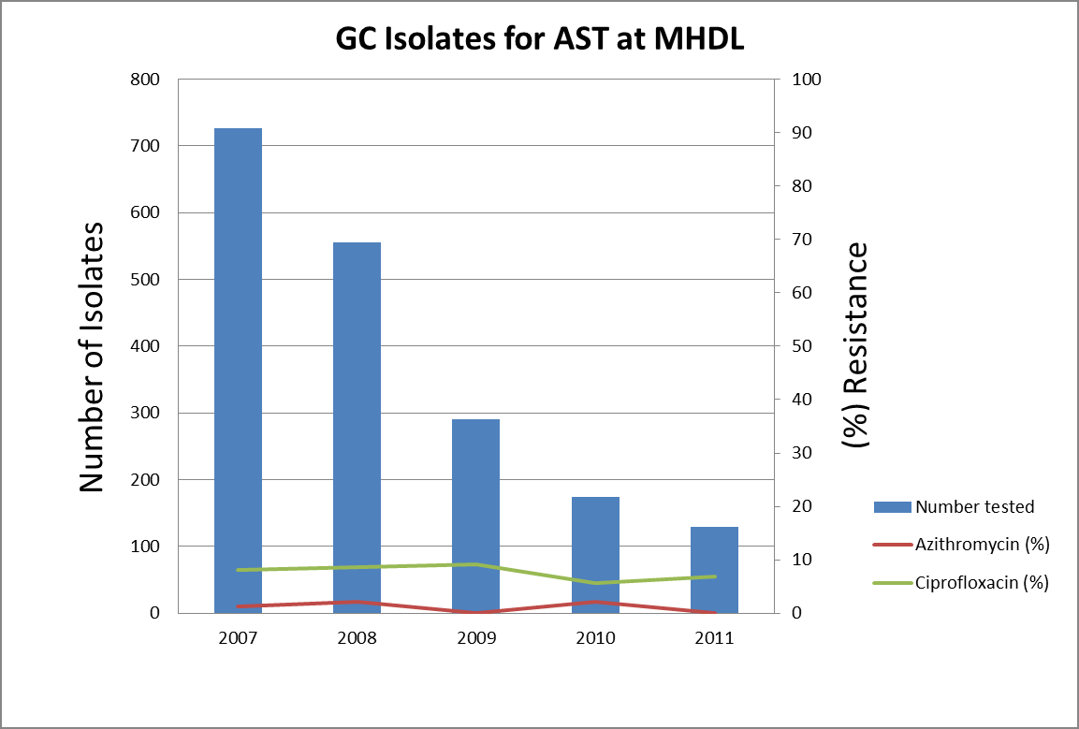
City of Milwaukee Health Department Laboratory
No resistance seen to ceftriaxone, cefixime, or spectinomycin

Slide 86
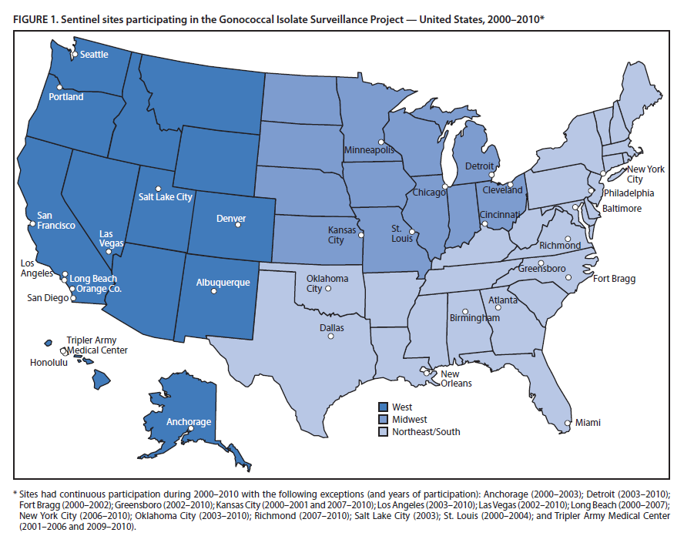
Surveillance for Resistance
GISP Laboratories

Slide 87
Neisseria gonorrhoeae
“Antimicrobial resistance in N. gonorrhoeae is the most significant challenge to controlling gonorrhea.”
“It is of great importance to perform laboratory surveillance of antimicrobial
resistance in N. gonorrhoeae in order to assess the effectiveness of locally recommended therapies.”
Manual for Identification and Antimicrobial Susceptibility Testing, WHO, 2002

Slide 88
Neisseria gonorrhoeae
Milwaukee Health Department Laboratory (MHDL)
  Voluntary submission of GC susceptibility testing data to CDC for national surveillance
  Follow CLSI guidelines for AST testing
  Culture collected at the Milwaukee Sexually Transmitted Disease Clinic and tested in parallel with a molecular diagnostic assay
Gonorrhea Isolate Surveillance Project
  Resistance monitoring at regional sites in U.S.

Slide 89
Neisseria gonorrhoeae
Chromosomal and/or plasmid-mediated resistance
  Penicillins
  Tetracyclines
Chromosomal- mediated resistance
  Azithromycin (emerging)
  Fluoroquinolones (emerging)
  Spectinomycin

Slide 90
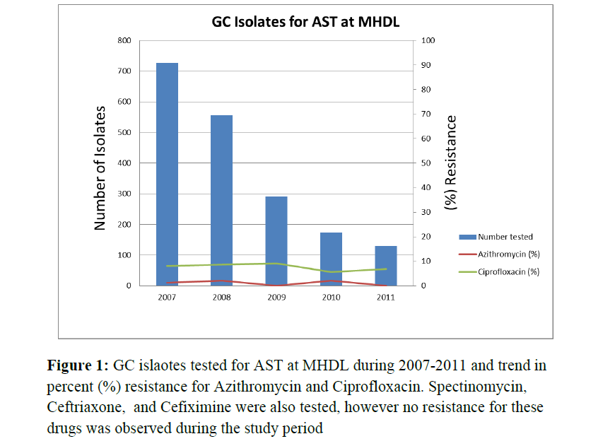
Neisseria gonorrhoeae
MHDL

Slide 91
NDM-1 Metallo-Beta- Lactamases
“Indian Superbug”
Discovered in 2008 in Sweden; patient had traveled to New Dehli, India; developed K. pneumoniae UTI found to be resistant to all carbapenems
“New Dehli Metallo-beta-lactamase” enzyme responsible (bla_{NDM-1} gene)
Plasmid-mediated transfer

Slide 92
NDM-1 Metallo-Beta- Lactamases
Discovered in the U.S. in 2010
  IL, MA and CA
  E. coli, E. cloacae and K. pneumoniae
  All three patients had history of travel to South Asia
Confer resistance to all carbapenems except aztreonam (monobactam)
  However all three 2010 isolates had also developed resistance to aztreonam as well

Slide 93
NDM-1 Metallo-Beta- Lactamases
MMWR; June 25, 2010 / 59(24);750
  Clinicians should be aware of carbapenem- resistant Enterobacteriaceae in patients with history of travel to India or Pakistan
  All carbapenem-resistant Enterobacteriaceae should be forwarded to state public health laboratories for shipment to CDC for further studies
  Infection control measures should be taken to avoid further transmission

Slide 94
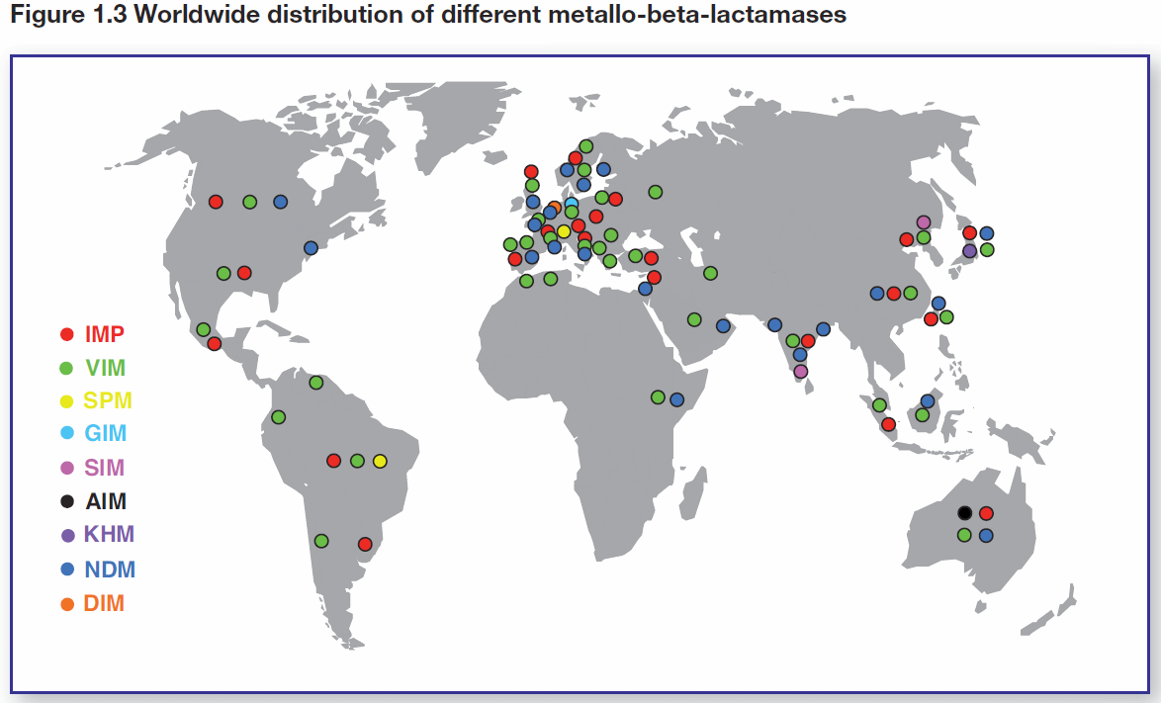
Metallo-Beta-Lactamases
Evolving Threat of Antimicrobial Resistance- Options for Action, WHO, 2012

Slide 95
ESBL-Producing GNR
Isolated in mid-1980’s in Western Europe
Plasmid-mediated enzymes which hydrolyze third generation cephalosporins and monobactams
Do not affect carbapenems or cephamycins
Found in a variety of Enterobacteriaceae
  K. pneumoniae, K. oxytoca and E. coli commonly implicated

Slide 96
ESBL-Producing GNR
Three groups of ESBL-producing isolates
  TEM
  SHV
  CTX-M
If found, all cephalosporins, penicilins and aztreonam should be reported as resistant
NCCLS standards only available currently for screening of K. pneumoniae, K. oxytoca, E. coli and P. mirabilis

Slide 97
Acinetobacter baumannii
Global emerging MDR pathogen
Have developed/obtained numerous antibiotic resistant mechanisms
Increasingly seen in wound infections in U.S. soldiers returning from overseas
May survive up to 5 months on environmental surfaces (BMC Infect. Dis. 6: 130. 2006)

Slide 98
Summary
Antimicrobial resistance is an emerging global public health threat
Microorganisms are continually evolving to produce new mechanisms of resistance
It is critical that clinicians, infection control practitioners, clinical and public health laboratorians and pubic health officials partner to effectively respond to the growing threat of antibiotic resistance

Slide 99
Summary
Please continue to submit isolates for the invasive bacterial surveillance program
Clinical laboratories are a vital part of public health
The World Health Organization and the Centers for Disease Control and Prevention recognize the significant threat of resistant microorganisms and are taking the lead in responding to this global threat

Slide 100
Acknowledgements
City of Milwaukee Health Department Laboratory
  Sanjib Bhattacharyya, Deputy Lab Director
Centers for Disease Control and Surveillance
  Amanda Cohn, MeningNet Program
  Allison O’Donnell, NARMS Surveillance
Wisconsin Division of Public Health
  Gwen Borlaug, HAI Program

Slide 101
Acknowledgements
WSLH Bacteriology Unit
  Mike Rauch
  Ann Valley
  Jared Shelerud
  Kristin Gundlach
  Holly Oxley
WDPH
  Susann Ahrabi-Fard, Invasive Diseases
  Anna Kocharian, Invasive Diseases

Slide 102

Questions/ Comments?

