Slide 1
Creative Problem Solving in the Workplace
Crystal Barrett
2025

Slide 2

Welcome
Please take 2 minutes to think of a problem that you want to solve
Jot it down on the paper provided
Examples:
  Improve communication with my partner
  Streamline a time-consuming process
  Reduce my stress
  Get my kids to do their homework
  Get my email inbox to zero

Slide 3
Creative Problem Solving: Unlocking Creativity for Better Solutions
What is creative problem solving?
Why is it important in the workplace?
How can it improve productivity and teamwork?

Slide 4
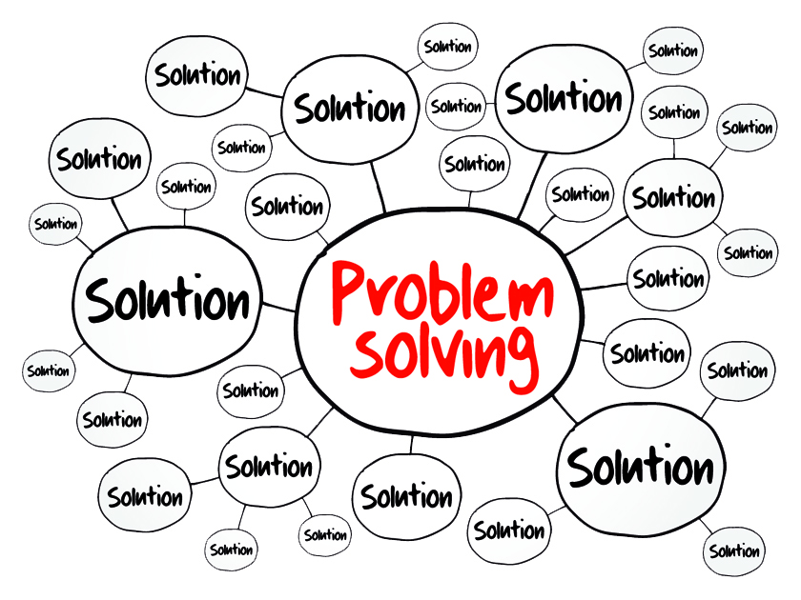
What is Creative Problem Solving?
Problem: Gap between current and desired state
Creativity: Process of generating new possibilities or alternatives
Creative problem solving: Using techniques that increase the number and variety of ideas

Slide 5

What is Creative Problem Solving?
Thinking outside the box to find innovative solutions to challenges
Encourages
  fresh ideas
  unconventional thinking
  adaptability
  fail early and often
Discourages
  “TTWWHADI”
  fear of failure
Notes:
“TTWWHADI” = That’s the way we have always done it

Slide 6

What is Creative Problem Solving?
Notes:
What do you see here? Travel overseas
Rebus puzzles are visual brainteasers based on common words or phrases, and your job is to figure out that word or phrase. You’ll do so by looking at the puzzle, which is often a combination of words, numbers and symbols arranged in such a way that they have a deeper meaning. If you deciphered that the above image means “travel overseas,” good job!

Slide 7


Myths and Misperceptions
Creativity realistic solutions
You can be creative, or you can get work done, not both
Creativity wastes time and money
Notes:
Small group activity:
Participants will name various superpowers and pick one
Handout worksheet A: Participants will vote on the “problem” from Worksheet A
(Optional) Now switch – give your superpower to another table
How can you use this superpower to solve your problem?

Slide 8



Why is Creative Problem Solving Important?
Increases innovation
Improves efficiency
Fosters teamwork
Enhances adaptability
Allows YOU to address your own unique pain points
Starting point for other solutions and fresh perspectives
Notes:
Increases Innovation: Helps generate new ideas and solutions.
Improves Efficiency: Finds quicker, more effective solutions.
Fosters Teamwork: Encourages collaboration and diverse viewpoints.
Enhances Adaptability: Enables teams to adjust to changes in the workplace.
LEGO: Facing declining sales, LEGO embraced collaboration with popular franchises like Star Wars and Harry Potter, revitalizing its brand and appealing to new generations.
Airbnb: By turning unused spaces into accommodations, Airbnb created a platform that disrupted the hospitality industry and provided travelers with unique lodging experiences.
Etsy: Etsy launched "Gift Mode," an AI-powered feature that helps users find the perfect gift based on recipient preferences. This innovation boosted their sales and enhanced the shopping experience

Slide 9

But What if I’m Not Creative?
What’s the problem?
What’s the solution?
Notes:
Small group activity:
Participants will name various superpowers and pick one
Handout worksheet A: Participants will vote on the “problem” from Worksheet A
(Optional) Now switch – give your superpower to another table
How can you use this superpower to solve your problem?

Slide 10
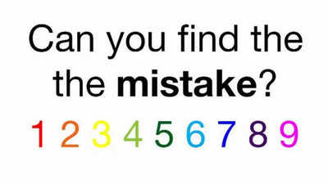
Let’s Try Another One
What’s the problem?
What’s the solution?
Notes:
Small group activity:
Worksheet B
Horse and rider puzzle
Sam Loyd

Slide 11

Key Traits of Creative Problem Solvers
Open-Mindedness
Curiosity
Flexibility
Persistence
Collaboration
Others?
Notes:
Open-Mindedness: Willingness to explore new ideas.
Curiosity: Constant desire to understand and learn.
Flexibility: Ability to adapt to new solutions and approaches.
Persistence: Continuing to find solutions despite setbacks.
Collaboration: Working well with others to generate ideas.

Slide 12
The Creative Problem Solving Process
Creative Problem Solving
Identify Problem
Analyze Problem
Generate Solutions
Evaluate Solutions
Implement Solutions
Review Outcomes
Notes:
Identify the problem
Gather information and analyze the problem
Generate potential solutions
Evaluate solutions
Implement the best solution
Review and reflect on the outcome

Slide 13
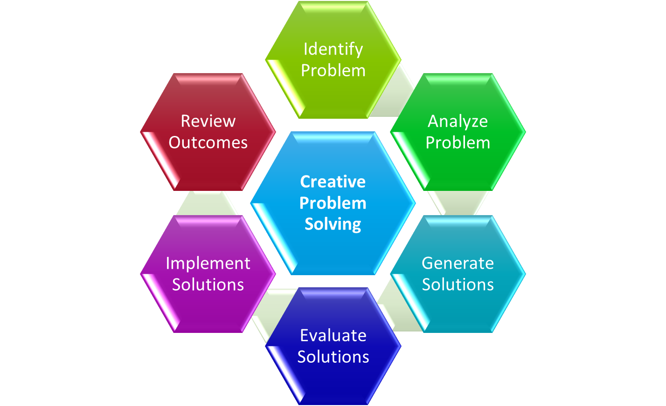
Step 1: Identify the Problem
Clarify the Issue
  Understand the exact nature of the problem
Ask Questions:
  What’s working?
  What’s not?
  What’s causing the problem?

Slide 14
Step 2: Gather Information
Collect Data:
  Gather relevant facts, opinions, and perspectives
  Benchmark
  Landscape analysis
Analyze the Situation:
  Look at the root causes, not just the symptoms
  5 Why’s
Notes:
The 5 Why's is a simple yet effective problem-solving technique used to identify the root cause of a problem by asking "Why?" multiple times. Here's how to use it:
Start with the problem: Clearly define the issue you're facing.
Ask "Why?": Ask why the problem is happening. The answer will lead you to the next question.
Repeat: For each answer you get, ask "Why?" again. Do this five times, or until you reach the root cause of the problem.
Identify the root cause: By the 5th "Why" (or sometimes fewer), you should uncover the deeper cause behind the issue, allowing you to address the core problem rather than just its symptoms.

Slide 15
Step 3: Generate Potential Solutions
Many techniques to use
Brainstorming:
  Encourage the generation of as many ideas as possible, without judgment
  “Blue sky” thinking
Divergent Thinking:
  Think of multiple solutions, even if they seem unusual or far-fetched
  Reverse engineer the problem
    How can I make this WORSE?
    Start with desired outcome and work backwards

Slide 16
Step 4: Evaluate Solutions
Assess Feasibility:
  Which solutions are practical?
  3 Options Model
    Do Nothing
    Do Minimum
    Do Something/Everything
Weigh Pros and Cons:
  What are the risks of each option?
  What are the benefits of each option?
Notes:
Sample Assessment Criteria
Pros and Cons: List the positives and negatives for each option
Benefits: What are the financial and non-financial benefits?
Time-frame: How long will this option take the design / implement?
Assumptions / Constraints / Risks: List any assumptions, constraints or risks involved
Cost: How much is this going to cost?
Resources: How many people are needed to implement this option?

Slide 17
Step 5: Implement the Best Solution
Plan the Execution:
  Create an actionable plan
  SMART goals
    Specific, Measurable, Actionable, Realistic, Timebound
Allocate Resources:
  Ensure the right resources (people, time, budget) are available
  RACI Matrix
    Responsible, Accountable, Consulted, Informed
Notes:
SMART = Specific, Measurable, Actionable, Relevant, Time-bound
RACI = Responsible, Accountable, Consulted, Informed

Slide 18
Step 6: Review and Reflect
Monitor Results:
  Track how well the solution is working
  Check your metrics
Reflect:
  What did you learn?
  What can be improved next time?
  Schedule ‘hotwash’ meeting early so you can fail fast

Slide 19
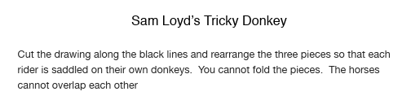

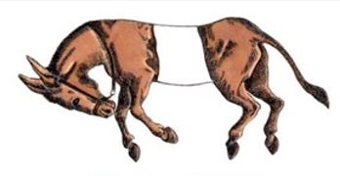
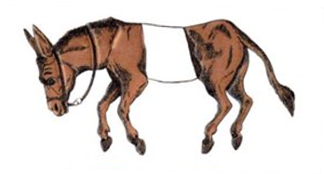
Let’s Try Another One
Notes:
Small group activity:
Worksheet B
Horse and rider puzzle
Sam Loyd

Slide 20
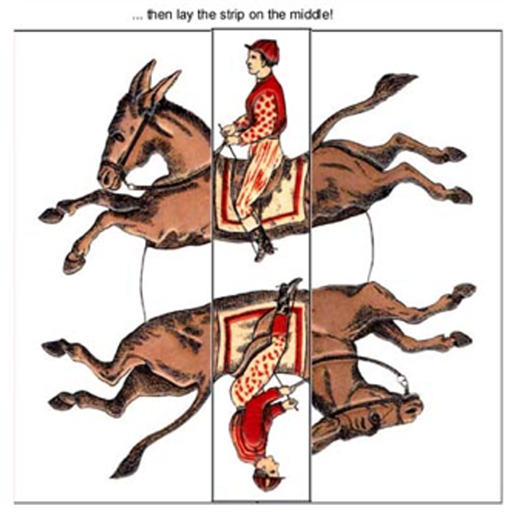
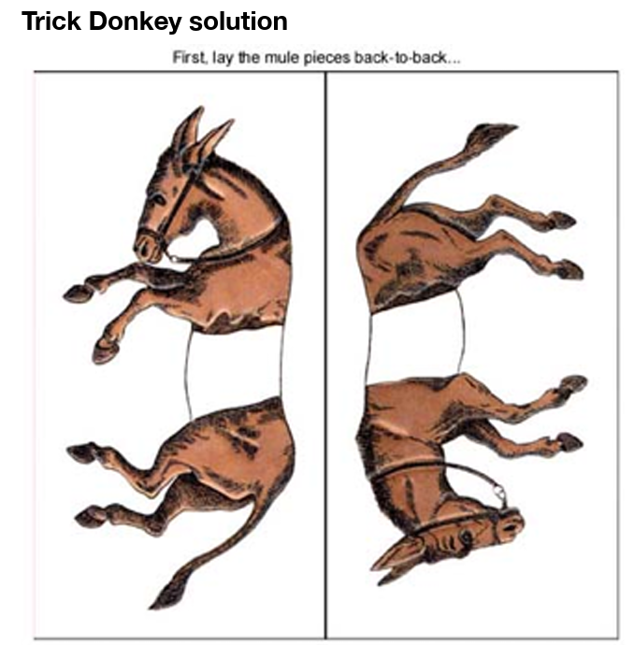
Let’s Try Another One: Solution
Notes:
Small group activity:
Worksheet B
Horse and rider puzzle
Sam Loyd

Slide 21

Types of Creative Problem-Solving Techniques
Brainstorming
  generating ideas in a group, without judgment or criticism
Notes:
Brainstorming
Definition: A method of generating ideas in a group, without judgment or criticism.
Best for: Generating lots of ideas quickly.
Mind Mapping
Definition: A visual tool for organizing thoughts and ideas.
Best for: Visualizing connections between different aspects of a problem.
SCAMPER
Definition: A checklist tool to help think of new ideas by asking:
Substitute, Combine, Adapt, Modify, Put to another use, Eliminate, Rearrange
Best for: Analyzing and improving existing ideas.
Design Thinking
Definition: A human-centered approach to problem-solving that focuses on empathy, ideation, and prototyping.
Best for: Addressing user-centered challenges and improving customer experience.
Reverse Thinking
Definition: Think about the opposite of the problem, or how to cause the problem, to spark creative solutions.
Best for: Shifting perspective to identify unique approaches.

Slide 22
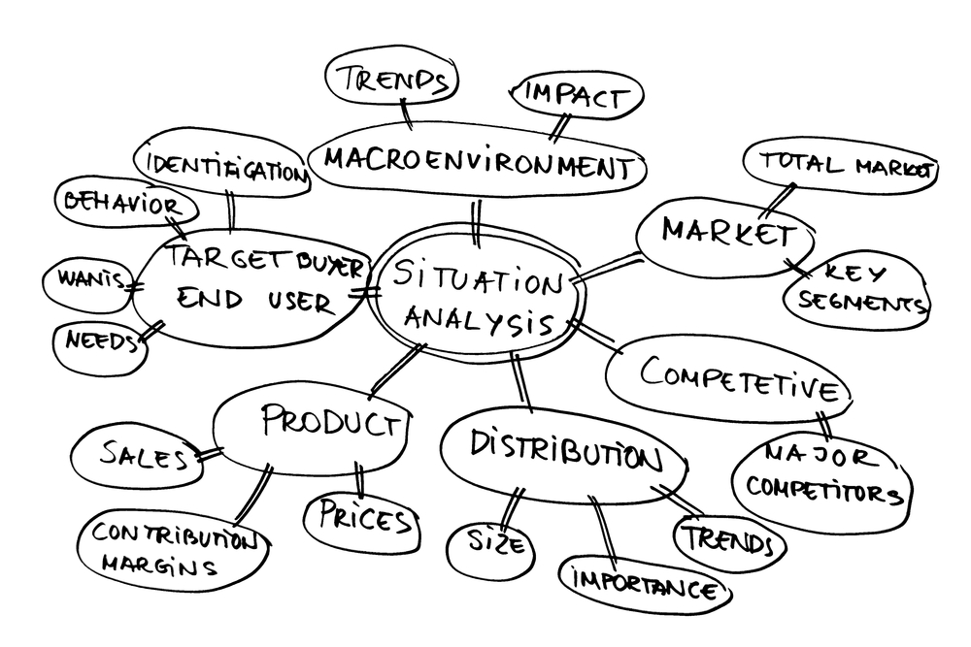
Types of Creative Problem-Solving Techniques
Mind Mapping
  visual tool for organizing thoughts and ideas
Notes:
Brainstorming
Definition: A method of generating ideas in a group, without judgment or criticism.
Best for: Generating lots of ideas quickly.
Mind Mapping
Definition: A visual tool for organizing thoughts and ideas.
Best for: Visualizing connections between different aspects of a problem.
SCAMPER
Definition: A checklist tool to help think of new ideas by asking:
Substitute, Combine, Adapt, Modify, Put to another use, Eliminate, Rearrange
Best for: Analyzing and improving existing ideas.
Design Thinking
Definition: A human-centered approach to problem-solving that focuses on empathy, ideation, and prototyping.
Best for: Addressing user-centered challenges and improving customer experience.
Reverse Thinking
Definition: Think about the opposite of the problem, or how to cause the problem, to spark creative solutions.
Best for: Shifting perspective to identify unique approaches.

Slide 23
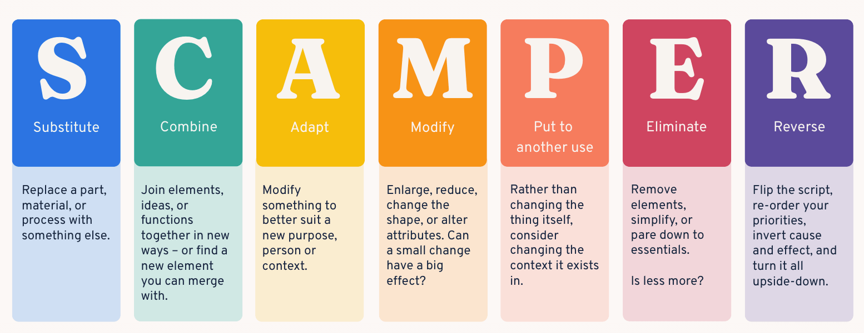
Types of Creative Problem-Solving Techniques
SCAMPER
  Substitute, Combine, Adapt, Modify, Put to another use, Eliminate, Reverse/Rearrange
Notes:
Brainstorming
Definition: A method of generating ideas in a group, without judgment or criticism.
Best for: Generating lots of ideas quickly.
Mind Mapping
Definition: A visual tool for organizing thoughts and ideas.
Best for: Visualizing connections between different aspects of a problem.
SCAMPER
Definition: A checklist tool to help think of new ideas by asking:
Substitute, Combine, Adapt, Modify, Put to another use, Eliminate, Rearrange
Best for: Analyzing and improving existing ideas.
Design Thinking
Definition: A human-centered approach to problem-solving that focuses on empathy, ideation, and prototyping.
Best for: Addressing user-centered challenges and improving customer experience.
Reverse Thinking
Definition: Think about the opposite of the problem, or how to cause the problem, to spark creative solutions.
Best for: Shifting perspective to identify unique approaches.

Slide 24
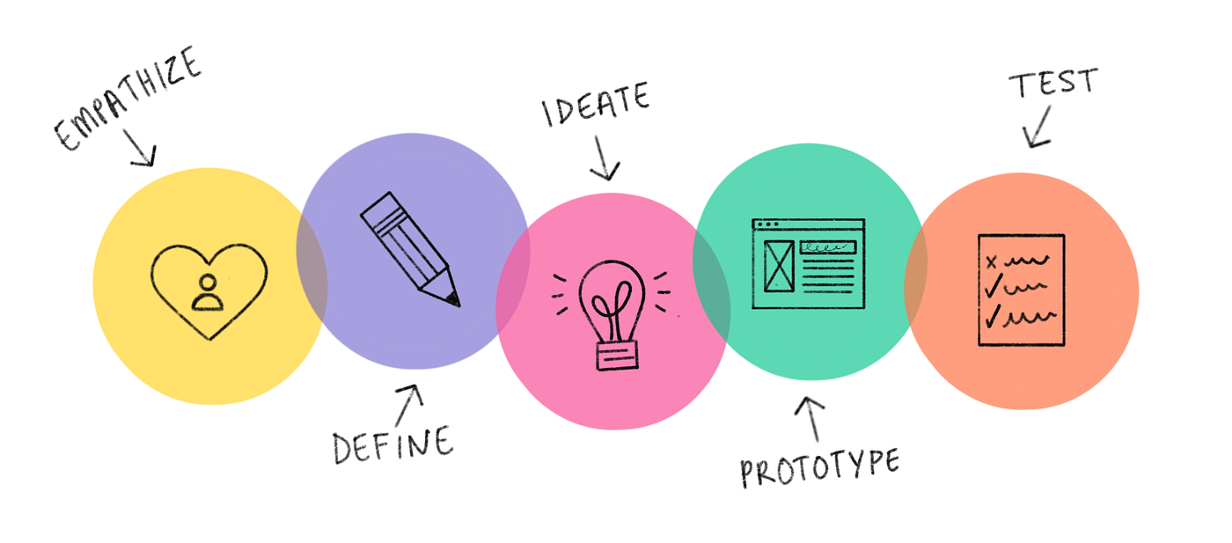
Types of Creative Problem-Solving Techniques
Design Thinking
  human-centered, focuses on empathy, ideation, and prototyping
Notes:
Brainstorming
Definition: A method of generating ideas in a group, without judgment or criticism.
Best for: Generating lots of ideas quickly.
Mind Mapping
Definition: A visual tool for organizing thoughts and ideas.
Best for: Visualizing connections between different aspects of a problem.
SCAMPER
Definition: A checklist tool to help think of new ideas by asking:
Substitute, Combine, Adapt, Modify, Put to another use, Eliminate, Rearrange
Best for: Analyzing and improving existing ideas.
Design Thinking
Definition: A human-centered approach to problem-solving that focuses on empathy, ideation, and prototyping.
Best for: Addressing user-centered challenges and improving customer experience.
Reverse Thinking
Definition: Think about the opposite of the problem, or how to cause the problem, to spark creative solutions.
Best for: Shifting perspective to identify unique approaches.

Slide 25
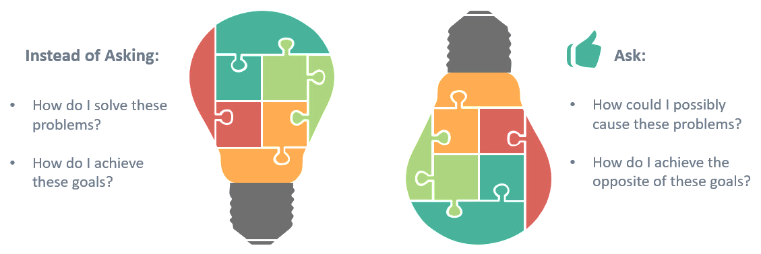
Types of Creative Problem-Solving Techniques
Reverse Brainstorming
  opposite of the problem, or how to cause the problem, to spark creative solutions
Notes:
Brainstorming
Definition: A method of generating ideas in a group, without judgment or criticism.
Best for: Generating lots of ideas quickly.
Mind Mapping
Definition: A visual tool for organizing thoughts and ideas.
Best for: Visualizing connections between different aspects of a problem.
SCAMPER
Definition: A checklist tool to help think of new ideas by asking:
Substitute, Combine, Adapt, Modify, Put to another use, Eliminate, Rearrange
Best for: Analyzing and improving existing ideas.
Design Thinking
Definition: A human-centered approach to problem-solving that focuses on empathy, ideation, and prototyping.
Best for: Addressing user-centered challenges and improving customer experience.
Reverse Thinking
Definition: Think about the opposite of the problem, or how to cause the problem, to spark creative solutions.
Best for: Shifting perspective to identify unique approaches.

Slide 26
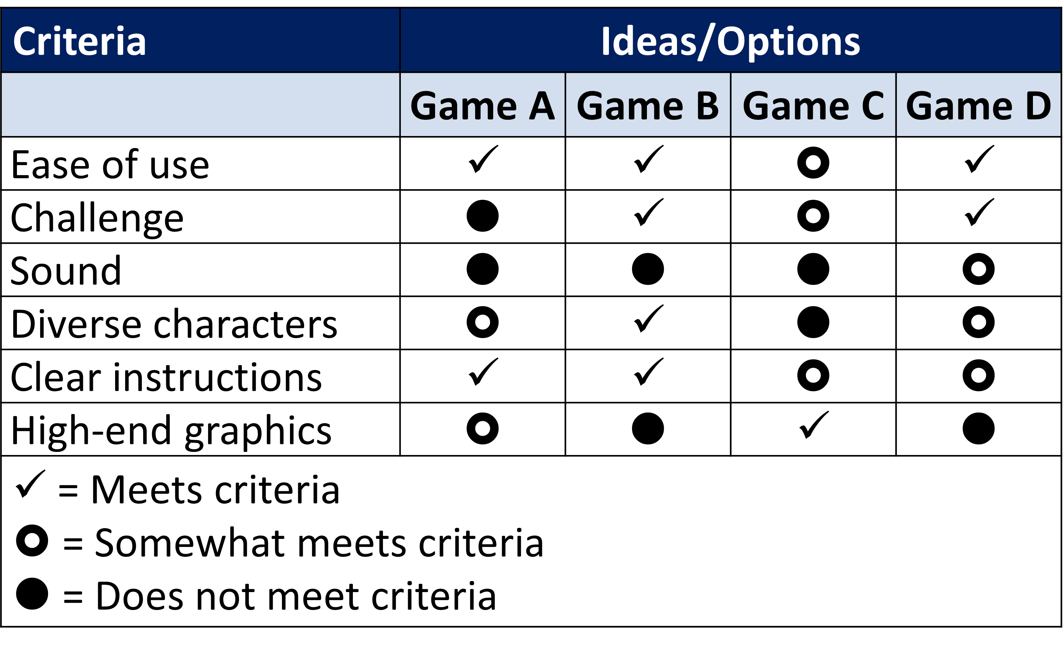
Evaluate and Choose a Solution
Voting
Pros/Cons
Advocacy; Devil’s Advocate
Advantage; Disadvantage

Slide 27

Brainstorming
Notes:
"Random Object Connections" Show them an everyday object (like a spoon or a rubber band) and ask them to think of 10 ways that object could be used in a different context. This breaks them out of the typical thought patterns and shows them that creativity is often just about perspective.

Slide 28

Overcoming Barriers to Creative Problem Solving
Common barriers:
  Fear of failure
  Lack of resources
  Limited time
  Resistance to change
Tips to overcome barriers:
  Growth mindset
  Dedicate space and time for creativity
  Culture of experimentation
Notes:
1. FedEx
Problem Solving Approach: FedEx encourages creative problem solving through their Purple Promise initiative, which empowers employees to go above and beyond to solve customer issues. The company fosters a culture of innovation and problem solving, particularly with their emphasis on efficiency, customer service, and technology integration (e.g., real-time package tracking).
Creative Solutions:
The introduction of FedEx Express in 1973 was a groundbreaking solution for delivering packages overnight, changing the logistics industry.
FedEx uses a continuous improvement culture (e.g., "Six Sigma") to encourage employees to identify problems, develop creative solutions, and streamline operations.
2. Google
Problem Solving Approach: Google is well-known for fostering a creative environment where employees are encouraged to spend 20% of their time on personal projects. This freedom has led to the development of many successful products like Gmail, Google News, and Google Maps. Google also uses design thinking and user-centered innovation to solve both internal and external problems.
Creative Solutions:
Google’s 20% time policy encourages employees to explore innovative solutions outside their regular duties.
Their use of hackathons encourages rapid prototyping and idea-sharing.
3. 3M
Problem Solving Approach: 3M is famous for its focus on innovation and the support of its employees to think creatively. The company has fostered a culture of experimentation and failure, believing that creative problem-solving often comes through trial and error.
Creative Solutions:
The invention of Post-it Notes is one of the most famous outcomes of their creative problem-solving culture. It was created after a 3M scientist, Art Fry, used a "failed" adhesive in an entirely new way.
3M has a 15% innovation time policy allowing employees to spend part of their workweek on their own projects, which led to breakthroughs like Scotch Tape and Corning glass.

Slide 29
Let’s Try Another One
GNIMROTSNIARB
Notes:
Worksheet C: Reverse Brainstorming

Slide 30

Practice: The Pipeline
Start a timer for 10 minutes
Review the objectives and safety protocols
Select a project manager
Review your ideas and plan how to proceed
Execute your plan
Stop wherever you are at the end of the 10 minutes
GROUP DEBRIEF with facilitator
Notes:
Worksheet D and E: SCAMPER Activity – Refer back to Worksheet A: Common Problems to select a new problem to solve at your table
Modification: 15 Minute Pipeline Activity
The invention of Post-it Notes by 3M is a fascinating story of accidental discovery and creative problem-solving. In 1968, Dr. Spencer Silver, a scientist at 3M, was working on developing a strong adhesive. Instead, he accidentally created a low-tack, reusable adhesive made of microspheres. This adhesive could stick lightly to surfaces and be removed without leaving residue, but at the time, it was considered a "solution without a problem"2.
Years later, in 1974, Art Fry, another 3M scientist, had a practical need. While singing in his church choir, he used scraps of paper to mark hymns in his hymnal, but they kept falling out. Remembering Silver's adhesive, Fry realized it could be used to create a bookmark that would stick to pages without damaging them. This idea evolved into the concept of sticky notes3.
The product was initially launched under the name "Press 'n Peel" in 1977 but received a lukewarm response. However, a marketing campaign called the "Boise Blitz," which involved giving free samples to consumers, turned the product into a massive success. By 1980, Post-it Notes became a household name3.
This story highlights the importance of persistence, collaboration, and finding practical applications for innovative ideas.

Slide 31
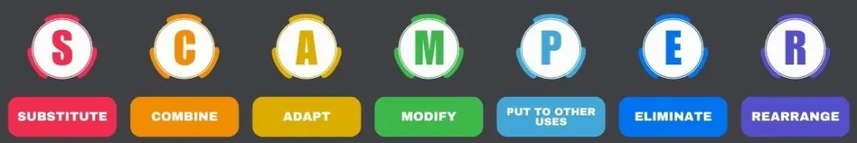

Practice: SCAMPER
Substitute
Combine
Adapt
Modify
Put to Another Use
Eliminate
Reverse/Rearrange
Notes:
Worksheet D and E: SCAMPER Activity – Refer back to Worksheet A: Common Problems to select a new problem to solve at your table
Modification: 15 Minute Pipeline Activity
You now have more resources to use – all of the other rules stay the same
The invention of Post-it Notes by 3M is a fascinating story of accidental discovery and creative problem-solving. In 1968, Dr. Spencer Silver, a scientist at 3M, was working on developing a strong adhesive. Instead, he accidentally created a low-tack, reusable adhesive made of microspheres. This adhesive could stick lightly to surfaces and be removed without leaving residue, but at the time, it was considered a "solution without a problem"2.
Years later, in 1974, Art Fry, another 3M scientist, had a practical need. While singing in his church choir, he used scraps of paper to mark hymns in his hymnal, but they kept falling out. Remembering Silver's adhesive, Fry realized it could be used to create a bookmark that would stick to pages without damaging them. This idea evolved into the concept of sticky notes3.
The product was initially launched under the name "Press 'n Peel" in 1977 but received a lukewarm response. However, a marketing campaign called the "Boise Blitz," which involved giving free samples to consumers, turned the product into a massive success. By 1980, Post-it Notes became a household name3.
This story highlights the importance of persistence, collaboration, and finding practical applications for innovative ideas.

Slide 32
Practice: The Pipeline SCAMPER
Start a timer for 8 minutes
Review the objectives and safety protocols: You have more resources
Select a project manager
Review your ideas and plan how to proceed
Execute your plan
Stop wherever you are at the end of the 8 minutes
GROUP DEBRIEF with facilitator
Notes:
Worksheet D and E: SCAMPER Activity – Refer back to Worksheet A: Common Problems to select a new problem to solve at your table
Modification: 15 Minute Pipeline Activity

Slide 33

Building a Creative Problem-Solving Culture in Your Team
Creativity = Innovation
Support continuous learning
Encourage risk taking
Create a ‘pain point’ bulletin board
Host ‘hack-a-thons’
Engage everyone
Have fun!
Celebrate successes
Notes:
Innovation through Creativity:
Creative problem solving directly contributes to innovation within an organization.
Encourages new approaches and breakthrough ideas that drive business success.
Support Continuous Learning: Offer workshops, training, and time for creative exercises.
Encourage Risk-Taking: Support employees when they try new things, even if they don’t always succeed.
Celebrate Successes: Recognize and reward creative solutions and innovations.

Slide 34

Tips for Becoming a Better Creative Problem Solver
Stay curious
Practice regularly
Collaborate with others
Embrace failure
Others?
Notes:
Stay Curious: Keep asking questions and looking for new ways to solve problems.
Practice Regularly: Use exercises and activities to keep your creative muscles active.
Collaborate with Others: Diverse input leads to better solutions.
Embrace Failure: Learn from setbacks and iterate.
Support Continuous Learning: Offer workshops, training, and time for creative exercises.
Encourage Risk-Taking: Support employees when they try new things, even if they don’t always succeed.
Celebrate Successes: Recognize and reward creative solutions and innovations.

Slide 35

Key Takeaways
Creative problem solving involves everyone
Leads to innovation
Follow the 6 steps
But…. Use the best tool
Practice, practice, practice
Collaborate
Notes:
Creative Problem Solving: A crucial skill for overcoming challenges and driving innovation.
The Process: Follow the steps to identify, analyze, and solve problems creatively.
Techniques: Use brainstorming, mind mapping, SCAMPER, and more to spark creative ideas.
Practice and Collaboration: Creativity thrives when regularly practiced and shared among teams.
Support Continuous Learning: Offer workshops, training, and time for creative exercises.
Encourage Risk-Taking: Support employees when they try new things, even if they don’t always succeed.
Celebrate Successes: Recognize and reward creative solutions and innovations.

Slide 36

Action Plan
Notes:
Participant worksheet – refer back to the problem you wrote at the beginning of this session. Spend 5 minutes thinking over Part 1 (if you have not finished that yet) and Part 2. Select a method you want to try for generating ideas such as brainstorming, mind mapping (free association), reverse engineering, SCAMPER, etc. and jot down some notes for yourself while your creativity has been sparked. Ask others around you for input if you are comfortable sharing. Now write down on the front page a date that you will implement your solution. Make a deal with your neighbor to be an accountability partner. Tell them your implementation date and plan to check in with each other afterwards to see how things went.

Slide 37
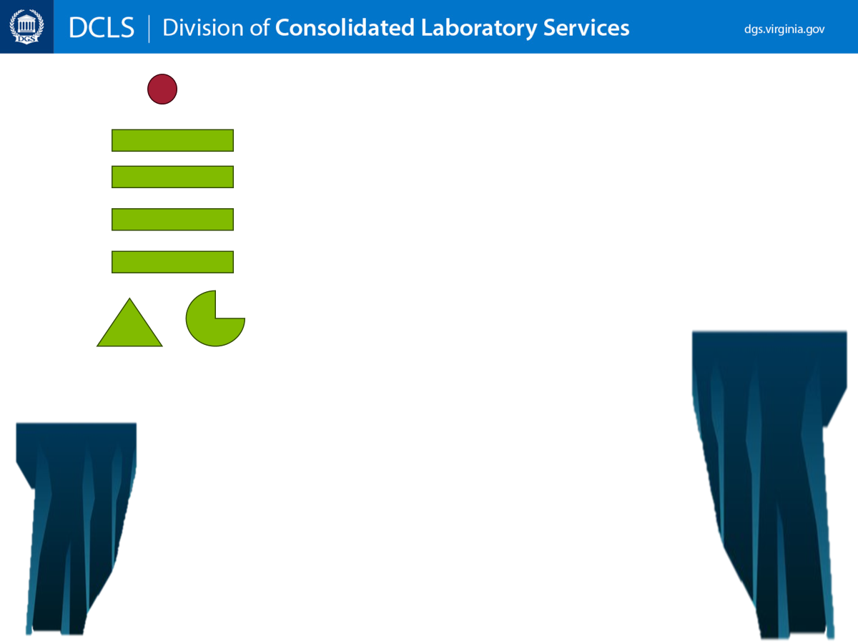

Questions?
Thank you for your participation today!

