Slide 1

Biosecurity
for
Clinical Laboratories
Notes:
Most laboratorians associate biosecurity with bioterrorism which is a reasonable association. However, bio-threat agents are not our only concern . . .

Slide 2
Why is Biosecurity Important?
The year is 1996.
Disgruntled Texas laboratory technician, Diane Thompson, spikes donuts with Shigella dysenteriae Type 2.
An email is sent out to the lab that there are donuts in the break room.
12 people become ill.
She gets 20 years in prison.
Notes:
On October 29, 1996 in a Dallas hospital clinical laboratory, an email was sent from the laboratory supervisor. The subject line read: “There are blueberry muffins and donuts in the break room!” On November first, 12 people became ill with dysenteries. Four were eventually hospitalized.
Diane Thompson, a laboratory technician and hematologist had exposed the donuts to Shigella dysenteriae type 2 from frozen cultures kept in the laboratory. Could it have been revenge against her boyfriend or was it the depression she was being treated for as she worked at the hospital? During the investigation it was discovered that Ms. Thompson had also made her boyfriend ill the previous year and was successful in covering up the incident up. Her motive for both incidents is still unclear.
Diane knew the laboratory supervisor's office was usually left unlocked and the computer was rarely logged-off. She was able to send an email that appeared to originate from the laboratory supervisor, so no one questioned the email or the pastries. As a lab technician and hematologist, she also knew where the stock cultures were kept. She took the cultures from the lab, added them to the donuts, reminded her colleagues about “the goodies in the break room.” She then sat beside them as they ate the tainted food. In September of 1998, Diane Thompson was convicted of food tampering and received 4, 20 year prison sentences to be served concurrently.

Slide 3
Objectives
Describe the relationship between biosafety and biosecurity
Discuss how the elements of a biosecurity plan are important to clinical laboratories
Describe the impact of the Select Agent Rule on Clinical Laboratories
Notes:
At the end of this presentation, you will be able to describe the relationship between biosafety and biosecurity, discuss how the elements of a biosecurity plan are important to clinical laboratories, and describe the impact of the select agent rule on clinical labs.

Slide 4
Why Develop a Biosecurity Plan?
Protect self and staff
Protect patients
Protect records and sensitive information
Protect your facility and its reputation
Protect the biological materials
Protect the public and outside environment
Notes:
It is important to protect your staff and your patients.
You are protecting records and sensitive information at your laboratory and you are protecting your facility's reputation. If the reputation of either are tarnished, then funding may be cut, placing jobs at risk and stalling important research and diagnostics.
Finally, biosecurity and biosafety practices protect you, your colleagues and family’s health, and the health of the public environment.
Just like biosafety in the laboratory is proactive protection from pathogens, biosecurity for the laboratorian is a matter of proactive protection from dangerous people.
Laboratorians need to protect biological materials from misuse.

Slide 5
Biosafety Goal:
Protect people from dangerous pathogens
Biosecurity Goal:
Protect pathogens from dangerous people
Notes:
The goal of biosafety is to protect workers and the environment by reducing or eliminating accidental exposures with potentially hazardous biological agents. In other words, protect people from dangerous pathogens.
Whereas, the goal of biosecurity is to protect records, people and microorganisms, and the environment from dangerous people. In other words, protect pathogens from dangerous people.

Slide 6
Biosafety vs. Biosecurity
Biosafety-To reduce or eliminate accidental exposures with biological agents.
Biosecurity-To protect from loss, theft, and subsequent misuse
Laboratory practices
Procedures
Laboratory facilities
Safety equipment
Practices
Procedures
Facility Design
Security Measures and Equipment
Personnel Management Policies/Procedures
Notes:
Biosafety is the application of laboratory practices, procedures, laboratory facilities, and safety equipment to reduce or eliminate accidental exposures when working with potentially infectious microorganisms.
Biosecurity is the application of practices, procedures, facility design, security measures, security equipment, and personnel management policies and procedures to protect infectious and toxic agents from loss, theft, and subsequent misuse.

Slide 7
Overlap Between Biosecurity and Biosafety
Good Laboratory Practices
Risk Assessment and Risk Management
Inventory and Tracking
Appropriate Packing and Shipment of Infectious Materials
Adoption, Implementation, and Accountability
Training
Emergency Planning
Management Oversight
A good biosafety plan is a good start for a biosecurity plan
Notes:
Biosafety and biosecurity share many common program components.
Establishing good laboratory practices, conducting risk assessments, and establishing risk management programs are components of both biosafety and biosecurity.
In biosafety, you want to know what you're working with in the laboratory. In biosecurity, you need to know what you are protecting from malicious use in the laboratory.
Both require safe packaging, accurate documentation, and inventory practices. Both require safe transportation, tracking, and handling procedures of infectious materials.
Both should be reinforced by training on general practices, laboratory specific standard operating procedures, awareness of potential risk and hazards and how to mitigate risk.
Both require developing emergency response plans, and management oversight. Senior management must ensure the adoption, implementation, and accountability of biosafety and biosecurity programs. However, a plan on the shelf is not a program, it must be active and pervasive.
Managers should serve as role models, diligently adhering to the policies and practices of both biosafety and biosecurity programs. These elements are essential to ensuring the daily adherence to safety and security policies. Finally, both biosecurity and biosafety need to be institutional core values. Creating a community of practice where everyone thinks safety and security.
So, establishing an excellent biosafety program, will help establish an excellent biosecurity program.

Slide 8
Conflicts Between Biosafety & Biosecurity
Emergency Response
  Rapid egress of staff
  Rapid access for responders
  Ensure security of assets
  Locks – do they release when there is an alarm or do they stay secure?
Signage
  Warns of safety concerns
  Don’t divulge too much information
Notes:
Biosecurity practices may conflict with biosafety practices, requiring personnel and management to devise policies to accommodate both biosafety and biosecurity objectives. Therefore, biosafety and biosecurity considerations should be balanced and proportional to the identified risks when developing institutional policies.
Examples of conflicts between biosafety and biosecurity:
Emergency access or egress: Security measures should include procedures to ensure that emergency responders can enter the laboratory to treat or remove a person with a medical emergency. But, evacuation procedures should not allow unauthorized entrance by someone with malicious intent. What is the procedure if someone has a medical emergency? Can emergency responders come in and remove the person, because they need to be treated immediately?
Are they working with something to which the emergency responder shouldn't have access or be exposed?
When the fire alarm goes off, do all of the doors unlock so that the emergency responders can enter? Does this allow others to enter also?
Therefore, you have to ensure that your assets, the things you're trying to protect, are secure, even during an emergency. You need to have a plan. Life safety measures must not allow an adversary access to biological materials by activating an emergency alarm system.
Signage: Divulging too much information on signs may provide those with evil intentions the information they need to locate materials or information. Biosafety requires that you have signs to warn people what's in the facility, in that room, what are the hazards. However, you don't want to put so much information out there such as the name of an agent like Bacillus anthracis. You don't want to tell everybody what you have and what you're working with. You don't want to divulge too much information, but you have to give enough information to be safe.

Slide 9
Elements of a Biosecurity Plan (FIPPA)
Facility – Physical Security and Access Controls
Information – Data/Information and Reporting and Communication Records
People – Personnel and Training
Procedures – Emergency Response Plans and Transport, Shipping and Receiving
Assets – Employees, Equipment, and Agents (inventory and accountability)
Notes:
A security plan is based on risk assessment and should be developed after performing one. How to perform a risk assessment is discussed in another presentation. You can use the acronym FIPPA to summarize the 5 elements of a security plan:
Facility includes laboratories, buildings and premises, including biological material storage areas. Facility biosecurity is intended to prevent the removal of assets for non-official use through physical security and access controls.
Information is paperwork and computer data related to facility infrastructure, agent inventories and locations, personal information, the biosecurity plan. Information biosecurity is intended to prevent unauthorized access to sensitive information. HIPPA covers some of it in terms of who has access to some information. However, there's a lot of information that needs to be kept secure. Medical identity theft is one of the most common security problems in healthcare.
People are a key element of a biosecurity plan. Responsible and well trained employees ensure a biosecurity plan is implemented and adhered to. They need to understand why complying to a biosecurity plan is a benefit to them personally.
Procedures are the operating instructions employees follow in specific situations, such as, a medical emergency or the safe packaging and shipping of infectious substances. The goals of procedures biosecurity is to ensure accountability, proper documentation and consistency.
Assets are the things you are trying to protect such as your employees, expensive equipment, and important biologic agents that are in your facility. Knowing where they are, what they are and who is responsible for them is the goal of asset biosecurity.

Slide 10
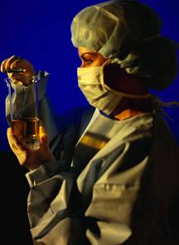
Challenges to Securing Biological
Micro-organisms
Nature of the Material
Dual-use Characteristics
Laboratory Culture
Notes:
There are numerous challenges in securing biological agents, because microbes are living organisms that grow, mutate, and die. They are found in the lab in petri dishes, tubes, cell cultures, flasks, freezers, incubators, refrigerators, clinical specimens, animal carcasses, biological waste. Microorganisms are also found in animals and the environment. Like with Diane Thompson, she knew where the cultures were and it was easy for her to take a plate or tube of the Shigella.
Maintaining a current inventory and safe-guarding all this is complicated. Knowing “working” quantities such as number of colony forming units is impossible, but counting the number of tubes or laboratory infected animals is possible.
What is dual use characteristics of biological materials? Basically it means that these materials can be used for good or for malicious purposes. For example, growing large quantities of an infectious agent such as Bacillus anthracis might be for the purpose of making vaccines. On the other hand, another person with malicious motives may be growing large quantities to infect people, crops or animals.
Another issue in laboratory security is the general culture of the laboratory-- scientists and laboratorians often do not see infectious agents as particularly dangerous because they work with them every day. They become so used to what they work with that they may resist measures to protect the agents, such as locking them up, which may impede or slow down their work.

Slide 11
Select Agents and Clinical Laboratories
Federal regulation and clinical laboratories DO need to know about the regulation and their responsibilities
Clinical laboratories may be the first to receive and suspect a select agent
Clinical laboratories do NOT need to register if they do not intend to confirm the identity or maintain stock cultures
Notes:
The information in this presentation referring to select agents is for instructional purposes only. It is a federal regulation and clinical laboratories do need to know about it and have responsibilities if an isolate is confirmed as a select agent. This is important because clinical laboratories may be the first to receive and suspect a select agent. However, clinical laboratories do NOT need to register with the Select Agent Program providing they do not intend to confirm the identity or maintain stock cultures of any select agents or toxins. Any laboratory intending to confirm the identity of a select agent and/or maintain a stock of viable select agents or toxins must register with the Select Agent Program.

Slide 12
Select Agents and Clinical Laboratories
You should review the current select agent list on the Select Agent Program website and verify that you don’t have any in your laboratory
Contact your LRN Reference Laboratory for more information and guidance
If you do not know who your LRN Reference Laboratory is then contact your state public health laboratory
Notes:
You should review the current select agent list and verify that you don’t have any isolates in your laboratory. You should check all of your freezers just to make sure there not any in storage from many years ago. For example, there was a recent case where smallpox was found in a National Institute of Health freezer. If you do find that you have a select agent or just want more information, you should contact your Laboratory Response Network (LRN) Reference Laboratory for guidance. If you do not know who your LRN Reference Laboratory is then contact your state public health laboratory. They can give you the contact information.

Slide 13
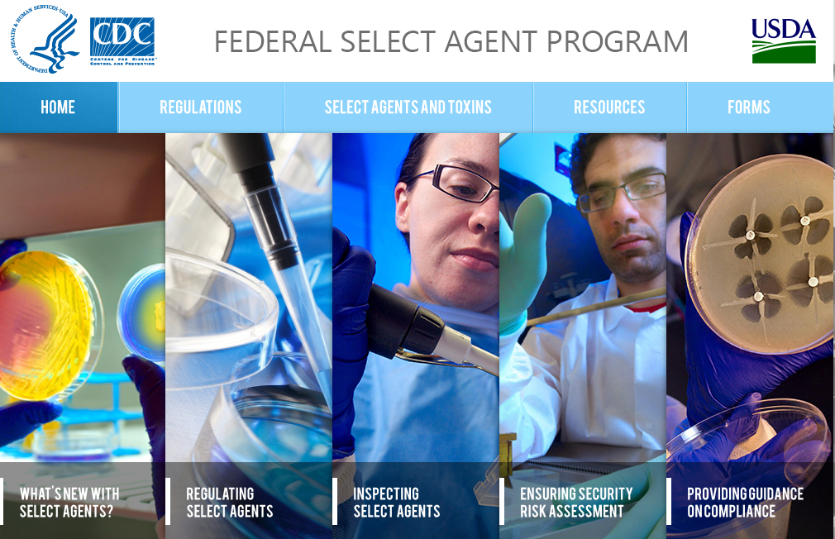
Federal Select Agent Program Website
http://www.selectagents.gov
Notes:
Here is the Federal Select Agent Program Website for more information.

Slide 14
Select Agents and Clinical Laboratories
Responsibilities if an isolate is suspected or confirmed as a select agent:
  Need to secure specimens and cultures
  Chain of custody may also be advisable
  Forward isolates to your LRN Reference Laboratory as quickly as possible
  Isolates confirmed as a select agent must be destroyed or transferred within 7 days after confirmation and this process is properly documented
  Stock cultures are not maintained
Notes:
If an isolate is suspected or confirmed as a select agent, you have responsibilities as a non-registered laboratory.
You need to secure all specimens and cultures from theft, loss, or release until they can be destroyed or transferred to your LRN Reference Laboratory. For example, you can use a lockable cabinet with limited access.
Chain of custody may also be advisable – your LRN Reference Laboratory will assist you with this if it is needed.
You should forward suspected isolates to your LRN Reference Laboratory as quickly as possible for confirmation. It is imperative that you do not continue to investigate the organism for your own safety and the safety of others.
Isolates confirmed as a select agent must be destroyed or transferred within 7 days after confirmation. This process must be properly documented. Contact your LRN Reference Laboratory for guidance.
You cannot maintain stock cultures of select agents.

Slide 15
Secure Select Agent
Secure the specimen, isolate, suspect isolate, or toxin from identification to transfer or destruction against:
Theft – removal by unauthorized personnel
Loss – unaccounted absence
Release – agent is outside of primary containment, for example, an occupational exposure due to working with it on the open bench
Notes:
The clinical laboratory must secure the specimen, isolate, or toxin from identification to transfer or destruction against:
Theft- is the unauthorized removal of a select agent or toxin.
Loss - is the unaccounted absence of a select agent or toxin. A missing agent is considered lost until there is evidence of theft.
Release of an agent is when the agent is outside its primary containment, such as a petri dish, culture tube.
It is important to understand that an occupational exposure is a release because the agent is outside its primary containment. For example, you have isolated a potential Brucella, which could be a select agent, and you worked with it out on the open bench before you realized what it could be. You and others working near you may have been exposed. That is considered to be a release, and it has to be documented and the proper form filled out. Your LRN Reference Laboratory can assist you with this process.

Slide 16
Select Agents and Clinical Laboratories
For specific questions and guidance please consult with your LRN Reference Laboratory or your State Public Health Laboratory or refer to:
CDC Select Agent Program (http://www.selectagents.gov/)
Federal Regulations 42 C.F.R. 73
Possession, Use, and Transfer of Select Agents and Toxins, Final Rule
Notes:
For specific questions and guidance, you should contact your LRN Reference Laboratory or your State Public Health Laboratory. They are a great resource.

Slide 17

Barriers / Challenges to Implementing a Biosecurity Plan
Lack of resources
Lack of management support
Resistance to change
Inadequate training
Insufficient information
Not a personal value
NOT an organizational value
Notes:
There are always barriers and challenges when you are trying to implement new procedures, especially in the busy clinical laboratory. Remember without management support, your biosecurity program will not succeed. Time and money are both precious to your laboratory because your priority is completing your laboratory work, but the consequences of a biosecurity incident can be serious.
Although funding is helpful, especially if you wish to purchase security equipment (e.g., locks or cameras), some measures require no money just a little time. For example, it requires little to no financial cost to train your staff to question individuals who don’t seem to belong in a restricted area or to at least display the poster from the United States Postal Service on how to recognize suspicious letters and packages.
This is a new concept for many clinical laboratorians so you may run into some resistance. People are resistant and often threatened by change, but education, communication, and training can help overcome that resistance especially if you help your staff identify why implementing and adhering to biosecurity program is important to them personally.
Finally, management needs to makes the concept of biosecurity an organizational value so all of the employees will buy into it.

Slide 18
Effective Biosecurity Planning Requires Collaborative Effort
  Senior management
  Scientific staff
  Security officials
  Safety personnel
  Engineering and Maintenance staff
  Information Technology (IT) staff
  Human resources officials
  Public Relations/Media spokes person
  Create a Culture of Awareness and Accountability
Notes:
To have an effective biosecurity plan is a collaborative effort. In developing your biosafety plan you worked within your lab, documenting your own procedures, doing your risk assessments, and figuring out what kind of PPE you need. You may not have needed any outside assistance unless, for example, the mitigation required some special engineering.
However, for biosecurity, you definitely need to get a whole group of people involved in planning this out and figuring it out from the beginning. It is important that representatives from these groups jointly draft the policies and procedures for biosecurity. Acceptance and adherence to the biosecurity program is more likely if all believe that their concerns have been heard, their perspectives considered, and their expertise valued. In today’s complex labs, no one person or small group can understand all the issues to be considered.
Each of these individuals contributes unique perspectives and expertise; each person’s input is valuable in developing a biosecurity plan.
The scientific staff understands the nature of their work and the characteristics of the agents with which they work.
Security and safety professionals may want more security and safety measures than your scientific staff believes are indicated. Through collaboration, sharing information, and educating each other, a mutual understanding can be reached.
Engineering and maintenance staff understand the HVAC, electrical, plumbing and other systems that most of us in the clinical laboratory never see. Yet all of these areas may be vulnerable to biosecurity breaches.
Human resources needs to be involved so they can provide input on background checks of potential employees.
IT can provide ideas on how to secure information – patient and other sensitive information.
Public relations/media spokesperson needs to be involved so they are aware of the biosecurity program. Then he or she can speak with confidence if the need arises and be aware of what cannot be communicated with the public.
Of course senior management needs to be involved to provide support and to allocate funds for biosecurity measures.
Finally, don’t forget the janitorial staff that move freely about the facility. They often see and hear things, see records inappropriately disposed of and possibly biohazardous materials in the regular trash.

Slide 19

Areas to Evaluate for Biosecurity
Access/Physical
Personnel
Inventory
Data & Information
Transport / Transfer
Accidents, injuries, emergencies
Reporting & Communication
Training and Drills
Evaluation
Notes:
A well designed biosecurity program addresses the areas listed here and it needs to be tailored to your facility. Weakness or vulnerability in any area is likely to affect other components of your security.

Slide 20
Vulnerability
Vulnerability-Exploitable capability or asset, security weakness or deficiency
A weakness that could allow a harmful event (theft, loss, malevolent misuse of assets) to happen
Notes:
First, we need to understand what vulnerability is. To be vulnerable is defined as being susceptible to attack. For security purposes, vulnerability is a security weakness or deficiency; susceptibility for malicious actions to occur; the capacity to suffer harm. A weakness could allow a harmful event to happen.
We are going to look at it as a potentially exploitable weakness, the weak link in your security chain. It can also be an exploitable capability or deficiency in your security plan. We will be discussing examples of vulnerabilities to biosecurity and how to mitigate these vulnerabilities. We will also view some pictures that address security breaches / measures.

Slide 21
Access/Physical Vulnerabilities
Easy entry to facility/laboratory
Poor lighting
Trees or shrubs that obscure entrances
Inoperable locks
Unlocked doors
Lack of monitoring of entry areas
Others?
Notes:
A good way to evaluate your laboratory is to begin with an assessment of how individuals gain entry to your facility and to your laboratory. Physical security tends to overlap with access security. This slide lists examples of access/physical vulnerabilities. How many of these apply to your laboratory? Trees and bushes near entrances can provide a hiding place, block lighting or video cameras. Do you have inoperable locks or unlocked doors? Are there entry points that are not monitored? Think about your facility and what other ones may exist.

Slide 22
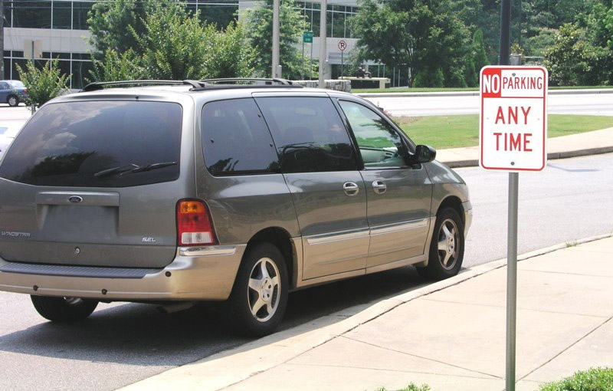
Access/Physical Vulnerabilities
Visitors
Unauthorized personnel in restricted areas
Unsecured storage
Parking close to buildings
Multiple entry points
Others?
Notes:
Look at the picture. Do you notice a security problem? Yes, the car is parked in a no parking zone. This could be a serious problem if it is very close to the entrance. It has darkened windows, so you can't see what's in the car. There's no license plate on the car. This highlights a few more access/physical vulnerabilities. All hospitals have visitors and many of them are there 24/7. Many clinical laboratories also have visitors, such as sales people. Do you know what areas are restricted and who should have access to them? Many hospitals and clinical laboratories have multiple entry points. Do you have unsecured storage?

Slide 23
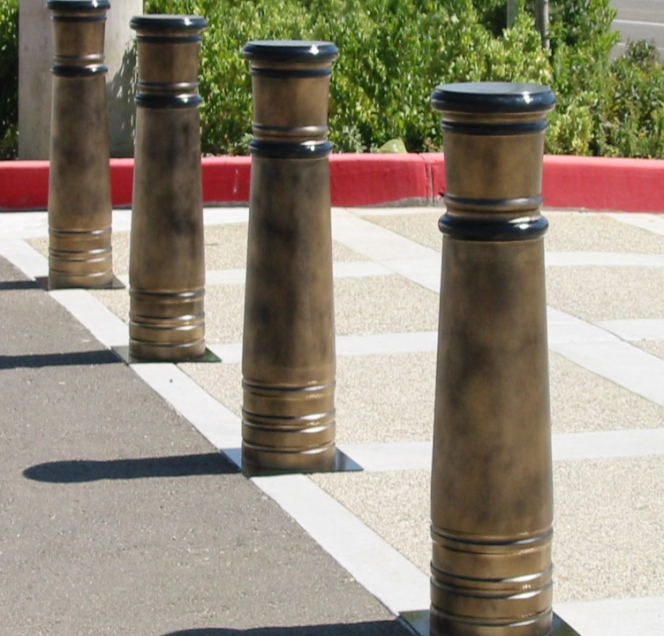
Access/Physical Security Measures
Secure entry points
Fence perimeter access points
Install lighting
Parking checkpoints
Hire on-site security guards
Install tamper-proof locks
Others?
Notes:
Here we list some measures you can put in place to implement access/physical security. Not all of these may be appropriate for your facility. You can start small by just locking doors or making sure the locks work.
What do you see in this picture? These are called bollards, and they are solid cement posts that prevent vehicles from getting through and into the building or restricted areas. This is just one type of physical security that is used to prevent cars and trucks from getting too close. Another option or in addition to bollards is to have parking checkpoints, and not let people park too close to the building. You can require parking stickers for employees’ vehicles.

Slide 24
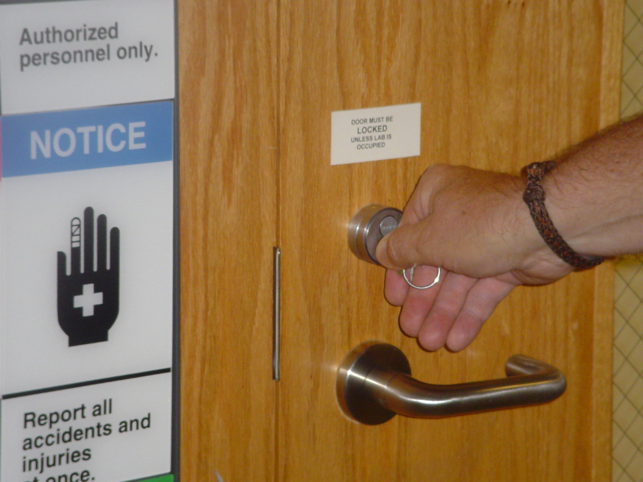
Access/Physical Controls
Escort visitors
Require photo ID badges
Restrict access
Log in/Log out sheets
Install video cameras
Others?
Notes:
It is can be difficult to secure clinical labs due to the nature of the work. Clinical labs are usually open 24/7 and have multiple entries. Laboratorians, phlebotomists, nurses, physicians, and other people are coming and going all of the time.
You need to think about what you can control and how. This slide lists some measures or ways to control access to your facility and to your laboratory.
If you have photo badges, do they have to be renewed? Are they collected when someone retires or resigns? Does your laboratory restrict access? You can restrict access by making people use badges to get into certain rooms, or have keys and locks. Do you have log in, log out sheets for visitors? Do patients come to your laboratory to have blood drawn? Make sure it is in area outside of the restricted laboratory area. You can install video cameras, for example, in parking areas, near entry points, and even within the laboratory to monitor who is accessing an area.

Slide 25
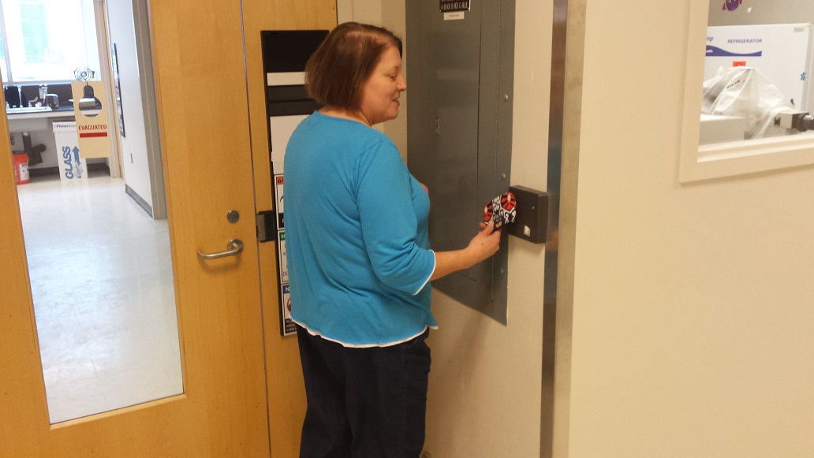
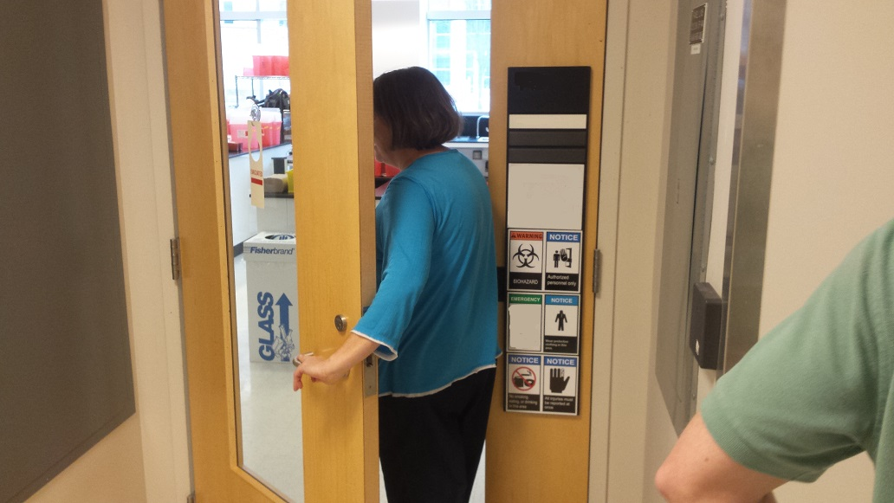
What is happening in this series of pictures?
Notes:
What do you see in these pictures? This employee is using her security badge to unlock the door to the laboratory. Now she is going through the door.

Slide 26
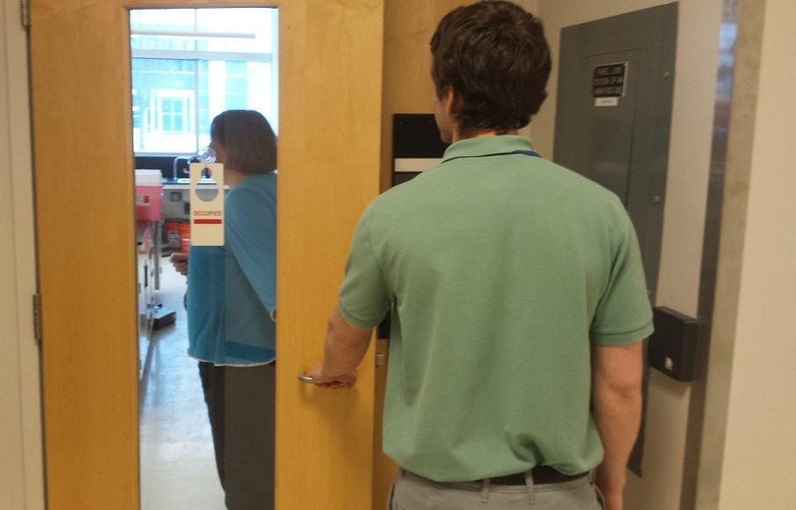
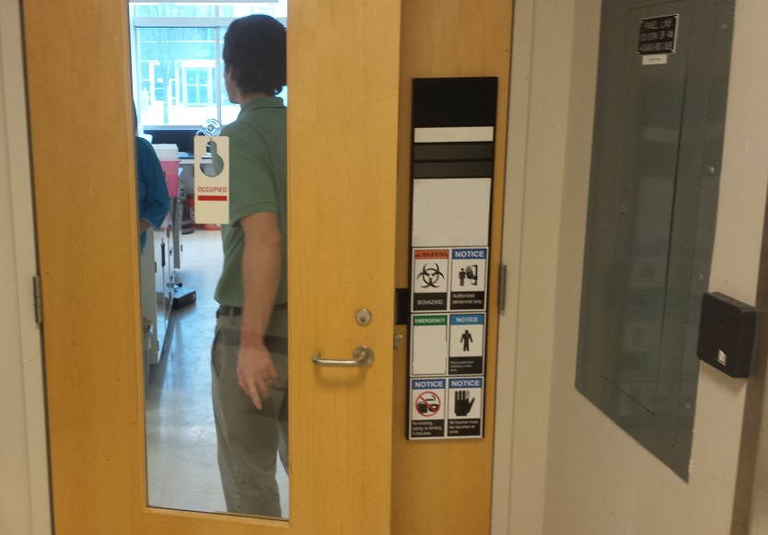
What is happening in this series of pictures?
Notes:
Now a second person: is it an employee or a visitor? You don’t know because you cannot see any ID. This person has grabbed the door before it closed and is now entering the lab. This is called piggybacking or tailgating: when someone follows another person through a secure door without using the proper credentials. If you do have an ID badge system in your facility, you've got to watch out for people who do piggybacking. You have to be careful to prevent this from happening. It may feel awkward to shut the door in somebody's face, but it is a security issue. Another thing that must be considered is whether the person piggybacking even understands the potential hazards in the laboratory.
If you are officially escorting a visitor in, you need to make sure they understand the hazards. This includes equipment repair people or delivery personnel. They should follow the same safety and security procedures as employees.

Slide 27
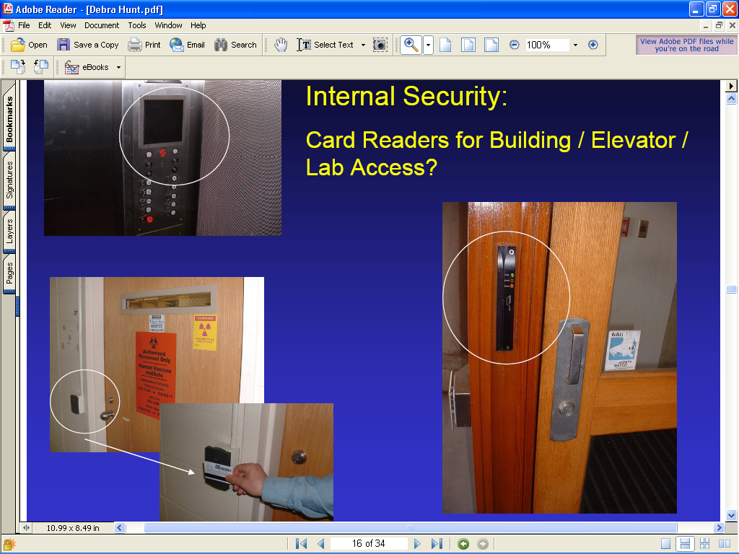
Internal Security:
Card Readers for Building / Elevator Lab Access
Notes:
Here are some examples of internal access security measures. They can be used to secure doors and only allow access to people with badges. They can also be used to secure elevators so you are limited to what floors you can access. The picture in the upper left hand corner is an example of how you might restrict access within an elevator. It requires a badge in order for it to operate at all or to access certain floors. The photo on the right shows the swipe type of card reader and the one on the bottom left is an example of the type where you put the badge in front of the reader in order to get through the locked door.

Slide 28
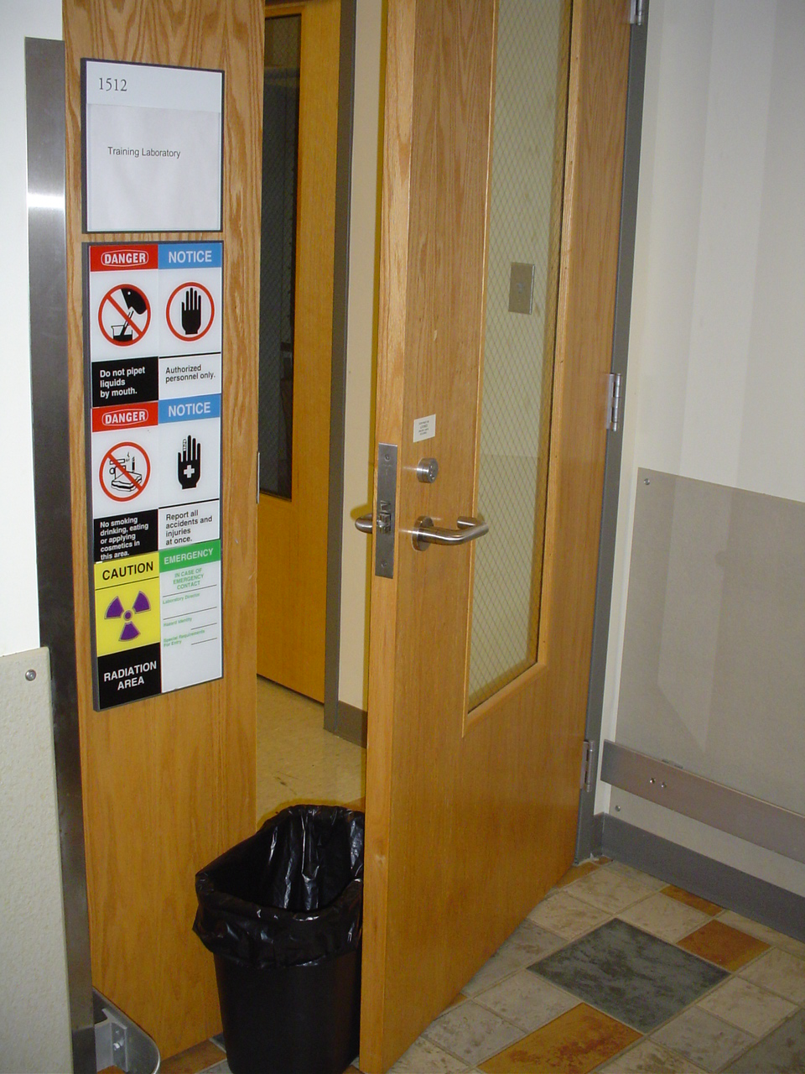
Identify security measure or breach
Notes:
How many times have we seen this in our labs? A trash can or other object used to prop open a door. Why? Because it is too warm, so someone decides to prop the door open to get air circulation. Or someone doesn’t have their badge and needs to go out to get something and doesn’t want to bother other people to let them back in.
Is this just a security breach? No, it's also a safety breach. Do you see the safety signs? So you don't want people coming in for security and safety reasons. Remember: unless your employees understand and value biosecurity, no plan or equipment will be adequate.

Slide 29
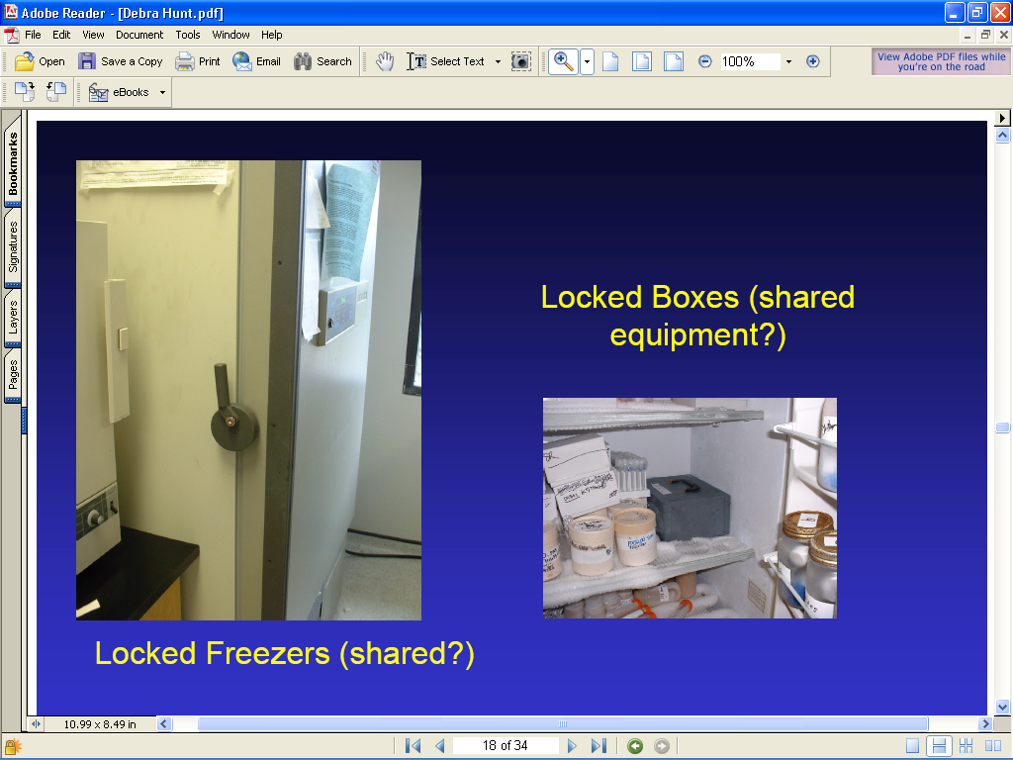
Notes:
What security measures do you see? The left-hand picture shows a freezer that has a lock right in the handle. That will secure everything that is in in it. For example, a locked freezer can be used in the clinical laboratory to secure specimens and isolates. Alternatively, if you have shared equipment and cannot lock the whole freezer you can always use a locked box that is secured to the inside of the freezer and place high consequence agents inside it. In the clinical microbiology laboratory you can have a cabinet with a lock on it. That works well for more short-term storage of isolates. So there are a lot of things you can do to lock things up without having to go to a lot of expense. But remember to always make sure the locks are in fact locked.

Slide 30
Personnel Vulnerabilities
Ignorance of employees’ backgrounds
Disgruntled employees
Employees with criminal background
Employee not aware/
comply with security plan
Tired or stressed employees
Workplace violence
Others?
Notes:
Here are some examples of personnel vulnerabilities. The people you work with can be a liability as well as an asset. So why would they be a liability? Well, if you don't know their backgrounds, if they're disgruntled, if they have a criminal background, if they are tired, stressed out, or financially stressed they are vulnerable to someone from the outside putting pressure on them. They may be unaware that there's a security plan and what they're supposed to do, so they may unwittingly allow people in to an area they shouldn't. In addition, we worry about workplace violence when people get overly distressed. Your greatest security measure is your employees who will abide by the security policies. That is why it is necessary to at a minimum check previous work references.

Slide 31
Personnel Security Measures
Know your employees and coworkers
Check employee references
Conduct police background checks
Include name, photo, and expir. date on ID
Provide biosecurity training
Collect ID badges, keys, parking permits when no longer an employee
Challenge people without badge or ID
Challenge people who are unknown or in restricted areas
Others?
Notes:
So what can you do? This slide lists some personnel security measures that you may want to consider for your facility. You need to know your employees and your coworkers. This may not be easy, but it is important to know what is going on with folks. When you hire someone, you want to be able to check their references very carefully. If it's appropriate for the type of work you do you may need to do background checks with the police or FBI.
When you give people ID badges, make sure there's a name and the photo and an expiration date on the badge. And if somebody leaves, make sure you collect their ID badge, keys, and parking permits so that they don't have access when they shouldn't.
Make sure you're giving everybody all the training they need, so they understand why there's a biosecurity plan and why they have to comply with it. They need to be comfortable challenging unknown persons or people in restricted areas. Finally, they need to be accountable for their part in making the system work.

Slide 32
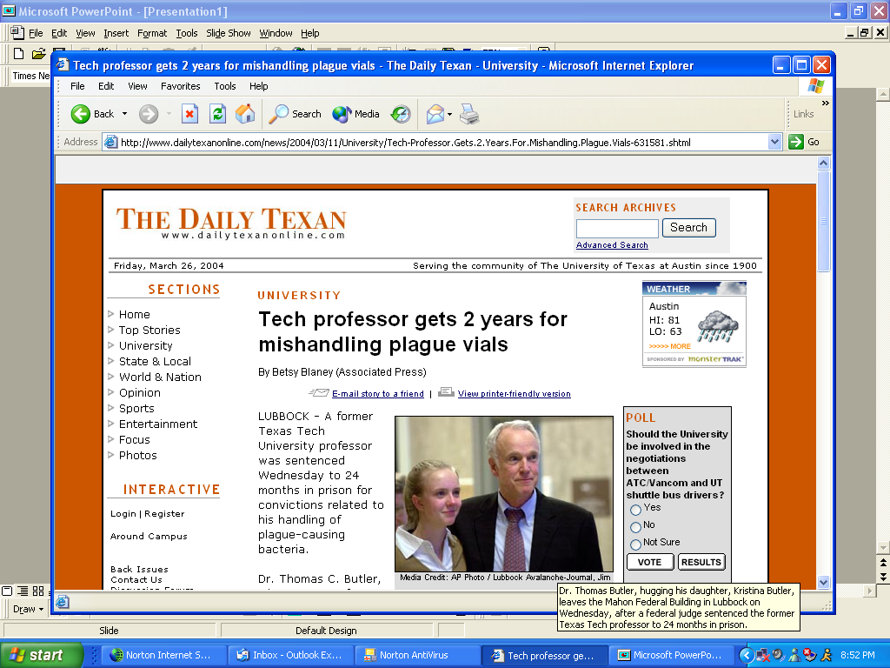
Inventory and Accountability Vulnerabilities
Access to highly infectious materials
Lack of current inventory
Unsecured storage
Long term storage of microbes
Poor records
Others?
Notes:
Inventory and accountability vulnerabilities are listed on this slide.
Laboratory professionals have access to highly, infectious materials, and we're not talking just about select agents here. We are talking about organisms like Shigella spp., (remember the Diane Thompson case from the beginning of the biosecurity presentation?). You may also have other highly infectious organisms such as, E. Coli O157:H7 and others in your laboratory. If they fall into the wrong hands they can be used to hurt people. Another example is the Rajneesh group in Oregon. They wanted to influence an election. Somehow, they were able to obtain Salmonella and they put it into a salad bar trying to make all the townspeople sick so nobody would vote in the election. Eventually, they were found and arrested.
You have to know what you have. Do you keep your organisms for a while? Do you have unsecured storage? Are they just sitting out where anybody can get at them? Do you freeze isolates for long-term storage? Even though we aren’t just concerned about select agents, you should compare your current inventory of biological materials with the current list of select agents. In some cases, clinical laboratories have found they have select agents in their freezers, and other storage areas. What should you do if this happens? Contact your LRN Reference Laboratory or your state public health laboratory for advice about to transport or destroy and document the disposal of these agents.
So why is there a picture of Dr. Butler on this slide? This is to emphasize the importance of record keeping. He did a poor job of it and suffered very serious consequences. You can look up his story. He ended up getting arrested and fined, losing his job, and losing his medical license. All this happened because he had a discrepancy in his inventory of select agents.

Slide 33
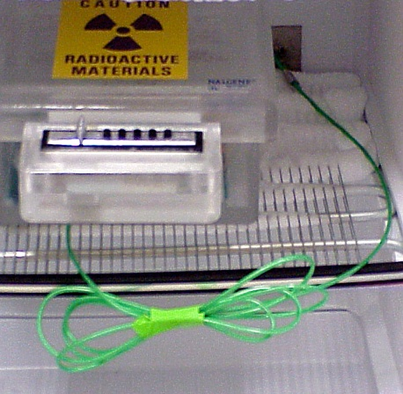

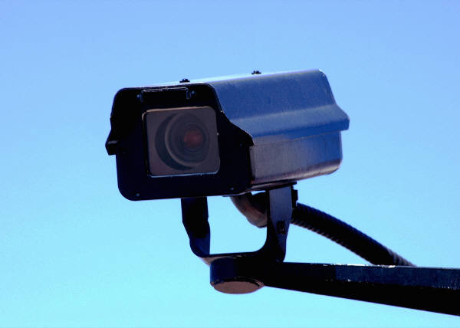
Inventory & Accountability Security
Measures
Limit access to high consequence agents
Check integrity of storage containers
Maintain records
Check inventory
Install monitoring devices
Notes:
This slide lists some inventory and accountability security measures.
You want to limit access to the things that you consider high-consequence agents. These are the agents that could be the most dangerous and you want to protect from people. You want to make sure that your storage containers are solid and lockable, if needed, so that people can't get into them. The top left picture illustrates another type of lockbox. This one has a key pad and is secured to the back of the freezer. These shows how certain materials can be adequately secured and provide restricted access within either an unlocked freezer or refrigerator or one that numerous individuals can access with keys or card keys.
Inventory and accountability should be integrated into information security. Management and laboratory personnel should check inventory periodically and check it again against the current select agent list to determine if stock needs to be transported to an LRN Reference Laboratory or be destroyed. Management and personnel should also maintain accurate records, limit access to significant pathogens, or install monitoring devices. Surveillance cameras are rarely needed by most clinical laboratories, but research laboratories may want to consider this measure.

Slide 34

Data and Information Vulnerabilities
Unsecured sensitive data
Unorganized records
Documents visible on desk tops
Lack of passwords
Lack of locks
Broad access
Others?
Notes:
How many times have you seen file cabinets like this or people leaving documents on their desks?
You need to think about what information you need to keep secure.
Patient information and test results
Security and architectural plans
Computer files, disks, CDs and paper documents
If you have computer systems, do you have passwords that are changed regularly? Do areas where sensitive information is stored have locks? Is access limited to offices or to the cabinets or wherever the data is stored? Access is one of the biggest vulnerabilities in a laboratory.
Do you have laptops, are computers secured physically to prevent theft? How are CDs, jump drives, and other data storage devices destroyed? Are records shredded when not needed?

Slide 35
Data and IT Security Measures
Centrally locate computer information systems
Install firewalls
Limit access to sensitive information
Change passwords
Install devices to detect security breaches
Keep paper records out of view
Lock file cabinets
Shred/destroy sensitive
records/data/CD ROMs
Secure personal identifying
information
Others?
Security Patch Notice: Log out, but leave your computer on Wednesday Night……
Notes:
So what can you do? This slide lists examples of some measures laboratories can use to secure information and data.
It is important to destroy records, CDs and other data storage devices when they are no longer needed. Shredders are available that will shred paper and CDs. Simple actions such as keeping paper documents out of public view and returning paper documents to file cabinets and locking them each night provide a deterrent to others who may want to access sensitive information. IT personnel can advise about encryption, fire walls, passwords to prevent someone from obtaining information from your computer. They can install software to detect if people are accessing information they shouldn’t be. It is important to keep laptops in secure locations. And remember to log out when you are not using your computer to prevent someone from accessing computer files. Remember Diane Thompson and the email message she sent from her supervisor’s computer to the lab about the donuts?

Slide 36
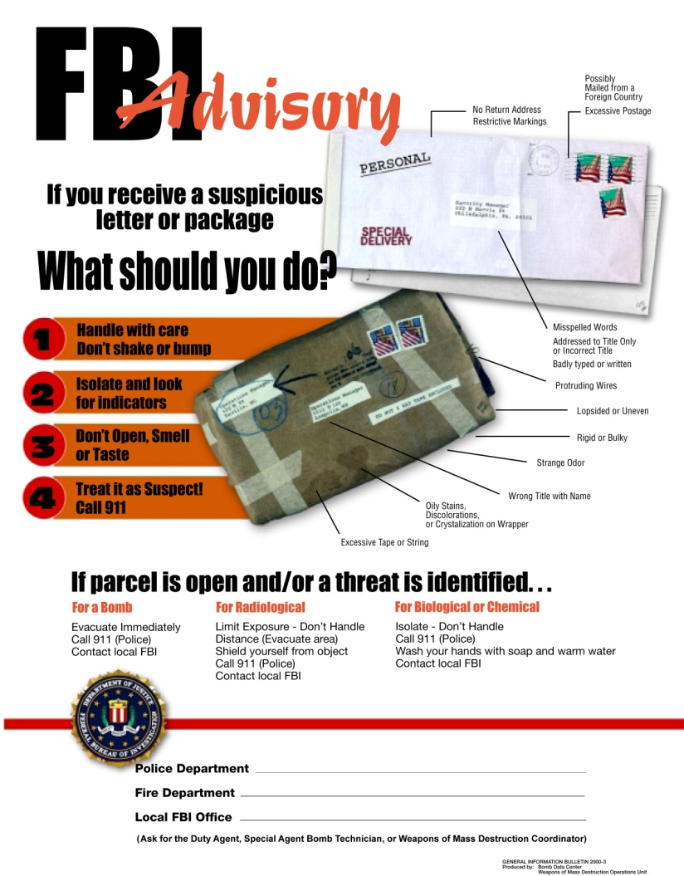
Transport of Biological Materials
Security Vulnerabilities
Parking close to building
Multiple delivery points
Unidentified persons
Improperly packaged/shipped packages
Suspicious letters
Couriers, drivers and cabs
Notes:
Here’s some information on transport security vulnerabilities. Again, are people parking too close to a building, do you have multiple delivery points, do you have unidentified people in restricted areas? Do you know who is transporting your materials? Are they trained in safety and abide by security measures? You should be aware of the federal regulations for packaging and shipping infectious organisms.
One way to recognize potentially dangerous packages is how they are packaged. If an unexpected package arrives you should inspect it. This picture is from the FBI suspicious package poster. In the picture on this slide what do you see that might alert you to potential problems? Examples include excessive postage and tape, warning labels such as do not x-ray, and letters or packages addressed without the appropriate person’s name. Packages that are heavy for their size, misshapen, or have wires sticking out of them may also signal problems.
You can obtain a poster from the United States Post office that lists the characteristics of suspicious packages and letters. The receiving department of your facility needs to know these characteristics, but everyone needs to be aware of them because dangerous packages might be left at the door.

Slide 37
Transport of Biological Materials
Security Measures
Institute procedures for internal agent transfer
Institute procedures for external agent transfer
Adhere to packaging and shipping regulations
Obtain proper shipping permits
Develop procedures for hazardous materials
Maintain accurate records (chain of custody for forensic cases)
Decontaminate materials before removal
Notes:
This slide lists some measures for transporting biological materials. You want to make sure you implement procedures for the internal transport within your own facility as well as external. You want to confirm that you're adhering to all the shipping regulations for hazardous materials including training. Verify that it is packaged and documented properly. Make sure you have all the permits that are required for shipping and that you maintain accurate records.
If you're dealing with a forensic case such as a rape case or a bioterrorist event then chain of custody is also involved. Your LRN Reference Laboratory will be glad to discuss documentation of chain of custody.
When possible, biohazardous waste should be decontaminated before removal from the facility. In many clinical labs, there is an outside contractor that transports the biohazardous waste off-site. Someone needs to verify that the carrier is reliable, the waste is properly packaged, transported, decontaminated and disposed of in compliance with local and state regulations.

Slide 38
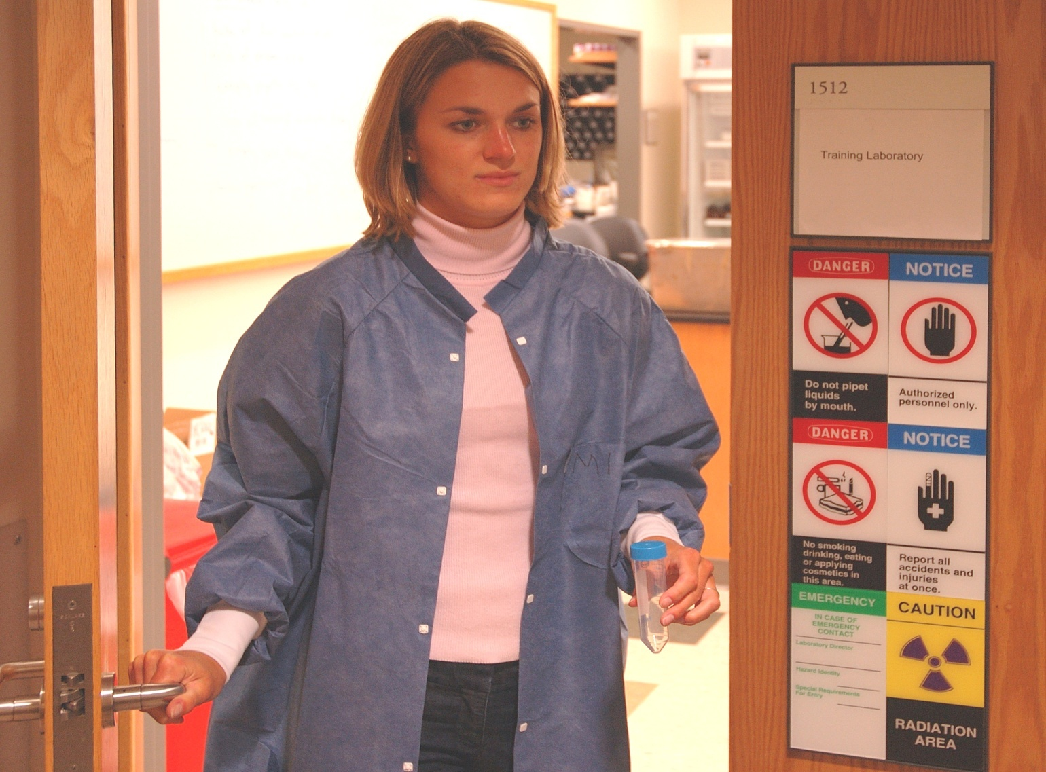
What is happening in this picture?
Notes:
What is happening in this picture? What security breaches do you see? This laboratorian is taking a specimen out of the lab without a proper transport container. How do we know if this person is authorized to handle this specimen? She is not wearing an ID badge. The sample appears to be unlabeled. Do you know what it is? Can you identify any laboratory safety violations? This laboratorian is not wearing gloves when holding this specimen and the lab coat is not buttoned and should not be worn outside the laboratory.

Slide 39
Accidents, Injuries & Emergency
Response Vulnerabilities
Failure to report accidents, injuries, near hits
No SOP for responding to accidents & injuries
No response plan or outdated response plan
Response plan not coordinated with local responders/authorities
Unprepared first responders
Lack of practice and drills
Others?
Notes:
Here are some examples of accident, injuries and emergency response vulnerabilities. A big issue in biosecurity as well as biosafety is failure to report accidents, injuries, near hits or misses, and breaches in security &/or safety. It is important to create a safe way to report without penalizing the person who reports the near hit or miss or the employee who has had an accident. The accident or breach may be the result of a system problem. You need to find out what went wrong, and if possible involve the person in the solution. If you don’t know what happened you cannot correct it.
If there's no response plan, an outdated response plan, or the response plan is not coordinated with your local responders, how will anyone know what to do? What will unprepared first responders do? Finally, if no one practices what to do or you don’t have drills, how will people react when an emergency arises? Have you read the SOP?

Slide 40
Accident, Injury & Emergency Response Security Measures
Develop/review/update emergency plans
Provide ongoing training
Collaborate with first responders
Ensure that responders have access
Provide tours and training for responders
Conduct exercises of emergency response
Notes:
Here we list some examples of measures to mitigate the security risks related to accidents, injuries and emergencies.
Your facility and laboratory should maintain an up-to-date security plan that is accessible to employees and provide training and drills based on this plan.
In collaboration with first responders, develop response procedures if there is a fire or other emergency in the laboratory. Remember, if you're relying on your hazmat teams, or the fire department, or other emergency personnel to come in and deal with the situation, you need to talk to them ahead of time. Make sure they know the plan, you know the plan, what they can do, what they can't do, what everybody's going to be able to do. Ensure that they have access to the appropriate areas. Give them tours of your laboratory, explain the work done, where dangerous substances might be, and any protective measures that they should take in an emergency. Then train with them to ensure that you and your laboratory staff understand their own responsibilities in an emergency and the first responders feel comfortable entering your laboratory. An emergency is no time to study, it is time to act. Practice the behaviors/actions that should be taken. For example, determine how to extract someone from a BSL-3 laboratory. Will someone in your laboratory don PPE and drag the person out or will you help first responders don PPE and enter the BSL-3? After drills compare what happened with what was supposed to happen, were procedures followed, why or why not? Do the procedures need to be changed?

Slide 41
Reporting / Communication Vulnerabilities
Missing biological agents
Unusual or threatening phone calls
Uninformed supervisor
Unauthorized personnel in restricted areas
  Personnel, patient records
  Engineering or architectural plans
  Security procedures
  Testing data/results/patient information
Notes:
This slide lists some examples of reporting/communication vulnerabilities.
What do you do if you find you're missing biological agents? What if you have an unusual or threatening phone call such as a bomb threat? What if your supervisory staff are uninformed and don’t know what's going on? How do you deal with unauthorized personnel in restricted areas who may have access to personnel records, engineering, security procedures or architectural plans? Or unauthorized access to data and patient information? Remember, you have to protect your patient information. That's key to protecting the reputation of your facility.

Slide 42
Reporting and Communication Security Measures
Ensure current polices and procedures
Investigate injuries, accidents, security breaches
Reconcile inventory discrepancies
Investigate potential thefts of data
Post emergency contact information
Create safe environment for reporting breaches and near breaches of security
Notes:
Reporting and communication are important aspects of a biosecurity program.
The following actions should be considered when developing a biosecurity plan:
• Establish roles and responsibilities that are clearly defined
• Establish "Chain-of-Notification" (e.g., laboratory and program officials, institution management, and any relevant regulatory or public authorities)
• Consult with public relations and legal office
• Develop written policies that address the reporting and investigation of potential security breaches, injuries and accidents (e.g., inventory discrepancies such as missing biological materials, unusual or threatening phone calls, or unauthorized personnel in restricted areas, potential thefts of data)
• Post emergency contact information. But be careful, you don’t want the wrong people to see this.
• Conduct your exercises and drills.
• Again, you want to create a safe environment for reporting breaches and near breaches of security. Just like safety, it's top down. People have to feel comfortable telling you that something might be going wrong.

Slide 43
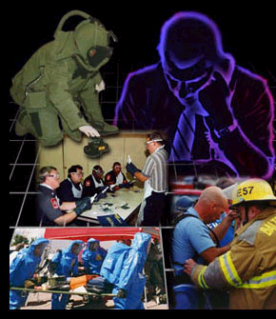
Training and Practice Drills
Train on responsibilities
Practice drills of several scenarios requiring response and incident reporting
Identify deficient areas
Notes:
One way to keep staff’s skills sharp is to have simple drills and practice sessions.
You can ask someone if there was a spill of a culture of a highly infectious microorganism, what would you do? You can even drop a fake culture on the floor or bench and tell someone it is highly infectious and ask them to show you what to do. Staff need to be able to perform, not just know.
Participate in fire drills, emergency evacuation exercises.
Ensure your staff knows to whom to report biosecurity and biosafety deficiencies.
Ensure staff knows how to question individuals in restricted areas.
Drills can be as simple as asking someone to remove their security badge, prop open a door, fail to lock a cabinet, etc. Then time how long it takes to report this security gap. You've got to practice it, and make sure it works, and if it doesn't work, identify those areas that are not working and then correct them.

Slide 44

Develop a Biosecurity Awareness Culture
Education and Communication
Management Support
Organizational values, cultural norms, symbols, awards
A small change in an organization
throughout
the system.
Ripples
Notes:
It is important to think about professional and personal values when working with biological materials that could be misused to cause harm. If the organization culture at your facility does not currently value biosecurity and biosafety there are 3 main ways to change workplace culture.
Education and Communication
Build consensus from the top down and bottom up. Education and communication about the benefits of biosecurity and biosafety are necessary to convince all employees that policies and procedures are valuable. People need to understand why you need a biosecurity plan, why you're worried about this, what it means to the institution, all the things you need to protect, the people you work with, the facility's reputation, the patient information, the expensive equipment you have. Open, honest, respectful discussions increase understanding of expectations and help develop solutions to security and safety issues. These discussions also provide a process for everyone to feel ownership in the biosecurity and biosafety efforts.
Management Support
Attitudes and behaviors of senior & middle management speak louder than any words. They need to be good role models. They must be convinced of the need for biosecurity and provide active and visible support of the plan and procedures when they are in place. They may want explanations of the reasons for specific components of the biosecurity plans.
Changing key values, norms and cultural artifacts.
These include the organization’s key values and norms, myths, heroes, symbols, physical surroundings, reward systems. Profile biosecurity leads in organization newsletters; give awards for quickly reporting breaches or vulnerabilities-incidents. During orientation or at other meetings, high ranking officials could discuss some biosecurity errors that they made or some incidents of near misses that were reported and mitigation measures instituted, preventing a breach. It is important that the reporting is immediately rewarded, e.g., ”I am so glad you observed this and brought it to my attention.” If the person has made a mistake, then the supervisor might add, we will talk about this later, but right now let’s address the breach/near breach. Focus on the system or process.
It's a ripple effect. If you start with a small change in the organization, it will ripple out to bigger and bigger changes.

Slide 45
Resources
"Laboratory Security and Emergency Response - Guidance for Laboratories Working with Select Agents”. MMWR 2002;51(RR-19): 1-8 http://www.cdc.gov/mmwr/PDF/rr/rr5119.pdf
Biosafety in Microbiological and Biomedical Laboratories (5th Edition)
http://www.cdc.gov/biosafety/publications/bmbl5/index.htm
Select Agent Program/Select Agent Rule
http://www.selectagents.gov/
Suspicious Packages
http://www.fbi.gov/about-us/investigate/terrorism/suspicious-packages-pdf/view
http://about.usps.com/securing-the-mail/suspiciousmail.htm
Notes:
Here are some internet sites that might be helpful to you.

