Slide 1

Biological Risk Assessment
for
Clinical Laboratories

Slide 2
Objectives
Describe the concepts of risk assessment (Why and What?)
Describe the basic steps of the risk assessment process (Who, When and How?)
Perform a basic risk assessment exercise
Notes:
The objectives of this presentation are to describe the concepts of a risk assessment, describe the basic steps of the risk assessment process, and perform a basic risk assessment exercise.

Slide 3

Why Do Risk Assessments?
Approximately 500,000 US laboratorians work with or handle infectious materials and/or cultures every day.
Because of where you work and what you do…
Notes:
3
Why is it so important to do a risk assessment? It is estimated that there are approximately 500,000 people who handle infectious materials every day, and prior to isolation and identification of agents that are present, the hazards present in primary specimens are unknown

Slide 4
Why Do Risk Assessments?
To reduce and minimize the risk of exposure to workers and the environment
But remember:
Risk is never zero!
Notes:
First, we must remember that when working in a clinical lab, the risk is never zero. So what is the purpose of doing a risk assessment? The intent is to reduce and minimize the risk of exposure to the lab workers and the environment, and therefore prevent lab-acquired infections and contamination of the environment.
4

Slide 5
Why Do Risk Assessments?
Prevent laboratory-acquired infections (LAIs) from:
  Direct contact (spills/splashes) to mucous membranes
  Inhalation of aerosols
  Percutaneous inoculation from cuts, sharps, vectors, non-intact skin
  Ingestion
  Indirect contact (contamination from fomites*)
*Fomite - an inanimate object (as a computer, doorknob, phone or work surface) that may be contaminated with infectious organisms and serve in their transmission
Notes:
Lab acquired infections, or LAIs, can be caused in different ways. In the lab, the modes of transmission of an infectious agent to the worker can result from direct contact such as spills and splashes to the mucous membranes, (the eyes, nose and mouth); by inhaling infectious aerosols; by inoculation through the skin with a sharp object or other vectors like insects or animal bites, which we call percutaneous; through non-intact skin such as cuts; by accidental ingestion; and by indirect contact from fomites to the hands, and then from the hands to the eyes or mouth, for example. Fomites are inanimate objects such as a work surface, computer keyboard or doorknob.

Slide 6
Definitions
  Hazard is something that is intrinsically dangerous such as an object, a chemical, an infectious agent or a situation.
  Risk is:
  the chance of injury or loss when exposed to a hazard.
  based on the probability of exposure and the severity of consequence from that exposure
  A prediction
Notes:
Before we talk about the risk assessment process, let’s begin with some basic definitions.
A hazard is something that is intrinsically dangerous. Hazards can be objects, chemicals, infectious agents, or situations.
Risk is a prediction that exposure to a hazard will result in injury. It is based on the probability of exposure and the consequence from that exposure. So it is an evaluation of what could happen and the severity if it does happen. Remember, there is risk in everything we do – whether working in the lab or crossing the street. We cannot eliminate the risk completely, but we can reduce it.

Slide 7
Definitions
Risk Assessment (RA) is a process that involves hazard identification and hazard control
Risk assessment requires
  knowledge of the hazards
  understanding of the work, the environment, and the staff
  management involvement and support
Notes:
In this presentation, we are defining risk assessment as the overall process to identify and control the hazards. In order to do this, management support is critical, as well as having knowledge of the hazards, which may include the work, the staff and the environment.

Slide 8
Definitions
Risk Assessment (RA) overall process:
Identify hazards
  What may happen?
  How may it happen?
Evaluate risks
  How likely, how severe?
Determine controls to mitigate risk
  To reduce risk if it is not acceptable
Implement controls
Review effectiveness of controls and adjust
Notes:
The process can be broken down into 5 steps which involve identification, evaluation, determination, implementation and review. We will go through each of these steps shortly.

Slide 9
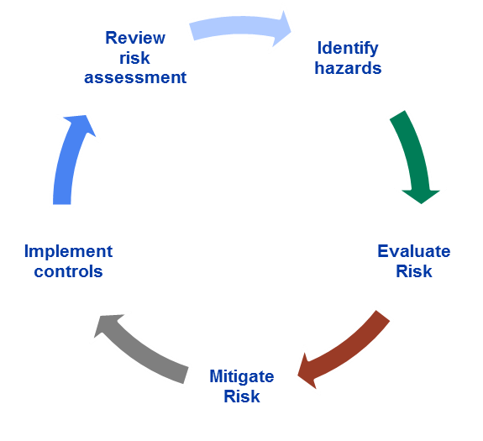
RA Process
Notes:
This diagram represents the risk assessment process. Notice that it is a circle that is continuous, and not a straight line with a beginning and an end. We will come back to this.

Slide 10
Who Does Risk Assessments?
  Ideally, a multidisciplinary team
    Laboratory staff
    Management/supervisors
    Health and safety specialists (biosafety, occupational health …)
    Facility staff
    Scientists with unique expertise & experience
      Microbiologists, molecular biologists, chemists
      Veterinarians
      Others
Notes:
Ideally, risk assessments are performed by a team of people with different expertise and experience. It is important to include the lab workers, including those that work off shifts, because they may encounter different risks if they are performing different tasks than those working the day shift. Management can implement policies and support administrative controls such as training and medical surveillance. Safety specialists and facility staff can help with evaluating and minimizing equipment hazards and selecting engineering controls. And your scientists will have the most knowledge of the organisms involved and will be able to assist with the characteristics of the organisms.

Slide 11
When?
Ideally, at regular intervals
  More frequently in problem areas
  When there is an incident, accident or exposure
  When changes occur
    Move, renovation or new facility
    New infectious agent or reagent
    New piece of equipment, technique or procedure
    New scientific information available
Notes:
Risk assessments should be repeated when there is a recurring problem identified, an incident or exposure, or a change in practice. Changes could involve a different lab, new equipment or a new procedure. Remember, this is a continuous process, so it is performed more than once.

Slide 12



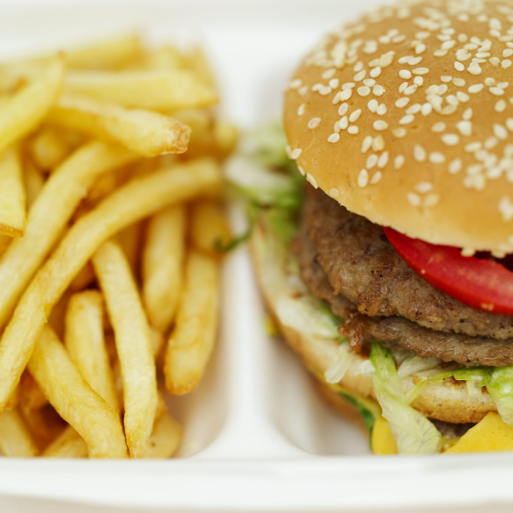
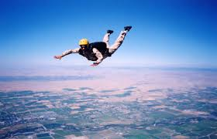
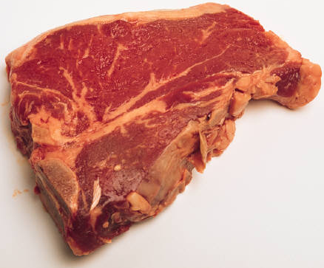

Risk Assessment Is Not New
We conduct risk assessments all the time…
Notes:
Risk assessments are not new, we actually do them all the time in our daily lives. We are constantly evaluating situations, and making decisions on whether the risk is acceptable or not. We just need to consciously think about the risks in the lab environment, and how we can mitigate those risks to an acceptable level.

Slide 13
Steps of RA
  1. Gather information and identify the potential hazard
  2. Evaluate and prioritize the risk (likelihood and consequence)
  3. Determine what additional safety precautions (controls) are needed to reduce the risk (mitigation)
  4. Implement controls
  5. Review and evaluate effectiveness, adjust
Notes:
We are now going to go through each step of the risk assessment, and the first step is to gather information and identify the potential hazard.
13

Slide 14
“Biosafety is an inexact science, and the interacting system of agents and activities and the people performing them are constantly changing.”¹
Every etiologic agent is different
Every laboratory is different
Every person is different
¹ Biological Safety: Principles and Practices, 4th Ed. Fleming DO, Hunt DL, eds., p. 81. Washington, DC. American Society for Microbiology, 2006
Notes:
14
14
In order to perform a comprehensive and practical assessment, we need to compile site-specific information, because every situation is different. So there is no one size fits all for a risk assessment, and a risk assessment performed for one lab is probably not appropriate for another lab. There is also an overlapping and unique interaction between the agent, the laboratory and the person.

Slide 15

Risk Assessment: Interaction of Factors
Pathogen
Agent
Place, PPE, Procedures
Environment
Host
People
Source: B. Johnson, Anthology of Biosafety, IV, 2001
Notes:
This slide depicts the overlapping interaction of these three factors. We need to be aware of the potential agent that may be present, the work environment, and the host, or people performing that work. You will also notice the words outside of the circles. These 5 words beginning with a P represent categories that can be used to determine what information we need to include in our assessment. The first P is Pathogen, or the agent. The second P is People– your colleagues. The environment includes the Place – the laboratory where you work, the procedures being performed, and the Personal Protective Equipment being used.

Slide 16
Risk Assessment Considerations
Biological Agent
Environment
People
Bacteria, fungi, viruses, protozoa, algae, prions, recombinant organisms, cell lines, cell cultures, human/animal specimens, toxins…
Notes:
Let’s talk more in depth about the first P – the agent or pathogen. For this presentation, we will include microorganisms, but also toxins, animal specimens, GMOs, cell lines, and anything else that may contain an infectious organism.

Slide 17
Agent Definitions
    Pathogenicity-the ability/capacity of an infectious agent to cause disease
Virulence-the quantitative ability of an agent to cause disease, the disease-evoking severity of a pathogen (virulent agents cause disease when introduced in small numbers)
Transmissibility/communicability- contagious, ease of spread between persons or species by contact with the sick or their fluids
Notes:
To begin, let’s define a couple of terms that are used in relation to an infectious organism. They are pathogenicity, virulence and transmissibility. Pathogenicity is the inherent ability of the agent to cause disease. Virulence refers to the extent of pathology or harm that an organism can cause. A highly virulent organism can cause severe disease when introduced in smaller numbers, whereas a less virulent organism can require higher numbers of organisms to initiate disease and the result may be less severe. A non-virulent (or avirulent) strain does not normally cause disease in immunocompetent adults. Finally, communicability or transmissibility is how easily the infection is spread between persons or species by contact (direct or indirect) with the sick or their secretions/excretions. In other words, how contagious is it? Is it spread person to person?

Slide 18
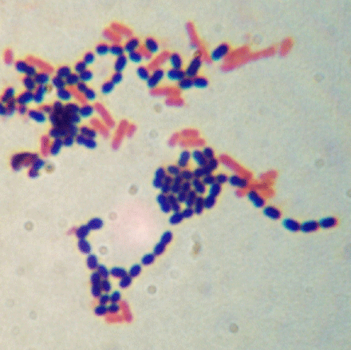

Some Agent Factors to Consider
Toxigenesis
Stability in the environment
Infectious dose
Route of transmission
Indigenous or rare
Availability of data
Availability of vaccine/treatment
Host range (humans, animals, plants)
Antibiotic resistance
Resistance to disinfection
Notes:
18
18
There are many other agent factors that you need to consider when identifying the hazards. Some of them are listed here. For example, can the organism produce toxins? Is it indigenous or common to your geographical region or is it an exotic or rare? Are there vaccines or treatment? Is it antibiotic-resistant? What is the host range, meaning does it infect humans and/or animals, or even plants?

Slide 19
Agent: Route of Transmission
Inhalation, ingestion, percutaneous, direct contact, indirect contact (fomites)
Infection/disease can differ based on the route of transmission
  B. anthracis
    Inhalational anthrax
    Cutaneous anthrax
    Gastrointestinal anthrax
Notes:
The route of transmission refers to how the organism is spread from one host (or person) to another. This is also sometimes referred to as route of exposure. Transmission routes can vary depending on the organism, and some organisms have several routes of transmission. You may see routes of transmission described in different ways, but for this presentation we will talk about inhalation (into the lungs), ingestion (into the GI tract), percutaneous (through a break in the skin), direct contact (such as a splash to the mucous membranes), and indirect contact such as vectors and fomites.
Different transmission routes of the same agent can result in different types and severity of disease. Bacillus anthracis is a good example. Inhaling spores can result in the most deadly form of disease – inhalational anthrax. You can also acquire cutaneous anthrax through open cuts and abrasions – this can occur with people who work with animal hides. The third form, gastrointestinal anthrax, can result from ingesting the organism.

Slide 20
Infectious Dose- The number of microorganisms required to initiate infection can vary greatly with the specific organism and the route of transmission
Organism | Route | Dose
E. coli | ingestion | ~10⁸
E. coli O157:H7 | ingestion | ~10
N. meningitidis | inhalation, direct contact | unknown
Salmonella spp. | ingestion | ~100-1000
Shigella spp. | ingestion | ~10-180
Brucella spp. | inhalation, direct contact, ingestion | 10-100* *By aerosol and subcutaneous routes in laboratory animals
Notes:
Infectious dose is the estimated or hypothetical number of microorganisms required to initiate infection. A word of caution here. Infectious dose is a number that is generated from lab studies with animals, so there are assumptions made that may or may not be true as far as extrapolating the data from animals to humans. Infectious dose can vary greatly with the specific organism and the route of transmission or exposure. Looking at the table you can see the infectious dose varies from 10 to 10 million for different strains of E.coli. Also notice that the infectious dose for Neisseria meningitidis is unknown, and we know that this organism can cause fatal LAIs.

Slide 21

Risk Assessment Considerations
Biological Agent
Environment
People
Notes:
Now let’s look at the host (or people in this case).

Slide 22
Host factors: Immune Status
  -Age or life-stage
  -Pre-existing conditions/medical status (stress, autoimmune disease, chemotherapy, non-intact skin, allergies, other infections/disease, medications, antibiotics)
  -Pregnancy (Cytomegalovirus, HIV, Herpes simplex virus)
  -Nutrition, diet
  -Immunizations (HBV, Meningococcus, Pneumococcus)
Notes:
The immune status of the host can affect the probability of getting infected, and can affect the severity of disease if infected. In general, children and elderly people are usually more susceptible to infection than young adults. Preexisting conditions such as autoimmune disease and people undergoing treatment for cancer can reduce the person’s immune response and ability to fight infection. Non-intact skin from excema or a latex allergy can provide a portal of entry for the organism to invade the body. Vaccination can boost the immune status and steroids such as prednisone can reduce the immune response. Laboratory staff of child bearing age may have increased risk to certain organisms that can have deleterious effects for a developing fetus.

Slide 23
Host: Behavioral Factors
  Stress, fatigue, mental status
  Cultural differences, age, habits
  Perception of risk
  Attitude toward safety
    Follow procedures?
    Use equipment/PPE as designed?
    Take shortcuts?
  Competency
    Education and experience
    Trained?
    Students, language barriers
  Dexterity or reaction time affected by medications or PPE?
Notes:
Behavioral factors can be significant and are sometimes overlooked. Stress and fatigue can affect our mental status and concentration. Stress can lower your ability to fight off disease. There are cultural differences which may be a factor when you have staff that are from other countries.
Perception of risk will vary between people. Everyone has a different acceptable level of risk, or risk tolerance, which is one reason that it is important to have a team of people conducting the risk assessment. Risk perception can also change with age and experience. Younger people generally have a higher risk tolerance than older people, perhaps because they are not aware of the potential harm that may occur.
Attitude toward safety can also vary among people. Do staff follow the procedures, or do they take short cuts? Do staff comply with wearing the appropriate PPE? Are staff trained and competent? Don’t forget about students in your lab, and potential language barriers when English is a second language for staff. Dexterity can be affected by excessive PPE, and reflexes can be altered by certain medications.

Slide 24

Risk Assessment Considerations
Biological Agent
Environment
People
Notes:
Environmental factors include the physical design and workflow of your lab, specific procedures being performed, and the personal protective equipment used.

Slide 25
Environmental Factors
  Place (facility)
  research, clinical, industrial, public health, BSL-2/3
  workflow-is the lab crowded/cluttered?
  lab equipment (biosafety cabinet [BSC], animal cages, sharps, centrifuges, vortex, autoclaves …)
      -is it available?
      -does it protect or is it a hazard by itself?
  PPE (hazard or protection?)
  appropriate PPE available?
  is it used?
  are people trained?
Notes:
Let’s begin with Place – the lab or facility where you work. Some things to consider are what kind of lab are you working in? Is it a clinical lab? Public health or research lab? What volumes are you working with? Are you growing large quantities in fermenters or producing vaccines? Is your lab crowded or do you have good workflow?
What type of equipment do you have? Does the equipment protect or is it a hazard? For instance, if you work with animals, there are hazards with the animal cages, such as sharp edges. Do you work with sharps, and if so, do you have sharps containers available and located close to the point of generation? Do you use centrifuges and autoclaves which can both be dangerous if not used properly?
PPE can also protect or become a hazard. When it comes to PPE, more is not always better. Excessive PPE can be hot and uncomfortable which can cause distraction. If your staff are uncomfortable, they will lose focus and accidents may occur. Too much PPE can also reduce sensory perception and dexterity.
Is your PPE appropriate for the task and are your staff trained how to use it? Does the PPE fit properly? Are various sizes and types of gloves available to accommodate hand size and allergies? Are the gloves compatible with any chemicals that may be used? Are insulated gloves available for opening an autoclave or removing cryovials from liquid nitrogen? And are staff allowed to wear jewelry under their gloves? These can tear and rip gloves, in addition to providing a 'safe harbor' for infectious agents.

Slide 26
Environmental Factors (Procedures)
  hand washing-cracked skin?
  large volume, high agent concentration
  centrifuging, autoclaving
  sharps
  generating aerosols-anything that imparts energy to a suspension
  waste management
  inoculating biochemicals
  doffing procedures
  not using or improper use of BSC
Notes:
There are numerous and diverse procedures conducted in clinical labs. Each task can have unique or similar hazards, and one way to assess lab procedures, is to break them down into individual steps and assess and mitigate each step individually. This approach, called a job hazard analysis, will be practiced later in the presentation.
Hand washing is key in preventing infections and laboratorians practice frequent handwashing. But one thing to consider is that handwashing can dry out your skin, especially in the winter. If your skin is dry and cracked, there is now a portal of entry for microorganisms. One way to mitigate this is to have lotion available. But, not all lotions are appropriate. Oils, including mineral, lanolin, coconut, palm or jojoba oils, as well as Vaseline and other petroleum-based products, should not be worn under latex gloves. These products break down chemical bonds in the material, thereby weakening the barrier properties. Water or glycerine-based lotions will not compromise the glove barrier integrity.
Are staff trained when to work inside a biosafety cabinet? For instance, are there specific SOPs for working with high volumes or high concentrations of the organisms, or for when there is a potential for generating aerosols?
Another process that may be overlooked is waste management. Often, there are non-laboratory staff that are responsible for collecting waste, so it is crucial to ensure that all biohazardous waste is segregated from routine non-regulated waste.

Slide 27
Steps of RA
  1. Gather information and identify the potential hazard
  2. Evaluate and prioritize the risk (likelihood and consequence)
  3. Determine what additional safety precautions (controls) are needed to reduce the risk (mitigation)
  4. Implement controls
  5. Review and evaluate effectiveness, adjust
Notes:
Now that you've identified the potential hazards—(the easy part), the next step is to evaluate and prioritize the risk based on the likelihood or probability that it will happen and the consequences and severity if it does happen. It is not realistic to try and protect against every risk, so prioritizing can help management determine what risks are considered “acceptable” and what risks are considered “unacceptable”.
27

Slide 28

Risk Assessment
Very seldom is risk assessment a black and white issue
Involves personal and social value judgments
  Everyone has different perceptions of risk and what is “acceptable”
Old woman or young girl?
Notes:
As mentioned previously, risk perception and what is acceptable will vary because everyone perceives and interprets differently. Risk assessment involves personal and social value judgements, so it is not black and white.
This slide illustrates how people can perceive the same image differently. Some people see an old woman, some people see a young girl, and some people can see both.

Slide 29
Evaluate and Prioritize Risk-Example
Likelihood (probability) of occurrence
Rare: could happen, but probably never will
Unlikely: could happen but rare
Possible: could happen but not likely
Likely: could happen sometime
Almost certain: expected to occur
Notes:
Determining the likelihood or probability that something will occur can be accomplished in various ways. This is one example from the MMWR referenced in the resources that uses a qualitative scale from “rare” to “almost certain.” Some institutions prefer to use a quantitative method and assign a number to the likelihood which then results in a final numerical score.

Slide 30
Evaluate and Prioritize Risk-Example
Consequence (severity) of exposure
  Minor: Colonization, asymptomatic
  Moderate: Medical treatment or first aid
  Major: Infection and recovery
  Critical: Disease and sequelae
  Catastrophic: Death
Notes:
To evaluate the consequences and severity of an exposure can also be rated qualitatively or quantitatively. In our example, we are again using the MMWR example of using a qualitative scale from minor consequence to catastrophic. The consequences may depend on the duration and frequency of the exposure, and also the availability of vaccines and appropriate treatment.

Slide 31
Evaluate and Prioritize Risk-Example
Performing Gram stain:
  Potential Hazard: Aerosols from flaming slides — mucous membrane exposure
  Likelihood: Possible
  Consequence: Colonization; medical treatment
  Risk: Moderate
AFB culture work-up
  Potential Hazard: Aerosols — inhalation
  Likelihood: Likely
  Consequence: Infection; medical treatment; disease
  Risk: High
Notes:
Here are two examples of how you may evaluate and prioritize the risks. The first is performing the Gram stain. One potential hazard is exposure to your mucus membranes from aerosols that are produced when the slides are flamed to fix them. It was determined that the likelihood was possible, and the consequences could include colonization or medical treatment. Plotting those values on the matrix resulted in moderate risk.
However, working with an acid-fast bacilli culture, the potential hazard could be inhalation of an organism like Mtb which has a very low infectious dose. In this example, the consequence is much higher and more severe, because the exposure could result in a serious infection, treatment or disease. So this overall risk was rated as high.
As you can see from these examples, the evaluation of risk is quite subjective and may vary from person to person.

Slide 32
Risk Matrix-Example
Likelihood
5- Almost
certain
4- Likely
Red = HIGH RISK
Yellow=Moderate Risk
Green= low risk
3- Possible
2- Unlikely
1- Rare
1- Minor
2- Moderate
3-
Major
4- Critical
5- Catastrophic
Consequence
Notes:
For those of you that prefer visual graphics, this slide illustrates the risk matrix with the likelihood plotted on the vertical axis and the consequence plotted on the horizontal axis.

Slide 33
Steps of RA
  1. Gather information and identify the potential hazard
  2. Evaluate and prioritize the risk (likelihood and consequence)
  3. Determine what additional safety precautions (controls) are needed to reduce the risk (mitigation)
  4. Implement controls
  5. Review and evaluate effectiveness, adjust
Notes:
Now we'll move onto step 3. This is where you determine what additional safety precautions and mitigation controls are needed to reduce the risk to an acceptable level. Step 4 is to implement these controls.
33

Slide 34
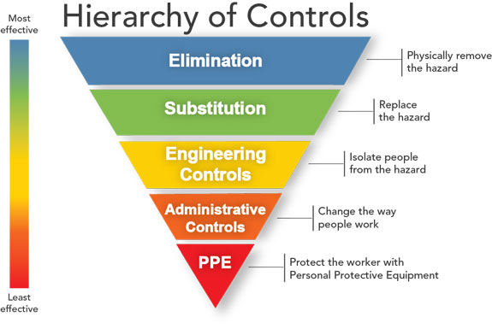
Notes:
This diagram depicts the hierarchy of controls that we typically use in the United States to mitigate or reduce the risks. Notice that elimination and substitution are at the top to represent the most effective controls, but this is not always feasible in a clinical lab. So we will start with engineering controls, which are barriers to isolate people from the hazard. We will then continue with administrative controls which includes work practices, and are intended to change the way people work. The reason we portray PPE as the least effective control is because it only protects the individual worker, so PPE should be used as a last resort for protection.

Slide 35
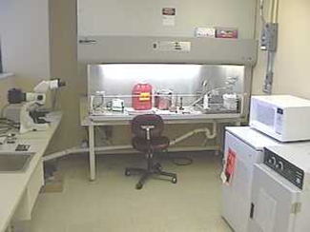
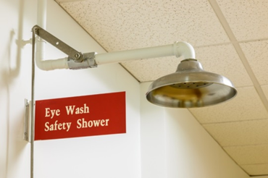
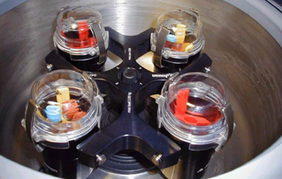
Some Engineering Controls
  - Safety Equipment (BSC, sharps containers, centrifuge safety cups, eyewash, sealed rotors)
  -Facility Design (directional airflow, lockable doors, hands-free faucets)
Notes:
Engineering controls include safety equipment and facility design. Shown here are some examples of each one. Safety equipment could include a BSC and centrifuge safety cups. Your facility design includes things like directional airflow, lockable doors, and hands-free faucets.

Slide 36
Some Administrative Controls and
Work Practices
  Training
  Signage
  SOP’s and site-specific safety manuals
  Medical surveillance program (including a process to address unusual absences, sickness, and injury)
  Frequent hand washing
  Appropriate use of PPE
  No mouth pipetting
  Limiting use of needles and sharps
  Minimizing aerosols
Notes:
Administrative controls are generally higher level policies delegated by management like required training and medical surveillance programs. Work practices cover Standard Precautions and site-specific procedures

Slide 37
PPE
PPE is your last resort, after all other mitigation steps have been taken
Proper technique for donning and doffing PPE is as important as having the correct PPE-staff must be trained!
More PPE is not always better (decreased dexterity and sensitivity, uncomfortable, hot)
PPE can vary on what you are doing and where you are doing it-depends on risk assessment!
Institutions must establish policies for adherence
Notes:
As stated previously, PPE is reserved as the last line of defense. It became apparent during the recent Ebola outbreak that healthcare workers were relying primarily on PPE for protection, and the belief was that more PPE is more protective. But remember, the more PPE that is put on, the more PPE that has to be taken off, and taken off safely. Also evident from the hospital assessments, was that staff were not sufficiently trained on how to take off or doff their PPE without contaminating themselves or the lab environment. Another consideration is the comfort of your staff. If they are hot and uncomfortable, they may become distracted, which is when accidents can occur. So be sure that the PPE is appropriate and proportional to the risk.

Slide 38
Routes of Transmission | Mitigation Strategies
inhalation | BSC, respiratory protection, centrifuge safety cups
ingestion | No mouth pipetting, gloves, hand washing
percutaneous | Safer sharps, sharps containers, cover compromised skin
direct contact with mucous membranes | Gloves, hand washing, face protection
indirect (fomites) | Disinfecting surfaces, spill procedures, designated clean and dirty areas
Notes:
This table lists various routes of transmission and possible mitigation strategies that you could use to reduce the risk of transmission. For example, if the route is inhalation, then you need controls that will contain the aerosols and prevent them from being inhaled. You could use a biosafety cabinet, respiratory protection such as a respirator, or if centrifuging, use centrifuge safety cups.

Slide 39
Steps of RA
  1. Gather information and identify the potential hazard
  2. Evaluate and prioritize the risk (likelihood and consequence)
  3. Determine what additional safety precautions (controls) are needed to reduce the risk (mitigation)
  4. Implement controls
  5. Review and evaluate effectiveness, adjust
Notes:
The 5th step is to evaluate the effectiveness of the strategies you have implemented and adjust.
39

Slide 40
Review and Evaluate Effectiveness
  -Review incidents, accidents, illnesses
    Encourage and support non-punitive reporting
  -Identify causes/problems, make changes, follow-up training
    Document and maintain records
  -Conduct routine lab inspections
  -Repeat RA when incidents or changes occur

Slide 41
Perform a Risk Assessment
In order to simplify the entire process and make it more practical for laboratorians, a Job Hazard Analysis framework can be used to break down a complex process into individual steps.
Each step is then evaluated separately, and mitigation controls can be determined and implemented at each step of the process.
Notes:
As mentioned before, one way to do a risk assessment is to break the entire procedure down into its component parts and determine the hazards associated with each step in the protocol and then identify a way to control each hazard. This process is known as a job hazard analysis.

Slide 42
OSHA Job Hazard Analysis
“A technique that focuses on job tasks as a way to identify hazards before they occur.
Ideally, after you identify uncontrolled hazards, you will take steps to eliminate or reduce them to an acceptable risk level.”
https://www.osha.gov/Publications/osha3071.html
Notes:
OSHA recommends using a job hazard analysis in order to identify hazards before they happen. There is more information on this OSHA website.

Slide 43

Job Hazard Analysis Steps
Break procedure down into individual components
Determine hazard(s) associated with individual component* (hazard ID)
Identify way to deal with each hazard (hazard control)
*5 P’s: pathogen, people, place, PPE, procedures
Notes:
We are going to go through two examples and then you will perform a risk assessment using the job hazard analysis template. Use the “5 Ps” to help you remember what information you need in order to identify the hazards.

Slide 44
Job Hazard Analysis-Example
Procedure or Process | Principal Steps (Procedure) | Health Hazards (Pathogen) | Safety Equipment/ Engineering controls (Place) | Administrative Controls and Work Practices (Personnel) | Recommended PPE
Slide Catalase Test | Touch colony of organism with stick or plastic loop Put on slide Add Hydrogen Peroxide Observe for bubbles | Pathogen (?) Aerosol generation Chemicals Sharps | Perform this test in a tube, BSC, or use other engineering controls. Sharps containers | Proper BSC usage; safe sharps handling; aerosol containment; SOPs and demonstrated competency | Gloves Lab coat Face shield (optional if using a bench shield or BSC)
Hematology differential | Label slide Open tube Place drop of blood on slide Swipe to make diff Air dry Stain | Sharps Aerosol generation Auto-inoculation Spill Chemicals | Use automated system, splash shields, absorbent pads, tube holders Sharps containers | SOPs and demonstrated competency; Safe sharps handling; Aerosol containment Splash shield | Gloves Lab coat Face shield (optional if using a bench shield or automated system)

Slide 45
Don’t Forget:
There is some risk in everything we do-we can reduce it, but not eliminate it
To ask questions
Your staff, their training and competency
To evaluate, review and adjust
Notes:
In summary,

