Slide 1
Module L4
Practical strategies for sequencing and molecular characterization of influenza viruses

Slide 2
Considerations for Sequencing
What are my resources?
  Personnel
  Equipment
How many samples will my lab sequence?
  What kind of sequencer do / will I have?
    How many samples can it process simultaneously?
    What kind of read length does / will my sequencer produce?
  What kind of primer design strategy will I use?
    How much redundancy in my sequence do I want or need?
    What amplification and sequence strategy will I employ?
      Conventional
        Subtype / gene specific primers to amplify (~1000 bp amplicon)
        Different set of primers internally to sequence for each subtype and gene
      M13–labeled
        Subtype / gene specific primers to amplify (~500 bp amplicon)
        Only M13-forward and M13 reverse to sequence

Slide 3
Considerations for Sequencing (cont.)
Do I have a specimen and data management system in place?
Need a solid method to identify the “uniqueness” of a specimen or isolate that is sequenced
Standard naming conventions need to be implemented when lab is set up
  Specimen names
  Amplifying and sequencing reactions
What type of pipeline will I use to analyze and report my sequencing results?
  Standardization is very important

Slide 4
What and How Many Viruses/Genes do you Sequence?
Despite the increasing numbers of sequencers to choose from, sequencing is not cheap
  Need to choose the samples to sequence wisely
    Geographic location and temporal distribution
    Fatal or severe
    Antigenic variant
    Antiviral resistant
    Novel subtype in novel host
    Epidemiological study
How many depends on your research question
  New mutation – may want to see how widespread is the circulation
  New antigenic variant – may want to sequence a representative population to determine if there is molecular basis for the reactivity / emergence of new variant

Slide 5
Determination of Sequencing Needs
What do you want to sequence
  Partial gene fragment for diagnosis?
  Whole gene
  Multiple genes
  Whole genome
Why do you want to sequence?
  Pathogen detection
  Mutation detection
  Understand the evolution of viruses
  Genetic basis of antigenicity and/or pathogenicity
  Comparison to vaccine strain

Slide 6
High-throughput vs. Low-throughput
Resources
  Equipment
    Single channel vs. multichannel pipettes
    Manual versus robotic liquid handling
    Sequencer
      4 channel to 96 channel to NGS platforms
      How many sequencers available?
Throughput
  4 capillary ABI ~ 1 full genome / 40 hrs (3-5x coverage)
  96 capillary ABI ~ 12 full genomes / 24 hrs (3-5x coverage)
Financial Considerations
  Cost / reaction
  Some cost-savings through protocol modifications

Slide 7
Data Management
Start-to-finish
  Specimen login – accessioning systems to track sample by number not by name
Take into account some metadata
  Specimen id#
    Most labs assign specimen number or code that makes that sample unique
      Can be as simple as a numerically increasing number and an Excel-style spreadsheet that records specimen number or code, date of specimen collection, patient age, patient gender, passage information for isolates, and possibly the extent of illness (recovered to fatal)
  Example
    Specimen ID = 2010216745
    Sample is a C1 Passage and we want to sequence the HA gene
      Example of an appropriate unique ID = 2010216745_C1_HA_v1
        This would be cross-referenced with the CDCID
        Could have additional versions of the same passage re-sequenced
        (i.e., _v2)
        Could have additional gene segments (i.e., _PB2, _PB1, _PA, etc…)
        Could have a different passage sequenced (i.e., _C2)

Slide 8
First Generation Sequencing

Slide 9
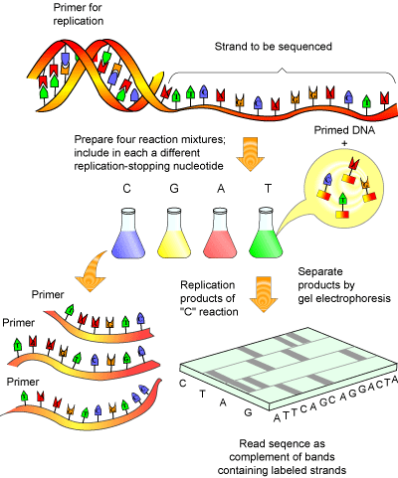
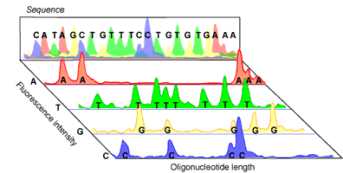
Sanger Sequencing
PCR reaction with chain termination and the ddNTPs are labeled
  Radioisotope
  Fluorescent
Amplified DNA is then separated according to size on gel electrophoresis
  Smallest to largest
  As fluorescent label passes through instrument laser beam, the kind of label is recorded in an electropherogram
Overlapping sequences are assembled into contigs
Notes:
No citation for these images

Slide 10
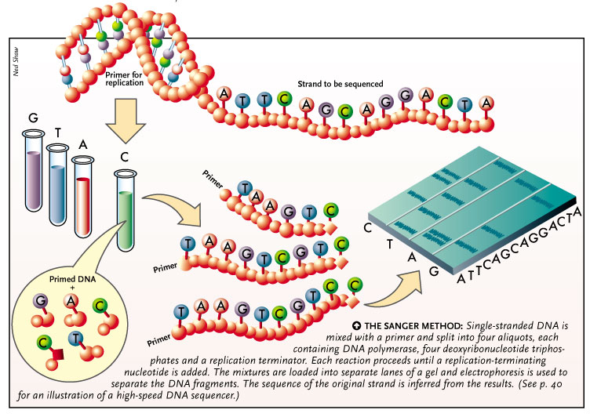
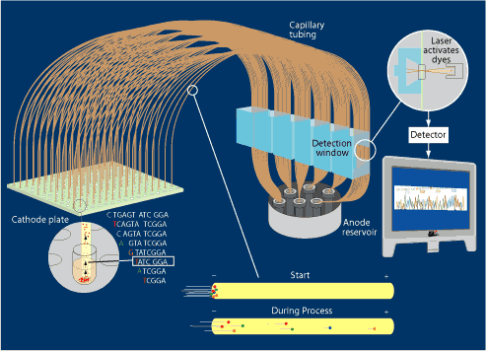
Sanger Methodology
Notes:
Sanger Method Image http://www.the-scientist.com/?articles.view/articleNo/15939/title/DNA-Sequencing-Industry-Sets-its-Sights-on-the-Future/
Capillary Sequencing : https://jgi.doe.gov/archived-educator-resources/sanger-sequencing-archive/how-sanger-sequencing-is-done/step-10-capillary-sequencing/
No citation for these images

Slide 11
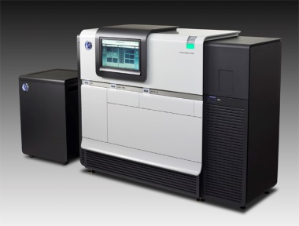


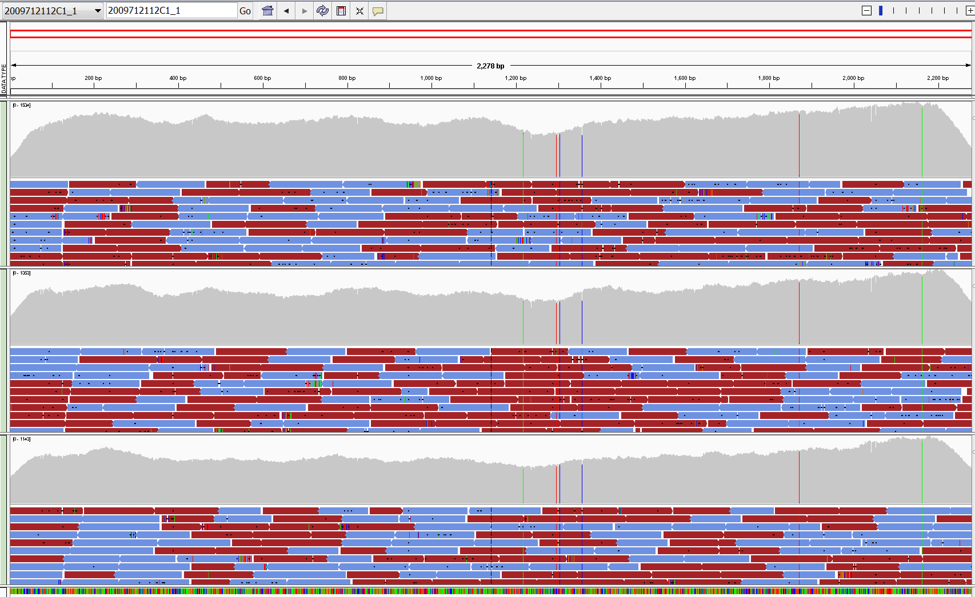
Deep Sequencing & Next Generation Sequencing (NGS)
Influenza viruses exist as a quasi-species within a host
- NGS provides understanding of the frequency of mutations at a particular codon
Properties of the Virus:
  Genomic variation
  Receptor binding
  Transmission in lab animals
  Antiviral Drug resistance
Next Generation Sequencing (NGS)
Notes:
Image PacBio RS II from Pacific Biosciences http://www.pacb.com/products-and-services/pacbio-systems/

Slide 12
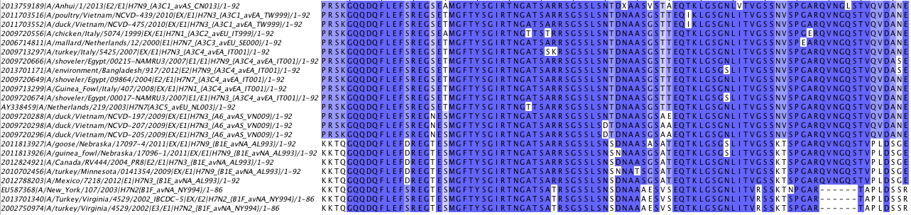
Sequence Variation
What factors impact variability?
Are the tools we have sufficient?
    Right tools / methods? Bioinformatics bias
    Instrument bias False negative and false positives
Notes:
No citation for this image

Slide 13
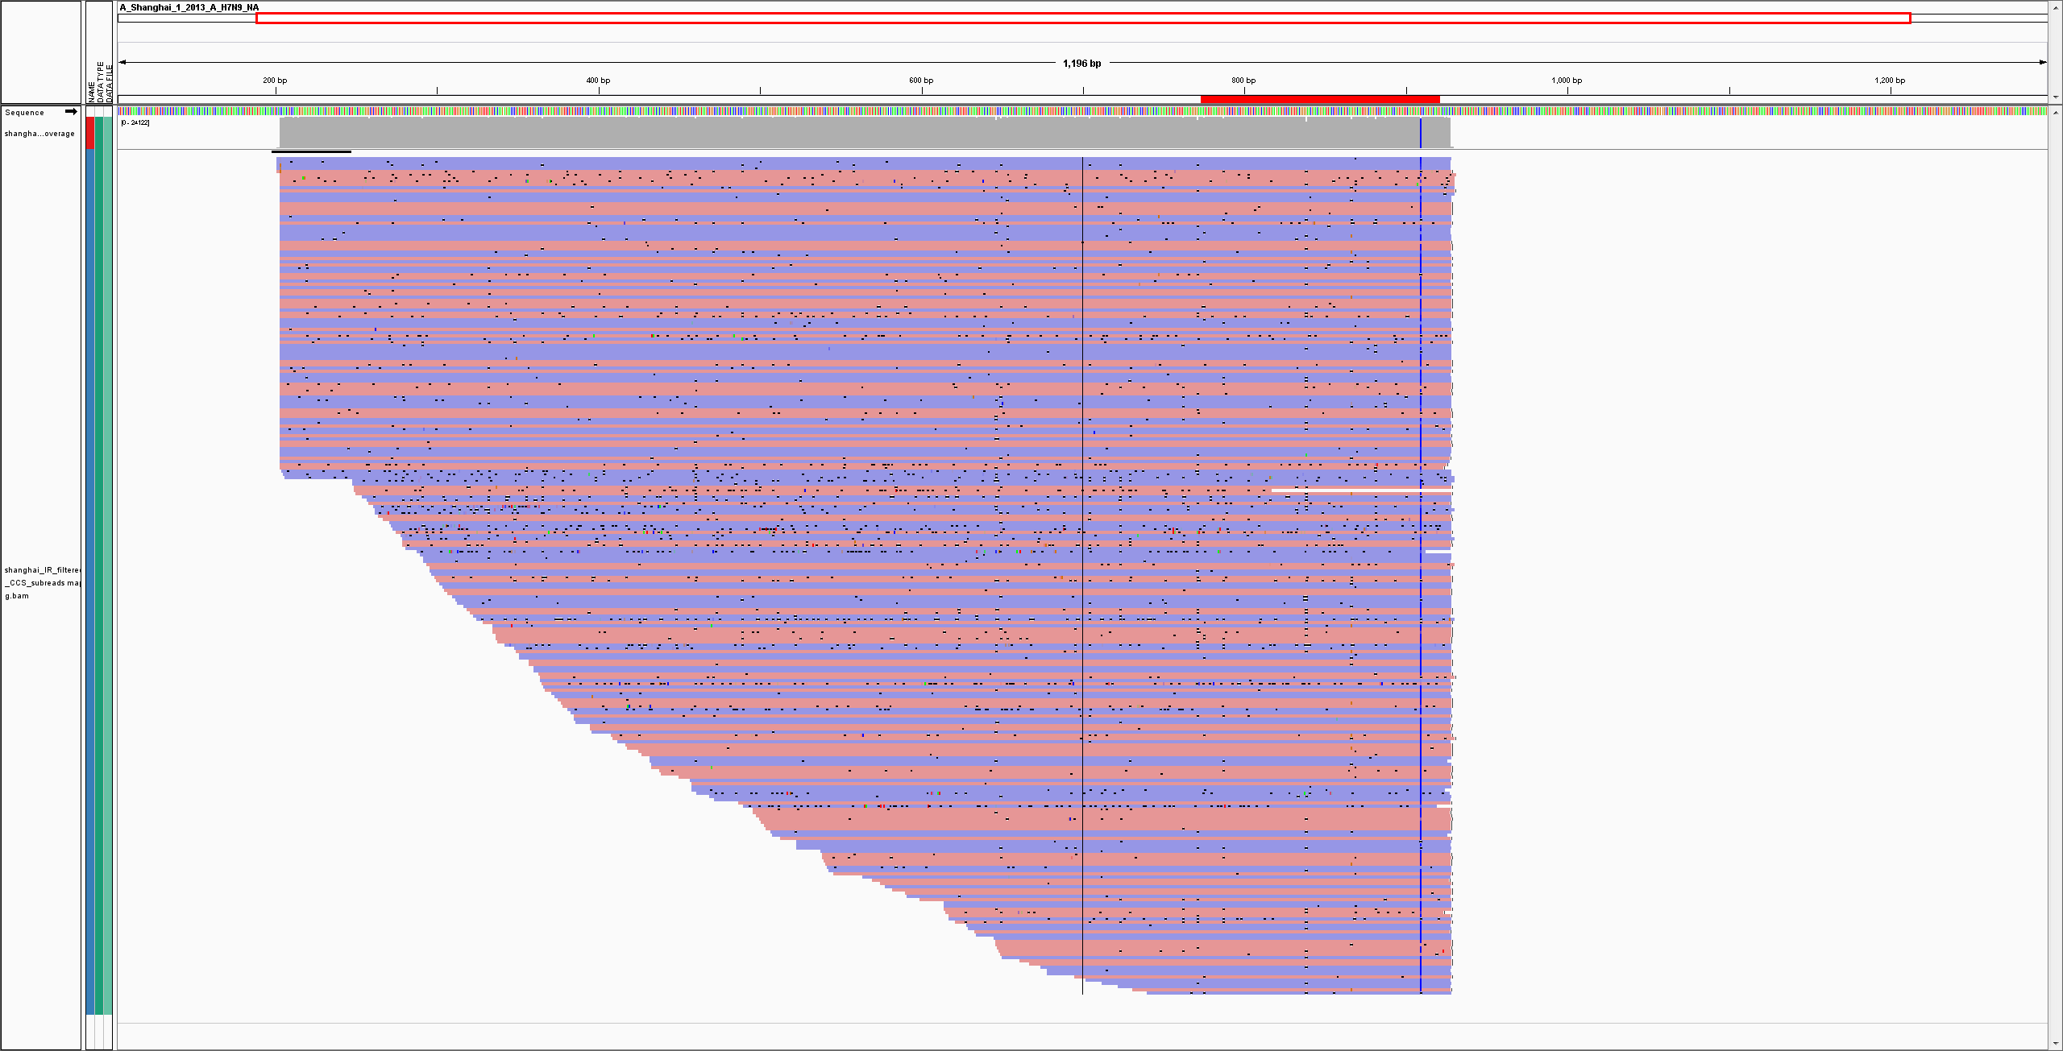

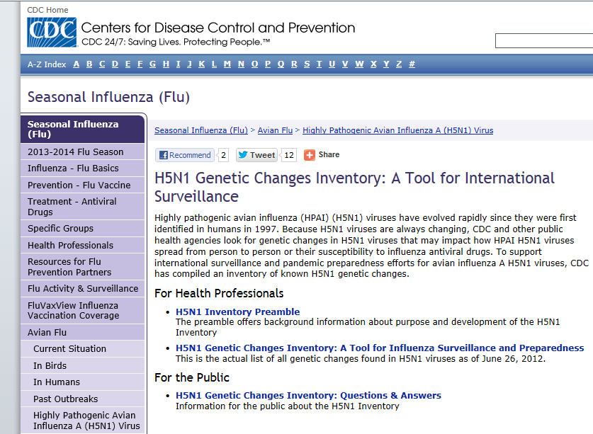
Mapping Mutations
Once desired depth of coverage is achieved, utilize variant detection software to detect mutations
Annotated reference
Known marker for mammalian adaptation, virulence etc.
Mutations detected may not be representative of the dominant population.
Mutations found may occur in residues that impact risk assessment.
http://www.cdc.gov/flu/avianflu/h5n1-genetic-changes.htm
Notes:
No citation for this image

Slide 14
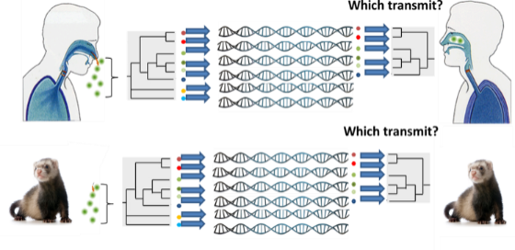
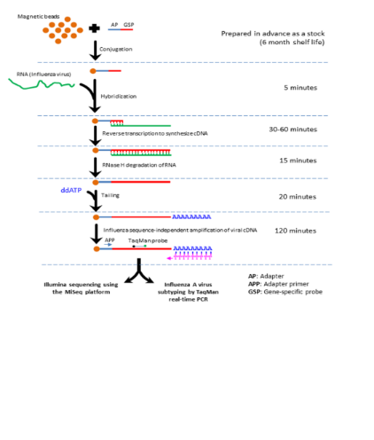
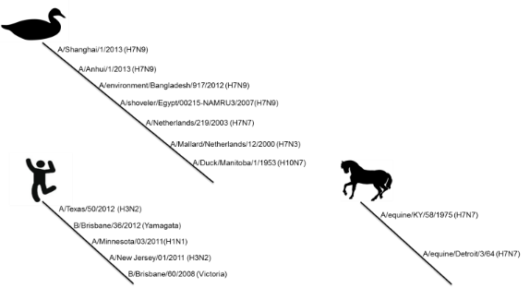
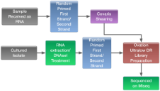
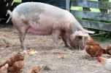


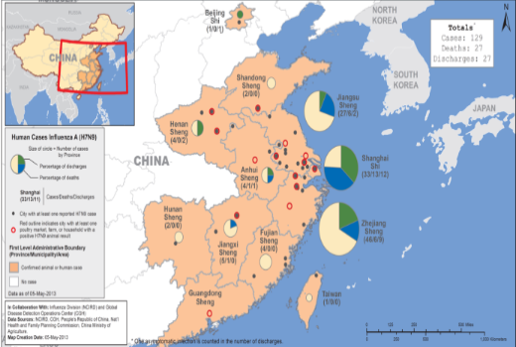
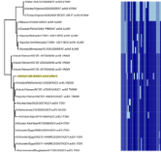

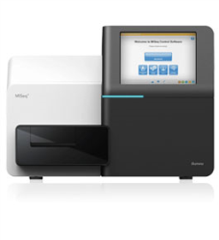
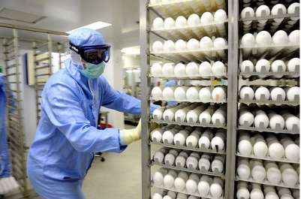


Influenza Next Generation Sequencing (NGS) Efforts
Disease transmission
Disease detection
Universal NGS sequencing
Outbreak response/ surveillance
Vaccine improvement
Unknown respiratory disease outbreak
Notes:
No citation for these images except:
Chickens and pig: Image purchased from Shutterstock. Stock photo ID: 116037238
Coughing person at bottom right: Image purchased from Shutterstock. Stock vector ID: 201932494

Slide 15
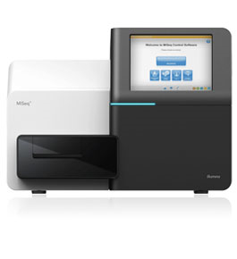
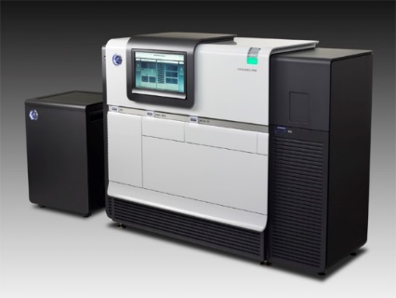
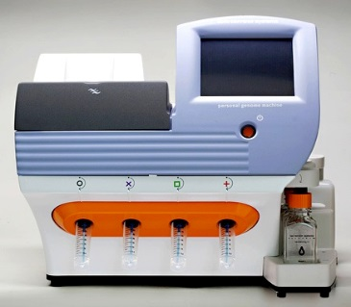
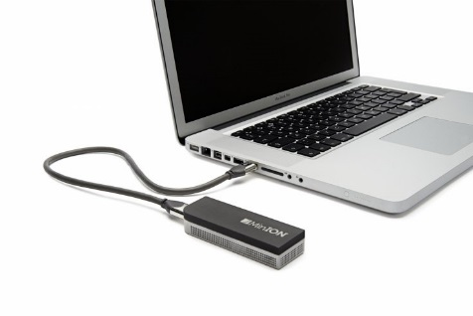
The Instruments – Pros and Cons
PacBio RS
Long read length (8.5KB average) but high indel error high susceptibility to reference bias
Illumina MiSeq
Short read length, lowest error, generates the most sequence
Ion Torrent PGM
Short read length homopolymer error
Oxford Nanopore
MinION
Beta testing now
Long read length
Very high error rate
Notes:
No citations for these images

Slide 16

Which Tool is Best for Your Lab?
Wet lab process has to be tailored to the question
Considerations
  Error
  Input
  Outcome
  Cost
Notes:
Image purchased from Shutterstock. Stock vector ID: 584901160

Slide 17
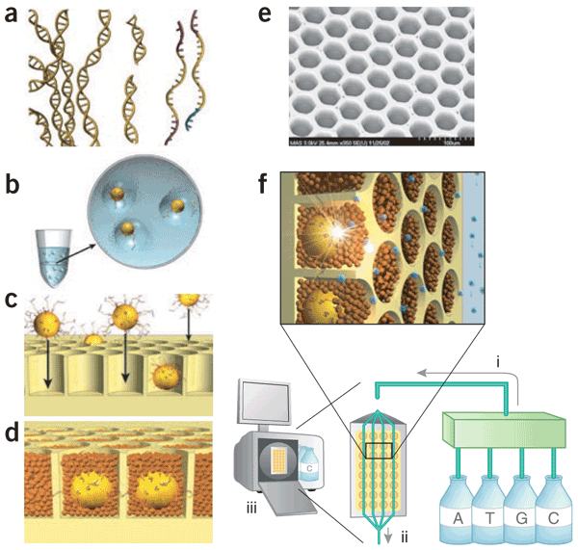
454 Sequencing
Direct sequencing of PCR products (amplicons)
  Clinical materials
  Identification of quasi-species
  Identification of rare SNP patterns
  De Novo sequencing
  Longer reads all assembly of “shotgun” sequence data into a minimal number of contigs
  Whole Genome Sequences from different microbial genomes can be obtained with unprecedented throughput and speed
  Large-scale, parallel pyrosequencing
  Improved accuracy and read lengths (~ 400 bp)
  Process
  Library prep – genomic DNA isolated, fragmented, and ligated to adapters and separated into single strands
  Emulsion PCR – fragments bound to beads (1 frag/bead)
  Emulsion is broken, DNA denatured, beads enriched and deposited in well of fiber-optic slide
  Small beads with pyroseq rxn deposited in each well
  Scanning em of empty wells
  454 instrument components consist of fluidic assembly (i) flow cell (ii) CCD Camera (iii)
Nature Biotechnology 26, 1117 - 1124 (2008) Published online: 9 October 2008
Notes:
No citations for these images.

Slide 18
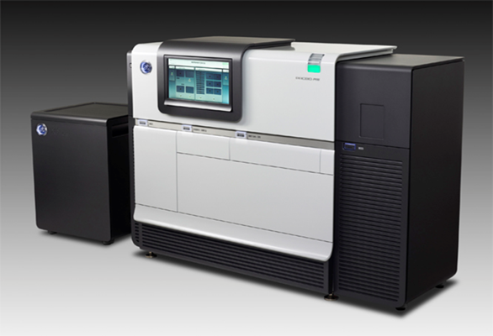
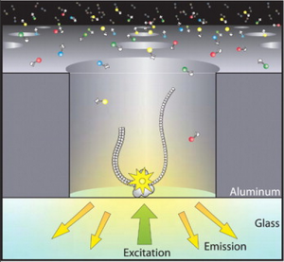
PacBio RS
Works by fixing DNA polymerase to wells on a plate
Laser detects sample through bottom of wells
Add ssDNA and fluorescently labeled nucleotides
Watch the bases being incorporated in real time
There is a limit to the read length
  The laser used for detection heats up the system and eventually burns out the polymerase
Notes:
No citations for these images.

Slide 19
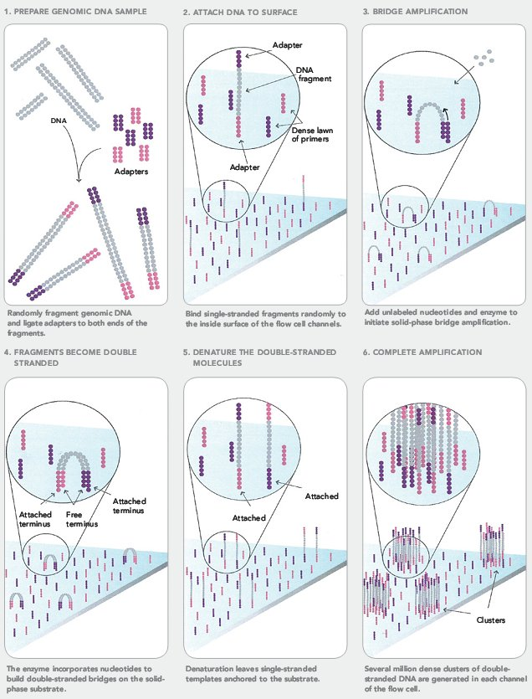
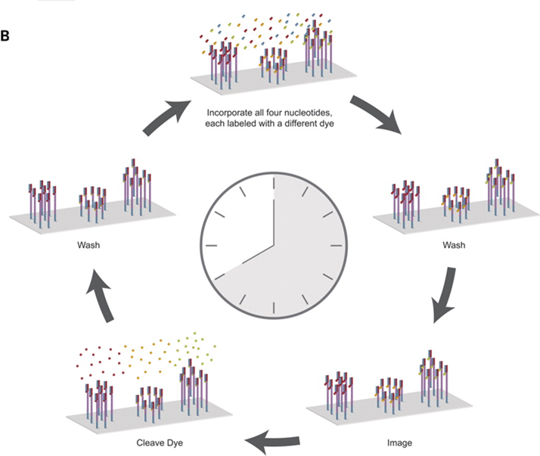
Illumina MiSeq
Notes:
No citations for these images.

Slide 20
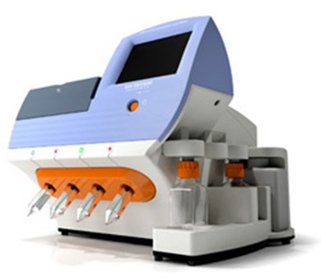
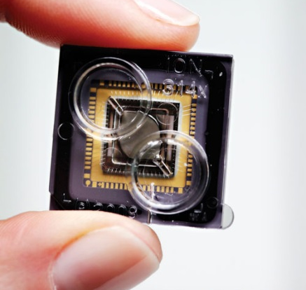
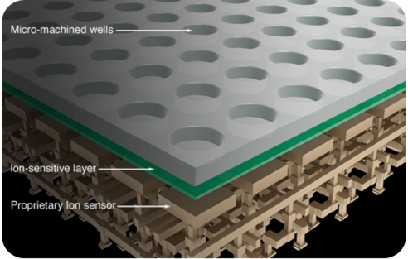
Ion Torrent PGM
Semiconductor sequencing
High density array of micro-machined wells that sense the release of H⁺ as part of base incorporation
  No lights, camera or action (scanning)
  Advantages
    Quick results
    Small footprint
    Low cost
  Still requires amplification of DNA template in each well and “wash-and-scan” methodology
    Limits read length (currently at 400 bp)
    Limits throughput
1-7-12 million sensors
Notes:
No citations for these images.

Slide 21
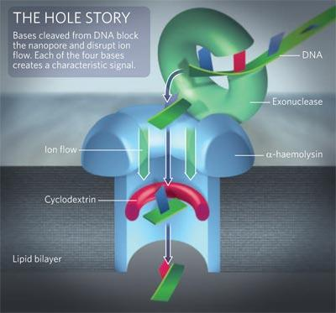
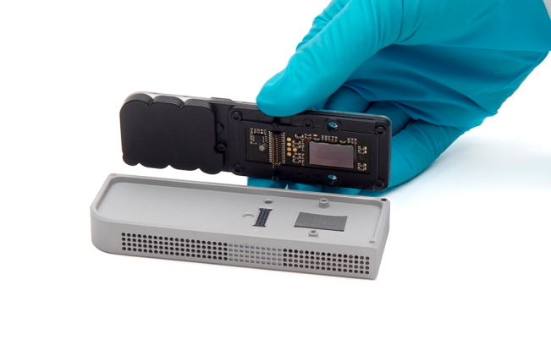
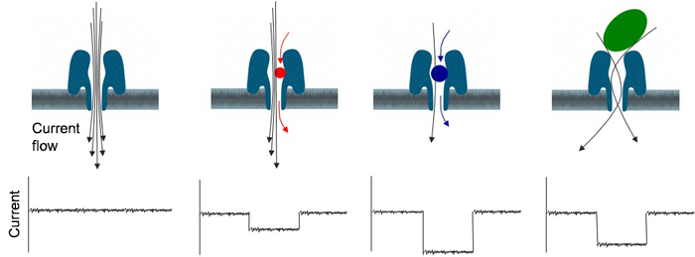
Oxford Nanopore Technology
Biological Nanopore construction
  Modified α-hemolysin pore
    exonuclease attached to extracellular face of the pore
  synthetic cyclodextrin sensor is covalently attached inside surface of the nanopore
  System wrapped in synthetic lipid bilayer
How it works
  DNA loaded onto exonuclease-containing face
  Voltage applied across bilayer by changing salt concentration
  Exonuclease cleaves off individual nucleotides
  Individual nucleotides detected
    Cleavage causes characteristic disruption of onic current through pore
Advantages
  Long read length
  High scalability
  Low cost (electronics vs optics)

Slide 22

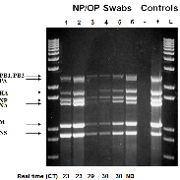
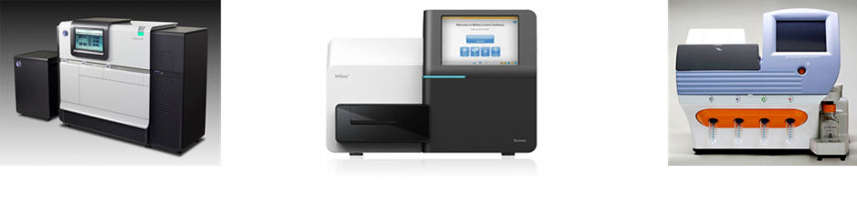

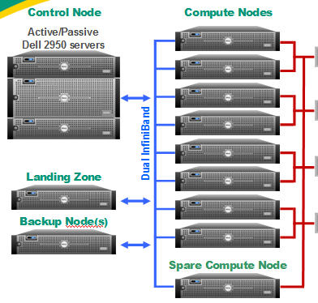
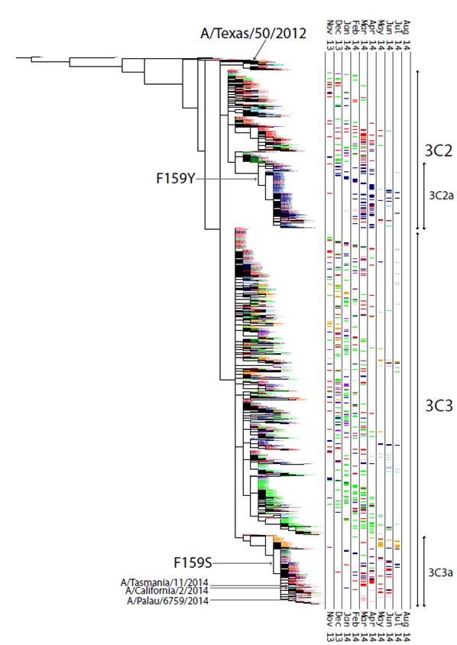


Typical Influenza Virus NGS Pipeline
RNA extraction
1
2
4
Universal
genomic amplification
3
Next Generation Sequencing
NGS library construction
7
Analysis
Data Base
Database
8
6
Data integration and storage
5
Genome assembly and curation
Inquiries regarding CDC’s sequencing SOPs and other questions can be directed to:
Dr. John Barnes (@cdc.gov); Dr. Todd Davis (eou8@cdc.gov)
Multiple vendors supply instruments/reagents/consumables for Sanger and NGS platforms
should be made in-country as there are cost differences depending on delivery location
Budget estimates should include purchasing annual warranties/service contracts for instrument preventative maintenance and repairs
Notes:
No citations for these images.

Slide 23
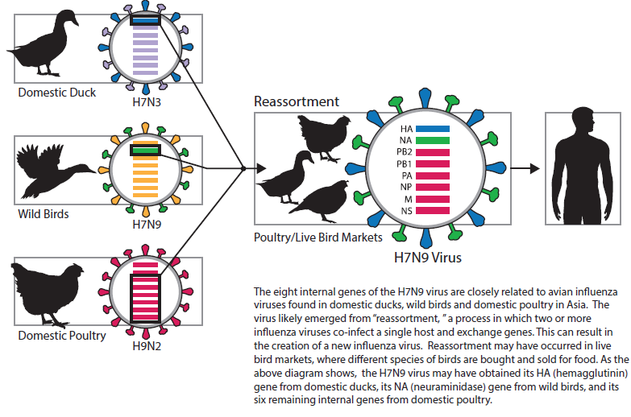
Molecular Characterization of influenza A(H7N9) Viruses

Slide 24
Phylogenetic Tree of H7 Hemagglutinin Gene
A/duck/Zhejiang/DK16/2013 H7N3
A/duck/Zhejiang/DK10/2013 H7N3
A/duck/Zhejiang/10/2011 H7N3
A/duck/Zhejiang/2/2011 H7N3
1st wave H7N9 viruses
2nd and 3rd wave H7N9 viruses
Amino acid changes compared to vaccine strains
Vaccine strains in red
A/duck/Zhejiang/12/2011 H7N3
A/duck/Fujian/6326/2010 H7N3
A/duck/Fujian/6380/2010 H7N3
A/chicken/Wenzhou/279/2013 H7N7
A/chicken/Wenzhou/690/2013 H7N7
A/silkie chicken/Wenzhou/793/2013 H7N7
A/goose/Guangdong/7472/2012 H7N7
S275G I317S
A/duck/Wenzhou/771/2013 H7N3
V264I
A/pigeon/Wenzhou/559/2013 H7N7
A/Shanghai/1/2013 H7N9
A128S S165N V177G P212T L217Q N267D H274Y
A/chicken/Shanghai/S1410/2013 H7N9
L217Q
A/environment/Henan/SD429/2013 H7N9
L217Q
V24G C54G L56P L57R I78M
A/chicken/Zhejiang/DTID-ZJU01/2013 H7N9
A/wild pigeon/Jiangsu/SD001/2013 H7N9
R47K L217Q
A/Taiwan/1/2013 H7N9
L217P S281N
A/homing pigeon/Jiangsu/SD184/2013 H7N9
G119E L217Q
A180T L217Q P230S D289E S304R
A/Environment/Guangdong/C13281030/2013 H7N9
A/Environment/Guangdong/C13281025/2013 H7N9
L217Q/L
A/environment/Zhenjiang/4/2013 H7N9
L217Q
A/Nanjing/4/2013 H7N9
R47M
A/environment/Suzhou/14/2013 H7N9
L217Q
A/Zhenjiang/1/2013 H7N9
R47K
A/Nanjing/2/2013 H7N9
A/Nanjing/7/2013 H7N9
N190S
A/Wuxi/4/2013 H7N9
A/Xuzhou/1/2013 H7N9
A/Suzhou/5/2013 H7N9
A/environment/Suzhou/8/2013 H7N9
A/Wuxi/3/2013 H7N9
T122A
A/Nanjing/6/2013 H7N9
R47K
A/Hong Kong/5942/2013 H7N9
N282S
A/Guangdong/1/2013 H7N9
N267D
A/environment/Shenzhen/1/2013 H7N9
Q213P
A/Guangdong/2/2013 H7N9
A/Zhejiang/DTID-ZJU10/2013 H7N9
A/Zhejiang/22/2013 H7N9
L217I
A/Suzhou/3/2013 H7N9
A/Jiangsu/01/2013 H7N9
A/Zhejiang/1/2013 H7N9
A/Hangzhou/1/2013 H7N9
A/Shanghai/2/2013 H7N9
A/chicken/Jiangsu/1021/2013 H7N9
A/Anhui/1/2013 H7N9
L217Q
0.01
A/chicken/Zhejiang/SD007/2013 H7N9
Notes:
No citations for this image.

Slide 25
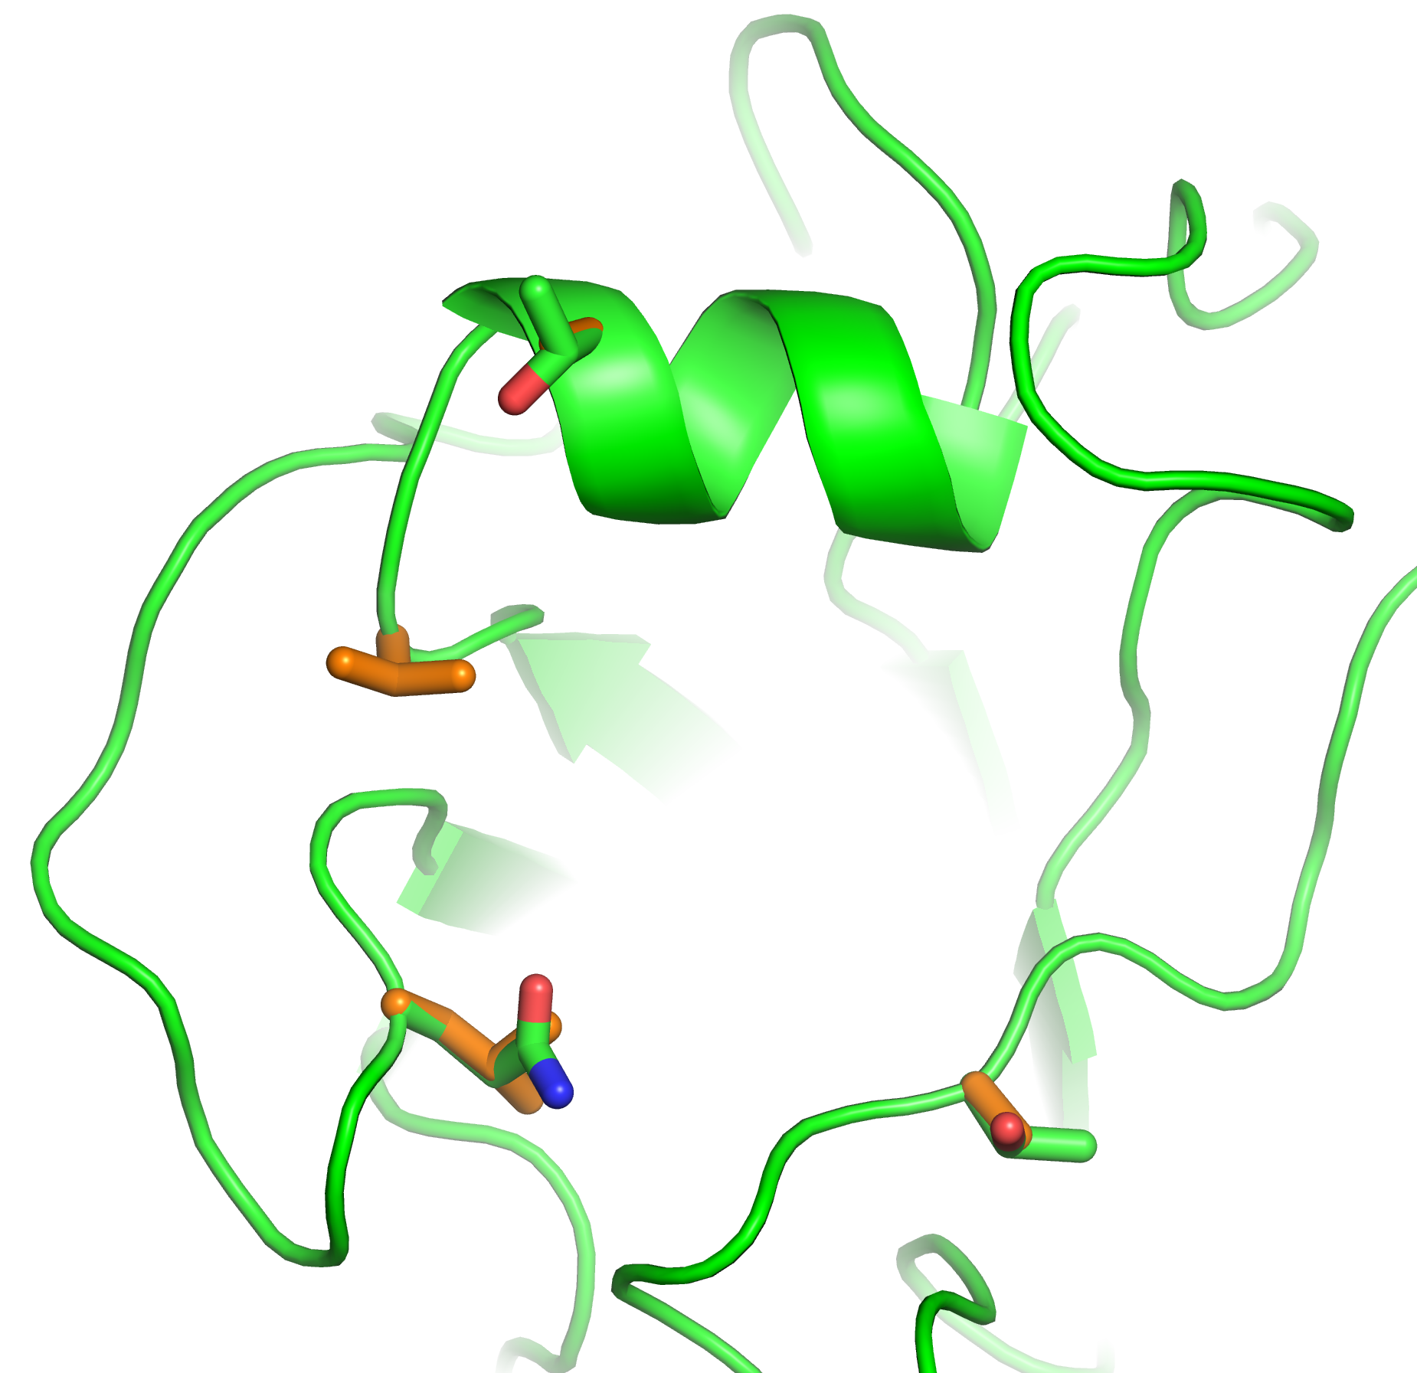
Receptor Binding Alteration Compared to Other Avian H7 Viruses
Asian H7N9: orange
Netherlands: green
180
A or T
Minimal impact on the RBS
190-helix
150-loop
Points towards the RBS pocket; reduce α2-3 interactions
177
V or G
217
L or Q
125
A or T
130-loop
Equivalent to residue 226 in H3 numbering. Crucial for switching between α2-3 and α2-6 receptor specificity
220-loop
Glycosylation site at position 125 not present in Anhui/1/2013 HA
Angela Yang/James Stevens

Slide 26
A(H7N9) Receptor Binding Site (RBS) Mutations
RBS at positions 226 and 228 (H3 numbering)
98% of LPAI viruses from humans, birds and environment | 226L/228G (indicates decreased binding to alpha 2-3 receptors)
Less then 1% of LPAI viruses | 226Q/228G (H7 avian consensus); majority of HPAI H7N9 viruses are 226Q
Less than 1% of viruses | 226I/228G (point mutation change to isoleucine)
Less than 1% of viruses | 226P/228G (point mutation to proline)

Slide 27
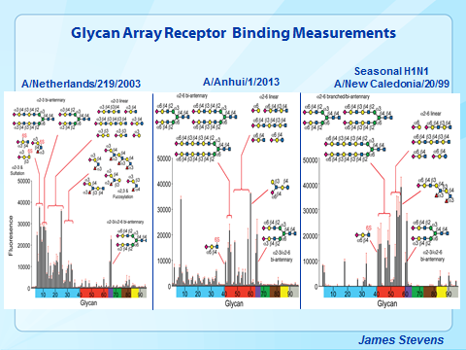
Notes:
No citations for these images.

Slide 28
Genetic diversity among H7N9 viruses found in internal genes
A/Jiangsu/2/2013_H7N9
A/Zhejiang/22/2013_H7N9
A/Jiangsu/1/2013_H7N9
A/Zhejiang/DTID-ZJU05/2013_H7N9
A/Nanjing/1/2013_H7N9
A/Anhui/1/2013_H7N9
A/Nanjing/2/2013_H7N9
A/chicken/Shanghai/S1076/2013_H7N9
Internal genes derived from avian influenza A(H9N2) viruses circulating in China
At least 9 unique genotypes detected in China in first 2 waves (multiple reassortment events prior to or after emergence)
Viruses from southern China have somewhat different genotype from northern China
H7N9 virus is well-distributed across several regions of China
A/Zhenjiang/1/2013_H7N9
A/environment/Suzhou/14/2013_H7N9
A/Zhejiang/2/2013_H7N9
A/Zhejiang/DTID-ZJU01/2013_H7N9
A/Zhejiang/DTID-ZJU01/2013_H7N9
A/Wuxi/3/2013_H7N9
A/Zhejiang/20/2013_H7N9
A/environment/Suzhou/8/2013_H7N9
A/environment/Suzhou/8/2013_H7N9
A/Xuzhou/1/2013_H7N9
A/Changsha/2/2013_H7N9
A/Wuxi/2/2013_H7N9
A/Changsha/1/2013_H7N9
A/chicken/Zhejiang/SD033/2013_H7N9
A/Taiwan/T02081/2013_H7N9
A/Nanjing/4/2013_H7N9
A/Taiwan/1/2013_H7N9
A/environment/Zhenjiang/4/2013_H7N9
A/Shanghai/2/2013_H7N9
A/Shanghai/2/2013_H7N9
A/Anhui/1/2013_H7N9
A/Taiwan/1/2013_H7N9
A/Suzhou/3/2013_H7N9
A/Zhejiang/1/2013_H7N9
A/Shanghai/1/2013_H7N9
A/Nanjing/6/2013_H7N9
A/chicken/Zhejiang/SD007/2013_H7N9
A/Xuzhou/1/2013_H7N9
A/chicken/Dawang/1/2011_H9N2
A/Nanjing/7/2013_H7N9
A/chicken/Shuanggou/1/2011_H9N2
A/Suzhou/5/2013_H7N9
A/chicken/Xigou/1/2011_H9N2
A/Nanjing/4/2013_H7N9
A/environment/Shanghai/S1436/2013_H7N9
A/Wuxi/4/2013_H7N9
A/brambling/Beijing/16/2012_H9N2
A/Shanghai/1/2013_H7N9
A/chicken/Vietnam/OIE-1611/2012_H9N2
A/brambling/Beijing/16/2012_H9N2
A/environment/Shanghai/S1438/2013_H7N9
A/environment/Suzhou/14/2013_H7N9
A/environment/Shanghai/S1437/2013_H7N9
A/Zhejiang/22/2013_H7N9
A/chicken/Taixing/10/2010_H9N2
A/Zhejiang/DTID-ZJU05/2013_H7N9
A/chicken/Yangzhou/11/2010_H9N2
A/chicken/Shanghai/C1/2012_H9N2
A/chicken/Shandong/1231/2008_H9N2
A/chicken/Zhejiang/329/2011_H9N2
A/chicken/Shandong/SG2/2009_H9N2
A/chicken/Tibet/S1/2009_H9N2
A/environment/Zhenjiang/4/2013_H7N9
A/chicken/Tibet/S4/2009_H9N2
A/chicken/Zhejiang/Q1D4/2010_H9N2
A/chicken/China/AH-10-01/2010_H9N2
A/chicken/Shanghai/C2/2012_H9N2
A/chicken/Shandong/01/2010_H9N2
A/chicken/Shanghai/C3/2012_H9N2
A/chicken/Shandong/02/2009_H9N2
A/chicken/Jiangsu/Q3/2010_H9N2
A/environment/Xinjiang/6/2009_H5N1
A/chicken/Zhejiang/607/2011_H9N2
A/chicken/Shandong/12/2008_H9N2
A/chicken/Wuxi/7/2010_H9N2
A/environment/Chang Sha/6/2009_H9N2
A/chicken/Anhui/HF/2010_H9N2
A/chicken/Zhejiang/HJ/2007_H9N2
A/chicken/Tongshan/1/2011_H9N2
A/chicken/Shandong/HY/2009_H9N2
A/chicken/Jiawang/2/2011_H9N2
A/chicken/Shandong/KD/2009_H9N2
A/chicken/Yongcheng/1/2011_H9N2
A/chicken/Hubei/10/2009_H9N2
A/chicken/Qianzhou/12/2010_H9N2
A/chicken/Hunan/6108/2005_H9N2
A/chicken/Shandong/03/2010_H9N2
A/chicken/Hunan/4444/2005_H9N2
A/chicken/Hunan/5260/2005_H9N2
A/chicken/Shandong/H/2009_H9N2
A/chicken/Hebei/0329/2007_H9N2
A/chicken/Shandong/02/2010_H9N2
A/chicken/Shandong/LY/2006_H9N2
A/chicken/Shandong/BD/2010_H9N2
A/chicken/Shanghai/1/2002_H9N2
A/chicken/Guangdong/ZHJ/2011_H9N2
A/chicken/Shanghai/2/2002_H9N2
A/chicken/Guangdong/ZCY/2011_H9N2
A/duck/Zhejiang/3/2002_H9N2
A/chicken/Vietnam/NCVD-1156/2011_H9N2
A/chicken/Henan/1/2004_H9N2
A/canine/Guangxi/1/2011_H9N2
A/Hong Kong/5942/2013_H7N9
A/equine/Guangxi/3/2011_H9N2
A/Guangdong/1/2013_H7N9
PB2
A/Hong Kong/5942/2013_H7N9
NS
A/Guangdong/02/2013_H7N9
A/Guangdong/1/2013_H7N9
A/swine/Taizhou/5/2008_H9N2
A/Guangdong/02/2013_H7N9
A/chicken/Vietnam/NCVD-1156/2011_H9N2
A/chicken/Jiangsu/Q3/2010_H9N2
Notes:
No citations for these images.

Slide 29
Molecular-based surveillance of A(H7N9) viruses indicated stability of mutations associated with mammalian adaptation, transmission, virulence and susceptibility to antiviral drugs
Gene | Mutation(s) | Phenotype | H7N9 viruses
NA | R292K | Marker of decreased susceptibility to neuraminidase inhibitors | ~10% of human viruses in the 5th wave
PB2 | 89V E627K D701N | Increased virulence in mice Increased virulence in mice Mammalian host adaptation, increased virulence and transmission | All viruses Few human viruses have 627E, all avian/environmental are 627E Multiple human viruses have 701N
PB1 | H99Y/I368V | H5 virus transmissible among ferrets | All viruses 99H; majority have 368V
M1 | N30D/T215A | Increased virulence in mice | All viruses
M2 | S31N | Decreased susceptibility to adamantane drugs | All viruses
NS | P42S PDZ ligand | Increased virulence in mice Increased virulence in mice | All viruses All viruses are truncated

Slide 30

Evolution of Influenza A(H7) HA, China
S118N
A/Jiangsu/60466/2016 H7N9 *
V170I
A/Zhejiang/6/2016 H7N9 *
T126A/T V262A
A/Jiangsu/60451/2016 H7N9 *
A/Fujian/02152/2017 H7N9
L217I
A/Anhui/60936/2016 H7N9 *
I120T
A/Zhejiang/13/2016 H7N9 *
A/Hunan/02285/2017 H7N9
A/Jiangsu/60459/2016 H7N9 *
V214F
R130K
A/Jiangsu/60457/2016 H7N9 *
A/Jiangsu/60458/2016 H7N9 *
A/Zhejiang/11/2016 H7N9 *
A/Zhejiang/14/2016 H7N9 *
A/Jiangsu/60447/2016 H7N9 *
A/Zhejiang/16/2016 H7N9 *
S127N/S
A/Zhejiang/10/2016 H7N9 *
A/Jiangsu/60450/2016 H7N9 *
G261R/G D271G
Reassortant vaccine candidate in red
CDC HI reference viruses in blue
Viruses analyzed by CDC
5th epidemic H7N9 viruses
Tree branches of human viruses are in red (─)
Amino acid differences shown are relative to A/Shanghai/2/2013
A/Hong Kong/VB16064646/2016 H7N9 *
A/Zhejiang/9/2016 H7N9 *
P208T
A/Anhui/60932/2016 H7N9 *
A/Anhui/60931/2016 H7N9 *
D271N
R130K
A/Anhui/60933/2016 H7N9 *
R298K
A/Anhui/60935/2016 H7N9 *
S281N/S
A/Anhui/60934/2016 H7N9 *
A/Anhui/60926/2016 H7N9 *
A/Environment/Guangdong/43966/2016 H7N9 *
S118N
R130K
A/Hong Kong/125/2017 H7N9
A/Hong Kong/4553/2016 H7N9 *
G261E
A/Hubei/39269/2016 H7N9 *
R130K
A/Beijing/39450/2016 H7N9 *
R130K
A/Beijing/44066/2016 H7N9 *
R130K
A/Hebei/38604/2016 H7N9 *
R130K N282S
A266D
A/Environment/Hebei/40053/2016 H7N9 *
R130M N267Y
A/Environment/Hebei/40049/2016 H7N9 *
R130K
T122I M256I
A/Environment/Hebei/40052/2016 H7N9 *
R130M
R130K
A/Jiangsu/15026/2016 H7N9 *
T59A
A/Hong Kong/793/2016 H7N9 *
A/Anhui/45322/2016 H7N9 *
A/Fujian/30766/2016 H7N9 *
A/Hunan/02650/2016 H7N9 *
A128V/A
R130K
A/Fujian/4/2016 H7N9 *
A/Fujian/17527/2016 H7N9 *
A/Fujian/54840/2016 H7N9 *
K184N
Eastern China / Yangtze River Delta lineage
A/Fujian/45970/2016 H7N9 *
K184N/K
A/Fujian/5/2016 H7N9 *
A/Jiangsu/15027/2016 H7N9 *
K184N/K
A/Liaoning/44068/2016 H7N9 *
A/Jiangsu/05155/2016 H7N9 *
A112T M227I
S127G
A/Tianjin/43917/2016 H7N9 *
A/Hunan/04137/2016 H7N9 *
A/Hunan/04135/2016 H7N9 *
A/Guangdong/16SF007/2016 H7N9 *
I120T
A/Fujian/3/2016 H7N9 *
R130N
A/Hunan/06196/2016 H7N9 *
A/Anhui/26835/2016 H7N9 *
R130K
A/Guangdong/15SF871/2015 H7N9 *
A/Environment/Guangdong/15125/2016 H7N9 *
A/Fujian/30767/2016 H7N9 *
S118N R130K V264I I317V
A/Fujian/8/2016 H7N9 *
A/Jiangsu/60454/2016 H7N9 *
S118N R130K R303K
A/Jiangsu/60460/2016 H7N9 *
A/Jiangsu/60456/2016 H7N9 *
S118N R130K
M227L A292T
A/Hunan/02286/2017 H7N9
A/Zhejiang/12/2016 H7N9 *
A/duck/Jiangsu/J3619/2014 H7N9
A/Jiangsu/03753/2016 H7N9 *
A/Hebei/46587/2016 H7N9 *
I38V A112T
S118N R130K
A/Jiangsu/06307/2014 H7N9
P212Q/P
T59I
N17D A266V
A/Environment/Jiangsu/03758/2015 H7N9 *
M256I I280V
A/Jiangsu/03756/2016 H7N9 *
S218F M227I
S118N
I258V
A/Jiangsu/15028/2016 H7N9 *
A/Zhejiang/15/2016 H7N9 *
D367Y/D
A/Anhui/26837/2016 H7N9 *
V86F
A/Anhui/26836/2016 H7N9 *
A/Anhui/40094/2015 H7N9
A125V
A/Beijing/40610/2015 H7N9 *
A/Quzhou/1/2015 H7N9 *
A/duck/Wenzhou/YJYF24/2015 H7N9 *
A/Guangdong/MZ828/2015 H7N9 *
A/Environment/Guangdong/15120/2016 H7N9 *
S118N
A112S
A/Guizhou/03240/2015 H7N9 *
A/Environment/Guangdong/15123/2016 H7N9 *
A/Fujian/09273/2015 H7N9 *
G23E K319R
A/Chicken/Guangdong/SW154/2015 H7N9 *
A/Fujian/10/2015 H7N9 *
A/Shantou/2004/2015 H7N9
G133E
D109E P206L
A/Fujian/06198/2016 H7N9 *
A/chicken/Wenzhou/HATSLG01/2015 H7N9 *
A/Fujian/1/2016 H7N9 *
I101V R130K N282S
A/Hunan/06197/2016 H7N9 *
A/Environment/Hunan/10125/2015 H7N9 *
V49I
A/Environment/Hunan/10086/2016 H7N9 *
A/Jiangsu/19758/2015 H7N9 *
A/chicken/Anhui/A1065/2014 H7N9
R103K M256I D271I
S118N
R130K S134P
A/Xinjiang/98692/2014 H7N9
E269V
L168I
A/duck/Anhui/A1618/2014 H7N9
A/Xinjiang/05845/2015 H7N9 *
S118N I288V
A/chicken/China/028/2014 H7N9
A/Huai'an/001/2015 H7N9 *
I108L S218F I258V D289N
N37S S290R
A/Fujian/27/2015 H7N9
S118N
A/British Columbia/1/2015 H7N9 *
K184N
A/Fujian/18/2015 H7N9 *
G216D
A/goose/Jiangsu/J1111/2014 H7N9
A/Fujian/5/2015 H7N9
A/Taiwan/2/2014 H7N9
A/Taiwan/1/2014 H7N9
R346K/R
A/Huzhou/5/2013 H7N9
A/duck/Jiangxi/15044/2014
S304G
A/Shanghai/PD-01/2014
P206S E269K
A/Shanghai/Mix1/2014 H7N9
A/Shanghai/01/2014 H7N9
A/Taiwan/3/2013 H7N9
R252K
A/Shanghai/5190T/2013 H7N9
A/Taiwan/1/2013 H7N9
L217P S281N
A/pigeon/Zhejiang/P2/2013 H7N9
L217Q
A/Taiwan/T02081/2013 H7N9
A/Zhenjiang/1/2013 H7N9
R47M
A/Zhejiang/HZ1/2013 H7N9
A/Zhejiang/DTID-ZJU02/2013 H7N9
N190S
A/chicken/Jiangsu/S002/2013 H7N9
A/Xuzhou/1/2013 H7N9
A/Suzhou/5/2013 H7N9
A/Nanjing/6/2013 H7N9
A/Huzhou/10/2013 H7N9
S127G R211G
A/Nanjing/7/2013 H7N9
R47K
A/Wuxi/3/2013 H7N9
A/Huzhou/1/2013 H7N9
A/Zhejiang/DTID-ZJU05/2013 H7N9
V24G
A/Zhejiang/DTID-ZJU08/2013 H7N9
L57R
A/Shanghai/07/2013 H7N9
I38F L57R
A/Changsha/1/2013 H7N9
A/Beijing/1/2013 H7N9
A/chicken/Guangdong/SD641/2013 H7N9
A/Shanghai/2/2013 H7N9
A/Wuxi/1/2013 H7N9
A/Anhui/1/2013 H7N9
Q213P
A/Zhejiang/DTID-ZJU10/2013 H7N9
A/Zhejiang/22/2013 H7N9
A/chicken/Jilin/SD020/2014 H7N2
A/Jiangsu/98342/2014 H7N9
L168I S290N zzz
R47K R303K
A/silkie chicken/Jiangxi/9469/2014
A125V
V49I I280T
A/Zhejiang/LS01/2014 H7N9
A125T
A/Zhejiang/1/2016 H7N9 *
T36K D109E z
A/chicken/Shanghai/PD-CN-02/2014
A/chicken/Zhangzhou/8585/2014
A/duck/Wenzhou/RAQL10/2015 H7N9 *
E104G V177A S237N D246V
A/silkie chicken/Huzhou/4213/2013
A/Huai'an/083/2014 H7N9
K2R R130K Q154H
A/Hong Kong/214/2017 H7N9
E104K
Southern China / Pearl River Delta lineage
N267D
M227I
N190S
A/Hong Kong/61/2016 H7N9 *
E104K N282K
A/Hong Kong/VB16049808/2016 H7N9 *
A/Guangdong/60923/2016 H7N9 *
E104R T156N T179I
A/chicken/Shantou/1550/2014
E104K
L168I
A/Hong Kong/8122430/2014 H7N9
A/chicken/Guangdong/G1381/2014 H7N9
A9S
R47K N267D
A/Hong Kong/5581/2014 H7N9
A74T S275N
A/chicken/Dongguan/1100/2014 mixed
A/Hong Kong/4495/2014 H7N9
A/Hong Kong/8194273/2014 H7N9
R47K I78V V262A N282K
E104K
V177A
N267D
A/Duck/Guangdong/DG103/2015 H7N9 *
M256I
A/Environment/Guangdong/DG127/2015 H7N9 *
N37S
A/Guangdong/02496/2014 H7N9
A210E
G276R
A/Hong Kong/2550/2015 H7N9 *
A/Hong Kong/8130773/2015 H7N9 *
E25V T194I S207I
A/Chicken/Guangdong/DG592/2014 H7N9
R47K
A/Duck/Guangdong/DG527/2014 H7N9
I280M
A/Hong Kong/5731/2014 H7N9
A/Guangdong/15SF010/2015 H7N9 *
I108L S134P Q213P G216A M227I S237N M256I N267D
A/Hong Kong/3263/2014 H7N9
V264I N267G
A/Hong Kong/2212982/2014 H7N9
A/silkie chicken/Dongguan/1264/2014
V49I
D246E
A/chicken/Shenzhen/138/2014
R47K
A/silkie chicken/Shantou/1406/2014
A/environment/Guangzhou/XN12917/2014 H7N9
A/Hong Kong/8113530/2014 H7N9
A/environment/Guangzhou/XN07390/2014 H7N9
R47K T122A
A/Guangzhou/1/2014 H7N9
0.0025
A/Shenzhen/SP-W1/2014
N282S
A/Guangdong/1/2013 H7N9
N267D
A/Hong Kong/470129/2013 H7N9
A/Hong Kong/5942/2013 H7N9
A/Hong Kong/734/2014 H7N9
V86I R130K N282S
T122A
A/chicken/Shenzhen/712/2013 mixed
T116K
R47K
A/Guangdong/03/2013 H7N9
R47K L217Q
A/wild pigeon/Jiangsu/SD001/2013 H7N9
A/chicken/Guangzhou/1/2013 H7N9
Apr-2015
Apr-2016
A/chicken/Zhejiang/C481/2013 H7N9
Apr-2013
Oct-2016
Oct-2013
Apr-2014
May-2016
May-2014
Nov-2016
Nov-2014
Dec-2014
May-2013
Dec-2015
Dec-2016
Nov-2013
Dec-2013
Jun-2016
Jul-2016
Jun-2014
Jan-2017
Jan-2015
Feb-2015
Jan-2016
Feb-2016
Feb-2013
Mar-2016
Mar-2013
Jul-2013
Aug-2013
Jan-2014
Feb-2014
A/chicken/Shanghai/S1410/2013 H7N9
L217Q
Mar-2014
A/Shanghai/JS01/2013 H7N9
A/pigeon/Wuxi/0405007G/2013 H7N9
G119E L217Q
A/Shanghai/1/2013 H7N9
S165N V177G V205A P212T L217Q N267D
A128S S165N V177G P212T L217Q N267D H274Y
Notes:
No citations for this image.

Slide 31
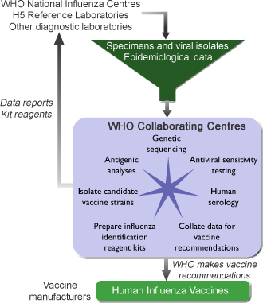
WHO Global Influenza Surveillance and Response System (GISRS)
Surveillance and Vaccine Development

Slide 32
Global Influenza Surveillance Network
Disease surveillance: Determine the extent and severity of epidemics / pandemics
  networks of sentinel physicians
  mortality due to pneumonia and influenza (P&I)
Virologic surveillance: Determine antigenic and genetic properties of viruses that are circulating
  antigenic analysis using HAI, neutralization tests
  sequence analysis of HA, NA / full genomes
  screening for resistance to amantadine / rimantadine and neuraminidase inhibitors
  Create diagnostic tools for circulating viruses

Slide 33
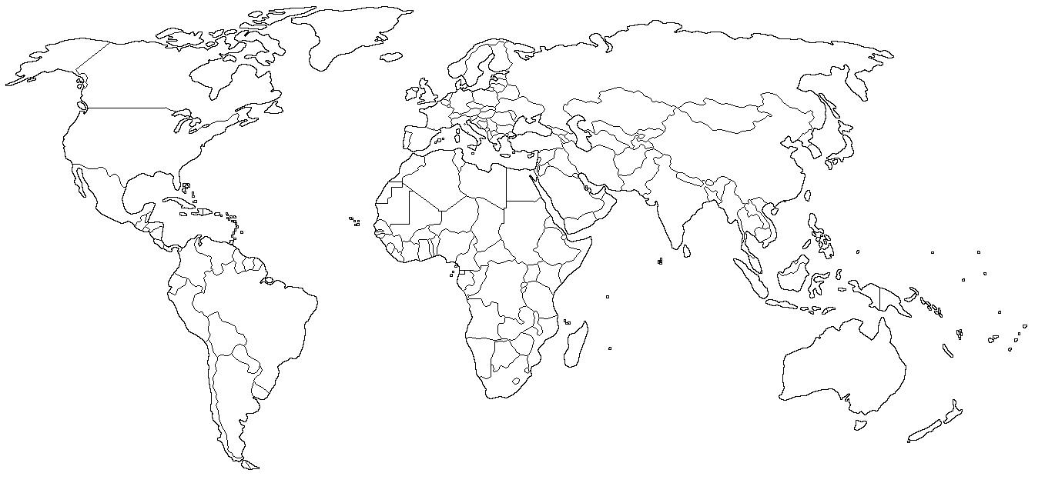
WHO Vaccine Recommendations
Northern Hemisphere Season: November – April
WHO Vaccine Recommendation: February
London
Beijing
Tokyo
Atlanta
Memphis
Melbourne
Southern Hemisphere Season: April – September
WHO Vaccine Recommendation: September
Notes:
No citations for this image

Slide 34
Considerations for New Vaccine Strain Recommendations
Are there new antigenic variants?
  Antigenic and genetic characterization
Are new variants spreading?
  Influenza activity and isolation of variants
Are current vaccines able to induce antibodies to the new variants?
  Serological evaluation of vaccinated individuals
Are any new variants useful for vaccine production?
  Egg isolate
  High growth in egg reassortants

Slide 35
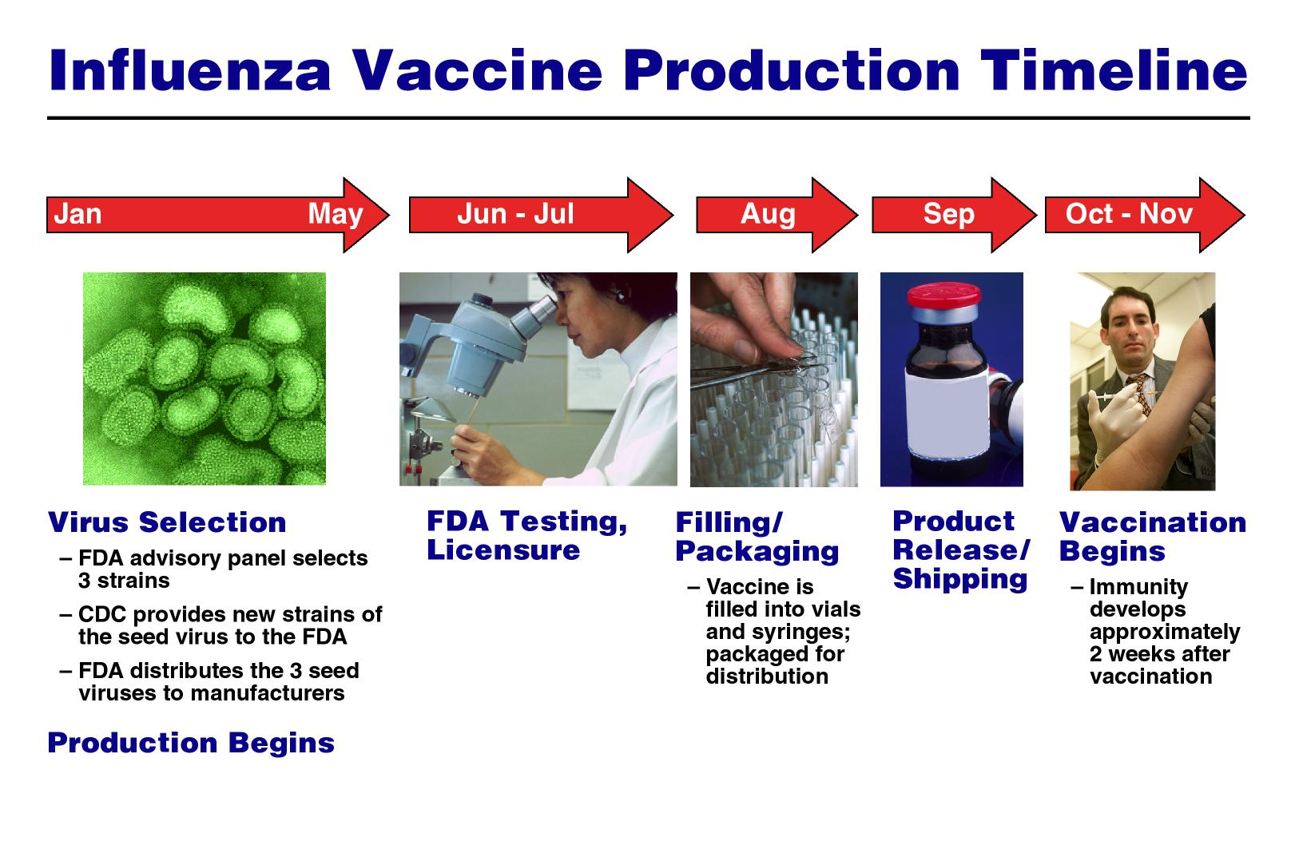
Vaccine Strain Selection:
Time Line
Note: FDA is the U.S. Food and Drug Administration
Notes:
No citations for these images, which are all grouped.

Slide 36



Egg-Based Production Time
Respiratory Specimens Positive for Influenza, USA
800
A(H3)
20
720
A(H1)
18
A(Unsubtyped)
640
B
Vaccine production
16
560
14
480
Percent Positive
Number of Isolates
12
400
10
320
8
240
6
160
4
80
2
0
0
40
42
44
46
48
50
52
2
4
6
8
10
12
14
16
18
20
Week
Notes:
No citations for these images.

Slide 37
Northern Hemisphere Season
Respiratory Specimens Positive for Influenza, USA
2500
A(H3)
40
A(H1)
36
A(Unsubtyped)
2000
B
32
28
1500
Percent Positive
Number of Isolates
24
20
1000
16
12
500
8
4
0
0
40
42
44
46
48
50
52
2
4
6
8
10
12
14
16
18
20
Week
Notes:
No citations for these images.

Slide 38
When Genetic Drift Leads to Antigenic Drift
Nucleotide changes can be silent (synonymous) or result in an amino acid change (non-synonymous)
If the amino acid change is in an antigenic site (regions where antibodies bind) of a surface protein (HA and/or NA) then antigenic drift can occur
Antigenic drift: antibodies to the previous strain no longer recognize new strain
A new vaccine is needed!
B
A
D
E
C
Notes:
No citations for this image

Slide 39
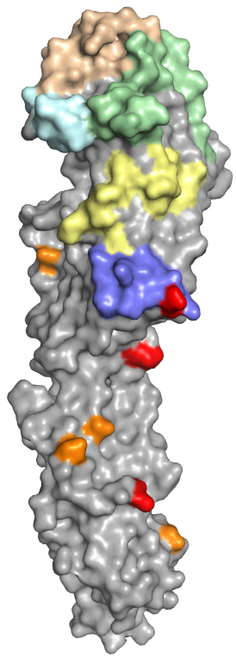
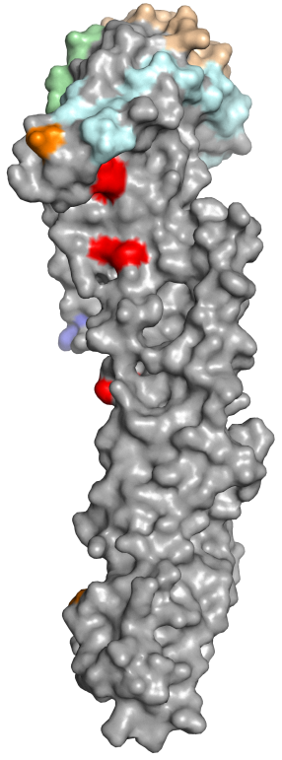
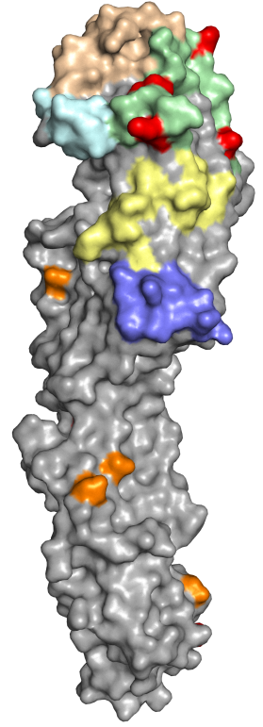
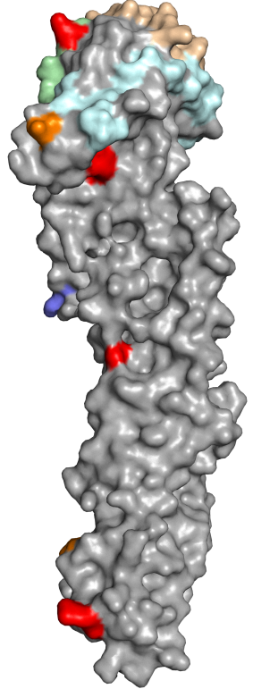
A(H7N9) 5th wave hemagglutinin changes compared to A/Shanghai/2/2013 (candidate vaccine virus)
Pearl River Delta lineage
Yangtze River Delta lineage
S118N
M227I
A125V
M227I
R130K
A112T
E104K
L168I
L168I
N267D
E378A
N282K
180° rotation
180° rotation
D340N
Not visible
V425I
S485R
Site A - green
Site B - brownish
Site C - dark blue
Site D - cyan
Site E - yellow
CHO – orange
HA2 changes in red
Notes:
No citations for these images.

Slide 40
A/Fujian/02152/2017
93
A/Jiangsu/06463/2017
89
A/Jiangsu/06454/2017
A/Anhui/60936/2016
A/Jiangsu/15027/2016
A/Jiangsu/60466/2016
A/Hunan/04137/2016
A/Jiangsu/15026/2016
A/Hunan/02650/2016
A/chicken/Fujian/11089/2016
A/silkie chicken/Shantou/9473/2016
A/Anhui/60933/2016
A/Liaoning/44068/2016
A/Tianjin/43917/2016
A/Hubei/39269/2016
A/chicken/Fujian/11766/2016
A/Hong Kong/4553/2016
A/Hong Kong/125/2017
A/Fujian/30767/2016
A/Fujian/45970/2016
A/Fujian/54840/2016
98
A/Beijing/44066/2016
A/Hebei/38604/2016
Yangtze River Delta
A/Anhui/45322/2016
A/Jiangsu/60460/2016
P
E
I
P
K
G
-
-
-
-
R
G
A/Jiangsu/18828/2014
A/Hunan/06196/2016
P
E
V
P
K
R
K
R
T
A
R
G
98
A/Jiangsu/03753/2016
A/Hunan/06948/2017
A/Hebei/46586/2016
A/Jiangsu/15028/2016
A/chicken/Wenzhou/WZTSLG02/2015
A/Taiwan/1/2017
100
A/Guangdong/17SF003/2016
A/Guangdong/17SF006/2017
71
A/chicken/Jiangxi/14879/2015
A/Environment/Guangdong/C16283222/2016
A/Hunan/02287/2017
A/chicken/Guangzhou/4954/2016
86
A/Fujian/1/2016
A/Xinjiang/05916/2014
88
100
A/Fujian/18/2015
83
A/Taiwan/2/2014
A/British_Columbia/1/2015
A/Environment/Jiangsu/03137/2013
A/chicken/Jiangxi/18482/2014
A/Taiwan/1/2014
A/chicken/Wuxi/SC4315/2015
A/chicken/Guangzhou/1083/2016
A/Guangdong/60923/2016
95
A/Hong Kong/VB16049808/2016
87
A/Guangdong/60061/2016
A/Hong Kong/VB16189623/2016
87
100
A/Hong Kong/214/2017
Pearl River Delta
70
A/Guangdong/60060/2016
A/Guangdong/17SF004/2017
A/Shenzhen/SP195/2015
A/Hong Kong/8130773/2015
A/Guangdong/0012/2014
A/chicken/GD/874/2014
A/Guangdong-Guangzhou/XN08763/2014
A/Guangzhou/1/2014
A/Guangdong/SP38/2014
A/Anhui/02/2013
A/Hong Kong/5942/2013
A/Shandong/01/2014
A/chicken/Wenzhou/201/2014
93
A/Zhejiang/17/2014_W2-4
A/Zhejiang/1/2016
76
A/chicken/Shaoxing/5201/2013
A/ZJ/22/2013
A/Huaian/065/2014
88
A/Fujian/15/2014
A/Shanghai/14/2013
A/Jiangsu/09387/2014
A/Anhui/1/2013
A/Beijing/01-A/2013
A/Shanghai/2/2013
A/ZJ/DTID-ZJU05/2013
85
A/shanghai/05/2013
A/Shanghai/1/2013
0.005
Notes:
No citations for these images.

Slide 41
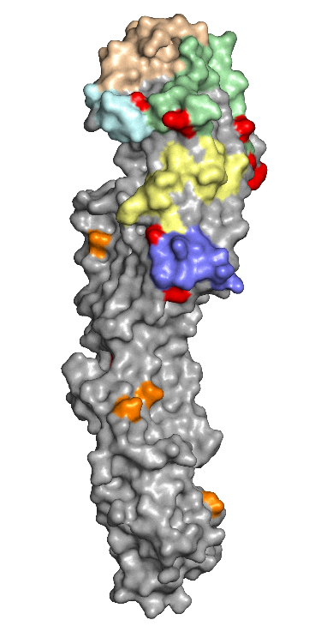
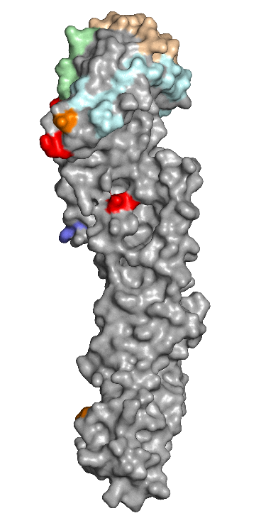
Genetic changes Identified in HPAI A(H7N9) Viruses
A/Guangdong/17SF003/2016 HPAI
K130R
L217Q
T112P
R163K
E389K
G261R
K164E
I38T
180° rotation
Cleavage site has polybasic insertion (KRTA)
Not visible:
I317V
V425I
Notes:
No citations for this image

Slide 42
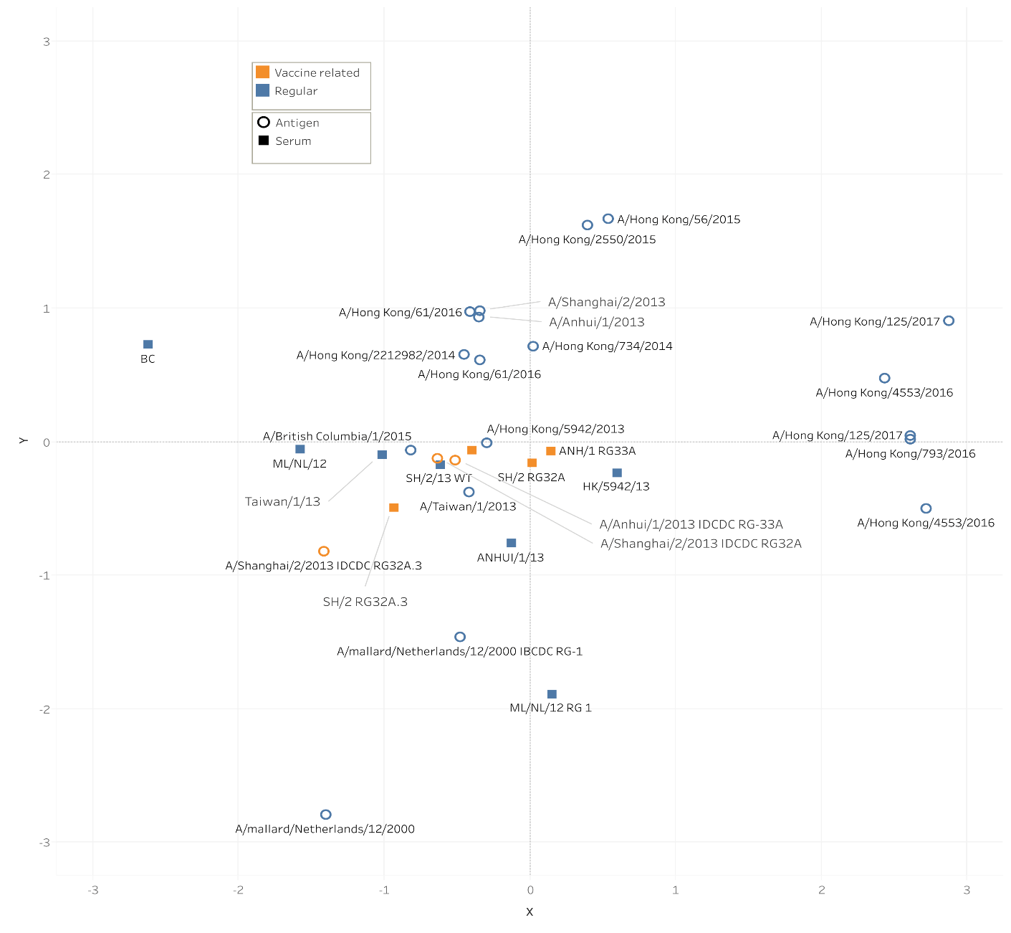
A(H7N9) Antigenic Cartography
Antigenic relationships of current and previous A(H7N9) viruses performed by CDC
Antigenic analysis indicated some viruses from Eastern China lineage have reduced cross-reactivity with existing candidate vaccine viruses
Serum raised to current CVVs
Antigens
Pearl River delta lineage isolates
Notes:
No citation for this image

Slide 43
A(H7N9) Antigenic Cartography
Antigenic relationships of current and previous A(H7N9) viruses performed by CDC
Antigenic analysis indicated some viruses from Eastern China lineage have reduced cross-reactivity with existing candidate vaccine viruses
Serum raised to current CVVs
Antigens
Yangtze River delta lineage isolates
Notes:
Anhui/1 wt virus and Anhui/1 RG33A CVV were 4-fold down comparing homologous to heterologous titers
Shanghai/2 wt virus were 4 to 8-fold down
Shanghai/2 CVV RG32A virus were 4 to 8-fold down
Both Anhui/1 and Shanghai/2 wt and CVVs were 2-fold down or equivalent comparing homologous to heterologous titers
No citation for this image

Slide 44
A(H7N9) Antigenic Cartography
Antigenic relationships of HPAI A(H7N9) viruses performed by CDC
Antigenic analysis indicated have reduced cross-reactivity with existing candidate vaccine viruses
Serum raised to current CVVs
Antigens
HPAI A(H7N9) isolates
Notes:
Anhui/1 wt virus and Anhui/1 RG33A CVV were 4-fold down comparing homologous to heterologous titers
Shanghai/2 wt virus were 4 to 8-fold down
Shanghai/2 CVV RG32A virus were 4 to 8-fold down
Both Anhui/1 and Shanghai/2 wt and CVVs were 2-fold down or equivalent comparing homologous to heterologous titers
No citation for this image

Slide 45


Engineering Candidate Vaccine Viruses (CVVs) for A(H7N9)
CDC
A/Hong Kong/125/2017 RG56B
CDC
A/Hong Kong/125/2017 +
RG56N
A/Guangdong/17SF003/2016 HPAI
Development by NIBSC, UK and China CDC
AS-A
K130R
K130R
AS-B
AS-D
L217Q
T112P
L217Q
T112P
R163K
AS-C
E389K
K164E
G261R
K164E
AS-E
I38T
180° rotation
CHO
Cleavage site has polybasic insertion (KRTA)
Not visible:
I317V
V425I
AS – Antigenic Site
CHO – Carbohydrate
HPAI-like (4 substitutions)
WHO-VCM HPAI Recommendation
David Wentworth, Vivien Dugan et al.

Slide 46
WHO Website for Vaccine Recommendations
http://www.who.int/influenza/vaccines/virus/recommendations/en/

Slide 47
The findings and conclusions in this presentation are those of the authors and do not necessarily represent the official position of the Centers for Disease Control and Prevention.
Questions?

