Slide 1




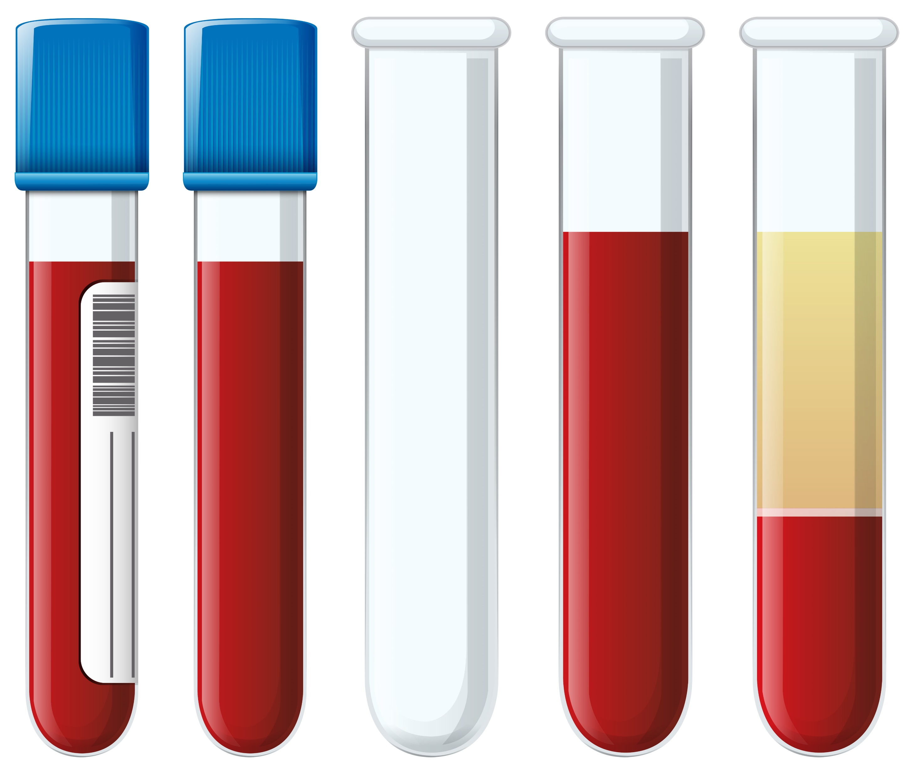



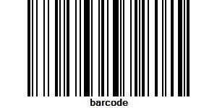


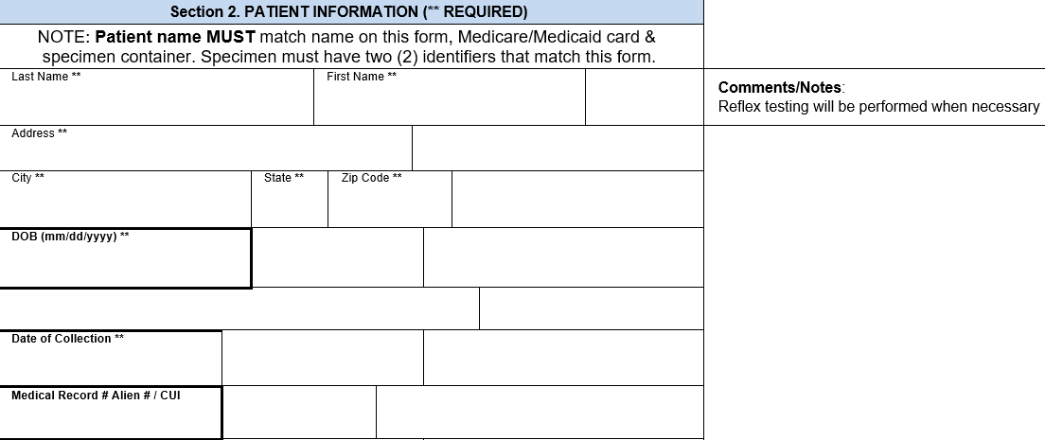






Guidelines for Proper Specimen Identification
All specimens submitted to DSHS for testing must be accurately labeled to ensure result integrity. Prior to shipment, please put at least two acceptable identifiers on the specimen container (tube, plate, etc.) that match the form exactly.
Specimens received with insufficient or mismatching identification will not be tested.
The specimen and form must have at least two acceptable identifiers that match exactly.
Acceptable Identifiers
Rejected Specimen Example
Acceptable Solutions
Full Patient Name
Date of Birth
Medical Record Number
CDC / Medicare / Medicaid Number
Unique Identification Number
Name is cut off and does not match form
Unique ID # does not match form
DOE, JOH
Doe, John
DOB: 07/09/1949
223410754
Rotate text to display full name and include
≥ 2 identifiers as backup.
223410754
Doe, John 45322581
Example Form
Legible handwritten corrections on specimens are accepted
Doe John
1100 W 49th St
Austin TX 78756
07/09/1949
12/14/2022
45322581
DOE, JOH
N
Common Rejection Reasons
Specimen container identifiers
do not match form
Lack of secondary identifier
Unlabeled specimen
Missing submission form
If applicable: Missing previous lab reports (such as prior antibiotic sensitivity tests)
Accessioning Code: 223410754
JOHN DOE
45322581
223410754
Write unique ID# in comments section or MRN box
*Note: Address and date of collection are required form items, but they are not considered acceptable specimen identifiers
For more information visit:
[Lab webpage URL]
[Lab email address]

