Slide 1
Document & Record Control
ISO 17025:2005
2017-01 v1.0

Slide 2

Terms and Acronyms
Documents: “say” what you are going to do
“e.g.”: for example (clarifying a statement)
“i.e.”: in other words (in essence; a finite list)
QMS: Quality Management System; the quality, administrative and technical systems that govern the operations of the laboratory
Records: “proof” of what you are doing/have done
SOP: Standard Operating Procedure

Slide 3

Documents
Documents are controlled within the Quality Management System (QMS)
What is the Quality Management System?
  Every part of the laboratory that management oversees
  Essentially everything
When ‘define’ and ‘specify’ are used in ISO 17025— it means the lab is expected to build a document that defines or specifies that “issue/item”
  ISO 17025:2005 4.1.5e) “define the organization and management structure of the laboratory, its place in the parent organization, etc…”
  ISO 17025:2005 4.1.5f) “specify the responsibility, authority and interrelationships of all personnel, etc…”

Slide 4
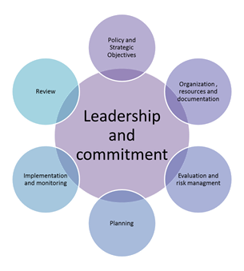
Quality Management System Documents
What are Policies?
  Rule of “what” you are going to do
What are Procedures?
  “How” you are going to do it
How do you know you are doing what you say you do?
  Review
  Monitor
  Audit (evaluate)

Slide 5
Which QMS Documents Need to be Covered by a Document Control System?
Policy Statements
Regulations and standards (e.g., AIHA, CLIA, NELAP)
Procedures, SOPs (Internal and External); Instructions
Notices, Memoranda
Job Descriptions
Plans (temporary) and Schedules
Arrangements (e.g., Memorandum of Understanding, Contracts, Grants)
Test Reports
Textbooks
Instrument Manuals, Software & Equipment Manuals
Posters, Charts, drawings, tables, forms
Specifications, Calibration tables
Flowcharts
Checklists
Excel spreadsheets with formulas
Audits (internal/external)
Software, etc.

Slide 6
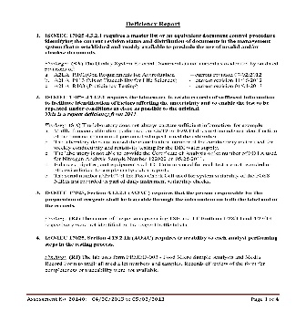
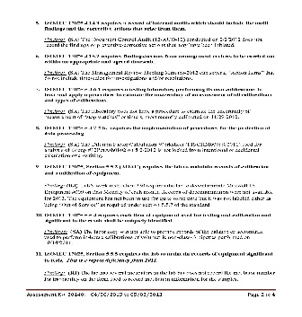
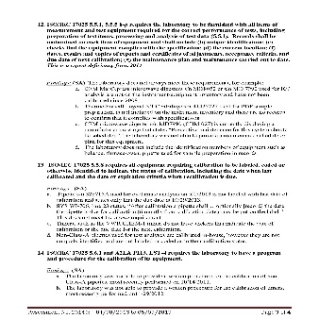
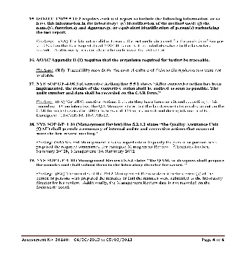
ISO 17025 Standard
Documents vs. Records
The ISO 17025 Standard distinguishes between documents (section 4.3) and records (section 4.13)
Each section has requirements that need to be met in order to comply with the standard
6

Slide 7

Documents
(SOPs, Quality Manual, etc.)
Establish and maintain procedure to control all documents that form QMS
Documents need to be reviewed and approved for use before issue
Establish a Master List of documents

Slide 8

Records
(Audit Reports, Test Reports, etc.)
  Records need to be Legible!!
Establish Procedures for
      Identification
      Collection
      Indexing
      Access
      Filing
      Storage
      Maintenance
      Disposal
Customer requirements drive record maintenance and security with minimum levels established
Procedures to protect and back up electronic records and to prevent unauthorized access or amendment

Slide 9
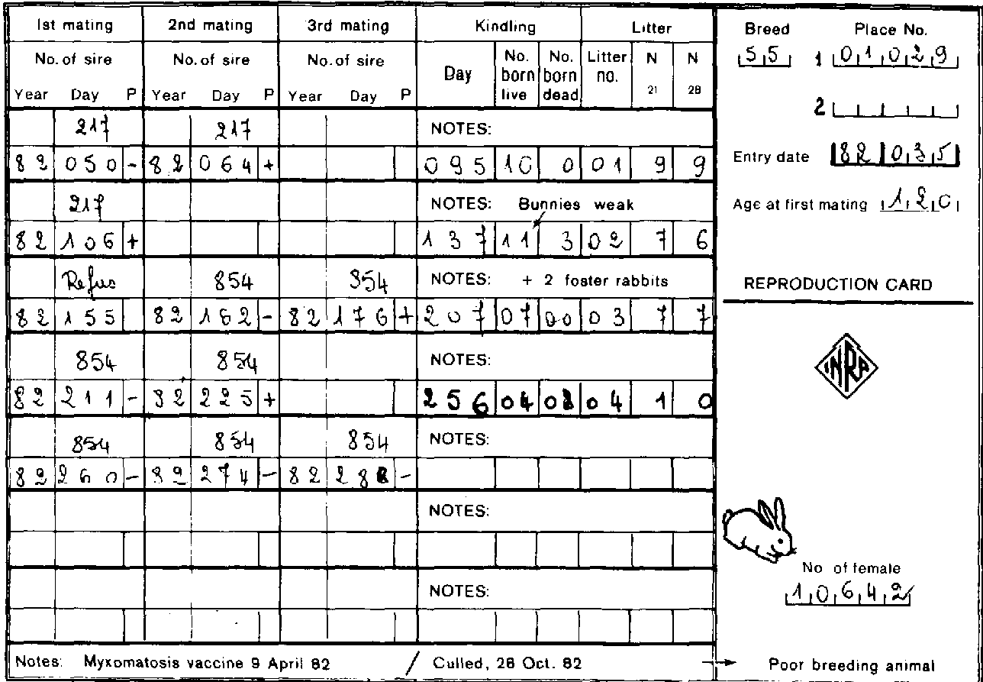
Technical Records
(Forms, Work Sheets, Control Graphs, etc.)
Retain records of original observations, derived data and sufficient information to establish an audit trail, calibration records, staff records, and a copy of each test report issued
Define how long technical records kept
Sufficient information to facilitate identification of factors affecting the uncertainty

Slide 10
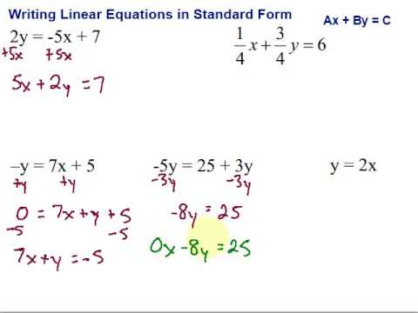
Technical Records
Records of each test/calibration contain sufficient information to enable test/calibration to be repeated under conditions as close as possible to the original (traceability)
Identity of personnel responsible for
  Sampling
  Performance of each test/calibration
  Checking of results

Slide 11
Technical Records
Observations, data and calculations recorded at the time they are made and identifiable to a specific task
Mistakes are crossed out (not erased or obviated), the correct information recorded alongside, along with the initials of the individual making the correction
Electronic records have the ability to track who is making any correction and be able to retain original information just as non-electronic records

Slide 12
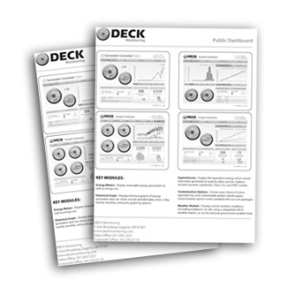
Why is Document Control needed?
To ensure that:
  Management is aware of, and has approved, all documents used by staff to guide them in their work (authority)
  All documents specifying procedures have been checked by those with appropriate knowledge (accuracy)
  There is a record of all copies of documents, so that they can be Reviewed, Withdrawn, or Amended
    They can be recalled and updates issued
    So all copies reflect the same procedure
    (consistency)

Slide 13
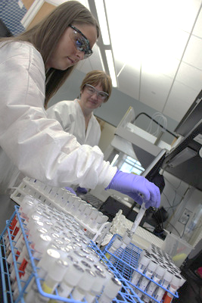
Why is Document Control needed?
Most importantly:
To ensure that all staff are using the most current SOP, form, policy or related document

Slide 14
What does a Documentation System Do?
It is a mechanism for defining the Quality Management System so that it is:
  A Consistent system
  A Secure system
  One that can be easily Monitored
It is a means to communicate to staff:
  What their responsibilities are
  What procedures and policies to follow

Slide 15

Can you still have Checklists, Templates, and Forms?
Absolutely!
They can be controlled in the same manner as Standard Operating Procedures (SOPs), policies, or other documents by making them attachments to the SOP
OR by identifying them as an independent document in the document system

Slide 16
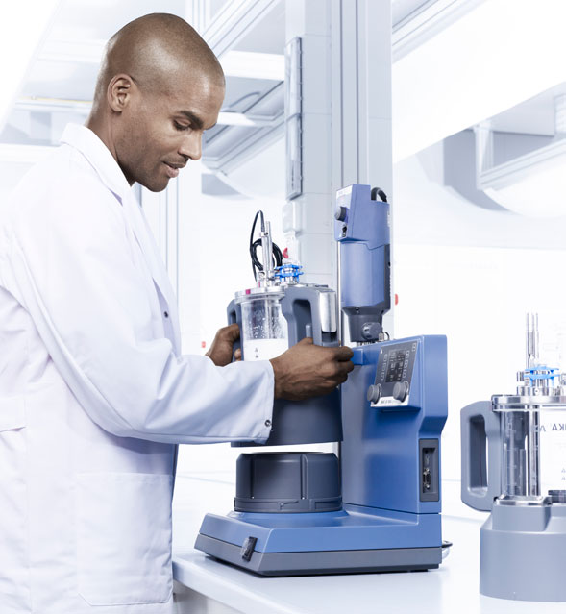
Why do we have to record so much information?
Reproducibility provides confidence in results and assures that results are not erroneous or random in nature and is one of the main principles of the scientific method
In order for results to be reproduced it is necessary to know (document) all the conditions (instruments used, environmental conditions, etc.) used to generate original results

Slide 17

Why do we have to record so much information?
Documenting, or being able to trace back, all the conditions that existed when the original analysis was done is how laboratories can assure their results can be reproduced
This is why so much record keeping is necessary

Slide 18
Controlling Documents Means:
Have a Master List system that:
  Identifies the current revision status
  Determines the location of the document
  Is updated to ensure no invalid or obsolete documents are in use
    Obsolete or archived documents must be retained for either legal or knowledge purposes and must be suitably marked (electronic or hardcopies)
    Obsolete or archived documents must be promptly removed from all points of use

Slide 19
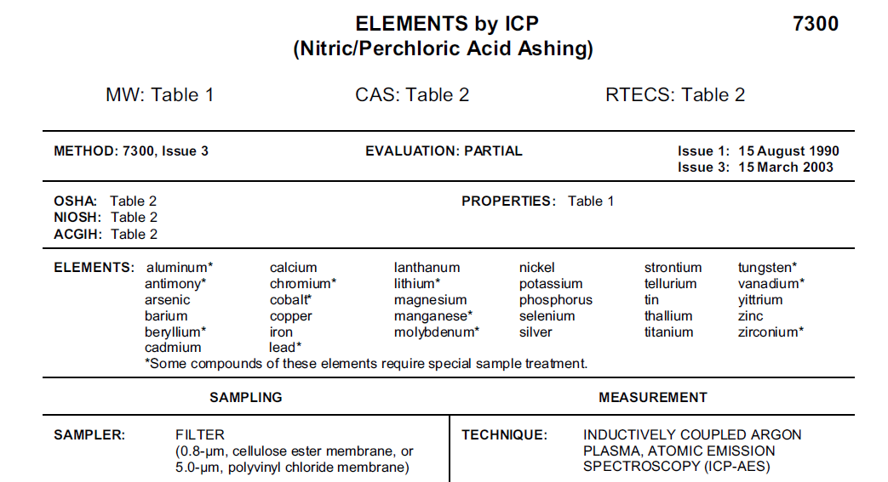
QMS Documents:
Must accurately reflect all phases of current laboratory activities, including:
  Assessing data integrity
  Corrective actions
  Handling customer complaints
  All methods (from laboratory SOPs to administration and support procedures)
May be a copy of a published or referenced method
  Modifications must be clearly described

Slide 20
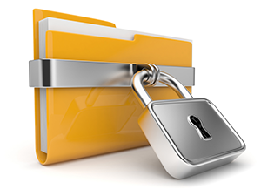
In Conclusion: Purpose of Controlled Documents
To establish a systematic process for documents to be:
  Developed
  Approved
  Edited
To assure they are:
  Up-to-date (especially important to many regulatory agencies, e.g., CLIA, NELAP, AIHA, etc.)
  Reviewed and where necessary, revised, in the proper time frame (at a minimum):
    QMP-annually
    Standard Operating Procedures-biennially (every 2 years)
    Policies (e.g., Quality Assurance Section Plans, etc.) every 3 years
  Uniquely identified (index # in iPassport™)
Authorized documents must be available to staff who will use them

