Slide 1




Sample Handling and Assuring the Quality of Test Results
QMS Quick Learning Activity
ISO/IEC 17025:2017
clauses 7.3, 7.4 and 7.7
www.aphl.org

Slide 2

Abbreviations and Acronyms
QC-Quality control

Slide 3
What will be covered in this training?
Sample Handling
  What does this encompass?
  What does the laboratory need to consider?
Quality Control (QC)
  What happens when QC fails?
  Proficiency testing

Slide 4
Connections
How are sample handling and QC related to each other?
  Results are only as good as the sample which is tested
  Ensuring proper sample handling supports the validity of testing
  Sample handling and QC also play a part in regulatory work by ensuring sample integrity and data defensibility

Slide 5
Sample Handling
7.4 Handling of test or calibration items*
7.4.1 The laboratory shall have a procedure for the transportation, receipt, handling, protection, storage, retention, and disposal or return of test or calibration items, including all provisions necessary to protect the integrity of the test or calibration item, and to protect the interests of the laboratory and the customer.
*italics is actual ISO text
  This also means the laboratory must be aware of any customer requirements for sample handling

Slide 6
Sample Handling
7.4.1 The laboratory must have procedures and facilities for avoiding deterioration, contamination, loss or damage to the test item during handling, storage/waiting, and preparation for testing.
  Any handling instructions that come with the sample must be followed
7.4.4 If samples must be stored or conditioned under specific environmental conditions, these conditions must be maintained, monitored, and recorded.

Slide 7
Sample Handling
7.4.2 The laboratory shall have a system for the unambiguous identification of test or calibration items.
  Retain the identification on the sample throughout its time in the laboratory (including conditions such as storing and destruction)
  Have procedures to avoid mixing up samples physically or in records
  Address subdividing and analysis of samples and retaining identity
  Address how to transfer items within and from the laboratory

Slide 8
Sample Handling
7.4.3 Upon receipt of a sample the laboratory must:
  Record deviations from normal or specified conditions
  Consult the customer if a sample may not be suitable for testing, does not conform to the description provided, or the requested test is not specified in sufficient detail
  Discussions with the customer and instructions received from the customer must be recorded

Slide 9
Ensuring the quality of test results
7.7 Ensuring the validity of results
The laboratory must have QC procedures
  For monitoring the validity of results (plan the monitoring, review the results) to ensure:
    Accuracy
    Precision
  Record QC results so that trends can be detected
  Apply statistical techniques to review of QC data, where practical

Slide 10
What does ISO/IEC 17025 require as a QC sample?
The standard does not require any specific QC sample. These are dictated by test methods and accreditation bodies.
The standard recommends are use of the following :
  Certified Reference Materials
  Internal QC using secondary Reference Materials
  Participation in proficiency testing or interlaboratory comparison programs
  Replicate tests using the same or different methods
  Retesting retained samples
  Correlation of results for different characteristics of a item

Slide 11

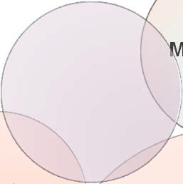
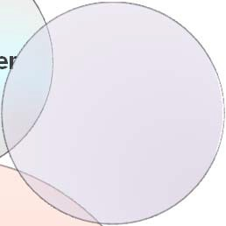








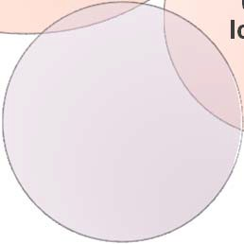



Most Accrediting Bodies Require Procedures and Documentation for:
M
anufactu
rer
Transport
Certificate of Authenticity
How to Purchase
Purity
Reagents, Reference Materials and Reference Standards
Dates of Use
Date of Receipt
Prepared by
Unique entifier
Id
E
xpiration
Storage conditions
QMS Quick Learning Activity

Slide 12
What happens when QC fails?
When QC is outside predefined criteria, planned action must be taken to:
  Correct the problem
  Prevent incorrect results from being reported
Key terms:
  Predefined criteria: The laboratory must define acceptance criteria for its routine QC
  Planned action: The laboratory must specify what to do if QC fails to meet acceptance criteria. This may be corrective action

Slide 13
Proficiency Testing
ISO/IEC 17025 does not require any particular amount or frequency of proficiency testing
Accrediting bodies have their own requirements for amount and frequency of proficiency testing that laboratories must follow
Additional information in Proficiency Testing QMS module

Slide 14









Summing it up: Sample Handling
How is the sample transported?
Courier
Mail
Sample handling includes ensuring the laboratory meets customer requirements, protects sample integrity, and provides appropriate security of samples
Who receives it?
Unique ID
Entry into LIMS
Are there special precautions in handling/storage?
Temperature
Humidity
Disposal
Who authorizes?
What method is used?
Write procedures for recording relevant data/information
Ensure staff are trained and authorized in all procedures

Slide 15
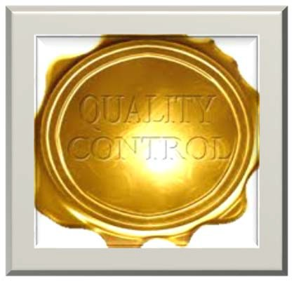
Summing it up: QC
QC - A system that compares performance against specific requirements and defined standards
QC data must be monitored, reviewed, and analyzed
Failing QC requires action
Proficiency testing is part of the
laboratory’s overall QC plan

Slide 16
Reference
ISO/IEC 17025:2017
–https://www.iso.org/standard/66912.html

