Slide 1




QMS Quick Learning Activity
Proficiency Testing
ISO/IEC 17025:2017
7.7 Ensuring the validity of results
www.aphl.org

Slide 2
Abbreviations and Acronyms
AAFCO – American Association of Feed Control Officials (www.aafco.org)
AB – Accrediting Body
ALACC – AOAC Analytical Laboratory Accreditation Criteria Committee
AOAC International–Organization that provides the ALACC guidelines (www.aoac.org)
CRM – Certified Reference Materials
EPA-Environmental Protection Agency
PDP-Pesticide Data Program
ppb-parts per billion
ppm-parts per million
PT– Proficiency Testing
RM – Reference Material

Slide 3
Abbreviations and Acronyms
Accrediting Bodies (ABs):
A2LA-American Association for Laboratory Accreditation
AIHA-American Industrial Hygiene Association
ANAB-ANSI National Accreditation Board
PJLA-Perry Johnson Laboratory Accreditation
IAS-International Accreditation Service

Slide 4
What ISO/IEC 17025 says
Section 7.7 Ensuring the Validity Results
7.7.1 The laboratory shall have a procedure for monitoring the validity of results. The resulting data shall be recorded in such a way that trends are detectable and, where practicable, statistical techniques shall be applied to review the results. This monitoring shall be planned and reviewed and shall include, where appropriate, but not be limited to:…

Slide 5
ISO Section 7.7.1 continued
Use of reference materials or quality control materials
Participation in interlaboratory comparison (or proficiency testing programs)
Replicate tests or calibrations using the same or
different methods
Retesting or recalibration of retained items
Correlation of results for different characteristics of an item.
Note: The selected methods should be appropriate for the type and volume of work undertaken.

Slide 6
ISO/IEC 17025 section 7.7.2
7.7.2 The laboratory shall monitor its performance by comparison with results of other laboratories, where available and appropriate. This monitoring shall be planned and reviewed and shall include, but not be limited to, either or both of the following:
participation in proficiency testing;
NOTE ISO/IEC 17043 contains additional information on proficiency tests and proficiency testing providers. Proficiency testing providers that meet the requirements of ISO/IEC 17043 are considered to be competent.
participation in interlaboratory comparisons other than proficiency testing.

Slide 7
ISO/IEC 17025 section 7.7.3
7.7.3 Data from monitoring activities shall be analysed, used to control and, if applicable, improve the laboratory's activities. If the results of the analysis of data from monitoring activities are found to be outside pre-defined criteria, appropriate action shall be taken to prevent incorrect results from being reported.

Slide 8
ISO/IEC 17025 section 8.6 Improvement
8.6.1 The laboratory shall identify and select opportunities for improvement and implement any necessary actions. NOTE Opportunities for improvement can be identified through the review of the operational procedures, the use of the policies, overall objectives, audit results, corrective actions, management review, suggestions from personnel, risk assessment, analysis of data, and proficiency testing results.

Slide 9



Requirements in addition to ISO/IEC 17025:2017

Slide 10
AAFCO Quality Assurance Control Guidelines for Feed Laboratories supplement to ISO/IEC 17025:2005, (2014). This includes accreditation requirements added by AAFCO.

Slide 11
AOAC International Guidelines for Laboratories Performing Microbiological and Chemical Analysis of Food, Dietary Supplements, and Pharmaceuticals, An aid to interpretation of ISO/IEC 17025:2017. This document is also known as the ALACC Guidelines.

Slide 12
Accrediting Bodies (AB) Requirements
ABs may have either guidance or policy in place for section 7.7 of the standard.
Check their websites. They are generally available to download for free.
ABs for ISO/IEC 17025:2017:
  A2LA
  AIHA
  ANAB
  PJLA
  IAS

Slide 13
So what are you supposed to do?
Determine if there is a suitable PT available for:
Analyte of Interest
Matrix
Fit-for-Purpose

Slide 14
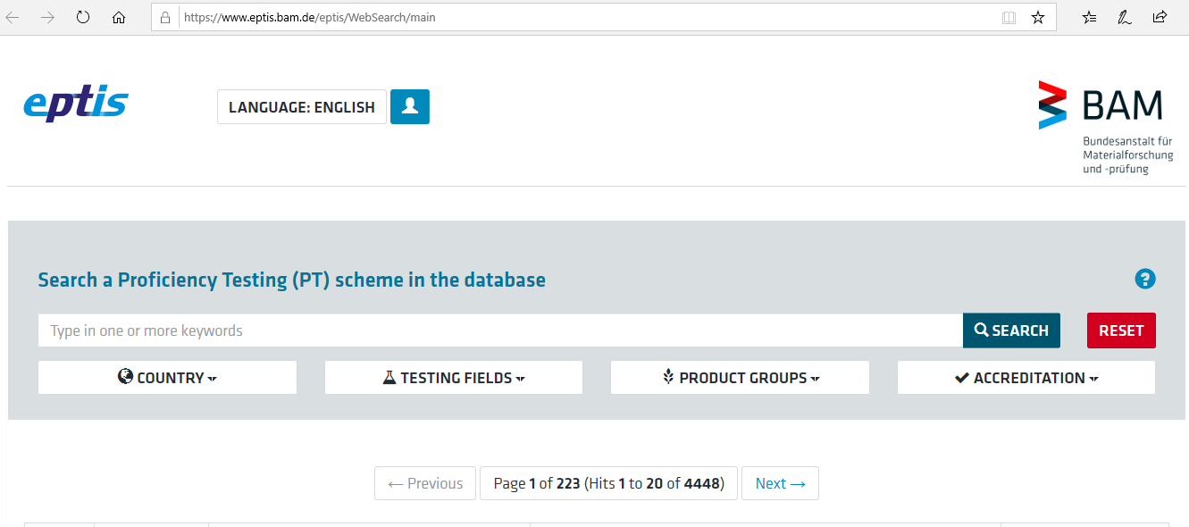
eptis
https://www.eptis.bam.de/eptis/WebSearch/main

Slide 15
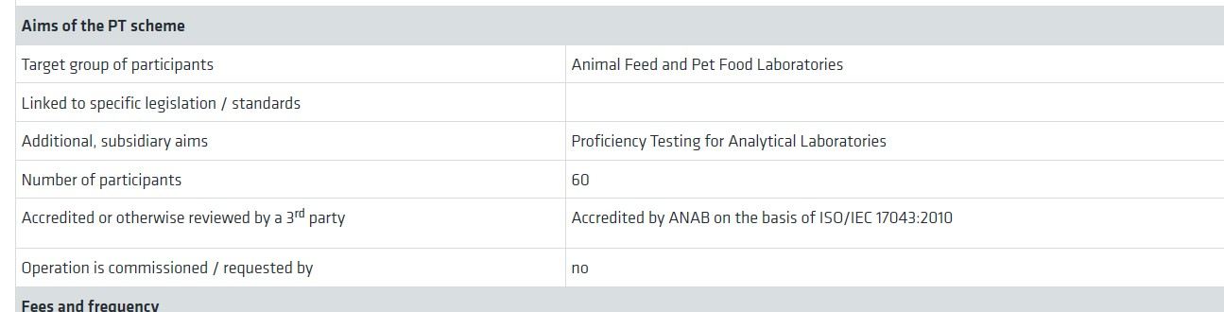
So what are you supposed to do?
After you have located a PT provider, determineif the provider is accredited to ISO/IEC 17043:2010 Conformityassessment - General requirements for proficiency testing
The European Proficiency Testing Information System (EPTIS) database can be used to help located a PT provider and often provides the 3rd party accreditation information. Here is information on the AAFCO PT for Mycotoxins Scheme:

Slide 16
Additional thoughts…
If there is an accredited provider, the AB may strongly encourage the use of the provider.
However, you and your customer may jointly agree that use of a non-accredited program is fine. Just thoroughly document the conversation.

Slide 17
PT Provider's Scope
If the PT provider is accredited, review their scope of accreditation.
A provider may be accredited for a limited number of analytes/compounds.
Their literature should indicate if the PT is covered by their scope of accreditation.

Slide 18
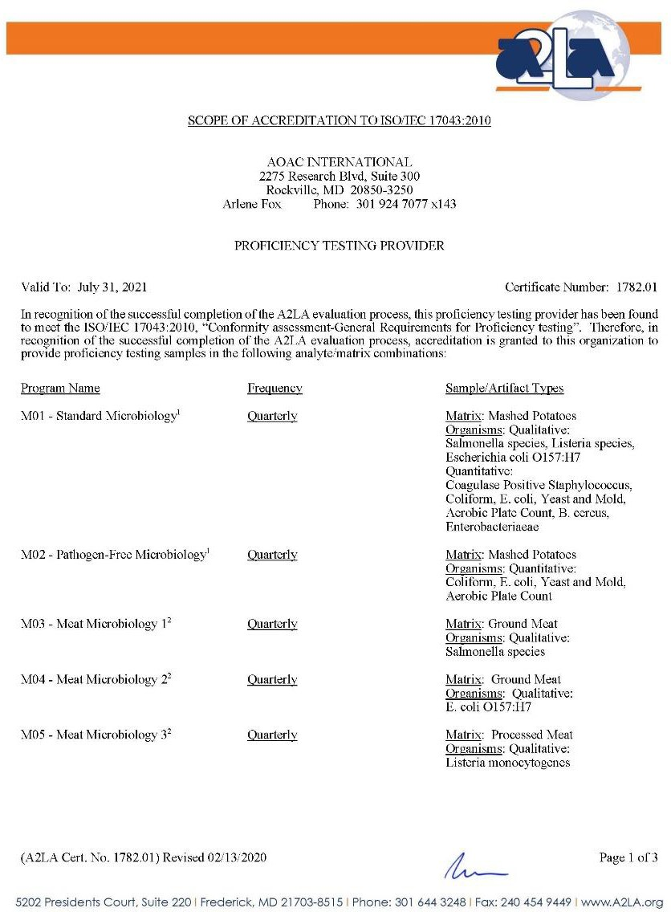
Example of a PT Provider's Scope

Slide 19
Remember…
…the standard states in 7.7.1 (a) regular use of reference materials or quality control materials.
Reference material providers can also be accredited to ISO 17034:2016
General requirements for the competence of reference material producers

Slide 20
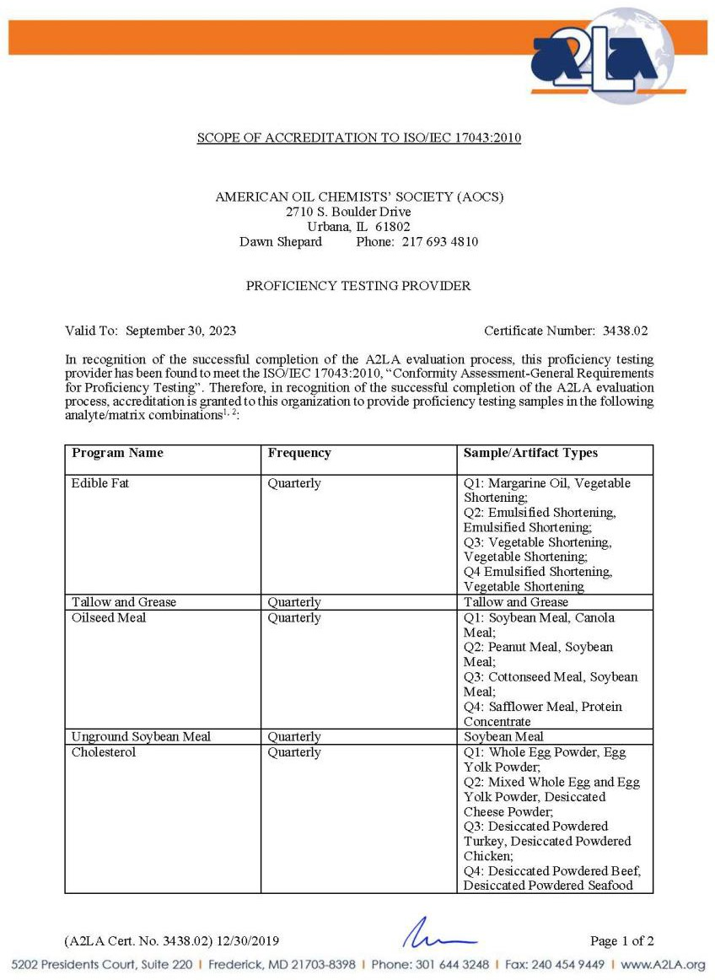
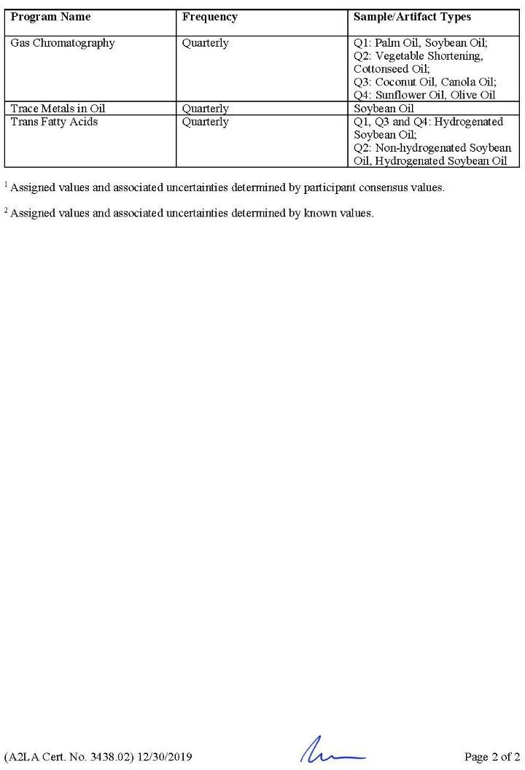
Example: Reference Material Producer’s Scope

Slide 21
Common Road blocks
If a PT has to be shipped from outside the country, there may be restrictions for importing the sample matrix
The analyte of interest may be found, but it may not be in matrix, or may be at the wrong concentration i.e., parts per million (ppm) and parts per billion (ppb) are needed
PT provider issues – cannot meet needs or not fit-for-purpose

Slide 22

ALWAYS DOCUMENT the
ISSUES if a suitable PT cannot be located .

Slide 23
Use of Internal Check Samples
Internal check samples may be an acceptable alternative when external PT samples are not commercially available or are determined to be unacceptable for your customer's analytical requirements.

Slide 24
Internal Checks
1) Use a reference material or quality control material (ISO 17034)

Slide 25
Internal Checks
Use a reference material or quality control material (ISO 17034)
Participate in a round robin with other laboratories

Slide 26
Internal Checks
Use a reference material or quality control material (ISO 17034)
Participate in a round robin with other laboratories
Perform a comparison with another method

Slide 27
Internal Checks
Use a reference material or quality control material (ISO 17034)
Participate in a round robin with other laboratories
Perform a comparison with another method
Perform an interlaboratory comparison

Slide 28
Interlaboratory comparison
ISO/IEC 17025:2017
3.3 interlaboratory comparison
organization, performance and evaluation of measurements or tests on the same or similar items by two or more
laboratories in accordance with predetermined conditions
[SOURCE: ISO/IEC 17043:2010, 3.4]

Slide 29
Internal Checks
Use a reference material or quality control material (ISO 17034)
Participate in a round robin with other laboratories
Perform a comparison with another method
Perform an interlaboratory comparison
Test previously analyzed samples

Slide 30
Internal Checks
Use a reference material or quality control material
Participate in a round robin with other laboratories
Perform a comparison with another method
Perform an interlaboratory comparison
Test previously analyzed samples
Correlate results for different characteristics of an item

Slide 31
Use a reference material or quality control material
Participate in a round robin.
Perform a comparison with another method.
Perform an interlaboratory comparison.
Test previously analyzed samples.
Correlate results for different characteristics of an item.
Internal Check Samples

Slide 32
Pesticide Data Program (PDP) example
As part of the USDA Pesticide Data Program (PDP), Colorado, New York and Montana analyzed groundwater and surface water samples. These laboratories were required to become accredited.
In addition, Minnesota (MN) has an extensive ground water and surface water program for monitoring pesticides. Over 2,000 ground water and surface water samples were analyzed in Fiscal Year 2014. The list is unique to this state.

Slide 33
PDP example continued
The pesticides list is not the “common” EPA list for drinking water or wastewater; there were no commercial PTs that adequately covered the MN list.
PDP provided the water laboratories in their program two specialty PTs made for them by Ultra Scientific.
PDP experienced large budget cuts and discontinued the water analysis for its programs. The PTs ended but the MN laboratory’s accreditation did not.

Slide 34
PDP example continued
The MN laboratory tried a couple commercial PTs but those were quickly deemed unacceptable. The laboratory analyzed for parts per trillion and many of the commercial are ppb/ppm. Additionally, the compound lists did not adequately cover the list of analytes.
The laboratory went back to Ultra Scientific and had them produce 2 to 3 specialty mixes each year covering each class of compounds. It was expensive but met their customer's needs. They cannot cover all of the analytes in the mixes. Their AB accepts using class of compound.
The laboratory also reviews internal matrix spike recovery data especially for compounds that Ultra Scientific is not able to add to a mix because of stability issues.

Slide 35
Internal Check Sample
Here are some examples of approaches that can be taken:
  Find a matrix with the analyte
  Develop in-house using CRM/RM
  Work with a CRM/RM company
  Have another laboratory make it
  Use a previously analyzed sample
  Compare results for different characteristics of the sample

Slide 36
Re-Purpose PT Samples
Use as a laboratory control sample.
Use for testing competency of analytical staff.
Use for verification/validation of methods.

Slide 37
References
ISO/IEC 17025:2017
–https://www.iso.org/standard/66912.html
AB websites for their policies on proficiency testing
Eurachem: The Fitness for Purpose of Analytical Methods, A Laboratory Guide to Method Validation and Related Topics
  https://www.eurachem.org/index.php/publications/guides
/mv
AOAC: How to Meet ISO 17025 Requirements for Method Verification
  http://aoac.org/aoac_prod_imis/AOAC_Docs/LPTP/alacc
_guide_2008.pdf

