Slide 1








Quality Management System
QMS Quick Learning Activity
Introduction
ISO/IEC 17025:2017
Calibration
ISO/IEC 17025:2017
Quality Management
System
Uncertainty
Validation
Verification
www.aphl.org

Slide 2

Abbreviations and Acronyms
Assessment-a systematic process of collecting and analyzing data to determine the condition of an organization
Change Management-a process that supports moving from the current state to a future state by revising policies, processes or procedures
Confidentiality-the principle of using restrictive processes and policies to guard against unauthorized disclosure of client and personnel records and information
CI-Continuous Improvement
Customer-the clients or end users of a product or service; customers may be internal or and external to the company
Data Integrity-guarding against improper information modification or destruction to ensure information is authentic
Ethics-Moral rules that govern a person or group
FDA-Food & Drug Administration
ILAC-International Laboratory Accreditation Cooperation
ISO-International Organization for Standardization
IEC-International Electrochemical Commission
QMS Quick Learning Activity
2

Slide 3
Abbreviations and Acronyms
Procedure-a specified way to carry out an activity or process
Process-a set of interrelated or interacting activities to achieve a particular end
Proficiency Testing-an evaluation of the laboratory’s performance by analyzing samples of external origin to determine accuracy and adequacy of the laboratory’s pre-analytical, analytical, and post-analytical processes
Quality-the degree in which a set of inherent characteristics fulfills requirements
QA-Quality Assurance: planned and systematic activities implemented in a quality system to ensure quality goals are fulfilled
QC-Quality Control: processes and techniques to detect, reduce, and correct deficiencies in an analytical process
QC data-measures that reflect the accuracy, precision, and reliability of test results
QMS-Quality Management System: all aspects of the laboratory operation, including the organizational structure, processes and procedures, that need to be addressed to ensure quality
QMS Quick Learning Activity
2

Slide 4
ISO/IEC 17025:2017-Internationally Accepted Standard for Quality Systems
Launched in 1988 to improve Quality Management Systems (QMS) and updated in 1999, 2005, and 2017
Compliance with these standards aids the laboratory to:
  Identify mechanisms to develop and show commitment to continually improving the QMS
  Communicate with customers by actively soliciting feedback and using the information to improve the QMS
  Use the information from measurement and quality control (QC) data to evaluate the performance of the QMS and identify opportunities for improvement
QMS Quick Learning Activity
2

Slide 5

Why ISO/IEC 17025:2017 Accreditation?
Accreditation provides formal recognition that laboratories can achieve a level of reliable testing and measurement
Customers are then able to identify and select laboratories that produce services to meet their needs
One element to take appropriate regulatory action based on human and animal food testing
– Accredited by an International Laboratory Accreditation Cooperation (ILAC) recognized Accrediting Body (AB)
What is an Accrediting Body?
  Internationally recognized to carry out quality system assessments of a laboratory (for ISO/IEC 17025:2017
accreditation)
They also must be accredited
  Conform to the requirements of the ISO/IEC 17011:2017,
“Conformity Assessment – General Requirements for Accreditation Bodies Accrediting Conformity Assessment
Bodies”
QMS Quick Learning Activity
2

Slide 6
What is the Scope of Accreditation?
Methods and technologies covered by assessment
Laboratory is accredited for a specific list of methods, analytes, matrices, and/or technologies
Also called
  Fields of Accreditation
  Fields of Testing
QMS Quick Learning Activity
2

Slide 7

Quality Management System
The term ‘Quality Management System’ (QMS) covers the quality, technical, and administrative system that governs the operations of the laboratory
Quality: How well you do something
Technical: How you do something (in the laboratory area as well as in the support services area)
Administrative: How it all comes together
ISO/IEC 17025:2017: “The Laboratory shall establish, document, implement, and maintain a QMS.”
QMS Quick Learning Activity
2

Slide 8





Quality Management System
The laboratory shall document its policies, systems, procedures and instructions to the extent necessary to assure quality test results
The QMS shall be communicated to, understood by, and implemented by the appropriate staff
Calibration
ISO/IEC 17025:2017
Quality
Management System
Uncertainty
Validation
Training on ISO/IEC 17025:2017
Review policies & objectives
Verification
QMS Quick Learning Activity
2

Slide 9



Quality Management System
QMS policies and procedures must be applied comprehensively, appropriately, and consistently.
A QMS assures that all testing is performed with the utmost quality as described in
Quality Manual
Quality Manual (or equivalent)
Standard operating procedure (SOP) manuals, or documented processes
SOPs/Processes
Staff use these procedures and management processes to minimize errors before they occur (error prevention)
Work Instructions, Forms, Checklists, Flowcharts, etc.
QMS Quick Learning Activity
2

Slide 10
Objectives of the QMS
Establish procedures, which ensure that data generated in by the laboratory are within acceptable limits of accuracy and precision
Ensure that Quality Control (QC) measures are performed
Ensure accountability of data through sample/specimen and data management procedures
Perform complete and accurate documentation
Maintain confidentiality and practice the highest ethical standards.
Evaluate the quality of data
Sustain data integrity through technical data reviews, internal audits, and SOPs that cover all aspects of the testing, such as chromatographic manipulations or calculations, documentation of training and competency, and adherence to the error correction protocol

Slide 11
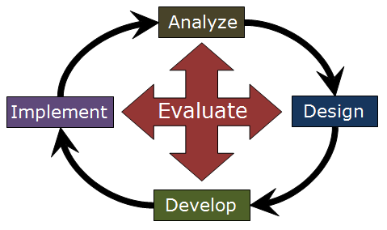
Quality Management System Activities
Examples include
  Client satisfaction surveys
  Internal Audits
  Management Reviews
  Corrective Actions & Risk Assessment
  Identifying and addressing Risks & Opportunities
  Determining & implementing quality policies and objectives
  Proficiency Testing

Slide 12
Quality Management System (QMS)
Chain of Custody
Method Validation/Verification
Document Retention
The QMS documents the Laboratory's
policies
regarding these topics:
Manual Integration/Processing Chromatography Data
Management of Risks and Opportunities
Impartiality
Consistent Laboratory Operations
Fulfilling Purposes of this Document

Slide 13
Familiarizing Staff with the QMS
It is a requirement that all staff familiarize themselves with quality documentation and implement the policies & procedures in their work.

Slide 14
Example of a Quality Policy:
The Laboratory holds firmly that the validity of testing decisions made by data users are determined by the reliability of laboratory data.
The validity and reliability of the information generated is maximized by adherence to documented QC procedures and QMS protocols that are based upon principles of
  Data quality indicators.
  Good professional practice and good laboratory practice (GLP).
The purpose of management is to provide the highest quality product to its customers.
Management is committed to these practices, and the quality of testing provided to all customers, and to continual improvement.

Slide 15





Contributions to a Quality Culture
Leadership
A quality culture can only be accomplished when all staff are involved in the following:
Information and Analysis
Strategic Planning
Process Management
HR focus
Focusing on the customer
Leading by example
Continually improving
Using information and analysis when making decisions (Project Planning)
Strategically planning for the future
Knowing that cost effective quality measures can improve laboratory performance and decrease costs
Business results
Customer and market focus
Total Involvement
Customer Focus
Process Improvement
Quality System

Slide 16
The Organization
Must be a legal entity in order to be held responsible for actions of the laboratory
Must meet requirements of the ISO/IEC standard, satisfy the needs of the customer, and regulatory agencies
Every location and all testing areas within the organization must adhere to a QMS for in-scope methods.
  Many laboratories have one overarching QMS that governs all sections and locations.
  Some have separate yet aligned QMS.
  Others have whole sections that do not fall under a QMS.

Slide 17
Staff Must be Committed to Achieving and Maintaining Quality
All staff are accountable to the QMS.
All staff should have knowledge of quality concepts.
  All work occurs in a system of interconnected processes
  Variation exists in all processes, but can be controlled with the correct checks and balances
All staff should practice ethical behavior.
  All staff must be committed to integrity of data and confidentiality
Skilled Staff Performance
  Staff should have the proper skills, education, competencies, training, experience and certification/license (if required) for position
  Staff should use Critical Thinking Skills
Continue with Training
  Staff continue to seek professional development and training opportunities

Slide 18

Staff Responsibilities
Know that
  What you do is relevant and important!
  You contribute to the overall effectiveness of the QMS
All staff must be committed and competent to safe work practices.
  Perform risk assessments
  Know emergency protocols
  Participate in required training
  Competent to perform testing

Slide 19
Staff Responsibilities
Conflict of interest: Staff should be free from undue commercial, financial, or other undue pressures.
Staff should authorized to perform testing and there should be record of that authorization.
Identify management with responsibility for the laboratory.

Slide 20
Staff Responsibilities
Staff should be impartial and objective.
  Carry out duties.
  Conduct laboratory activities without bias
  Cannot be influenced by internal or external pressures
  Relationships (e.g. business, family, financial) cannot influence laboratory activities.
The laboratory is required to identify potential risks to impartiality and demonstrate that the risk has been eliminated or minimized.

Slide 21
Staff Responsibilities
Management & technical personnel must have the appropriate decision making authority and resources to:
  Carry out duties.
  Identify when there are departures from the QMS and test procedures.
  Initiate actions to prevent or correct these departures.
There must be adequate supervision by those familiar with:
  Methods & procedures.
  Purpose of each test.
  Assessment of test results.

Slide 22
Examples of Staff Responsibilities
Use Proper Measurement Tools
  All staff are committed to using appropriate quality control measures and fit for purpose testing methods.
Protect customers’ confidential information. For example:
  Use a “Declaration of Confidentiality & Ethics” statement and/or form which staff must sign.
  HIPAA training (Health Information Portability & Accountability Act), if applicable
  Follow correct procedures for electronic storage & transmission of results.

Slide 23
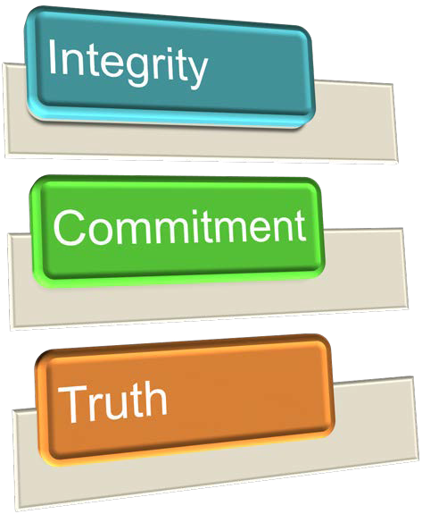
Staff Responsibilities
Follow policies and procedures for competence, impartiality, judgement, or operational integrity.
  Take Ethics Training.
  Take Data Integrity Training.
  Perform Documentation of Competencies.
  Annual Document Demonstration of Capabilities
There should be an organization chart or other description of the interrelationship of staff and supervisory personnel.

Slide 24









Organization Chart - where are you?
Quality Engineer/ Manager
Quality Technician
Analyst
Associate Director
Manager
Supervisor
Director
Analyst
Analyst
Associate Director
Manager
Supervisor
Analyst

Slide 25
Management Responsibilities
Provide overall management of personnel, facilities and equipment, ensuring they are adequate to meet client, agency, regulatory and certification / accreditation requirements and needs are met
Monitoring standards of performance in QMS/QC and compliance to ISO/IEC 17025:2017
Periodically review QMS reports and provide feedback to sections as appropriate
Monitor the validity of the analyses performed and data generated in the laboratory to assure reliable data
Technical Managers must be named and have deputies or designated representatives.

Slide 26
Management Responsibilities
Top management must ensure that the integrity of the management system is maintained when changes to the management system are planned and implemented.
  Are changes in the QMS carefully planned?
Perform an annual documented management review of the QMS.
  SOPs and other documents must align with the policies set forth in the QMS
Review training requirements to ensure that staff understand the importance of the QMS and adhere to ethical practices and data integrity.
  Ensure employees meet the qualifications defined in the job description.
Authorize employees to perform quality management functions.
Ensure audits are carried out (internal, external, and proficiency).

Slide 27
Management Responsibilities
Monitoring risks and opportunities, showing documentation of risk elimination or minimization.
Providing access to necessary resources to perform job duties
Validate laboratory information management system (LIMS)

Slide 28

Quality Manager Responsibilities
Quality Managers have defined responsibility and authority to ensure that the QMS is followed at all times.
Have direct access to the highest level of management at which decisions are made on laboratory policy and use of resources
Responsible for monitoring and verifying QMS activities for compliance with ISO/IEC 17025:2017 (e.g., review QMS annually)
Report QMS activities to top management
Review assessments
Coordinate accreditations
Coordinate training with Human Resources (HR) & Safety Directors
Maintain QMS documents

Slide 29

Communication
There must be appropriate communication about the effectiveness of QMS.
  Staff Training
  Meetings
    Administrative
    Sections/Areas
    All staff
    Strategic Planning
Project meetings with outside partners and customers
Reviews/Audits
  Internal Audits
  Management Reviews

Slide 30










Staff Must Know How to Use Quality Tools
Know how to establish an audit trail to track:
where errors have occurred
make modifications which address the cause(s) of the problem
Design
Look at the process—identify the primary event
Ask questions
  What is the problem?
    We don’t want this to happen again
Analyze
Develop
Evaluate
Implement
When did it happen?
Where did it happen?
2019-06 v1.0

Slide 31













Five Whys — Brainstorm about Root Causes of Problems
Primary Effect W hat? W hen?
W here?
[W hat] caused by?
(Why the what?)
[W hen] caused by?
(Why the when?)
[W here] caused by?
(Why the where?)
Caused by?
Caused by?
Caused by?
Caused by?
Caused by?
Caused by?
caused by?
caused by?
caused by?
caused by?
caused by?
caused by?
caused by?
caused by?
caused by?

Slide 32
Challenges
Invalid cause(s) (e.g., excuses); dig deeper to find out the ‘why’ of the following:
  Human Error
  Mistake
  Distraction
Unacceptable Corrective Actions
  Reminded employees
  Retraining (may use if process has changed or SOPs are updated or training was inadequate)
  Instructed to pay more attention
Instead:
Improve processes and/or procedures
Utilize engineering controls to minimize human error, mistakes, distractions, etc.
Use checklists as reminders of tasks
Communicate new processes with training and ensure it is conducted and documented prior to employee performing work
Evaluate new processes to ensure success

Slide 33
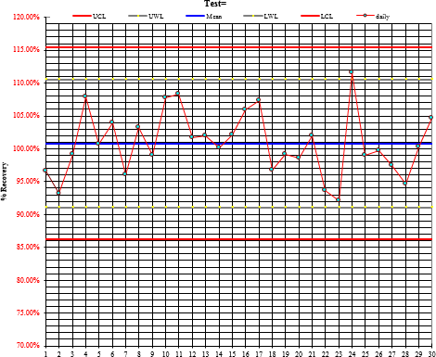
What is Quality Control (QC)?
A set of procedures laboratories follow that compares performance against specific requirements and defined standards (e.g., positive, negative, duplicates, spikes, blanks).
QC must be continuously monitored to ensure reliability and to study how a process changes over time.
QC is designed to show that nothing has gone wrong in the testing process (error detection).
QC is designed to monitor and document, track and trend method performance.

Slide 34
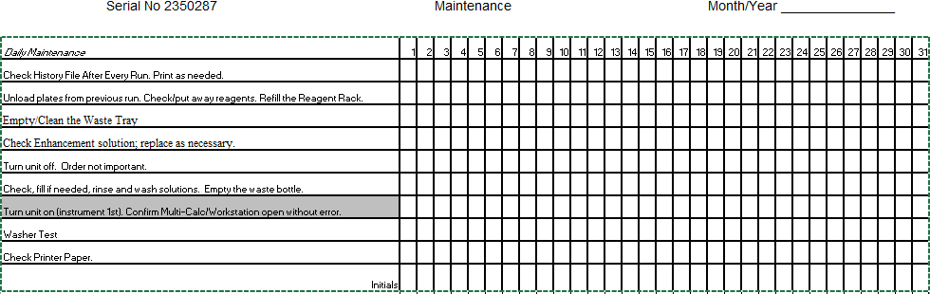
Checklists/Check Sheets are Used to:
Collect and analyze data using a structured form
Example Maintenance Checklist:

Slide 35
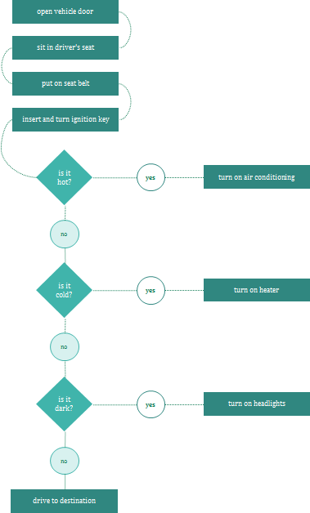
Flow charts
Visualize a process; Can contain decision points along the way

Slide 36
BEFORE WE CONTINUE, YOU MUST ALSO KNOW THIS…
For any result, do you have documentation to demonstrate the following?

Slide 37

Training Documentation and Authorization
Was the work performed by a qualified person who was trained in the relevant technical operations and had access to all necessary information?
Were they authorized to perform that task?
– Per method and/or SOP with Documentation of Capability/Competence
Have they had the proper:
  Safety training?
  Ethics & Data Integrity training?
QMS Quick Learning Activity
43

Slide 38

Methods & Equipment
The method must be approved, validated or verified, authorized, and appropriate to the sample and the requirements of the customer.
The equipment must be properly maintained and calibrated when data is generated.
All QC checks must be carried out and the results within specifications of the method or SOP.
All staff must be adequately trained to use, calibrate, and maintain equipment.
QMS Quick Learning Activity
43

Slide 39


SUMMARY
QMS Quick Learning Activity
43

Slide 40












Responsibilities
Quality responsibilities must be clearly assigned.
Staff training must be documented.
Staff should know and use quality tools.
  Quality Control in testing
  How to perform Corrective Actions
  Use Critical Thinking Skills
Policy and Strategic Objectives
Review
Organization, resources, and documentation
Leadership and Commitment
Implementation and Monitoring
Evaluation and risk management
Planning
QMS Quick Learning Activity
43

Slide 41



Implement Document Control
Procedures must be in place to ensure quality is maintained.
  Are these procedures documented and controlled?
  Do you have (and follow) a procedure to ensure all documents are kept up to date?
  Staff must know and follow all document control policies and procedures.
    This must be documented, as well.
QMS
SOPs/Processes
Work Instructions, Forms, Checklists, Flowcharts, etc.
QMS Quick Learning Activity
43

Slide 42
Know the Difference between a Policy, Process, Procedure and Records
Policies
“What we do”
Processes
“How it happens” (flow charts/tables)
Procedures and Job Aids
(assignment aids)
“How to do it”
Forms & Records
“What happened”
QMS Quick Learning Activity
43

Slide 43








Management must ensure that
The QMS is reviewed and monitored and is implemented and followed by all staff.
Staff are trained to identify departures from the management system, and take action to manage them.
Staff are trained on and follow a corrective action procedure.
There is a mechanism to identify possible problems (risks) and ways to take action to prevent them (risk assessment).
Opportunities to improve the effectiveness of the quality system are identified and implemented.
Plan
Act
Do
Check
QMS Quick Learning Activity
43

Slide 44
Ensure Data Integrity
What precautions do professionals take to secure the integrity of data generated in the laboratory?
  Ethics trainings are provided, and steps are taken to ensure no conflicts of interest.
  Instruments must be calibrated.
  Calibrations must be checked.
  QC samples must be used.
  Use Proficiency Testing as an external check.
  Perform Internal Audits as scheduled.
QMS Quick Learning Activity
43

Slide 45
How Does the Laboratory Ensure Confidentiality of Customer Information?
Unless otherwise agreed with the customer, or required by law, customer information is safeguarded against disclosure.
The laboratory informs customers in advance, when confidential information must be publicly disclosed (for example, when legally required).
QMS Quick Learning Activity
43

Slide 46
Ensure the Integrity of the QMS
Top management must ensure that the integrity of the management system is maintained when changes to the management system are planned and implemented.
  Are changes in the QMS carefully planned?
Perform an annual management review of the QMS.
Review training requirements to ensure that staff understand the importance of the QMS and adhere to ethical practices and data integrity.
  Do all understand that ‘management system integrity' means that there is a lack of contradiction between documents?
QMS Quick Learning Activity
43

Slide 47
References
ISO/IEC 17025:2017
— https://www.iso.org/standard/66912.html
“Complying with ISO 17025: A practical guidebook for meeting the requirements of laboratory accreditation schemes based on ISO 17025:2005 or equivalent national standards”, United Nations Industrial Development Organization, Vienna, 2009 (not endorsed by UNIDO)
  https://www.unido.org/fileadmin/user_media/Publications/Pub_free/Complying_with_ISO_17 025_A_practical_guidebook.pdf
American Industrial Hygiene Association Policy Modules
  http://www.aihaaccreditedlabs.org/Policies/Pages/default.aspx
American Society of Quality
  http://asq.org/learn-about-quality/seven-basic-quality-tools/overview/overview.html
EPA online courses
  https://www.epa.gov/sites/production/files/2015-07/documents/2014aphllabethicstraining.pdf
QMS Quick Learning Activity
43

