Slide 1




Document and Records Control System
QMS Quick Learning Activity
ISO/IEC 17025:2017
www.aphl.org

Slide 2

Abbreviations, Terms, and Acronyms
Documents-say what will be done
Policies-rule of what will be done
Procedures-how it will be done
e.g.- for example (clarifying a statement)
i.e.- in other words (in essence; a finite list)
QMS-Quality Management System; the quality, administrative and technical systems that govern the operations of the laboratory
Records-“proof” of what you are doing/have done
SOP-Standard Operating Procedure

Slide 3


Documents
Documents are controlled within the Quality Management System (QMS)
ISO/IEC 17025:2017 5.5 c)
“document its procedures to the extent necessary to ensure consistent application of laboratory activities and the validity of the results”
What is the QMS?
  Every part of the laboratory that management oversees
  Essentially everything
When ‘define’ and ‘specify’ are used in ISO/IEC 17025— it means the laboratory is expected to build a document that defines or specifies that “issue/item”
– ISO/IEC 17025:2017 5.5.a)
“define the organization and management structure of the laboratory, its place in any parent organization, etc…”
– ISO/IEC 17025:2017 5.5 b)
“specify the responsibility, authority and interrelationship of all personnel…”–

Slide 4

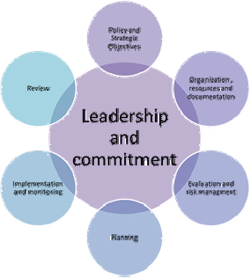
Quality Management System Documents
What are Policies?
  Rule of “what” you are going to do
What are Procedures?
  “How” you are going to do it
How do you know you are doing what you say you do?
  Review
  Monitor
  Audit (evaluate)

Slide 5
What is Document Control and a Document Control System?
Document control includes:
reviewing and approving documents prior to release
Reviewing documents and updated
ensuring changes and revisions are clearly identified
ensuring that only the relevant versions of applicable documents are available at the point of use
ensuring that documents are legible and identifiable; uniquely identified
ensuring that external documents relevant to the work are identified and controlled
preventing unintended use of obsolete documents and they are clearly identified
A document control system is a system used to track, manage, and store documents. It can be:
  manual-hands on with hard copies and perhaps an Access or Excel list
  or electronic, e.g. a software solution that stores and archives documents; oftentimes, has tracking of documents through the review, approval, and even archival stages

Slide 6
Which QMS Documents Need to be Covered by a Document Control System (hard copy or digital)?
Policy Statements
Regulations and standards (e.g., AIHA, ALACC, NELAP, ISO)
References
Procedures, SOPs (Internal and External); Instructions
Job Descriptions
Drawings, Plans, and Schedules
Arrangements and Client Specifications (e.g., Memorandum of Understanding, Contracts, Grants)
Notices, Memoranda
Test Reports
Textbooks, Posters
Instrument Manuals, Software & Equipment Manuals
Posters, Charts, Drawings, Tables, Forms
Specifications, Calibration tables
Flowcharts
Checklists
Excel spreadsheets with formulas
Audits (internal/external)
Software, etc.

Slide 7


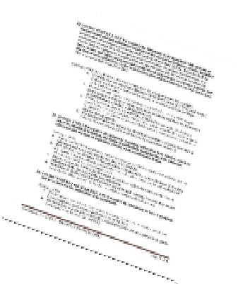


ISO/IEC 17025 Standard
Documents vs. Records
The ISO/IEC 17025 Standard distinguishes between documents-internal and external (section 8.3.1) and records (section 8.3.2)
Each section has requirements that need to be met in order to comply with the standard

Slide 8

Documents
(SOPs, Quality Manual, etc.)
Establish and maintain procedure to control all documents that form QMS and fulfill the requirement of the ISO standard
Documents need to be reviewed and approved for use before issue

Slide 9

Records
(Audit Reports, Test Reports, etc.)
Records need to be Legible!!
Establish Procedures for
  Identification
  Storage
  Protection
  Back-up
  Archive
  Retrieval
  Retention time
  Disposal
Customer requirements drive record retention and the establishment of minimal levels of security
Procedures to protect and back up electronic records and to prevent unauthorized access or amendment

Slide 10

Technical Records
(Forms, Work Sheets, Control Charts, etc.)
Retain records of original observations, data and calculations with sufficient information to establish an audit trail of calibration records, staff records, and a copy of each test report issued
Define how long technical records kept
Maintain sufficient information to facilitate identification of factors affecting the measurement result and its associated measurement uncertainty

Slide 11

Technical Records
Records of each test/calibration contain sufficient information to enable laboratory activity to be repeated under conditions as close as possible to the original (traceability)
The date and identity of personnel responsible for
  Sampling
  Performance of each test/calibration
  Checking data and results

Slide 12

Technical Records
Observations, data and calculations recorded at the time they are made and identifiable to a specific task
Amendments to the record (i.e. mistakes) are crossed out (not erased or obliterated), with the correct information recorded alongside, along with the date & initials of the individual making the correction
Electronic records have the ability to track who is making any correction and be able to retain original information just as non- electronic records

Slide 13
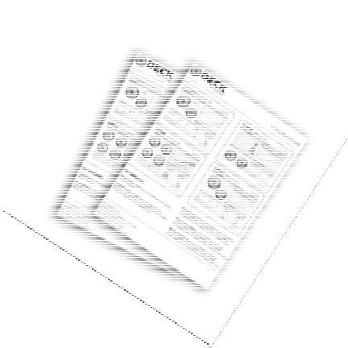
Why is Document Control needed?
To ensure that:
  Management is aware of, and has approved, all documents used by staff to guide them in their work (authority)
  All documents specifying procedures have been checked by those with appropriate knowledge (accuracy)
  There is a record of all copies of documents, so that they can be Reviewed, Withdrawn, or Amended
    They can be recalled and updates issued
    So all copies reflect the same procedure (consistency)

Slide 14
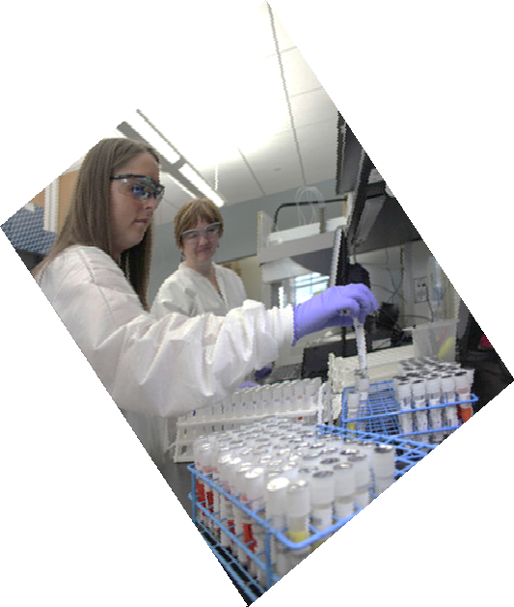
Why is Document Control needed?
Most importantly:
To ensure that all staff are using the most current SOP, form, policy or related document

Slide 15
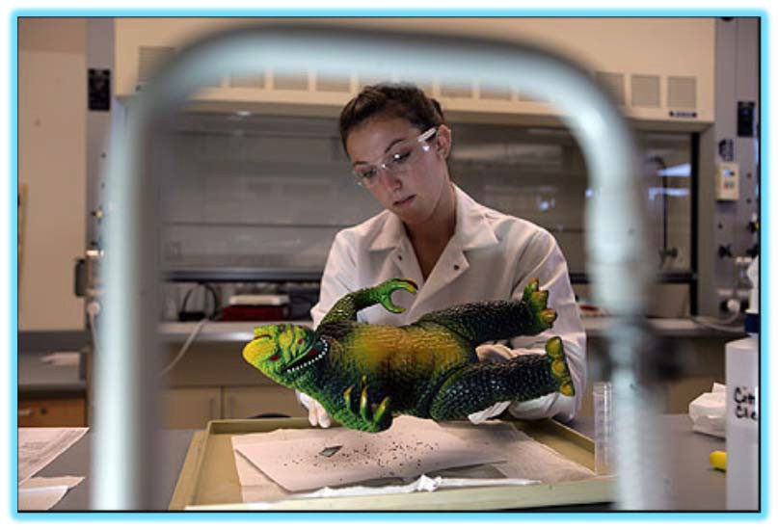
What does a Documentation System Do?
It is a mechanism for defining the QMS so that it is:
  A Consistent system
  A Secure system
  One that can be easily Monitored
It is a means to communicate to staff:
  Their responsibilities
  What procedures and policies to follow

Slide 16

Can you have Checklists, Templates, and Forms?
Absolutely!
They can be controlled in the same manner as Standard Operating Procedures (SOPs), policies, or other documents by making them attachments to the SOP
OR by identifying them as an independent document in the document system

Slide 17

Why do we have to record so much information?
Reproducibility provides confidence in results and assures that results are not erroneous or random in nature and is one of the main principles of the scientific method
For results to be reproduced it is necessary to know (document) all the conditions (instruments used, environmental conditions, etc.) used to generate original results

Slide 18

Why do we have to record so much information?
Documenting, or being able to trace back, all the conditions that existed when the original analysis was done is how laboratories can assure their results can be reproduced
This is why so much record keeping is necessary

Slide 19
Controlling Documents Means:
Having a system that:
  Identifies the current revision status
  Determines the location(s) of the document
  Is updated to ensure no invalid or obsolete documents are in use
    Obsolete or archived documents must be retained per retention policies for either legal or knowledge purposes and must be suitably marked (electronic or hardcopies)
    Obsolete or archived documents must be promptly removed from all points of use

Slide 20
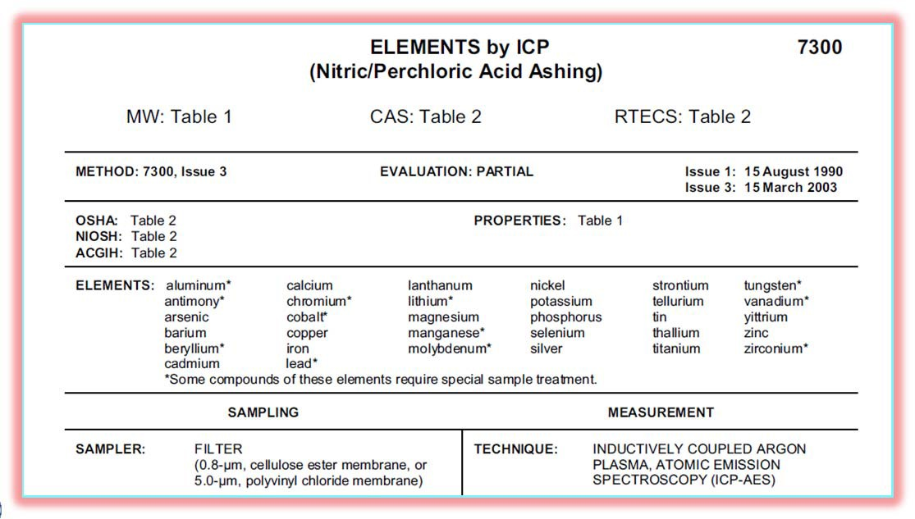

QMS Documents:
Must accurately reflect all phases of current laboratory activities, including:
  Assessing data integrity
  Corrective actions
  Handling customer complaints
  All methods (from laboratory SOPs to administration and support procedures)
May be a copy of a published or referenced method
– Modifications must be clearly described
– Source must be given

Slide 21
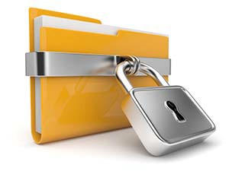
In Conclusion: The Purpose of Controlled Documents
To establish a systematic process for documents to be:
  Developed
  Approved
  Edited
To assure they are:
  Up-to-date, which is especially important to many regulatory agencies using standards (e.g., ALAC, NELAP, AIHA, ISO, etc.)
  Reviewed, and where necessary, revised, in the proper timeframe (at an optimum minimum timeframe or as specified by the standard or client). As an example, one laboratory decided to review its::
    Quality Manual-annually
    Standard Operating Procedures-biennially (every 2 years)
    Policies (e.g., Quality Assurance Section Plans, etc.) every 3 years
  Uniquely identified (e.g., index # in a document control system such as iPassport™)
Authorized documents must be available to staff who will use them

Slide 22
References
ISO/IEC 17025:2017
  https://www.iso.org/standard/66912.html

