Slide 1




QMS Quick Learning Activity
Controls and Control Charting Control Charts and Trend Analysis for ISO/IEC 17025:2017
www.aphl.org

Slide 2
Abbreviation and Acronyms
RM-Reference Materials
PT-Proficiency Test(ing)
QMS-Quality Management Sytem
QC-Quality Control
STD-Standard Deviation
Ct-cycle threshold

Slide 3
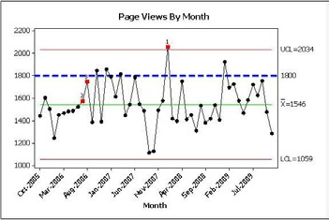
ISO/IEC 17025 Requirements Section 7.7 - Ensuring the validity of test results: The laboratory shall have:
quality control procedures for monitoring the validity of tests undertaken
data recorded so trends are detectable
where practicable, statistical techniques applied to the reviewing of the results

Slide 4

ISO/IEC 17025 Requirements
Monitoring shall be:
Planned
Reviewed
Includes, as appropriate, not limited to:
  Use of Reference Materials (RM) or Quality Control materials
  Replicate tests using same or different methods
  Retesting
  Correlation of results for different characteristics

Slide 5
ISO/IEC 17025 Requirements
Monitoring includes: (continued)
  Use of alternative instrumentation
  Functional checks of equipment
  Use of check or working standards with control charts, where applicable
  Intermediate checks on measuring equipment
  Review of reported results
  Testing of blind samples

Slide 6
ISO/IEC 17025 Requirements
Monitoring includes: (continued)
  Comparison of results with other laboratories (if available and appropriate). Shall include participation in:
    Proficiency testing (PT)
    Interlaboratory comparisons other than PTs

Slide 7
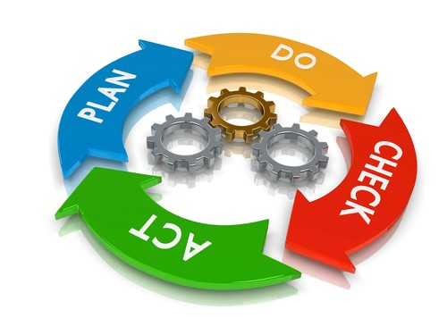
Quality Management System (QMS)
The term ‘Quality Management System’ covers the quality, technical, and administrative system that governs the operations of the laboratory.
The laboratory’s QMS will have procedures for monitoring the validity of tests and calibrations undertaken in the laboratory.

Slide 8
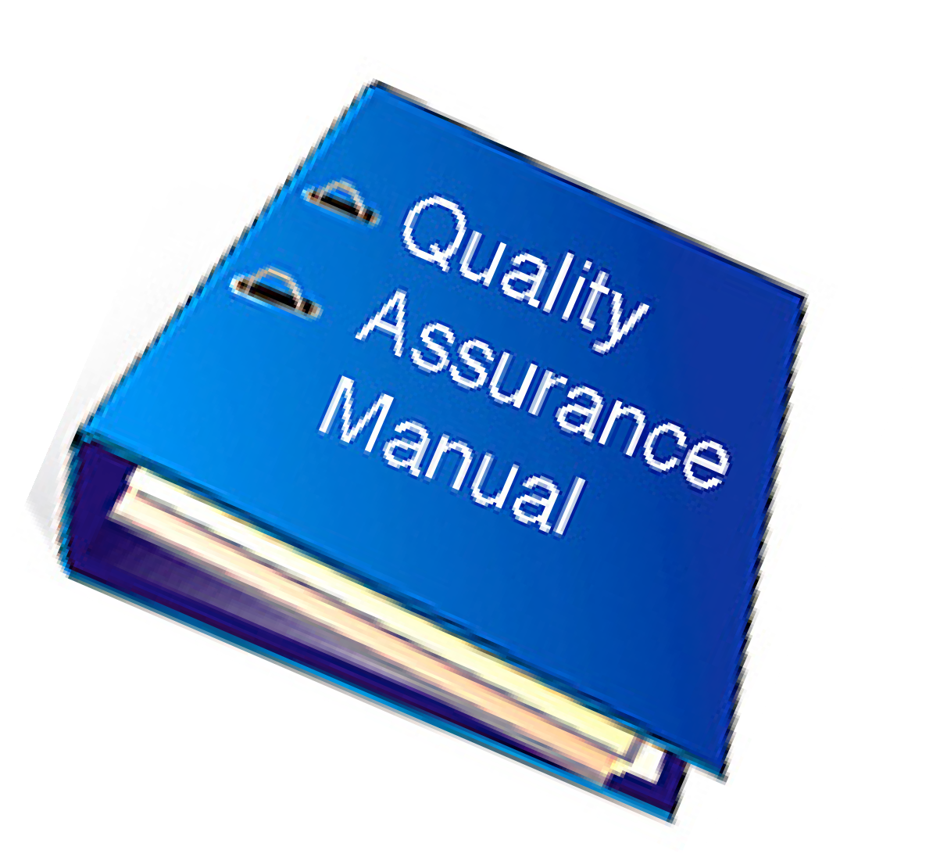
Quality Management System (QMS)
Quality Manual may state:
The laboratory monitors the quality of test results by the inclusion of quality control measures in the performance of tests and participation in proficiency testing programs.The laboratory runs Quality Control (QC) samples with each batch of samples.

Slide 9
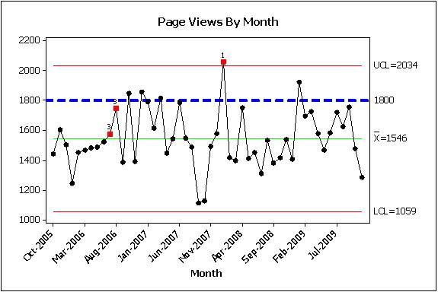
ISO/IEC 17025 Requirements
Section 7.7.3
Monitoring data analyzed and used to control, and if applicable to improve the activities of the laboratory
If found to be outside of predefined criteria, appropriate action shall be taken to correct the problem and prevent incorrect results from being reported

Slide 10
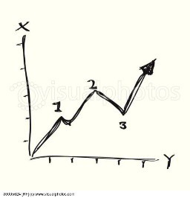
Range Control Charts
Control Charts for Duplicate Sample Data
  Used when impossible to use same QC over time
  Two samples of a batch are analyzed in duplicate
    % difference plotted
    Absolute difference plotted
  After 10-20 points collected calculate mean range of duplicates
  Tables (Youden) for determining % that should fall above/below 50% line

Slide 11
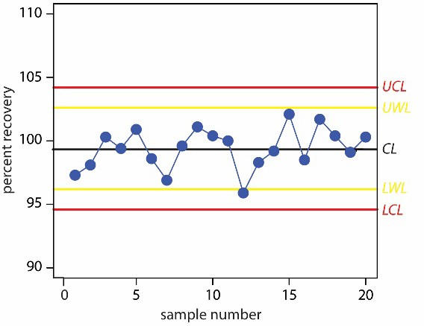
Mean Value Control Charts Types
Laboratory Control Sample (QC samples)
  Charting the results over time of the same sample
Matrix Spike Control Samples
  With each batch (however defined) of samples a blank matrix sample
is spiked with desired analyte.
Recoveries (percent, count) are charted each time.

Slide 12
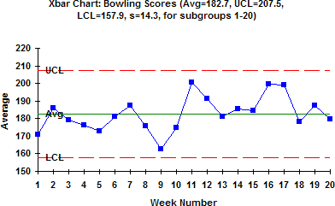
Laboratory Control Sample Control Charts
Charting “QC samples” – must have known value associated with it.
  Reference material
  Old PT sample
  Characterized by your laboratory
Optimal QC sample
  Similar matrix as samples
  Value close in range of expected results

Slide 13
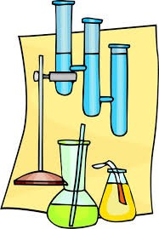
Matrix Spike Sample Control Charts
Charting blank matrix that has been spiked with known concentration of analyte.
  Finding blank to use is often a challenge especially when looking at trace levels
  Used when appropriate RM is unavailable
  RM not available in appropriate matrix
  RM cost prohibitive

Slide 14
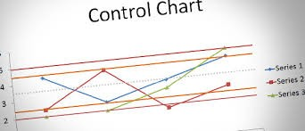
Matrix Spike Sample Control Charts
Typical acceptance for matrix spike recovery
– 70 – 120%
– When large screens with many analytes or when trace levels are being analyzed acceptance can be 50 – 150%

Slide 15

Parts of a Control Chart
Upper Control Limit (Mean + (3 x STD))
Upper Warning Limit (Mean + (2 x STD))
Variable
Mean
Lower Warning Limit (Mean - (2 x STD))
Lower Control Limit (Mean - (3 x STD))
Time

Slide 16
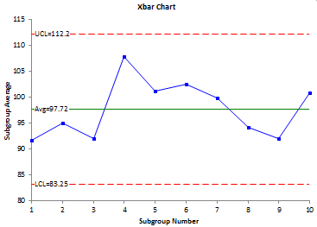
Parts of a Control Chart
X axis – time
Y axis – variable (ex. % recovery)
Mean
Upper warning limit
Lower warning limit
Plotted data
Upper warning limit (sometimes)
Lower warning limit (sometimes)

Slide 17
Parts of a Control Chart - Axis
X axis
– Each time QC sample/matrix spike is analyzed result is plotted. Could be the date run, or the instance (first time run, second time run, etc.)
Y axis – variable (ex. % recovery, Ct value)
y-axis
x-axis

Slide 18
Parts of a Control Chart - Mean
If a RM is being used that has a certified value with statistics (i.e. an acceptable range or standard deviation)
  Use given mean
  After ~20 point have been run, recalculate using own in-house statistics
If a spiked sample or in-house material is being
used
– Run ~20 times (using all analysts that will be running the analysis on samples)
y-axis
Mean
x-axis
QMS Quick Learning Activity

Slide 19
Parts of a Control Chart – Upper/Lower Control Limits
Calculate standard deviation (STD) of points used to determine mean
Upper and lower control limits
  calculated by multiplying the STD x 3
  Add (STD x 3) to mean
(Upper Control Limit)
– Subtract (STD x 3) from mean
(Lower Control Limit)
y-axis
Upper Control Limit
3 x STD
Mean
3 x STD
Lower Control Limit
x-axis
QMS Quick Learning Activity

Slide 20
Parts of a Control Chart – Upper/Lower Warning Limits
Some control charts will have upper and lower warning limits
  Calculate STD of points used to determine mean
Upper and lower warning limits
  calculated by multiplying the STD x 2
Add (STD x 2) to mean (Upper Limit)
Subtract (STD x 2) from mean
(Lower Limit)
y-axis
Upper Control Limit
Upper Warning Limit
2 x STD
Mean
Lower Warning Limit
2 x STD
Lower Control Limit
x-axis
QMS Quick Learning Activity

Slide 21
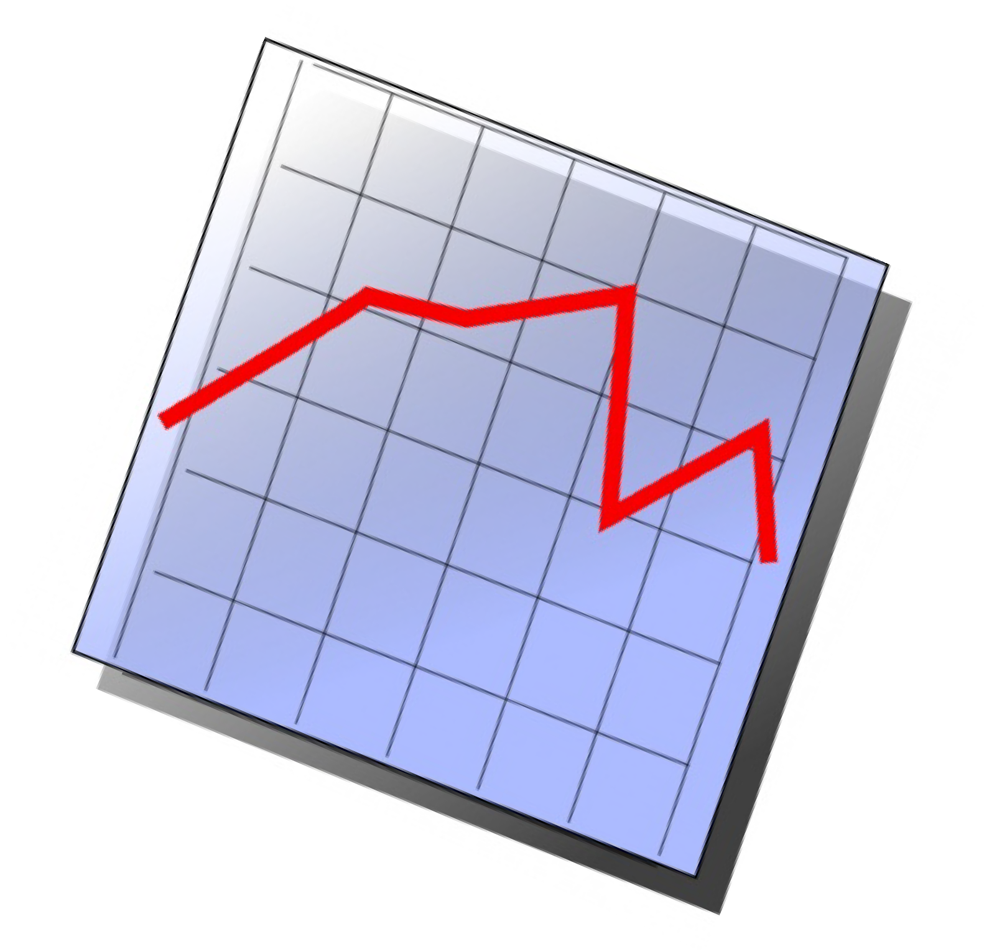
Parts of a Control Chart –Plotted Value
Value of the control being charted
  % recovery
  Ct value
  Fluorescence reading

Slide 22

Control Charting Statistics
QMS will set interval at which control charting statistics (average, upper/lower control limits, etc.) are recalculated.

Slide 23
Statistical Control
Control limits based on probability
System in statistical control
  2/3 of values should be within mean ± 1 STD
  19/20 or 95% of values should be within ± 2 STD (Upper/Lower Warning Limits)
  “All” or 99.7% of values should fall within ± 3 STD (Upper/Lower Control Limits)

Slide 24

Out of control!
Laboratory’s QMS will describe when a process (method) is considered “out of (statistical) control”
  When the QC falls outside of the upper or lower limit
  Two or more consecutive values fall outside 2 STD (outside the upper or lower warning limits) on the same side of the mean
  A series of seven or eight consecutive values fall all above or all below the mean
  An increasing or decreasing trend is detected (TRENDING analysis)

Slide 25
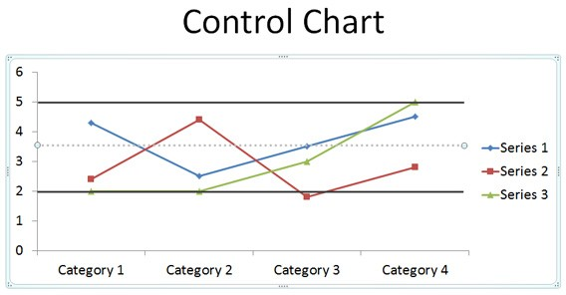
Control Charts - Trending
Control charts reviewed to catch problems and make corrections before the process goes “out of control”
QMS will determine interval at which control charts are reviewed

Slide 26
Control Charts – Qualitative Trending
Qualitative (presence/absence) analyses do not need to have control charts for charting QC; however, the laboratory’s QMS may require this
Qualitative analyses do need to be evaluated for trending. This can be done using control charts

Slide 27

Control Charts – Qualitative Trending
Qualitative analyses done using instruments can have numeric values. For example
  Microbiology PCR analysis
    Ct value of positive control
    Ct value of positive sample looking at whether or not sample confirmed positive (rate of false positive)

Slide 28
Conclusions – Control charts
Are used to meet the requirements of the ISO/IEC 17025 standard by providing a way for laboratories to monitor the validity of test performed
Use RM, spiked samples, laboratory characterized materials, percent/absolute difference in duplicate samples
Make it possible for the laboratory to track trends in analysis

Slide 29
References
ISO/IEC 17025:2017
  https://www.iso.org/standard/66912.html
Youden WJ (1959) Graphical diagnosis of interlaboratory test results. Industrial Quality Control, 15, 24-28.

