Slide 1



QMS Quick Learning Activity
Customer Service, Feedback, and Complaints
ISO/IEC 17025:2017
www.aphl.org

Slide 2


Abbreviations and Acronyms
Feedback - Information on performance received from a customer
Customer Service - Cooperation with customer
Cause Analysis - Determination of reason(s) why a problem occurred
Corrective Action - Action to eliminate the cause of a detected nonconformity

Slide 3
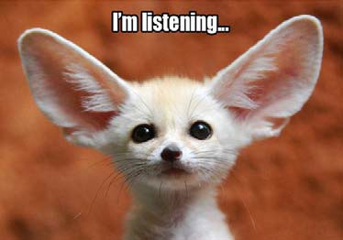

Feedback
Photo credit: unbounce.com
Why should you seek feedback?
  Good customer service
  Address complaints
  Identify and manage risks and opportunities
  Correct errors, if applicable
    If necessary, perform cause analysis
The laboratory must seek feedback, both
  Positive
  Negative
Possible ways include:
  Annual customer satisfaction survey
  “Tell us what you think” link to email
  Talk to customers
  Web page link

Slide 4
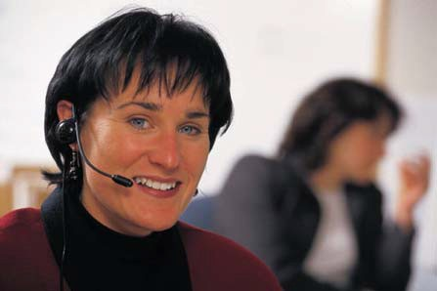
Customer Service
The laboratory must be willing to cooperate with customers to:
  Clarify requests
  Monitor the laboratory’s performance related to the work performed
  Ensure confidentiality of customers
Staff must use good communication skills with customers.
  Customers may have to be provided a guide in technical matters, such as opinions, results, interpretations, etc.
  Inform the customer of delays or deviations in the performance of tests.

Slide 5

Customer Complaints – Internal and External
The laboratory needs to have a documented process for receiving, evaluating, and making decisions on complaints.
Does the person who receives the complaint document it? All complaints must be logged.
The laboratory ensures the competency of staff who review complaints and determines if the complaint has merit.
  If so, take corrective action
  If not, document and contact client
If complaint is repeated, then it should be reviewed for corrective/preventive action.

Slide 6

Customer Complaints
Keep records of the investigations and resolutions
  Were they addressed?
  How were they corrected?
    Verify reported test results are correct
    Review the analytical data
Perform a follow-up audit
Photo credit: shl.uiowa.edu
Actions are reviewed, approved, and communicated to the customer by staff not involved with the original laboratory activities
Complaints and feedback provide inputs to the laboratory’s process for managing risks and opportunities, and they are evaluated during management review.
The customer is informed of the process (and its end).

Slide 7
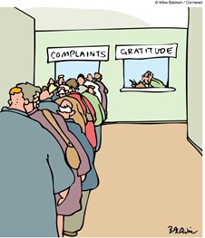
Why Listen to Customer Complaints?
Addressing complaints will help to find and solve any problems
When a customer’s complaints are addressed successfully, loyalty and foster goodwill are built; even dissatisfied customers may be able to be won back
Research shows that normally only 1 in 26 people are likely to complain and as many customers do not think it is worthwhile
Someone who has a good experience is likely to tell 3 other people, but someone who has a bad experience will tell, on average, 11 people
Photo credit: Mike Baldwin

Slide 8

How to Respond to Complaints
Use empathizing techniques
Have a sympathetic ear
Treat others as you would like to be treated
Summarize what the speaker says and the underlying feelings
Paraphrase the reason for the complaint
Acknowledge feelings
Ignore the excessive and erroneous
For example, say “You must be very upset about this.”
Example: insults

Slide 9
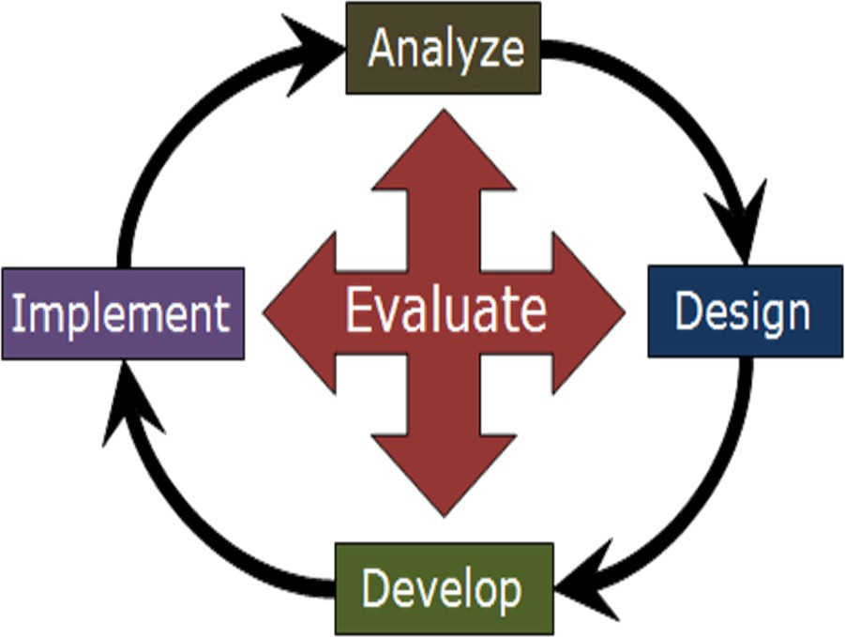
How to Respond to Complaints
Find solutions to complaints while on the phone with the customer.
  Don’t talk about what can’t be done, but what can be done.
  If possible, offer alternatives.
  If something has gone wrong, don’t argue about the problem, act to rectify it.
Demonstrate to the customer concern about them and the desire to correct the situation as quickly as possible.

Slide 10

If a cause analysis is needed, some ideas to remember include:
People are generally not the ultimate cause of problems.
People implement processes.
Most people do not come to work planning to sabotage their own work.
Do not waste time looking at surface issues.
Use passive voice to avoid “blame game.”
Examples:
  “Bob didn’t complete the form AB correctly.” (WRONG)
  “Form AB lacked necessary review and approval.” (CORRECT)
Photo credit: medicalsea.org
10

Slide 11
Correction vs. Corrective Action
Correction
  Action to eliminate a detected nonconformity
  The immediate action taken to correct a problem, usually to allow data to be reported to a customer
  Examples include:
    making an adjustment
    fixing a mistake
    repeating analysis
Corrective action
  Action to eliminate the cause(s) of a detected nonconformity
  Must address the cause(s) to prevent recurrence
10

Slide 12


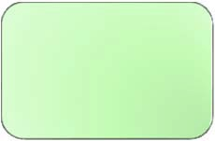


Determine the Cause(s)
What’s the problem? (DEFINE & MEASURE)
Sometimes “Why” is not the starting question
What is it?
When did it happened?
Where did it happen?
How were overall goals affected?
Keep it simple—make an outline
People see problems differently
Why did it happen? (ANALYZE)
What will be done? (IMPROVE)
EVALUATE to ensure the problem has truly been solved (PREVENT)
Define
Evaluate
Measure
Improve
Analyze
10

Slide 13

Potential Causes of Problems
Customer requirements (e.g., delayed delivery of samples,“batching”)
Sample
  Representivity
  Integrity
Methods & procedures (most correct or most up-to-date utilized for testing?)
Consumables not delivered on time
Equipment & its calibration
10

Slide 14


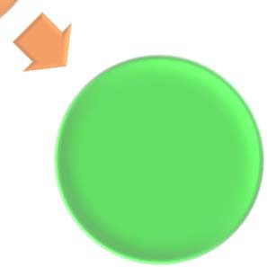
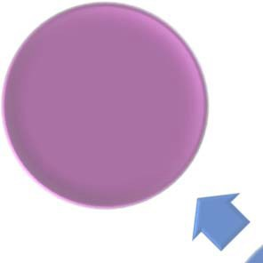
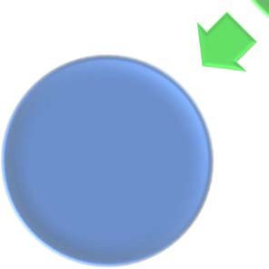
Implement Solution & Monitor
Implement the corrective action
Monitor to ensure corrective action is effective
  Record findings and observations to see if the adjustment fixes the problem
  If the problem happens again, select another variable from list
Audit the area as soon as possible to confirm effectiveness
Close the corrective action
Report back to the customer, if applicable
Plan
Act
Do
Check
10

Slide 15
Conclusion
Customers usually only complain when things are very bad.
Complaints should be addressed immediately.
Treat customers empathetically.
Perform cause analysis to understand the “why” of the problem.
When things go wrong—look at the system and/or process to see what may have caused the error—do not assign blame to people.
“Take time to deliberate; but when the time for action arrives,
stop thinking and go in.” Andrew Jackson
10

Slide 16
References
ISO/IEC 17025:2017
– https://www.iso.org/standard/66912.html
10

