Slide 1
The use of WGS in France for the monitoring of major foodborne pathogens
C. Cordevant
  2023 GenomeTrakr Meeting
  College Park, MD

Slide 2

An agency whose mission is to investigate, evaluate and protect
ANSES is a French scientific expert appraisal agency.
It is a public administrative body under the authority of the French Ministries of Health, Agriculture, Ecological Transition, Labour and Consumer Affairs.
Our role
To provide public decision-makers with the scientific benchmarks needed to better protect human health (including at work), animal health and plant health.
Our ambition
To promote the production of data and knowledge to safeguard global health with our European and international counterparts.
Created in 2010
1400 employees
Annual budget of 145 million €
1400
employees

Slide 3
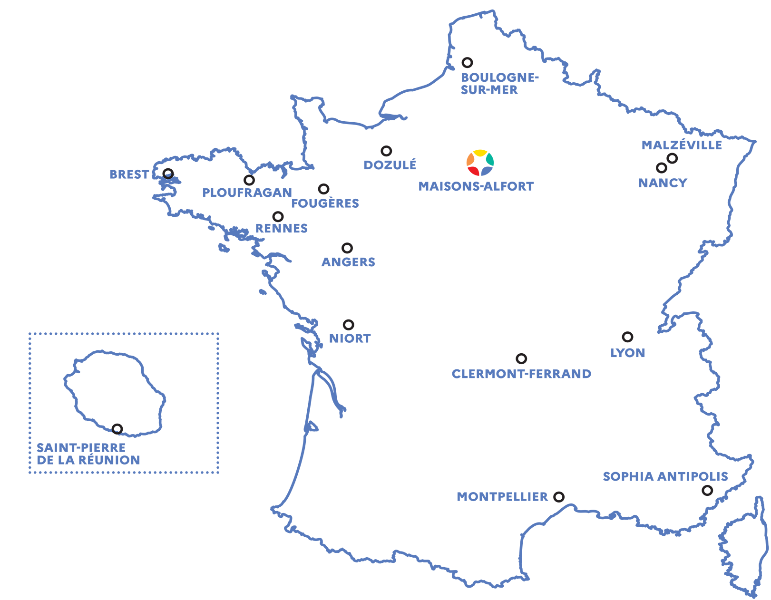
Producing scientific knowledge
The ANSES laboratories: watchdogs and reference bodies in France and beyond
Three fields of research:
Plant health
Animal health and welfare
Food safety, including drinking water
Laboratories recognised for their scientific excellence, with reference mandates for numerous pathogens and chemical contaminants in animal health, plant health and food safety.
>100 national, European or international reference mandates
9 laboratories on 16 sites
700 employees

Slide 4
The food surveillance system in France

Slide 5





Food surveillance system in France
Monitoring of human cases
Monitoring of the food chain
National Ref. Center
Clinical isolates
Analyses and strain isolation
Strain characterization
NRL: Coordination of national labs
  Analyses and strain isolation
  Strain characterization
  Epidemiological Investigations
  Food chain monitoring PTF
Ministry
of
Health
DGS
CORRUSS
Epidemiological Investigations
Trend analysis and annual reporting
DGAl: Food authority
Politics and laws for food safety
Coordination between institutions
Risk management

Slide 6
Food outbreak management system
Monitoring of human cases
Monitoring of the food chain
National Ref. Center
Data sharing of clinical isolates characterization
National Ref. Lab
  Confirmation of analysis
  Strain characterization
  Data sharing of food isolates
  Epidemiological Investigations
CORRUSS
DGS
MUS
DGAL
DGAl: Food authority
Food recalls and withdrawals
Plant inspection & investigations
Coordination between institutions
Epidemiological investigations
Trend analysis and annual reporting

Slide 7
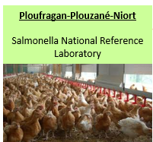

Outbreaks notifications involving the Salmonella NRL
 | Number of alerts | Number of alerts in which NRL Salmonella participated (WGS) | Some examples
2021 | 29 | 13 (≈80 strains) | S. Give: charcuterie; S. Typhimurium variant: fuet; S. Chester: poultry meat; S. Bovismorbificans: dry sausage
2022 | 39 | 16 (≈80 strains) | S. Enteritidis: eggs; S. Menston: sesame seeds S. Agona: lamb meat; S. Ajiobo: goat's milk
2023 | 13 | 6 (≈30 strains) | S. Derby: dry sausage; S. Senftenberg: tomatoes ?

Slide 8
Use of WGS in France for the monitoring of major foodborne pathogens

Slide 9
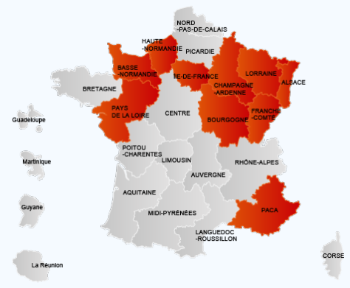
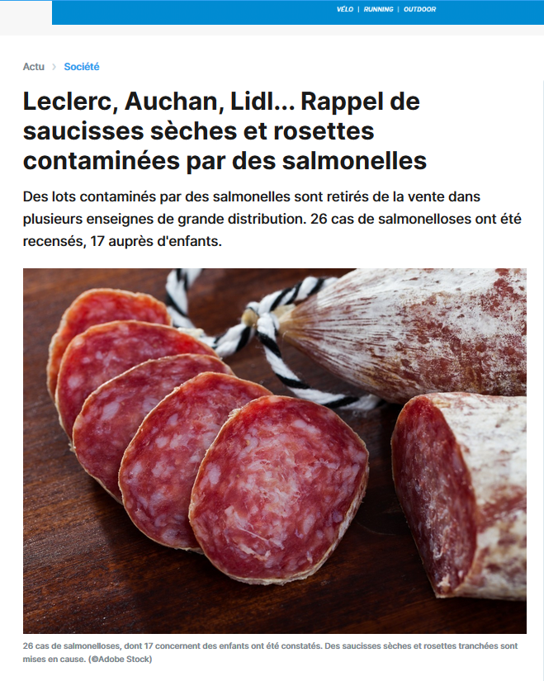
Countrywide multi-serotype outbreak of
S. Bovismorbificans & monophasic S. Typhimurium
Santé publique France reported 33 human cases of salmonellosis in 10 regions Sept. to Nov. 2020 / S. Bovismorbificans
Outbreaks linked to dried pork sausages from the same manufacturer
S. Bovismorbificans associated to human outbreaks and consumption of vegetables / humus or tahini in Australia, EU and the US
Anses NRL additional lab investigations => monophasic variant of Salmonella Typhimurium in one food sample
WGS investigation
Enterobase: cgMLST for sequence comparison
=> 11 cases infected by monophasic variant (ST34, HC5_198125) Oct - Dec 20
  => 33 cases linked S. Bovismorbificans (ST142, HC5_243255)
Eurosurveillance January 2023 https://doi.org/10.2807/1560-7917.ES.2023.28.2.2200123

Slide 10
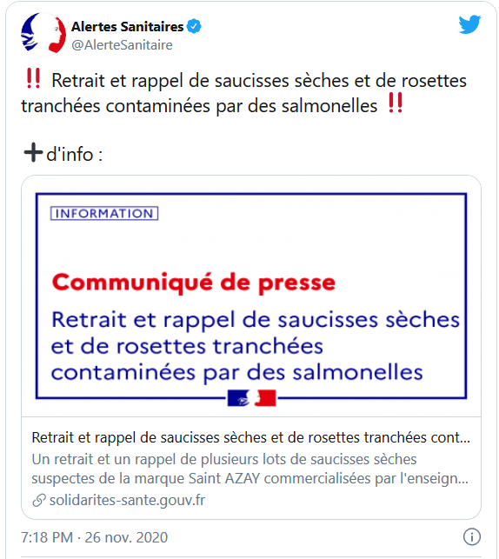
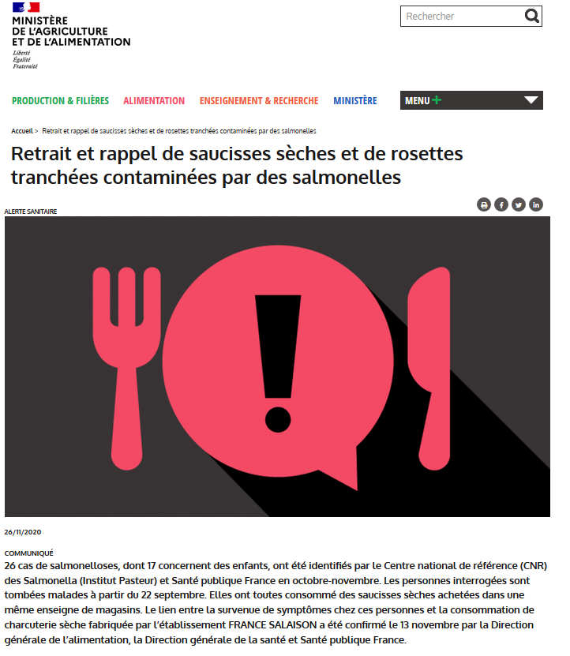
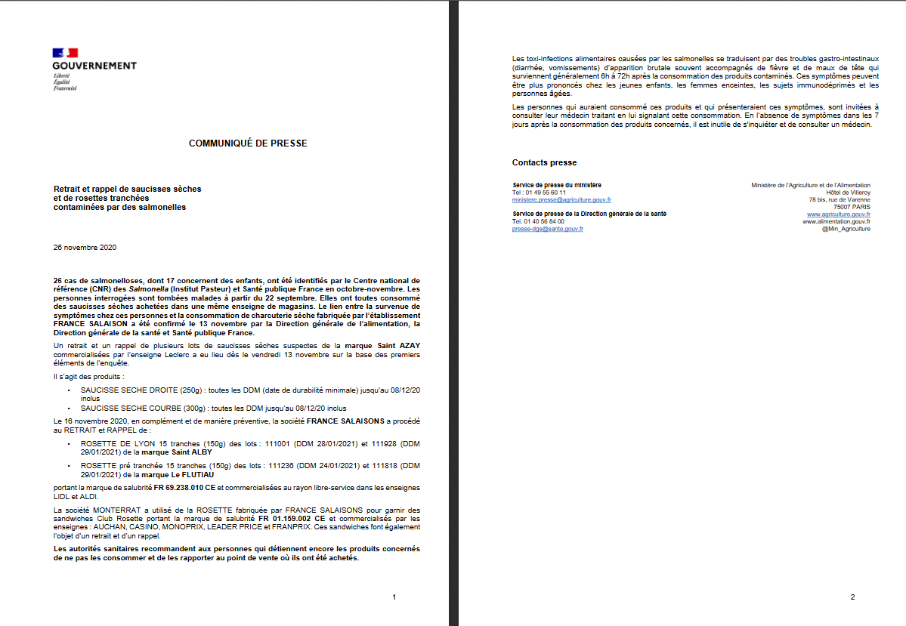
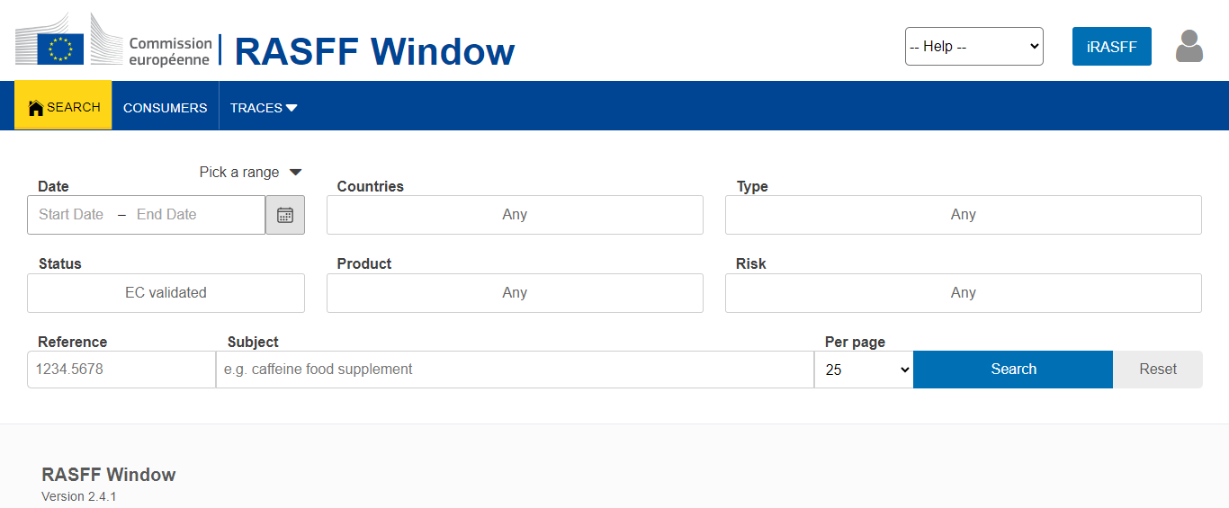
Countrywide multi-serotype outbreak of
S. Bovismorbificans & monophasic S. Typhimurium
Three recalls and withdrawals of dried pork products issued by the DGAl in November 2020 - 8 supermarket chains
At EU level, notifications launched on :
- European Rapid Alert System for Food and Feed (RASFF)
- EPIS-FWD = EpiPulse
One case reported by Germany, Ireland, Norway, UK
Comparison to S. Bovismorbificans genome - NRC for Salmonella Institut Pasteur
=> SNP analysis & epidemiological data excluded them of the cluster
Eurosurveillance January 2023 https://doi.org/10.2807/1560-7917.ES.2023.28.2.2200123

Slide 11
Key Public Health Message
1
2
3
S. enterica subsp. enterica main cause of food-borne diarrhoeal infections in Europe
Current diagnostic protocols target single-agent detection but not multi-serotype !
National outbreak affected 44 people in association with the consumption of dried pork sausages contaminated by 2 different serotypes of Salmonella
This investigations required the collaboration of seven different institutions
The identification of the two serotypes was only possible in a single food sample
This study highlights the need to improve the procedures to better detect mixed contaminations of food products by different serotypes of Salmonella, that we believe may go undetected with the present standard laboratory procedures

Slide 12

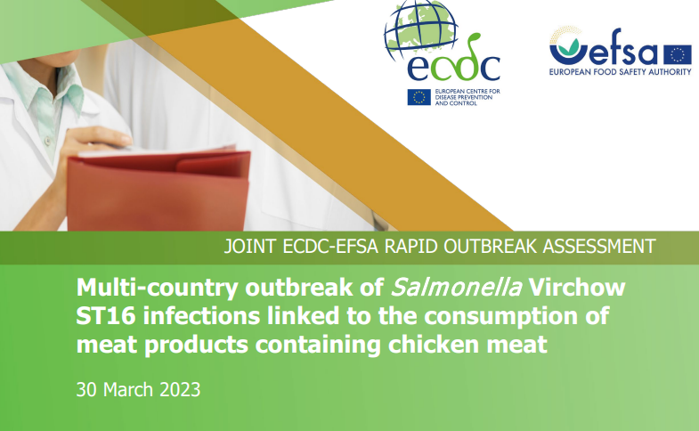
Case study 2: EU alert for S. Virchow
SpF contacts Anses NRL Salmonella - December 09, 2022
  36 human cases of Salmonella Virchow identified
  All strains isolated associated with HC5|82819 genomic profile
  No specific food suspicion
  Search in Anses NRL strains library for S. Virchow ST16 HC5_82819 strains isolated in 2022
Epidemiological situation in January, 2023
    52 human cases of Salmonella Virchow - January 17, 2023
    CORRUSS meetings set up
    Suspicion of Kebab meat consumption (chicken meat)
    WGS analysis: clinical strains grouping with other EU strains (Germany)
  2 S. Virchow strains identified in NRL Salmonella strains collection
    Genomic analysis : identical HC5|cluster => results shared with NRC & SpF & MUS/DGAl & CORUSS
    Sequences were deposited in the EFSA One Health DB
    Results were subject to Rapid Outbreak Assessment
https://www.ecdc.europa.eu/sites/default/files/documents/ROA-Salmonella-Virchow-ST16-march-2023.pdf

Slide 13
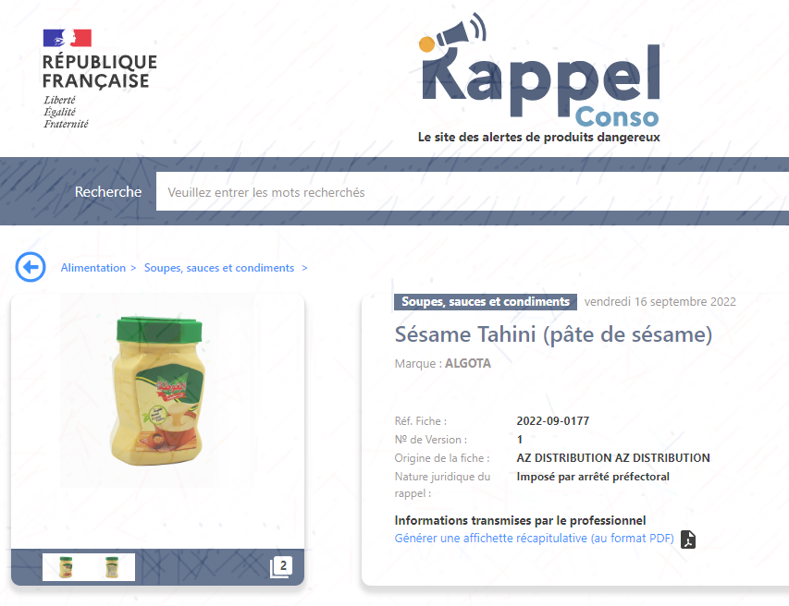
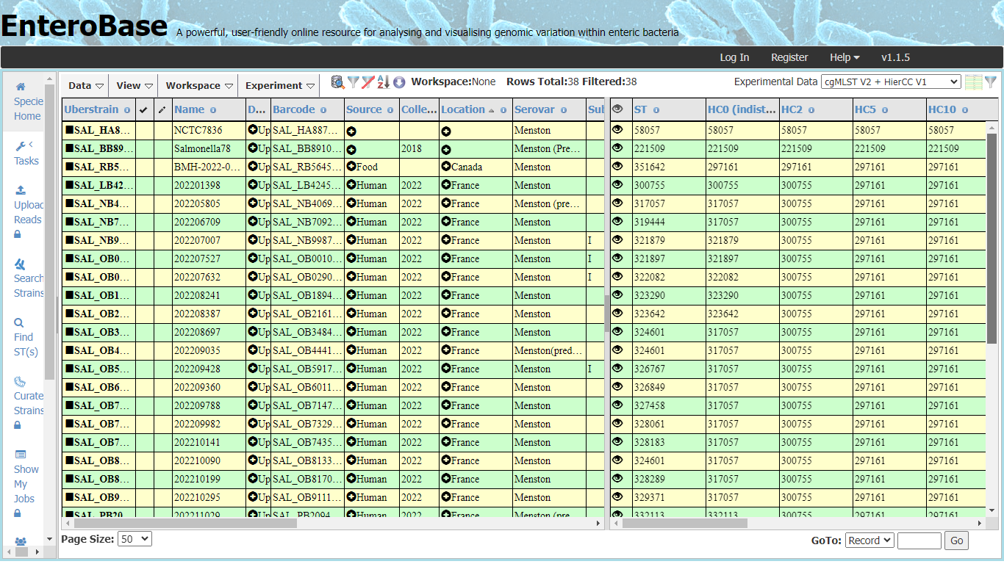
Case study 3: "S. Menston Alert" ex international?
SpF contacts NRL Salmonella on November 04, 2022
14 human cases of Salmonella Menston identified
  WGS analysis: all strains belong to the HC5|297161 genomic profile
  Suspicion of sesame paste / tahini consumption
  "Clustering" of human strains with a strain isolated from tahini distibuted in Canada
  Search in Anses NRL strain library for S. Menston strains
No S. Menston in the NRL Salmonella strains collection !
  Follow-up to CORRUSS meetings
  Taking new samples of sesame paste
  Anses NRL additional investigations : S. Menston serotype confirmed in sesame paste
  and discovery of another serotype S. Kaevlinge !
  WGS analysis: same HC5|cluster for S. Menston food and clinical isolate
  => results shared with SpF, NRC, MUS/DGAl, CORUSS
  Sequences deposited in the EFSA One Health DB

Slide 14
Concluding remarks

Slide 15
Concluding remarks
1
2
3
Monitoring in the food chain from farms to forks is very important to avoid critical situations and protect the consumers
WGS should be privileged for epidemiological investigations for a gain in accuracy and time
Data sharing within and abroad the country: a challenge but in progress both at EU and international levels

Slide 16

Thanks for your attention!
Questions?

Slide 17


Anses contacts
Christophe CORDEVANT
Senior Scientific Advisor for Emerging Infectious Diseases
Strategy & Programs Department
Research and Reference Division
Anses Headquarter
Tel : +33 (0)1.56.29.19.47 Mobile: +33 (0)7.71.54.16.12
Mail : christophe.cordevant@anses.fr
Marianne CHEMALY
Scientific Director Food Safety
Head of HQPAP Unit
Anses Ploufragan Laboratory
Tel : +33 (0) 2 96 01 62 27
Mail : marianne.chemaly@anses.fr

Slide 18




Surveillance system: Salmonella model in the EU
ECDC: monitoring of human cases
  Analyses and strain isolation
  Strain characterization
  Coordination of EU public health labs
  EU Databases
EFSA: Monitoring in the food chain
  Risk assessment (WGs, opinions)
  Data analysis and annual reporting (EUSR)
  Epidemiological Investigations
EURL: Monitoring in the food chain
  Coordination of MS National Reference Labs
  Analyses, strain isolation and strain characterization
  Epidemiological Investigations
DG Santé: Food authority
  Politics and laws for food safety
  Risk management

Slide 19
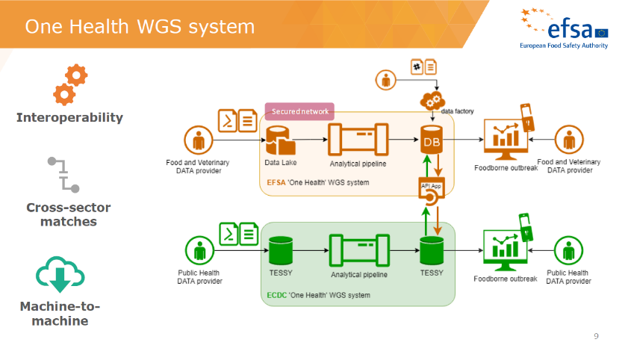
Surveillance system: Salmonella model in the EU

