Slide 1


CFSAN SNP Pipeline 2 (CSP2):
Rapid high-resolution SNP distance estimation directly from genome assembly data
Dr. Bob Literman
HFP – OSSRP – DSDI - SDBB
GenomeTrakr 2024

Slide 2
Contemporary Genomic Analysis @ OSSRP
1. OSSRP (1) receives a request to analyze samples
or (2) detects targets through routine surveillance
2. DSDI geneticists identify related pathogens from the
NCBI Pathogen Detection database
3. We use the CFSAN SNP Pipeline to analyze the genomic data for each distinct pathogen cluster

Slide 3
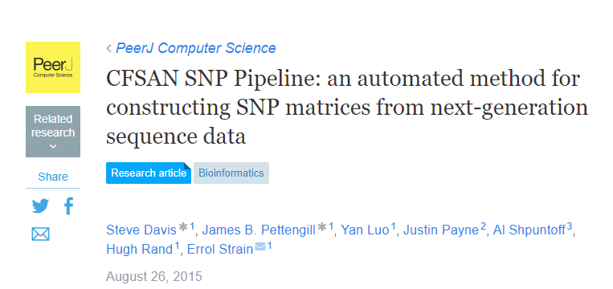
CFSAN SNP Pipeline (cited 269 times)

Slide 4
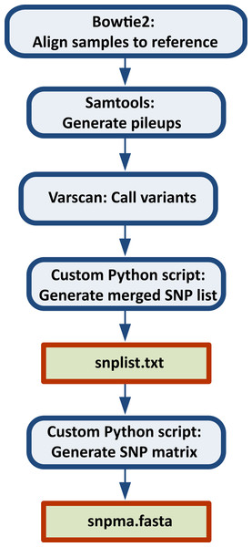
CFSAN SNP Pipeline Workflow
Choose reference (RefChooser)
Map reads
Call variants
Filter dubious SNPs (density, allele frequency)
Generate SNP alignments
Can take between
2 minutes – 40+ minutes
per sample

Slide 5
From sample to sequence

Slide 6

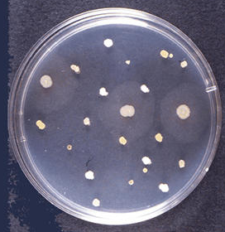

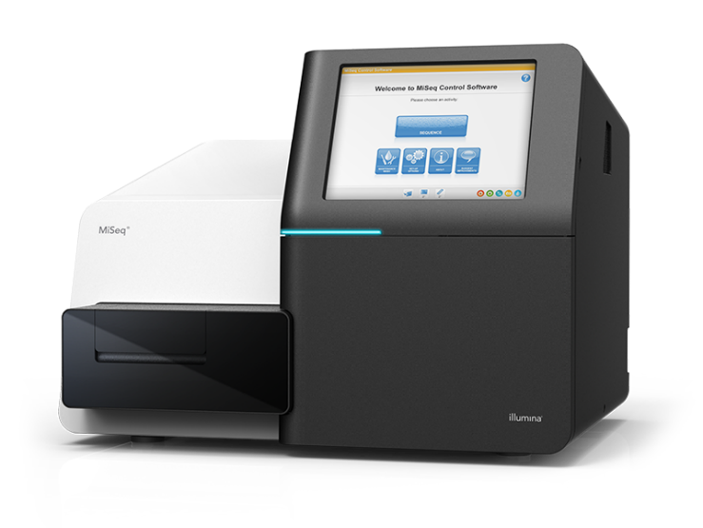

Slide 8
If….
And If….
Then….

Slide 9
CSP2: A Faster Solution
CSP2 calculates accurate genetic distances using
only the genome assemblies
MUMmer4 ultrafast genome alignment replaces read mapping steps (SKESA, BBTools, BEDTools, MASH)
Data filtration steps mirror CFSAN SNP Pipeline, and results are highly correlated
Coded in Nextflow and Python

Slide 10
CSP2 Workflow
Query Data
Reference Data
‘snpdiffs’ files
Assembly
(SKESA)
MUMmer
Alignments for all Query vs. Reference

Slide 11
‘snpdiffs’ files
All snpdiffs files contain:
1) Header: Query/Reference data + alignment stats
2) BED File: All aligned and unaligned regions between the ref/query
3) Mutation data: Data on every SNP variant
< 1Mb

Slide 12
 |  | Output Size
Species | Isolate Count | CSP1 (1 ref.) | CSP2 (3 ref.)
E. coli | 118 | 391 Gb | 324 Mb
Listeria | 80 | 216 Gb | 111 Mb
Salmonella | 127 | 350 Gb | 198 Mb

Slide 13

CSP2 Workflow
Python script to generate alignments and pairwise distances
Query Data
Reference Data
Assembly
(SKESA)
‘snpdiffs’ files
MUmmer
Alignments for all Query vs. Reference

Slide 14
Large-Scale Validation
In the CSP2 manuscript, we investigate 150 NCBI SNP clusters
  50 x E. coli (4,018 isolates)
  50 x Listeria (3,910 isolates)
  50 x Salmonella (4,266 isolates)
12,194 total isolates
  2,696,796 million pairwise comparisons
We compared all pairwise distances between CSP2, CSP1, and NCBI PD
Four CSP2 Reference Genomes
  CSP1 reference genome
  3 additional reference genomes selected by CSP2

Slide 15
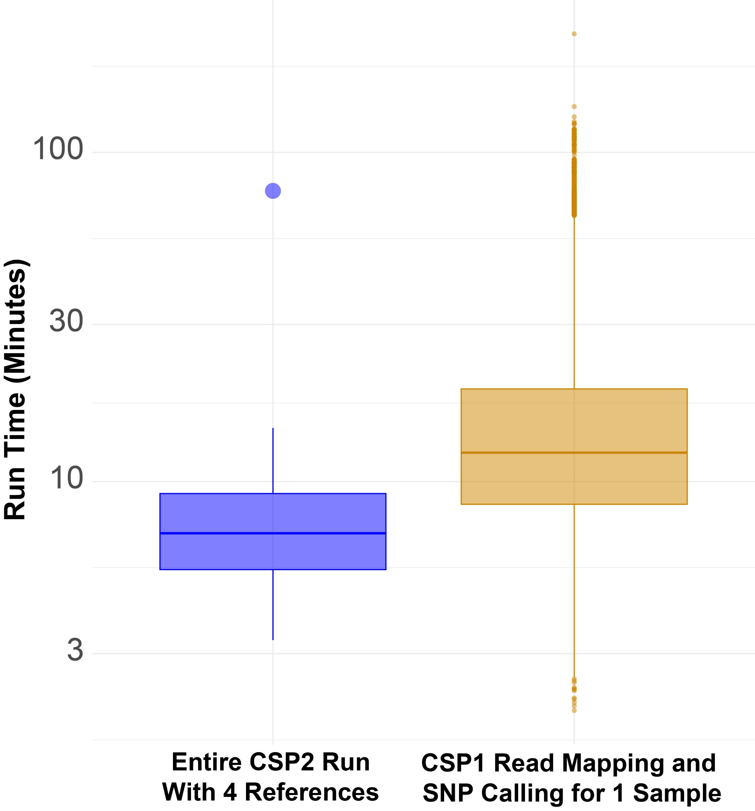
Run Times
CSP2 runs with 4 reference genomes took 3 minutes – 15 minutes*
Median:
~12m
Median:
~7m

Slide 16
Results
For each cluster and method, we compared:
  SNP distance differences
  Cluster-level correlations (Overall relationship strength)
  Cluster-level slopes (1-to-1 across diversity levels)
CSP2, CSP1 and NCBI all use slightly different data filtration techniques
Concordance between methods was defined as +/- 3 SNPs

Slide 17
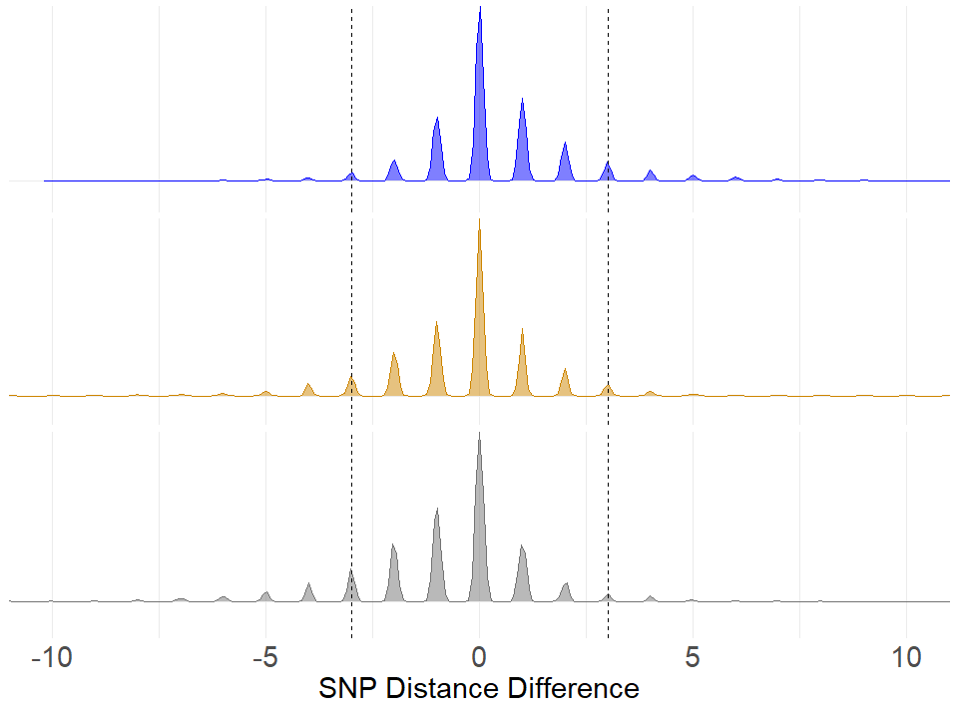
Results (Listeria)
1.5%
93.5%
5%
CSP2 vs. CSP1
4.8%
93.0%
2.2%
CSP2 vs. NCBI
7.9%
90.3%
1.8%
CSP1 vs. NCBI

Slide 18
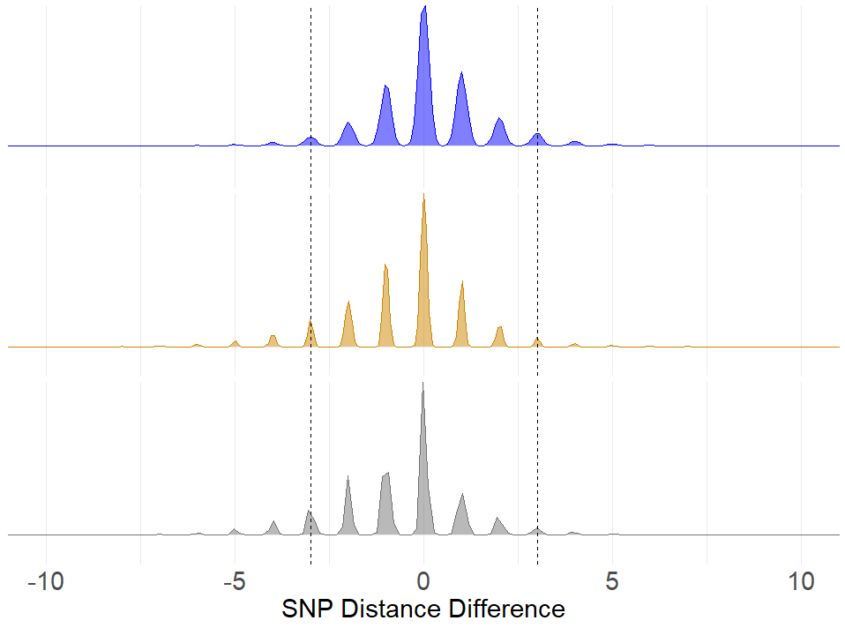
Results (Salmonella)
1.7%
96.2%
2.2%
CSP2 vs. CSP1
5.1%
93.1%
1.8%
CSP2 vs. NCBI
5.6%
92.6%
1.8%
CSP1 vs. NCBI

Slide 19
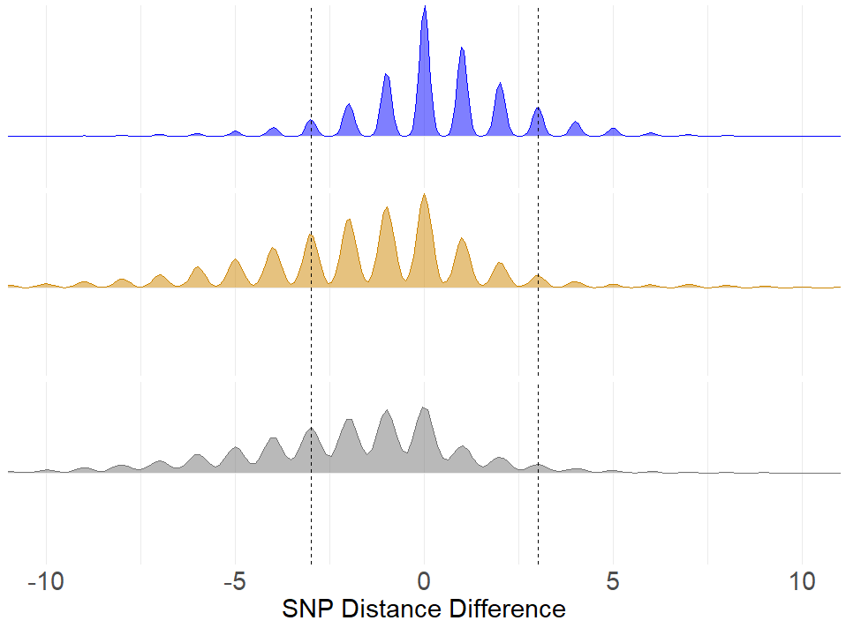
Results (E. coli)
4.5%
89.1%
6.5%
CSP2 vs. CSP1
24.2%
71.3%
4.5%
CSP2 vs. NCBI
28.0%
67.9%
4.1%
CSP1 vs. NCBI

Slide 20
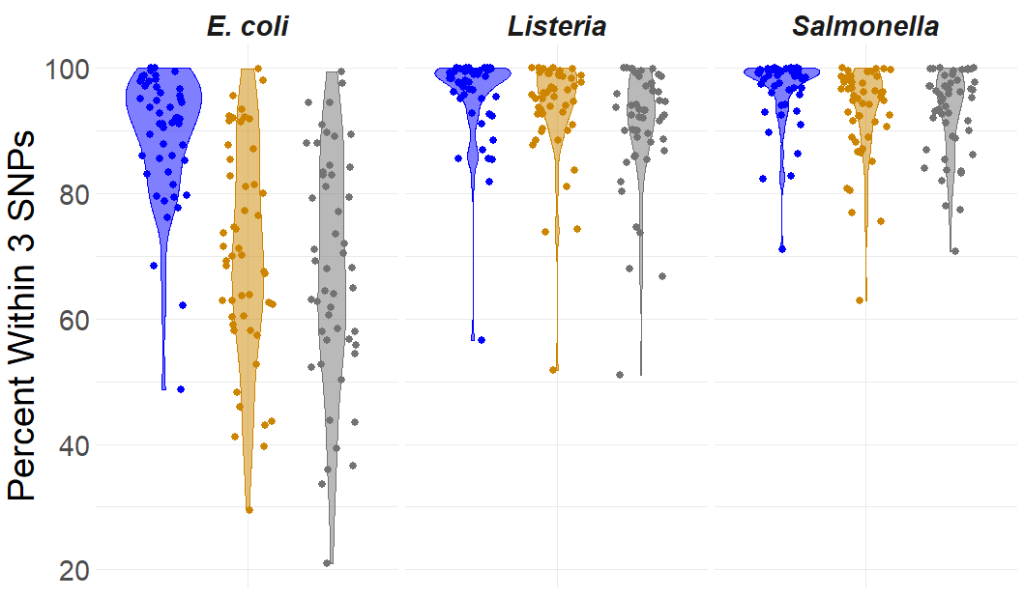
Results
CSP2 and CSP1 had the highest proportion of comparisons within 3 SNPs
CSP2 vs. CSP1
CSP2 vs. NCBI
CSP1 vs. NCBI

Slide 21
Results
CSP2 and CSP1 had the highest proportion of comparisons within 3 SNPs
  CSP2 versus CSP1
  CSP2 versus NCBI
  NCBI versus CSP1
  E. coli: 92% [0.86,0.92]
  Listeria: 98% [0.94,0.98]
  Salmonella: 99% [0.95,0.98]
  E. coli: 70% [0.66,0.75]
  Listeria: 96% [0.91,0.96]
  Salmonella: 95% [0.91,0.95]
  E. coli: 68% [0.63,0.73]
  Listeria: 92% [0.88,0.93]
  Salmonella: 95% [0.91,0.95]

Slide 22
Results
CSP2 and CSP1 had the highest proportion of comparisons within 3 SNPs
  CSP2 versus CSP1
  CSP2 versus NCBI
  NCBI versus CSP1
  E. coli: 92% [0.86,0.92]
  Listeria: 98% [0.94,0.98]
  Salmonella: 99% [0.95,0.98]
  E. coli: 70% [0.66,0.75]
  Listeria: 96% [0.91,0.96]
  Salmonella: 95% [0.91,0.95]
  E. coli: 68% [0.63,0.73]
  Listeria: 92% [0.88,0.93]
  Salmonella: 95% [0.91,0.95]

Slide 23
Results
CSP2 results were highly correlated to results from CSP1 and NCBI
  CSP2 versus CSP1
  CSP2 versus NCBI
  E. coli: 0.99 [0.99,0.99]
  Listeria: 0.99 [0.97,1]
  Salmonella: 0.99 [0.99,0.99]
  E. coli: 0.99 [0.98,0.99]
  Listeria: 0.99 [0.97,1]
  Salmonella: 0.99 [0.98,0.99]

Slide 24
Results
Slopes between CSP2 and CSP1/NCBI were consistent across species
  CSP2 versus CSP1
  CSP2 versus NCBI
  E. coli: 0.99 [0.97,1]
  Listeria: 0.99 [0.98,0.99]
  Salmonella: 0.99 [0.97,1]
  E. coli: 0.96 [0.93,0.97]
  Listeria: 0.98 [0.97,0.99]
  Salmonella: 0.97 [0.97,0.99]

Slide 25
Conclusions
Runtime is critical when analyzing active outbreak situations
CSP2 is a faster alternative to the CFSAN SNP Pipeline with
smaller storage and computational needs
CSP2 allows for the analysis of assembly-only data (no reads required)
Relative to the NCBI PD database, CSP2 distances are closer to the CFSAN SNP Pipeline
CSP2’s Screening Mode can be used to quickly identify outbreak strains or laboratory control strains as soon as sequencing data is available

Slide 26
Acknowledgements
Bioinformatics Team
Jamie Pettengill
Jayanthi Gangiredla
Hugh Rand
Joseph Baugher
Yan Luo
Tim Muruvanda
Arthur Pightling
Ruth Timme
Engineering and BIS Team
Michael Hammond
Gunnar Engelbach
Kranti Konganti
Tom Farrell
Charles Strittmatter
Jamie Evans
CFSAN ORS Support
Maria Balkey
Hope Bias
Any questions?

