Slide 1
NCBI Pathogen Detection Tool Updates
Arjun Prasad, PhD

Slide 2





NCBI Pathogen Detection Pipeline
NCBI Pathogen Pipeline
BioProject
BioSample
NCBI
SRA
International agencies/
collaborators
GenBank
Basic researchers
Clinical sources
Reports

Slide 3
Pathogen Detection Analysis goals
Are these isolates clonally related?
What is the anti-microbial resistance, stress response, and virulence gene repertoire of this isolate?
Notes:
The Pathogen Detection pipeline was initiated as part of this effort. There are effectively two main analytical goals of the pipeline: 1) the first is to identify if the isolates are clonally related to aid in the identification of food sources making people sick, and the second is to identify the genetic elements contributing to pathogenicity including antimicrobial resistance genes, stress response genes that contribute to environmental persistence, and virulence genes such as toxins. The results are presented in an easy-to-use web interface and I will give a brief demonstration in a few minutes of that for the first point.

Slide 4
Pathogen Detection Pipeline
SRA
Assembly
Annotation
GenBank
Clustering
AMRFinderPlus
Trees
Goal <24 hours
Notes:
Once sequence data is submitted to NCBI, the Pathogen Detection pipeline automatically assembles and clusters the isolates. Within each cluster, which can consist of two or more isolates represented as assembled genomes, a phylogenetic tree is reconstructed after assembly-to-assembly comparisons are done to identify single nucleotide variants. The clusters are constructed with very short distance thresholds so that the clusters represent clonally related isolates. In parallel we annotated and identifify the antimicrobial resistance genes using PGAP and AMRFinderPlus, a process that is not timebound.

Slide 5
Pathogen Detection Pipeline
SRA
Assembly
Annotation
GenBank
Clustering
AMRFinderPlus
Trees
Goal <24 hours
Notes:
Once sequence data is submitted to NCBI, the Pathogen Detection pipeline automatically assembles and clusters the isolates. Within each cluster, which can consist of two or more isolates represented as assembled genomes, a phylogenetic tree is reconstructed after assembly-to-assembly comparisons are done to identify single nucleotide variants. The clusters are constructed with very short distance thresholds so that the clusters represent clonally related isolates. In parallel we annotated and identifify the antimicrobial resistance genes using PGAP and AMRFinderPlus, a process that is not timebound.

Slide 6
AMRFinderPlus
Identifies acquired AMR genes
Known AMR-associated point mutations
PLUS
  Some intrinsic AMR genes (e.g., blaEC)
  Relevant stress and virulence genes for some taxa
Makes an affirmative call as to what the gene is
  Attempts to give the sequence the name that one of our curators would give it if they were looking at it manually
Feldgarden M, Brover V, Gonzalez-Escalona N, Frye JG, Haendiges J, Haft DH, et al. AMRFinderPlus and the Reference Gene Catalog facilitate examination of the genomic links among antimicrobial resistance, stress response, and virulence. Sci Rep. 2021 Jun 16;11(1):12728. PMID 34135355

Slide 7
Novel stx types discovered by screening pathogen assemblies
Initially discovered 4 novel stx types in Pathogen Detection and established an international collaboration
After consulting experts in the field we discovered 3 had studies in progress by other groups
Published pre-print characterizing the 4th (stx2n)
Under peer review

Slide 8
Our browsers
Pathogen Detection Isolate Browser
Every row is an assembled isolate, possibly with AMR, virulence, and/or stress response genes and AST data
Reference Gene Catalog
Every row is a reference gene or point mutation
1,000 X N
100,000 X N
Reference Gene Hierarchy
Every row is a node in our hierarchy
Download genomes
MicroBIGG-E (Microbial Browser for Identification of Genetic and Genomic Elements)
Every row is an AMR, virulence, and/or stress response genes with method, type, subtype, class, subclass, and supporting evidence
1000 X N
Reference HMM Catalog
Every row is an HMM
1, 000,000 X N
100 X N
Download genes, genes + flanks, contigs

Slide 9
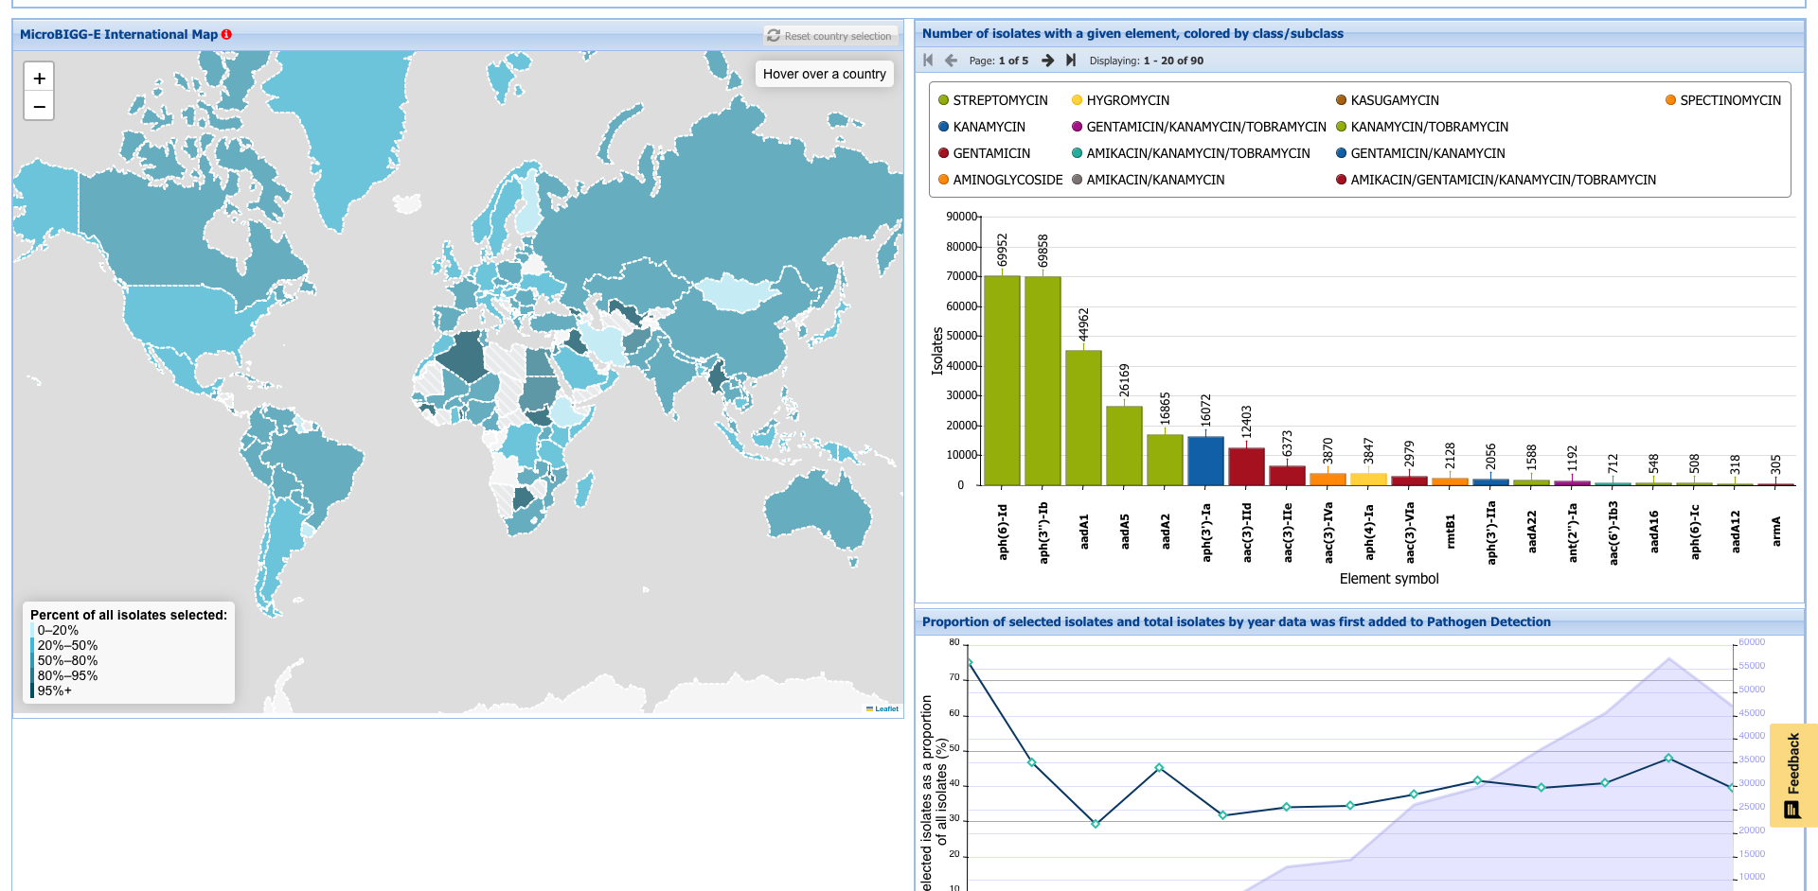
MicroBIGG-E Map
Graphical representation of AMR gene prevalence
Dependent on what has been sequenced and submitted
https://www.ncbi.nlm.nih.gov/pathogens/microbigge_map

Slide 10
Acknowledgements
Richa Agarwala
Victor Ananiev
Azat Badretdin
Slava Brover
Joshua Cherry
Jinna Choi
Vyacheslav Chetvernin
Pavan Chilamakuri
Robert Cohen
DeAnne Cravaritis
Michael DiCuccio
Olga Ermoleava
Boris Fedorov
Mike Feldgarden
Lewis Geer
Renata Geer
Dan Haft
Lianyi Han
Avi Kimchi
Michel Kimelman
William Klimke
Alex Kotliarov
Valerii Lashmanov
Aleksandr Morgulis
Eyal Moses
Chris O'Sullivan
Arjun Prasad
Edward Rice
Kirill Rotmistrovskyy
Alejandro A. Schaffer
Nadya Serova
Sergey Shiryev
Martin Shumway
Oleg Shutov
Douglas Slotta
Alexandre Souvorov
Tatiana Tatusova
Francoise Thibaud-Nissen
Igor Tolstoy
Ed Wachtel
Lukas Wagner
Jay Worley
Hlavina Wratko
Chunlin Xiao
Alexander Zasypkin
Eugene Yaschenko
Mingzhang Yang
David Lipman
James Ostell
Kim Pruitt
Stephen Sherry
ASM
BWH
CDC
FDA/CFSAN
FDA/CVM
GenFS
USDA-FSIS
PHAC/CFIA
PHE/FERA
NIAID
Wadsworth/MDH
pd-help@ncbi.nlm.nih.gov
This work was supported in part by the National Center for Biotechnology Information of the National Library of Medicine (NLM), National Institutes of Health, as well in part by the National Institute of Allergy and Infectious Diseases,
National Institutes of Health

