Slide 1
Update on Pathogen Detection Roadmap
Bill Klimke - FDA GenomeTrakr 2023

Slide 2
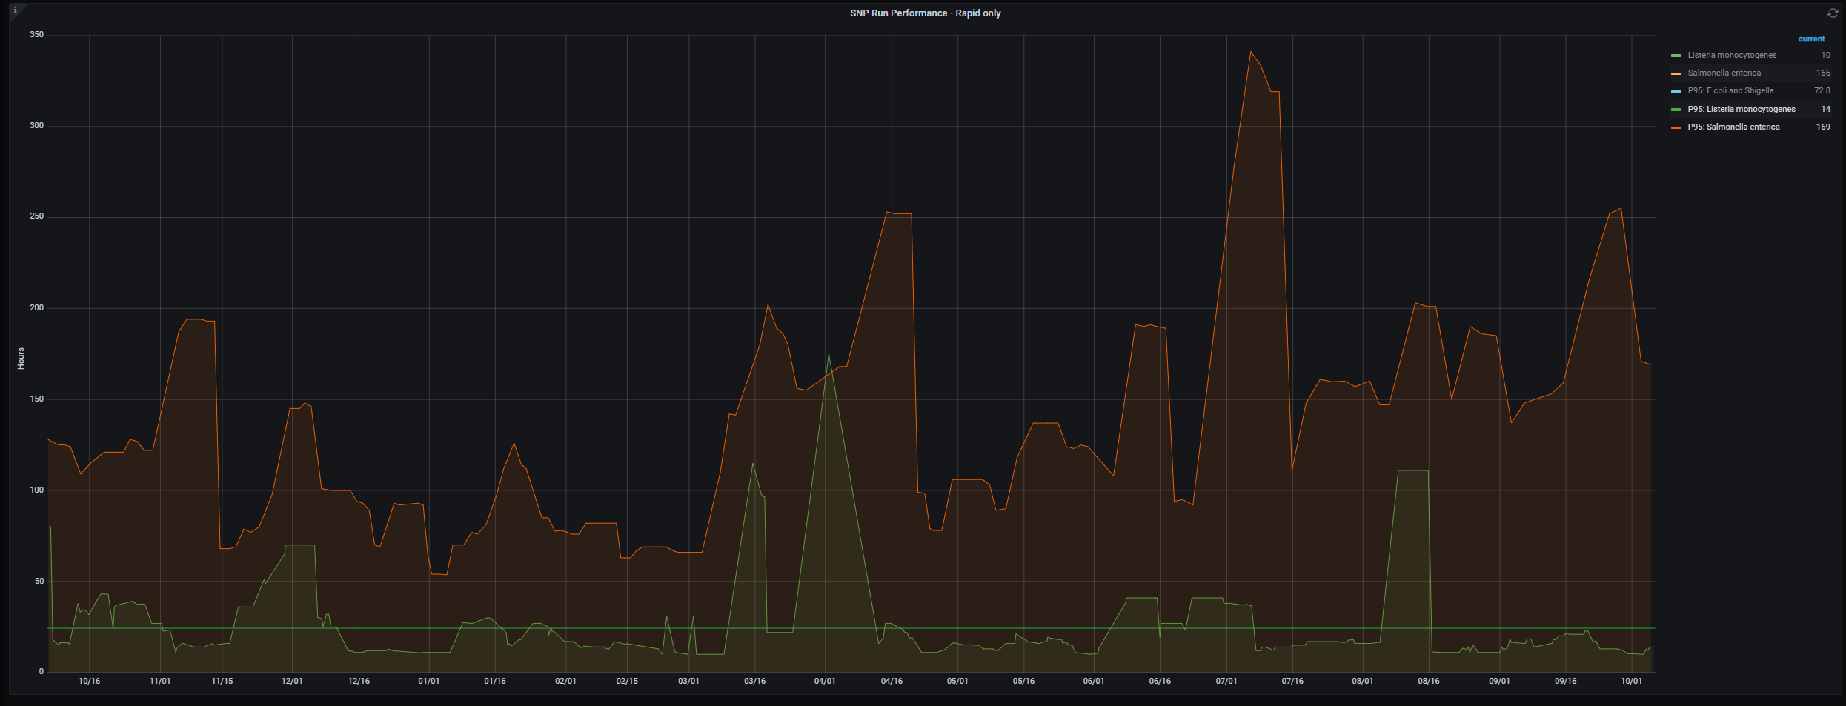

Measure turnaround time - Last Year
Turnaround time (95th percentile) -> increasing delays
Last year's slide (one year prior to Oct 5th)
Hours (linear) ->
24 hrs
Date ->

Slide 3
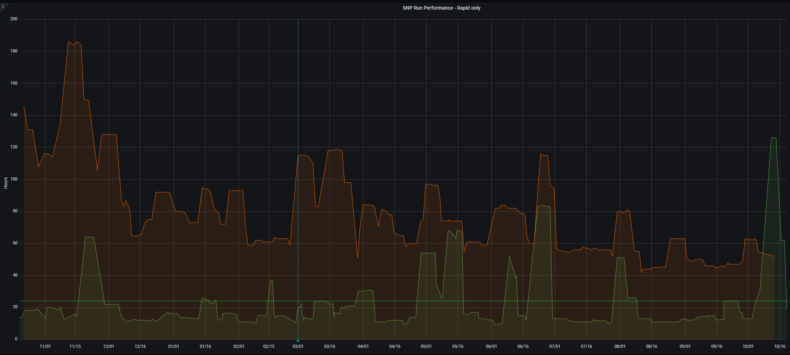
Measure turnaround time - This Year
This year's slide (one year prior to Sept 25)
filesystem change (planned)
Hours (linear) ->
24 hrs
Date ->

Slide 4
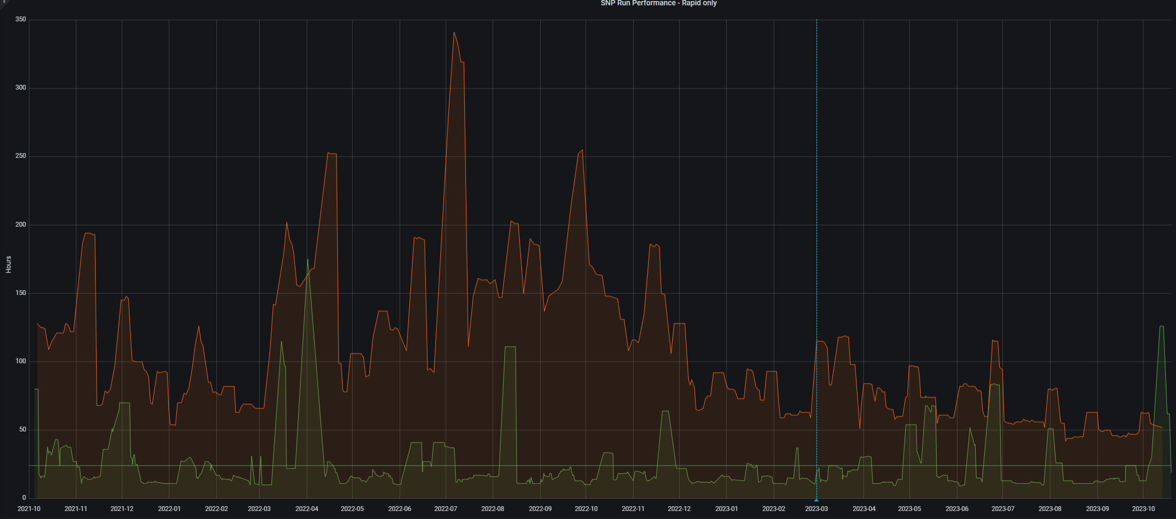
Two years of Measurements
24 hrs

Slide 5
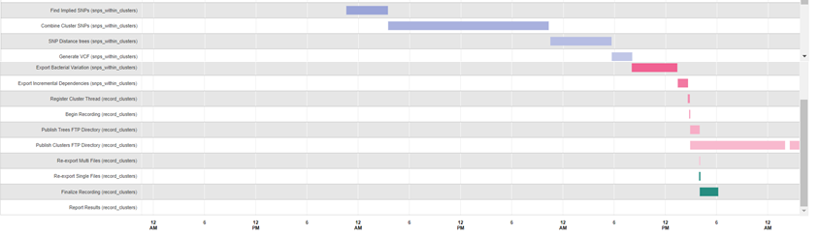
Last year's slide (individual compute modules)
Time taken for individual steps in pipeline
Step | Minutes
Compute Genomes Pairwise Distances | 1037
Make Clusters | 119
Combine Cluster SNPs | 1140
Export Bacterial Variation | 322
Find Implied SNPs | 294
Generate VCF | 144
SNP Distance trees | 430
Finalize Recording | 130
Publish Clusters FTP Directory | 668
Variation Group Metadata | 210
Publish Clusters FTP Directory | 83
These processes require previous steps to finish before proceeding – there are significant timesinks

Slide 6
Improvement comparison to times for last year
Measurement of improvements
Step | Minutes (Oct, 2022) | Minutes (Sept. 2023 - avg. for 2 months) | Fold improvement
Compute Genomes Pairwise Distances | 1037 | 74 | 14X
Make Clusters | 119 | 147 | N/A
Combine Cluster SNPs | 1140 | 105 | 11X
Export Bacterial Variation | 322 | 125 | 2.5X
Find Implied SNPs* | 294 | 85 | 3.5X
Generate VCF | 144 | 79 | 1.8X
SNP Distance trees | 430 | 155 | 2.7X
Finalize Recording | 130 | 54 | 2.4X
Publish Clusters FTP Directory | 668 | 89 | 7.5X
Variation Group Metadata | 210 | 14 | 15X
* includes cloud processing

Slide 7
Efforts to improve turnaround time
Algorithmic improvements - for compute pairwise distances
Engineering changes
switch to JSON for data files for SNP processing
cleaned up SNP distance processing
optimized grid engine usage for output file production in some steps
Hardware changes - switch to VAST from panfs for filesystem
Improving GUI and filter performance in the Isolates Browser
made GUI faster for users
Cumulative knock-on effects have resulted in ~50% reduction from 4 days to 2 for Salmonella
- caveat - recent SRA data access issues caused these to spike again
therefore getting analysis results back more quickly to help solve outbreaks and save lives

Slide 8
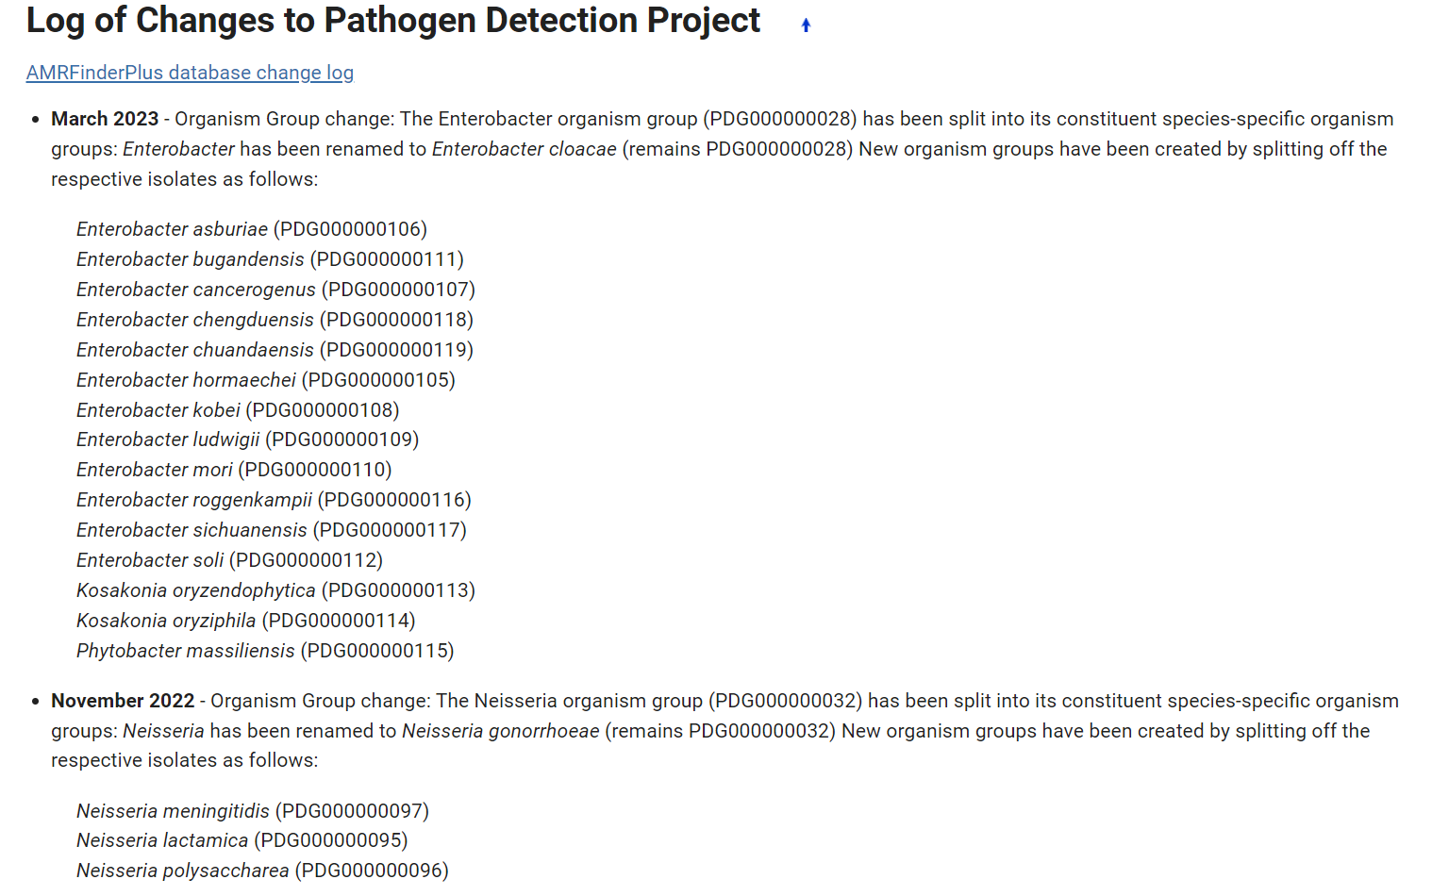
Other accomplishments
Pathogen Detection
Added seven organism groups
Finished two organism group splits (Enterobacter and Neisseria)
https://www.ncbi.nlm.nih.gov/pathogens/pathogens_help/#change-log

Slide 9
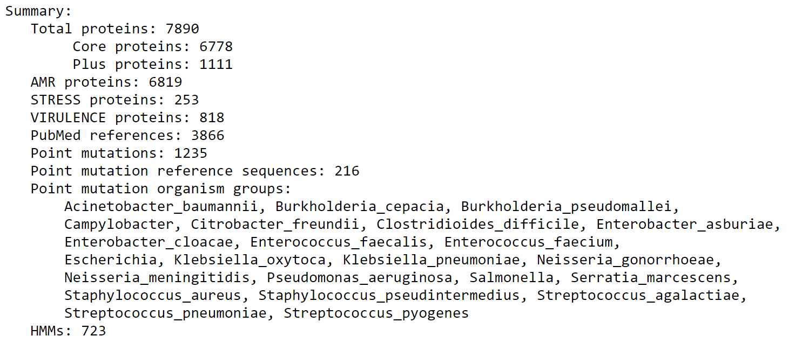
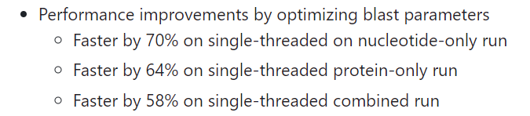
Other accomplishments
AMRFinderPlus
Seven AMRFinderPlus database and ten software releases including performance improvement
Working on recomputing all isolates with latest AMRFinderPlus in order to automate data delivery for
geographical mapping interface

Slide 10
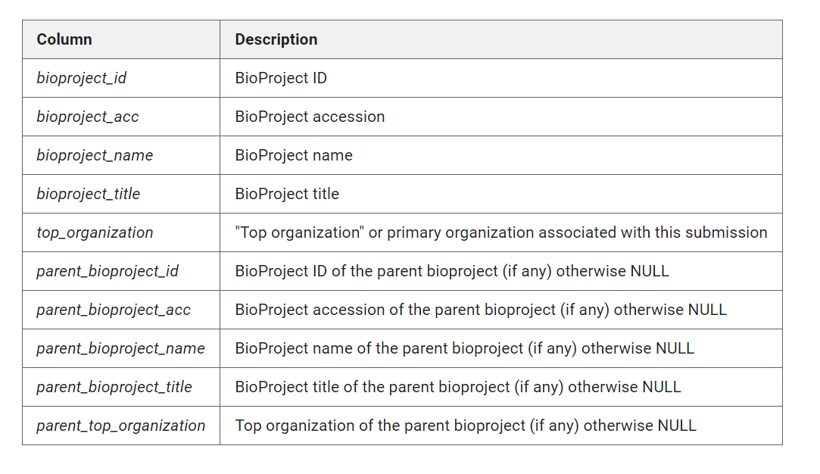
Other accomplishments
Pathogen data on cloud
Added Bioproject hierarchy table to GCP BQ
Added One Health Enteric Package metadata table to GCP BQ

Slide 11
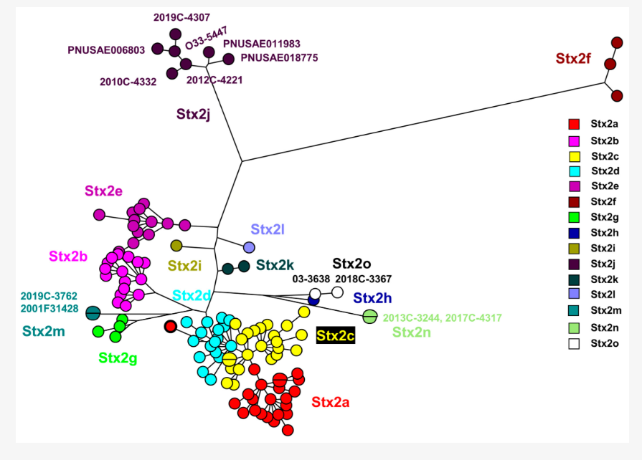

Other accomplishments
Presentation and papers
Multiple conference and workshop presentations including 2023 YouTube/webinar on pathogen data in cloud
Published a paper about identification of a novel toxin using PD resources with FDA, CDC, academic collaborators
BWH Lab
Published on cryptic MRSA transmission in NICU
https://doi.org/10.3390/microorganisms11102561
https://www.youtube.com/watch?v=j4dzFOo2FmI
https://doi.org/10.1128%2Fjcm.00014-23

Slide 12
Potential upcoming improvements
PD turnaround
Improve data processing in SNP tree export steps
Change how files are compressed on FTP (need to inform consumers of data) - especially
older data (retained data)
Move further computational steps to the cloud
Other changes
Massive effort to update old BioSamples with OHE attributes - this will not be fast
will impact several groups at NCBI (BioSample, GenBank, Submission Portal, PD)
Engineering more robust system for addition and modification of existing organism groups
Addition of Salmonella virulence gene from GenFS working group
Modify assembly process for clean up large chromosomally assembled segments from Saute
More new organisms and organism group splits
Sequence Typing (?)

Slide 13
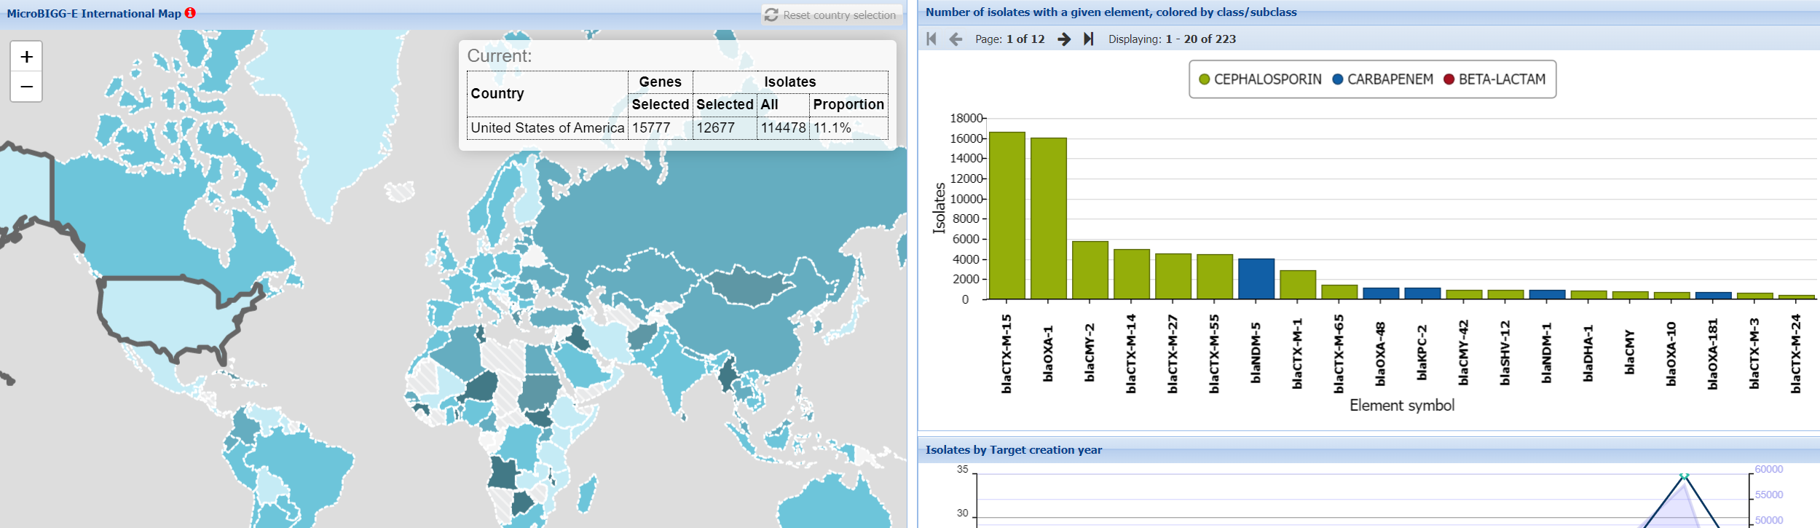
Future directions - mapping antimicrobial resistance genotypes
Cephalosporinases and carbapenemases in E. coli/Shigella spp.
https://www.ncbi.nlm.nih.gov/pathogens/microbigge_map/

Slide 14
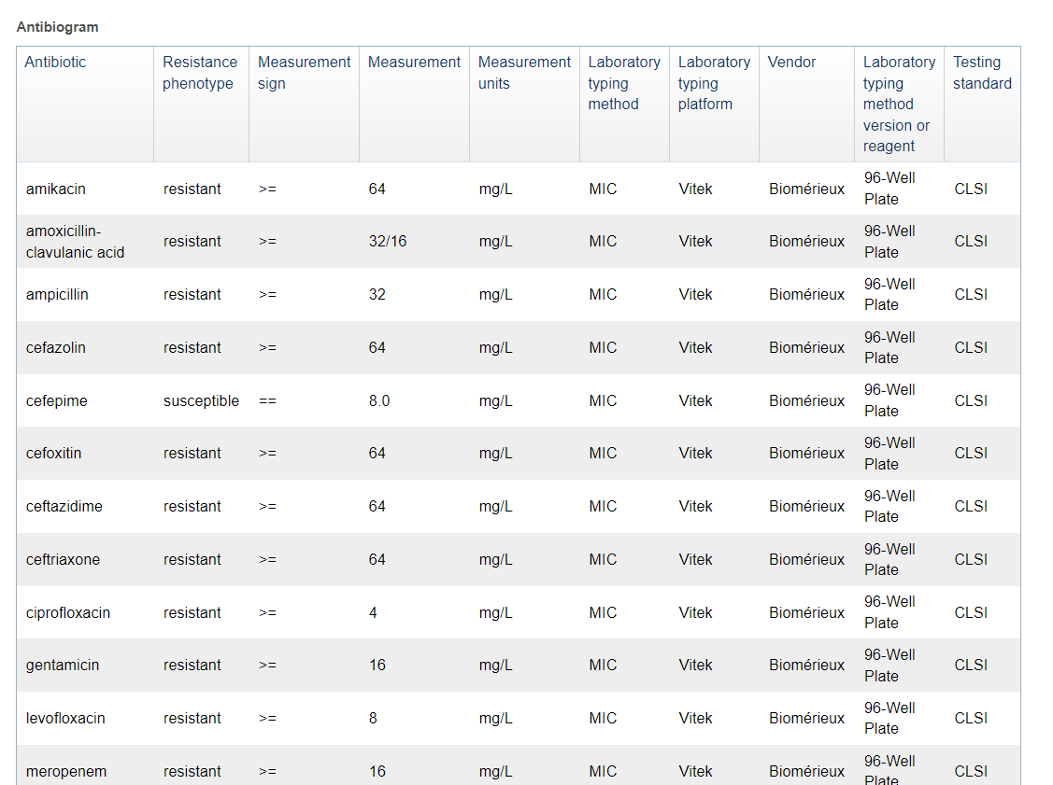
Antibiograms
~24K isolates with antibiograms
https://www.ncbi.nlm.nih.gov/biosample/?term=antibiogram%5bfilter%5d

Slide 15
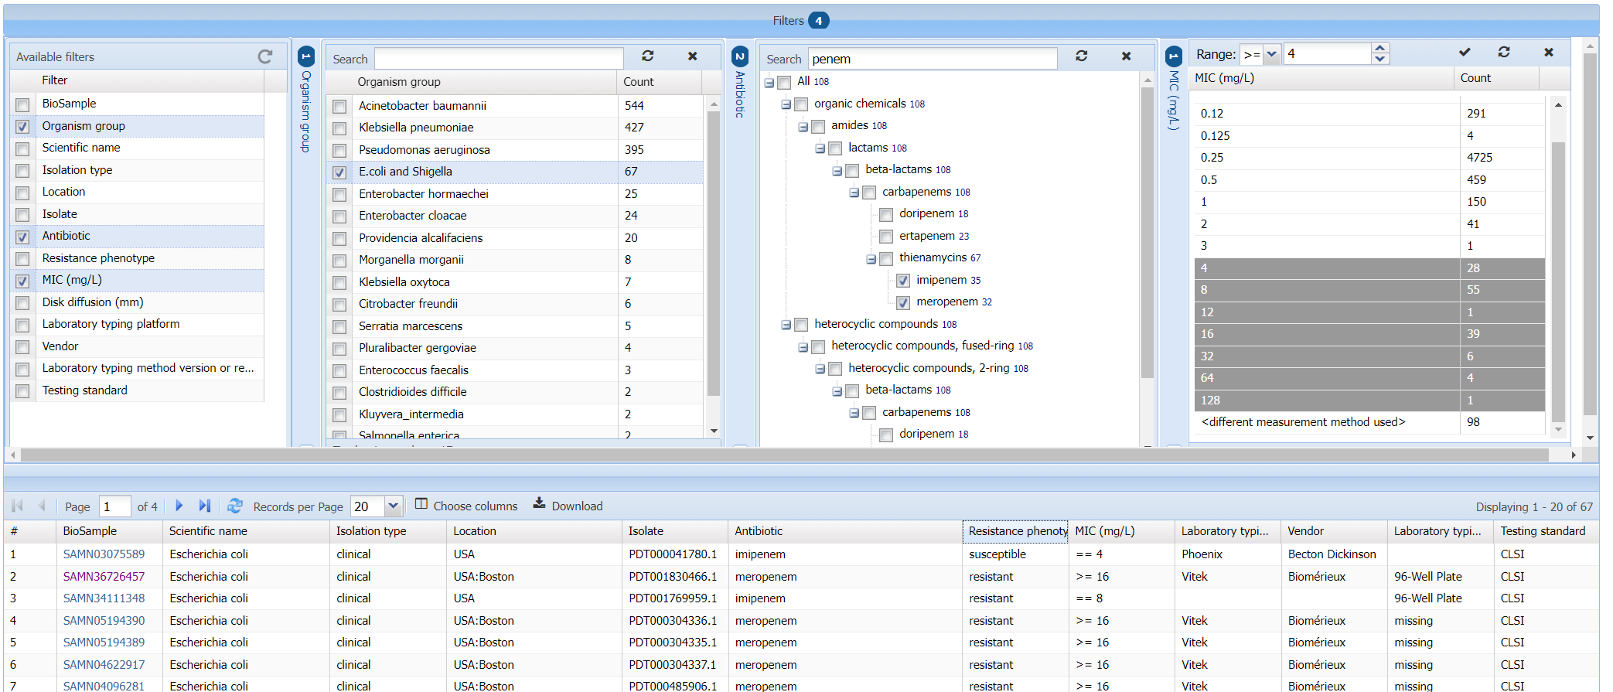
Future directions - AST Browser

Slide 16
Acknowledgements
Richa Agarwala
Victor Ananiev
Azat Badretdin
Slava Brover
Joshua Cherry
Jinna Choi
Vyacheslav Chetvernin
Pavan Chilamakuri
Robert Cohen
DeAnne Cravaritis
Michael DiCuccio
Olga Ermoleava
Boris Fedorov
Mike Feldgarden
Lewis Geer
Renata Geer
Dan Haft
Lianyi Han
Avi Kimchi
Michel Kimelman
William Klimke
Alex Kotliarov
Valerii Lashmanov
Aleksandr Morgulis
Eyal Moses
Chris O'Sullivan
Arjun Prasad
Edward Rice
Kirill Rotmistrovskyy
Alejandro A. Schaffer
Nadya Serova
Sergey Shiryev
Martin Shumway
Oleg Shutov
Douglas Slotta
Alexandre Souvorov
Tatiana Tatusova
Francoise Thibaud-Nissen
Igor Tolstoy
Ed Wachtel
Lukas Wagner
Jay Worley
Hlavina Wratko
Chunlin Xiao
Alexander Zasypkin
Eugene Yaschenko
Mingzhang Yang
David Lipman
James Ostell
Kim Pruitt
Stephen Sherry
ASM
BWH
CDC
FDA/CFSAN
FDA/CVM
GenFS
USDA-FSIS
PHAC/CFIA
PHE/FERA
NIAID
Wadsworth/MDH
pd-help@ncbi.nlm.nih.gov
This work was supported in part by the National Center for Biotechnology Information of the National Library of Medicine (NLM), National Institutes of Health, as well in part by the National Institute of Allergy and Infectious Diseases,
National Institutes of Health

