Slide 1

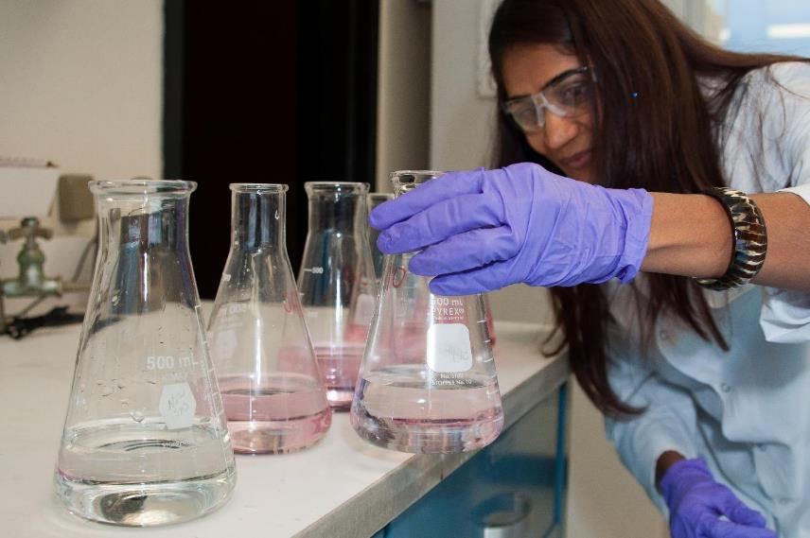
USDA-FSIS Whole Genome Sequencing (WGS) Update
Glenn Tillman, Ph.D.
GenomeTrakr Annual Meeting
College Park, MD
October 24, 2023

Slide 2

Take Home Message: Aligning Projects with FSIS Goals for WGS
Fully integrate WGS technology and associated policies into routine Agency operations
Support development of individualized inspection strategies for certain food pathogens and thereby inform the need for establishments to enhance sanitary practices and programs
Ensure alignment with public health partners
Set, advance, and promote vision for WGS application as technologies evolve
Prioritize projects aligning with the Strategic Plan

Slide 3
Milestones: FSIS Transition to WGS
FSIS began WGS on Salmonella and Campylobacter
for select cecal isolates
1- PFGE stopped for Lm
2- Began WGS on NARMS cecal indicator organisms
FDA ran WGS on Lm for FSIS
1- FSIS began WGS on STEC and Lm
2- Uploaded first Lm sequences to NCBI
FSIS begins to obtain Salmonella serotype isolates from WGS
FSIS creates new Campylobacter allele code scheme
FY14
FY17
FY19
FY21
FY13
FY15
FY16
FY18
FY20
FY23
FSIS runs first sequences for outbreak investigations
PFGE stopped on Salmonella, Campylobacter, and STEC
Lm allele codes released by CDC
WGS on all Salmonella and Campylobacter (product and cecal)
Abbreviations
FDA – Food and Drug Administration
CDC – Centers for Disease Control and Prevention
WGS – Whole genome sequencing
Lm – Listeria monocytogenes
NCBI – National Center for Biotechnology Information
PFGE – Pulsed-field gel electrophoresis
NARMS – National Antimicrobial Resistance Monitoring System
STEC – Shiga toxin-producing E. coli
Salmonella, Campylobacter, and STEC allele codes released by CDC
FSIS hosts WGS Public Meeting
Notes:
In this timeline you can see that implementing WGS has been a multi-year effort.
FSIS began using WGS in fiscal year 2013 for Listeria monocytogenes. Using a gradual process, FSIS expanded WGS to other foodborne pathogens. Now all Campylobacter, Shiga toxin-producing Escherichia coli (STEC), Salmonella and Listeria monocytogenes from product sampling or environmental samples (for L. monocytogenes) are sequenced as well as all Campylobacter and Salmonella and most, but not all, Enterococcus, and generic E. coli from environmental cecal sampling projects. By 2019, we successfully transitioned all subtyping activities to WGS. Now, we use WGS to characterize about 14,000 food isolates each year.
WGS has been in use for several years and has made a significant impact on investigations at FSIS. It has also helped to streamline multiple methods since WGS provides much greater detail about the genetic makeup of an organism than previous technologies. For example, WGS provides information about genes that impart characteristics including virulence and antimicrobial resistance. Importantly, in January 2020, we began using WGS data to obtain Salmonella serotype, resulting in enhanced laboratory efficiency.

Slide 4

WGS Data Sharing in FSIS:
Notes:
Next, we would like to discuss some ways that we analyze and then share WGS data in FSIS.

Slide 5
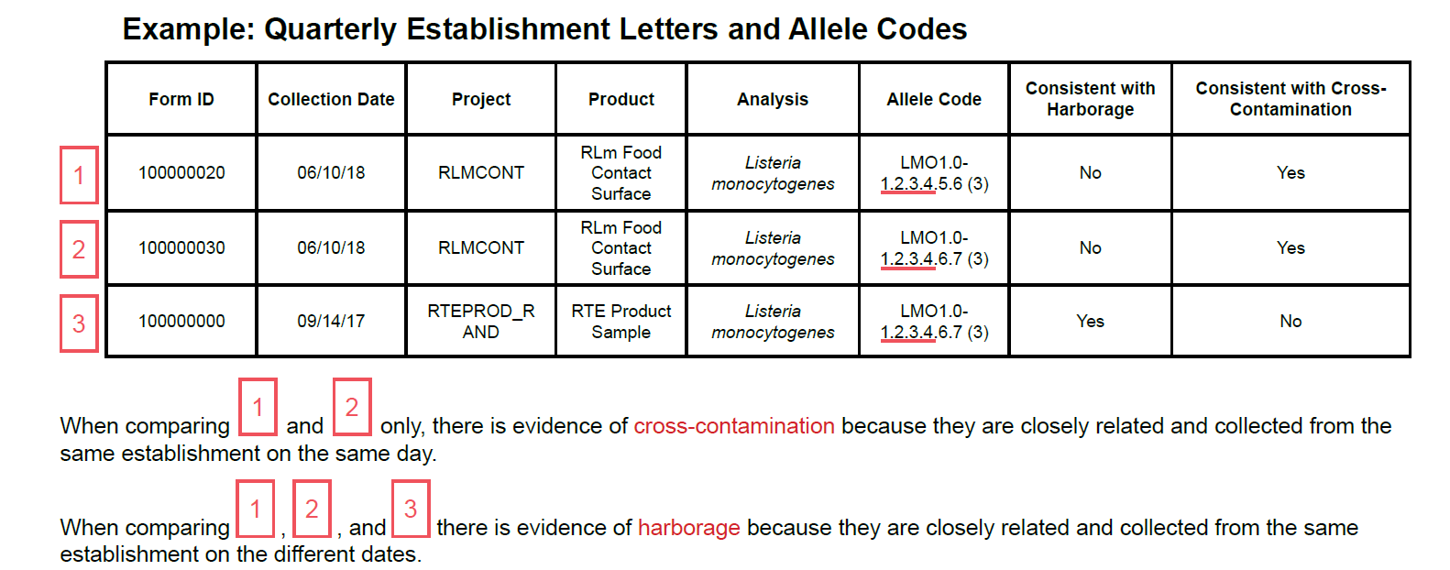
Data Sharing Activities with FSIS-Regulated Establishments
Cross-contamination is the transfer of harmful bacteria between food, other foods, food contact surfaces, or non-food contact environmental surfaces.
Harborage is the persistence of harmful bacteria in a processing establishment over time.
FSIS considers Lm isolates to be closely related if at least the first four fields of the allele code match.

Slide 6

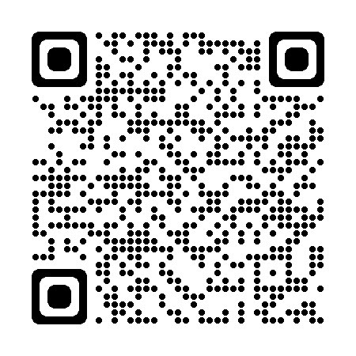
Public Data Sharing Activities
Quarterly, FSIS posts establishment-specific datasets to its website. FSIS includes the ‘FSIS Number’ so WGS data can be located on NCBI for informational purposes.
FSIS stores its WGS data and limited metadata, such as sample type and location, on a publicly accessible database hosted by NCBI.
https://www.fsis.usda.gov/science-data/data-sets-visualizations/laboratory-sampling-data
Metadata improvements are on the way via the Metadata Working Group
https://www.ncbi.nlm.nih.gov/pathogens

Slide 7
Example of Public Establishment-Specific Dataset
Product Sampling Isolate Results (mock-up example)
Raw Chicken Carcass Sampling – Data from FSIS Inspected Establishments
Establishment ID | Establishment Number | EstablishmentName | State | ProjectCode | ProjectName | FormID
1234567 | M9999999 | World of Poultry | NY | HC_CH_CARC01 | HACCP Verification for Young Chicken Carcasses | 102809827
CollectionDate | SampleSource | Salmonella SPAnalysis | Salmonella Serotype | Salmonella PFGEPattern | Salmonella AlleleCode | Salmonella FSISNumber
05Oct2021 | Animal-Chicken-Broiler / Young Chicken Carcass Rinse | Positive | Infantis | NULL | SALM1.0 - 6747.20.1.46 | 01/27/2022 | FSIS32105964
Salmonella AMR Resistance Profile | Campylobacter Analysis 1ml | Campylobacter Analysis 30ml | Campylobacter Species | Campylobacter PFGE Pattern | Campylobacter Allele Code | Campy AMR Resistance Profile | Campy FSIS Number
Amp Axo Chl Nal Tet | NULL | Negative | NULL | NULL | NULL | NULL | NULL

Slide 8
Laboratory Updates on WGS in FSIS:

Slide 9
FSIS Lab Updates: Integrating Illumina DNA Prep Kit
Resource and time savings
More isolates on a single run (90MB vs. 60MB on Nextera XT runs)
Cost Savings
  Cartridges
  Qubit reagents
Reduce turnaround time as can use 300 cycle kits (~26h vs. ~36h for 500 cycle)
Better quality
More consistent coverage
Down-sampling experiment through Gen-FS* showed libraries prepared with Illumina DNA Prep kits can characterize E. coli serotypes, stx subtypes, and virulence factors more consistently at lower coverage
* Genomics for Food and Feed Safety (Gen-FS)

Slide 10
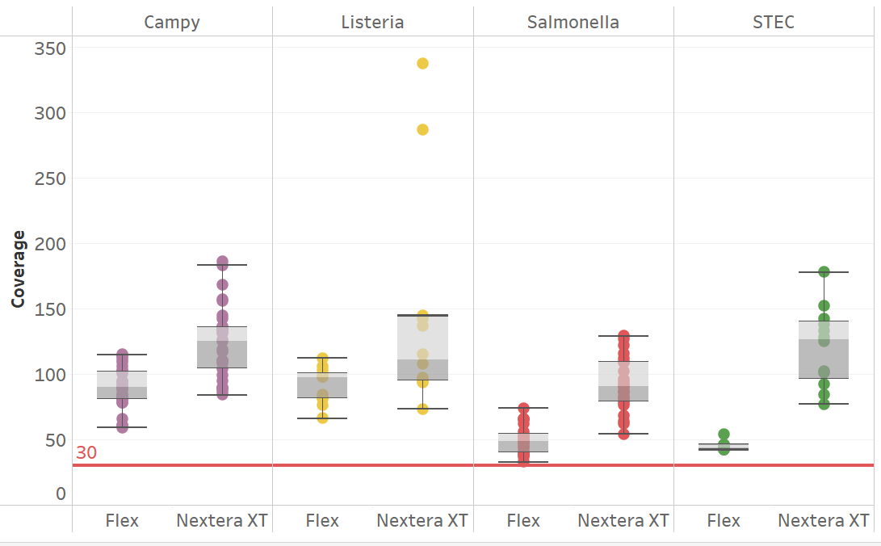
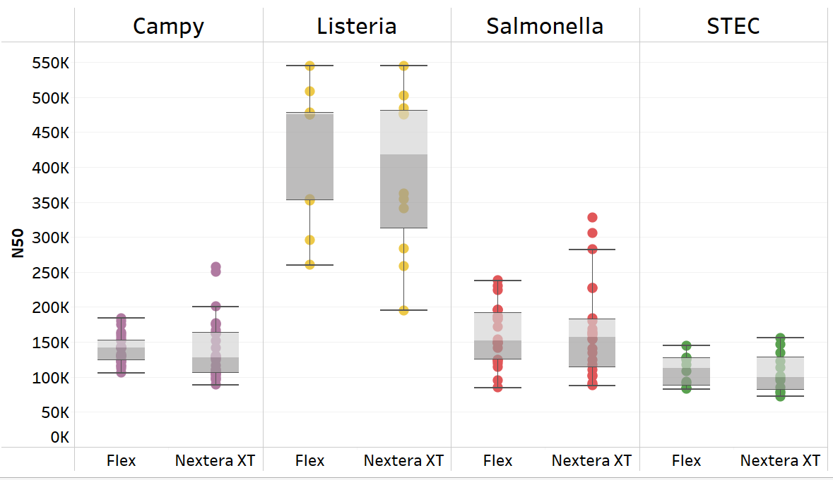
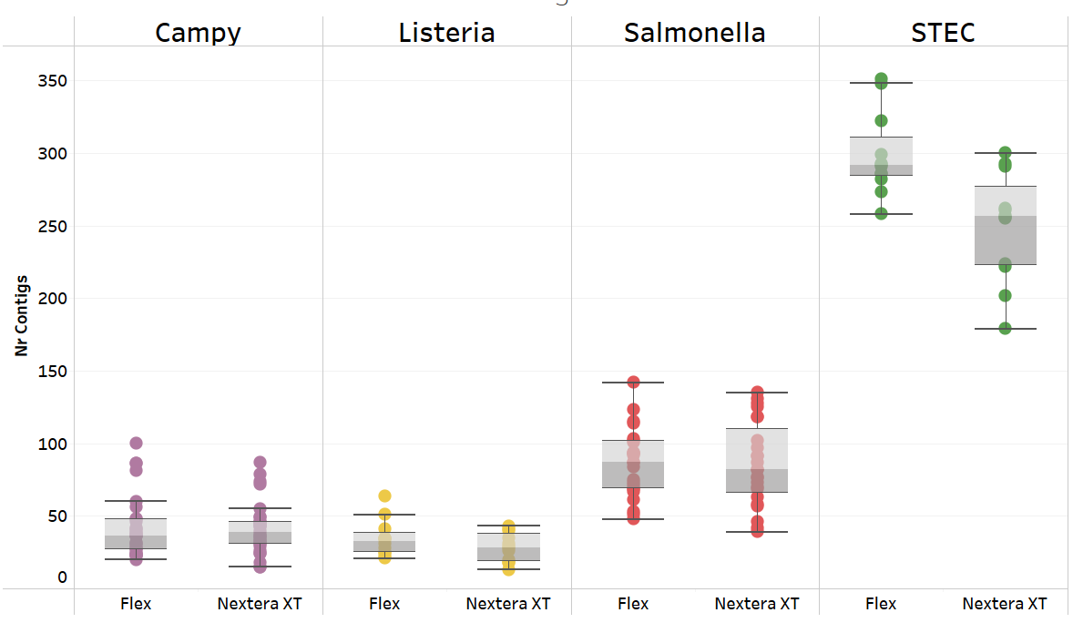
Laboratory Verification Study for Illumina DNA Prep Kit
All runs passed PulseNet quality criteria
Consistent metrics across runs and analyst

Slide 11
Characterizing Important STEC genes with Illumina DNA Prep Kit
O157
Non-O157
Sample Name | MLST | stx | Serotype
FSIS12321104 | ST13200 | stx1a; stx2c | O157:H7
FSIS12321104FLEX | ST13200 | stx1a; stx2c | O157:H7
FSIS12322677 | ST11 | stx2a | O157:H7
FSIS12322677FLEX | ST11 | stx2a | O157:H7
FSIS12322946 | ST11 | stx1a; stx2c | O157:H7
FSIS12322946FLEX | ST11 | stx1a; stx2c | O157:H7
FSIS12323183 | ST11 | stx1a; stx2c | O157:H7
FSIS12323183FLEX | ST11 | stx1a; stx2c | O157:H7
FSIS12323704 | ST7019 | stx1a; stx2c | O157:H7
FSIS12323704FLEX | ST7019 | stx1a; stx2c | O157:H7
Sample Name | MLST | stx | Serotype
FSIS12322323 | ST21 | stx1a | O26:H11
FSIS12322323FLEX | ST21 | stx1a | O26:H11
FSIS12322675 | ST29 | stx2a | O26:H11
FSIS12322675FLEX | ST29 | stx2a | O26:H11
FSIS12323361 | ST306 | stx1a | O45:H2
FSIS12323361FLEX | ST306 | stx1a | O45:H2
FSIS12321787 | ST17 | stx1a | :H2
FSIS12321787FLEX | ST17 | stx1a | O103:H2
FSIS12322633 | ST17 | stx1a | O103:H2
FSIS12322633FLEX | ST17 | stx1a | O103:H2
FSIS12322676 | ST17 | stx1a | O103:H2
FSIS12322676FLEX | ST17 | stx1a | O103:H2
FSIS12323984 | ST17 | stx1a | O103:H2
FSIS12323984FLEX | ST17 | stx1a | O103:H2
DNA Prep Kit identified the O antigen for FSIS1221787

Slide 12

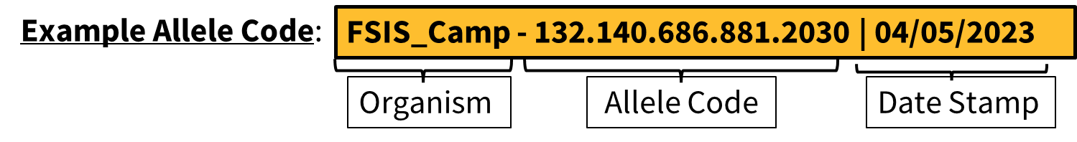
FSIS Lab Update: Campylobacter Allele Codes Success Story
Assessed Performance Measures of the Algorithm
Typeability (does it get named?) – ~98% for species coli and jejuni
Specificity – ~99% (different SNP Cluster and different allele code)
Sensitivity – 96-99% (same NCBI SNP Cluster and same allele code)
Accessibility – Is the algorithm accessible by the lab for 10 weeks straight?
Assigned Allele Codes to FSIS Campylobacter isolates
Entered and authorized ~26,000 records in LabWare
Report in Establishment-Specific Public Datasets in January 2024
Provide via Agency reports immediately
Continue use-case scenarios for the allele codes, including identifying repetitive subtypes

Slide 13
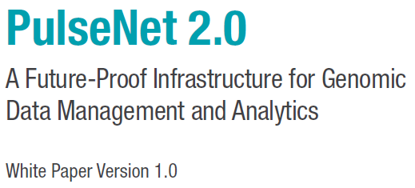
FSIS Lab Planning for PulseNet 2.0
2023
2024
May June July Aug Sept Oct Nov Dec Jan Feb Mar Apr May June July Aug Sept Oct
CDC published a White Paper describing the Minimum Viable Product (MVP)
Future White Paper describing Fully Operational Capability (FOC)
Full transition to PulseNet 2.0
Pilot labs begin testing MVP
Rollout of the FOC
Internal CDC Testing of the MVP began in June 2023
  FSIS and other pilot laboratories will begin testing after this is completed ~Dec. 2023
There will be a transition period between BioNumerics and PulseNet 2.0 during the summer and fall of 2024
May 2023

Slide 14
Looking Forward in FSIS:
Notes:
Next, we would like to discuss some ways that we analyze and then share WGS data in FSIS.

Slide 15

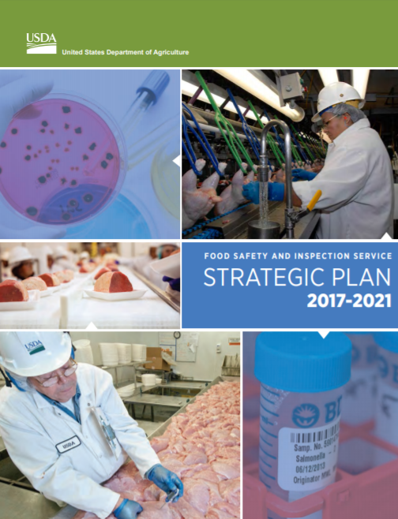

What is Next for WGS in FSIS?
Strategic Plan
2023-2026
WGS data analyses
Build foundation for regulatory policies
Strategic Plan
2011-2016
WGS Implementation
Strategic Plan
2017-2021
Upgrade infrastructure
Apply routine use of WGS

Slide 16
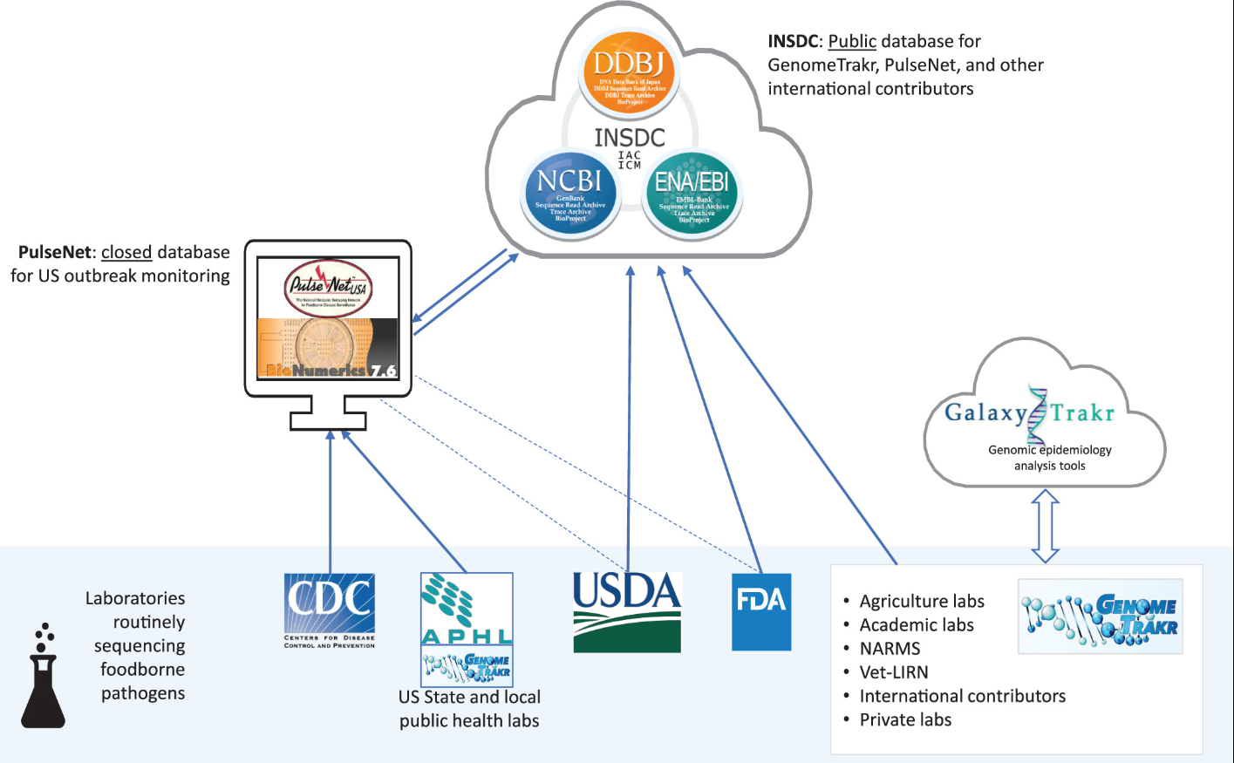
FSIS Coordinates with U.S. Public Health and Regulatory Agencies to Use WGS to Enhance Food Safety
WGS was deployed with substantial coordination across a large network of Federal, State, and local public health laboratories.
Major collaborations include:
  Gen-FS
  NARMS
  FDA GenomeTrakr
  CDC-PulseNet
Stevens, E.L. et al. Use of Whole Genome Sequencing by the Federal Interagency Collaboration for Genomics for Food and Feed Safety in the United States, Journal of Food Protection, Volume 85, Issue 5, 2022, Pages 755-772, ISSN 0362-028X, https://doi.org/10.4315/JFP-21-437.

Slide 17
FSIS Moving Forward with Genomics
Not all foodborne microbial pathogen subtypes inherently have the same risk associated with illness or patient outcome.
FSIS believes that genomic characterization will support identifying pathogen subtypes with higher risk for illness or patient outcome.
FSIS participates in activities around illness attribution using genomics as well as risk assessment using genomics.
FSIS plans to seek advice from NACMCF* on how genomics and current or emerging technologies and strategies can be used to identify foodborne microbial pathogen subtypes based on public health risk.
* National Advisory Committee on Microbiological Criteria for Food

Slide 18
Summary
Fully integrate WGS technology and associated policies into routine Agency operations
Support development of individualized inspection strategies for certain food pathogens and thereby inform the need for establishments to enhance sanitary practices and programs
  Data sharing with stakeholders
Ensure alignment with public health partners
  Prepare for and implement PulseNet 2.0
  Implement DNA Prep Kit into WGS lab workflow
Set, advance, and promote vision for WGS application as technologies evolve
  Campylobacter allele code project
Prioritize projects aligning with the Strategic Plan
  NACMCF Genomics Charge 2023-2025

Slide 19


fsis.usda.gov

