Slide 1
Global and Local Bioinformatics for Food Safety
The National Service of Health, Safety and Agrifood Quality (SENASICA)

Slide 2


MEXICO: global context
Mexico ranks as the twelfth largest food producer in the world
National Service of Health, Safety and Agrifood Quality (SENASICA)
National Reference Center for Food Safety and Biosafety (CNRIBA)
General Directorate of Agri-food, Aquaculture and Fisheries Safety (DGIAAP)

Slide 3

Food Safety Partnership (FSP)
Working groups:
1.- Strategic priorities and training
2.- Laboratory collaboration
3.- Outbreak response

Slide 4
SENASICA: activities GT-network
S. enterica (~1100)
L.monocytogenes (~180)
E.coli (~120)
C.coli (~45)
L.seeligeri (3)
V.parahaemolyticus (1)
GT 2023 → GT 2024
more than 400
~1450 sequences included
2021 QC metrics for reads and assemblies
2024 GT-PT
162 assemblies included
GT
NETWORK
Genomic information is enriched and strengthened
150 AST results included
Monthly meetings
850 records of sequences homologated
metadata cleanup challenge 2023

Slide 5
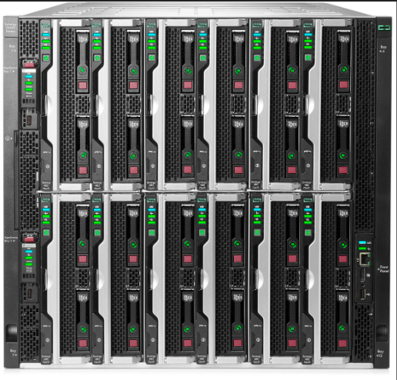
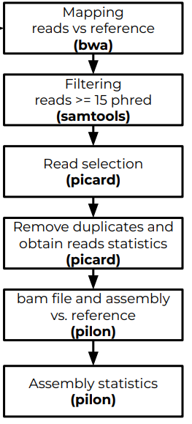
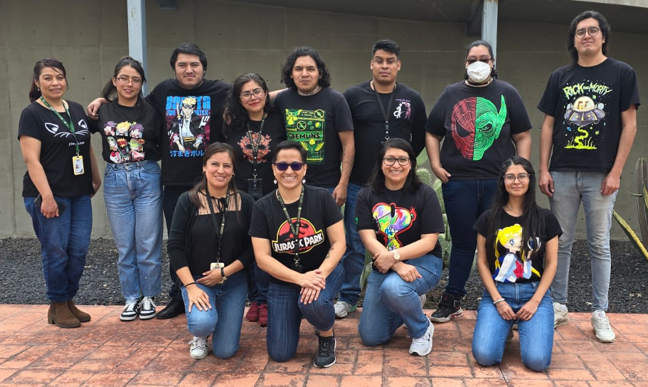
Bioinformatics: local resources
QC reads
Trimming reads
Statistics reads
Work Stations:
Precision 5820 Tower X-Series
Servers:
Synergy 480 Gen10 and RHEL
Assembly
Statistics Assembly
MLST, ST
AMR genes
Genomic characterization
Virulence genes

Slide 6
Bioinformatics: global needs
AMR y Virulece genes
Global needs
Long reads for genome and plasmids closure
Metagenomics and Quasi-metagenomics
Virus characterization

Slide 7







Bioinformatics: International enrichment
Technical support
Quality metrics for reads and assemblies
Standardization of metadata for incorporating sequence into NCBI
Workflows in GalaxyTrakr
Quasimetagenomic characterization of Salmonella
Bioinformatics tools like mlst, snippy, snp dist, abricate and prokka
Training sessions
Long-reads analysis for genomic characterization of bacterial isolates
NCBI Pathogen Detection
Antimicrobial Resistance

Slide 8
Publications: co-authorships
Name | doi
Genomic diversity of S.enterica isolated from raw chicken at retail establishments in Mexico | 10.1016/j.ijfoodmicro. 2023.110526
Genomic diversity and distribution of L.monocytogenes strains isolated from imported and national fresh produce in Mexico from 2014 to 2018 | Pre-print
L. seeligeri: genomic and phenotypic insights of a potential hazard of turkey deli meat products in Mexico | Pre-print

Slide 9
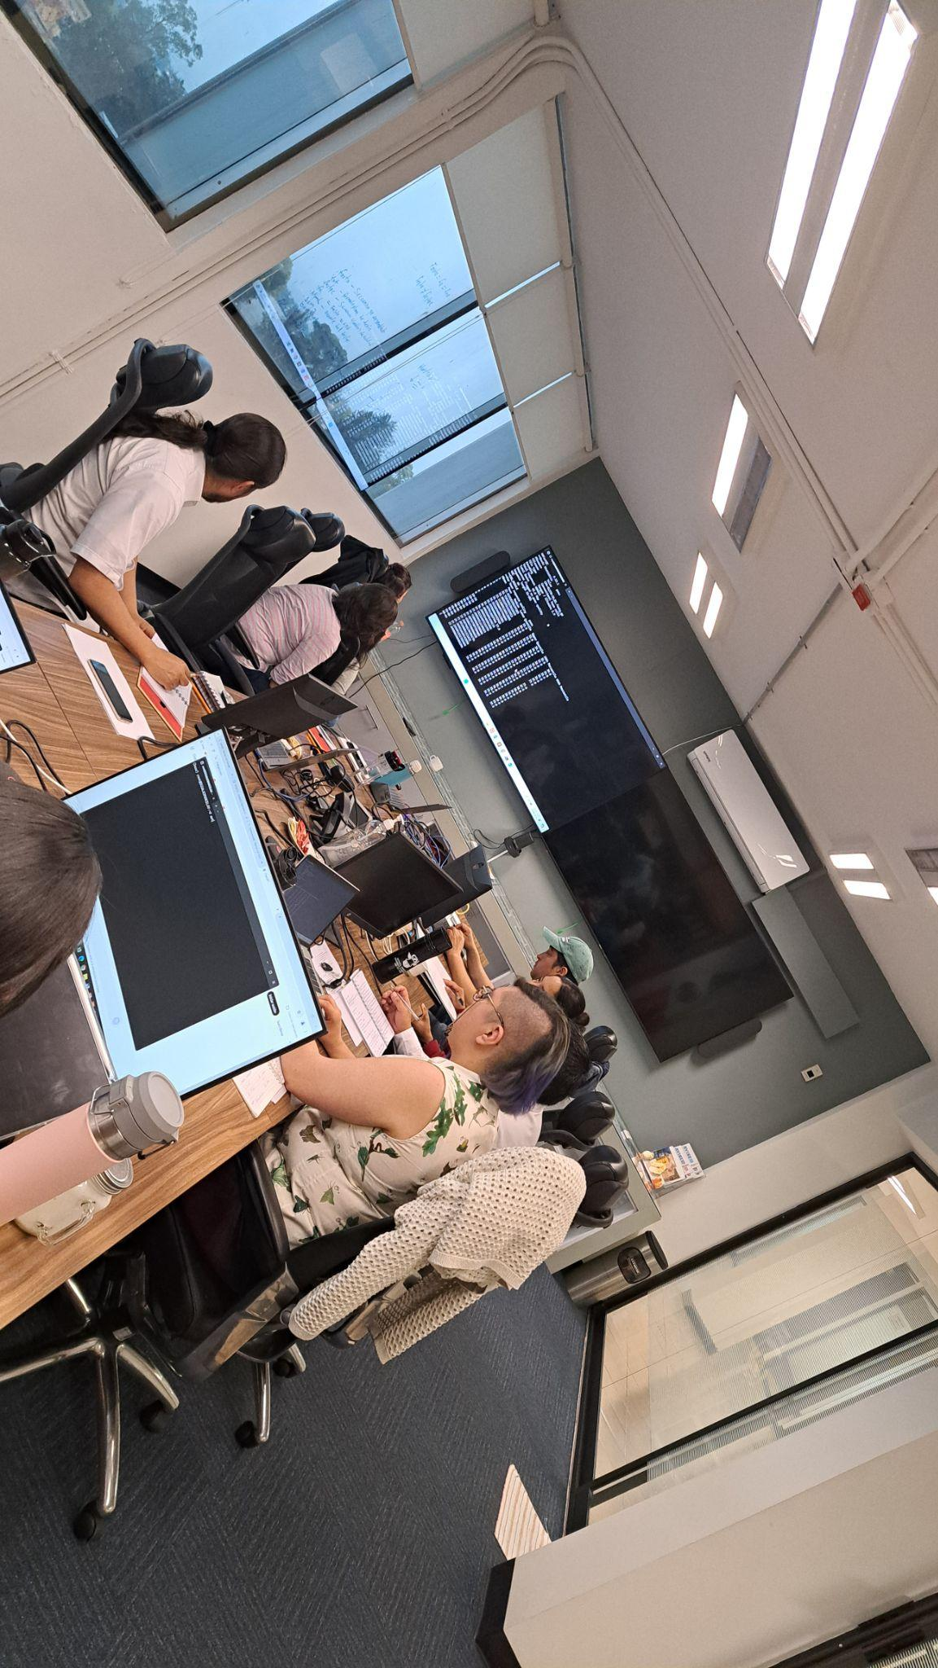

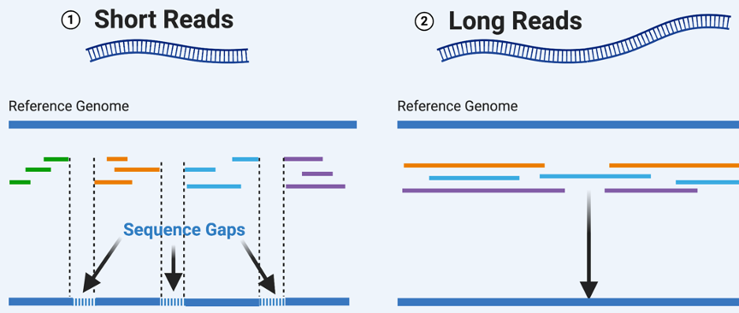
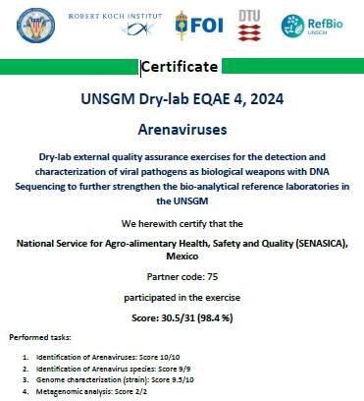
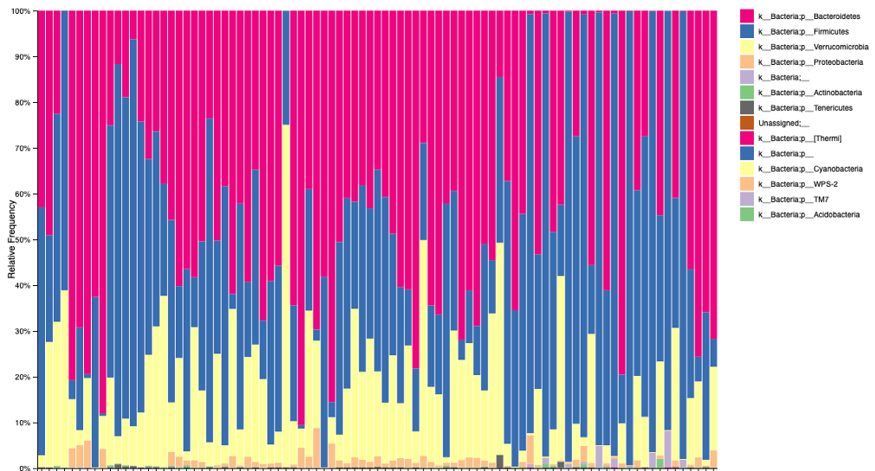
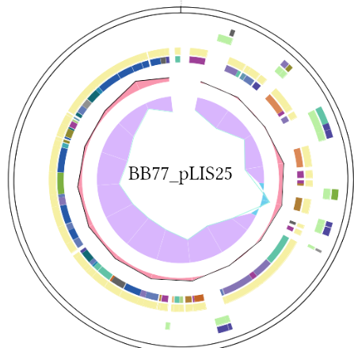
Bioinformatics: local activities
Train colleagues
Participate regional project PulseNet LA&C
Campylobacter and Salmonella
Participate in: UNSGM
Dry Lab EQAE 2024 on Arenavirus
Score 98.4%
Develop methodologies to obtain hybrid assemblies for genome closure
Identify and characterize
Virulence genes and plasmids
in Listeria
Identify of bacterial communities
(16S gene)

Slide 10
Bioinformatics: future actions
Hybrid assemblies will be integrated into NCBI
Plasmids assemblies will be integrated into NCBI
~500 AST results will be incorporated into NCBI
Sequences in conjunction with
Metagenomic and Quasi-metagenomic analysis

Slide 11
Thanks so much
Contact us:
Mayrén Zamora
Director of “National Reference Center for Food Safety and Biosafety”
mayren.zamora@senasica.gob.mx
Fabiola Hernández
Head of sequencing and bioinformatics team
dgiaap.iica44@senasica.gob.mx
Christhian Franco
christhian.franco.i@senasica.gob.mx

