Slide 1
CDC Federal Updates
Lavin Joseph
Peyton Smith
GenomeTrakr Meeting
October 2023

Slide 2
Agenda
Updates –
  Database Updates
    Sequence Submission Numbers
    InFORM 2024 Conference
    Trainings
    PulseNet 2.0
    NCBI Uploader Updates
    Cronobacter sakazakii is nationally notifiable
    C. sakazakii characterization
    Submitting C. sakazakii sequences to PulseNet
    BEAM Dashboard
  Laboratory Updates
    New wet-lab Standard Operating Procedures (SOPs) in PulseNet
    Automation in the PulseNet network
    Tech updates in progress
    PulseNet 2.0 integration and opportunities for the wet-lab
Notes:
Hi- We will be providing the following federal updates.

Slide 3
Database Updates

Slide 4
Overall Submissions to PulseNet, Human and Non-Human
*
†
* Transition from PFGE to WGS July 15, 2019
†March 11, 2020, COVID-19 declared pandemic
Notes:
This slide shows the number of human and non-human submissions to PulseNet up to 2022. The number of uploads in 2022 is approaching the pre-COVID numbers.

Slide 5
Notes:
This slide shows the number of uploads separated out by organism.

Slide 6
Human Uploads to PulseNet, 5-yr average compared to 2020-2023 by month
*
*
*
*
Notes: 5-year average calculated from 2015-2019; fully transitioned from PFGE to WGS July 15, 2019
*March 11, 2020, COVID-19 declared pandemic
Notes:
Here we show the number of STEC (including Shigella), Salmonella, Listeria, and Campylobacter uploaded by month for 2020-2023 compared to the five year average (prior to COVID). Again, the number of uploads in 2022-2023 approach or exceed the pre-COVID numbers.

Slide 7

https://www.neha.org/inform
Registration opens October 6 and ends December 1 (early bird, $200).
After that, it will be regular rate ($225).
Notes:
Now, I would like to switch based and mention that our InFORM conference is coming up in January in Washington D.C. The link for more information and registration is shown here. Registration is now open and early bird registration will close December 1. After that it will cost an additional 25 dollars.

Slide 8
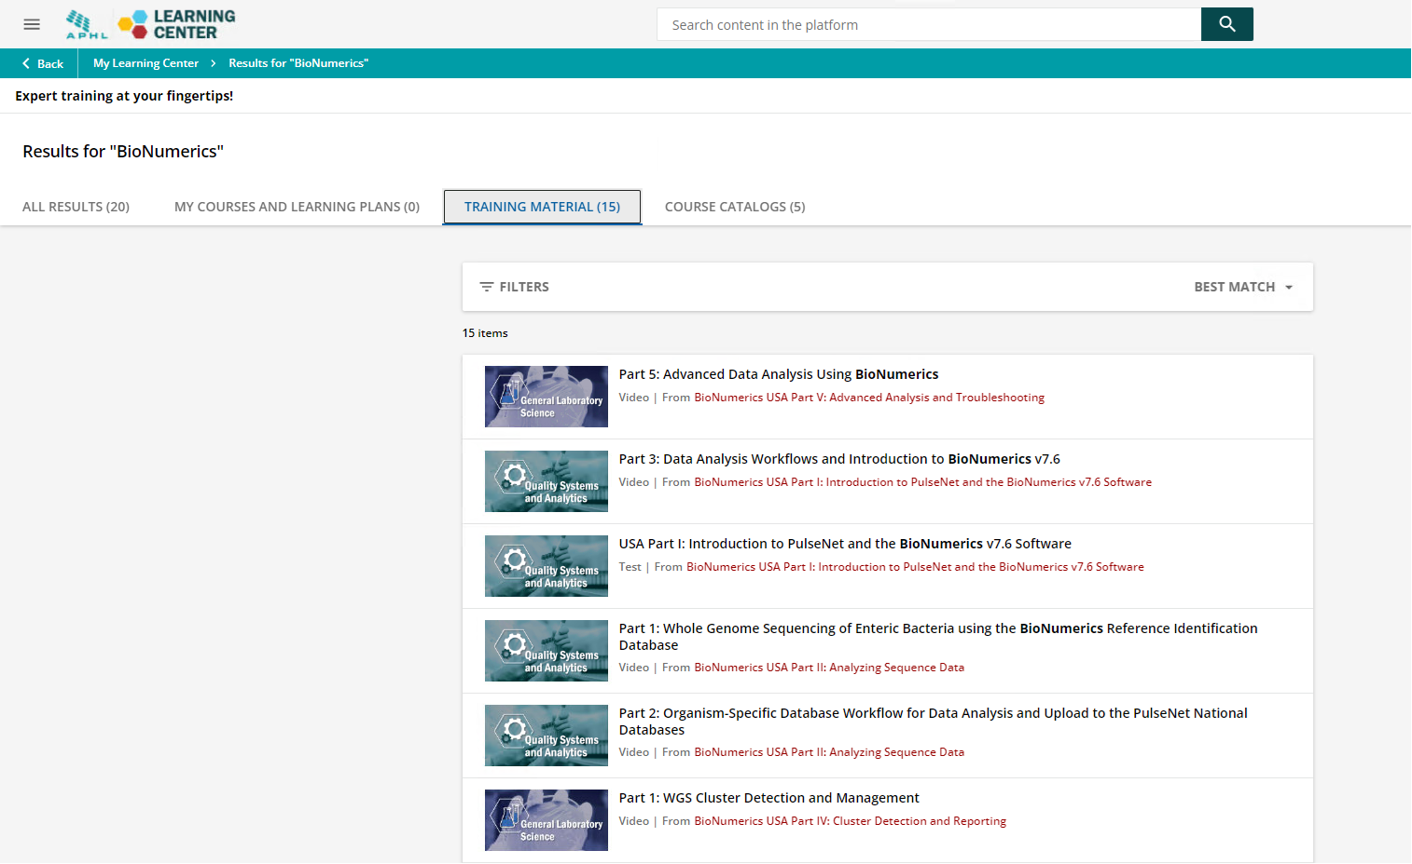
Trainings
APHL Webinars now on APHL Learning Center
Site has migrated to https://learn.aphl.org/learn
Search for "BioNumerics" to find the virtual training series
Notes:
PulseNet recorded some webinars that provide training on BioNumerics. These trainings have been migrated to the website shown here. Search on BioNumerics to get to the webinars. We recommend new personnel and even personnel who want to brush up on their BioNumerics sequence analysis skills to watch these webinars. We even provide an advanced analysis using BioNumerics.

Slide 9
PulseNet 2.0
Internal Testing of PulseNet MVP
  Increment 1: Tested importing, views, querying, edits to entries, exporting database fields
  Increment 2: Tested data validation on import, resolved bugs from increment 1, analysis pipeline
  Increment 3: Tested submitting sequence data to the pipeline, to include from linkage to NCBI
  Increment 4: Tested additional linking of sequence data through BaseSpace and publishing data to the national database
  Pilot laboratories have been invited to participate on the kickoff calls for awareness
    Pilot labs have received dedicated office hours for feedback on the MVP system
  PulseNet will also schedule additional office hours for the larger community for awareness as the system nears MVP
One Health Enteric Package
  Working through list of proposed fields and how they are mapped (or not) into existing BioNumerics fields
Notes:
We have been performing some internal testing on PulseNet 2.0. Read slide.
We are working through the list of proposed One Health Enteric Package/GT fields and how they are currently mapped or not to existing BioNumercs fields to see the feasibility on incorporating into PN 2.0.

Slide 10
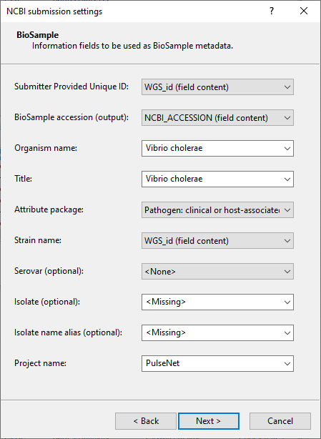
NCBI Uploader v2.6
Distributed to all GenomeTrakr Laboratories
New attributes include:
  Project Name: PulseNet for PulseNet templates or GenomeTrakr required name for GenomeTrakr templates
Notes:
The new NCBI uploader for BioNumerics was distributed to all GenomeTrakr labs. The new uploader has a place to enter a project name (PulseNet or GenomeTrakr for example).

Slide 11
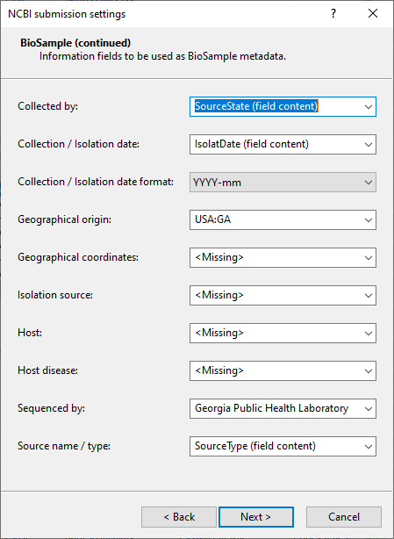
NCBI Uploader v2.6
New attributes include:
  Sequenced by: GenomeTrakr required naming convention of sequencing laboratory
  Source name/ type: SourceType field in BioNumerics
Updates also include updated instrument models and library names
Notes:
The uploader also includes a location for Sequenced by which is the same of the public health laboratory performing the sequencing and SourceType (i.e. Human, Animal, Food, Environmental). The updates also include updated instrument models and library names.

Slide 12
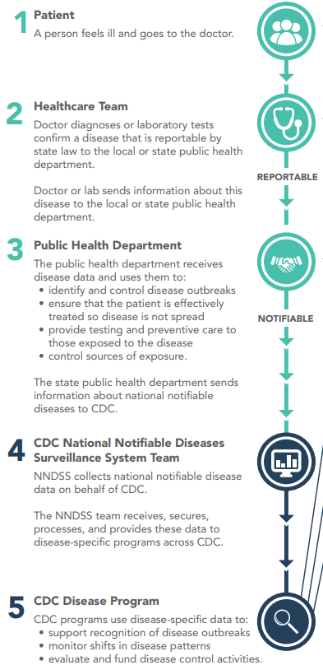
Nationally Notifiable Cronobacter Infections in Infants
The position statement was approved by CSTE’s Council
  Establishes standardized criteria for case identification and classification
    Used for public health surveillance
    Includes criteria for confirmed and probable cases
  Statement developed by CSTE members
    Supported by CDC, FDA, and APHL members
Standardized surveillance case definitions establish more consistent disease surveillance across the nation
  Improves national health monitoring
  Facilitates interactions between health care providers and public health disease investigators
Will go into effect January 2024
https://www.cdc.gov/nndss/index.html
https://www.cste.org/page/PSLanding
Notes:
These slides are word-heavy but provided for information
Cronobacter infections in infants is now nationally notifiable by CSTE. Read starting with first sub-bullet.

Slide 13
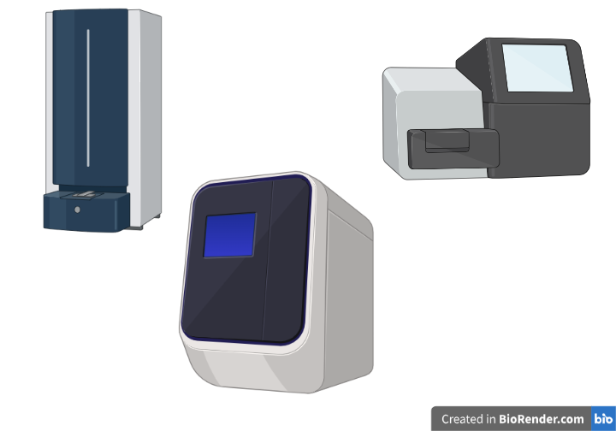
Identification of Cronobacter spp. and C. sakazakii
Bruker MALDI Biotyper CA for Clinical Applications Database (MBT CA) has FDA clearance for 424 microbial species, including Cronobacter sakazakii
https://www.accessdata.fda.gov/cdrh_docs/pdf14/K142677.pdf
Bacteriological Analytical Manual (BAM) Chapter 29: Cronobacter real-time PCR assay for identification at the genus level
https://www.fda.gov/food/laboratory-methods-food/bam-chapter-29-cronobacter
Whole genome sequencing (WGS)
PulseNet is currently validating a National Database for uploads/cluster detection – release date TBD
Notes:
This slide shows the various methods for identification of Cronobacter and C. sakazakii.

Slide 14
Isolates can be submitted to the National Enteric Reference Laboratories
Submission of isolates to CDC:
  For a CLIA report: CDC-10123 Yersinia (non-Y. pestis) and other Enterobacterales Identification
  POCs: Christine Lee (clee13@cdc.gov) and Monica Im (MonicaIm@cdc.gov) for coordination of isolate submissions
Submission of primary specimens to CDC:
  Work with state public health practitioners for all submissions; preliminary approval in communication with CDC required prior to submission
  For surveillance and Cronobacter isolation from primary sources (includes environmental samples, i.e., breast pump parts, opened cans of PIF, breast milk):
    CDC-10106 Enteric Isolation – Primary Specimens
    POC: Haley McKeel (hvw0@cdc.gov)
Current turnaround time for CDC-10123 currently is 14 business days
  Species identification/confirmation using Sanger-sequencing of the rpoB gene
WGS and input in the Cronobacter National Database (forthcoming in PulseNet) currently in validation
  Speciation using Average Nucleotide Identity (ANI) using type strains in our Reference Genome Database
  Whole genome MLST scheme for cluster detection
  High-quality SNP analysis(hqSNP using lyve-SET) is used for comparison across recent CDC clinical and FDA environmental isolates
  POC: Lavin Joseph (gyu4@cdc.gov) and PulseNet (PulseNet@cdc.gov)
Notes:
Isolates and/or specimens can also be submitted to CDC for Cronobacter identification. This slide shows all of the POCs.

Slide 15

Cronobacter Epidemiologic Surveillance
Developed standardized case report form for public health surveillance activities
  Streamlined case investigation to optimize data collection activities
  Collects clinical information, infant feeding history prior to illness, and infant feeding product details
Developing electronic surveillance system using enterprise platform DCIPHER
  Direct data entry into platform
  Visualize and analyze case data
  Integrated with SEDRIC (System for Enteric Disease Response, Investigation, and Coordination) which centralizes data from other DFWED surveillance systems including PulseNet
  Collaboration with FDA partners in real-time
Notes:
We have also developed a standardized care report form for public health surveillance activities. We are developing an electronic surveillance system into DCIPHER/SEDRIC.

Slide 16
PulseNet Cronobacter Submissions
We are currently working on a Cronobacter national database. In the meantime, we accept all C. sakazakii sequences and will upload the reads and biosamples to NCBI. If you sequence C. sakazakii isolates, please follow these steps.
  Request a WGS id from PulseNet CDC and share the patient isolate demographic data.
  Name the fastq files in the PulseNet standardized naming format using the WGS id (i.e., PNUSAR000185-GA-M06531-20230805).
  Share the sequence files through the PulseNet FTP site or BaseSpace.
Within a couple of days of sharing the sequence data you should be able to use the WGS id to search NCBI and the Pathogen Detection browser to find your sequence and make comparisons to potentially related strains.
Notes:
Read slide.

Slide 17
BEAM (Bacteria, Enterics, Ameoba, Mycotics) Dashboard
  DFWED is in the process of increasing the visibility of its data
  The BEAM Dashboard is an interactive tool to access and visualize data from PulseNet and the System for Enteric Disease Response, Investigation, and Coordination (SEDRIC).
  Currently, the dashboard focuses on data for Salmonella, Shiga toxin-producing E. coli (STEC), Shigella, Campylobacter, and Vibrio bacteria, antimicrobial resistance and multistate outbreaks
  Eventually, the dashboard could include epidemiologic data from outbreak investigations.
Notes:
One of the main informatics problems we were facing was the large number of data requests our division was receiving because our data was not accessible to the interested parties in a timely manner.
Following the CDC’s broader vision to make its data more accessible, our division is in the process of modernizing and making our data transparent and more visible.
Our team conducted informal, open-ended discussions with over thirty individuals representing a range of partners, including academics, regulatory partners, industry, trade associations, retail companies, and consumer groups, informing a multiphase plan for dashboard development.
We categorized partner needs in to these 6 categories:
data linkages with automated analytics - this includes pathogen, serotype, and resistance by time, region, and epidemiological data
data downloads
user training
customized programmable alerts
direct application programming interfaces (API) with industry to inform prevention efforts (preemptive environmental assessments, early identification of food vehicles, early market withdrawals, and traceback efforts)
future linkages with any available regulatory data to support farm-to-fork analyses.

Slide 18
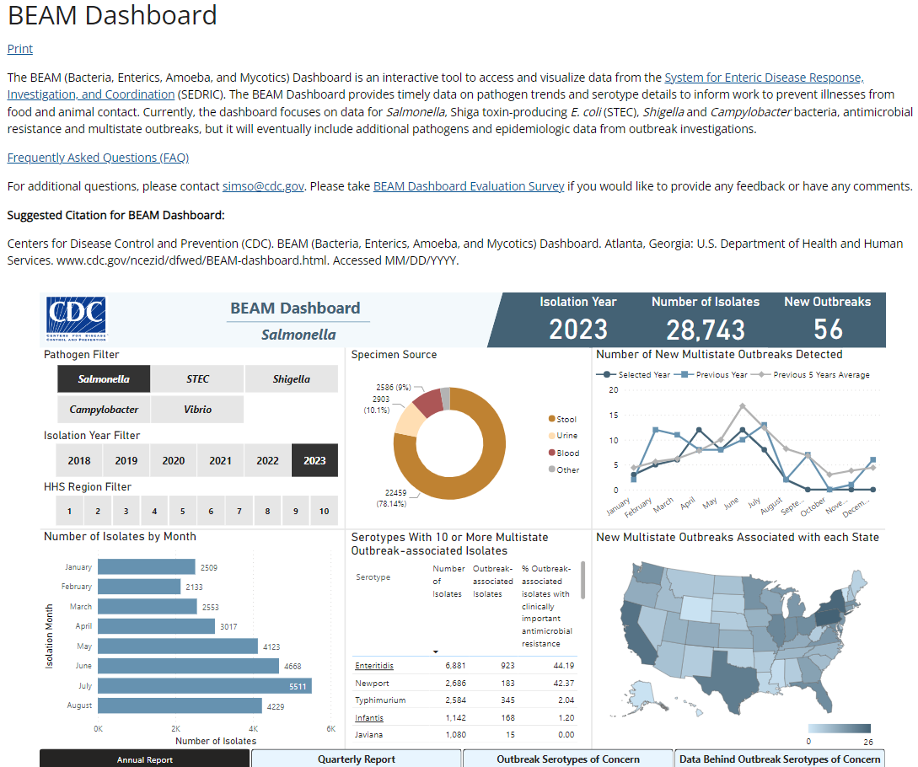
Navigating BEAM
  Filter by pathogen and year
  View submissions by month broken out by state/HHS region
  View common outbreak serotypes
  View trends in data
  Report sections include Annual, Quarterly, Outbreak Serotypes of Concern, and Data Behind Outbreak Serotypes of Concern
https://www.cdc.gov/ncezid/dfwed/beam-dashboard.html
Notes:
After 8 months of development, the first version of the dashboard went live on May 18th, last year, with Salmonella data.
We added Escherichia data in October and Campylobacter data in December last year.

Slide 19
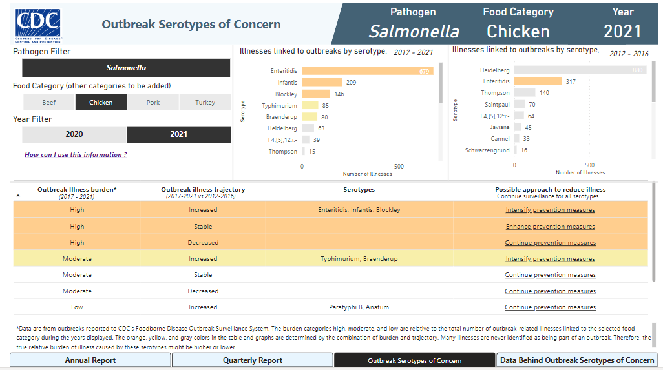
Navigating BEAM

Slide 20

Future Roadmap for BEAM
  Integrate antimicrobial resistance data from NARMS
  Add FDA & USDA non-clinical data
  Provide closer to real-time data, currently only monthly updates
Notes:
We have a roadmap for the BEAM dashboard with 8 versions. The BEAM dashboard is still in the first version.
We already have three pathogens represented in the dashboard and we will be adding the Listeria next.
Then we are going to integrate other internal systems like NARMS.
We are planning to connect other external systems to this dashboard like the ones in FDA and USDA.
Initially we were pushing data quarterly to the dashboard after cleaning and validation, but now we have increased the frequency of updates to once every month. We hope to make this process even faster and provide closer to real-time data in the future.

Slide 21
Laboratory Updates

Slide 22
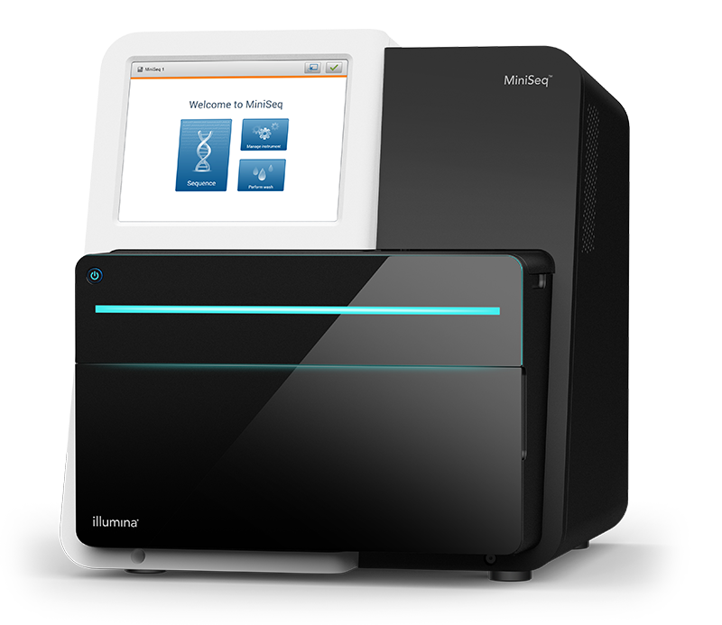
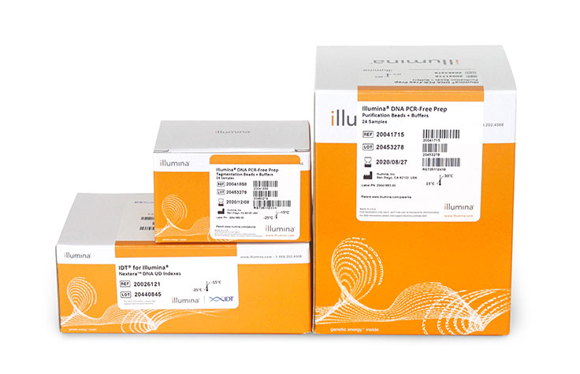
New Laboratory Procedures in PulseNet
Sequencing on the MiniSeq
Document PNL39 was published in Feb 2023 for the use of the Illumina MiniSeq instrument for sequencing PulseNet organisms using either the Mid or High Output kits
  The MiniSeq uses 2-color chemistry and has a loading capacity similar to the MiSeq
DNA PCR-Free Prep Library Preparation
Documents PNL43, PNL43.W1,and PNL43.W2 were published in Spring 2023 for the use of the Illumina PCR-Free DNA Prep library preparation kit in PulseNet
  PNL43 – SOP
  PNL43.W1 – Library Preparation Workbook
  PNL43.W2 – Checklist step-by-step procedure

Slide 23
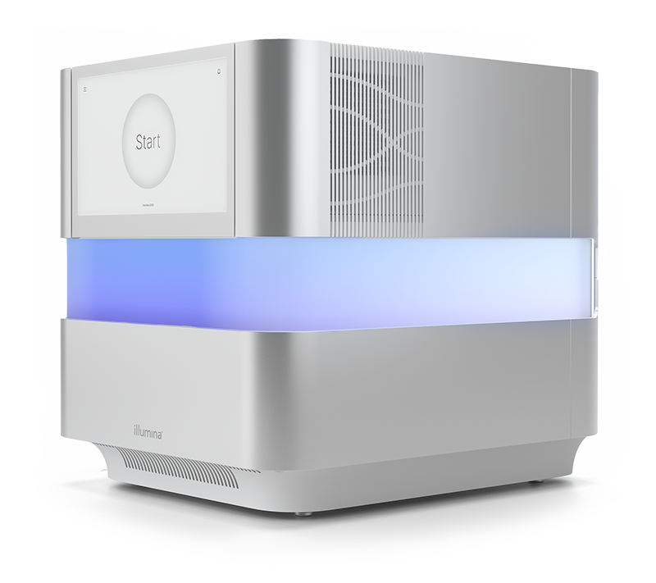
Upcoming Laboratory Procedures in PulseNet
NextSeq 1000/2000
Fastq-Toolkit Job Aid published Oct 2023
  The Fastq-Toolkit Job Aid is used for processing NextSeq Runs/Projects on BaseSpace for linking to BioNumerics and for downsampling reads
Maximum Capacity and underloaded runs
  The future NextSeq 1k/2k SOP will include procedure on how to load the instrument at maximum capacity as well as what to do when underloading the instrument
Expected timeline for SOP plus any associated worksheets and job aids: 2024

Slide 24

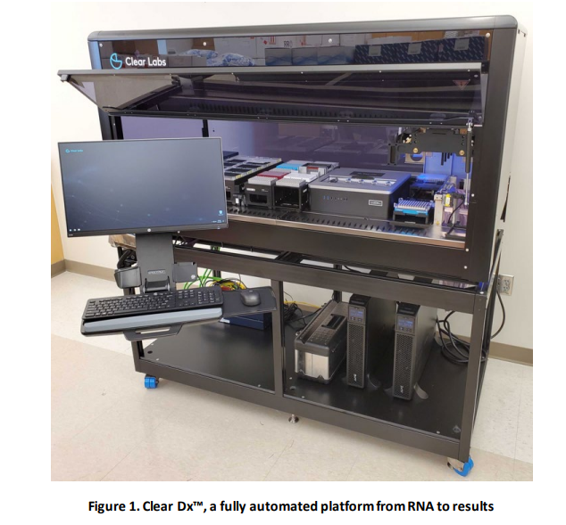
Upcoming Laboratory Procedures in PulseNet
ClearLabs Microbial Surveillance WGS
Automated platform intended to go from bacterial suspension to fastq using two on-board iSeqs
Reproducibility study with five states
Intra-run consistency
    Variability of read-length and coverage
Expected timeline for SOP plus any associated worksheets and job aids: 2024
PulseNet Certification and Proficiency Testing (PT)
  Currently PulseNet does NOT accept new user certification from fastq files generated using automated platforms
  However, PulseNet DOES accept PT testing results that were generated using automated platforms

Slide 25
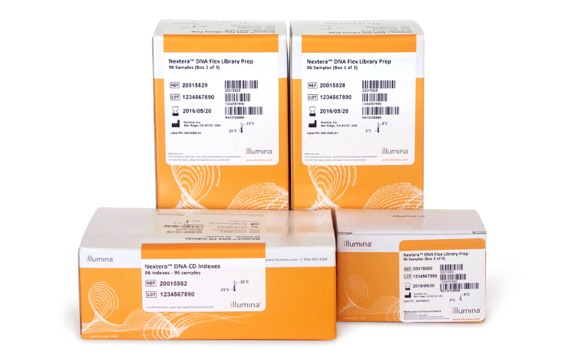


Upcoming Laboratory Procedures in PulseNet
Quarter-Volume Rapid DNA Prep Protocol
New protocol that uses only ¼ volume of the reagents for the Illumina DNA Prep library preparation kit, as well as skipping a few steps of the process, resulting in significant cost and time savings
  $30 per sample saved
  20 – 30 minutes hands-on time saved
    Skips tagment-stop reaction and subsequent tagment washing steps
    Dual-sided size selection performed on pool rather than individual libraries
Expected publishing timeline for SOP and all associated worksheets: Oct 2024
  SOP: PNL44
Efficiency
Decreased Hands-on Time
Lower Cost

Slide 26

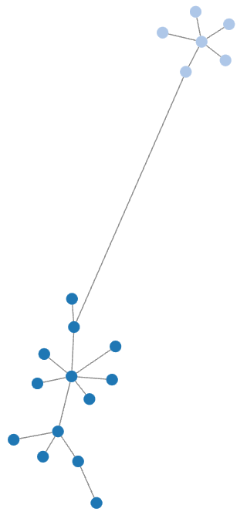
New Technology Being Explored for PulseNet Laboratories
Oxford Nanopore Technologies (ONT)
PNUSA does not currently accept ONT data for routine surveillance, certifications, or PT
PulseNet is working directly with ONT to assess and improve basecalling in challenging regions of bacterial genomes
Most recent basecalling algorithm including bacterial methylation profiles paired with the V14 kit / R10 flowcell chemistry show major progress in accuracy
PNUSA committed to bringing ONT online for surveillance as we complete our validation, and the analysis pipeline can be implemented in PN 2.0

Slide 27

New Technology Being Explored for PulseNet Laboratories
PulseNet 2.0 Opportunities for the Wet Lab
The introduction of PulseNet 2.0 analysis environment will have positive impacts on the wet lab, including:
  Additional tools for managing fastq files like automatic downsampling when large fastq files are uploaded
  More seamless integration of new pipelines and technologies like ONT

Slide 28
Questions?

