Slide 1


DOCUMENT
TITLE LINE
Update from DOwnunder
(Australia)
SUBTITLE TEXT LINE 1
Torsten Seemann
MELBOURNE, VICTORIA, AUSTRALIA

Slide 2
Who am I representing?

Slide 3



Slide 4
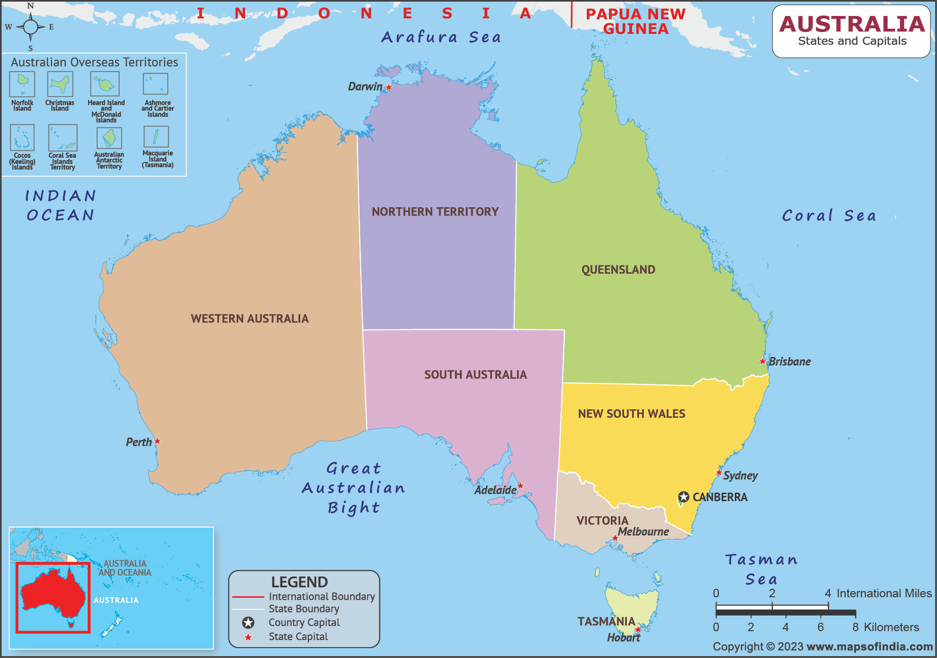

Slide 5
Population
23 million
Victoria
>6 million people

Slide 6
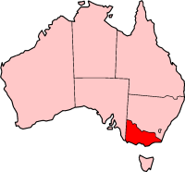



Public Health in Australia - we do not have CDC/FDA
State-based health system
Public Health Unit (PHU)
Public Health Lab (PHL)

Slide 7


“Immunity and infection”
Research
Teaching
Public health and reference labs
Diagnostic services
Clinical care in ID and immunity

Slide 8

MDU
PHL
Research, Clinical, and Public Health microbiology

Slide 9
How did I end up here?

Slide 10


ABPHM - 2013 - Hinxton, UK
Eric Brown
Steve Musser

Slide 11




7th GMI - 2014 - York, UK
Marc
Allard
Ruth
Timme
Bill
Klimke
Martin
Shumway

Slide 12


ASM NGS + GT - 2015 - Washington DC
“We promise to submit some Listeria genomes to GenomeTrakr within a year”
Errol
Strain

Slide 13

ASM NGS + GenomeTrakr - 2015 - Washington
“We promise to submit some Listeria genomes to GenomeTrakr within a year”
Errol
Strain

Slide 14
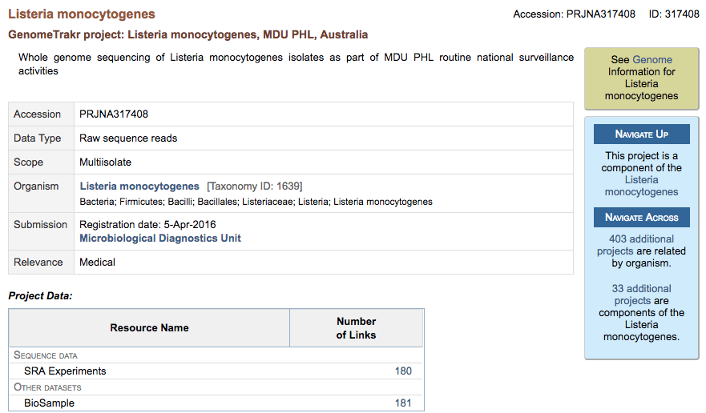

Slide 15

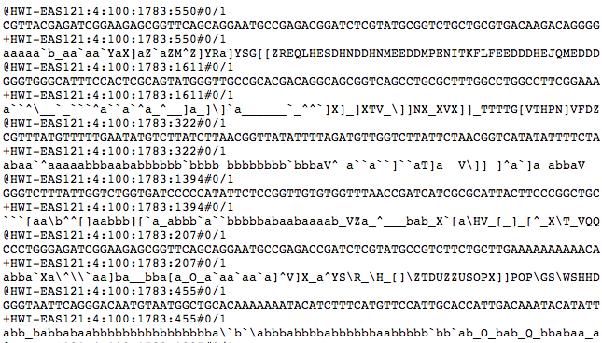
180 x Listeria monocytogenes

Slide 16
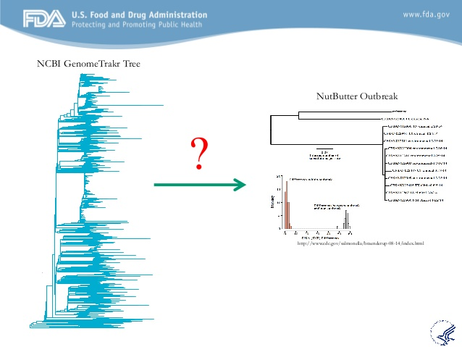




Nightly updates to find new matches
Errol Strain (CFSAN)

Slide 17
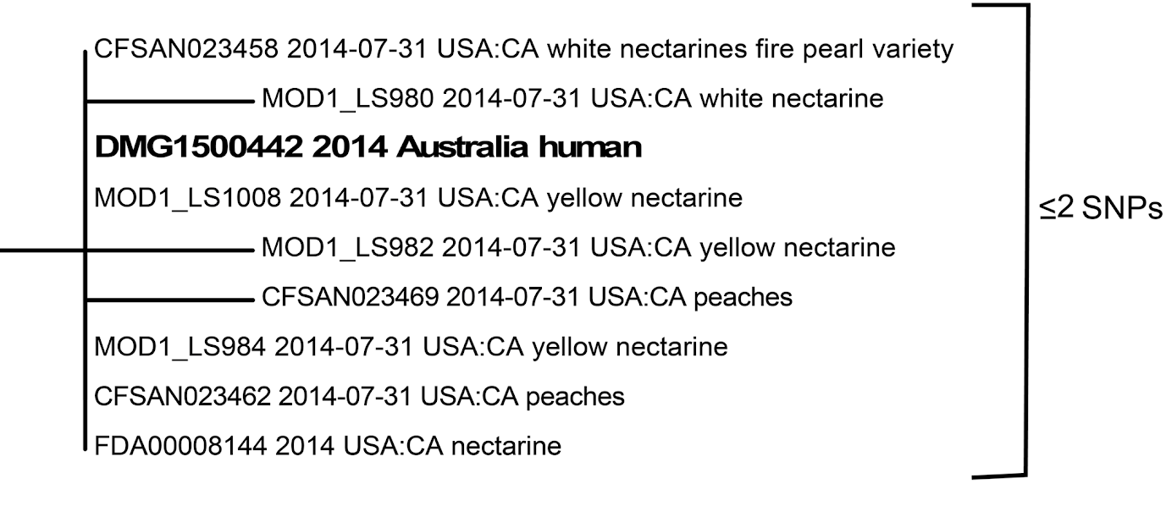

Slide 18


Slide 19


Slide 20
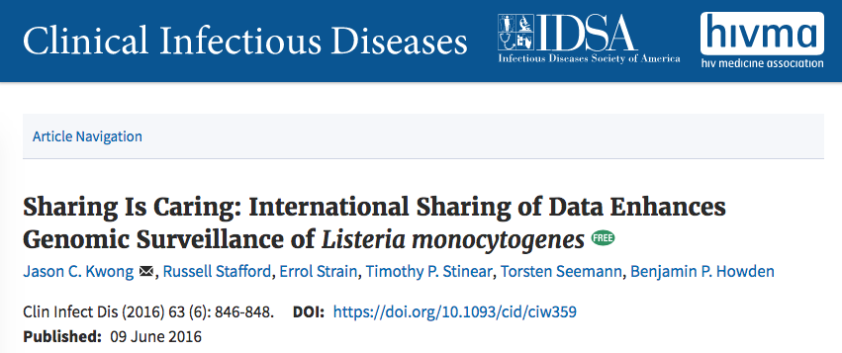
FIXME

Slide 21
PHL changes
since 2022

Slide 22


We got a new logo

Slide 23


Slide 24
Institute changes
since 2022

Slide 25

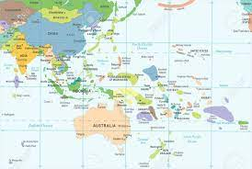

Asia/Pacific/Oceania

Slide 26

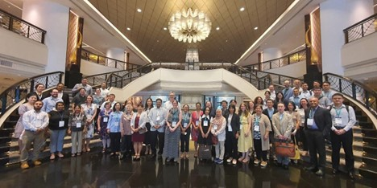
PulseNet Asia Pacific lead

Slide 27

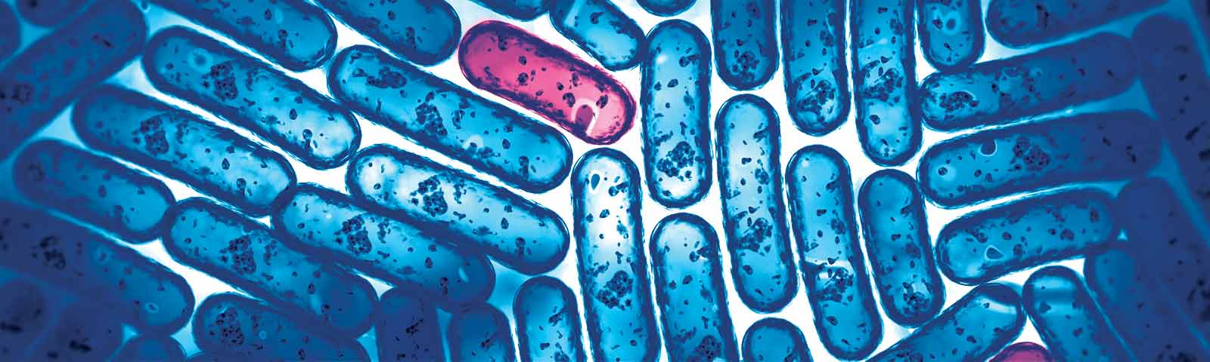

Slide 28
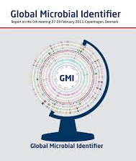

Hosting GMI 2025 in Melbourne!

Slide 29
National changes
since 2022

Slide 30
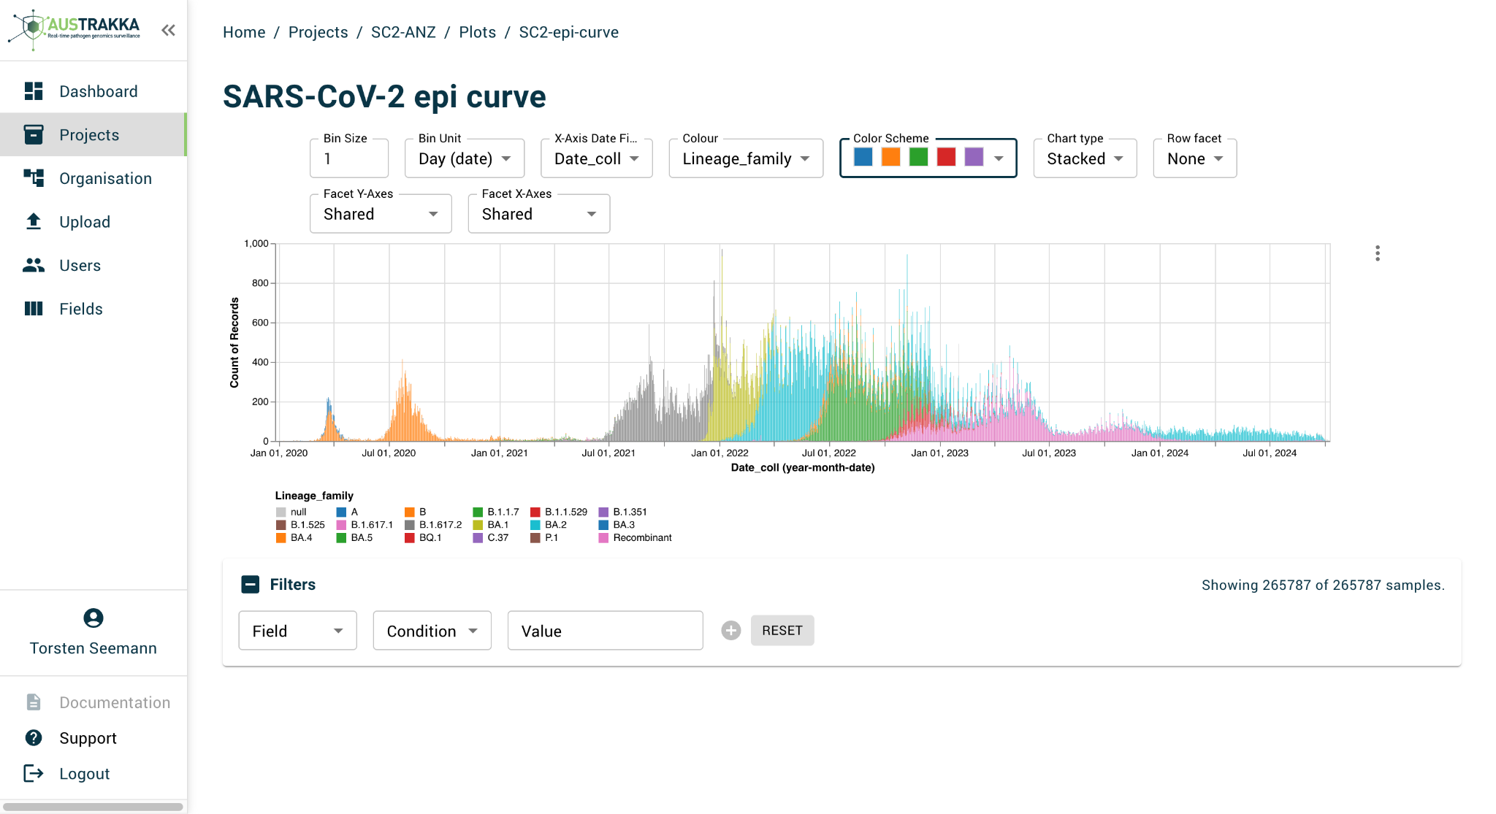
AusTrakk 2.0 released!
AusTrakka is Australia’s genomic surveillance platform

Slide 31



Slide 32

“It’s a long way to national disease control”

Slide 33
Data sharing

Slide 34

Uploading to GenomeTrakr
We fell behind but fixing this now!
  5500 Salmonella
  130 Listeria
  Getting permission for more species
Regular upload schedule
Goal: Upload from AT to GT for all States

Slide 35

Dr Jake Lacey
New PHL binfie lead
Big SRA clean up
  Created BioProjects per genera
  Consolidated BioSamples
  De-duplicated FASTQ uploads
Initiated upload schedule

Slide 36

Now >36,000 uploads
12,266 Salmonella
6,189 Neisseria
3,551 Shigella
2,625 Streptococcus
2,601 Mycobacterium
1,298 Enterococcus
876 Staphylococcus
299 Vibrio
266 Enterobacter
221 Legionella
163 Listeria
130 Serratia

Slide 37
Recent matches

Slide 38

May 2024
US CDC reach out about a Victorian case that clusters with a strain of MDR Salmonella Newport that they monitor. Linked to Travel to Mexico, Beef and Soft Cheese.
Review of the case details with DH showed a compatible history. Victorian case had reported travel to Mexico.

Slide 39
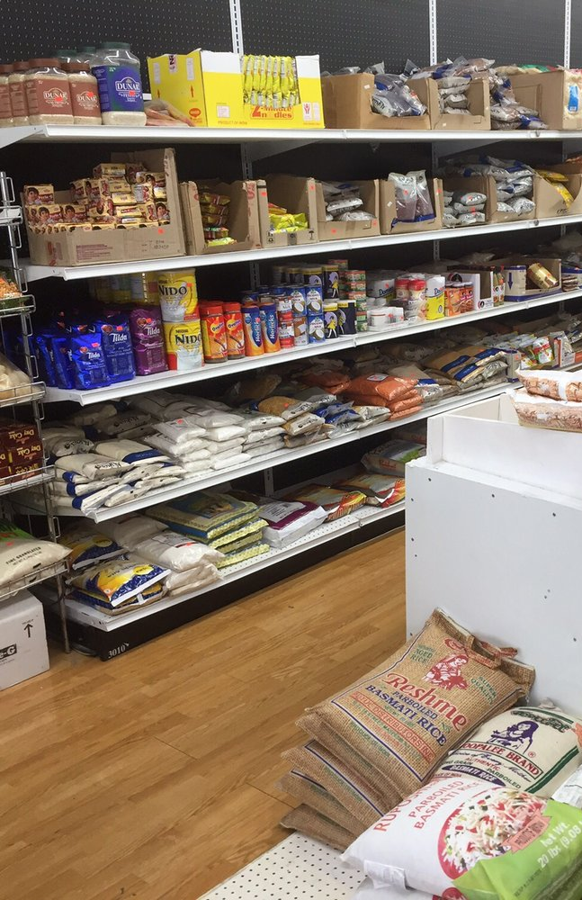
Sep 2024
CDC identified a Victorian case clustering food & clinical cases
US cases had South Asian / Indian origin and no travel
LIkely imported food
Our case was low concern, no epi
But patient name was consistent with Indian/South Asian origin

Slide 40
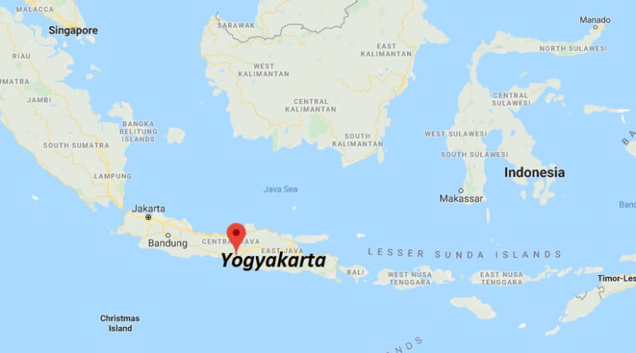
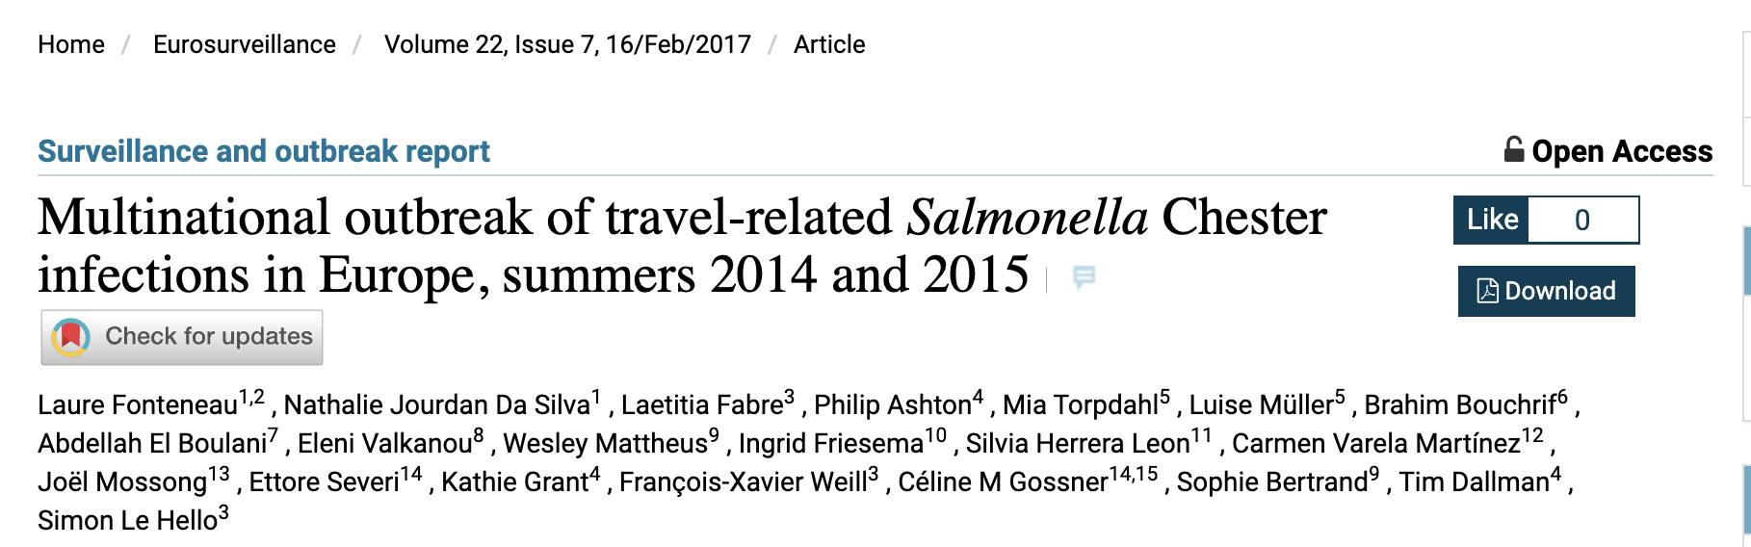
My own personal case
REPORT
Salmonella : positive
Serocar WGS : Chester
Erythromycin : sensitive
Amoxicillin : sensitive

Slide 41
AusPathoGen

Slide 42

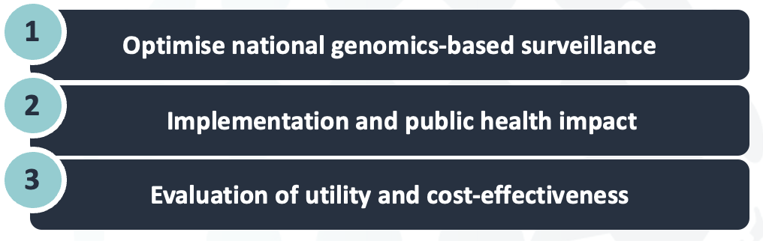

Slide 43
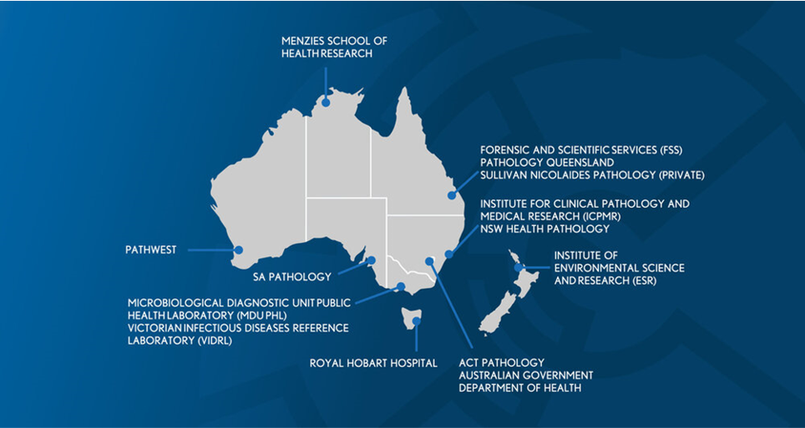
Helping Bring equity to all states

Slide 44
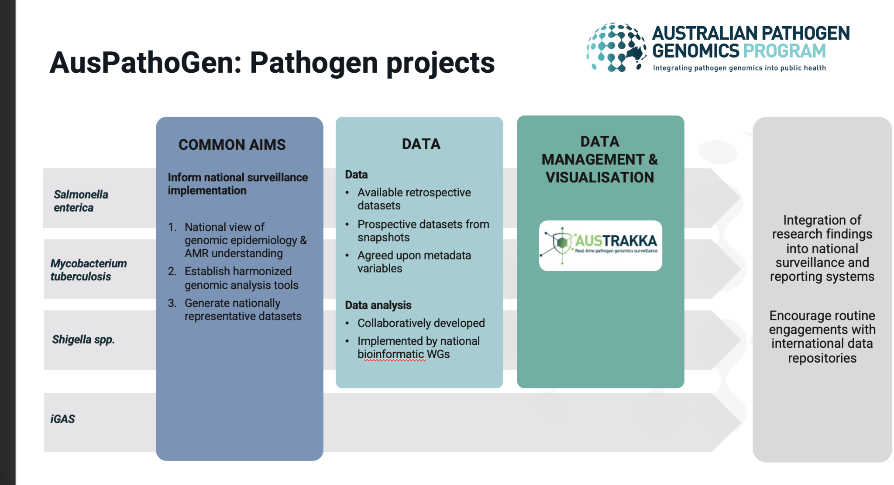

Slide 45
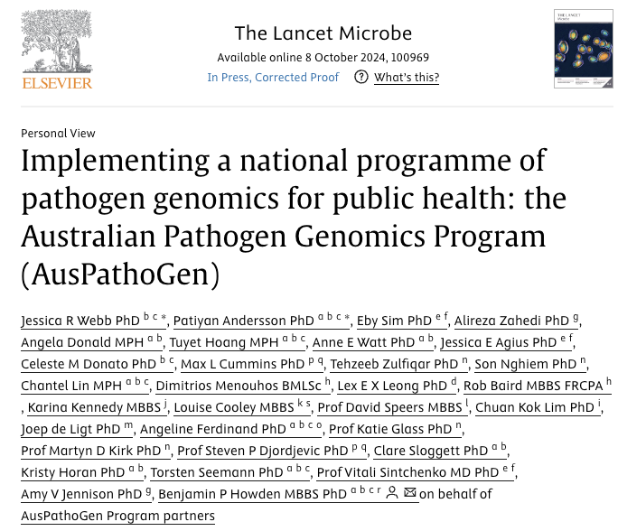

AusPathoGen foundation paper
Species-specific papers and data coming soon!

Slide 46
Conclusions

Slide 47

Conclusion
We shared our data.
Nothing bad happened.
Lots of good happened.

Slide 48

DOCUMENT
THANK YOU
TITLE LINE
SUBTITLE TEXT LINE 1
CONTACT
E: t.seemann@unimelb.edu.au

