Slide 1
Cornell CALS

Slide 2
Exploring the impact of sequencing historical Listeria isolates
Renato H. Orsi, PhD
Department of Food Science
Cornell University

Slide 3
Major findings
85 NY-clusters were identified (≤ 20 SNPs between clinical isolates, single-linkage clustering)
Most NY listeriosis clusters are small (2-3 cases)
  67/85 NY-clusters include 2 or 3 isolates
Most NY listeriosis clusters are long-lasting (> 2 years long)
  15/85 NY-clusters included isolates that were obtained more than 10 years apart
Most NY listeriosis clusters are geographically widespread (at least 2 cases in noncontiguous counties)
  33/85 NY-clusters are local, with isolates obtained from the same or contiguous counties
Deli meat, seafood and deli salad are among food items mostly associated with NY-clusters
  307 non-clinical isolates (78 food, 4 animal and 225 environmental) differed by ≤ 50 SNPs from at least one NY clinical isolate in 37 NY-clusters
  17/85 NY-clusters included food and environmental isolates highly related (≤ 10 SNPs) to clinical isolates

Slide 4
Objective
Investigate historical Listeria monocytogenes (Lm) isolates using whole genome sequencing (WGS) data to identify potential clusters of clinical cases and their association with non-clinical isolates
Notes:
20 years

Slide 5





Data Collection: Isolation dates and source
1,046 NY clinical Isolates (2000 – 2021)
NY State Department of Health
NY City Department of Health (2000 – 2004)
783 NY non-clinical Isolates (2000 – 2021)
Food Microbe Tracker
NY State Department of Agriculture and Markets
Genetical Relatedness (SNP distances)
NCBI Pathogen Detection database
(Last accession date: October 4, 2023)
Notes:
1,046 clinical isolates
1,268 non-clinical isolates

Slide 6


Identification of NY-Clusters was based on clinical isolates
a
Exclusion Criteria
Search Criteria
- Mother-Child pair
- Same patient
- Clinical isolates 1 or 2 months apart
- Same or contiguous counties
- SNP distance < 5
n = 45 clinical isolates excluded
SNP distance ≤ 20
b
Identification of NY-Clusters
- Any clinical isolates genetically related with a SNP threshold of ≤ 20
c
Recording
- # of clinical isolates, time-span of cluster, county information and genetic relatedness (SNP distances)
Clinical Isolates
Notes:
administrative divisions in each state

Slide 7


Identification of Non-Clinical Isolates in NY-Clusters
SNP distance ≤ 20
SNP distance ≤ 50
Non-Clinical Isolates
Clinical Isolates

Slide 8

NY-clusters and associated non-clinical isolates
n = 321 Clinical isolates in NY-clusters
n = 307 Non-Clinical isolates in NY-clusters
n = 85 NY-clusters
In total
4 animal feces (1.3%)
78 food isolates (25.4%)
225 environmental isolates (73.3%)
Notes:
The presence of long-lasting clusters might indicate the presence of a persistent source in the production facilities, retailers, or households.

Slide 9
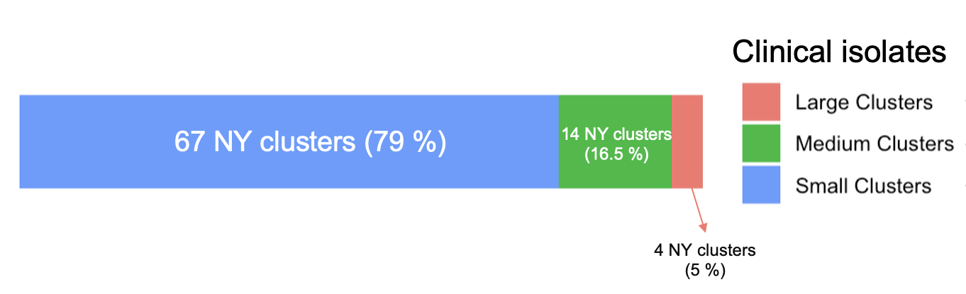
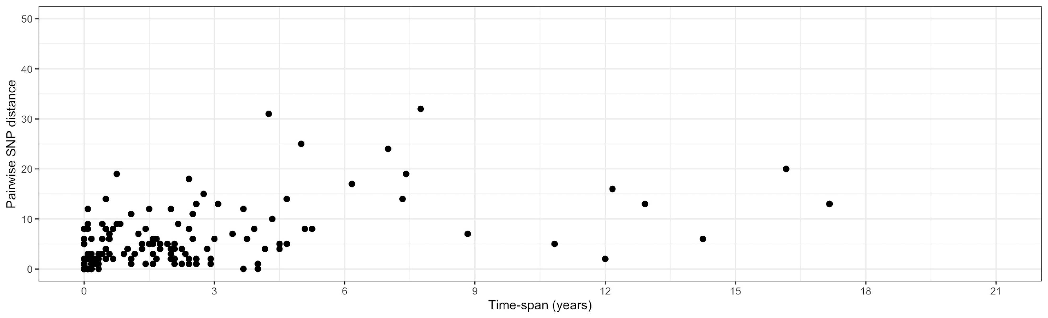
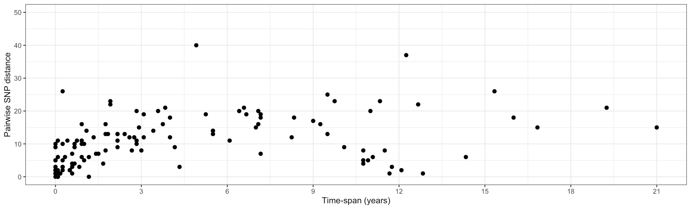
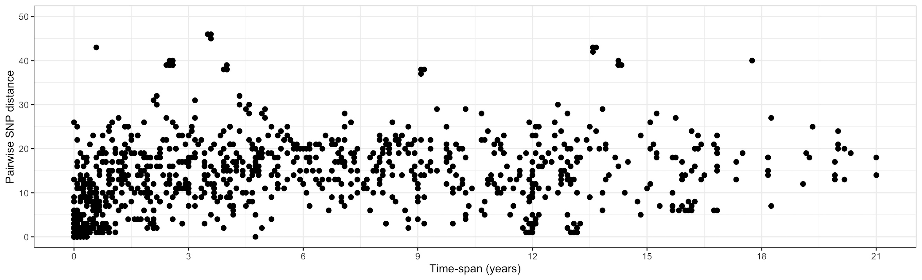
NY-cluster size, length and geographic spread
79% of NY-clusters (67/85) are small, containing only 2 or 3 clinical isolates.
(> 10 cases)
(4-10 cases)
(2-3 cases)
54% of the identified NY-clusters (46/85) included isolates obtained from clinical cases more than 2 years apart.
18% of NY-clusters (15/85) included isolates that were obtained from clinical cases more than 10 years apart.
Same county
Contiguous counties
Approximately 40% of the NY-clusters (34/85) included clinical isolates obtained in the same or in contiguous counties.
Non-contiguous counties

Slide 10
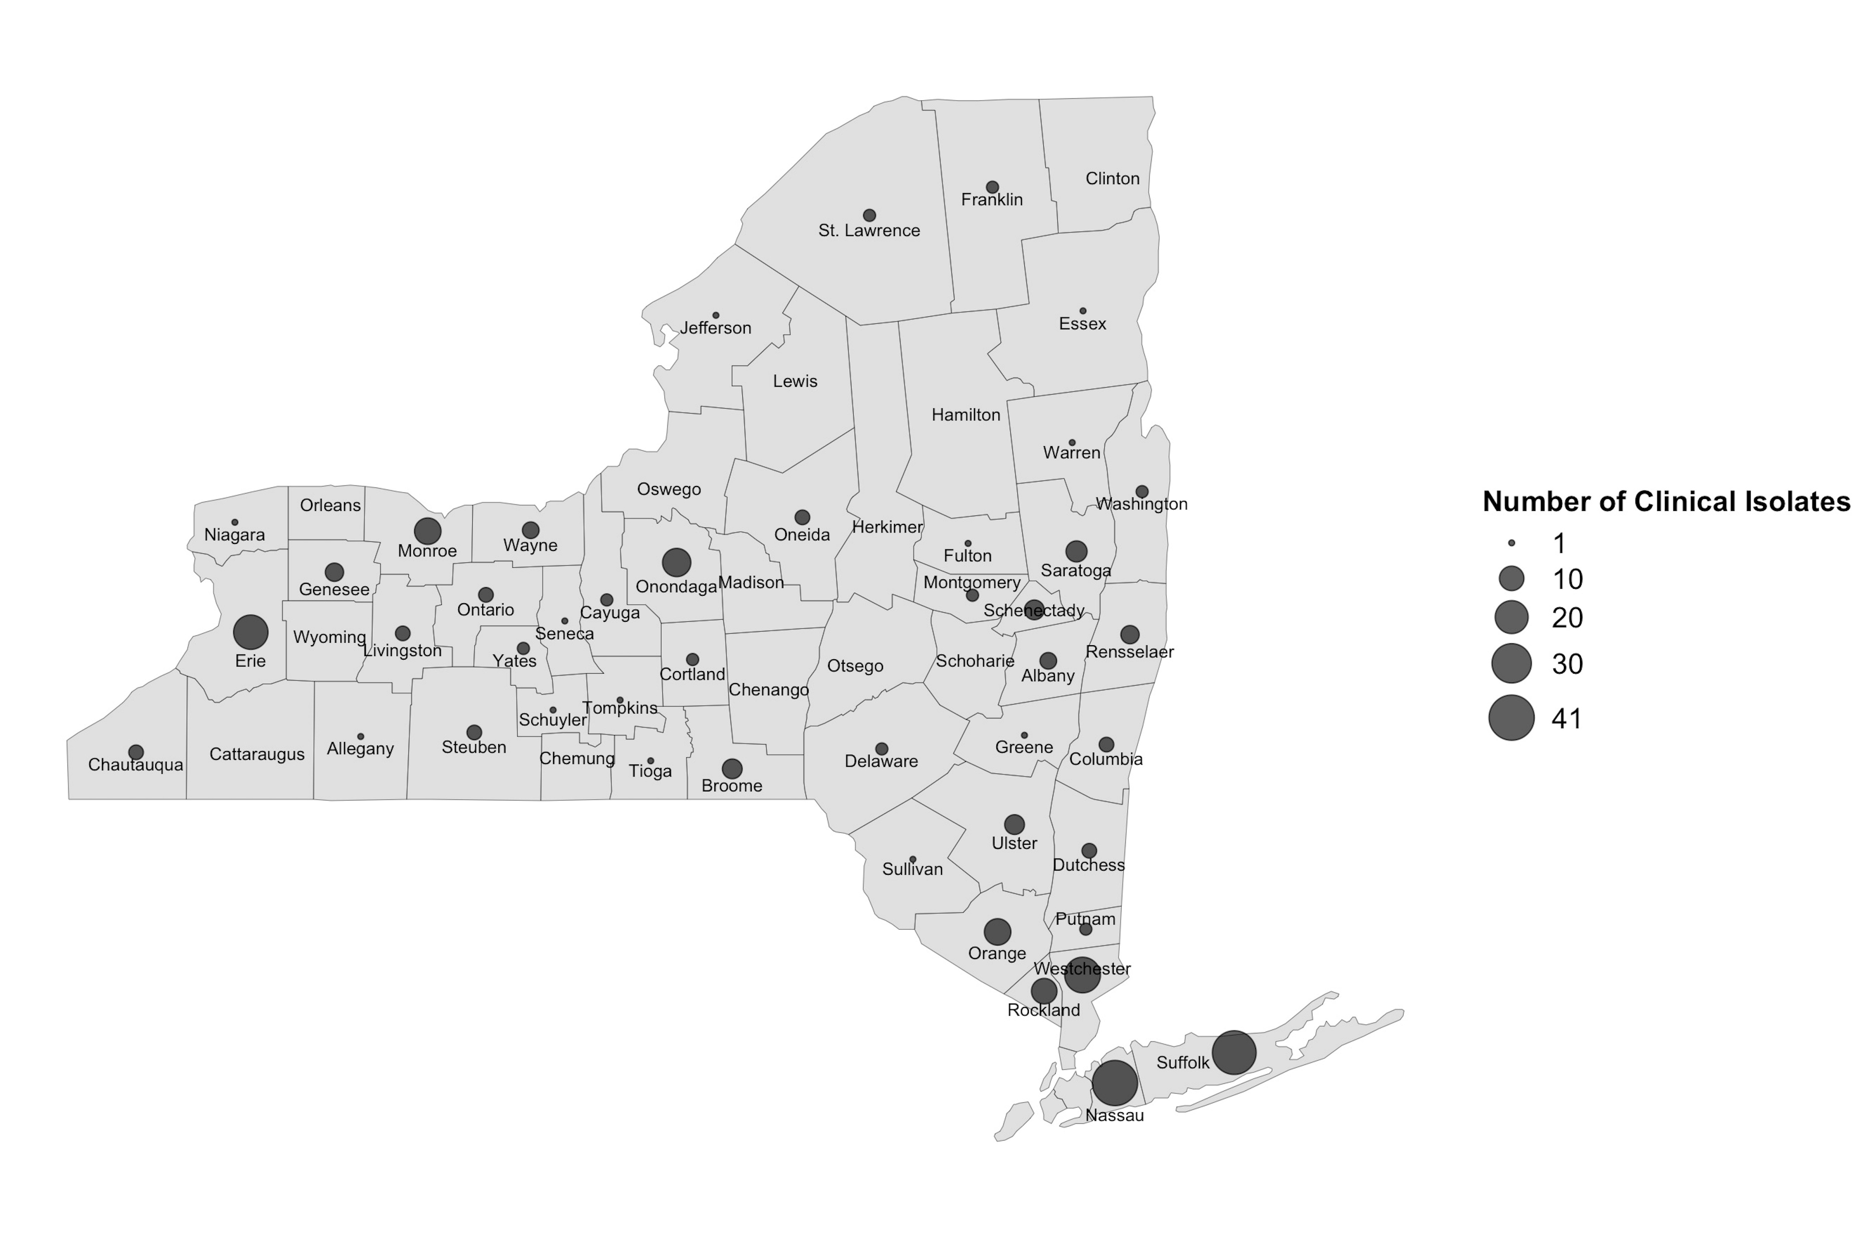
County and regional distribution of isolates in NY-clusters
Long island, and the upstate metropolitan regions accounted for most isolates (excluding NYC)
The Hudson Valley region has the smallest total number of cases compared to the other regions. However, while the other regions have most of their cases associated with small (and in a lower extend medium) clusters, most of the cases in the Hudson Valley region are associated with large clusters
Hudson Valley

Slide 11
Outbreak codes
22 outbreak codes among 85 NY-clusters
  5 NY-specific codes
    1 medium (2 codes assigned to this NY-cluster)
    3 small
  17 multi-state codes
    5 small
    3 medium
    2 large (2, and 7 multi-state codes assigned to these NY-clusters)
NY-specific codes were assigned to isolates in NY-clusters with short time span or from the same county

Slide 12
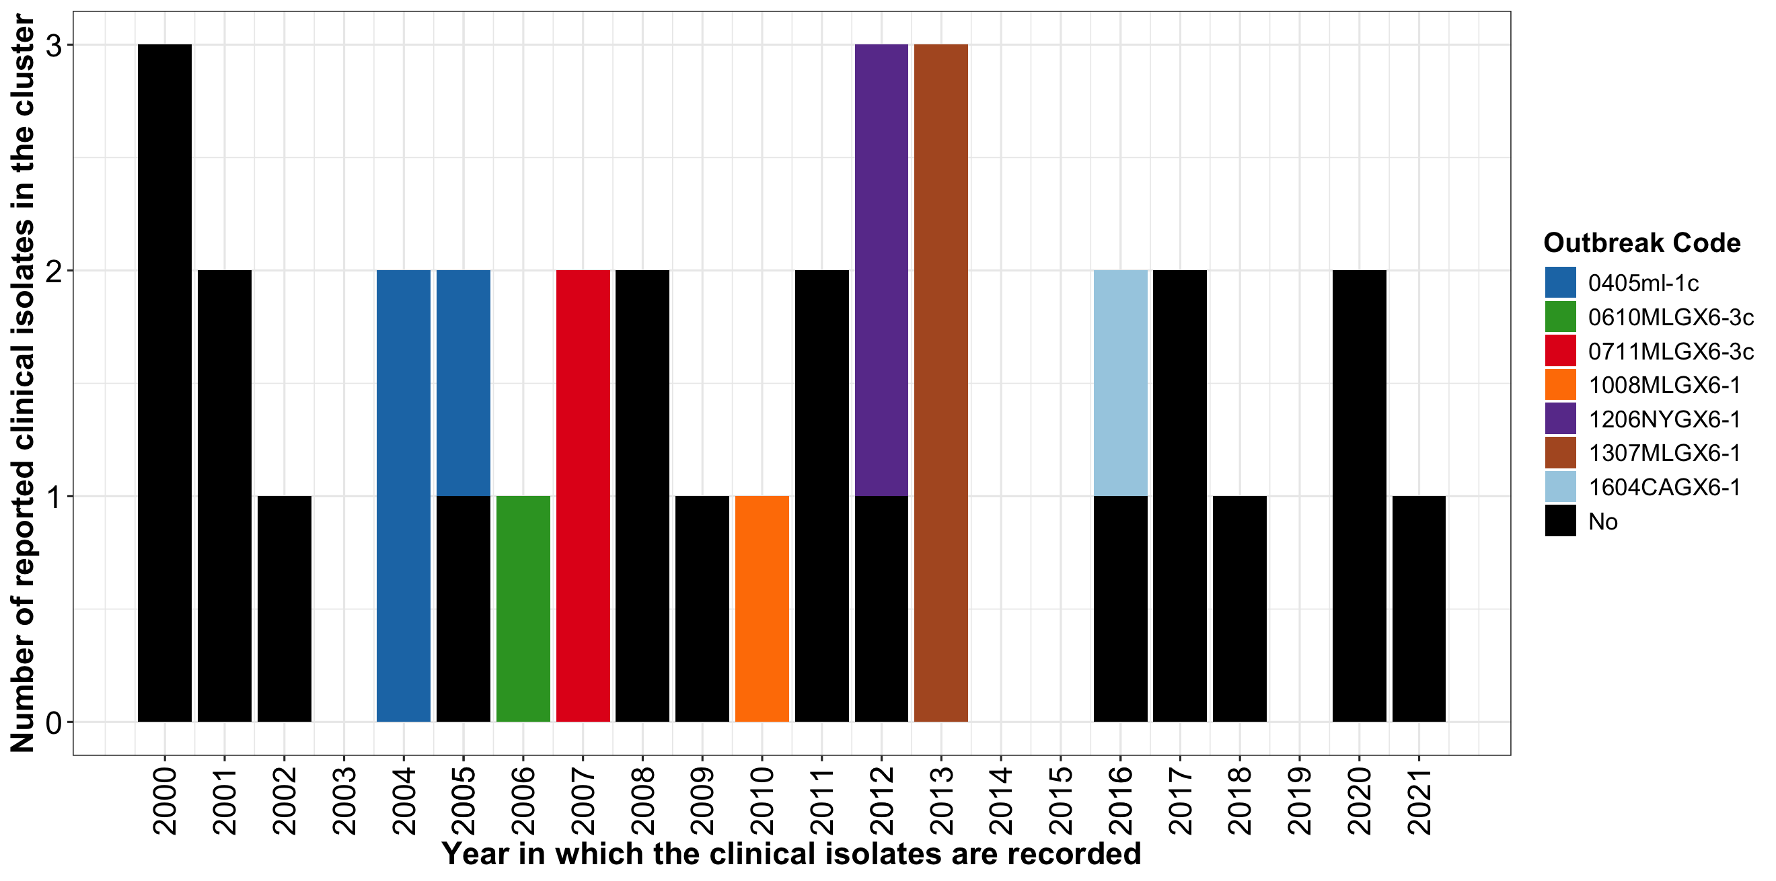
Largest NY-cluster included 33 clinical isolates that were collected for more than 20 years
Nearly 18% of the NY-clusters showed temporal persistence, lasting more than 10 years.
This supports that a substantial portion of the NY-clusters could be caused by Lm strains persisting over long periods.
Figure. Epidemic curve of a NY-cluster on a yearly basis from 2000 to 2021. Black bars represents cases that were not assigned an outbreak code, whereas the different colors represent cases that were assigned 7 different outbreak codes, suggesting that these cases were investigated as independent events at the time. Clinical isolates range from 0-31 SNP differences between each other.

Slide 13
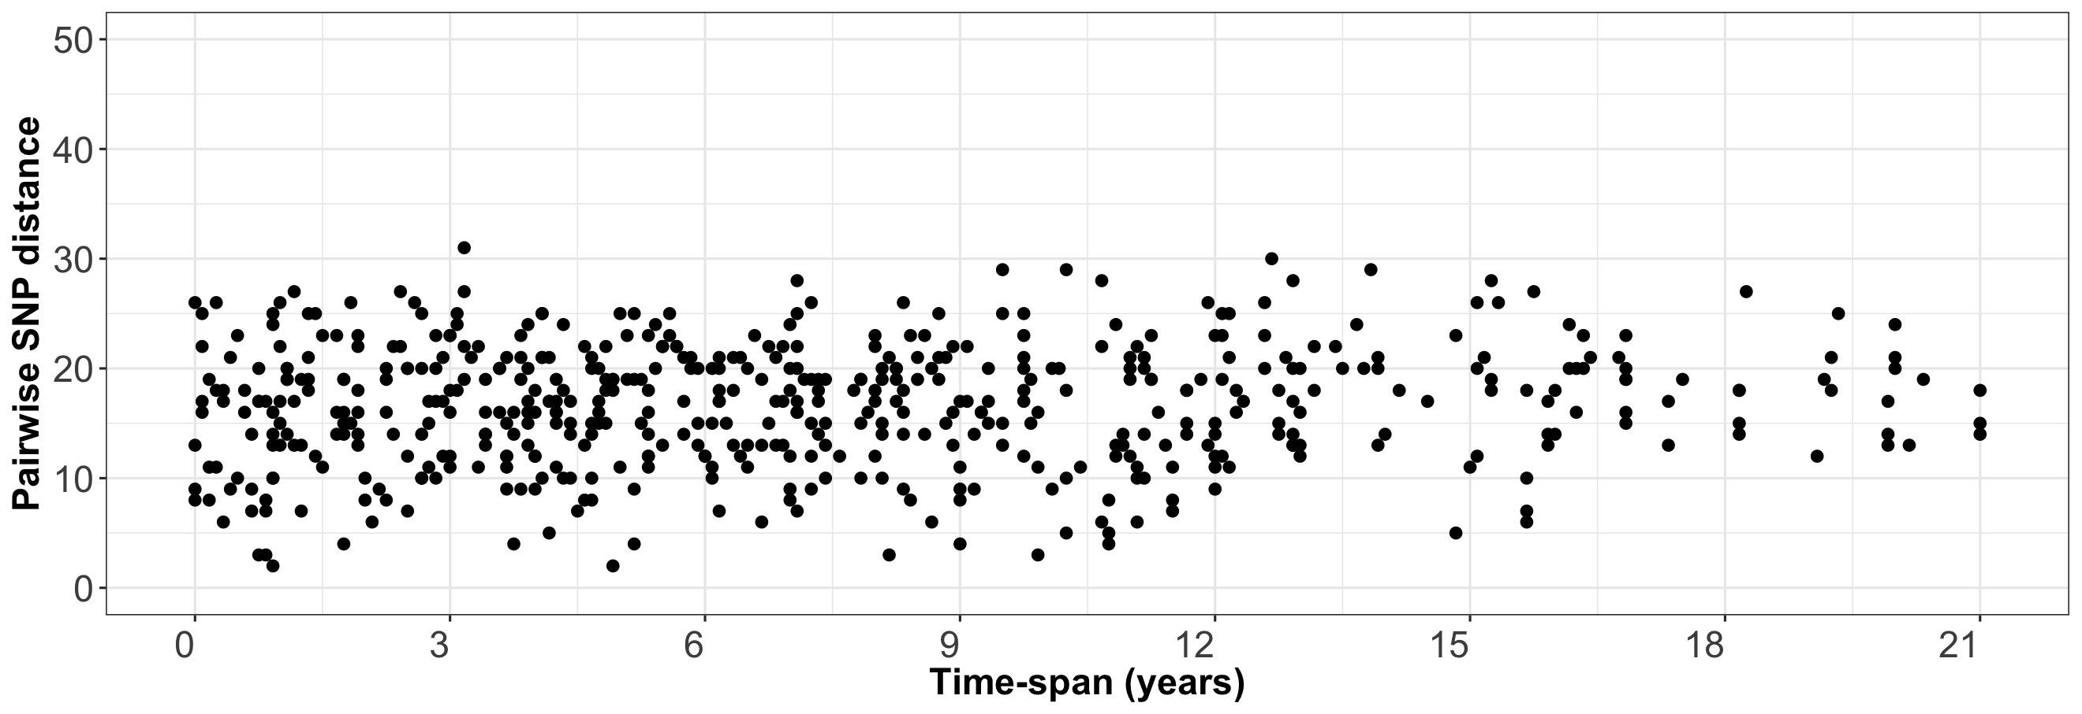
Isolates obtained more than 12 years apart tend to differ by more than 10 SNPs
OR = 0.2, 95%CI = (0.05, 0.56), p-value = 0.0004, Fisher’s exact test
N = 355
N = 96
N = 73
N = 4

Slide 14
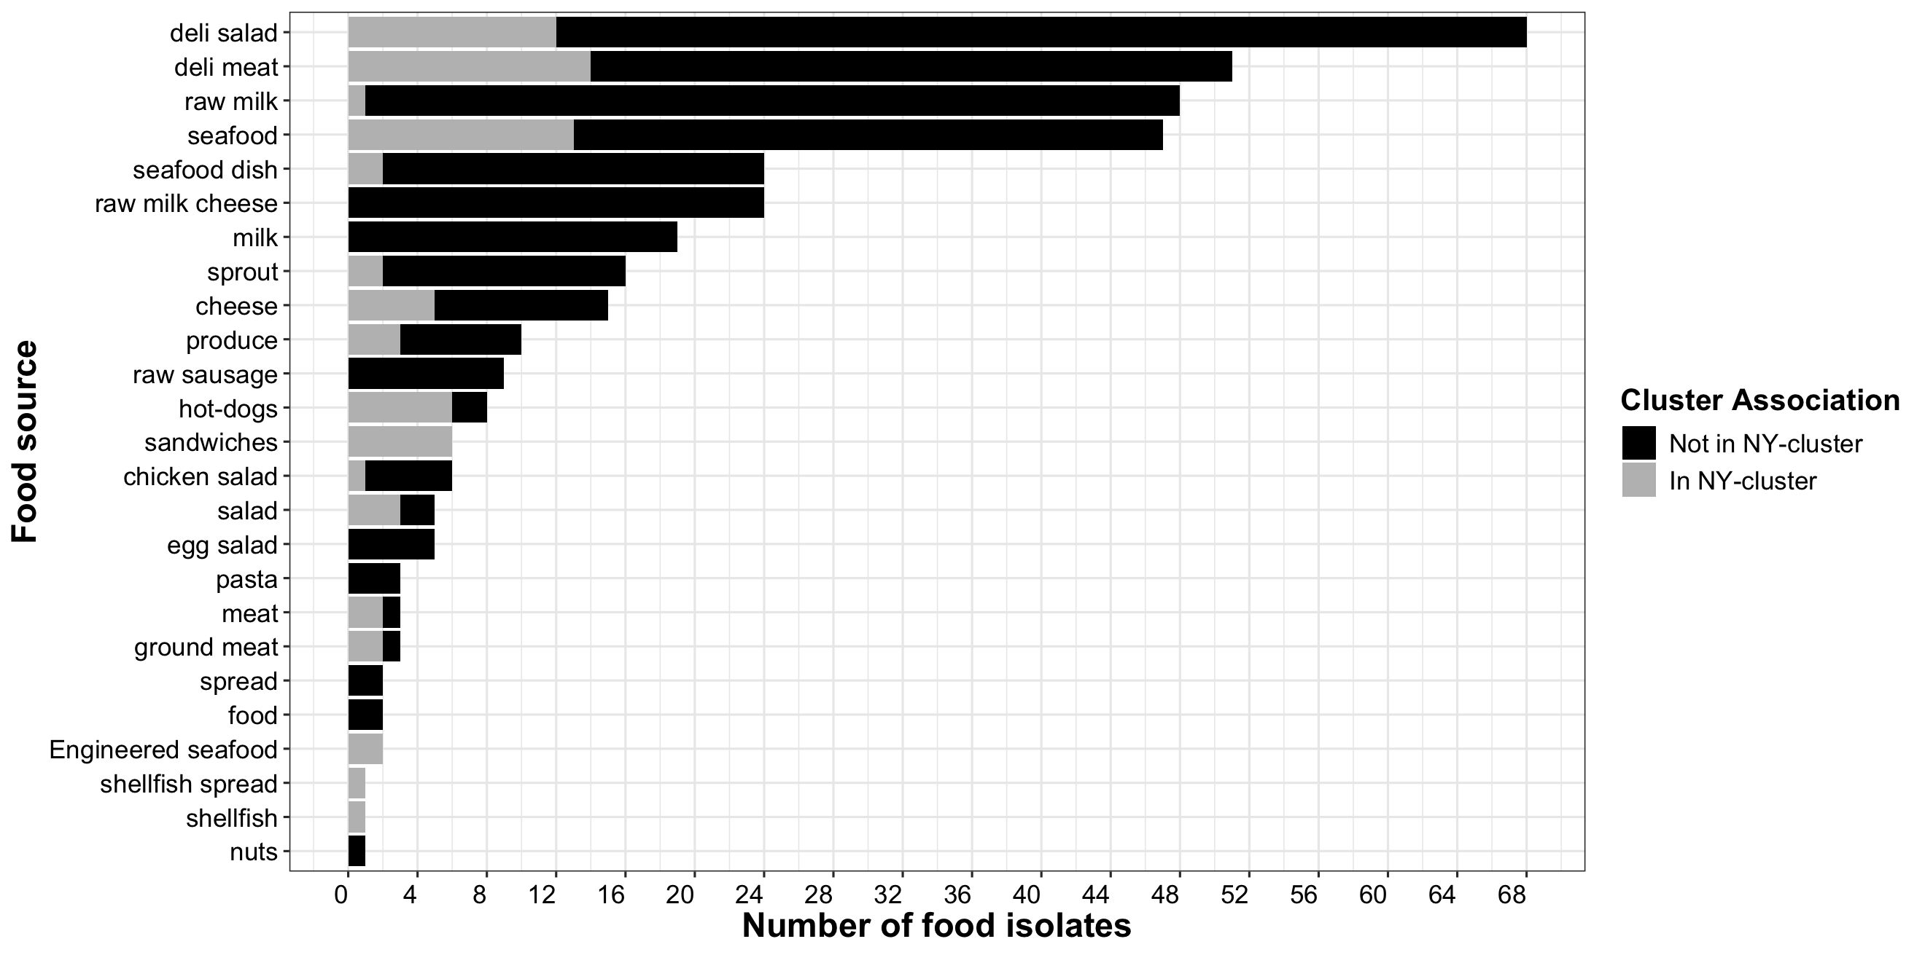
44% of NY-clusters included at least one food isolate with ≤ 50 SNPs differences to a clinical isolate.
Our data showed that several small and medium sized NY-clusters included food and environmental isolates that were highly related to, collected years apart from, and obtained in the same county as clinical isolates in the same NY-cluster.
This could suggest a local common source of potential small long-lasting outbreaks caused by Lm strains that persist in local small processors, farms, retail environments, or private (e.g., residential) and public (e.g., schools, hospitals, restaurants) kitchens.
Figure The number of food isolates in NY-clusters between 2000 and 2021 by food categories. Each bar represents a food type. The gray bars represent food isolates that are associated with the NY-clusters, while black bars represent the food isolates that are not associated with the NY-clusters.

Slide 15
Conclusions
Outbreak investigations tend to focus on clusters containing highly-related isolates from cases that are temporally connected, while small clusters including cases that are years apart, even from the same or contiguous counties, tend to not be further investigated.
Small and medium clusters (with ≤ 10 cases) including food and environmental isolates from the same counties as the clinical isolates could also indicate that the source may be small local food producers or retailers (e.g., local ice cream manufacturer, packinghouse, restaurant).
Our study also highlights the significance of performing routine environmental and food surveillance to enable public health and regulatory agencies to identify sources prone to persistence and take necessary control measures to mitigate further risk.

Slide 16

Acknowledgments
New York State Department of Health
  William Wolfgang
  Samantha Wirth
  Lisa Mingle
  Damaris Mendez-Vallellanes
  Hannah Hoyt
New York State Department of Agriculture and Markets
  Maria Ishida
  Brian Sauders
  Gregory Deiulio
  Alyssa Dickey
Cornell University
  Martin Wiedmann
  Hilal Samut
Genome Trakr funding (through NYSDOH and NYSDA&M)

Slide 17
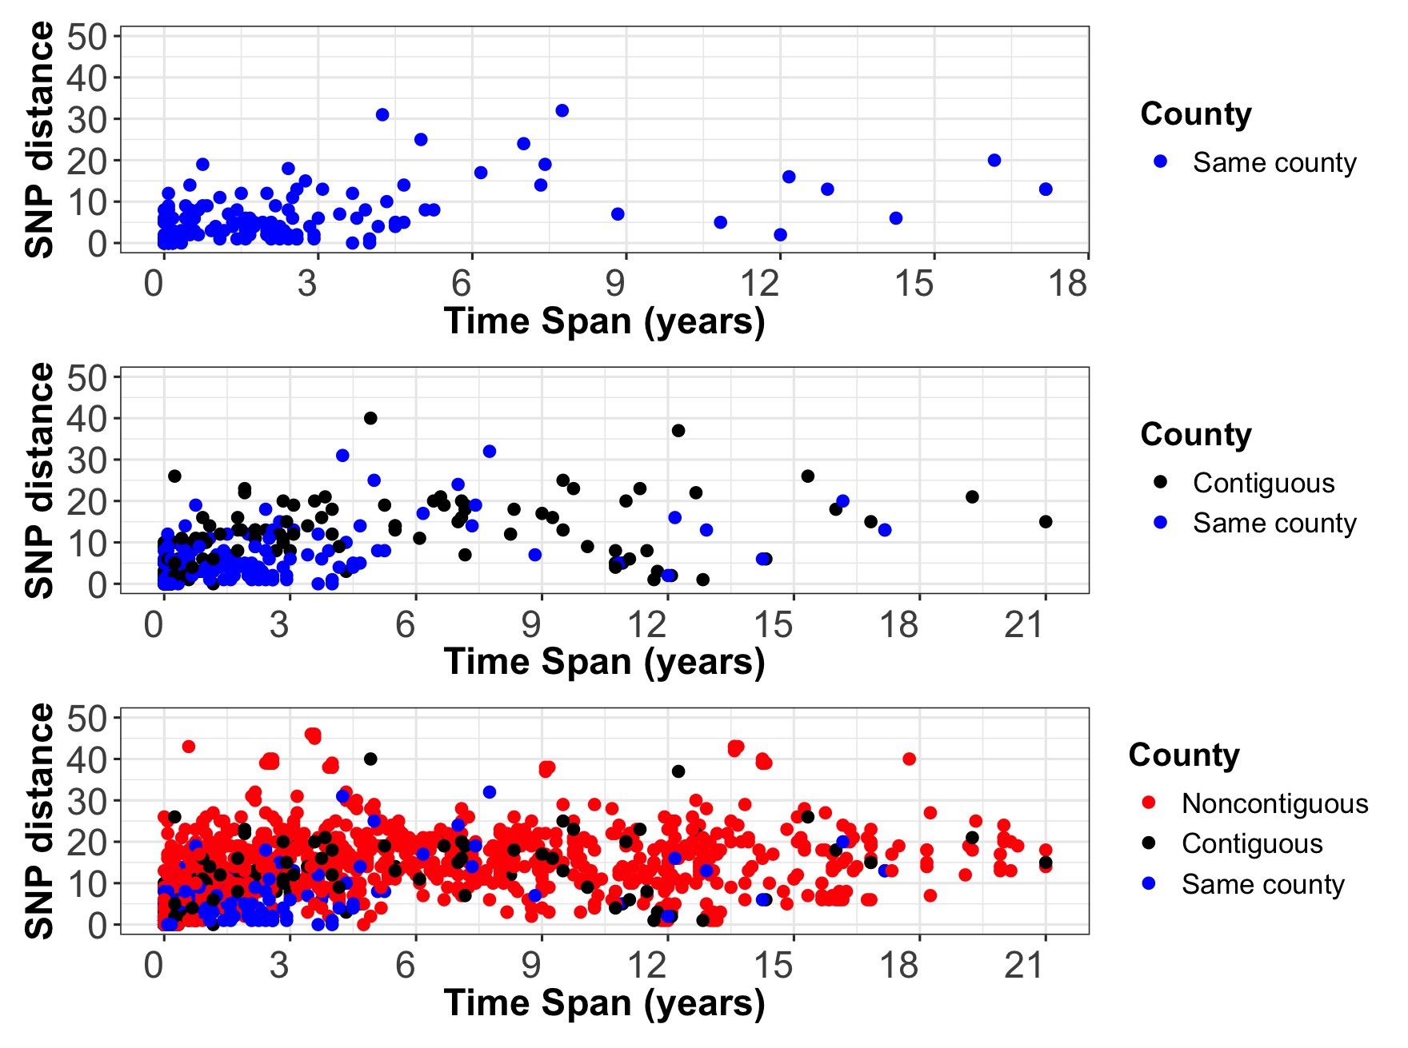
Pairwise SNP analysis showed that clusters that occurred in same and contiguous counties presented higher genetic relatedness.
The within NY-cluster pairwise SNP distance between isolates from the same and contiguous counties was significantly lower than the pairwise SNP distance between isolates from noncontiguous counties (p = 0.0300 and p < 0.0001, respectively).
The time span between the clinical isolates collected from the same and contiguous counties was relatively shorter than for isolates collected from noncontiguous counties.
Figure Pairwise SNP distances observed among 321 clinical isolates. The time span indicated here corresponds to the time interval between each isolate pair within NY-clusters in years. If the clinical isolates in a NY-cluster are collected within the same month of the same year, the time span for the NY-cluster is zero. Red, blue and black represent NY-clusters recorded in noncontiguous, same county and contiguous counties, respectively.

