Slide 1
An Automated Pathogen-Agnostic
Isolate Whole Genome Sequencing (iWGS) to Help Stamp Foodborne Outbreaks
2023 GenomeTrakr Meeting
Ramin Khaksar
Chief Scientific Officer & Chief Operating Officer, Clear Labs | October 2023

Slide 2




Foodborne Illness & Their High Level Impact
Opportunities for Improvement
Patient Safety
~ 48 million people get sick from a foodborne illness each year
Hospitalization & Fatality
~ 128,000 people are hospitalized and 3,000 die
Proliferation of Antimicrobial Resistance (AMR)
AMR leads to serious illnesses, prolonged admissions, increased healthcare costs, higher costs in second line drugs, and treatment failures
Macro Economic Burden
The USDA estimates that foodborne illnesses cost the United States > $15.6 billion each year

Slide 3
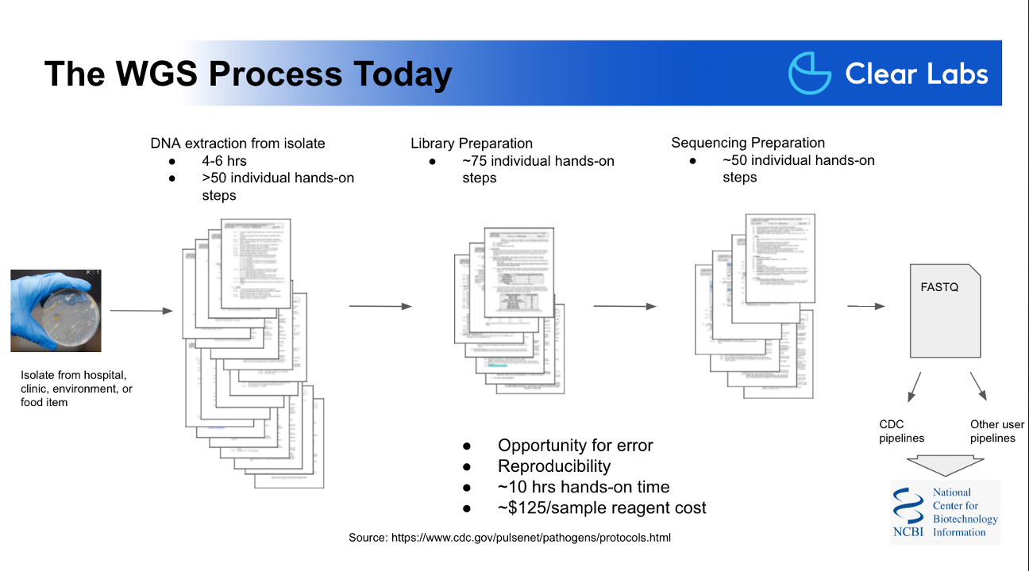
Bacterial Whole Genome Sequencing Process Today

Slide 4
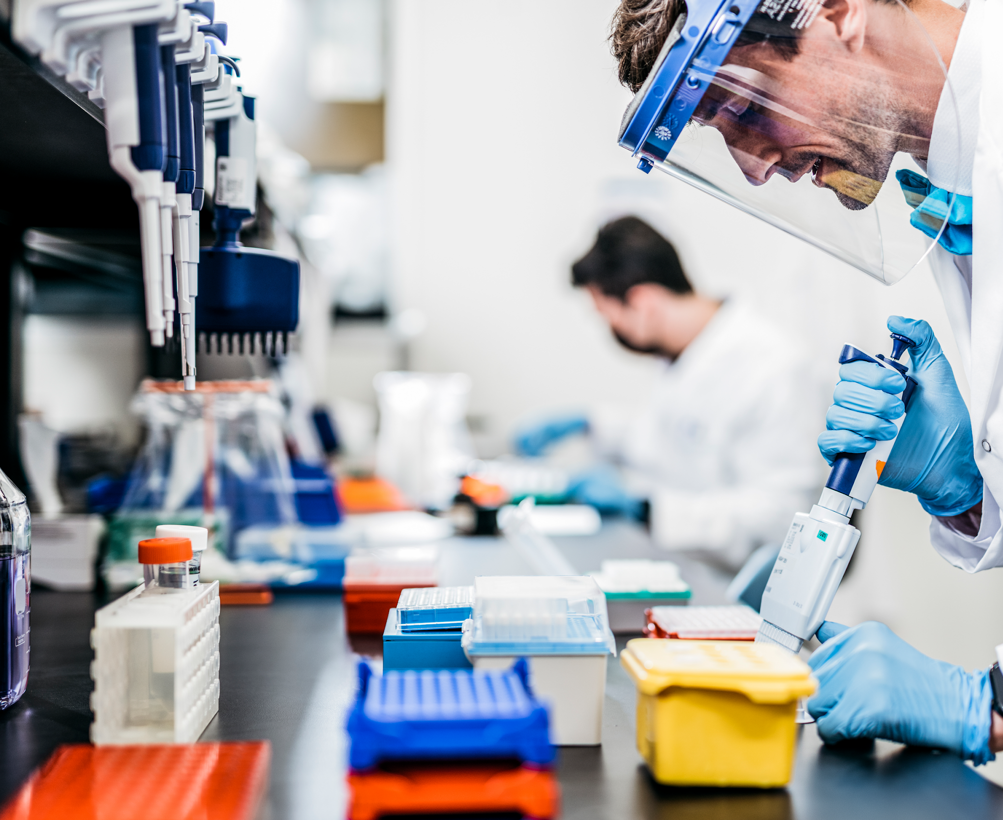
Challenges in Genomics Today
Highly manual, complex workflow
Risk of human error
Accuracy of results
Shortage of highly trained staff
Slow time to results
Fragmented supply sourcing
Complicated interpretation
4

Slide 5












One-Stop Shop for Turnkey Genomics Applications Remotely Deployed
End-to-End Genomics Solution for Any Lab Performing Next Generation Sequencing
The Clear Labs Solution
Hardware
Consumables
Cloud analytics / software
Installation and training
Application support and troubleshooting
Public health labs, government labs, and Veteran’s Affairs (VA) hospitals
Reference labs, commercial labs, and clinical labs
Food manufacturing
and processing plants
5

Slide 6


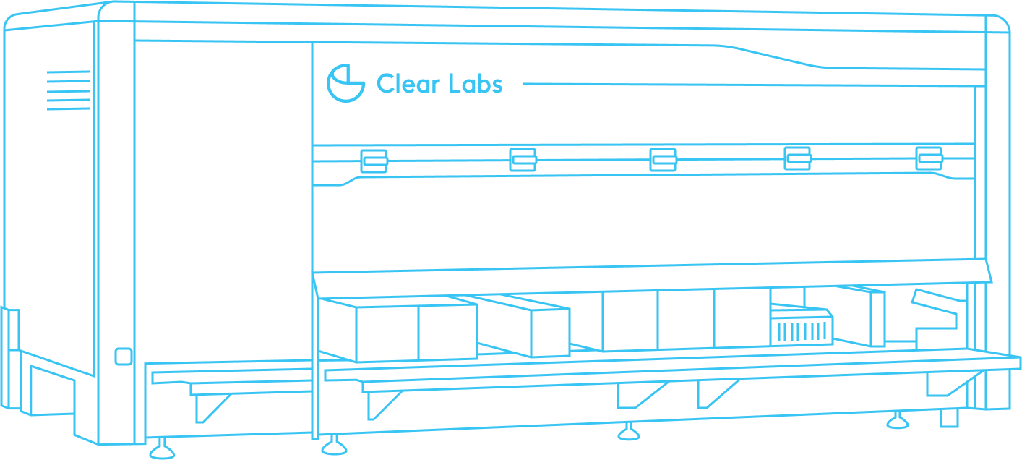
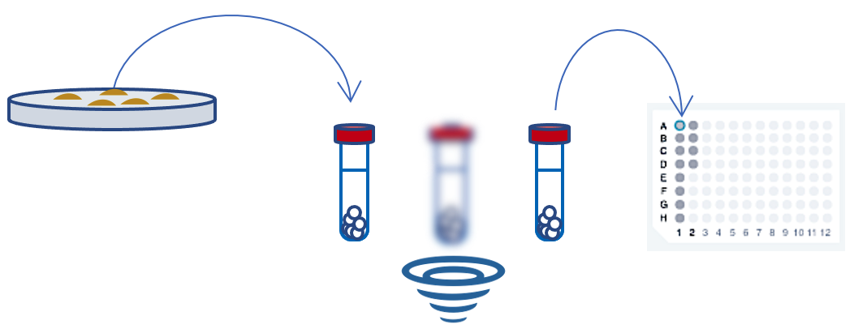
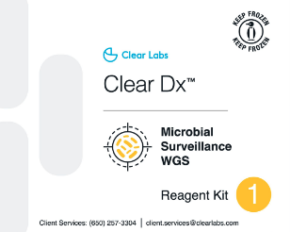







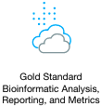


Clear Dx™ Microbial Surveillance WGS Workflow
Simplified Processing for Bacterial Isolates
Phylogenetic Tree
Bionumerics
Pure isolate
FASTQ
Up to 12 samples
Species ID
~45 min
Antimicrobial Resistance
~27 hrs
Batch 1
Batch 2 (+ 7 hrs)
6

Slide 7
Test of Clear Dx™ Systems in the Real World
3 test sites
  Indiana Department of Public Health
  Iowa State Hygienic Laboratory
  Nevada State Public Health Laboratory
2 sequencing runs (replicates) per site
GenomeTrakr pathogen-of-interest (Campylobacter, Listeria, Salmonella, E. coli)
GenomeTrakr Sequencing Requirements:
Organism | # of Contigs | Assembly Length | Coverage | Mean Q Score
Campylobacter | ≤ 300 | ~ 1.5 Mb – 1.9 Mb | ≥ 20x | R1 ≥ 30 R2 ≥ 30
Escherichia coli | ≤ 500 | ~4.5 Mb – 5.9 Mb | ≥ 40x
Listeria | ≤ 300 | ~ 2.7 Mb – 3.2 Mb | ≥ 30x
Salmonella | ≤ 300 | ~ 4.3 Mb – 5.2 Mb | ≥ 30x

Slide 8
Data from Indiana Department of Public Health (Replicate Study)
Time Taken: ~ 25 ¼ hours
Organism | # of Contigs (mean ± s.d.) |  | Assembly Length (mean ± s.d.) |  | Coverage (mean ± s.d.) |  | Mean Q Score (mean) |  | Meet GenomeTrakr Req.?
 | Run 1 | Run 2 | Run 1 | Run 2 | Run 1 | Run 2 | Run 1 | Run 2
Listeria #1 (duplicates) | 24.50 ± 2.12 | 25.50 ± 0.71 | 3.10 Mb ± 756 bp | 3.10 Mb ± 996 bp | 28.92 ± 1.88 | 26.48 ± 0.74 | R1: 36.0 R2: 35.7 | R1: 35.5 R2: 35.1 | ✓
Listeria #2 (duplicates) | 14.50 ± 2.12 | 14.50 ± 0.71 | 2.94 Mb ± 448 bp | 2.94 Mb ± 428 bp | 31.04 ± 3.93 | 25.46 ± 6.44 | R1: 36.0 R2: 35.7 | R1: 35.5 R2: 35.2 | ✓
Enterobacter (quadruplicates) | 35.50 ± 2.65 | 35.75 ± 2.50 | 4.65 Mb ± 281 bp | 4.65 Mb ± 534 bp | 42.51 ± 9.13 | 36.83 ± 9.63 | R1: 35.8 R2: 35.5 | R1: 35.3 R2: 35.1 | ✓
Thanks to Melissa Hindenlang, Neev Kadakia and Dr Lixia Liu for performing the sequencing runs and collaboration
Notes:
3 unique isolates (2 Listeria and 1 Enterobacter) in duplicate runs

Slide 9
Data from Indiana Department of Public Health (Replicate Study)
Time Taken: ~ 25 ¼ hours
Organism | # of Contigs (mean ± s.d.) |  | Assembly Length (mean ± s.d.) |  | Coverage (mean ± s.d.) |  | Mean Q Score (mean) |  | Meet GenomeTrakr Req.?
 | Run 1 | Run 2 | Run 1 | Run 2 | Run 1 | Run 2 | Run 1 | Run 2
Listeria #1 (duplicates) | 24.50 ± 2.12 | 25.50 ± 0.71 | 3.10 Mb ± 756 bp | 3.10 Mb ± 996 bp | 28.92 ± 1.88 | 26.48 ± 0.74 | R1: 36.0 R2: 35.7 | R1: 35.5 R2: 35.1 | ✓
Listeria #2 (duplicates) | 14.50 ± 2.12 | 14.50 ± 0.71 | 2.94 Mb ± 448 bp | 2.94 Mb ± 428 bp | 31.04 ± 3.93 | 25.46 ± 6.44 | R1: 36.0 R2: 35.7 | R1: 35.5 R2: 35.2 | ✓
Enterobacter (quadruplicates) | 35.50 ± 2.65 | 35.75 ± 2.50 | 4.65 Mb ± 281 bp | 4.65 Mb ± 534 bp | 42.51 ± 9.13 | 36.83 ± 9.63 | R1: 35.8 R2: 35.5 | R1: 35.3 R2: 35.1 | ✓
All samples tested passed GenomeTrakr requirements
Minimal intra-run variability observed
No inter-run variability observed
Thanks to Melissa Hindenlang, Neev Kadakia and Dr Lixia Liu for performing the sequencing runs and collaboration
Notes:
3 unique isolates (2 Listeria and 1 Enterobacter) in duplicate runs
Listeria in duplicates and Enterobacter in quadruplicates

Slide 10
Data from Iowa State Hygienic Laboratory
Time Taken: ~ 26 hours
Organism | # of Contigs |  | Assembly Length |  | Mean Q Score |  | Meet Coverage Requirement? |  | Meet Other GenomeTrakr Requirements?
 | Run 1 | Run 2 | Run 1 | Run 2 | Run 1 | Run 2 | Run 1 | Run 2
Campylobacter #1 | 28 | 27 | 1.64 Mb | 1.64 Mb | R1: 36.1 R2: 35.8 | R1: 36.1 R2: 35.8 | ✓ | ✓ | ✓
Escherichia coli #1 | 138 | 137 | 5.27 Mb | 5.27 Mb | R1: 35.9 R2: 35.3 | R1: 36.0 R2: 35.5 | ✓ | ✓ | ✓
Escherichia coli #2 | 154 | 147 | 5.34 Mb | 5.34 Mb | R1: 35.7 R2: 35.7 | R1: 35.8 R2: 35.5 | ✓ | ✓ | ✓
Listeria #1 | 15 | 15 | 2.87 Mb | 2.88 Mb | R1: 36.0 R2: 35.8 | R1: 36.1 R2: 35.7 | ✓ | ✓ | ✓
Salmonella #1 | 81 | 77 | 4.58 Mb | 4.59 Mb | R1: 35.9 R2: 35.6 | R1: 35.9 R2: 35.6 | ✓ | ✓ | ✓
Salmonella #2 | 37 | 39 | 4.86 Mb | 4.86 Mb | R1: 35.9 R2: 35.4 | R1: 35.9 R2: 35.7 | ✓ | ✓ | ✓
Thanks to Dr Valérie Reeb for performing the sequencing runs and collaboration
Notes:
6 unique isolates in 2 duplicate runs

Slide 11
Data from Iowa State Hygienic Laboratory
Time Taken: ~ 26 hours
Organism | # of Contigs |  | Assembly Length |  | Mean Q Score |  | Meet Coverage Requirement? |  | Meet Other GenomeTrakr Requirements?
 | Run 1 | Run 2 | Run 1 | Run 2 | Run 1 | Run 2 | Run 1 | Run 2
Campylobacter #1 | 28 | 27 | 1.64 Mb | 1.64 Mb | R1: 36.1 R2: 35.8 | R1: 36.1 R2: 35.8 | ✓ | ✓ | ✓
Escherichia coli #1 | 138 | 137 | 5.27 Mb | 5.27 Mb | R1: 35.9 R2: 35.3 | R1: 36.0 R2: 35.5 | ✓ | ✓ | ✓
Escherichia coli #2 | 154 | 147 | 5.34 Mb | 5.34 Mb | R1: 35.7 R2: 35.7 | R1: 35.8 R2: 35.5 | ✓ | ✓ | ✓
Listeria #1 | 15 | 15 | 2.87 Mb | 2.88 Mb | R1: 36.0 R2: 35.8 | R1: 36.1 R2: 35.7 | ✓ | ✓ | ✓
Salmonella #1 | 81 | 77 | 4.58 Mb | 4.59 Mb | R1: 35.9 R2: 35.6 | R1: 35.9 R2: 35.6 | ✓ | ✓ | ✓
Salmonella #2 | 37 | 39 | 4.86 Mb | 4.86 Mb | R1: 35.9 R2: 35.4 | R1: 35.9 R2: 35.7 | ✓ | ✓ | ✓
All samples tested passed GenomeTrakr requirements
No inter-run variability observed
Thanks to Dr Valérie Reeb for performing the sequencing runs and collaboration
Notes:
6 unique isolates in 2 duplicate runs

Slide 12
Data from Nevada State Public Health Laboratory
Time Taken: ~ 26 hours
Organism | # of Contigs |  | Assembly Length |  | Mean Q Score |  | Meet Coverage Requirement? |  | Meet Other GenomeTrakr Requirements?
 | Run 1 | Run 2 | Run 1 | Run 2 | Run 1 | Run 2 | Run 1 | Run 2
Escherichia coli #1 | 289 | 288 | 4.93 Mb | 4.93 Mb | R1: 36.1 R2: 35.6 | R1: 36.1 R2: 35.6 | ✓ | ✓ | ✓
Listeria #1 | 18 | 16 | 3.01 Mb | 2.99 Mb | R1: 35.5 R2: 36.0 | R1: 36.5 R2: 36.4 | ✓ | ✓ | ✓
Listeria #2 | 16 | 19 | 3.01 Mb | 3.01 Mb | R1: 35.4 R2: 35.9 | R1: 36.5 R2: 36.4 | ✓ | ✓ | ✓
Salmonella #1 | 32 | 35 | 4.87 Mb | 4.87 Mb | R1: 35.9 R2: 35.7 | R1: 36.1 R2: 35.7 | ✓ | ✓ | ✓
Salmonella #2 | 27 | 32 | 4.61 Mb | 4.62 Mb | R1: 36.0 R2: 35.4 | R1: 36.0 R2: 35.6 | ✓ | ✓ | ✓
Salmonella #3 | 30 | 32 | 4.58 Mb | 4.58 Mb | R1: 36.0 R2: 35.4 | R1: 36.0 R2: 35.5 | ✓ | ✓ | ✓
Thanks to Dr Mark Pandori for the collaboration
Notes:
6 unique isolates in 2 duplicate runs

Slide 13
Data from Nevada State Public Health Laboratory
Time Taken: ~ 26 hours
Organism | # of Contigs |  | Assembly Length |  | Mean Q Score |  | Meet Coverage Requirement? |  | Meet Other GenomeTrakr Requirements?
 | Run 1 | Run 2 | Run 1 | Run 2 | Run 1 | Run 2 | Run 1 | Run 2
Escherichia coli #1 | 289 | 288 | 4.93 Mb | 4.93 Mb | R1: 36.1 R2: 35.6 | R1: 36.1 R2: 35.6 | ✓ | ✓ | ✓
Listeria #1 | 18 | 16 | 3.01 Mb | 2.99 Mb | R1: 35.5 R2: 36.0 | R1: 36.5 R2: 36.4 | ✓ | ✓ | ✓
Listeria #2 | 16 | 19 | 3.01 Mb | 3.01 Mb | R1: 35.4 R2: 35.9 | R1: 36.5 R2: 36.4 | ✓ | ✓ | ✓
Salmonella #1 | 32 | 35 | 4.87 Mb | 4.87 Mb | R1: 35.9 R2: 35.7 | R1: 36.1 R2: 35.7 | ✓ | ✓ | ✓
Salmonella #2 | 27 | 32 | 4.61 Mb | 4.62 Mb | R1: 36.0 R2: 35.4 | R1: 36.0 R2: 35.6 | ✓ | ✓ | ✓
Salmonella #3 | 30 | 32 | 4.58 Mb | 4.58 Mb | R1: 36.0 R2: 35.4 | R1: 36.0 R2: 35.5 | ✓ | ✓ | ✓
All samples tested passed GenomeTrakr requirements
No inter-run variability observed
Thanks to Dr Mark Pandori for the collaboration
Notes:
6 unique isolates in 2 duplicate runs

Slide 14
Time and Motion Study Performed at Nebraska PHL @ UNMC
Comparison Features | Current Manual iWGS Workflow | Clear Dx™ Microbial Surveillance iWGS Workflow
# of Disparate Hardware Used | 5 (NA extraction device, Qubit, Thermocycler, Magnet rack & Sequencer) | 1 integrated platform
# of Kits Used (from Multiple Vendors) | 3 (Extraction kit, Qubit kit & Sequencing kit) | 1 kit from Clear Labs
Total Run Time | 44 hrs | 27 hrs
Hands-on-Time | 235 mins | 40 mins (> 80% reduction)
# of Discontinuous Human Touch Points | > 20 | 1
Thanks to Dr Pete Iwen for the collaboration

Slide 15
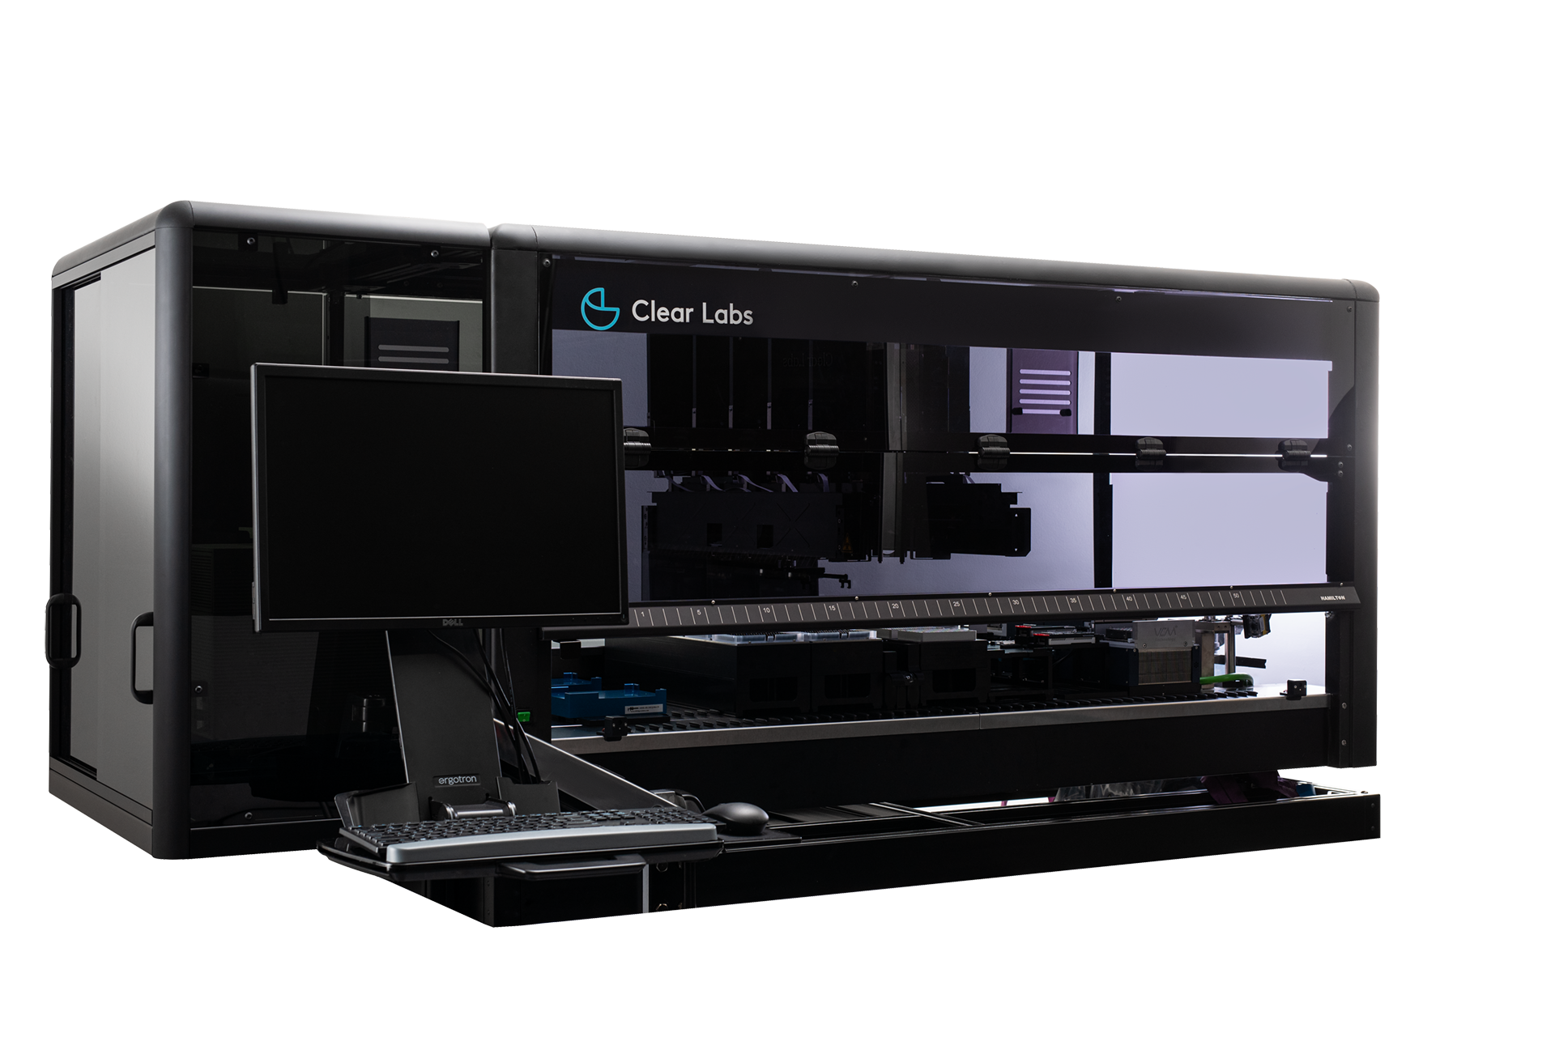
Multiple Benefits of a Fully Automated Solution
Simplified workflow with one human touch point
Reduction in labor costs
Increased lab productivity
Reduction in workflow errors; increased consistency
Fast turnaround time
Integrated analytics
Cost-effective
Cloud connectivity
Clear Dx™
Manual NGS
Time to results
27 Hrs
~44 Hrs
Approximate hands-on time
45 min
~ 235 min
Human touchpoints
1
> 20

Slide 16




Clear Dx™ Results Consistently Meet GenomeTrakr Requirements
100%
of Sequencing Runs Meet GenomeTrakr Requirements
Minimal inter- & intra-run variability
> 4 hours
Time Saved
(12 samples per sequencing run)
~$13 M
Potential Costs Saved by GenomeTrakr per Year*
(USD)
* 1,000,000 samples ÷ 12 samples/run x 4hr x $40/h
** 1,070,000 samples ÷ 12 samples/run x 4hr x $40/h
Notes:
# of samples to be sequenced are on an increasing trend year on year.
Data on # of samples (2022) based on GenomeTrakr site (https://www.fda.gov/food/whole-genome-sequencing-wgs-program/genometrakr-fast-facts)
Data on # of samples (2021) based on IFSH site (https://www.ifsh.iit.edu/sites/ifsh/files/departments/IFSH2022_PulseNetWGS_toshare.pdf)

Slide 17
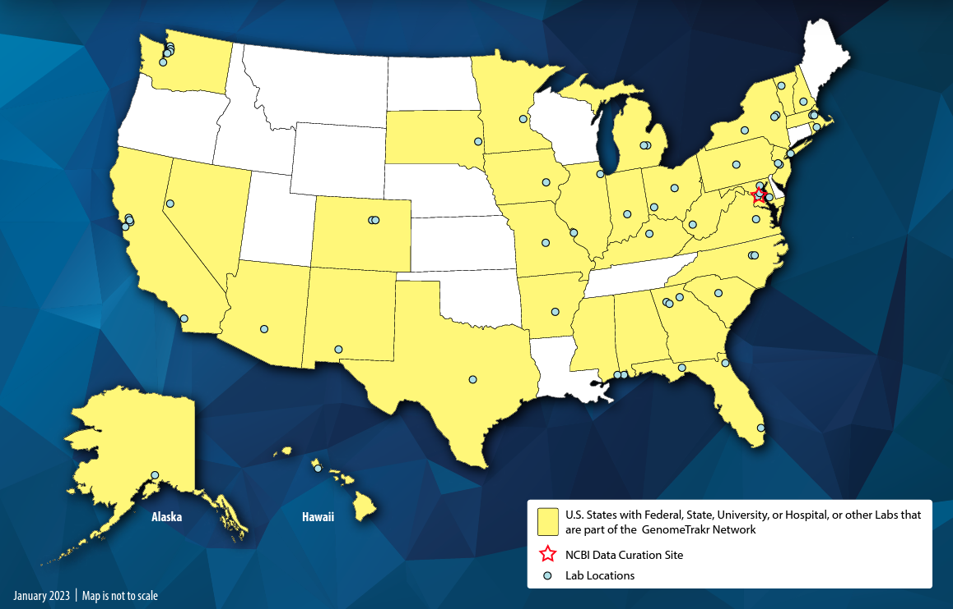

Synergistic Partnership Between FDA GenomeTrakr & Clear Labs
Dominant Majority of State Public Health Labs Are Using Clear Dx
Existing User (State Lab)
Existing User (City Lab)
U.S. GenomeTrakr Lab
Future User (Awaiting Approval)
16 Labs
6 early Microbial Surveillance adopters
Non-User
17
Notes:
Arizona Department of Health Services with the Translational Genomics Research Institute, Phoenix, AZ*
California Department of Public Health, Richmond, CA*
Florida Department of Health, Jacksonville, FL*
Hawaii Department of Health, Pearl City, HI*
Massachusetts State Public Health Laboratory, Jamaica Plain, MA*
New Hampshire Department of Health and Human Services, Concord, NH*
North Carolina State University, College of Veterinary Medicine, Raleigh, NC*
Texas Department of State Health Services, Austin, TX*
Virginia Department of Health, Richmond, VA*
West Virginia Department of Agriculture, Charleston, WV*
Indiana State Department of Health, Indianapolis, IN
State Hygienic Laboratory at the University of Iowa, Coralville, IA
Kentucky Cabinet for Health and Family Services, Frankfort, KY
Nevada Department of Health and Human Services with University of Nevada - Reno, Reno NV
New York State Department of Health - Wadsworth Center, Albany, NY
South Carolina Department of Health and Environmental Control, Columbia, SC
* Systems on COVID but not on MS.

Slide 18
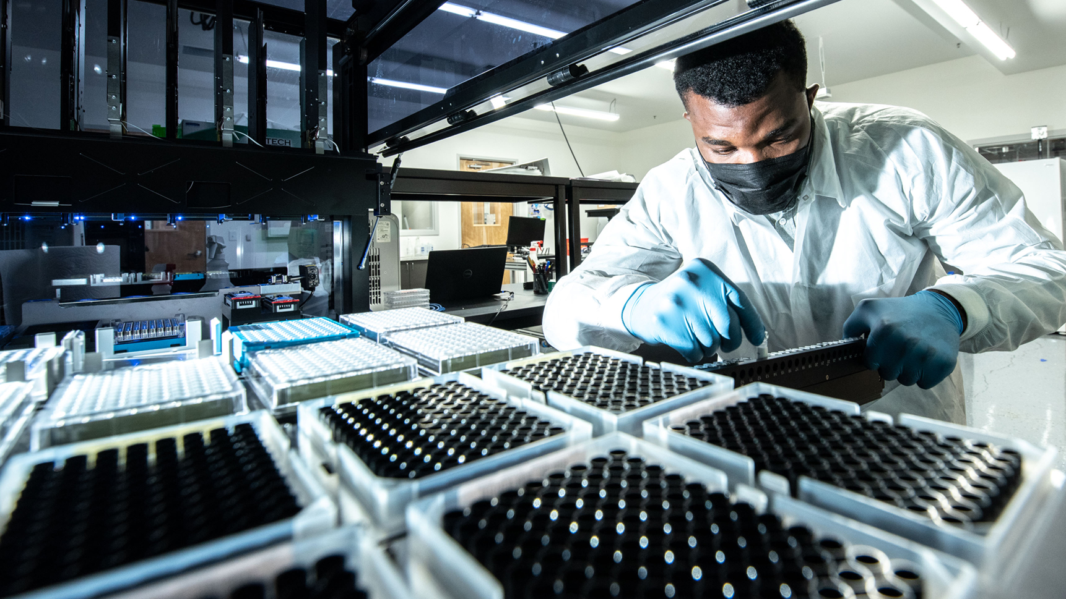
Liberating genomics to all.
Thank You
E: ramin.khaksar@clearlabs.com
W: clearlabs.com

