Slide 1
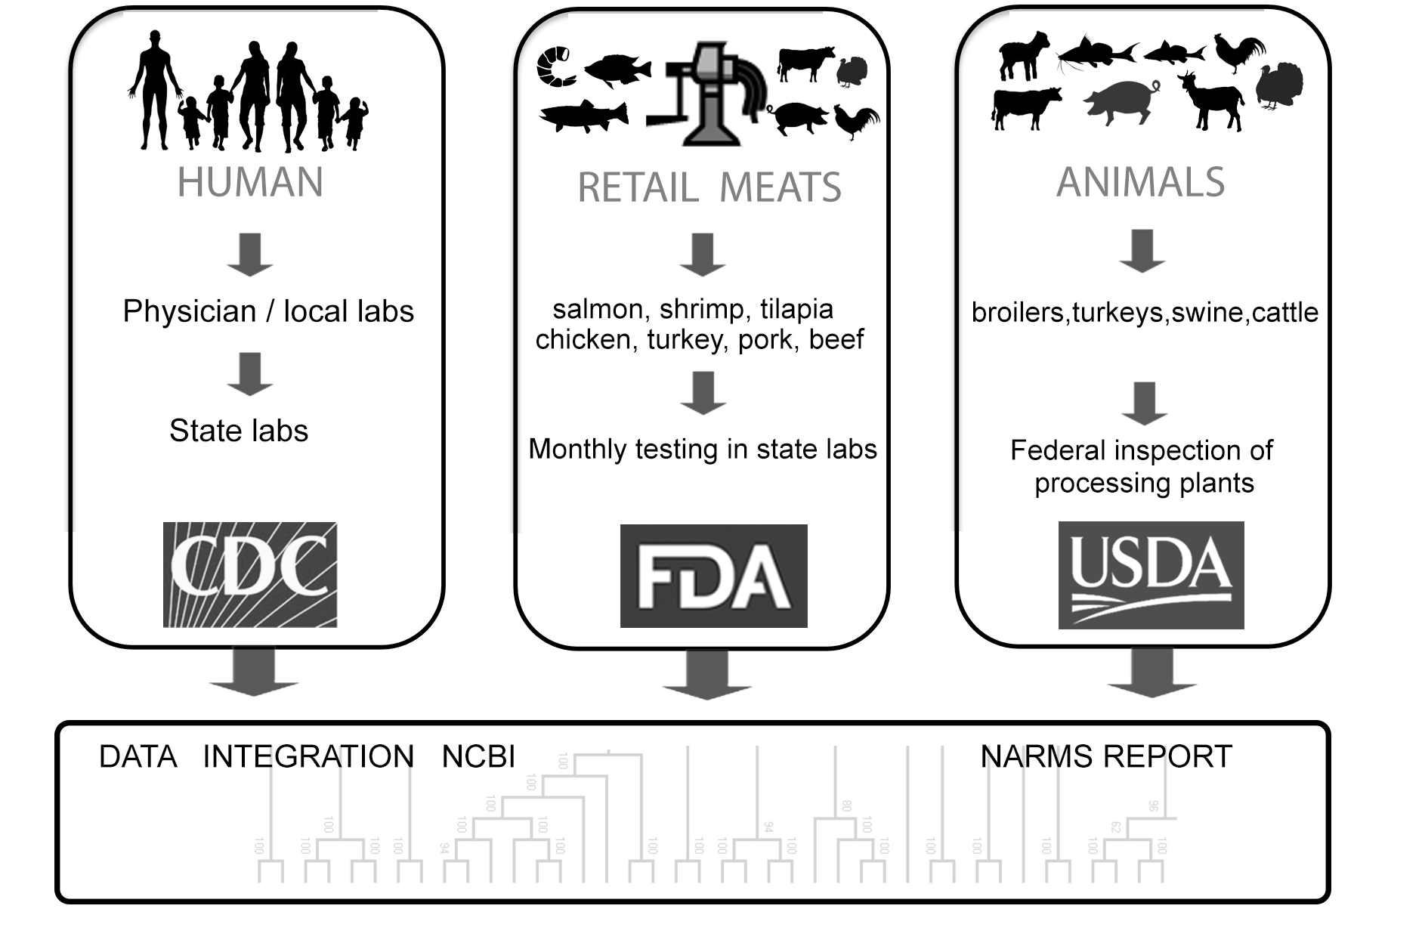

NARMS: Update
Presenter: Claudine Kabera, MPH
Notes:
Hello everyone, and thank you for giving NARMS the opportunity to come and provide an overview of NARMS
My name is Claudine Kabera and I manage the NARMS program

Slide 2
Outline
Background
Data
Retail Meat Monitoring
Routine whole genome sequences supported by NARMS
Expansion towards One Health
  Environmental Sampling
  Sheep/lamb pilot

Slide 3
Purpose
Vision
Watch: Monitor trends in antimicrobial resistance among enteric bacteria from humans, retail meats, and animals at slaughter;
Search: Conduct research to better understand the emergence, persistence, and spread of antimicrobial resistance;
Share: Disseminate timely information to stakeholders to promote interventions that reduce resistance;
Support: Provide timely antimicrobial resistance data for outbreak investigations; and
Decide: Provide data that assist the FDA in making decisions related to the approval of safe and effective antimicrobial drugs for animals
a world in which antimicrobials are effective for treating human and animal infections and the burden of antimicrobial-resistant infections is minimized
Mission
To provide scientifically reliable data to help reduce the human, animal and environmental health burden caused by antimicrobial-resistant bacteria

Slide 4
Scope of NARMS
 | Humans | Retail Meats | Food-Producing Animals | Animal Pathogens | Environment | WGS Data Repository
Agency | Centers for Disease Control and Prevention (CDC) | U.S. Food and Drug Administration (FDA) | United States Department of Agriculture (USDA) | FDA and USDA | Environmental Protection Agency (EPA) FDA, USDA, CDC, | National Institutes of Health (NIH)
 | Health departments in 50 states | Health departments in 15 states + PR | Food Safety and Inspection Service (FSIS) | Veterinary Laboratory Investigation and Response Network (Vet-LIRN) | Environmental Protection Agency Office of Water | National Center for Biotechnology Information (NCBI)
 |  | Institutions of higher education in 7 states | Agricultural Research Service (ARS) | USDA National Animal Health Laboratory Network (NAHLN) | Agricultural Research Service (ARS)
 |  |  | Animal Plant Health Inspection Service (APHIS) | Vet Dx Labs in 45 States
Source | Ill persons | Grocery stores | Ceca and regulatory samples | Ill Animals | Pilot Studies | Submitted Genomes
 |  | Chicken | Chickens | Dogs | Method dev. (2021-2) | AMRFinderPlus
 |  | Ground Turkey | Turkeys | Cats | Watersheds (2022-3)
 |  | Ground Beef | Cattle | Cattle
 |  | Pork | Swine | Pigs | Nat’l survey (2023-4)
 |  | Shrimp | Veal | Poultry
 |  | Tilapia | Lamb
 |  | Salmon | Goat
 |  |  | Catfish
Bacteria | Salmonella | Salmonella | Salmonella | Salmonella | Salmonella
 | Campylobacter | Campylobacter | Campylobacter
 | E. coli 0157 | Escherichia coli | Escherichia coli | E. coli | E. Coli
 | Vibrio | Enterococcus | Enterococcus | Enterococcus | Enterococcus
 | Shigella | Aeromonas |  | Other | Metagenome
 |  | Vibrio
Notes:
Objective 1.1: Enhance and maintain routine resistance monitoring in select pathogens causing illness in food-producing and companion animals.
Objective 1.2: Implement geographically-representative monitoring including surface waters to establish baseline AMR data in aquatic ecosystems.
Objective 1.3: Initiate an AMR testing program for animal feed and pet food, including their ingredients, and share data in an integrated database and in NARMS reports.
Objective 1.4: Add routine testing of seafood products and imported foods and conduct pilots to explore other possible sources of resistant bacteria affecting health such as minor food-producing animal species, produce, and wildlife.
Objective 1.5: Expand NARMS to explore the diversity of antimicrobial resistance in other foodborne microorganisms.

Slide 5
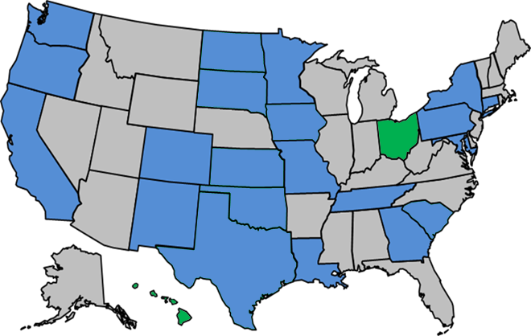
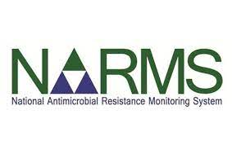

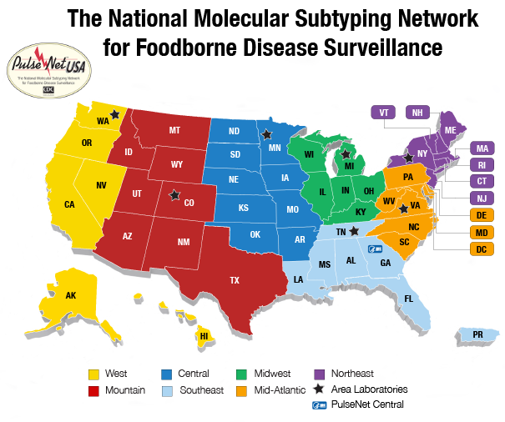
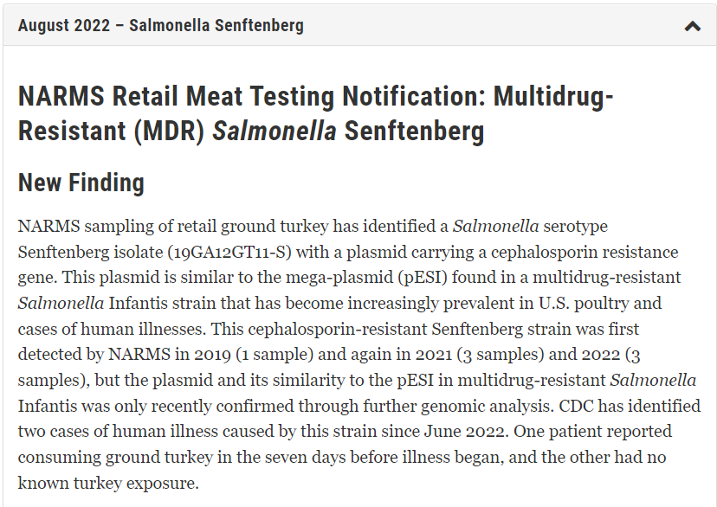
NARMS Data and Information Flow
FDA NARMS Labs
Integrated Reports & Summaries
Online Data Dashboards:
NARMS Now & ResistomeTrakr
AST & WGS
Results
Notes:
Alerts: Summarize recent unusual or concerning antimicrobial resistance findings found through surveillance of retail meats. These updates are based upon WGS analysis to screen for bacterial genes associated with resistance to one or more medically important antibiotics. Findings that would lead to a data update include but are not limited to:
Resistance to antimicrobials typically used to treat infections in humans (e.g., ceftriaxone and ciprofloxacin for treatment of severe Salmonella infections),
Resistance to antimicrobials used as last-resort treatments (e.g., colistin), and
Emergence of extensively drug-resistant clones.

Slide 6
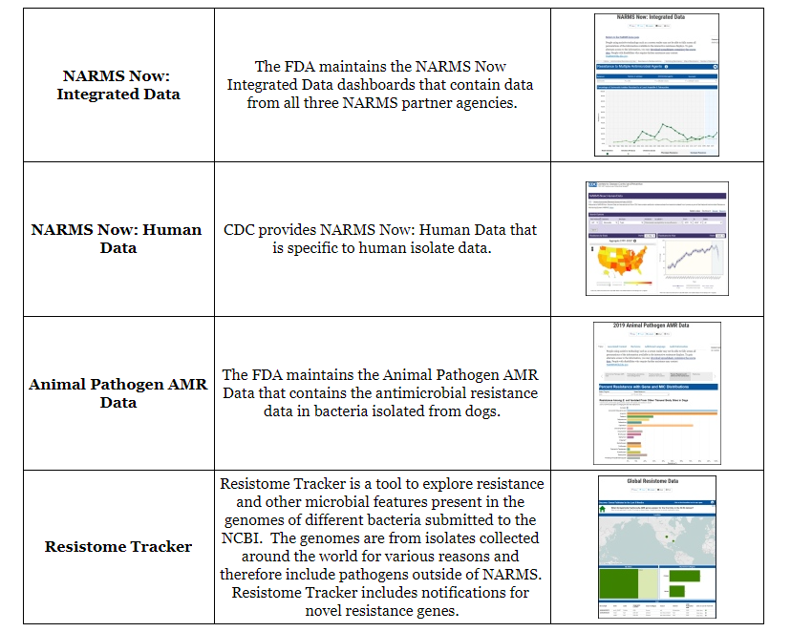

Accessing NARMS Data
Notes:
What are they used for? Who is the intended user?
Scan the QR to access NARMS webpage. Navigate to How is NARMS data shared to access the various NARMS interactive displays

Slide 7
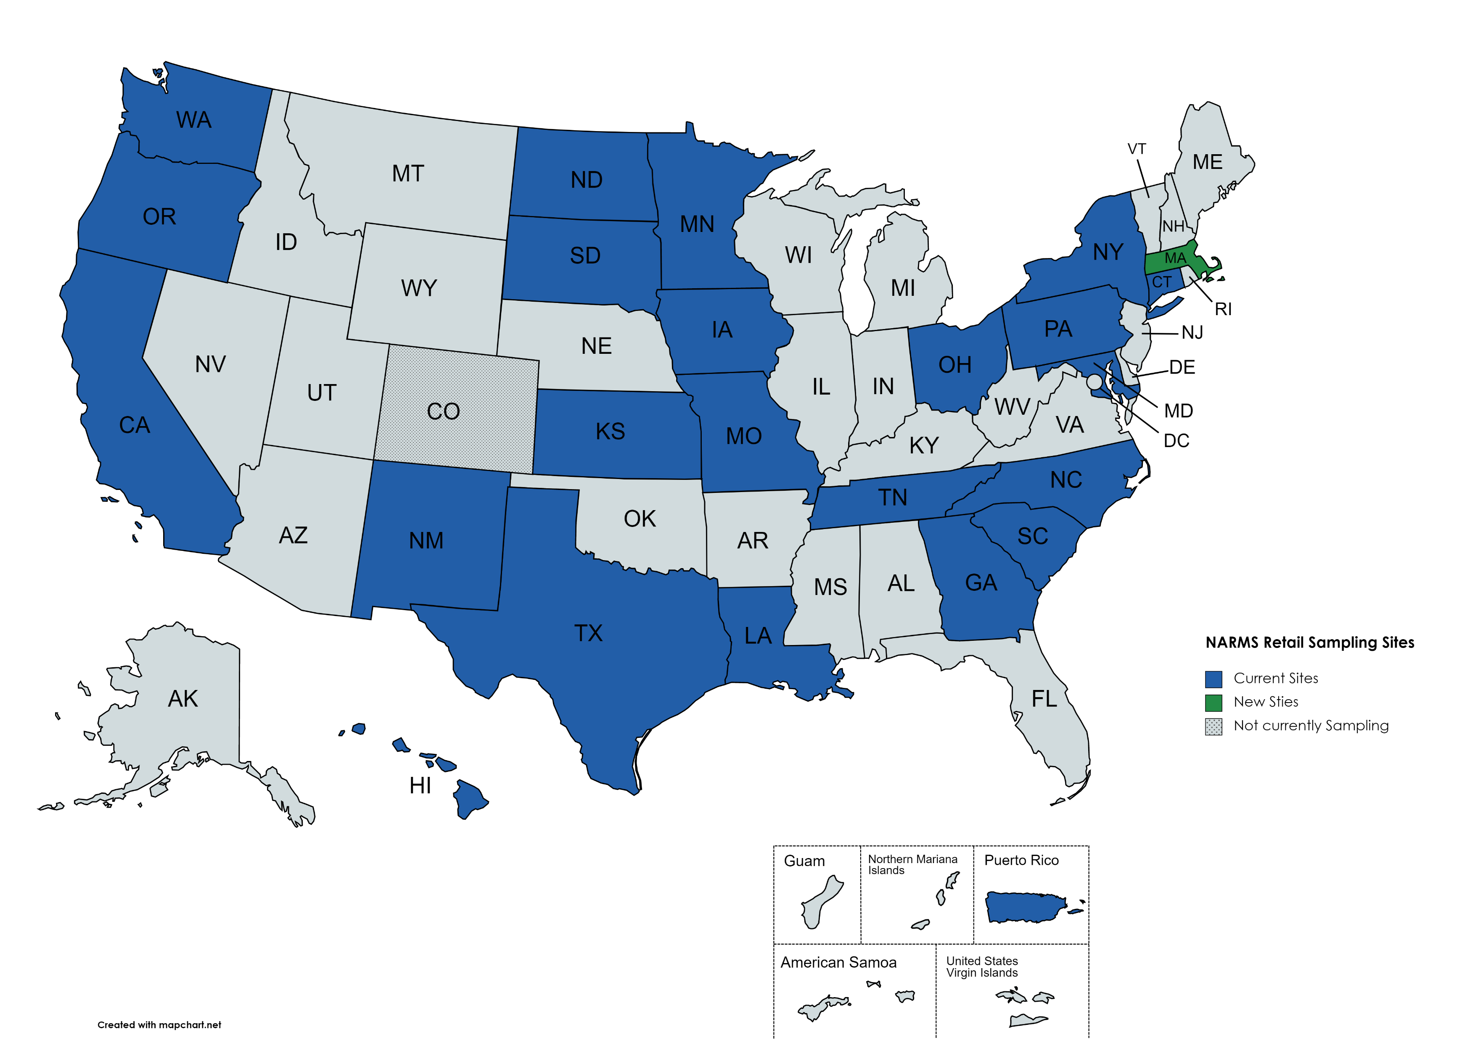
NARMS Retail Sites
2023 Sampling Scheme:
Each site purchases 17 packages per month
  4 retail chicken
  6 ground turkey
  4 ground beef
  2 Salmon
  2 Shrimp
  2 Tilapia
  1 Chicken Liver
  1 Chicken Gizzard
  1 Chicken Heart
Currently:
  All 24 sites culture for Salmonella and Campylobacter. Seafood, all sites test Enterococcus, Vibrio, and Aeromonas
  19 sites (CT, GA, HI, IA, KS, MD, NC, NM, OH, OR, PA, PR, SC, SD/ND, TN, TX/OKC, UCD, MA, WA) will culture for E coli (and other lactose⁺ bacteria)
  18 sites (CT, GA, HI, IA, KS, MD, OH, NC, NM, OR, PR, SC, SD/ND, TN, TX/OKC, UCD, MA, WA) culture for Enterococcus
Partnership with states
CT, GA, MD, MN, TN 1/2002
CT, GA, MD, MN, TN, OR 9/2002
CT, GA, MD, MN, TN, OR, NY, CA 1/2003
CT, GA, MD, MN, TN, OR, NY, CA, CO, NM 1/2004
CT, GA, MD, MN, TN, OR, NY, CA, CO, NM, PA 1/2008
CT, GA, MD, MN, TN, OR, NY, CA, CO, NM, PA, WA, LA, MO 1/2013
GA, MD, MN, TN , OR, NY, CA, CO, NM, PA, WA, LA, MO, IA, KS, SC, SD (ND), TX (Oklahoma City) 1/2017
GA, MD, MN, TN, OR, NY, CA, CO, NM, PA, WA, LA, MO, IA, KS, SC, SD (ND), TX (OKC), UC-D,
NC 1/2018
GA, MD, MN, TN, OR, NY, CA, CO, NM, PA, WA, LA, MO, IA, KS, SC, SD (ND), TX (OKC), UC-D,
NC, UC-D (HI), CT, OH 1/2020
MD, MN, TN, OR, NY, CA, CO, NM, PA, WA, LA, MO, IA, KS, SC, SD (ND), TX (OKC), UC-D, NC,
UC-D (HI), CT, OH, GA, PR 1/2022
MD, MN, TN, OR, NY, CA, CO, NM, PA, WA, LA, MO, IA, KS, SC, SD (ND), TX (OKC), UC-D, NC,
UC-D (HI), CT, OH, GA, PR, MA 1/2023

Slide 8
NARMS Laboratory Flexible Funding Model
State | Lab name | Type | Sample | Analyte* | Analysis
IA | Iowa Department of Agriculture and Land Stewardship | Ground beef | 24 | 2 | 48
 |  | Ground pork | 24 | 2 | 48
 |  | Ground turkey | 24 | 2 | 48
IN | Indiana University | Ground beef | 24 | 1 | 24
 |  | Ground pork | 24 | 1 | 24
 |  | Ground turkey | 52 | 1 | 52
MI | Michigan State Department of Agriculture and Rural Development | Ground beef | 24 | 1 | 24
 |  | Ground pork | 24 | 1 | 24
NH | New Hampshire State Department of Health and Human Services | Ground beef | 12 | 2 | 24
 |  | Ground pork | 12 | 2 | 24
NJ | New Jersey State Department of Agriculture | Ground beef | 24 | 1 | 24
 |  | Ground pork | 24 | 1 | 24
VA | Virginia Division of Consolidated Laboratory Services | Ground beef | 27 | 2 | 54
 |  | Ground pork | 27 | 2 | 54
 |  | Ground turkey | 72 | 2 | 144
VW | West Virginia Department of Agriculture | Ground beef | 24 | 1 | 24
 |  | Ground pork | 24 | 1 | 24
 |  | Ground turkey | 24 | 1 | 24
Total | 7 labs |  | 516 |  | 764
LFFM sites
  Funded by FDA ORA’s Office of Partnership
  Activities managed by FDA ORA’s Office of Regulatory Science (coordinating with Agency SMEs)
  Follow the NARMS retail meat sampling protocols
  WGS conducted on isolates and sequences submitted to NCBI
  Isolates shipped monthly to FDA for additional testing
* Analytes include Salmonella only (1) or Salmonella and Campylobacter (2)
Ground pork from July-December and ground beef from January-June. Ground turkey all year.
Notes:
minus CA and OH from year 3

Slide 9
Sequencing by Sites
19,938 sequences submitted to NCBI as of 9/22/2023
Routine sequencing by NARMS retail sites
  Salmonella, Campylobacter, and E. coli since 2019
  Isolates from chicken giblets not sequenced by sites until January 2023
Isolates not currently being sequenced by sites
  Vibrio, Aeromonas and Enterococcus from seafood
Salmonella- 7,844
Campylobacter- 8,099
E coli- 3,995

Slide 10
Sequencing by USDA FSIS
31,460 sequences submitted to NCBI as of 9/22/2023
FY24 FSIS collected approx. 6,800 intestinal samples
  Sampling based on
    Nationally representative design
    Ability of establishment to contribute samples
    Overall rates of target bacteria
  Slaughter categories: diary (2,000), beef (2,000), turkey (200), broilers (1,000), swine (1,600)
WGS performed on all Salmonella and Campylobacter isolates and at least
  1,000 E . coli isolates
  500 Enterococcus isolates
Salmonella- 11,750
Campylobacter- 13,404
E. coli- 6,306
Enterococcus- 2,230

Slide 11
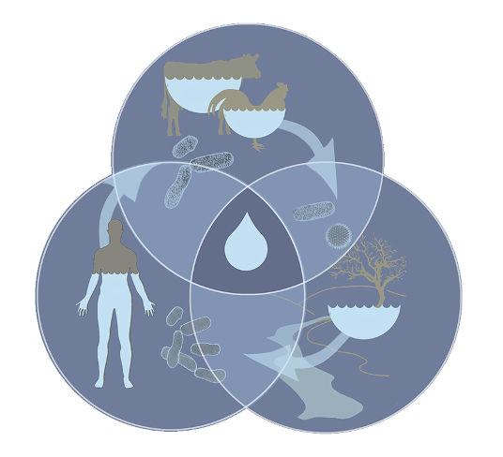
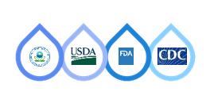

NARMS One Health Water
“Following the NARMS Review Subcommittee recommendations to incorporate the three major domains of the One Health model (humans, animals, environment), an important theme of this strategic plan is the expansion of testing to examine resistance in animal pathogens and the environment. For environmental monitoring, what constitutes the best sampling points will be refined over time. Surface waters as confluence points of ecosystems differentially affected by built environments is a starting point.”
NARMS Strategic Plan 2021-2025
From a One Health perspective, surface waters function as
key environmental integrators.
They receive human, agricultural, and wildlife input and are
water sources for humans, agricultural, and wildlife.

Slide 12




Analytical Targets – Surface Water Antimicrobial Resistance Monitoring (SWARM)
Culture
  Enterococcus, E.coli: Links to existing water quality methods
    Will quantify and determine resistance to specific antibiotics (cefotaxime, vancomycin, tetracycline)
  Salmonella: Links to food cycle & NARMS
    Presence/absence, WGS of isolates
Targeted Gene Analysis
  Defined panel of antibiotic resistance genes important to human, animal, and environmental health, including fecal source trackers (~90-100 genes)
Metagenomics +/- Enrichment
  Define environmental resistome in surface waters
  Determine new genes to quantify via targeted gene analysis

Slide 13
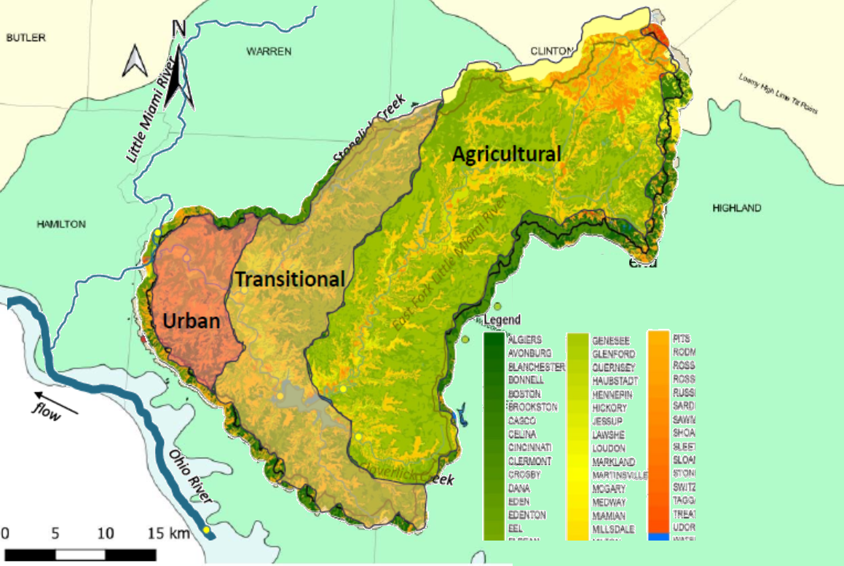
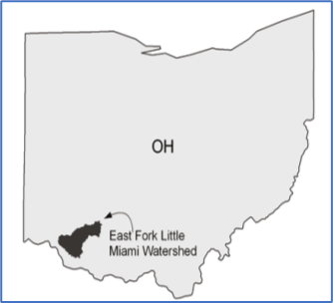
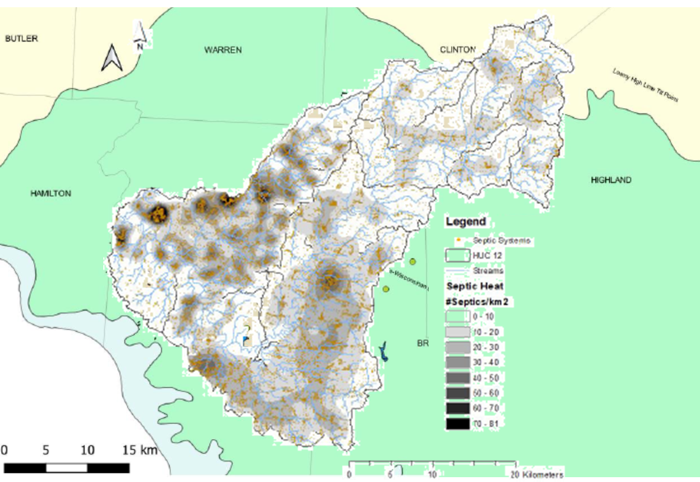
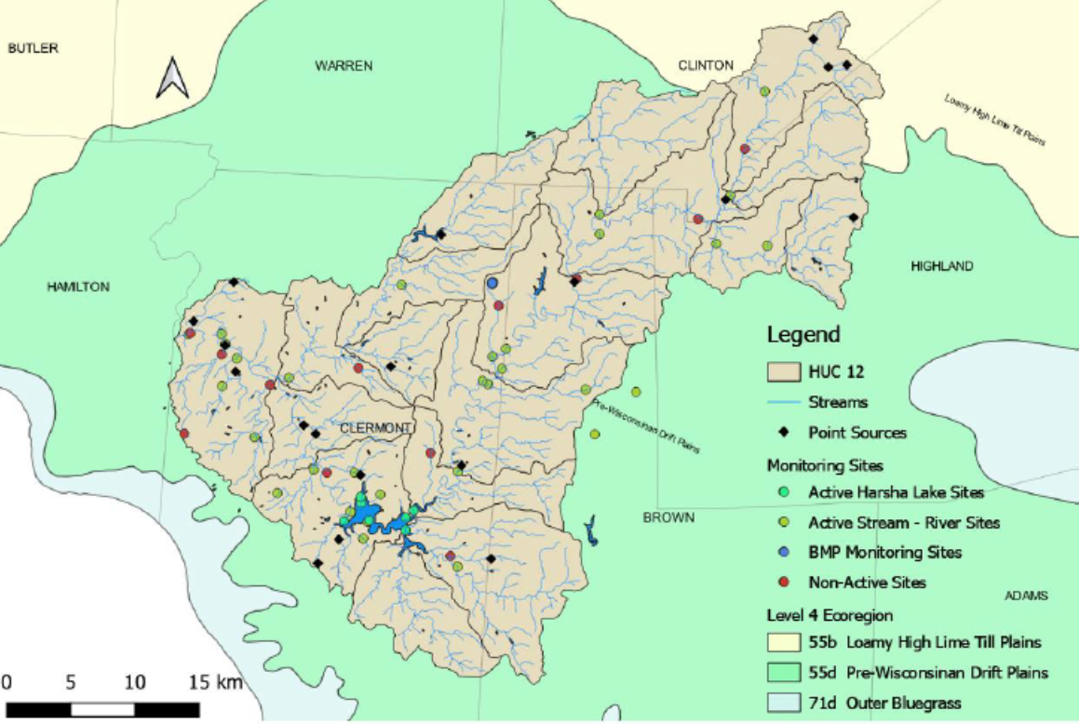
East Fork Little Miami Watershed AMR Pilot
Urban- Ag transition
12K septic systems mapped
Point sources and rec waters in relation to sample sites

Slide 14
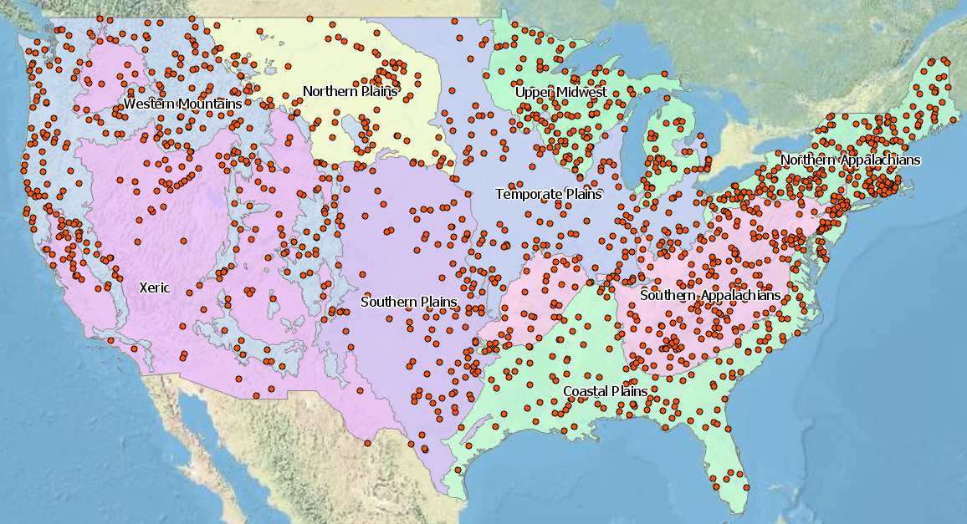
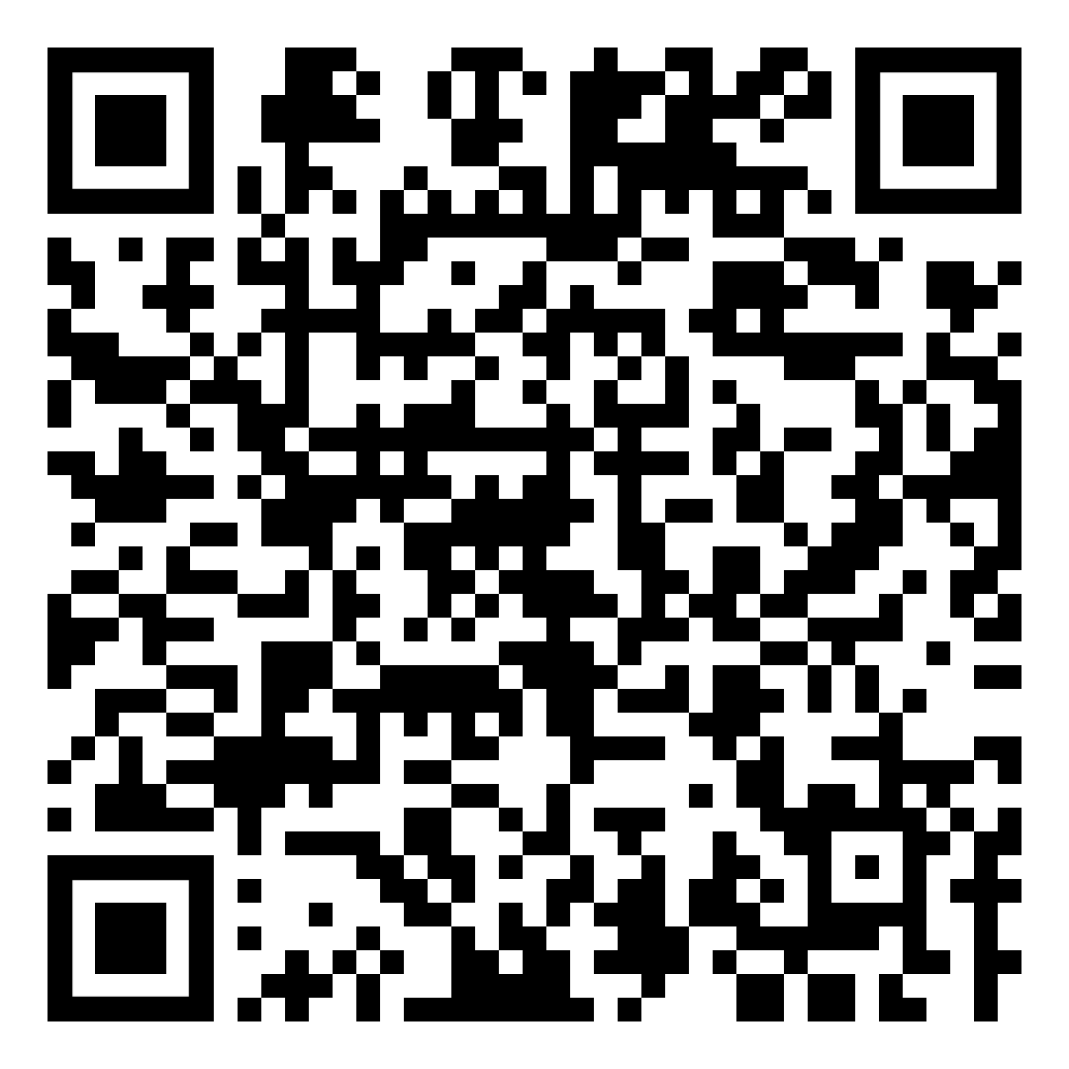
Leveraging EPA Programs – NRSA 2023-2024
Map of National Rivers and Streams Assessment (ECO9 Regions Shown)
Note: 4 of the ecoregions within the NRSA design (Northern Appalachians, Coastal Plains, Temperate Plains, and Western Mountains) culture and isolate Salmonella spp.

Slide 15
Impact of Environment Surface Water Monitoring
Data gathered will form a baseline for measuring long term environmental trends as a pilot component of NARMS
Provide information on which types of aquatic systems, environmental conditions, and landscape factors tend to be associated with higher antibiotic resistant genes and antibiotic resistance bacteria prevalence
Overall, the data will help agencies better assess and prevent waterborne risk associated with antimicrobial resistance pathogens in surface water, drinking water, irrigation and water reuse.

Slide 16
2024 Sheep/lamb Pilot Study
NAHMS Study
NARMS Parallel Study
USDA’s National Animal Health Monitoring System (NAHM) conducts a national sheep study approx. every 10 yrs.
Study participants- a random selection of ~5,000 sheep operations with at least ewe located in the study states
Timeline: 4/2024 through 7/2024
Fecal samples will be tested for Salmonella, Campylobacter, E. coli
USDA FSIS:
  will collect up to 540 cecal samples from sheep and lamb
  Samples will be cultured for Salmonella, Campylobacter, E. coli
  WGS will be conducted on Salmonella and Campylobacter and proportion of E. coli isolates
FDA:
  Utilize the LFFM to collect sheep and mutton at retail
  Full plan development underway

Slide 17



