Slide 1
The Importance of International Collaboration
Eric L. Stevens, PhD
U.S. Food and Drug Administration (FDA)
Human Foods Program (HFP)
Office of Policy and International Engagement (OPIE)

Slide 2
Total Number of Sequences at NCBI PD
Average Number of Sequences
Added Per Month Each Year
2013: 184
2014: 1,076
2015: 2,362
2016: 4,529
2017: 5,826
2018: 9,434
2019: 12,165
2020: 12,847
2021: 14,285
2022: 21,767
2023: 20,828
Number of Sequences
(as of the last day of the quarter)
Year
First sequences uploaded in February 2013
* Other pathogens: Cronobacter, V. vulnificus, C. botulinum, C. perfringens, and Bacillus cereus group

Slide 3
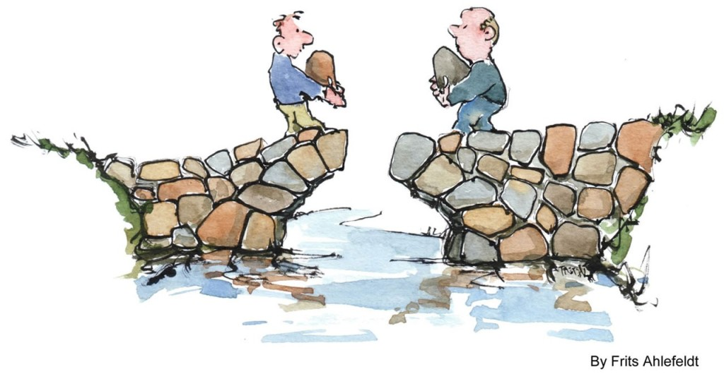
Building a Culture of Trust
Establishment of FDA CORE
    Epidemiologic staff in regulatory agency
Increased data transparency
    Open, controlled data access
Inclusive engagement
    End-to-end collaboration, detection to control
    FDA role in epidemiologic calls
    CDC role in industry/company calls
Ongoing assessments, iterative enhancement
    AARs, partner focus groups
    Honest dialogue; what works, what doesn’t
Routine and ad hoc team meetings during investigations
In-person meetings & team-building trainings

Slide 4
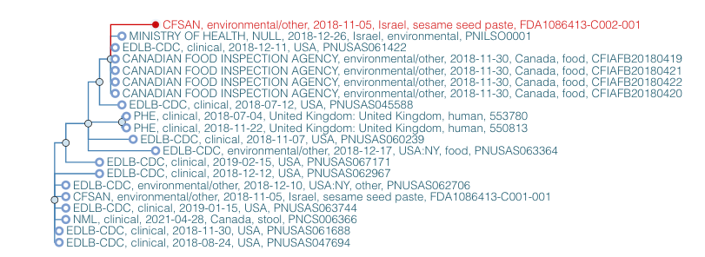


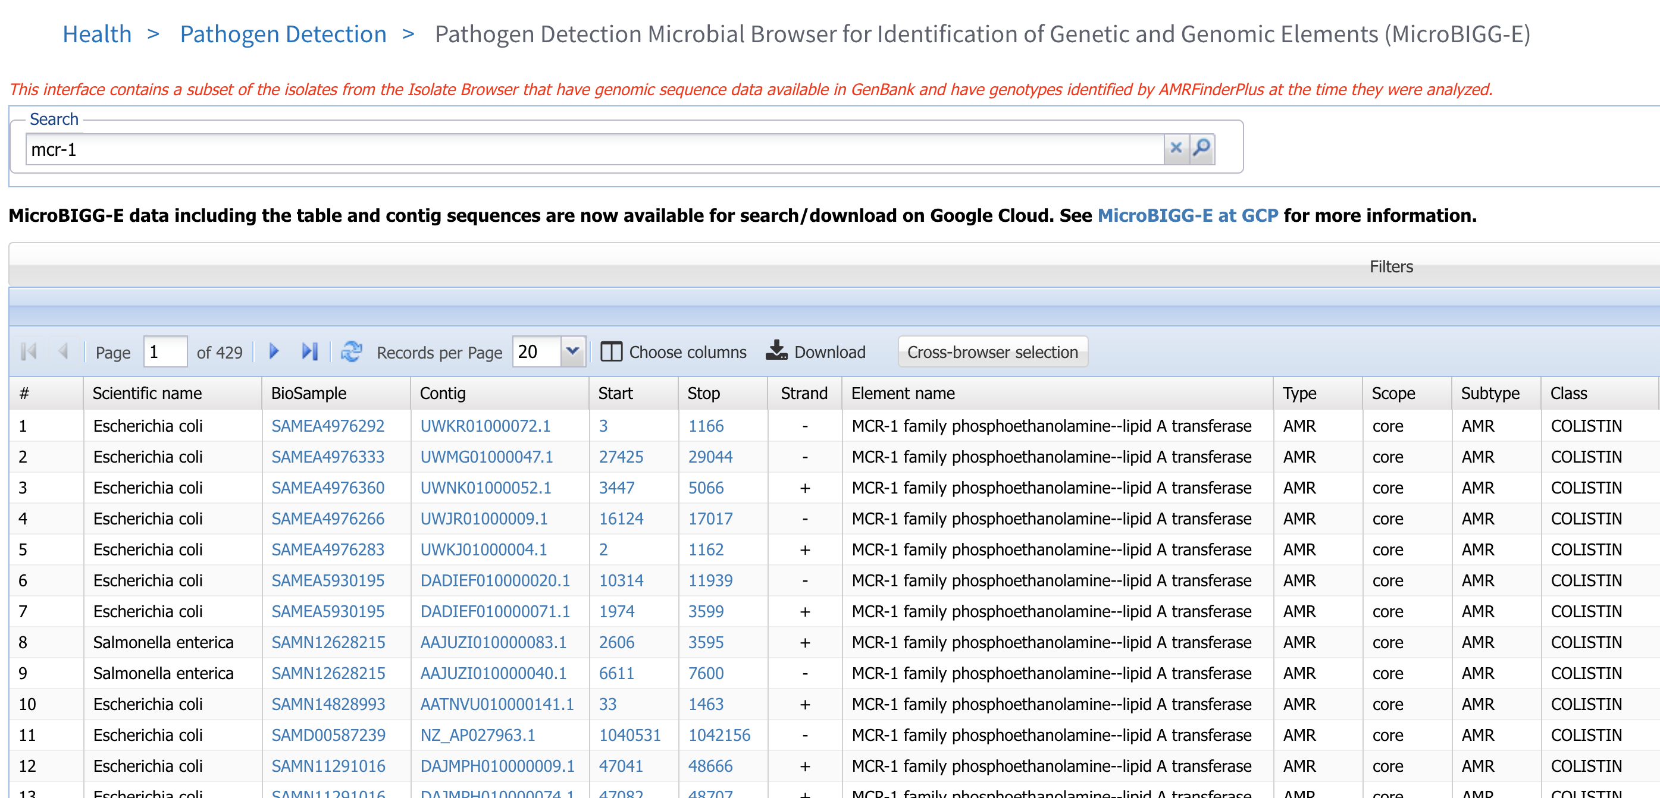





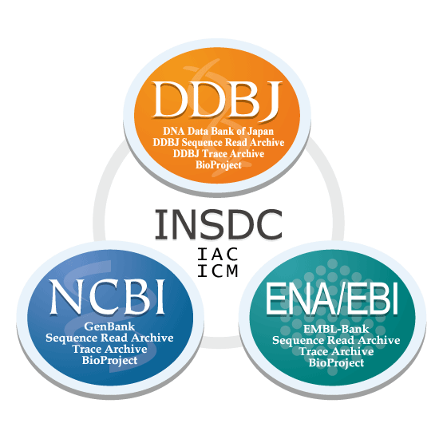
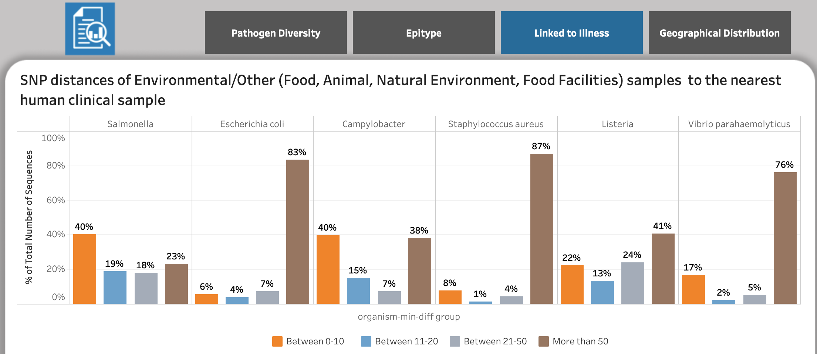


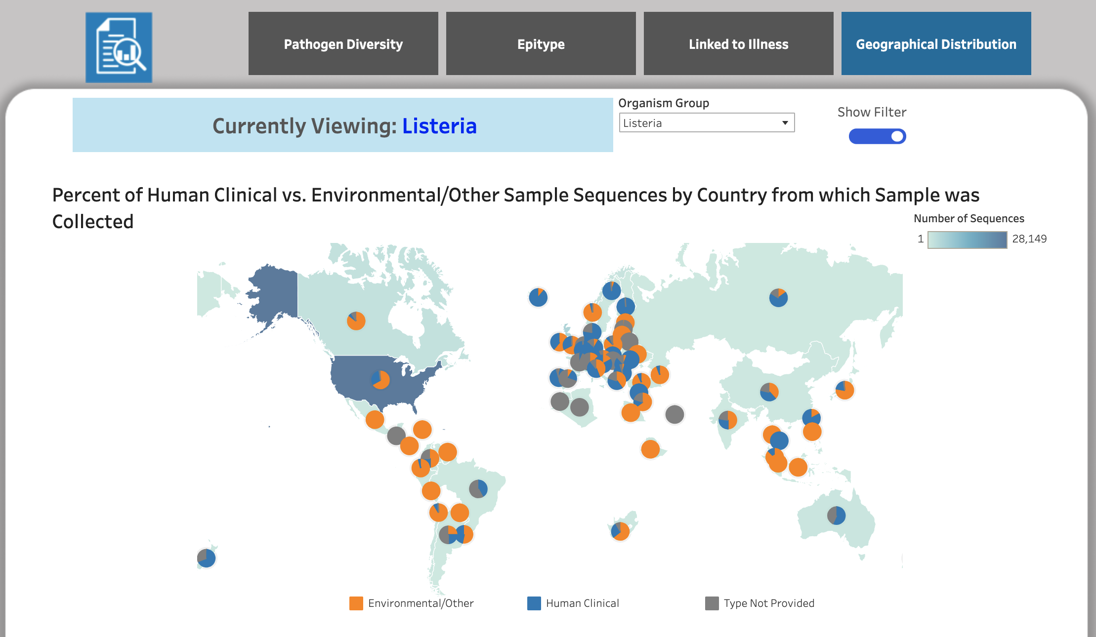


Global enteric pathogen surveillance
NCBI Pathogen Detection
Pathogens
Academia
Federal Agencies
Pathogen DOM
FDA public dashboards
Public health labs
Government
Research
INSDC Public repository
PulseNet
Pathogen DOM
Agriculture labs
Hospitals
Veterinary
Clinics
Industry

Slide 5

Public (at NCBI PD) versus Private Data
PUBLIC
Sequence Data *
Year
Uploader
General Geographic Location *
Source (environmental, food, clinical)
Facility, Farm, Retail Location
Age, Sex, other human identifiable info
Epi Information
Product Traceback Data (e.g. Lot Code)
Location within Facility, Farm, Retail
Other Private and Confidential Data
Private

Slide 6

What is a Regulatory Partnership?
New type of international arrangement for FDA to engage in cooperative activities with another government on a specific export commodity or program area
Government to government collaboration tool

Slide 7
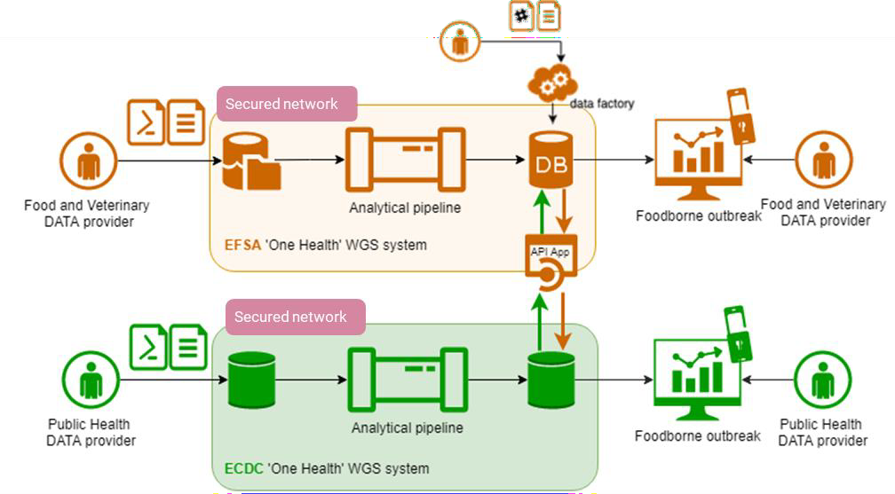
EU ONE HEALTH WGS DATA SHARING MODEL
COMBINATION OF APPROACHES
Controlled-Centralized Data Sharing at sector level: EFSA and ECDC collects data centrally based on their remit
Cross-Sectoral Collaboration: interoperability and comparability of the EFSA and ECDC platforms allow the data exchange for allowing cluster detection and outbreak investigation
4

Slide 8
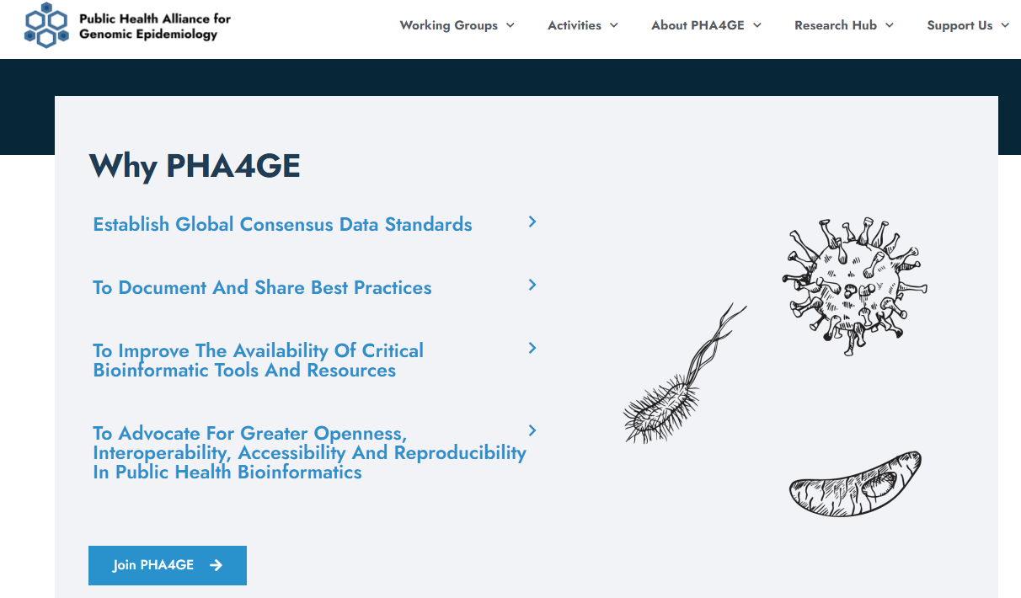

Slide 9


Slide 10
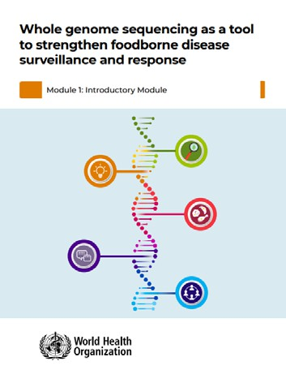
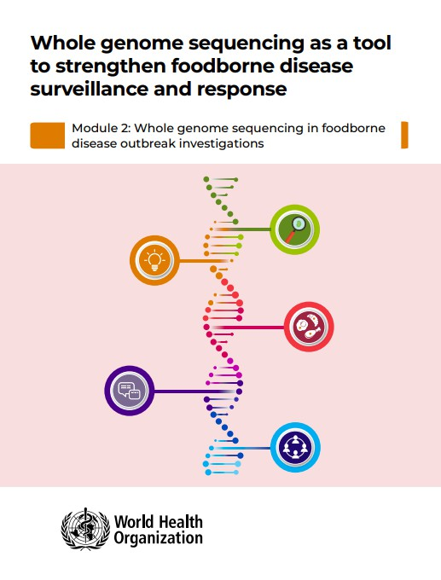
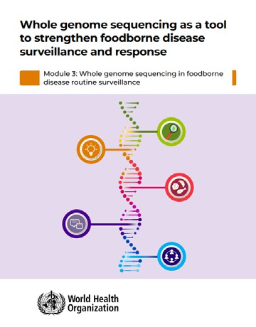
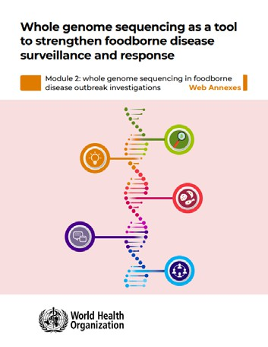
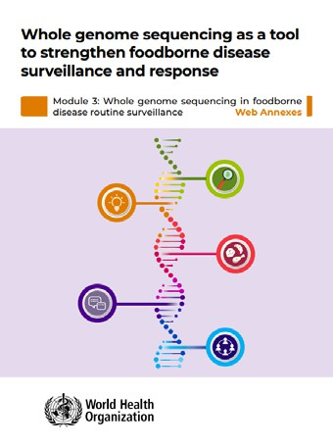
WHO’s new guidance document:
Whole genome sequencing as a tool to strengthen foodborne disease surveillance and response
Motivation
Development
Modules 1, 2,
and 3
Web Annexes 1
and 2

Slide 11
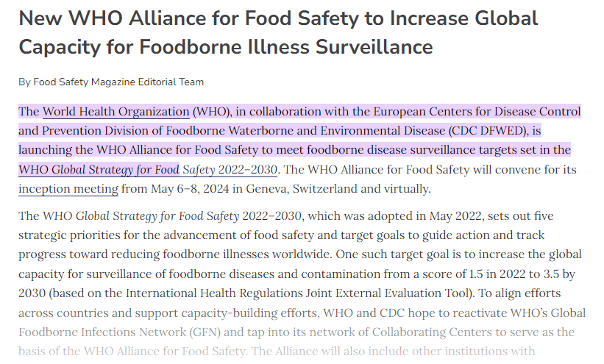

Slide 12
Upcoming Opportunities
FAO Water/Food Safety Meeting (May 2025)
Apply now to be considered to join the FAO global meeting on WGS in May 2025
https://www.fao.org/food-safety/news/news-details/en/c/1708392/
GMI15 in Melbourne, Australia (September 2025)

Slide 13
Thank you!
Eric L. Stevens
Email: eric.stevens@fda.hhs.gov

