Slide 1

Collaboration with UC Davis
David Kiang and Alice Yu
Microbiology Section
Food and Drug Laboratory Branch, CDPH
GenomeTrakr Meeting
October, 25 2023

Slide 2


Microbiology Section, Food Drug Laboratory Branch (FDLB), California Department of Public Health (CDPH)
State Reference Laboratory for Food Microbiology
Identification of pathogens for foodborne outbreak investigations
Food Surveillance testing for FDA LFFM
CDC PulseNET Certified Lab 2008
USDA FSIS and FDA Food Emergency Response Network (FERN) Lab 2007

Slide 3

GenomeTrakr- 2015

Slide 4



Slide 5

WIFSS

Slide 6
Identification of Antimicrobial Resistance Genes in Vibrio spp. From Retail Shrimp through Whole Genome Sequencing
Food and Drug Laboratory Branch at the California Department of Public Health

Slide 7
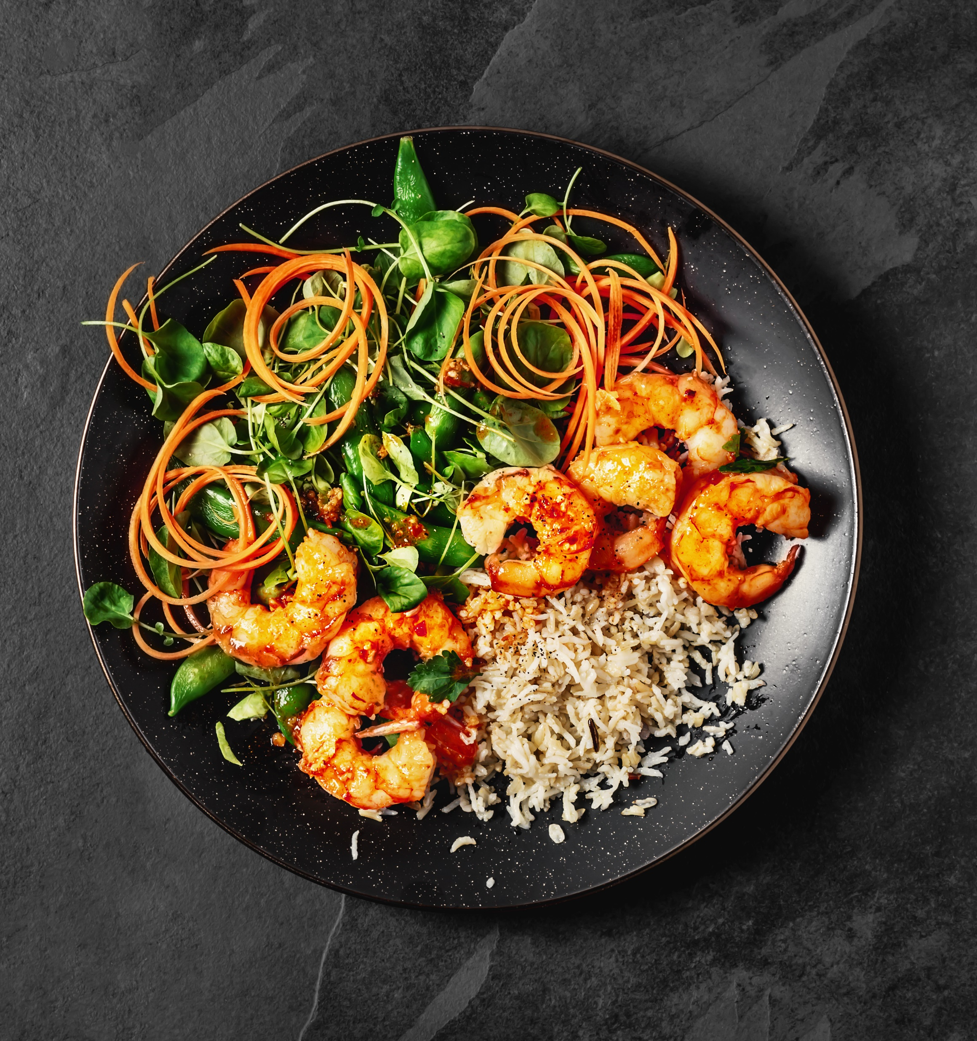
Background
Shrimp is the most popular seafood consumed in the country and considered a healthy protein by the United States Department of Agriculture (USDA)
  Annual per-capita consumption reached 5 pounds in 2020
Farm raised shrimp make up the majority of the market and are highly susceptible to contamination which leads to foodborne illnesses
  Due to the scale of the industry large quantities of antimicrobial drugs are administered to combat this
  2.7% of all global antimicrobial usage is attributed to shrimp aquaculture
  Feed-mediated metaphylaxis
Misuse of antimicrobials may lead to antimicrobial resistance (AMR) which has negative effects on animal and human welfare

Slide 8
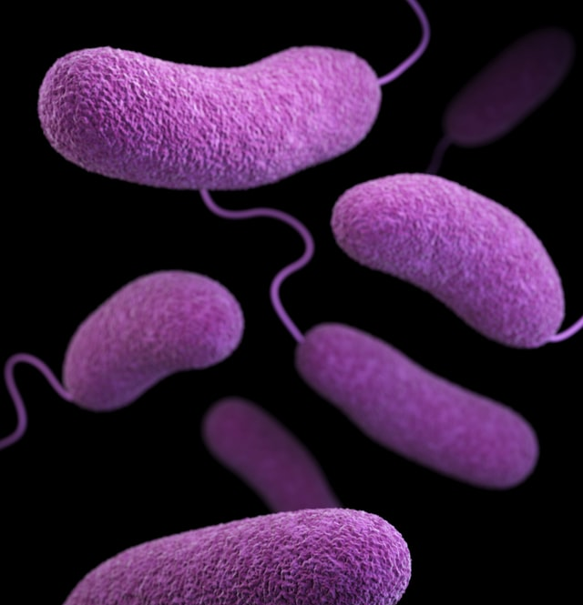
Background
National Antimicrobial Resistance Monitoring System (NARMS) identified Vibrio spp. and Enterococcus spp. as the most prevalent Gram-negative and Gram-positive bacteria in retail seafood samples
  Good candidates for tracking AMR
  Some Vibrio spp. are the most common seafood-borne pathogens in humans and the main pathogens for shrimp
Goal of the study was to evaluate the prevalence and AMR profiles of Vibrio spp. and Enterococcus spp. in retail shrimp collected in Northern California

Slide 9
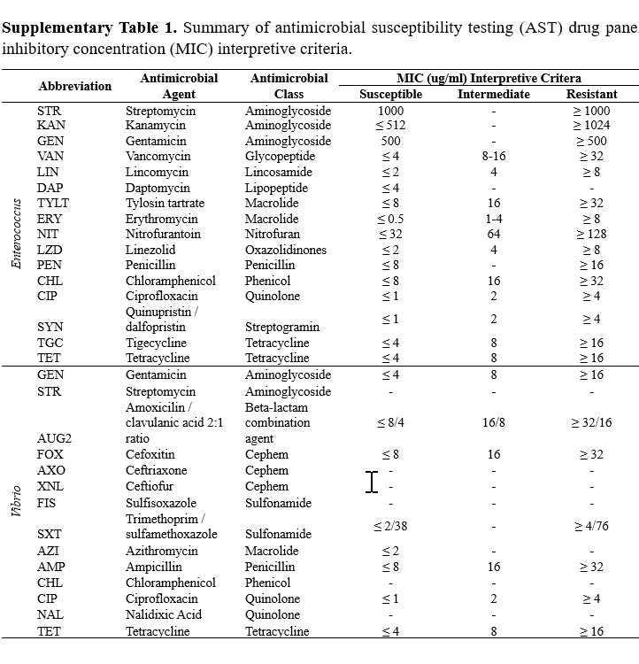
Methods
400 shrimp samples were collected from over 100 retail locations in the Greater Sacramento region of California
  Prepackaged or half-pound packages
Samples were processed according to the NARMS seafood pilot laboratory protocol for Vibrio spp.
  Enrichment in Alkaline Peptone Water (APW) at 35°C for 24 ± 2 h
  Plated onto thiosulfate-citrate-bile salts-sucrose (TCBS) agar
  Colonies that exhibited positive colony morphology were streaked for purity onto blood agar
  Confirmation by PCR
Antimicrobial susceptibility testing (AST) performed on 110 Vibrio isolates
  Subset of isolates that exhibited phenotypic resistance were sent to the Food and Drug Laboratory at the California Department of Public Health for whole-genome sequencing (WGS)

Slide 10
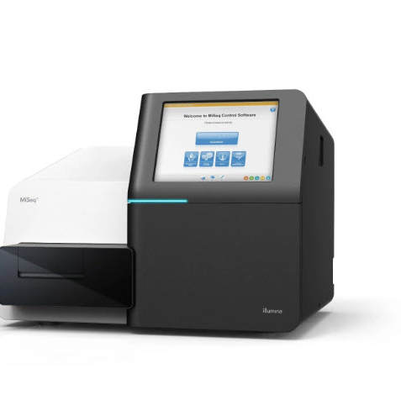
Whole Genome Sequencing
Total of 52 Vibrio isolates were sent from UC Davis to be processed for WGS
  Plated on Trypticase Soy Agar with 0.6% Yeast Extract (TSA-YE) and 3% saline for recovery
  Confirmed on CHROM Vibrio agar plates
  Single colonies were restreaked on TSA-YE with 3% saline and incubated at 35°C for 18–24 hr
  Genomic DNA was extracted from bacteria using the DNeasy Blood and Tissue Kit and quantified using a Qubit fluorometer
Performed on the Illumina MiSeq DNA sequencing system
  DNA libraries were prepared with Illumina DNA Prep kits
  MiSeq reagent kit version 2 (2 × 250-bp paired-end reads) per CDC PulseNet guidelines

Slide 11
Whole Genome Sequencing cont.
Initial sequencing of all the samples was carried out in 3 runs
CDC PulseNet performed data analysis of the FASTq files and NCBI upload
  Total of 42 isolates passed QC and were uploaded
  10 isolates failed quality metrics
Identification of antimicrobial resistance genes done with raw reads using the ResFinder database
  Genes determined as present if sequences met thresholds of 90% identity and 60% minimum length

Slide 12

Whole Genome Sequencing Challenges
Our lab could not perform the data analysis and NCBI upload via BioNumerics
  Vibrio database wasn’t connected to a CE project so the NCBI uploader plugin was unavailable
  Uploaded the FASTQ files and metadata to CDC PulseNet via their FTP site
Failed isolates had to be re-sequenced and re-uploaded from the beginning
  Went back to the glycerol stocks made from UC Davis isolates and plated onto TSA-YE w/ 3% saline and CHROM Vibrio
  DNA extraction and quantification
  6 of the 10 isolates that initially failed were successfully uploaded

Slide 13
Results
Vibrio prevalence of 60.25% in retail shrimp meat samples of different production types and geographic origins in northern California
Interesting trends identified by WGS
  V. metschnikovii was the most common Vibrio species identified followed by V. parahaemolyticus
  27 unique ARGs
  Domestic isolates averaged 0.29 ARGs compared to 1.63 ARGs on average for imported isolates
  Wild caught shrimp averaged 2.26 ARGs whereas farmed shrimp averaged 0.93 ARGs
  Most common ARGs were qnr genes that confer reduced susceptibility to quinolones
  More unique ARGs related to beta-lactam and penicillin resistance than any other antimicrobial classes

Slide 14
Acknowledgments
FDA GenomeTrakr
Eric Brown Marc Allard
Ruth Timme Maria Balkey
Tina Pfefer
FDA LFFM
Kirsten Hirneisen Lauren Yeung
Ruiqing Pamboukian Christopher Waggener
CDC PulseNet
APHL
Robyn Randolph
Terry Reamer
FDLB Team members

