Slide 1
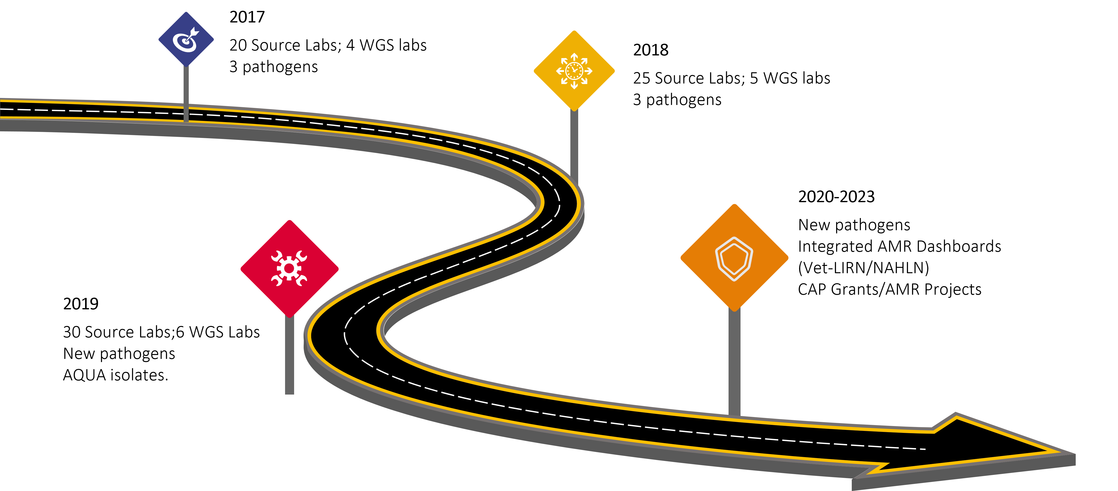

Vet-LIRN AMR Program
Roadmap
Olgica Ceric, DVM, MS, PhD
2023 GenomeTrakr Meeting, College Park, MD
The contents are those of the authors and do not necessarily represent the official views of, nor an endorsement, by FDA/Health and Human Services, or the U.S. Government. Reference to any commercial materials, equipment, or process does not in any way constitute approval, endorsement, or recommendation by the Food and Drug Administration.

Slide 2

Program Highlights
Outbreak detection and tracking
Manuscripts
Funding (Infrastructure and Capacity Building-CAP Grants)
Collaborations
Data collection
Emerging resistance tracking
EARWG
Alerts
2

Slide 3



Bacterial Pathogens (animal clinical isolates)
Bacterial pathogen | N⁰ of isolates/month | Animal host | AST | WGS
Salmonella enterica (SAL) | 4 | any animal host | yes | yes
Escherichia coli (ECOL) | 4 |  | yes | yes
Staphylococcus pseudintermedius (SPSE) | 4 |  | yes | yes
Klebsiella pneumoniae/variicola Pseudomonas aeruginosa Enterococcus faecalis or faecium | 4 | any animal host | yes | Klebsiella pneumoniae/variicola
Enterobacter cloacae complex | 4 |  | yes | yes
Campylobacter coli Campylobacter jejuni Campylobacter fetus | 4 | swine, poultry, cattle, small ruminants, dogs, cats | no | yes
AQUA labs: any bacterial pathogen | 4 |  | yes | yes

Slide 4
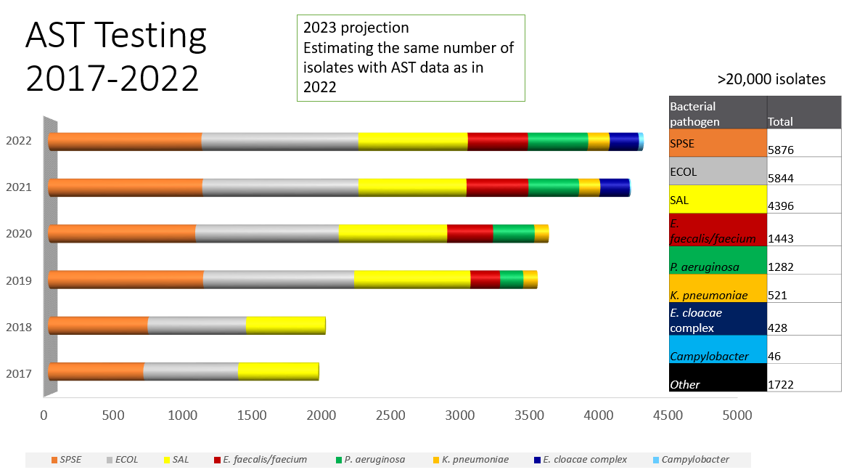
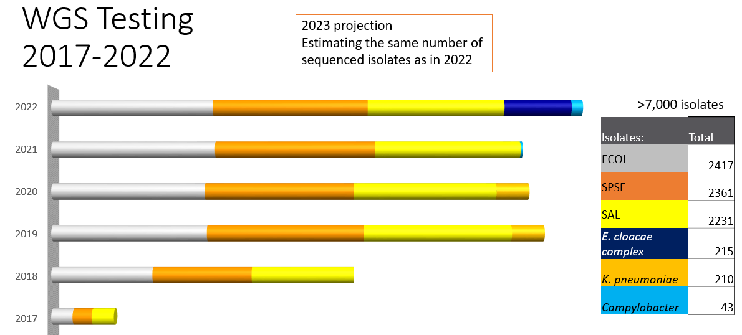
Data collection
How many isolates?
-uploading all WGS data to NCBI
-includes phenotypic data (AST) for most isolates

Slide 5
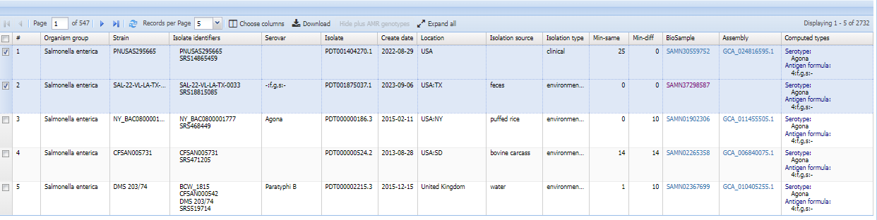

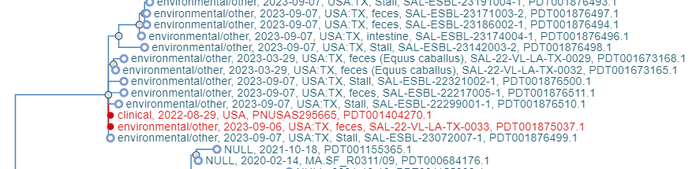
Outbreak Detection and Tracking
-many Vet-LIRN isolates cluster with
animal or human isolates

Slide 6
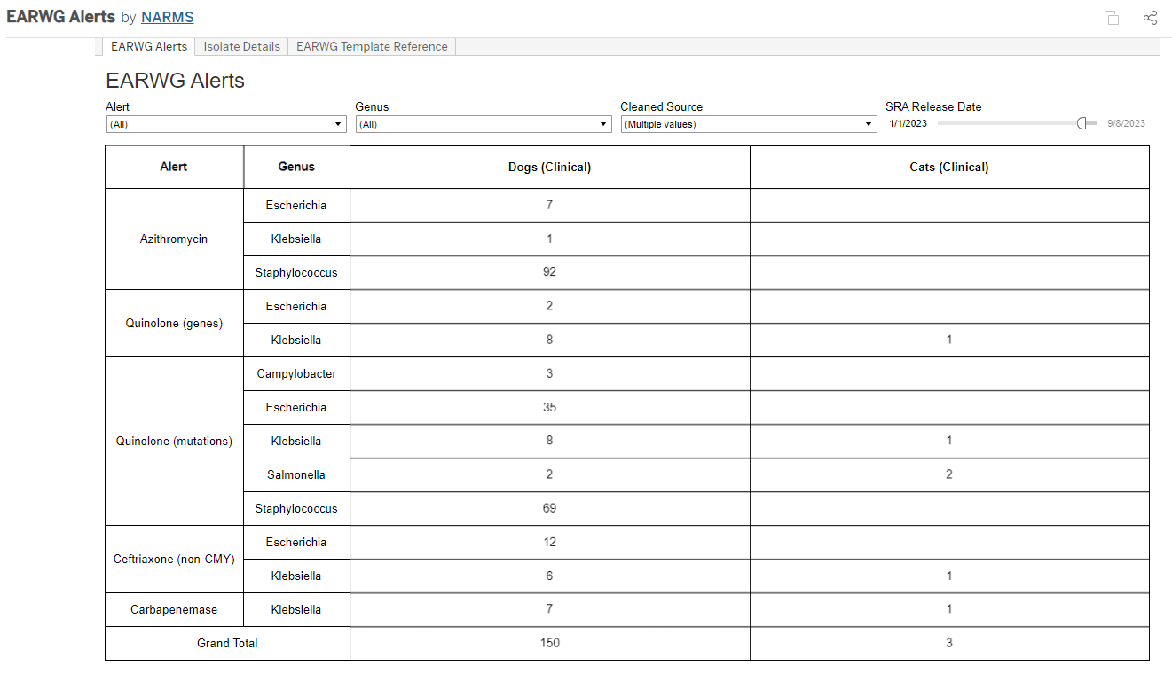


Emerging AMR Tracking (EARWG)
-CVM’s NARMS tracks emerging AMR
in both NARMS and Vet-LIRN isolates
Notes:
Stemming from an interagency (FDA, CDC, USDA) effort to track emerging resistances, the EARWG (Emerging Antimicrobial Resistance Working Group) Alerts dashboard was created to make this tracking easier for FDA NARMS/Vet-LIRN.
Genotypic data is downloaded from NCBI’s Pathogen Detection.
Isolates are then flagged if they contain any genes that confer resistance to any antimicrobial agent/class that the NARMS or Vet-LIRN programs deem important.
The dashboard contains the number of isolates that have been flagged in the previous 30 days broken out by antimicrobial agent/class, genus, and source.

Slide 7
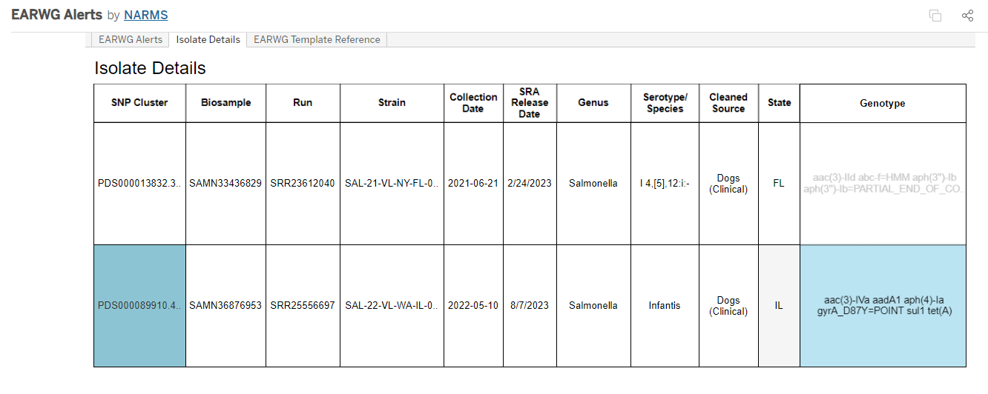
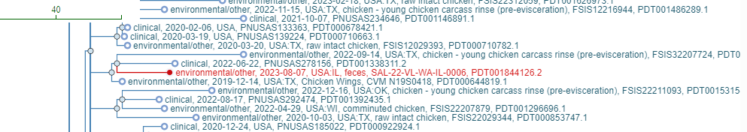
Emerging AMR Tracking (EARWG)
Notes:
The dashboard also includes the ability to see more details, like specific serotype/species, genes, geo location, collection date, etc.
Also includes link outs to Pathogen Detection, so users can see even more data about the individual isolates or SNP Clusters they fall under.
Once a month members of each program meet to discuss all the isolates that have been flagged in the previous 30 days and determine if any future action needs to be taken.

Slide 8
Manuscripts
Characterization of the pan-genome of E. coli (in dogs) and S. pseudintermedius (in dogs and cats) and analysis of genetic components of isolates from both host animals, correlated with AMR (in progress)
Characterization of Klebsiella pneumoniae complex isolates collected from animal hosts as a part of Vet-LIRN AMR Program (in progress)
Genomic characterization of antimicrobial resistance in aquatic bacterial isolates (submitted)
Prevalence and WGS of carbapenemase-producing Enterobacterales isolated from dog and cat feces submitted to veterinary laboratories in the USA (in progress)
8

Slide 9
CAP Grants
Carbapenem resistance in companion (and other) animals
WGS capacity building and characterization of pathogens of interest
Prototype reporting of AMR bacteria of public health importance in companion (and other) animals
Enhancing performance of AST in support of Vet-LIRN activities
9

Slide 10
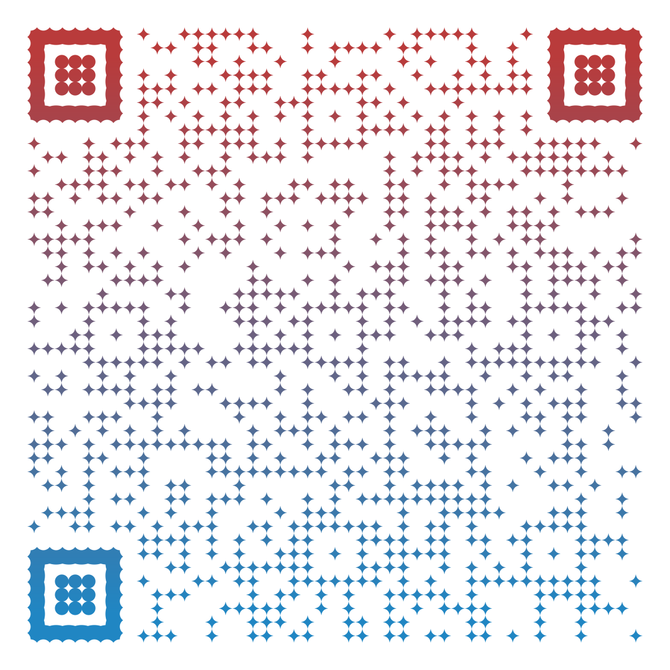
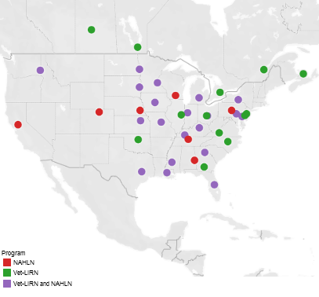
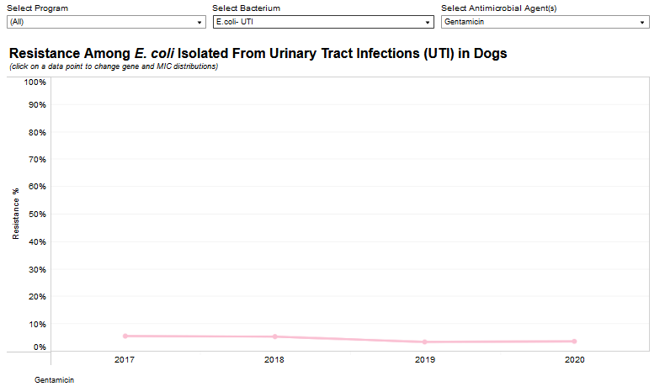
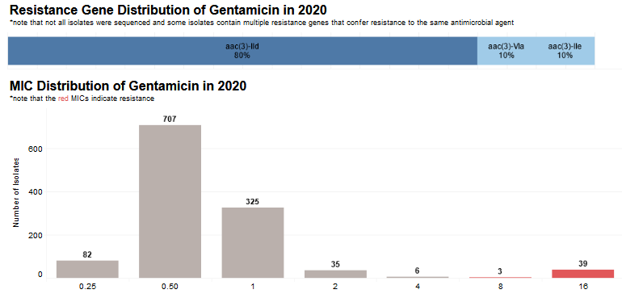
Collaborations
Vet-LIRN/NAHLN Integrated Animal Pathogen AMR Data
Notes:
Dashboards can be accessed using provided QR code.
The first integrated report for 2018 data was released in December 2020 as a part of NARMS’s Integrated Report Summary for 2018. This was the first time that integrated AMR monitoring data from dogs, collected from FDA and USDA’s networks, became available in the U.S. The report included dashboards with minimum inhibitory concentration (MIC) data for approximately 2,300 isolates. The second joint report for 2019 data was released in March 2022, which includes MIC data for approximately 4,000 isolates. Dashboards for the second report also included resistance mechanisms from genomics data, along with the percent resistance and MIC distributions for each of the antibiotics included in the panels. The third report for 2020 was released in August 2023, this report includes data for approximately 4,000 isolates. We are currently working on the 2021 report which will include the dashboards with trends for 2018-2021. In addition, we are continuing to review and implement suggestions for improvement received from several labs. Special thanks to ND and WA labs

Slide 11
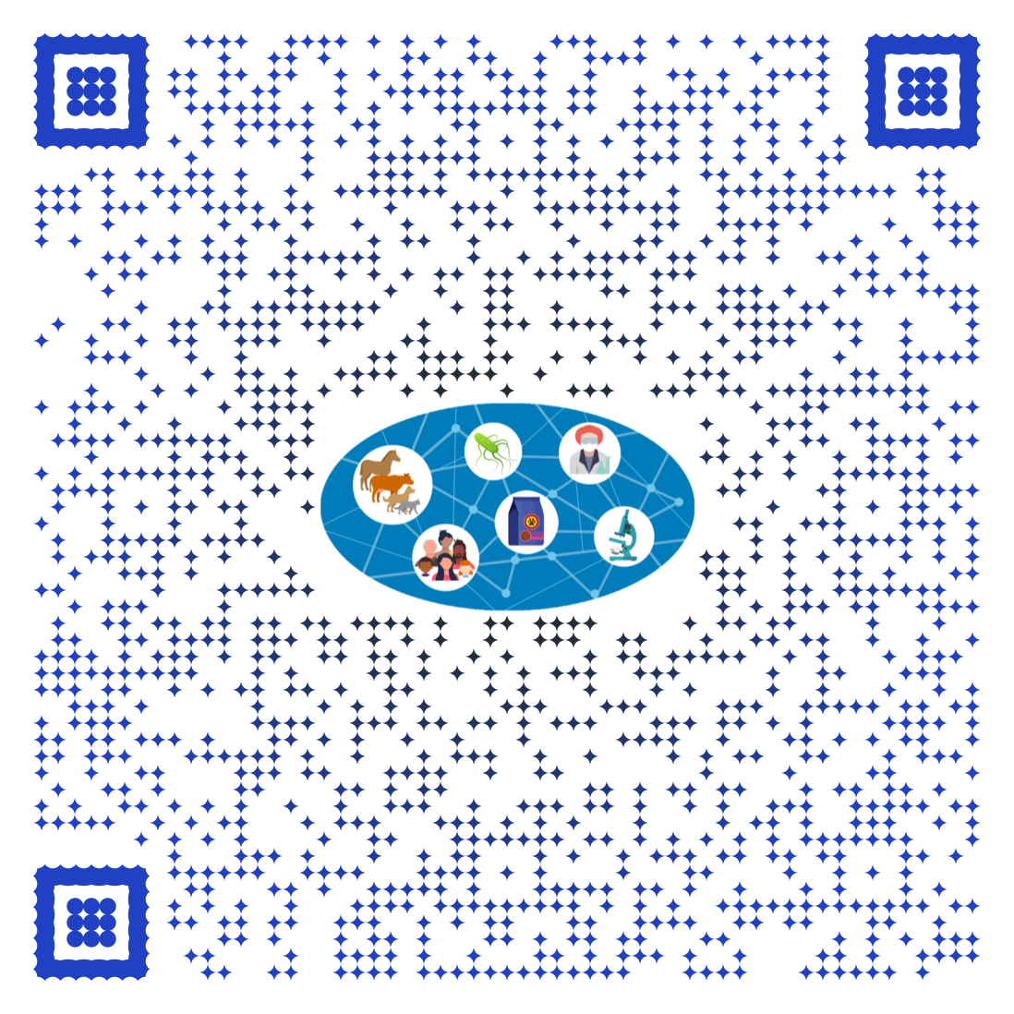
Email: olgica.ceric@fda.hhs.gov
Vet-LIRN Website
Vet-LIRN Isolates on NCBI
Vet-LIRN/NAHLN AMR Data
Thank you!

Slide 12
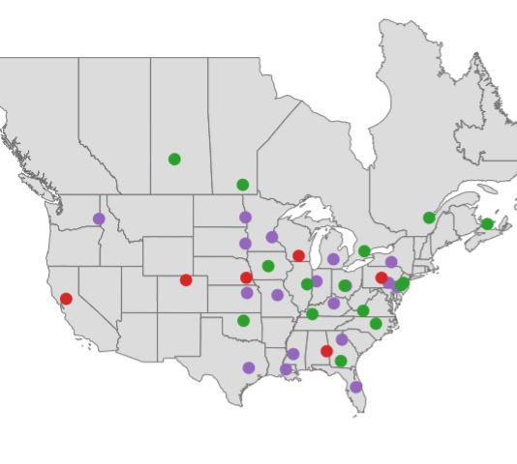



Acknowledgements
NARMS
Amy Merrill
Claudine Kabera
Chih-Hao-Hsu
Mike Grabenstein
Gordon Martin
Vet-LIRN/NAHLN Participating Laboratories
USDA APHIS
Beth Harris
Jennifer Rodriguez
Christina Loiacono
Christine Foxx
Vet-LIRN
Sarah Peloquin
Jake Guag
Gregory Tyson

