Slide 1

Foodborne virus sequence database ViroTrakr and sequencing efforts
Zhihui Yang
Research Biologist
Virology & Parasitology Branch (VPB)
Division of Food and Environmental Safety (DFES)
Office of Applied Microbiology and Technology (OAMT)
Office of Laboratory Operations and Applied Science (OLOAS)
Human Foods Program (HFP)
2024 APHL GenomeTrakr Meeting
October 16, 2024

Slide 2
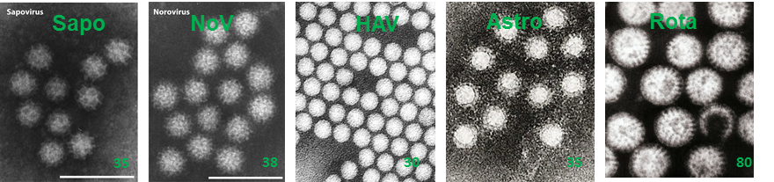
Background
Problem: major foodborne viral pathogens:
- responsible for close to 60% foodborne illnesses in the US (CDC)
- broad transmission routes/carriers
- low human infective doses
- high genetic diversity
- high mutation rates
Need: quick and accurate identification of foodborne pathogens to:
- improve foodborne virus surveillance
- speed up traceback of viral foodborne outbreaks
- enhance food safety
Potential tools: Sequence database for phylogenetic analysis and pathogen surveillance

Slide 3



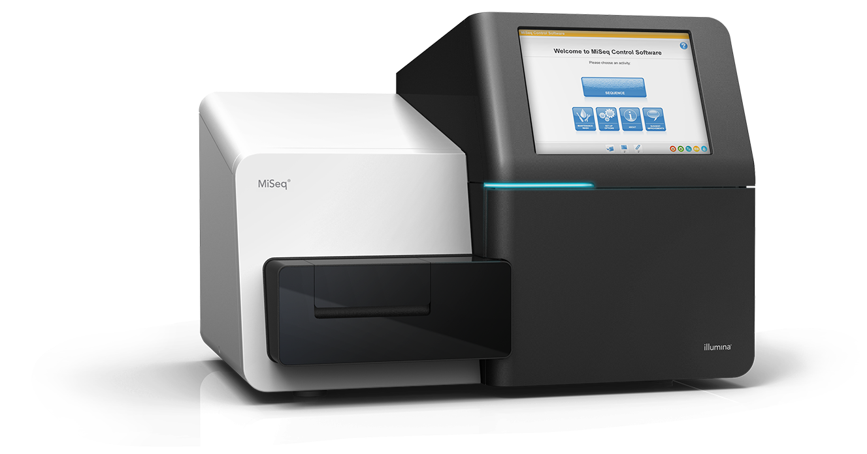
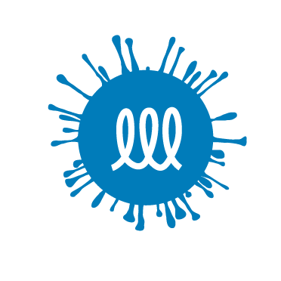
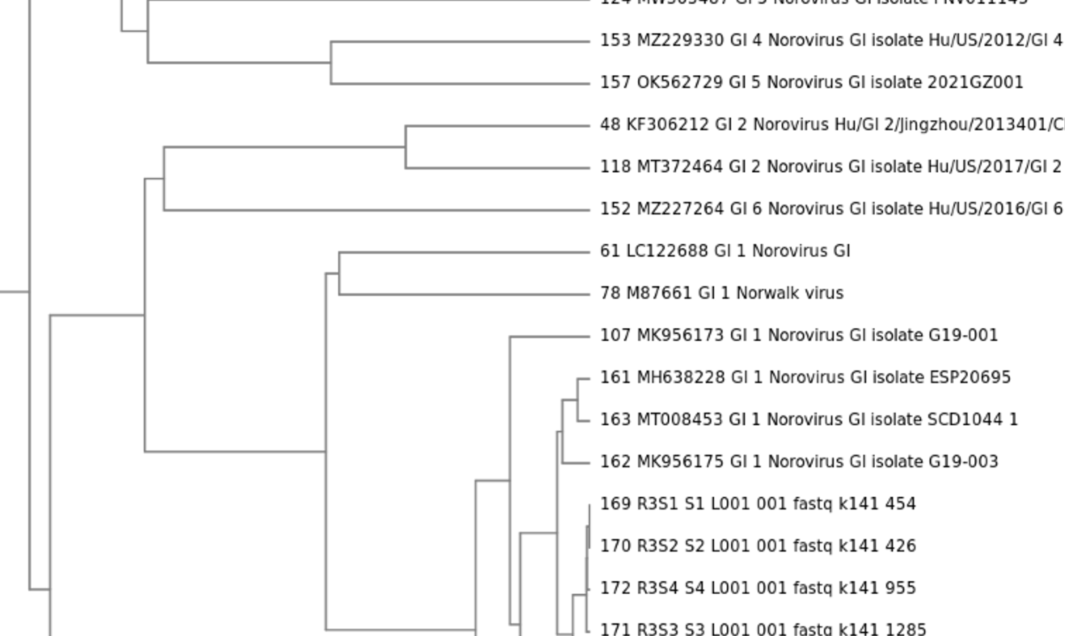
ViroTrakr: FDA foodborne virus sequence database in NCBI
Technical Assistance: ViroTrakr@fda.hhs.gov
Foodborne viruses:
isolated from environmental, food and clinical samples
sequenced
sequence data submitted to ViroTrakr
ViroTrakr:
A foodborne viral genomic database associated with geographic metadata
housed in NCBI foodborne viruses (ID 396739) - BioProject - NCBI (nih.gov)
accessible and sharable among public access databases
DDBJ
EBI
ViroTrakr
NCBI
Aims to:
genotype and phylogenetic analysis
assist foodborne virus surveillance
help traceback of viral foodborne outbreaks

Slide 4
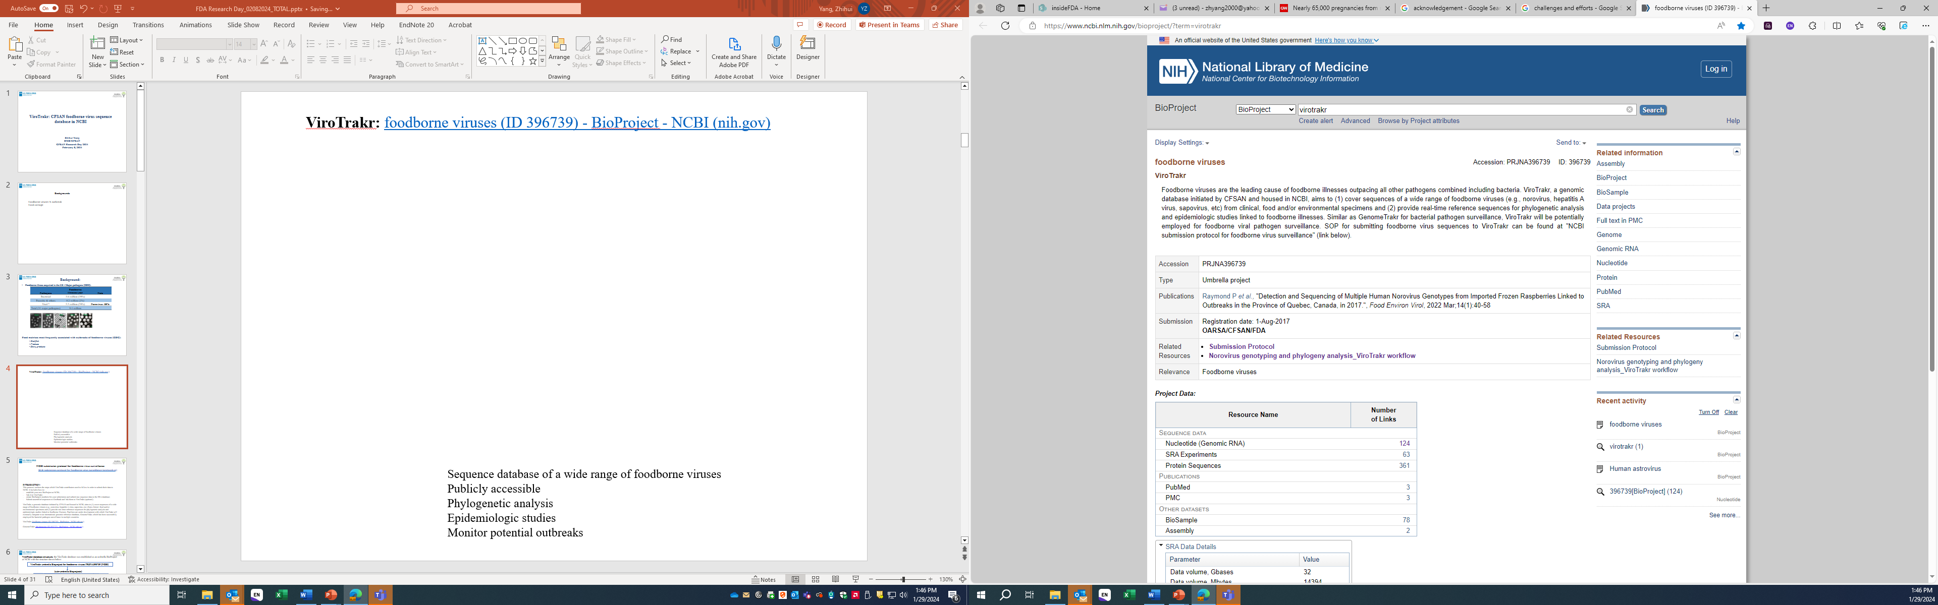
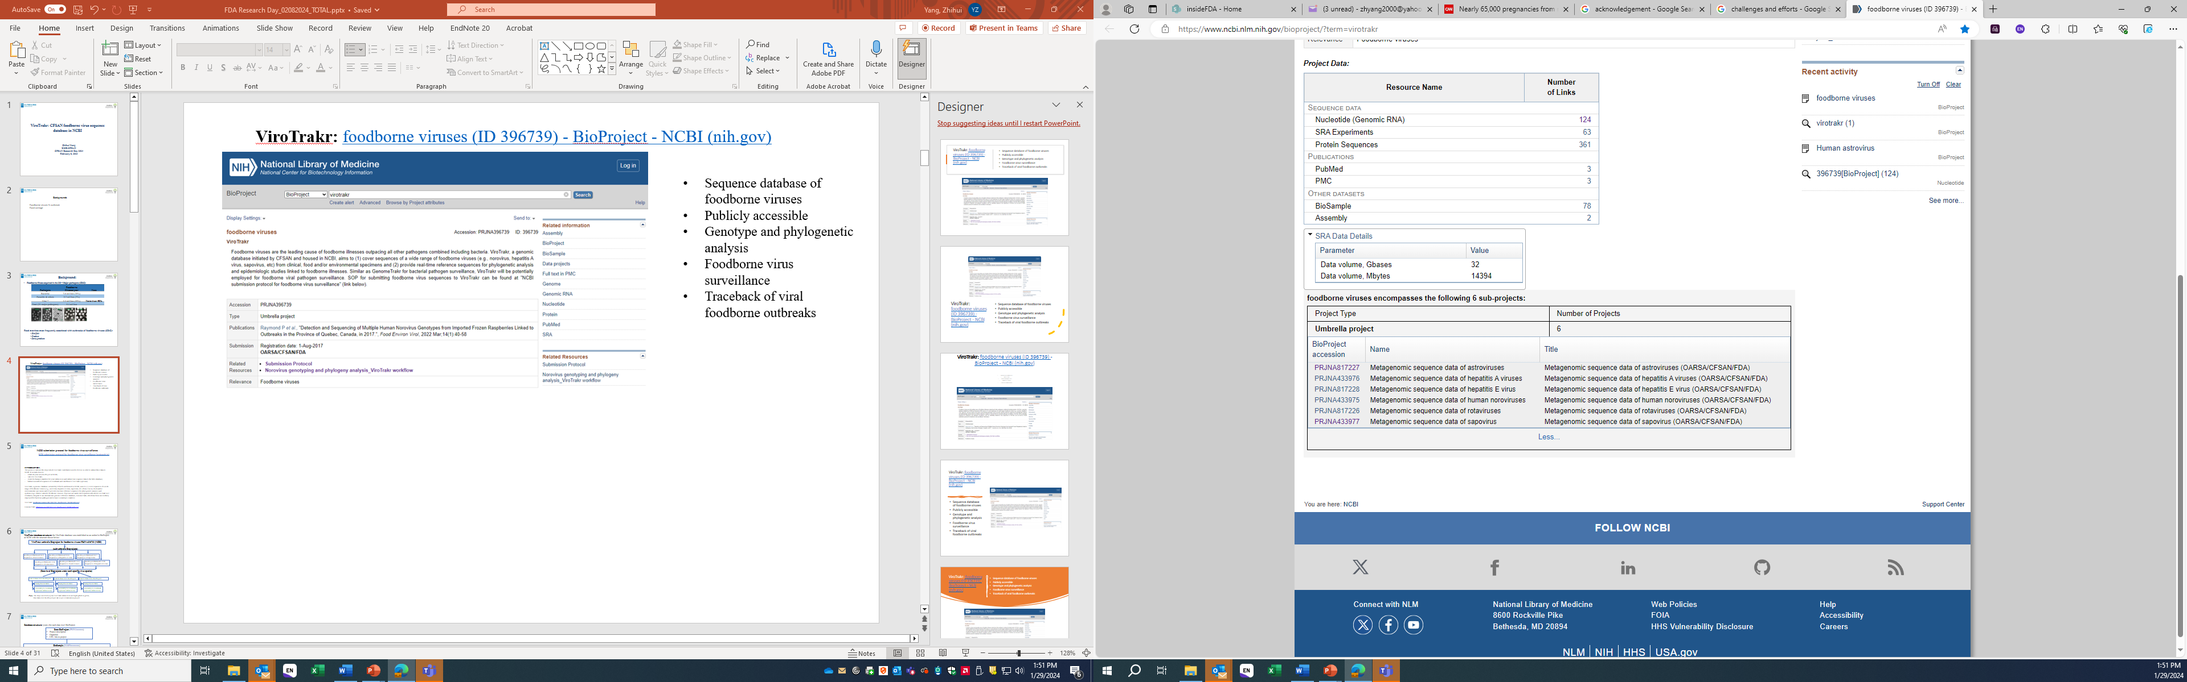
ViroTrakr: foodborne viruses (ID 396739) - BioProject - NCBI (nih.gov)
Sequence database of foodborne viruses (clinical/food/environmental)
Genomic and geographic data associated with pathogen sequences
Publicly accessible
Genotype and phylogenetic analysis
Foodborne virus surveillance
Traceback of viral foodborne outbreaks

Slide 5
Data submission protocol
NCBI submission protocol for foodborne virus surveillance:
NCBI submission protocol for foodborne virus surveillance (protocols.io)
This protocol establishes the database structure, outlines the steps which ViroTrakr contributors can follow to submit their data to NCBI. It includes how to:
establish a new BioProject at NCBI;
link it to ViroTrakr;
submit raw sequence data to the SRA database;
submit assembled sequences to GenBank and link them to ViroTrakr.

Slide 6
Data analysis protocol
Norovirus genotyping and phylogeny analysis_ViroTrakr workflow 1_v.1:
Norovirus genotyping and phylogeny analysis_ViroTrakr workflow 1_v.1 (protocols.io)
This workflow provides step-by-step instructions for norovirus analysis within the GalaxyTrakr platform.
It includes:
the quality assessment for raw sequencing data (from most next-generation sequencing platforms)
drafting de novo assemblies
reporting the sequence genotype and phylogenetic results.
(Will be published soon):
ViroTrakr workflow for hepatitis A virus (HAV)_v.1

Slide 7
Challenges and Efforts
Low number of viruses present in the contaminated food items
Low infectious doses (just a few particles are needed to produce disease)
- Viruses: Non-culturable
Other (co-contamination of multiple viruses, foodborne viruses genetically highly diverse)
Development of sensitive and accurate detection assays
Projects: (collaborations with national and international groups)
Non-targeted approaches
Targeted (NoV-, HAV-, etc.)sequencing methods
Panel viruses sequencing tool
Various sequencing platforms

Slide 8
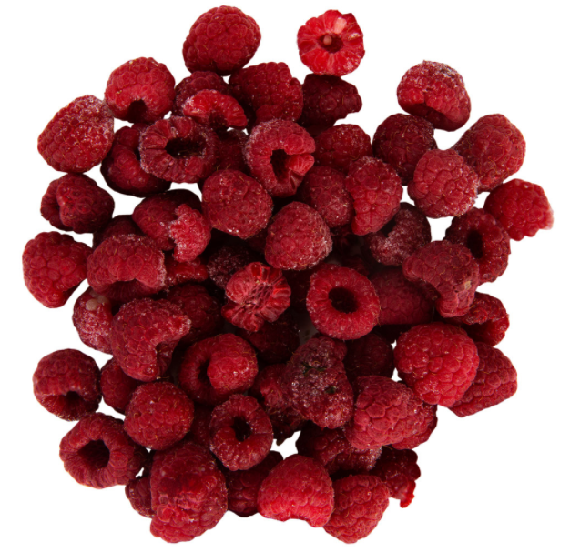
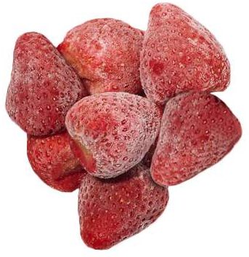
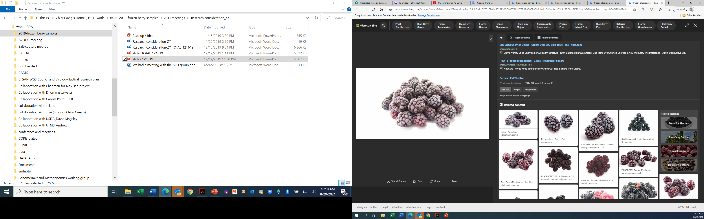
Whole-Genome Sequencing-Based Confirmatory Methods on RT-qPCR Results for the Detection of Foodborne Viruses in Frozen Berries (FEV, 2024)
Schematic representation of experimental approach for sample preparation, RNA isolation, PCR detection and whole genome sequencing.
Type 1
Type 2
Type 3
Frozen raspberries
Frozen strawberries
Frozen blackberries positive for HuNoV by RT-qPCR
RNA isolation
Serial dilutions of HAV/HuNoV
Berry RNA extract
Incubation and RNA isolation
RNA isolation
Serial dilutions of in vitro HAV/HuNoV RNA transcript
Virus transcripts-spiked berry RNA extract
Virus-spiked
berry RNA extract
Naturally HuNoV contaminated
berry RNA extract
RT-qPCR detection 1
RT-qPCR detection 2
RT-qPCR detection
RT-qPCR detection
DNase treatment
SPIA pre-amplification
WGS
DNase treatment
SISPA pre-amplification
WGS

Slide 9
Results from type I samples: HAV transcript RNA in berries
Table 1. Summary of the sequencing results of hepatitis A virus transcript-added RNA extracts from frozen raspberries.
Ct value (Ct Group) | Copies/3 uL |  | Total reads (M) |  | % of HAV reads |  | Length of HAV fragment by WGS (bp) |  | Identification (Confirmation rate; N) *
 | SPIA | SISPA | SPIA | SISPA | SPIA | SISPA | SPIA | SISPA | SPIA | SISPA
Ct ≤ 35 (Group I) | 1E3 -1E5 | 1E4 -1E5 | 0.04 – 4.04 | 3.68 – 6.71 | 7.2E-4 – 3.8E-1 | 2.1E-5 – 6.0E-1 | 6,612 – 7,423 | 5,286 – 7,439 | 9-GT | 7–GT
 |  |  |  |  |  |  |  |  | (100%; N=9) | (100%; N=7)
Ct ≥ 35 and ≤ 40 (Group II) | 1E2 -1E3 | 1E2 -1E3 | 0.08 – 5.10 | 3.63 – 6.57 | 1.9E-4 – 3.9E-3 | 4.1E-6 – 1.2E-2 | 3,258 – 7,417 | 1,149 – 7,326 | 5-GT | 6-GT; 1-SPP
 |  |  |  |  |  |  |  |  | (100%; N=5) | (100%; N=7)
Ct ≥ 40 (Group III) | <1E2 | <1E2 | 0.05 – 7.04 | 3.91 – 6.98 | 0 .0 – 7.5E-4 | 8.5E-7 – 1.68E-4 | 0 – 7,268 | 272 – 7,166 | 9-GT; 4-Und. | 9-GT
 |  |  |  |  |  |  |  |  | (69%; N=13) | (100%; N=9)
*GT: genotype; SPP: species; Und.: Undetectable. N: sample number; Confirmation rate: Percentage of RT-qPCR-positive samples confirmed by WGS.

Slide 10
Results from type I samples: HuNoV transcript RNA in berries
Table 2. Summary of the sequencing results of norovirus transcript-added RNA extracts from frozen raspberries.
Ct value (Ct Group) | Copies/3 uL |  | Total reads (M) |  | % of HuNoV reads |  | Length of HuNoV fragment by WGS (bp) |  | Identification (Confirmation rate; N) *
 | SPIA | SISPA | SPIA | SISPA | SPIA | SISPA | SPIA | SISPA | SPIA | SISPA
Ct ≤ 35 (Group I) | 1E3 -1E5 | 1E3 -1E5 | 0.04 – 5.02 | 3.67 – 5.44 | 3.5E-5 - 5.4E-3 | 0.0E0 - 5.0E-4 | 2,394 - 7,556 | 0 - 7,569 | 9-GT (100%; N=9) | 7-GT; 1-SPP; 1-Und. (89%; N=9)
Ct ≥ 35 and ≤ 40 (Group II) | 10-100 | 10-100 | 0.01 – 5.58 | 3.92 – 5.04 | 4.8E-6 - 7.6E-4 | 0.0E0 - 4.4E-6 | 920 – 4,348 | 0 – 2,170 | 4-GT; 2-SPP (100%; N=6) | 1-GT; 2-SPP; 2-Und. (60%; N=5)
Ct ≥ 40 (Group III) | <10 | <10 | 0.02 – 4.70 | 4.05 – 6.21 | 1.1E-6 - 4.9E-4 | 0.0E0 - 4.8E-7 | 412 – 1,745 | 0 - 225 | 1-GT; 4-SPP (100%; N=5) | 2-SPP; 3-Und. (40%; N=5)
*NoV: norovirus; GT: genotype NoV GII.4[P4]; SPP: species; Und.: Undetectable. N: sample number; Confirmation rate: Percentage of RT-qPCR-positive samples confirmed by WGS.

Slide 11
Results from type II samples: HAV particles spiked in berries
Table 3. Summary of the sequencing results of HAV-spiked frozen strawberry samples.
Ct value (Ct Group) | Cps for WGS* | Total reads (M) |  | % of HAV reads |  | Length of HAV fragment by NGS (bp) |  | Identification (Confirmation rate; N) **
SPIA/SISPA |  | SPIA | SISPA | SPIA | SISPA | SPIA | SISPA | SPIA | SISPA
Ct ≤ 35 (Group I) | 4,247 - 19,507 | 0.23 – 8.43 | 4.41-5.81 | 3.6E-5 – 1.4E-4 | 9.1E-7 – 2.8E-4 | 1,925– 6,919 | 539 - 5,671 | 5-GT | 4–GT
 |  |  |  |  |  |  |  | (100%; N=5) | (100%; N=4)
Ct ≥ 35 and ≤ 40 (Group II) | 101 - 792 | 0.26 - 5.22 | 3.20-5.76 | 1.9E-6 – 3.3E-5 | 0 – 3.8E-6 | 141 - 2,136 | 0 - 790 | 7-GT; 1-SPP | 6-GT; 2-Und.
 |  |  |  |  |  |  |  | (100%; N=8) | (75%; N=8)
Ct ≥ 40 (Group III) | 6.6 | 0.22 | 5.83 | 0 | 6.9E-7 | 0 | 748 | 1-Und. | 1-GT
 |  |  |  |  |  |  |  | (0%; N=1) | (100%; N=1)
*Cps: total copy numbers of HAV input for WGS.
**HAV: hepatitis A virus; GT: genotype, HAV 1B; SPP: species; Und.: Undetectable. N: sample number; Confirmation rate: Percentage of RT-qPCR-positive samples confirmed by WGS.

Slide 12
Results from type II samples: HuNoV particles spiked in berries
Table 4. Summary of the sequencing results of HuNoV-spiked frozen strawberry samples.
Ct value (Ct Group) | Cps for WGS* | Total reads (M) |  | % of HuNoV reads |  | Length of HuNoV fragment by WGS (bp) |  | Identification (N / Confirmation rate; N) **
SPIA/SISPA |  | SPIA | SISPA | SPIA | SISPA | SPIA | SISPA | SPIA | SISPA
Ct ≤ 35 (Group I) | 73 - 8,911 | 0.42 - 9.05 | 3.66 - 5.41 | 2.0E-3 - 4.3E-6 | 0 - 1.9E-2 | 755 – 7,023 | 0 – 6,123 | 10-GT; 1-SPP | 6-GT; 3-SPP; 1-Und.
 |  |  |  |  |  |  |  | (100%; N=11) | (90%; N=10)
Ct ≥ 35 and ≤ 40 (Group II) | 1.2 - 30 | 0.13 - 26.10 | 2.84 -4.79 | 0 - 8.3E-7 | 0 - 2.5E-6 | 0 – 3,024 | 0-3,309 | 6-SPP; 3-Und. (67%; N=9) | 4-SPP; 2-Und.
 |  |  |  |  |  |  |  |  | (67%; N=6)
Ct ≥ 40 (Group III) | 0.8 or less | 4.68 - 14.95 | 3.99 - 4.75 | 2.6E-6 or less | 0 - 1.1E-6 | 52 - 808 | 0 - 219 | 1-SPP; 3-Und. | 3-SPP; 1-Und.
 |  |  |  |  |  |  |  | (25%; N=4) | (75%; N=4)
*Cps: total copy numbers of HuNoV input for WGS.
**HuNoV: human norovirus; GT: genotype NoV GII.4[P4]; SPP: species; Und.: Undetectable. N: sample number; Confirmation rate: Percentage of RT-qPCR-positive samples confirmed by WGS.

Slide 13
Results from type III samples: naturally HuNoV contaminated berries
Table 5. RT-qPCR and Sequencing results of a frozen blackberry sample naturally contaminated with human norovirus.
Sample |  | RT-qPCR |  |  |  | SPIA-WGS |  |  |  | SISPA-WGS
sample ID | Sub-portion | Ct ª | Cps ^{b} | IAC Avg Cт | Positive Rep ^{c} | Total reads | HuNoV reads (%) | Length (bp) | GT ^{d} | Total reads | HuNoV reads (%) | Length (bp) | GT ^{d}
Bag A | A-1 | UD |  | 31.10 | 0/3 | didn't run WGS
 | A-2 | UD |  | 30.75 | 0/3
 | A-3 | UD |  | 32.55 | 0/3
 | A-4 | UD |  | 30.81 | 0/3
 | A-conc. | 41.95 or UD | 34.0 | 39.25 | 1/3 | 3.9M | 80 (2.0E-5) | 478 | GII | 10.4M | 0 | 0 | -
Bag B | B-1 | UD |  | 30.86 | 0/3 | didn't run WGS
 | B-2 | UD |  | 31.37 | 0/3
 | B-3 | UD |  | 30.96 | 0/3
 | B-4 | UD |  | 32.53 | 0/3
 | B-conc. | 42.65 or UD | 21.0 | 36.11 | 1/3 | 4.4M | 83 (1.8E-5) | 390 | UA ^{e} | 11.2M | 40 (3.6E-6) | 113 | UA ^{e}
Bag C | C-1 | UD |  | 31.10 | 0/3 | didn't run WGS
 | C-2 | UD |  | 31.04 | 0/3
 | C-3 | UD |  | 32.69 | 0/3
 | C-4 | UD |  | 32.09 | 0/3
 | C-conc. | UD |  | 34.58 | 0/3
ª Ct UD: undetermined
^{b} Cps: total copy number of norovirus recovered from 50g blackberries, calculated based on the ratio of total volume of berry extract and the volume of extract used for RNA isolation.
^{c} Positive Rep: positive replicates of RT-qPCR assay
^{d} GT: genotype NoV GII.4[P4]
^{e} UA: unassigned HuNoV: Human norovirus

Slide 14
Summary
- Non-targeted WGS strategy, using random pre-amplification, was applied to confirm positive RT-qPCR results in this study.
Results showed that both SPIA-WGS and SISPA-WGS method could confirm viruses even at a very low level.
The low number of viral reads relative to the total sequencing reads indicates the need for further method improvement before it can be routinely applied.
Future method optimization efforts should focus on removing background nucleotides, concentrating the samples, and/or using specific virus-targeted amplification techniques.

Slide 15
Ongoing:
Project: Development of tools for foodborne virus surveillance: norovirus whole genome sequencing and extended genotyping (CFSAN/CFIA)
Summary of the sequencing results of NoV-spiked frozen raspberries.
NoV-spiked berry samples | RNA input (min~9 cps) | Positive rate by WGS with non-targeted pre-amplification | Positive rate by MLR-2 with targeted pre-amplification
GI (20 different strains) | 4 cps/uL x 5 uL = 20 cps | 95% | 100%
GII (20 different strains) | 4 cps/uL x 5 uL = 20 cps | 75% | 80%

Slide 16
Ongoing:
Enteric virus sequencing program for food/water safety
Project: Development of tools for foodborne virus surveillance: norovirus whole genome sequencing and extended genotyping
Aims: to develop/improve a sensitive and accurate sequencing tool for norovirus detection and thus enhance NoV surveillance.
Collaborators: Canadian Food Inspection Agency
Project: Hepatitis A virus whole genome sequencing and extended genotyping, inter-laboratory comparison
Aims: to compare optimized sequencing methodologies for investigation of HAV in contaminated food, to assist HAV molecular epidemiology surveillance and transmission tracking of HAV.
Collaborators: Canadian Food Inspection Agency; Public Health Agency in Canada
Project: Application of whole genome sequencing technology for evaluation of enteric viral impacts from wastewater treatment outfalls on shellfish resources.
Aims: to develop whole genome sequencing and metagenomics approaches and use it as a tool for viruses screening in wastewater and oyster samples.
Collaborators: OFS at Dauphin Island (other: USDA, Fiocruz in Brazil)
Project: Development of tools for major viral foodborne virus surveillance: panel viruses sequencing and extended genotyping
Aims: to develop a sensitive, quick and accurate sequencing tool for major enteric viruses' identification and thus assist outbreak investigation.
Collaborators: IMM, Germany; the company in US
Project: ViroTrakr: Foodborne virus sequence database
Aims: to provide real-time reference sequences for phylogenetic analysis and viral pathogen identification; to assist foodborne virus surveillance and help traceback of foodborne outbreaks.
Collaborators/Participants: GenomeTrakr group (other: national/international groups)
foodborne viruses (ID 396739) - BioProject - NCBI (nih.gov);
Technical Assistance on ViroTrakr: ViroTrakr@fda.hhs.gov

Slide 17

Acknowledgements
ViroTrakr: Technical Assistance: ViroTrakr@fda.hhs.gov
Mark Mammel Marc Allard
Jayanthi Gangiredla Hugh Rand
Ruth Timme James Pettengill
Maria Balkey
GenomeTrakr group; GenFS metadata group
Berry publication (2024):
Molecular Virology Team;
Collaborative sequencing projects:
Collaborators (national and international)
Office and Division management
Thank you !

