Slide 1
Next Generation Methods to Subtype Foodborne Pathogens Directly from Stool
A. Jo Williams-Newkirk, PhD
Lead, Culture-Independent and Metagenomic Subtyping Team (acting)
Enteric Diseases Laboratory Branch
Division of Foodborne, Waterborne and Environmental Diseases
NCEZID/DDID/CDC
October 25, 2023

Slide 2






CIDTs Do Not Produce Isolates for PulseNet Surveillance
Goal: High resolution strain subtyping directly from stool
?
Clinical Lab
Public Health Lab
Pathogen
Subtyping
Diarrheal Illness
Clinician
Toilet by Berkah Icon, stool test by dDara, Doctor by Icon Lauk, buildings by adinda, Fingerprint by Icon Fair, report by Alfredo@IconsAlfredo.com from Noun Project

Slide 3
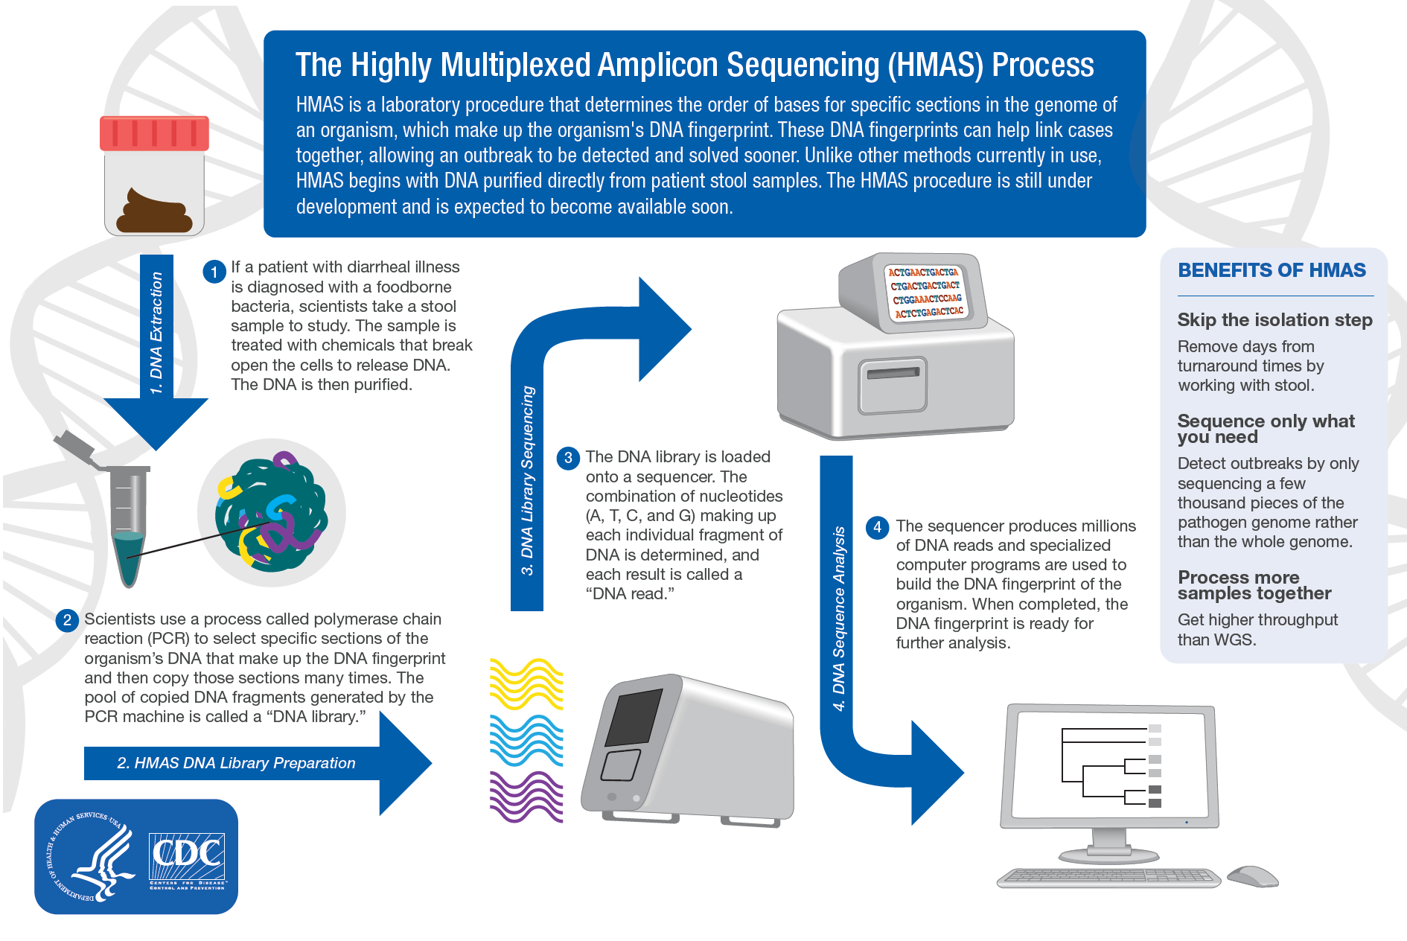

Slide 4
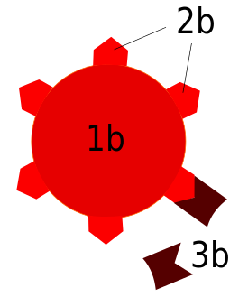







HMAS Targets
Partial cgMLST
Serotyping
Antimicrobial resistance
Short Informative Regions
Pathogen
Specific
1000’s of Targets
Virulence
Pills by hunotika, Zombie by Gan Khoon Lay from Noun Project

Slide 5
HMAS Captures Pathogen Data from Samples
    All steps shown to work in lab
      Design primers specific to Salmonella
      Multiplex them on the Juno then sequence
      Observe the predicted sequences, distinguish from noise

Slide 6





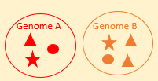
Primer Design Pipeline: T3Pio
Input Genomes
Filter for Conserved Genes
Consensus
Specificity Testing & Redundancy Removal
Orthogroup ID
Primer Pairs
Details for T3Pio can be found at https://github.com/ncezid-biome/T3Pio.

Slide 7
95%
*of primer pairs produced accurate amplicons for all 18 Salmonella DNAs
99% of primer pairs produced detectable numbers of accurate sequences for at least one Salmonella DNA
* 98.7% of amplicons were accurate for 17/18 DNAs
2461 Salmonella-specific primer pairs designed from 19 reference genomes
Primers tested in vitro on 19 isolates (1 isolate failed)
Number of primer pairs
Mean coverage depth (bin width = 20)

Slide 8


HMAS Captures Pathogen Data from Samples
    All steps shown to work in lab
      Design primers specific to Salmonella
      Multiplex them on the Juno then sequence
      Observe the predicted sequences, distinguish from noise
    Data from
      Isolates
      Stools
      Enriched stools

Slide 9
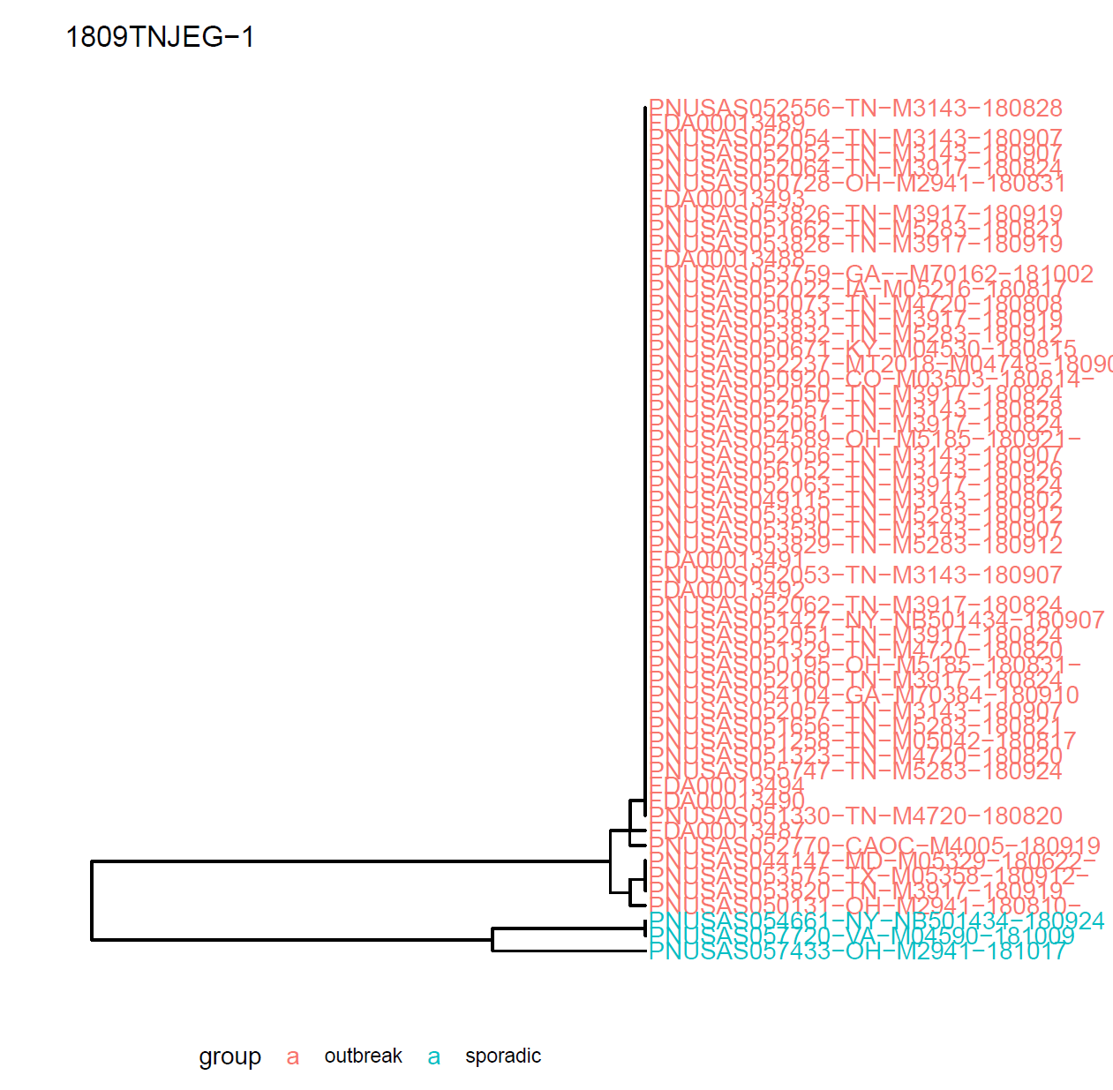
HMAS Detects Outbreak Clusters
In silico data from 9 well-characterized Salmonella outbreaks used in the validation of current PulseNet cgMLST scheme all clustered as expected
0-4 alleles
36-39 alleles
0-10 alleles
Notes:
Enteritidis

Slide 10


PulseNet HMAS Pilot
CO and MN first partner sites
Evaluating the performance of the technology in PHLs
  Does it return the expected data when used on real stool samples?
  How does the workflow fit with PHL operations?
Testing/providing feedback on protocols
  Stool DNA extraction
  HMAS library prep and sequencing
  Testing use of broth enrichments from stools before HMAS

Slide 11
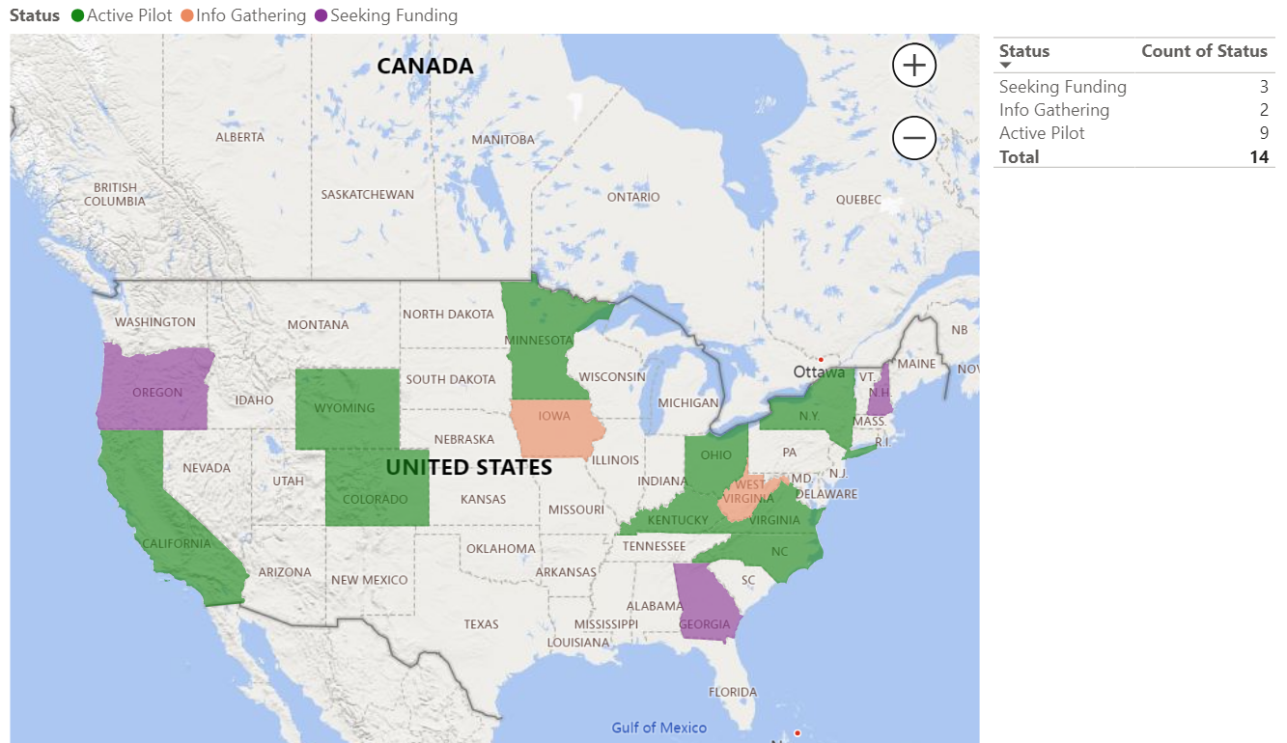

Slide 12
Key Points
PulseNet will be transitioning to an isolate-independent workflow
HMAS is the method currently being piloted in anticipation of broader deployment
Expansion rate of pilot program to new sites over next several years will be funding dependent
All methods, tools, and primers will be publicly available

Slide 13




Unlocking Undetermined Outbreaks (UnO)
UnO is a two-step, NGS-based pathogen discovery pipeline for outbreak samples with strong epidemiological links and negative or inconsistent CIDT results.
We are developing and deploying this pipeline to partner PHLs over the next four years.
Step one is a rapid, inexpensive HMAS known pathogen detection panel.
Step two is a pathogen-agnostic shotgun metagenomics approach designed to identify shared genomic material across a small number of outbreak samples
One in four foodborne outbreaks are caused by unknown agents¹, creating a gap in foodborne surveillance
Scallan et al., EID Journal, 2011
Notes:
Current culture dependent methods and culture-independent diagnostic tests do not identify novel pathogens
CIFOR guidelines offer stool collection guidelines for outbreaks of unknown etiology, but there is no pathway for analyzing samples

Slide 14


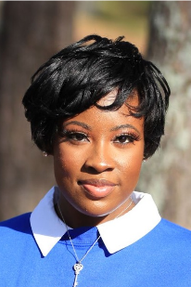


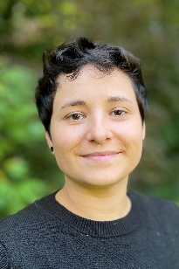
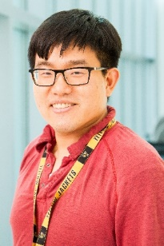
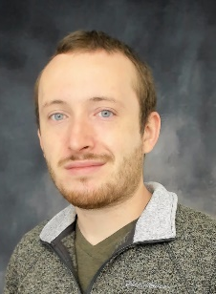
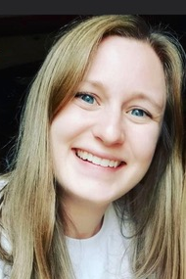


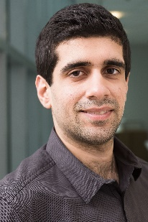
Culture-Independent and Metagenomic Subtyping Team
Project Leads
Laboratory
Bioinformatics
Jo Williams (igy7)
Jasmine Hensley (yhe7)
Ronya Nelson
(uuj2)
Mariana Vasquez
(suj7)
Roth Conrad
(sqi3)
Candace Cole
(uel3)
Andrew Huang (wwm8)
Ryan Paradis (qxy2)
Victoria Mooney (uuv3)
Gary Vestal (sio6)
Kenji Gerhardt (sgi5)
Mohit Thakur (pei6)

