Slide 1

GenomeTrakr updates from FDA-CFSAN
Oct 24, 2023
GenomeTrakr annual meeting
Ruth Timme, PhD
GenomeTrakr Program Lead
FDA Center for Food Safety and Applied Nutrition
ruth.timme@fda.hhs.gov
Notes:
GT has become a global WGS network for foodborne pathogen traceback.

Slide 2
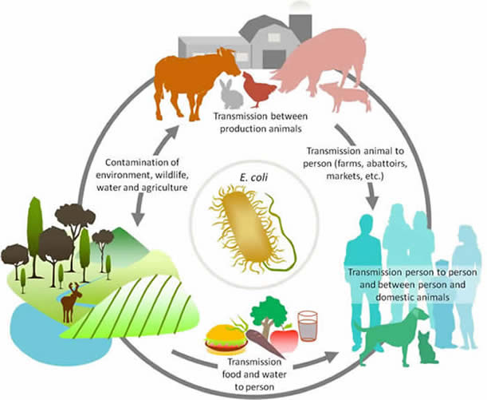
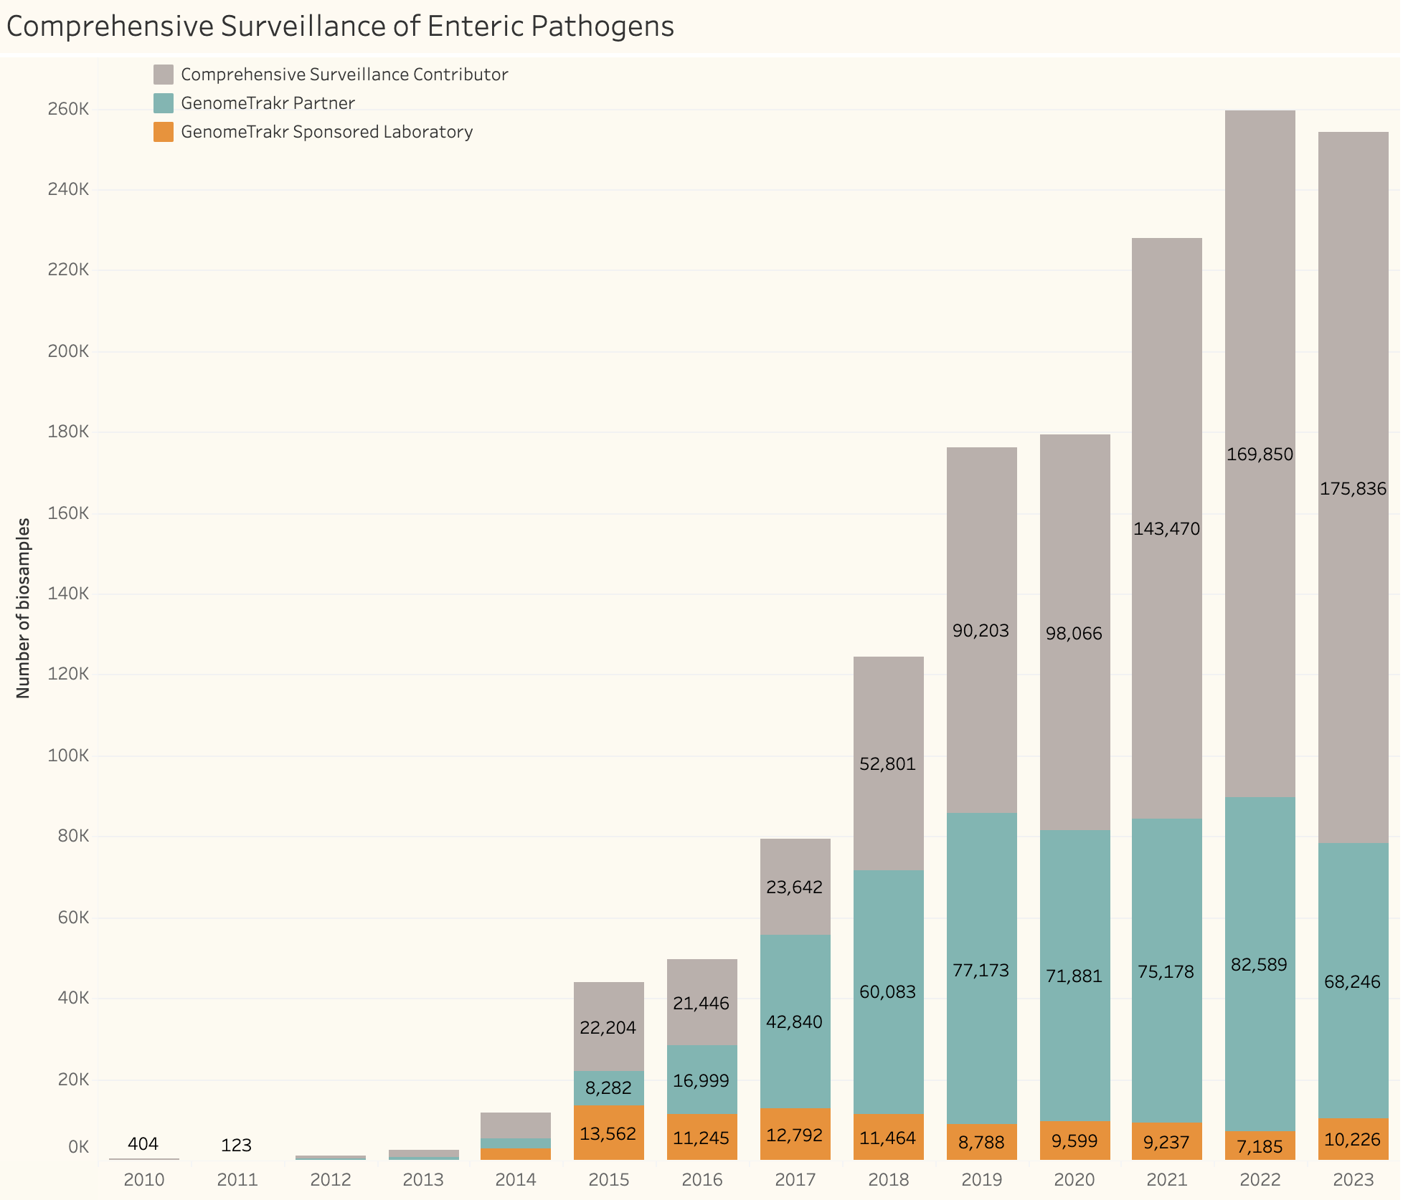
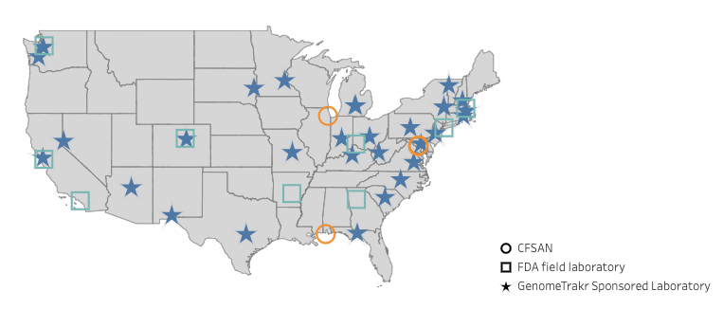
FDA’s GenomeTrakr program
Sequencing the genomes of foodborne pathogens found in food, food processing facilities, farm environment, water, etc.
Collaborate with other US agencies and international counterparts to integrate our data with genomic data collected from animals and human clinicals – data made public in real-time
Clustering at NCBI Pathogen Detection helps FDA identify causes of foodborne outbreaks and identify other events, like harborage.
Numerous GT partners and collaborators:
Public health, Ag, and academic labs
US agency partners: GenFS and others
International counterparts
GT Partners + collaborators
45 funded laboratories:
GT-funded records
Notes:
Before I talk about our project, I’d like to first tell you about FDA’s GenomeTrakr program. We celebrated our 10-year anniversary this fall and for the past decade we’ve been sequencing the genomes of foodborne pathogens founds in food, food processing facilities, farms, and water sources.
We collaborate closely with other USG agencies and international counterparts to integrate the data we collect with pathogens collected form other parts of the pathogen lifecycle, like animals and human clinicals. All data made public in real time.
The public genomic database helps the FDA identify the causes of foodborne outbreaks and other contamination events. Over the years, collectively we’ve amassed a very large database, nearing 1 million sequenced foodborne pathogens.

Slide 3
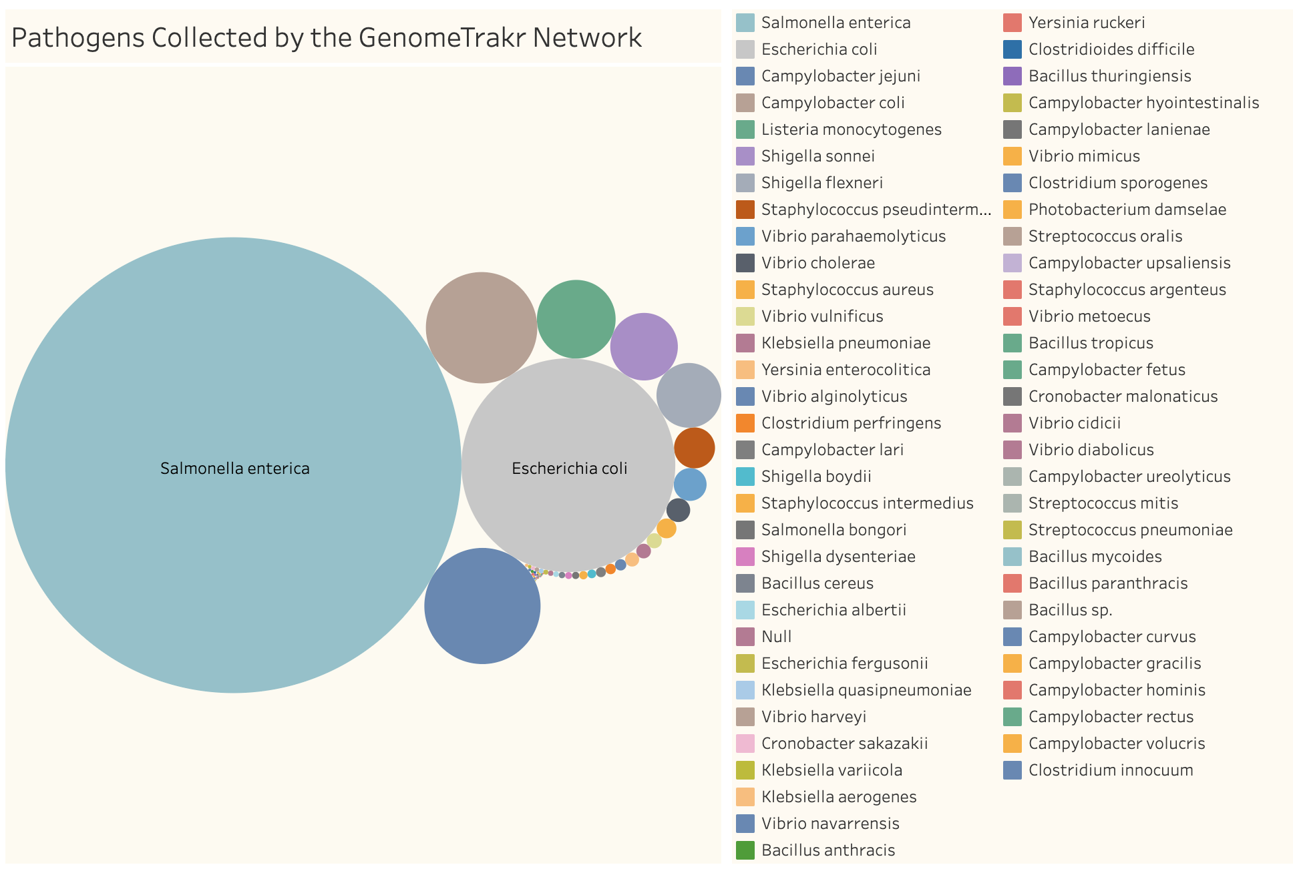
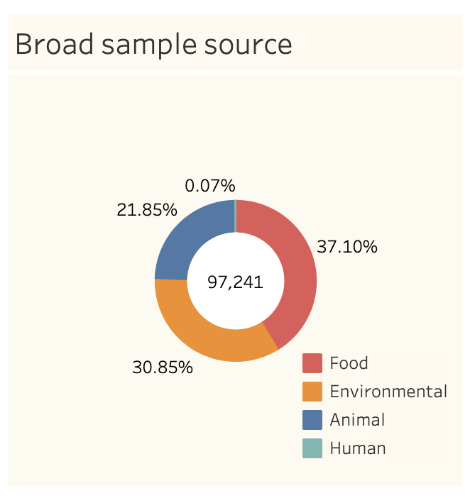
Genomes collected through GT-funded laboratories:
GenomeTrakr stats:
45 funded labs (inc. FDA labs)
97,241 total isolates in NCBI PD
19 enteric pathogen species
19 species:

Slide 4

GenomeTrakr focus in 2023
Increase usability of GenomeTrakr data in the public repository
Publish suite of visualization dashboards for enteric pathogens
Begin implementation of One Health Enteric package
GalaxyTrakr improvements
Initiate annual metadata hackathon

Slide 5
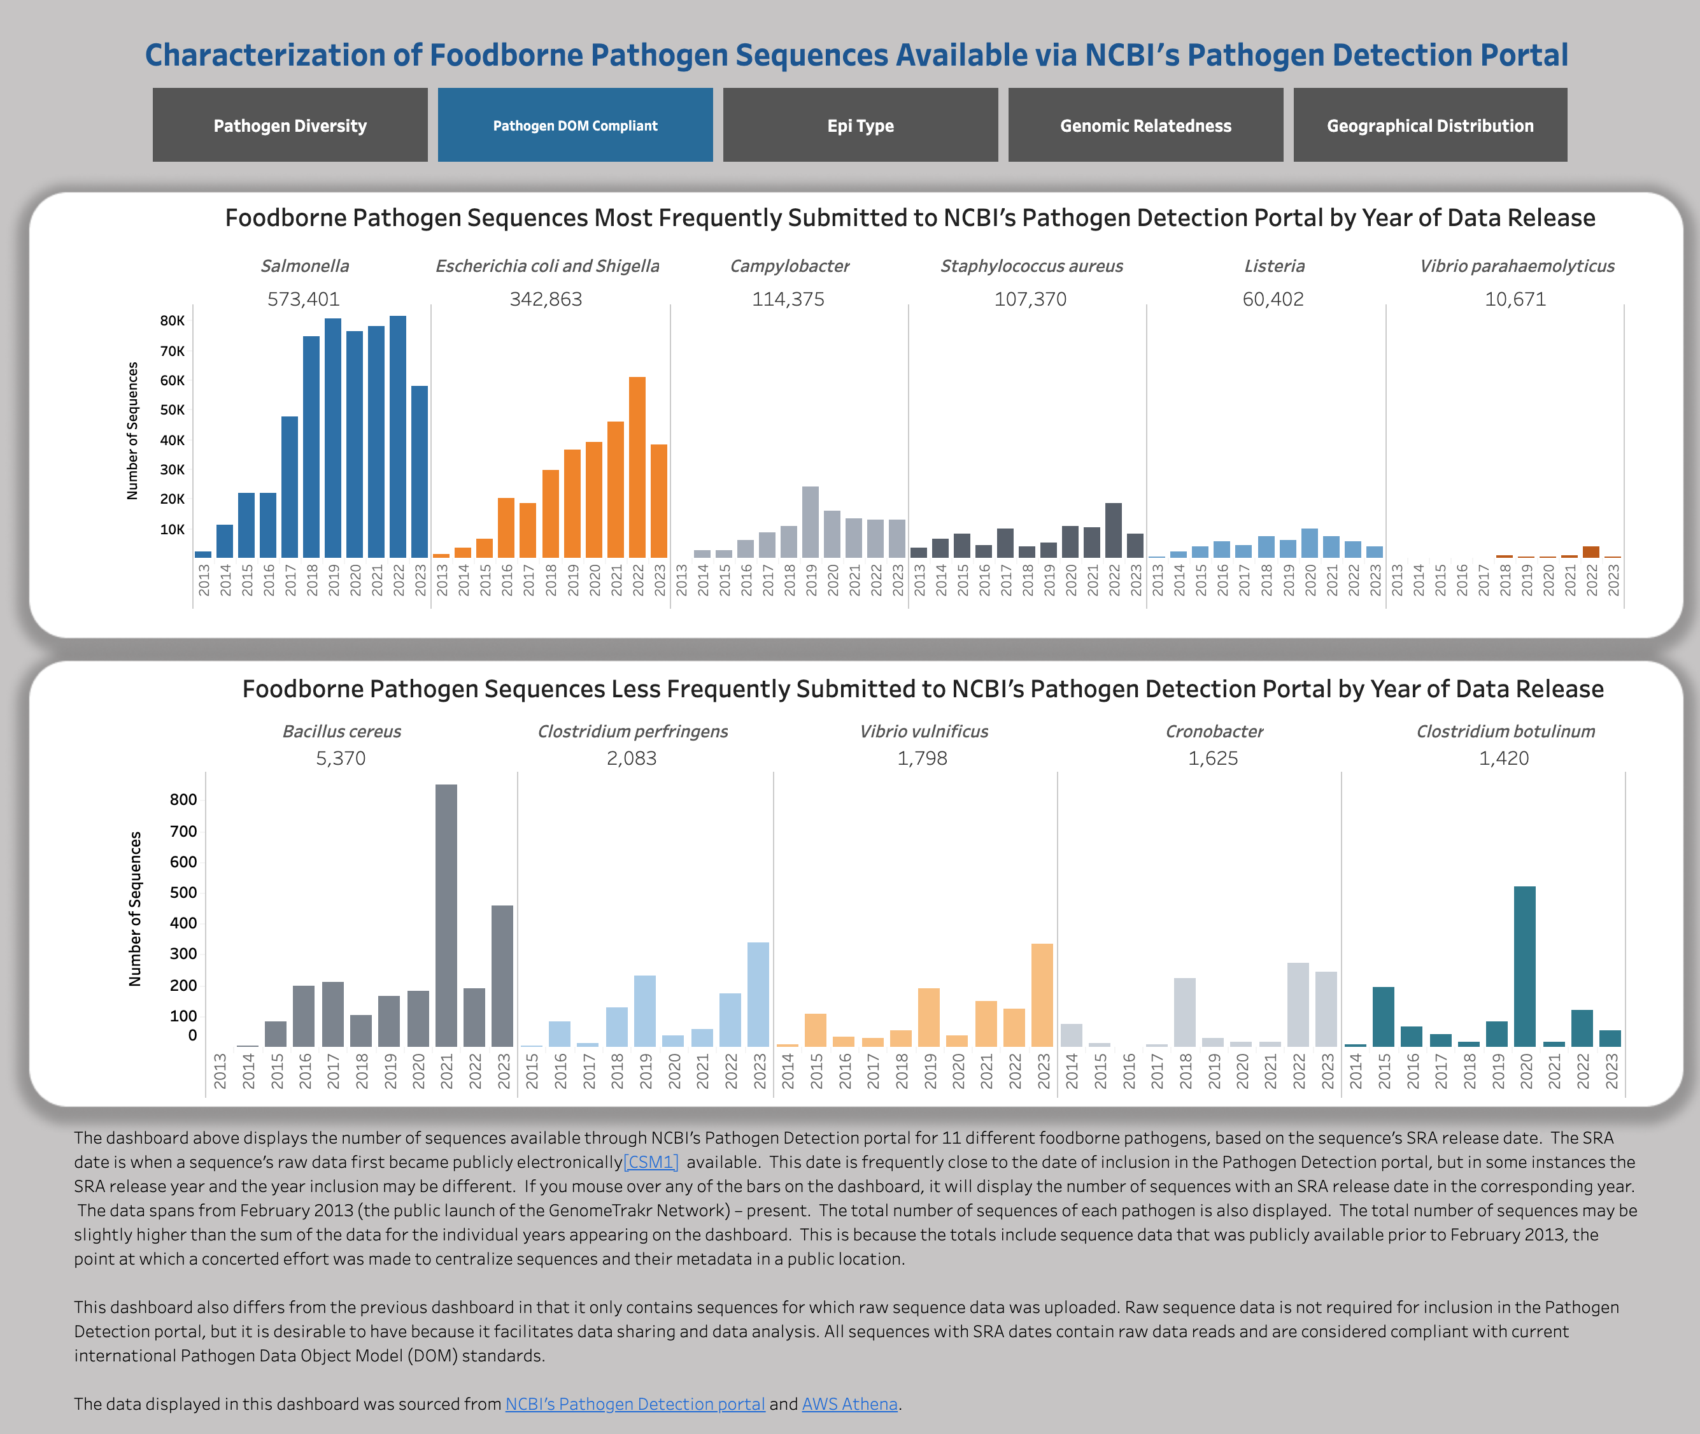
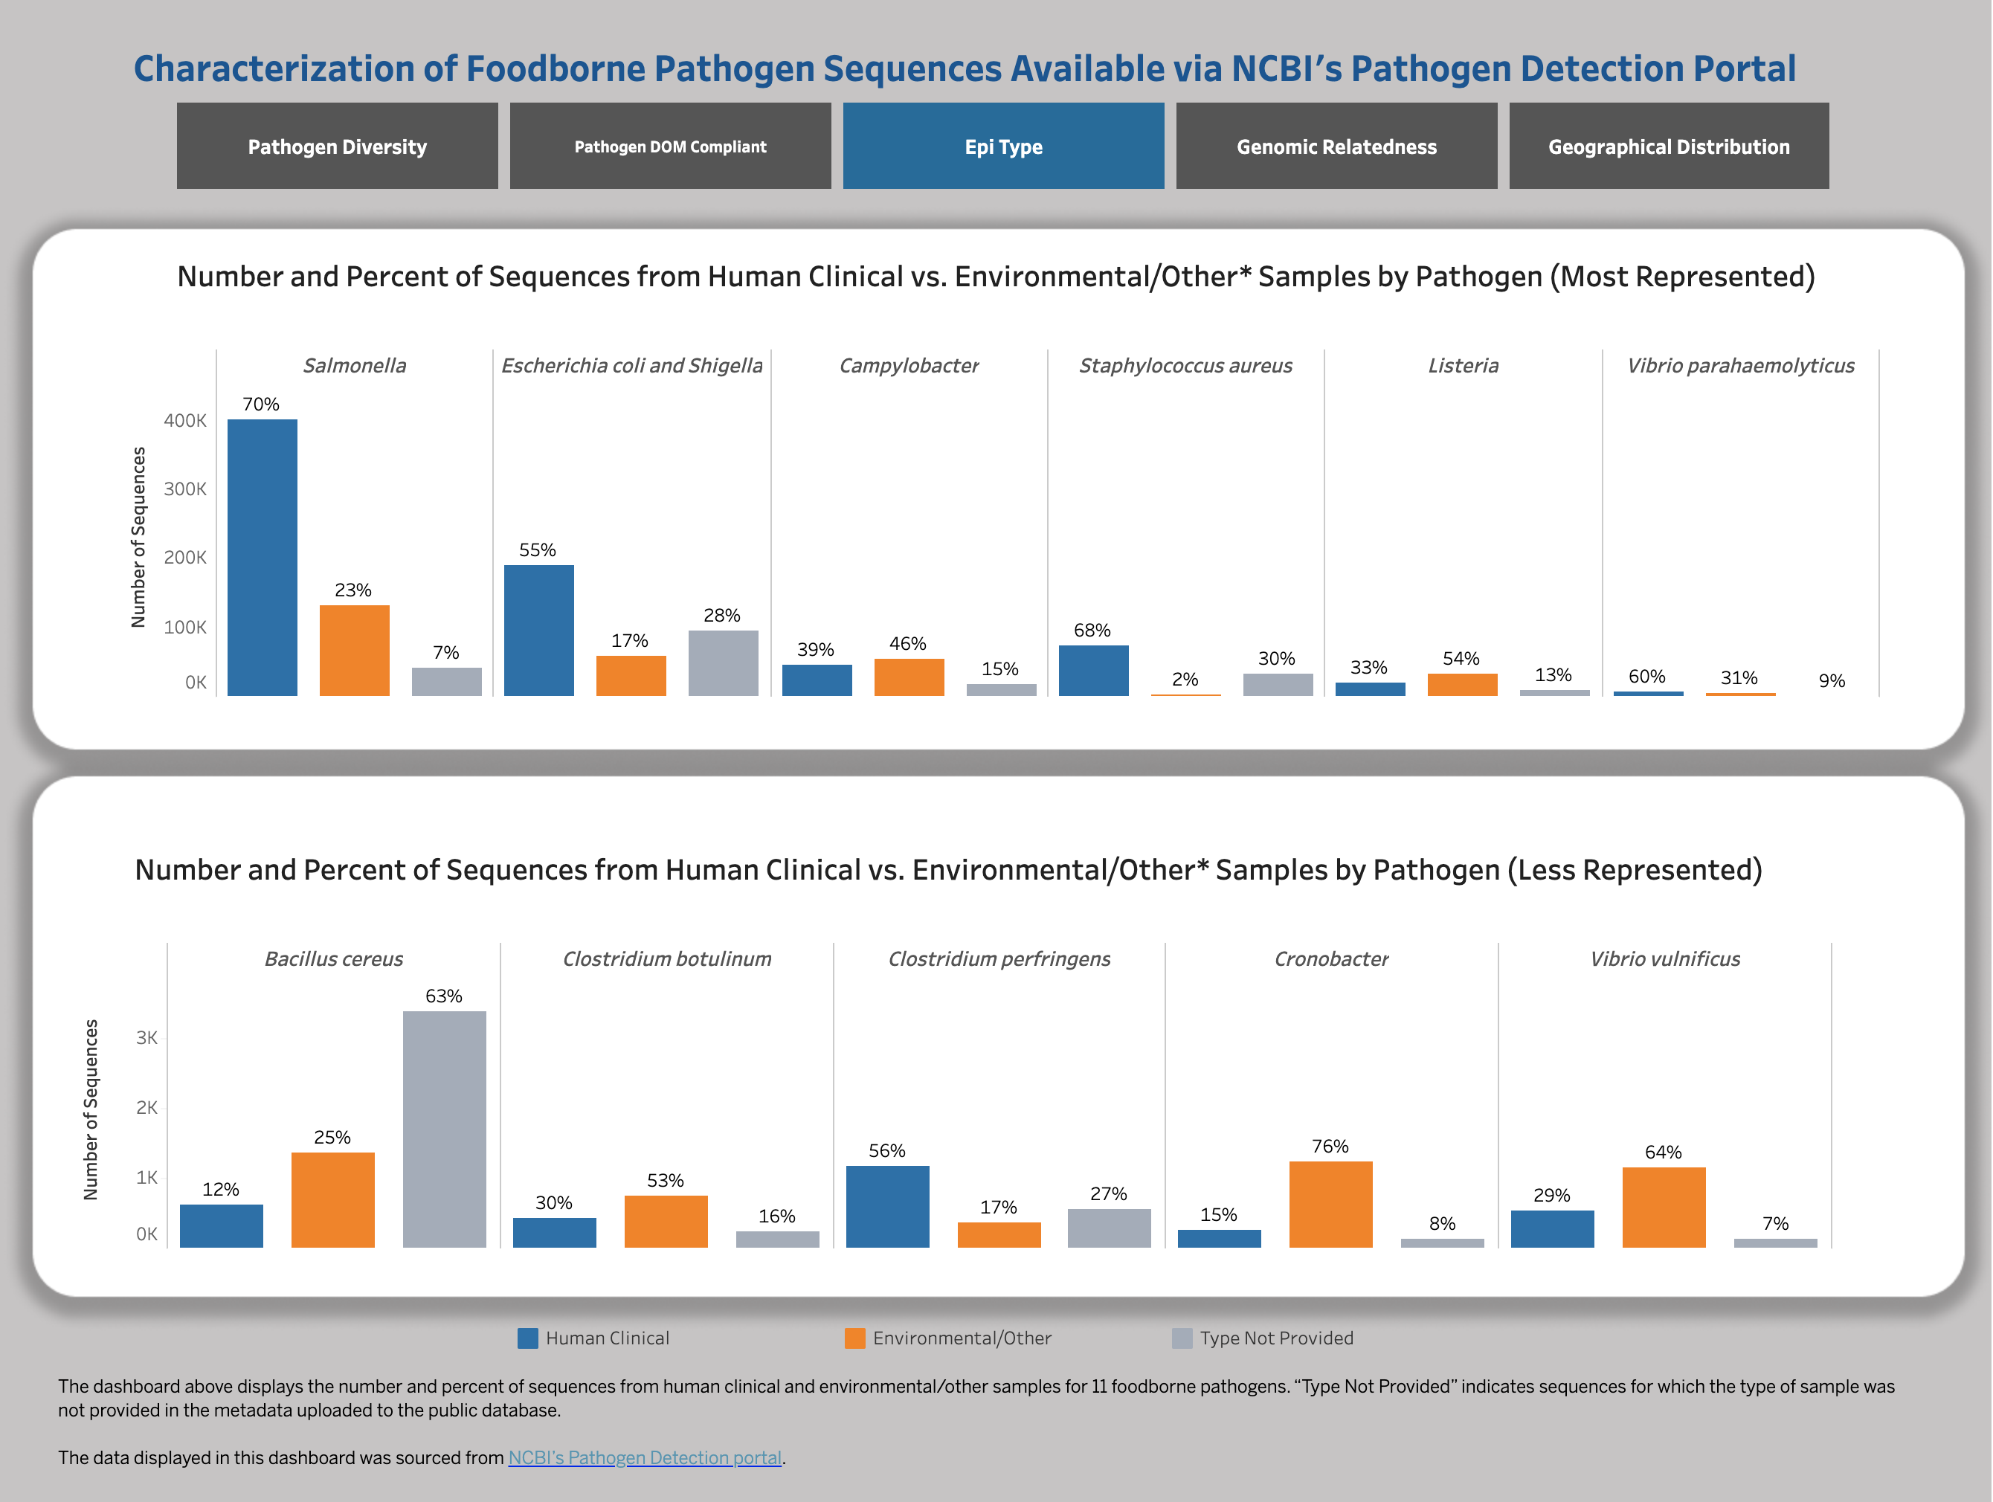
Dashboards

Slide 6
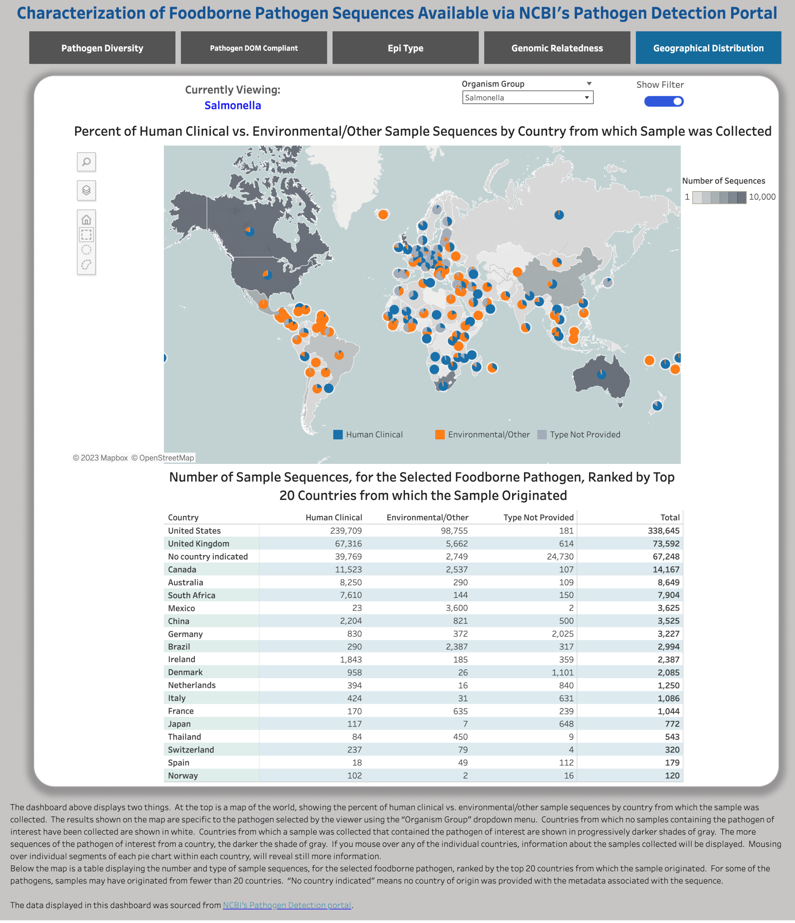
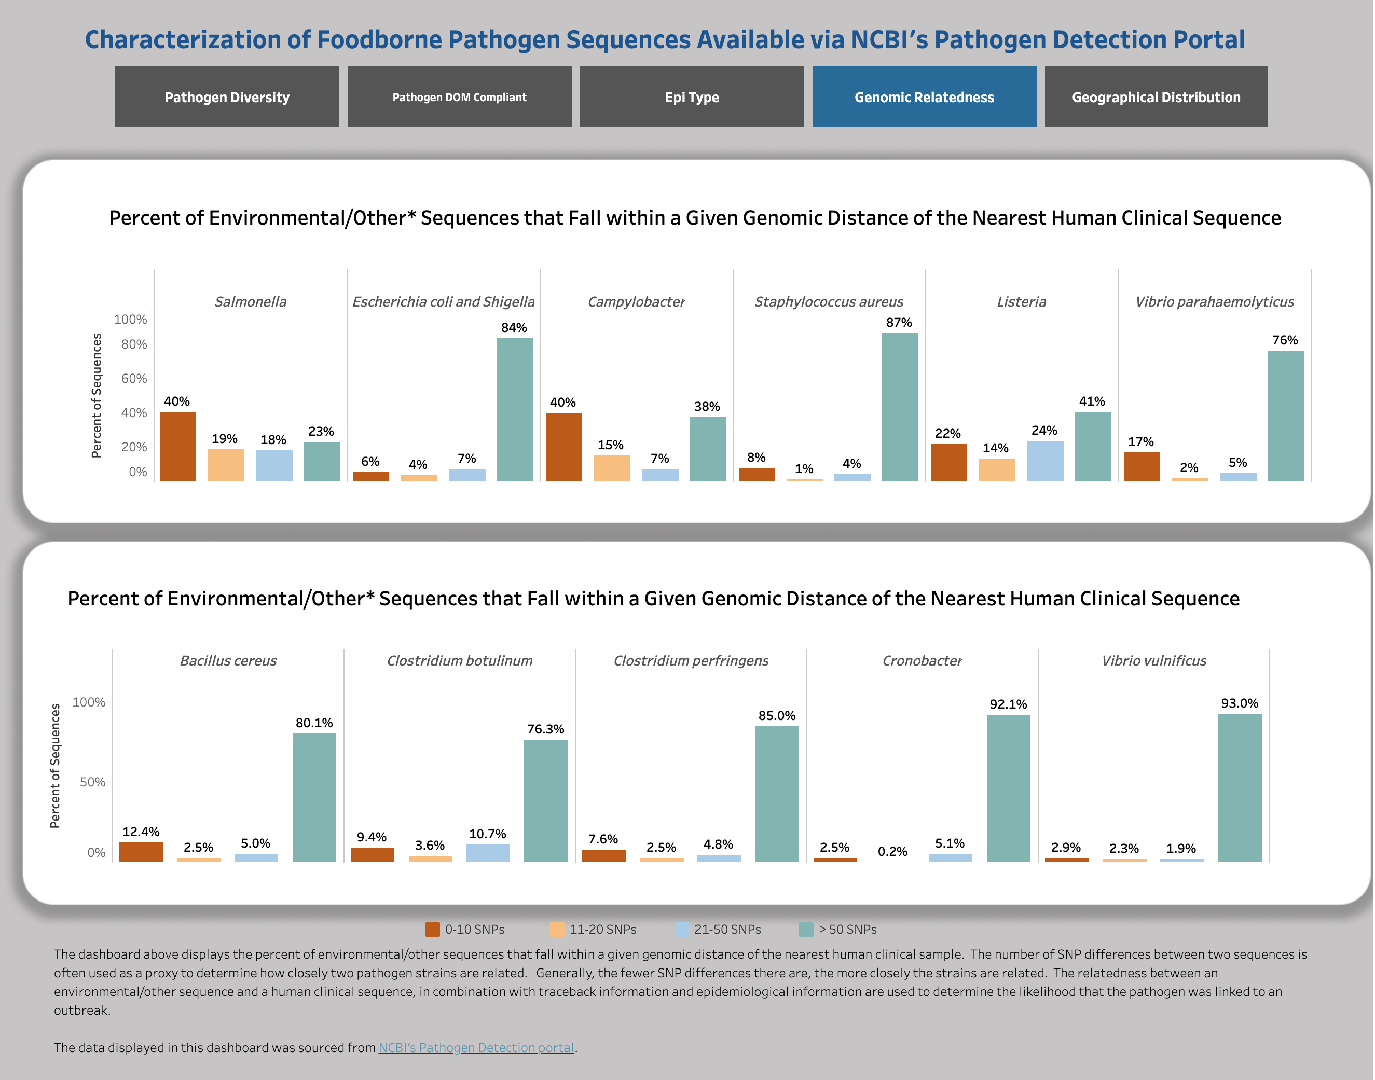
Dashboards

Slide 7


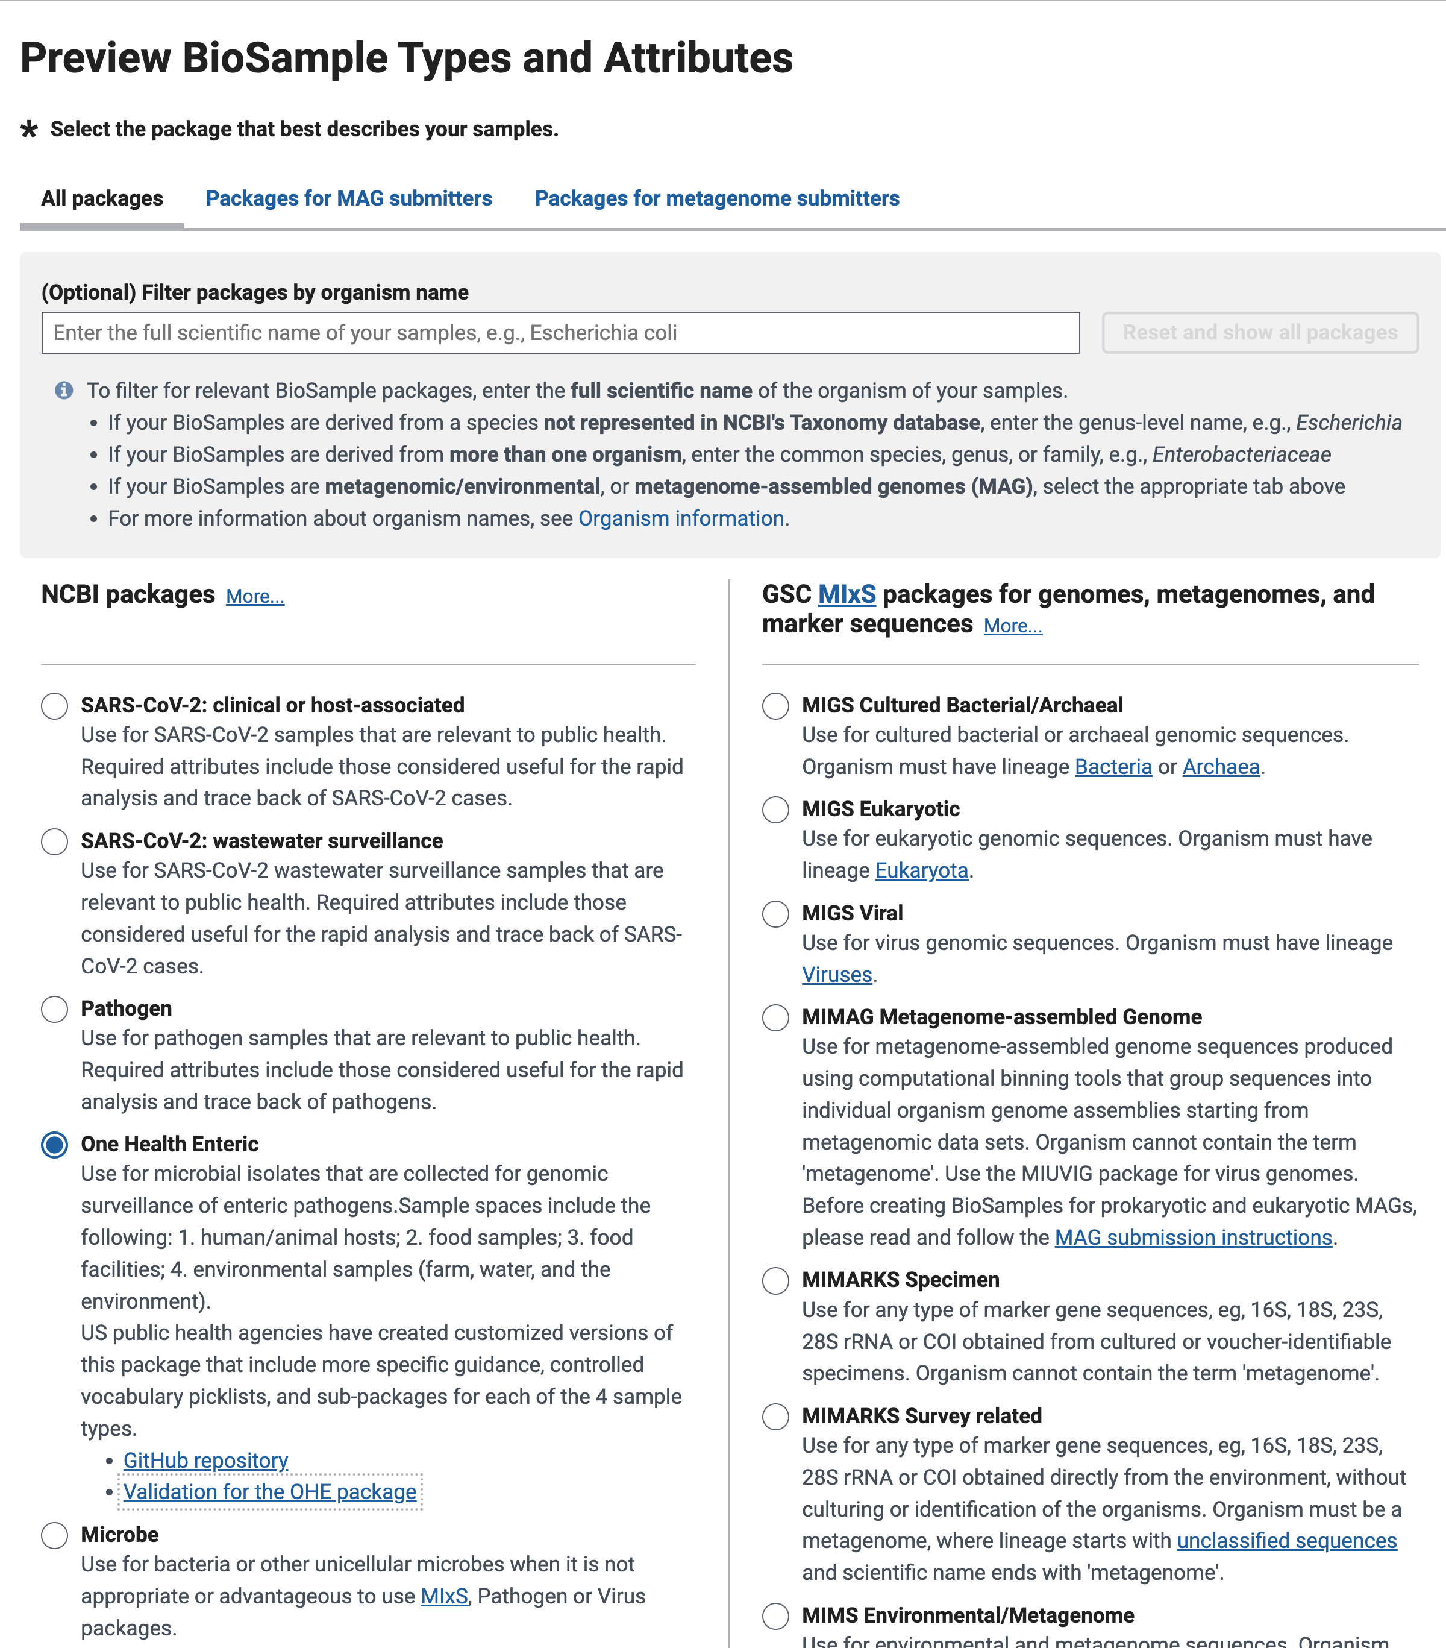


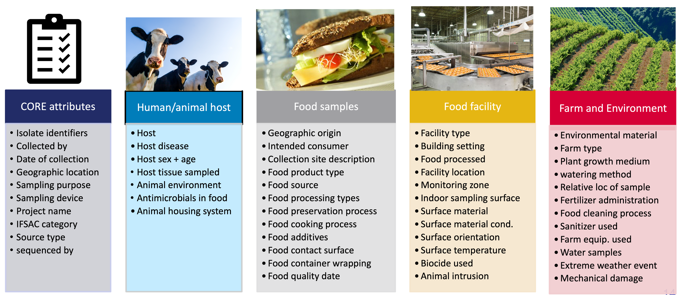
One Health Enteric package:
US Interagency Collaboration for Genomics for Food and Feed Safety (Gen-FS)
Generic template available at NCBI BioSample:
National Center for Biotechnology Information (NCBI)
Centers for Disease Control and Prevention (CDC)
Food and Drug Administration (FDA)
U.S. Department of Agriculture (USDA)
OHE package scope:
New links!

Slide 8


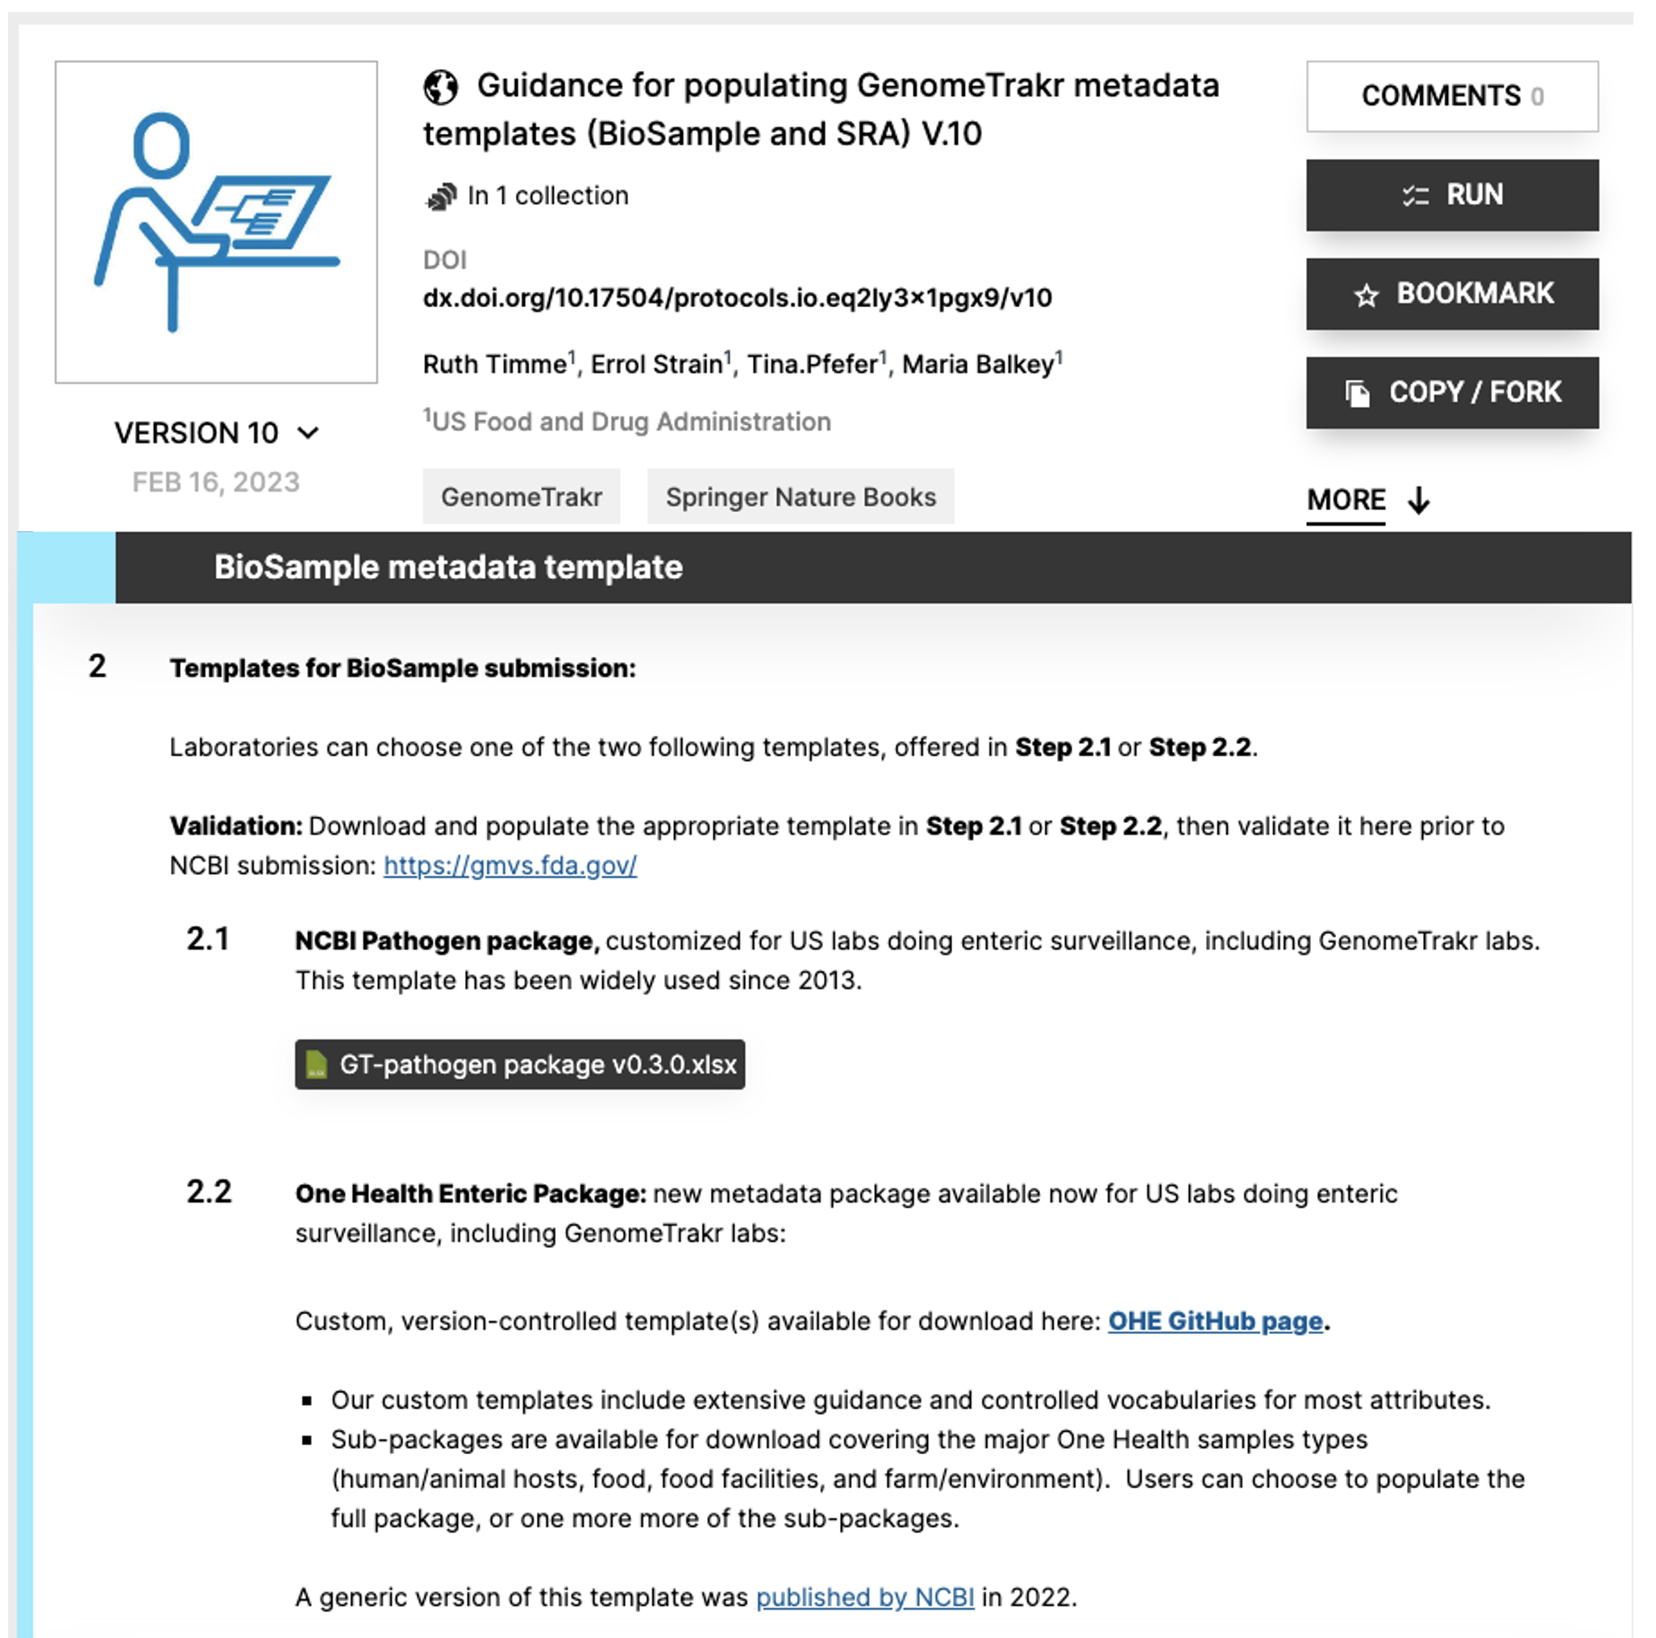
Tools to support OHE package:
Version-control for custom templates
2. Validation
Version-controlled templates
GitHub
Validation
GMVS.fda.gov
NCBI Submission

Slide 9
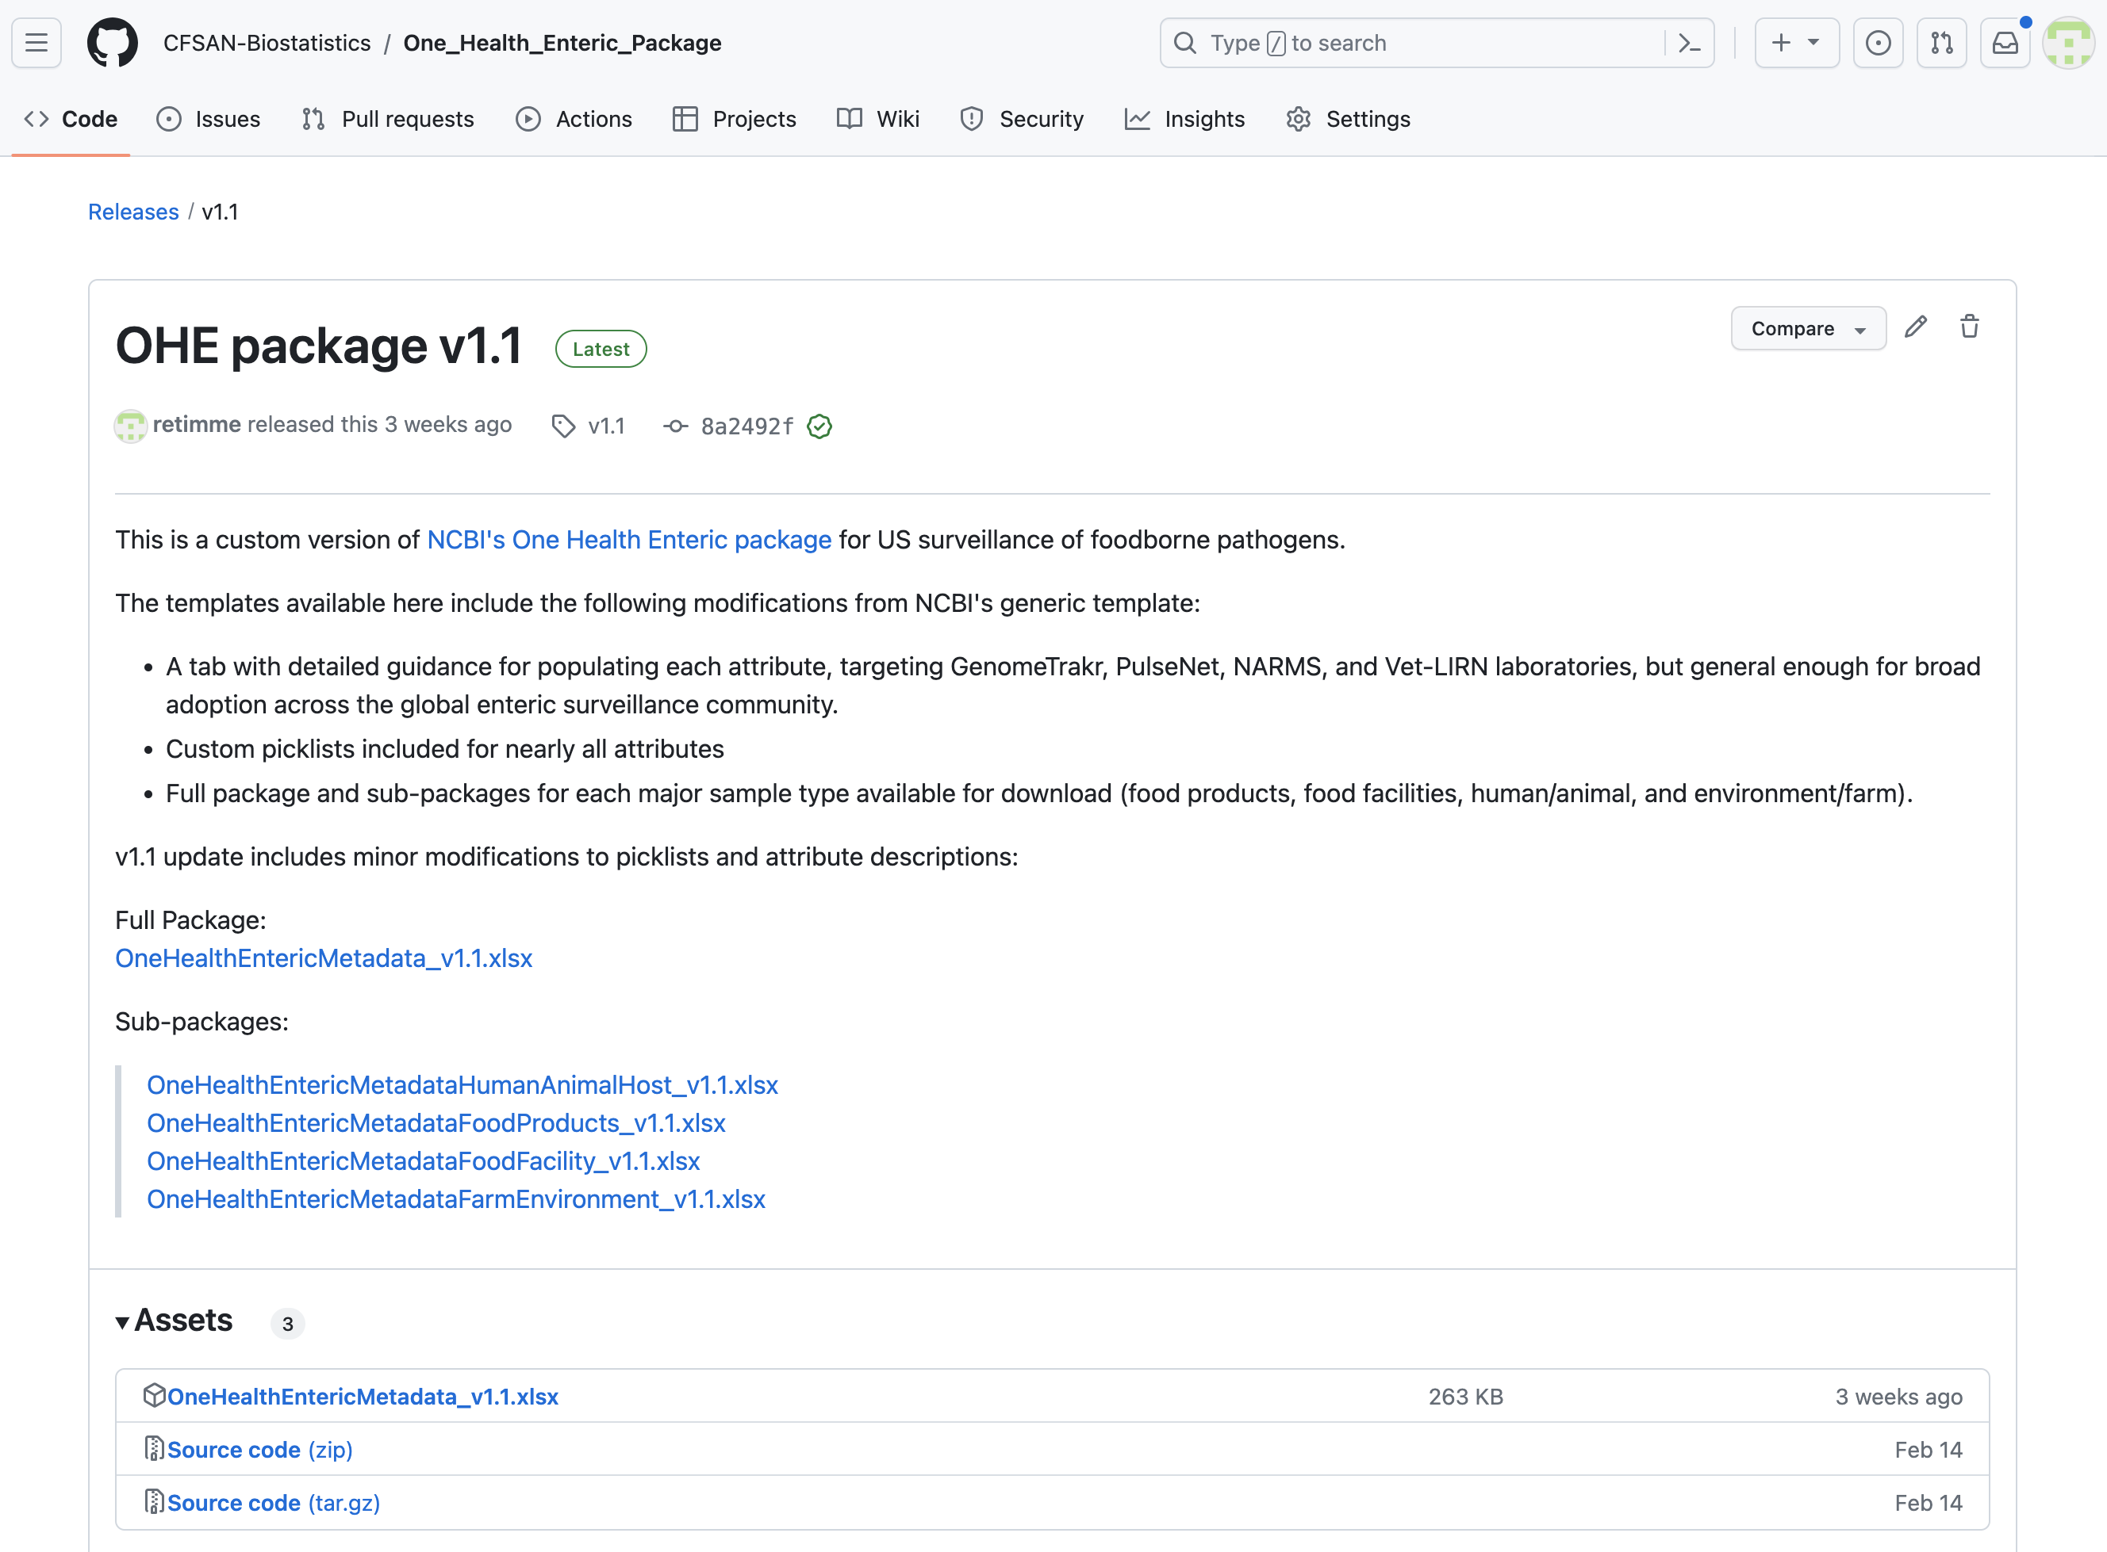
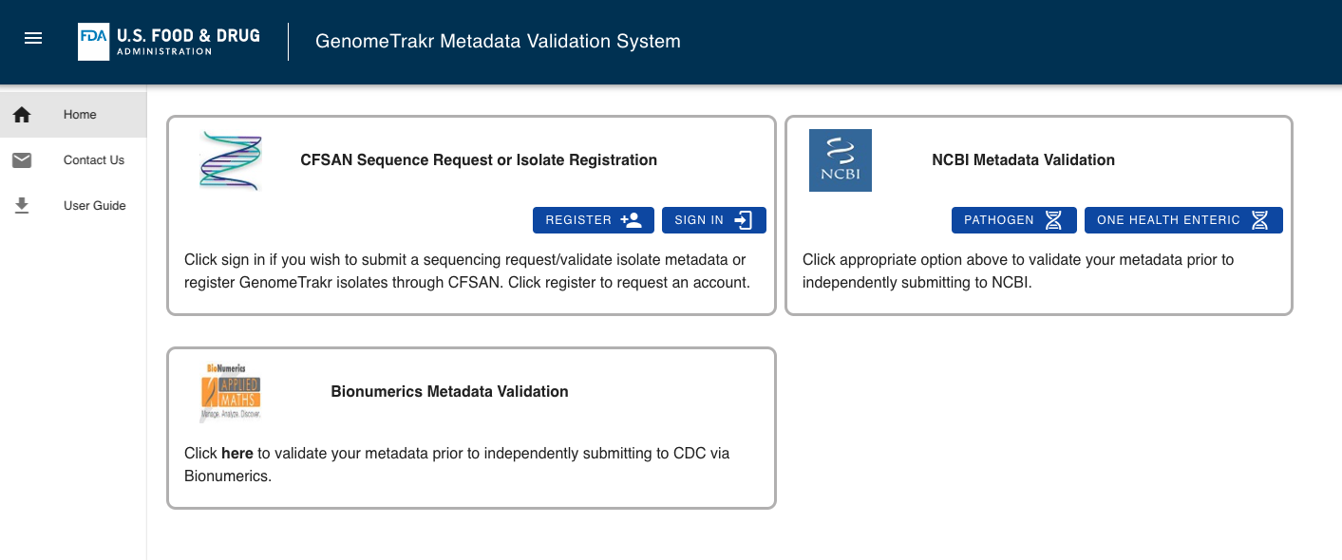
GitHub for OHE package version control:
Validation for the OHE package:
https://gmvs.fda.gov
OHE GitHub Link

Slide 10
Phased roll-out of OHE metadata template
Early 2023
Laboratories submitting to NCBI directly
  Animal isolates
  Facility inspection isolates
  Farm/environment isolates
Laboratories submitting to NCBI directly
  Food isolates (awaiting NCBI PD updates)
PulseNet Laboratories submitting through BioNumerics or other platforms
Late 2023
2024-25

Slide 11

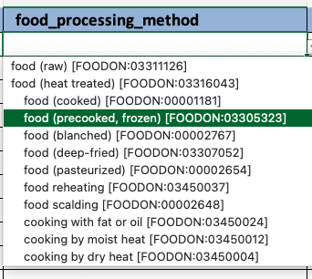
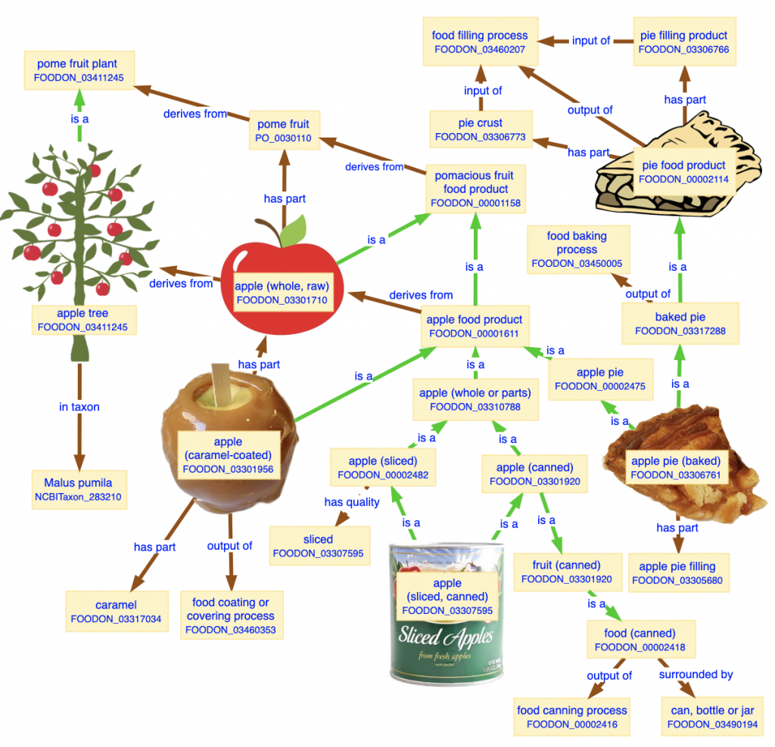
Major improvements:
Binary sample categories
  Human clinical
  Environment/food/other (animal, food, food facility, natural environment)
Ontology-aware queries:
Return all Salmonella isolates collected food that underwent a heat-treated processing method:
One Health categories:
1. Sub-packages for the following sample types:
    Human / Animal
    Food
    Food Facility
    Farm + natural environment
2. Implementation of PulseNet’s “SourceType”
    Human
    Animal
    Food
    Environment
    Other

Slide 12
Updates in NCBI Pathogen detection
min-diff / min-same calculation for OHE package submissions:
  “Clinical”: Source_type = Human
  “Environmental”: Source_type = Animal, food, environment, other
Geographic origin of food products in new field:
Location information | BioSample | Isolates Browser
Location where sample was collected | geo_loc_name | Location
Geographic origin of food product | food_origin | “Food origin”?

Slide 13

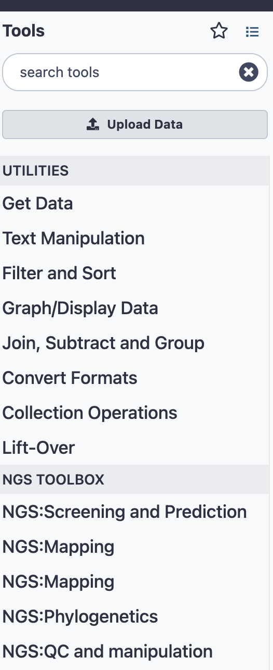
GalaxyTrakr Updates
Cluster Updates
  GalaxyTrakr is now able to provision nodes in multiple AWS zones, previously restricted to one zone
  Improved reliability and jobs should complete more quickly
Tool Panel Changes
  Tool Panel has grown in size and complexity over time. Effort in place to streamline tool display and remove tools that are not used
  Galaxy allows tools to be grouped into sections but not sub-sections, limiting our ability to structure tool displays
  New sections will be created, such as “Variant Calling” which will contain GATK, Snippy, snpSift, SNiPlay3, and snpEff
1,700+ active users and 200+ connected laboratories
Processed over 2,500,000 jobs to date (~50K per month)

Slide 14
Initiate annual Metadata Cleanup Challenge
GenomeTrakr
&
Gen-FS
GenFS participation:
GenomeTrakr, PulseNet, Vet-LIRN, NARMS, NAHLN, APHIS, ARS
GenomeTrakr laboratories targeted the following attributes:
Add source_type to current/historical isolates
Add project_name to all historical records (PulseNet, Vet-LIRN, NARMS, FSIS, GenomeTrakr, NAHLN, etc)
Standardize collected_by and add sequenced_by on all historical records
Populate host for all historical animal isolates
geo_loc_name -> food_origin for all historical food isolates
Organism name updates for Salmonella – where known, include serovar in the full organism name
Goals:
Hold hackathon annually to curate submissions from the prior year and keep historical records current.
Improve data curation tools

Slide 15
Goals for 2024:
Summarize and communicate results of metadata challenge and make improvements for next year’s event
Continue OHE implementation, including to improve vocabularies for food facility sub-package
Terra.bio pilot for NCBI submission
Re-org at FDA

Slide 16

GenomeTrakr at the FDA:
GenomeTrakr program:
Ruth Timme (Lead)
Marc Allard (Senior scientist)
Maria Balkey (Data curator)
Tina Pfefer (Project manager)
Julie Haendiges (laboratory method development)
C. Hope Bias (ORISE fellow)
Bioinformatics/analytics:
James Pettengill
Hugh Rand
Arthur Pightling
Bob Litterman
Justin Payne
Yan Luo
Yu Cao
Laboratory Flexible Funding Model:
Kirsten Hirneisen
Leadership support:
Sandra Tallent
Eric Brown
John Callahan
Errol Strain
Steven Musser
David Lipman

Slide 17
Acknowledgements
GenomeTrakr-funded Laboratories
  Animal Disease Research and Diagnostic Laboratory (ADRDL), South Dakota
  Animal Diseases Diagnostic Laboratory (ADDL) at the Ohio Department of Agriculture
  Arizona State Public Health Laboratory, Tgen
  Colorado State Department of Public Health and Environment
  Florida Department of Agriculture and Consumer Services
  Indiana State Department of Health
  Kentucky State Cabinet for Health and Family Services
  Maryland Department of Health
  Massachusetts State Department of Public Health
  Michigan Department of Agriculture and Rural Development
  Michigan State Department of Health and Human Services
  Minnesota State Department of Health
  New Hampshire State Department of Health and Human Services
  New Jersey State Department of Agriculture
  New Jersey State Department of Health and Senior Servces
  New Mexico State University -Food Safety Laboratory
  New York State Department of Agriculture & Markets
  New York State Department of Health - Wadsworth Center
  North Carolina Department of Agriculture and Consumer Services
  North Carolina State University, College of Veterinary Medicine
  Pennsylvania State University. Dudley's Lab
  Rhode Island Department of Health
  South Carolina Department of Health and Environmental Control
  Texas A&M University
  Texas Department of State Health Services
  University of Nevada - Reno
  Vermont State Agency of Human Services
  Virginia Division of Consolidated Laboratory Services
  Washington State Department of Agriculture
  Washington State Dept of Health
  West Virginia Department of Agriculture
U.S Food and Drug Administration (FDA)
  CFSAN
    ORS, OAO, OARSA, OFS, OIE
  Office of Regulatory Affairs
    ORA field labs, ORS
  Center for Veterinary Medicine
    Vet-LIRN, NARMS
National Institute of Health (NIH)
  National Center for Biotechnology Information (NCBI)
Centers for Disease Control and Prevention (CDC)
  PulseNet, AMD
US Department of Agriculture (USDA)
  Food Safety and Inspection Service (FSIS)
  Agriculture research service (ARS)
  Animal and Plant Health Inspection Service (APHIS)

