Slide 1

Swab Diversity Study:
FDA/GenomeTrakr Collaboration to Determine
Optimal Isolate Picks for Capturing Strain Diversity
Tina Lusk Pfefer, MSPH, PMP
Project Manager, GenomeTrakr
FDA Human Foods Program
Office of Laboratory Operations and Applied Science
Office of Scientific Coordination & Computational Sciences
GenomeTrakr and Computational Science Staff
2024 GenomeTrakr Annual Meeting
October 17, 2024

Slide 2
Swab Diversity Study
Background
Timeline
Collaborators
Study Design
Results
Conclusions

Slide 3
Swab Diversity Study
Background
Sampling is a resource-intensive activity. To ensure we are getting the most information we can, we conducted enhanced sequencing of colonies to determine whether the current number typically sequenced was sufficient to capture the diversity in the sample.

Slide 4
Swab Diversity Study
Timeline
Early 2024 - Asked for LFFM lab volunteers
February 2024 - Held kick-off call with participating laboratories
February – present – labs pick additional colonies as part of their normal workflow and uploaded them to NCBI
March 2025 – tentative project end date
Fall 2024 - Spring 2025 – Analyze data

Slide 5
Swab Diversity Study
Collaborators
  HFP GenomeTrakr Team
    Tina Pfefer, MSPH, PMP – Project Manager
    Ruth Timme, PhD - Team Lead
  HFP/Office of Surveillance Strategy and Risk Prioritization/Division of Surveillance & Data Integration
    Jamie Pettengill, PhD – Director, Division of Surveillance & Data Integration
    Martine Ferguson, MS - Signal Detection & Bioinformatics Branch
    Jayanthi Gangiredla – Bioinformatics Team Lead (Detail), Signal Detection & Bioinformatics Branch
    Tim Muruvanda - Signal Detection & Bioinformatics Branch.
  10 GenomeTrakr Laboratories

Slide 6
Swab Diversity Study
Collaborating Laboratories
Maryland Department of Health
Michigan Department of Agriculture and Rural Development
Michigan Department of Health and Human Services
Missouri Department of Health and Senior Services
New Jersey Department of Agriculture
NH Department of Health & Human Services
Rhode Island Department of Health
Texas Department of State Health Services
Virginia Division of Consolidated Laboratory Services
West Virginia Department of Agriculture

Slide 7
Swab Diversity Study
Study Design
Goal:
To sequence a target number of colonies of either Salmonella spp. and/or Listeria spp. to capture all the genetic diversity (i.e., unique strains) present on an environmental swab or product sample.
Design:
Labs targeted 11 total colonies per species to be sequenced per food/environmental sample for 7-10 samples from all selection media. This provides a high probability to detect 3 strains.

Slide 8
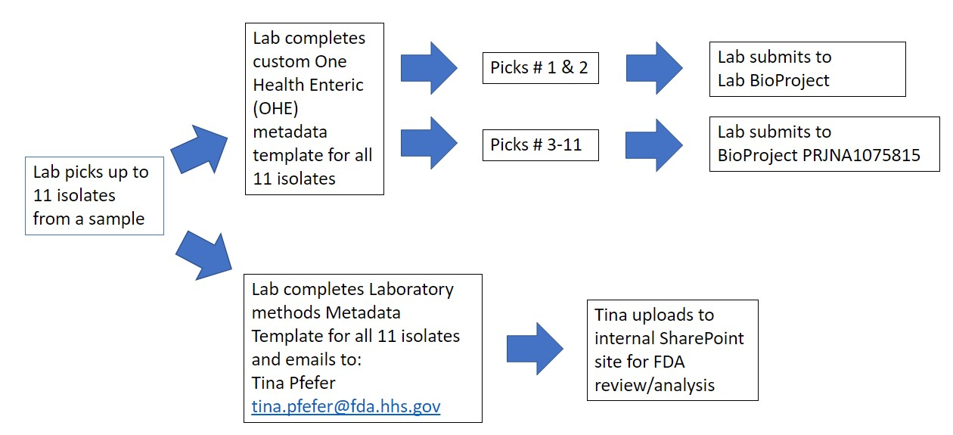
Swab Diversity Study
Study Design: Metadata Submission Workflow

Slide 9
Swab Diversity Study
Study Design: Custom One Health Enteric metadata package
Increased Metadata Capture: The following two attributes were added to the One Health Enteric package to capture the sample and individual colony pick information.
New attributes | Definition | Example
Experimental_specimen_type | A laboratory sample ("specimen”) derived from a biological sample or swab. For our project, this term applies to an individual colony pick. For other projects these specimens can be any type of replicate or pooled product within a laboratory workflow, ranging from enrichment broths to individual colony picks. | Individual colony pick
Specimen_source_id | An identifier that links together all items classified under "experimental_specimen_type". This ID represents the biological sample or specimen from which the replicates are derived. | FDA1216050-S001

Slide 10
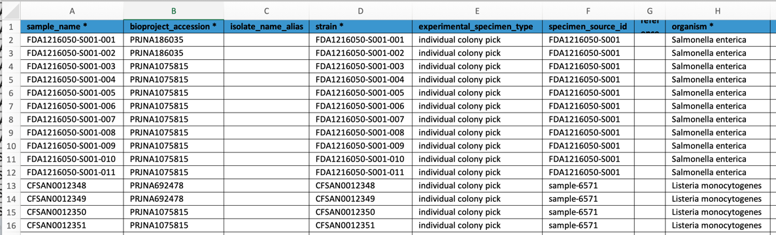
Swab Diversity Study
Study Design: Custom One Health Enteric metadata package
Example:

Slide 11
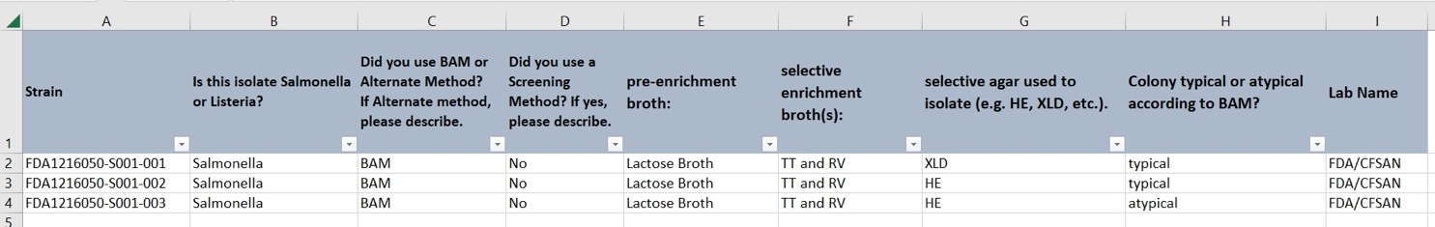
Swab Diversity Study
Study Design: Laboratory Methods Metadata Template - Example

Slide 12
Analysis -
Methods and Results to date

Slide 13
Bioinformatics methods
371 multi-colony picks from 38 swabs from several food, animal and environmental sources were analyzed to capture the diversity of Salmonella and Listeria sp.
Strain level identification from the assembled genomes were done using ANI (Average Nucleotide Identity) and CFSAN SNP pipeline to capture the SNP distance between the group of isolates(picks) per swab.
Strains were defined as follows: pairs or groups of isolates that are within 3 SNPs of one another are the same strains and if pairs or groups of isolates are >3 SNPs are identified as a different strain.

Slide 14
Bioinformatics methods
Hypothesis:
A preliminary power analysis estimated that 11 picks per swab would capture at least 3 strains with 95% confidence.
Method:
38 multi-pick swabs, with number of picks per swab ranging from 2 to 22, were collected to assess if
The number of strains per swab increased with the number of picks per swab.
Genus (Listeria or Salmonella) impacted the number of strains per swab.
Information on the source of the swab was also collected (animal / animal feed, condiment / RTE, dairy / beef / poultry, environmental, mushroom or produce / leafy greens).

Slide 15
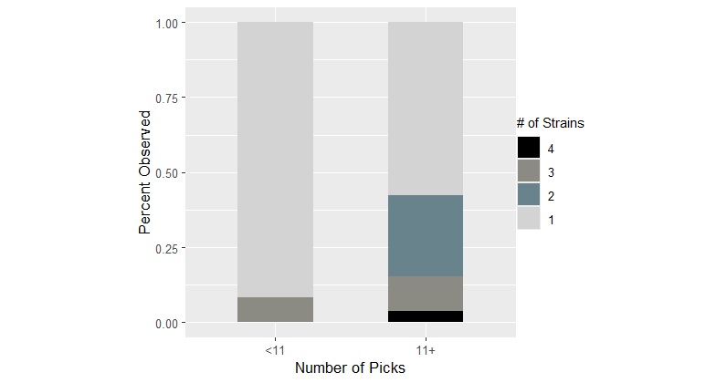
Results
# of strains increased significantly with # of picks
​Likelihood of observing 3 or more strains :
with 11+ picks is 15.4%​
with <11 picks is 8.3%​
​
Nearly double the likelihood of observing 3+ strains with 11+ picks.​
Notes:
*90% posterior high density interval is [0.03, 0.24]
Tina: Picking at least 11 colonies per swab dramatically improves the number of different strains observed per swab.

Slide 16
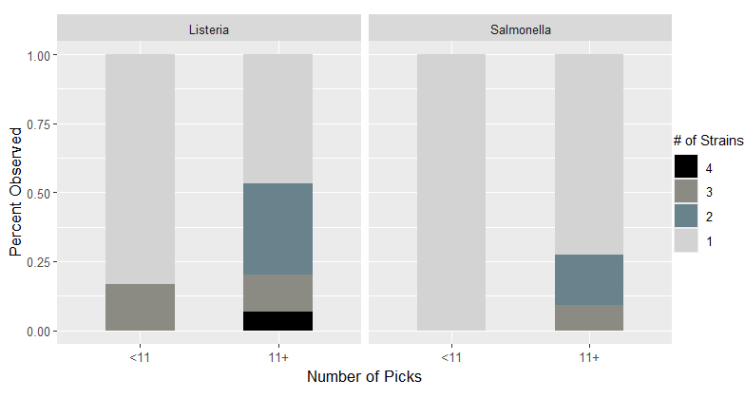
Results
A higher # of strains were noted in samples with Listeria versus samples with Salmonella when 11+ picks were collected (4 vs 3, respectively). However, this effect was not significant.
n=21 swabs
n=17 swabs
Notes:
Tina: Listeria+ swabs with at least 11 picks appear more diverse than Salmonella+ swabs with at least 11 picks

Slide 17
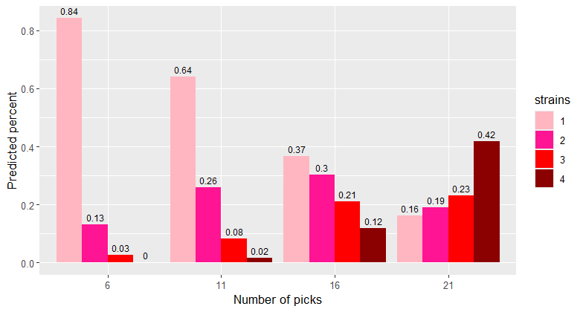
Results
Predicted* probability of observing 1, 2, 3, or 4 strains for varying number of picks per swab (6, 11, 16 or 21).
The (predicted) probability of observing 3 strains is
3% with 6 picks
8% with 11 picks (more than double that of 6 picks)
21% with 16 picks
23% with 21 picks
Notes:
*Probabilities predicted from the Poisson model
Tina: The likelihood of observing two or three strains increases dramatically (doubles) when the number of picks increases from 6 to 11. The likelihood of observing four strains increases dramatically (6-fold) when the number of picks increases from 11 to 16.

Slide 18

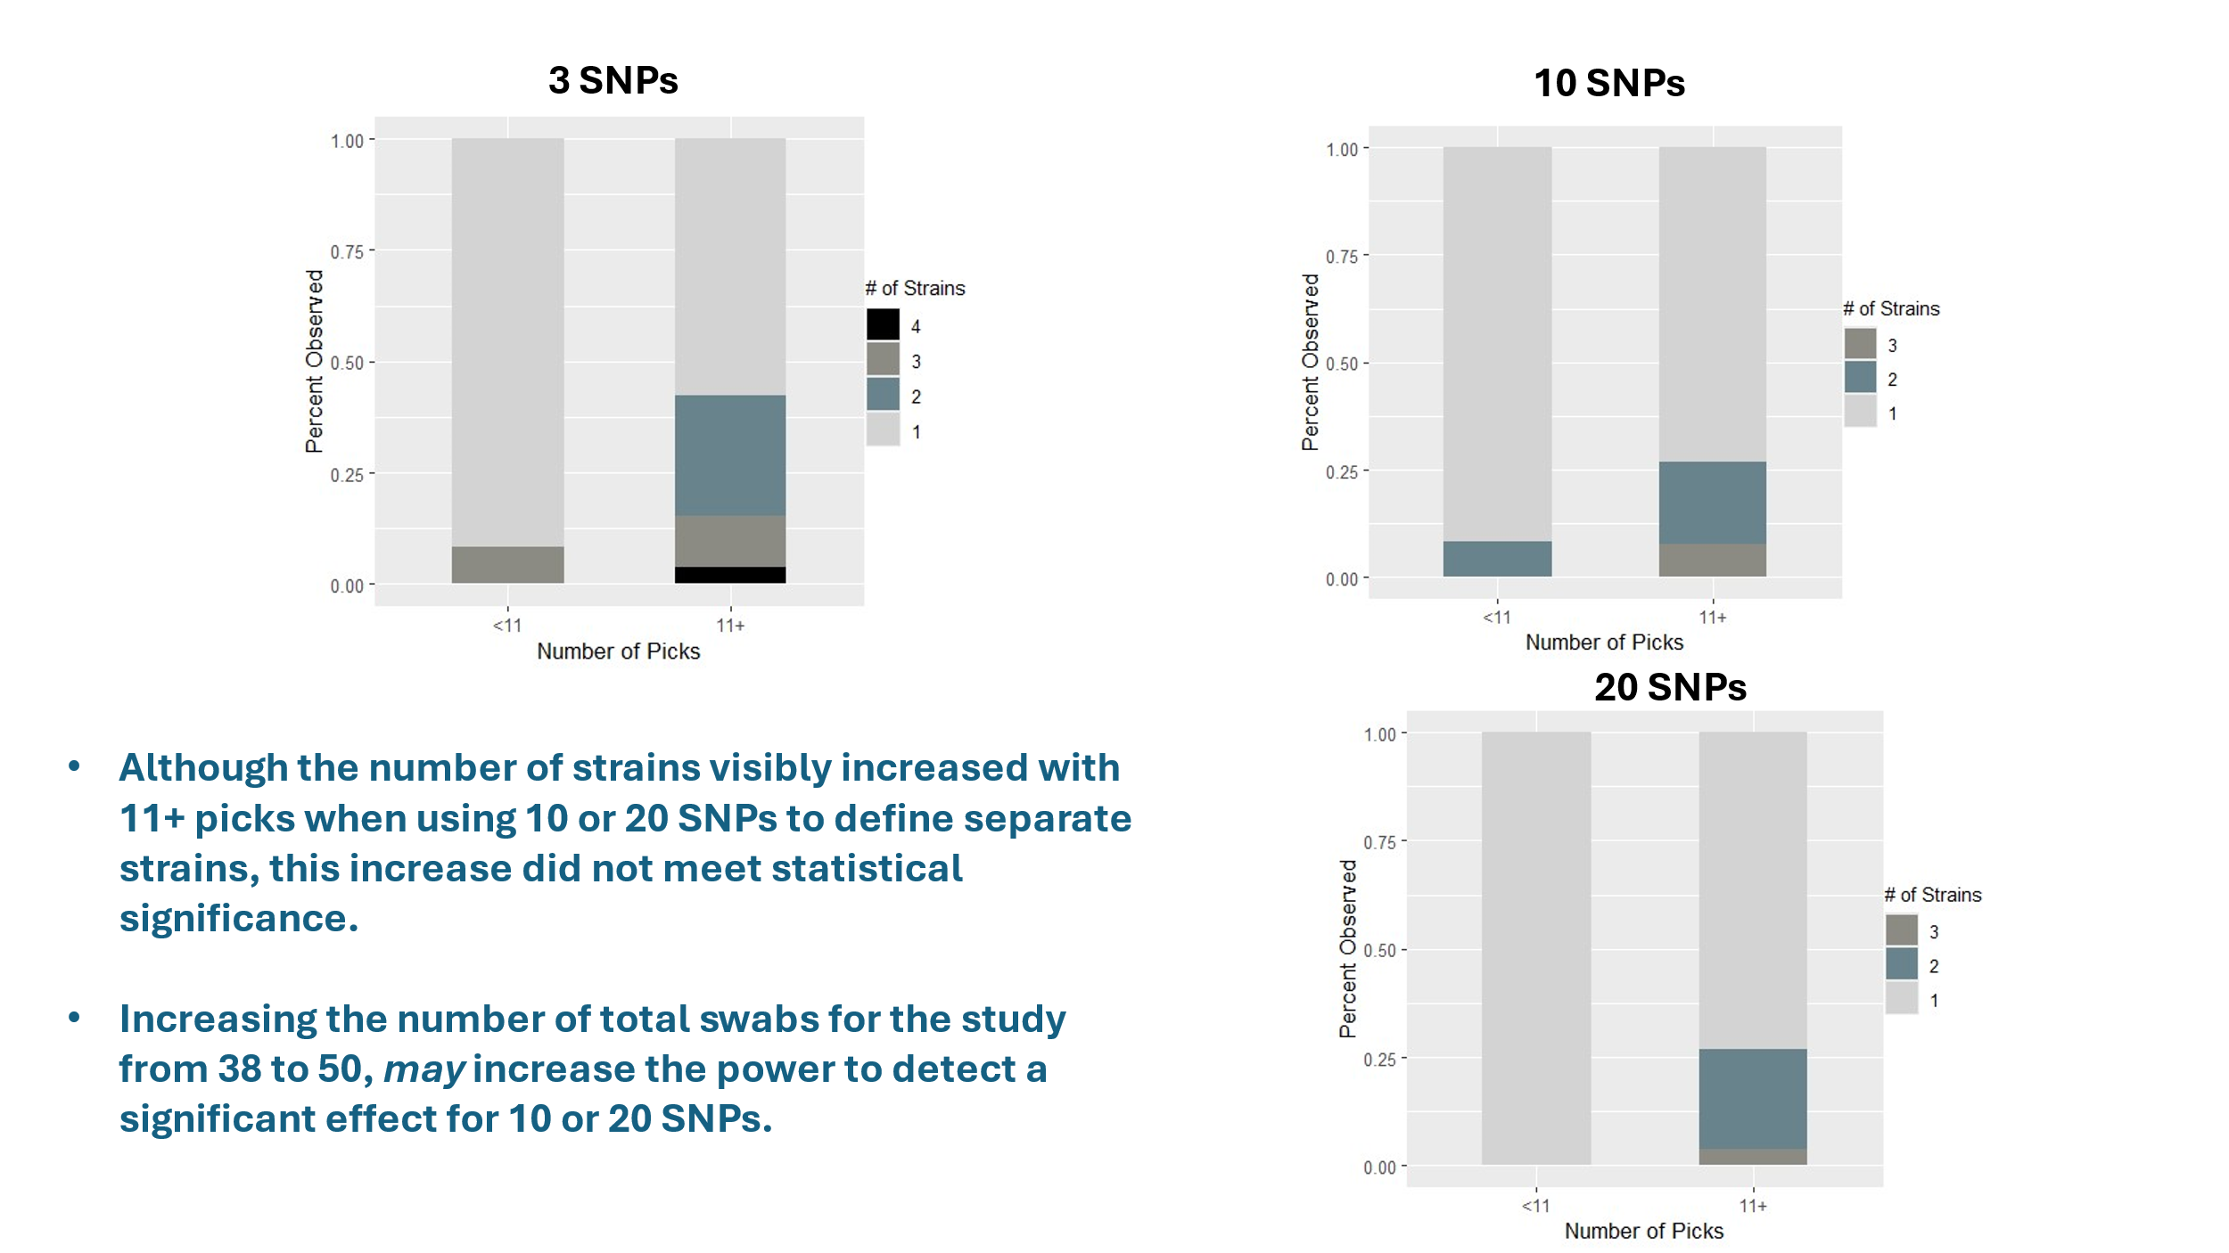
Results
Notes:
The results are dependent on the SNP threshold used. At 3 SNPs, increasing the number of picks does significantly increase the # of strains detected per swab. At 10 or 20 SNP threshold, it does not. We can also state that 3 is evaluated also because it has been helpful when allowing for some variability in the sequencing technology when trying to define genetically identical/replicate isolates.

Slide 19
Swab Diversity Study
Conclusions to date, based on 3 SNP threshold
Picking at least 11 colonies per swab dramatically improves the # of different strains observed per swab.
  The likelihood of observing 2 or 3 strains increases dramatically (doubles) when the number of picks increases from 6 to 11.
The likelihood of observing 4 strains increases dramatically (6-fold) when the # of picks increases from 11 to 16.
Listeria+ swabs with at least 11 picks appear more diverse than Salmonella+ swabs with at least 11 picks.

Slide 20
Swab Diversity Study
Next steps
  Perform analysis considering additional metadata collected
  Look into the actual SNP differences – serovars, clonal complex
  Study to continue - Is 3 SNPs the correct threshold to determine same/different bacteria? Should it be 10 or 20?

Slide 21
Acknowledgements - Thank you!
Collaborating Laboratories
Maryland Department of Health
Michigan Department of Agriculture and Rural Development
Michigan Department of Health and Human Services
Missouri Department of Health and Senior Services
New Jersey Department of Agriculture
NH Department of Health & Human Services
Rhode Island Department of Health
Texas Department of State Health Services
Virginia Division of Consolidated Laboratory Services
West Virginia Department of Agriculture
  HFP/Office of Surveillance Strategy and Risk Prioritization/Division of Surveillance & Data Integration
    Jamie Pettengill, PhD – Director, Division of Surveillance & Data Integration
    Martine Ferguson, MS - Signal Detection & Bioinformatics Branch
    Jayanthi Gangiredla – Bioinformatics Team Lead (Detail)
    Tim Muruvanda - Signal Detection & Bioinformatics Branch.

