Slide 1


MiSeq™ i100 Series
Kyle Miller
Assoc. Director, Segment Marketing
October 16, 2024
M-GL-03116
© 2024 Illumina, Inc. All rights reserved.

Slide 2
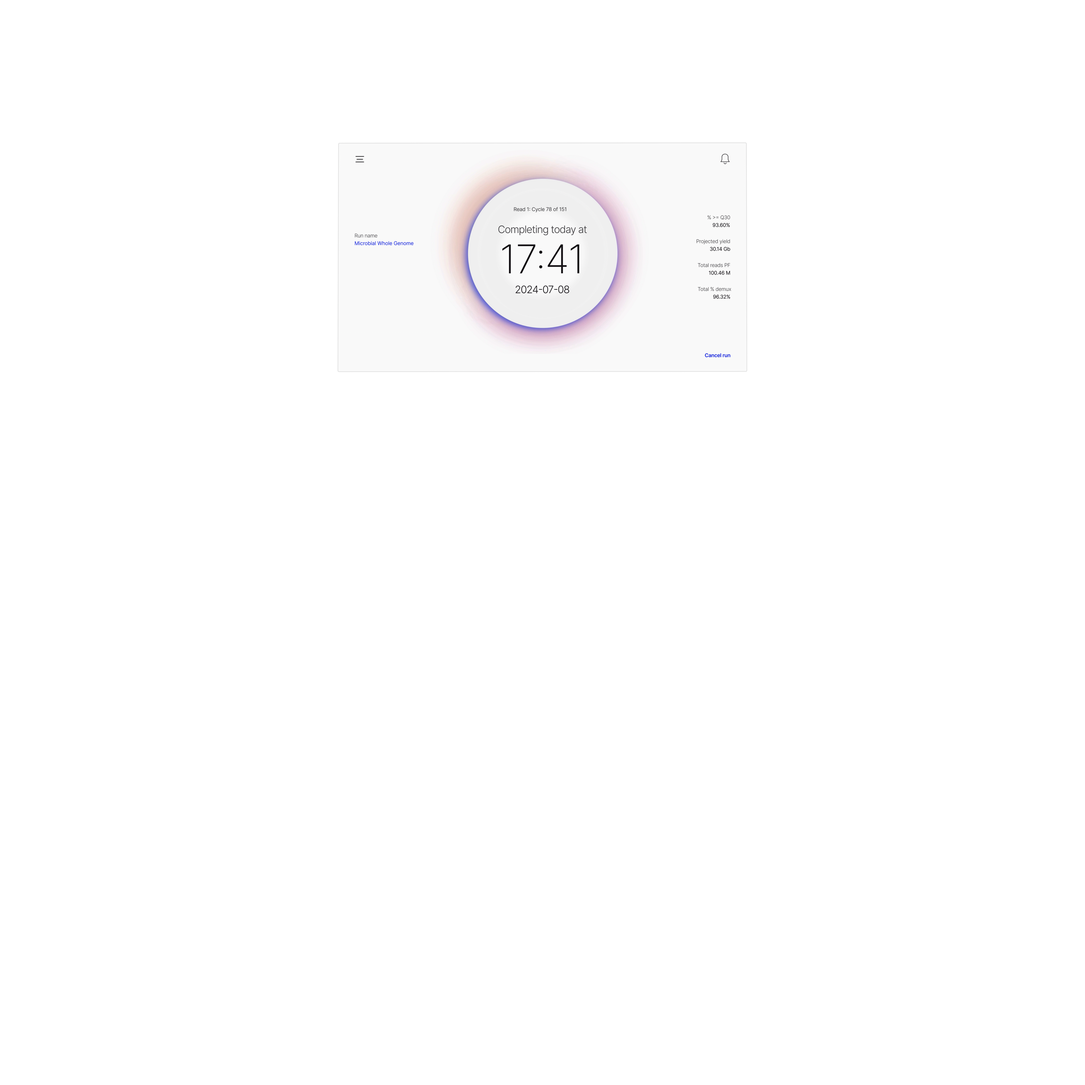
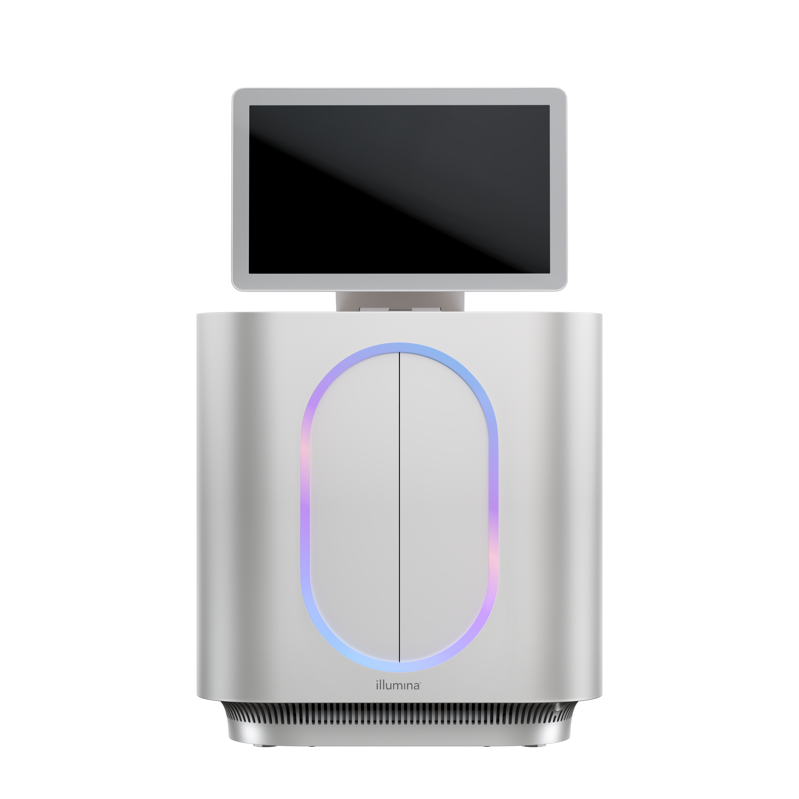
MiSeq i100 Series provides flexible configurations
MiSeq i100¹
Up to 15 Gb, 25M reads
Available mid-2025
MiSeq i100 Plus
Up to 30 Gb, 100M reads
Available late-2024
Cartridge
(Single reads)
5M
25M
50M²
100M²
Max output
2x150
1.5 Gb
7.5 Gb
15 Gb
30 Gb
2x300
3 Gb
15 Gb
30 Gb
-
  ¹ The MiSeq i100 System cannot be upgraded.
  ² 50M and 100M flow cells, available mid-2025, are compatible with the MiSeq i100 Plus only.

Slide 3
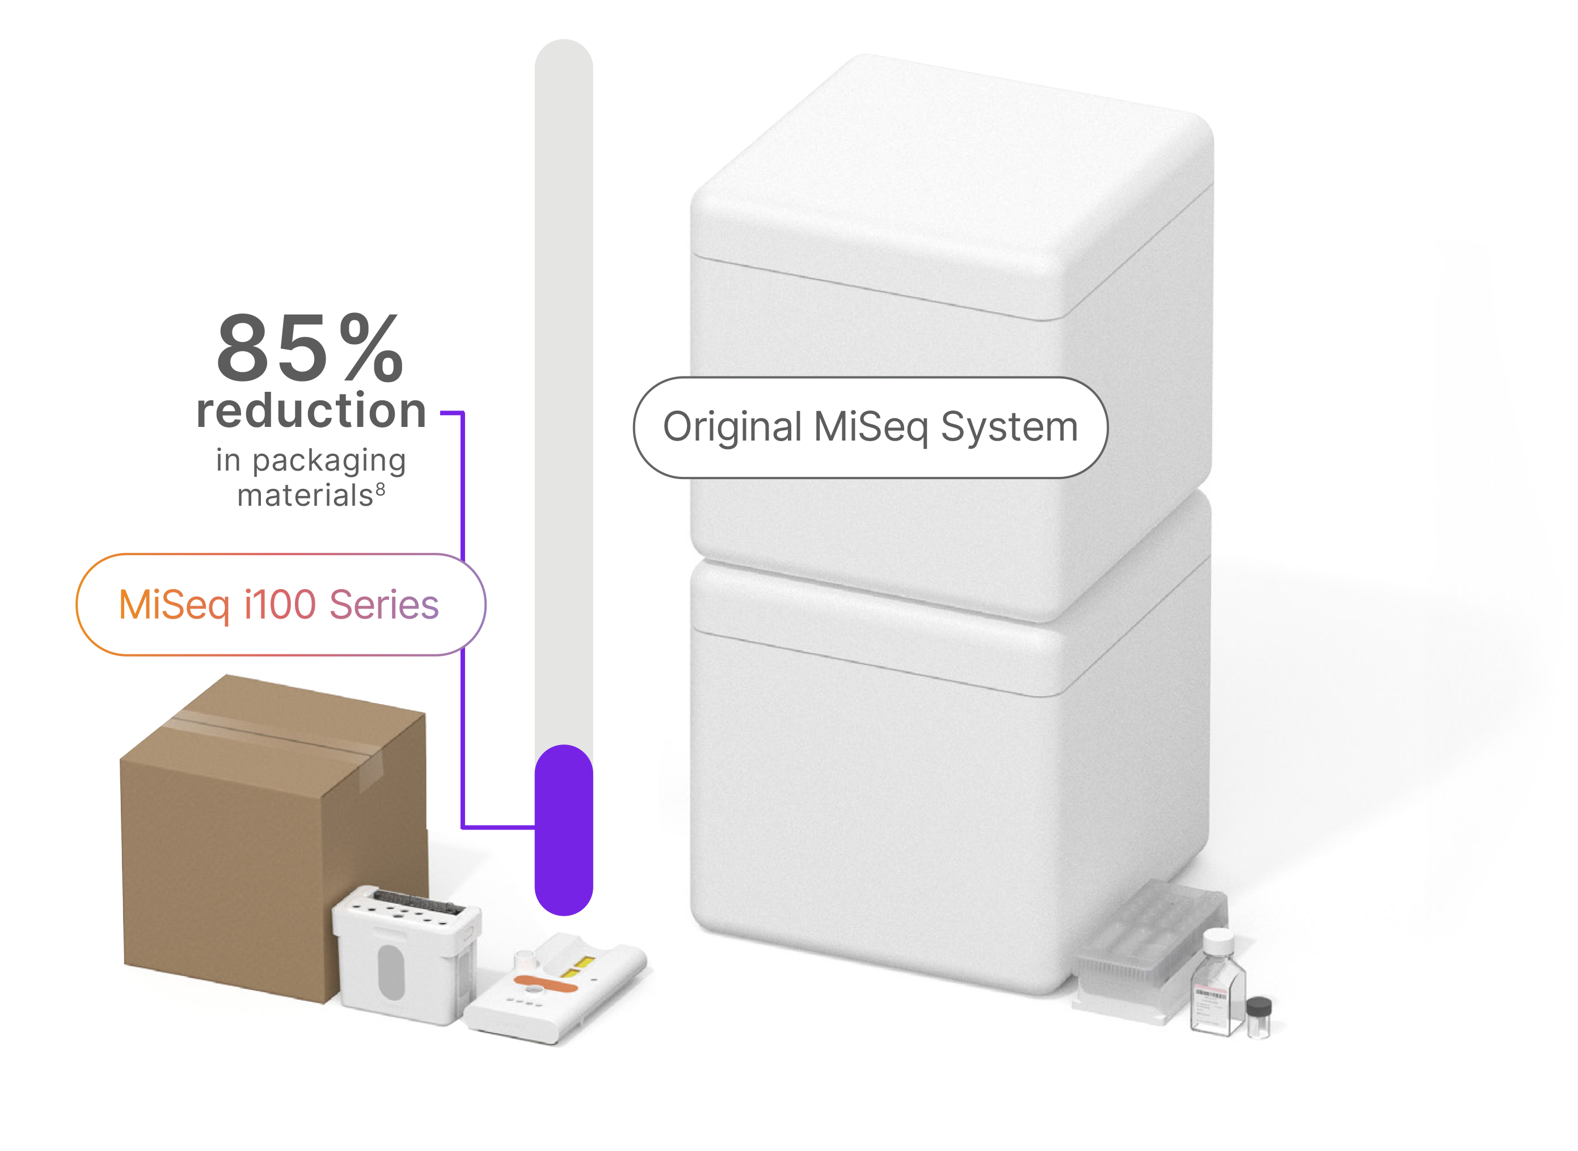

Streamline lab operations with more sustainable packaging
Eliminate ice packs and dry ice with room temperature shipping & storage
Reduce waste and simplify disposal with recyclable plastics and buffer cartridges
Minimize time unboxing with >85% reduction in packaging waste¹
Impact the world—not the environment.
  ¹ Compared to MiSeq consumable ship weight

Slide 4
Fastest, most efficient workflow from sample to analysis
System
Touchpoints
Setup
Sequencing
Analysis (sWGS)
MiSeq i100
Series
7h 15m
4:
20m
∼21m¹
MiSeq System
v2 chemistry
12:
24h 25m
1h 45m
~45 m²
MiSeq System
v3 chemistry
32h 25m
12:
2 h 15 m
~45 m³
3x reduction⁴ in touchpoints, 3-4x reduction⁴ in total workflow time
  ¹ 300 cycle, 25M flowcell using DRAGEN sWGS App onboard
  ² 300 cycle, 15M flowcell using sWGS pipeline on BaseSpace
  ³ 300 cycle, 25M flowcell using sWGS pipeline on BaseSpace
  ⁴ Compared to MiSeq System
Notes:
Move to simplicity area
Set up time (# of touchpoints)
90 min to 2 hours 15 min for total
20 min no thaw and onboard dthaw MiSeq, 30 min wash, 15 min denaturation, enaturation
Sequencing run
Analysis (touchpoints)
Histogram with description for each piece
Asterisk for each touchpoint

Slide 5
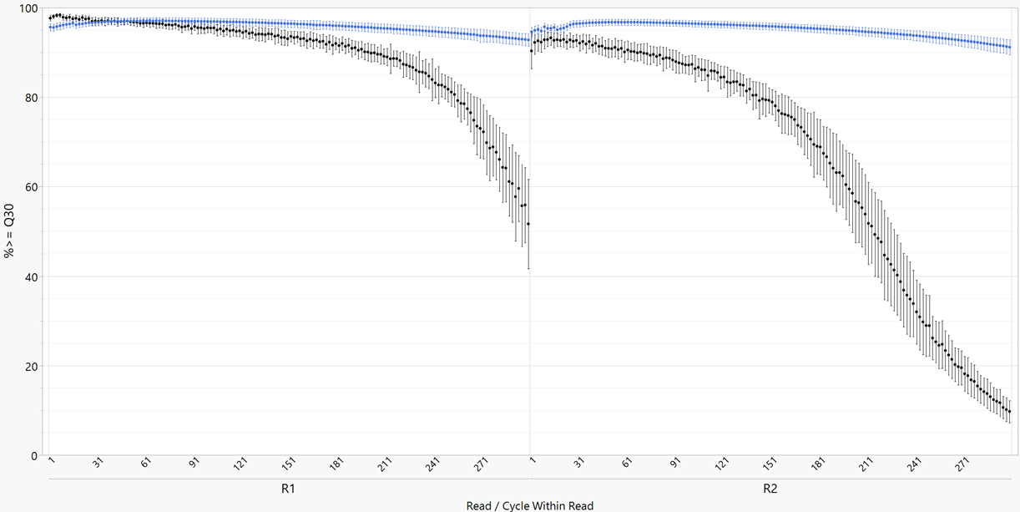
MiSeq i100 engineered for superior data quality throughout the cycle
 | MiSeq | MiSeq i100
≥Q30 (2×300, average), R1 | 89.1% | 95.8%
≥Q30 (2×300, last 10 cycles), R1 | 55.5% | 92.9%
≥Q30 (2×300, average), R2 | 65.8% | 95.1%
≥Q30 (2×300, last 10 cycles), R2 | 10.7% | 91.4%
> 1.5×)
> 8.5×
% ≥ Q30
MiSeq i100
MiSeq
Read/Cycle within Read
Longer read lengths have improved accuracy throughout the whole read.
Results were generated using sWGbugpool library with 600 cycle 25M Reagent kits on MiSeq i100 Plus System and 600 cycle 25M Reagent v3 flow cell on MiSeq System
Data generated on a prototype configuration and may change prior to launch
Notes:
Talk track: Novel optical architecture, and the innovative formulation and cartridge technology.
this is a plot. Michael burek to work on (wenyi)
No photo.

Slide 6
Compared to the MiSeq System the MiSeq i100 Series provides…
Faster run times
More accurate data
Overall cost reduction¹
Ambient temperature shipping & storage
  ¹ Based on comparison of US List price for equivalent MiSeq System and MiSeq i100 Series consumables
For Research Use Only. Not for use in diagnostic procedures.

Slide 7
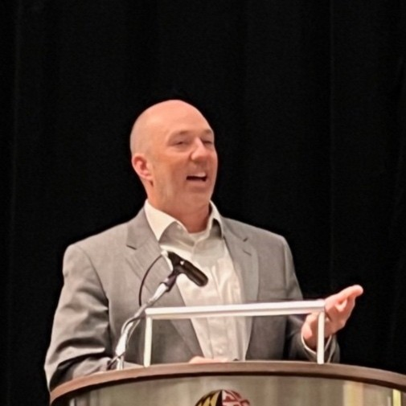
Want to learn more?
Visit us at the Illumina table
Watch the unveiling of the MiSeq i100 Series in the on-demand webinar and take the virtual tour¹
Attend a MiSeq i100 Series event in your city, or at an upcoming conference¹
Contact Jason Smith, Microbiology & Infectious Disease Sales Specialist
  jsmith6@illumina.com
Jason Smith presenting at 2023 GenomeTrakr Meeting
Learn more at www.illumina.com/miseqi100
  ¹ Details can be accessed via the Illumina website at www.illumina.com/miseqi100

Slide 8
Thank you

