Slide 1
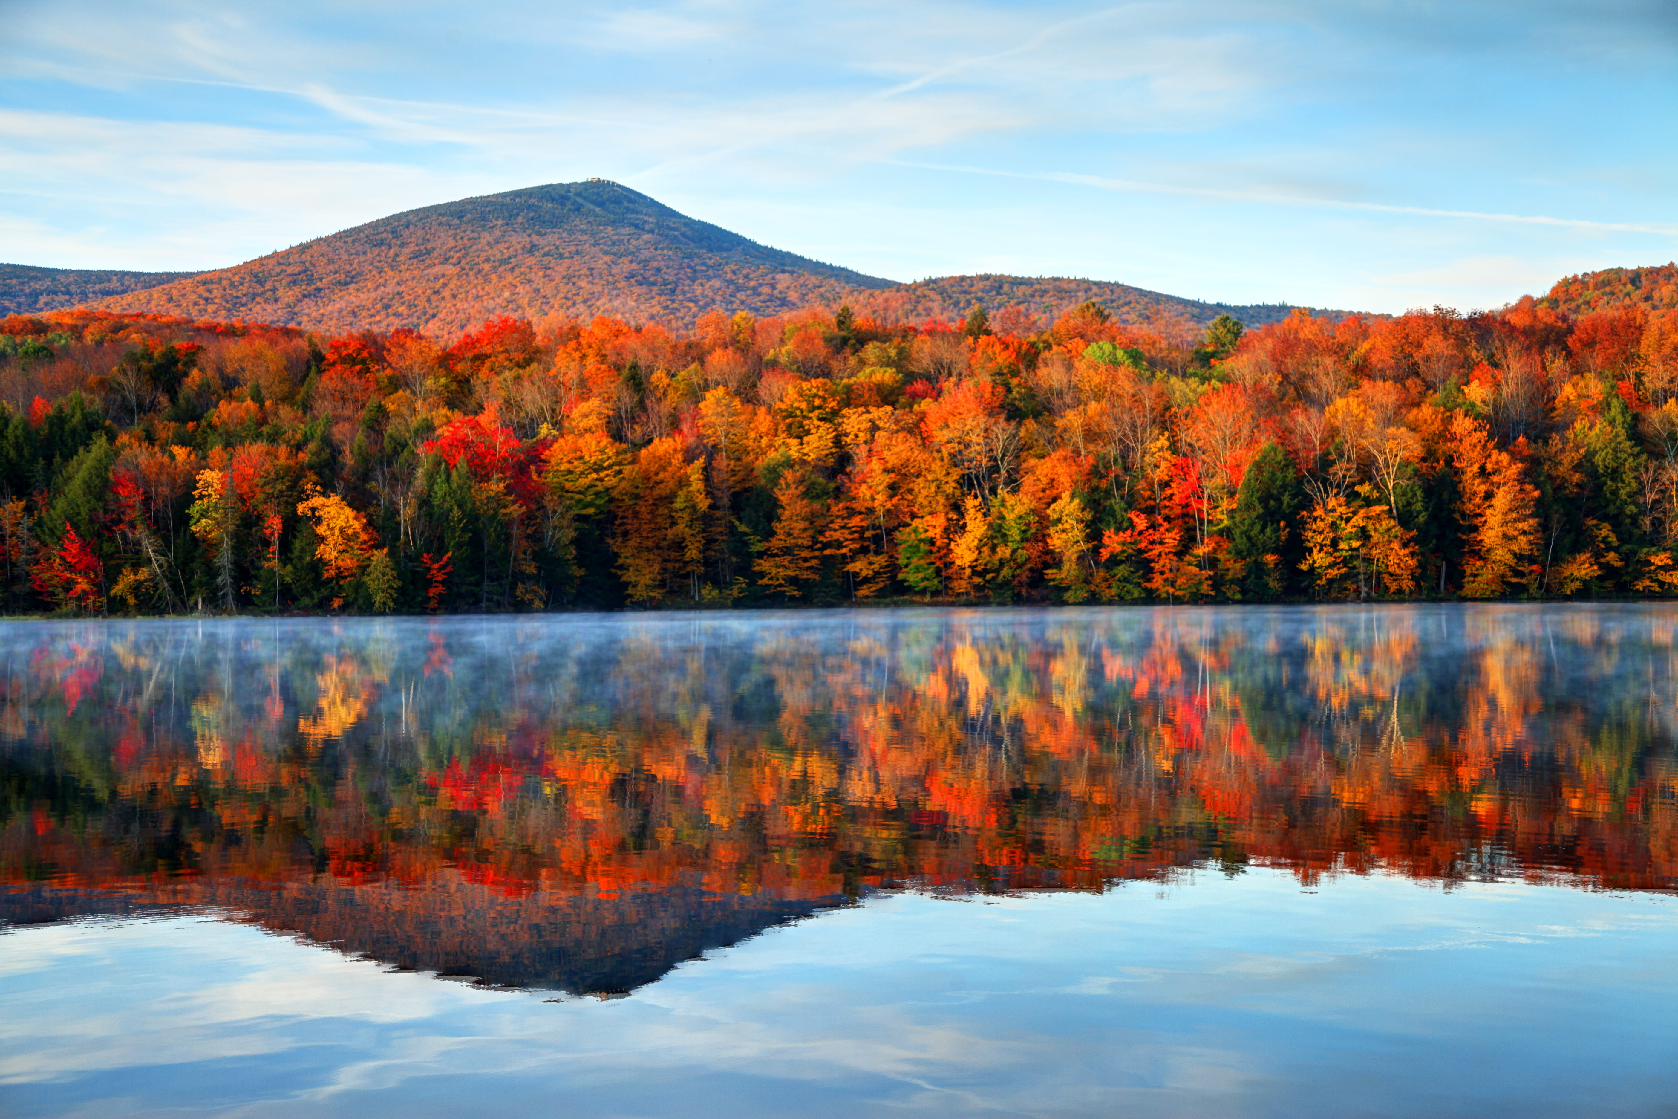
VDHL Collaborations for GenomeTrakr Isolates
Kelcey E. Harper, MS, MLS(ASCP)^{cm}
Public Health Microbiologist IV
Vermont Department of Health Laboratory
October 25th 2023

Slide 2
Overview
Where it all began (Year 1)
Our current partnership (Year 2-Present)
Lessons Learned

Slide 3
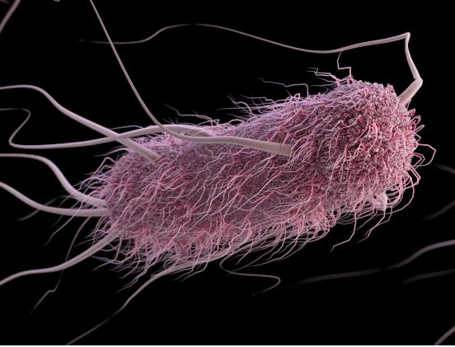
Year 1: The beginning
FDA assisted our lab in finding a partnership for sourcing our GT isolates
  International partner lab located in Ghana
  Provided 78 isolates of Salmonella & E.coli for sequencing
To get new labs off the ground for the LFFM grant, FDA had our collaborator send isolates directly to us
Credit: CDC/Alissa Eckert

Slide 4
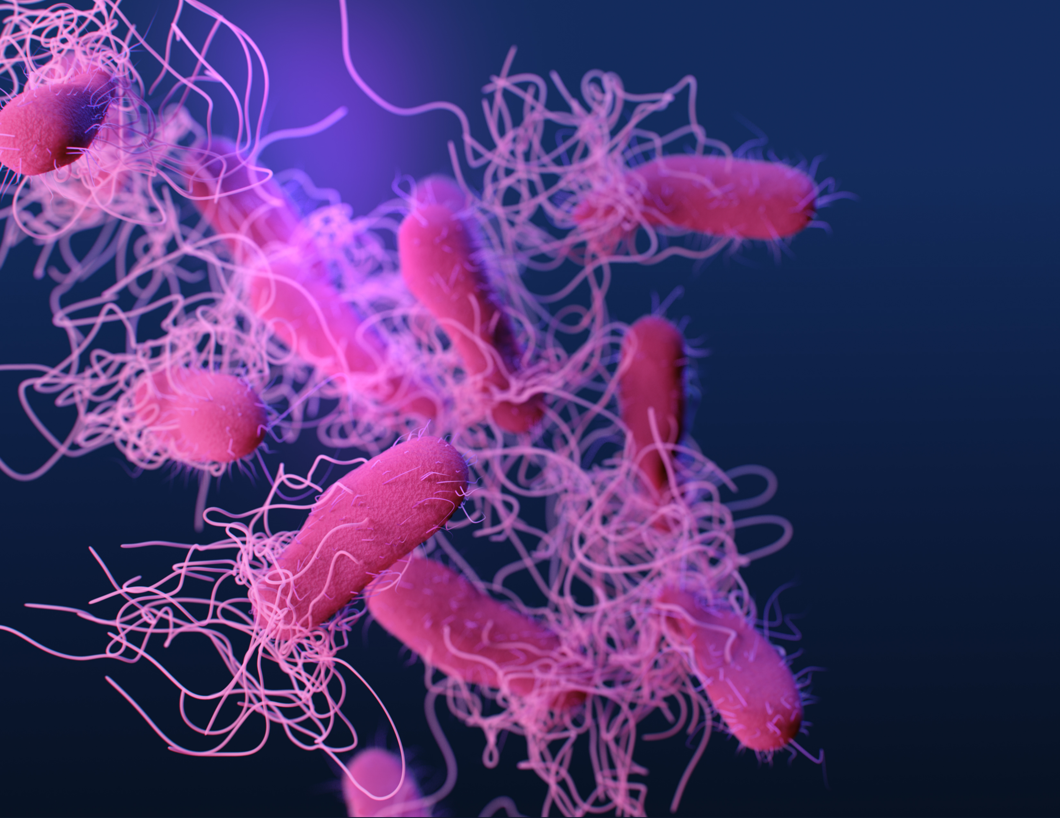
Year 1 Challenges
VDHL was required to apply for a Dept. of Health and Human Services permit to receive isolates from an international source
Our collaborator’s lab was slated to send 100 isolates
Of those 100 isolates, only 78 were provided
  42 for E.coli / 36 for Salmonella
Credit: CDC/James Archer

Slide 5
Year 1 Challenges
Only 27/42 E.coli sent sequenced as E.coli
Only 19/36 Salmonella sent sequenced as Salmonella
Many cultures were mixed or overgrown with suspect Proteus, Pantoea, Klebsiella, Enterobacter, Raoultella, Kluyvera, Serratia, and Citrobacter
This took A LOT of extra time and resources to confirm viability and tease out the growth we wanted– something we were not anticipating needing to do
  In some instances, there were two morphologies of Salmonella in the same culture which required additional workup to determine if they were the same serotype or not
Credit: CDC/James Archer

Slide 6
Year 1 Challenges
There was miscommunication regarding the expectations for data analysis once uploaded to NCBI
Our lab found that FDA would perform an extra step to provide analyzed data to international labs that we were not made aware of, so when our partner lab asked for data, our response was that it was located on NCBI
Credit: CDC/James Archer

Slide 7

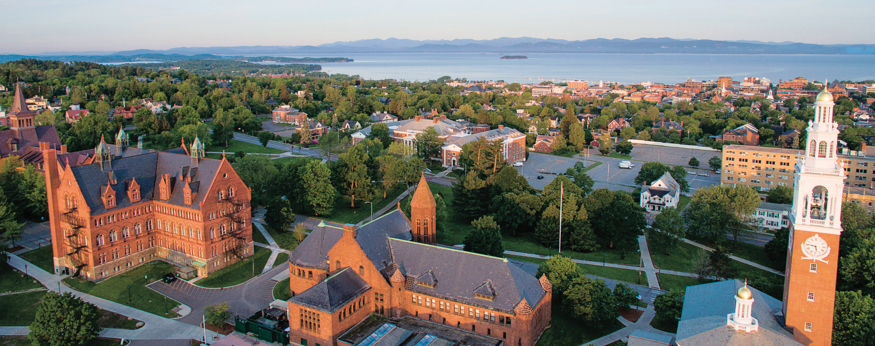
Post- Year 1
After this experience, our lab decided to move towards domestic isolates.
Collaborating internationally was more work than anticipated for a small team, with other testing responsibilities in addition to sequencing
And so our partnership with Dr. Andrea Etter’s lab
at the University of Vermont was formed…

Slide 8
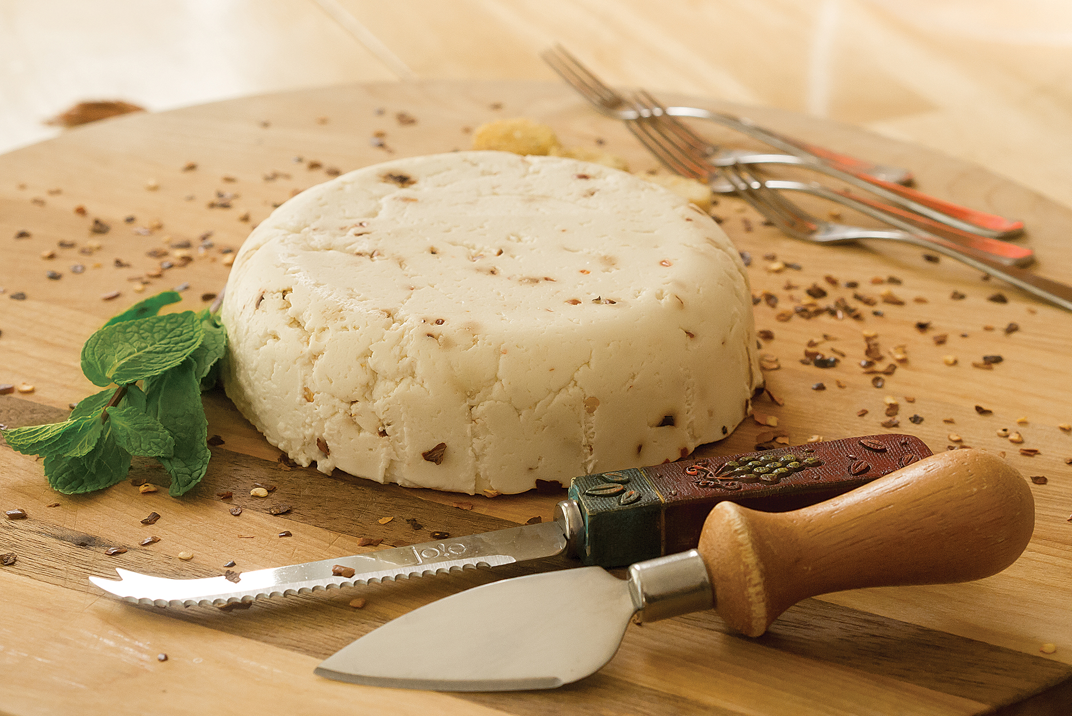
Year 1- Present
An artisan cheese food safety committee brought the VDHL together with Dr. Catherine Donnelly, a UVM researcher who after 40 years was retiring
Dr. Donnelly was interested in using our lab for bacterial isolates from artisan cheese and she had a stockpile of Listeria isolates that she was willing to share.
After her retirement, the isolates were transferred over to Dr. Andrea Etter, who joined UVM in 2019
Credit: UVM Professional & Continuing Ed

Slide 9
Historic Listeria monocytogenes
~1,000 L. monocytogenes from 1980s-2010s (Cathy Donnelly collection)
  ~200 from US food products
  ~150 from artisan cheese environment (under study for biofilm capacity & sanitizer tolerance)
  Never sequenced
VDH collaboration allowed for sequencing of 168 L. monocytogenes
  Assessing for virulence mutations (inlA PMSCs, inlB deletions); QAC genes; etc
    Undergraduate researcher currently doing thesis on genomic characteristics of these isolates
VDH partnership allowed the Etter Lab to sequence far more isolates than they could have afforded to otherwise
  Allowed them to choose isolates for further investigations of sanitizer tolerance
  Can assess distribution of virulence mutations, sanitizer tolerance genes across different foodstuffs

Slide 10
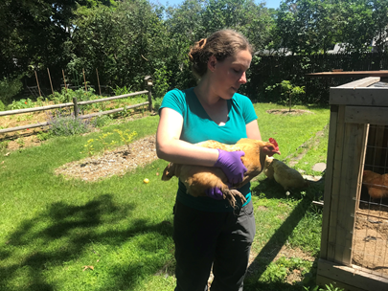
S. enterica in hatchling & adult poultry from Vermont
The Etter lab has been sampling adult backyard poultry and chick shipping boxes at Vermont agriculture supply stores since 2019/2020
  ~90 backyard flocks and ~25 stores/local hatcheries
  ~200 S. enterica isolates
Etter lab research on backyard poultry funded entirely by Vermont Experiment Station Funds (~$24k/yr for research supplies/services)
  This is not adequate for sequencing 200 isolates commercially or through UVM
  Etter lab doesn’t have consistent personnel to prep libraries to reduce costs
VDH sequencing arrangement has been a lifesaver
  “Free” sequencing → expanded sampling capacity, sampling for Campylobacter
    Automatically uploaded to NCBI, so the Etter lab can easily access it for serovar info and downstream analysis
Credit: Dr. Etter/UVM

Slide 11
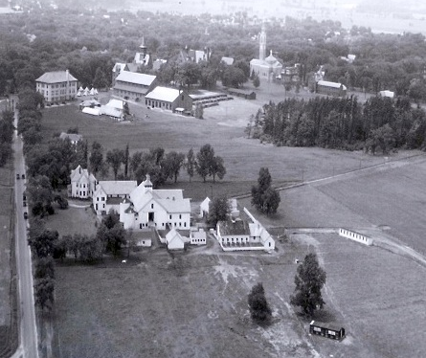
Vermont Agricultural Experiment Station (VT-AES) History
VT-AES (established in 1886) is comprised of 43 world-respected researchers tackling issues of agriculture, environment, nutrition, food safety, health, community and economic development
In addition to their research which adds new and exciting information to their fields, their work aims to provide practical solutions for rural and urban Vermonters
Funding for VT-AES comes from a mix of USDA and UVM, via the State of Vermont’s appropriation funds
Every state and territory has an agricultural experiment station! (Great place to look for collaborations…)
Credit: VT-AES/UVM
Source: www.uvm.edu/vtaes/whatisvtaes.htm

Slide 12
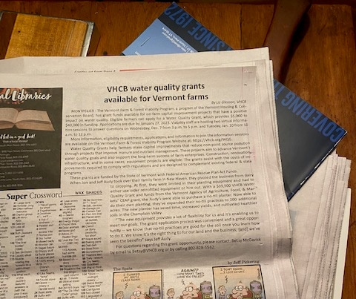
Additional Support from FDA for sourcing isolates
Throughout our experience, we’ve had the continuous support from Marc Allard (FDA)
Marc attended meetings with our team and collaborator-- listened to issues we were having and offered suggestions for improvement. He has always been a great resource for us!
In 2022, Marc sent us a photo from a local VT newspaper about grant funding for VT farms for on-farm improvement projects that would have a positive impact on water quality (manure, nutrient management)
Although we didn’t pursue this opportunity, it could have been another avenue for us to pursue had we not been able to obtain enough isolates for the year
Credit: Marc Allard/FDA

Slide 13
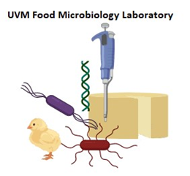
Lessons Learned & Key Takeaways
Know your lab’s workload capacity
Familiarize yourself with your collaborator’s needs and expectations
Academic laboratories are great places for collaboration
  Funding in academia, especially for newer labs and investigators, can be difficult to obtain
  Being able to help their research move forward, provide them with data, frees up resources for use in other areas
Look to Agricultural Experiment Stations for collaboration

Slide 14
Acknowledgements
Vermont Dept. of Health Laboratory
  Valarie Devlin (WGS Lab)
  Lorrie Blais (Food Lab)
  Rachel Cruise (Bacteriology Lab)
The Etter Lab at the University of Vermont
Special thank you to Marc Allard and the rest of our FDA partners for their support and expertise in helping make our program successful!

Slide 15
Questions & Contact Information
Contact Information:
Kelcey Harper, MS, MLS(ASCP)^{cm}
VT Dept of Health Lab
Email: Kelcey.Harper@vermont.gov
Phone: (802)338-4721
Questions?

